Slide 1
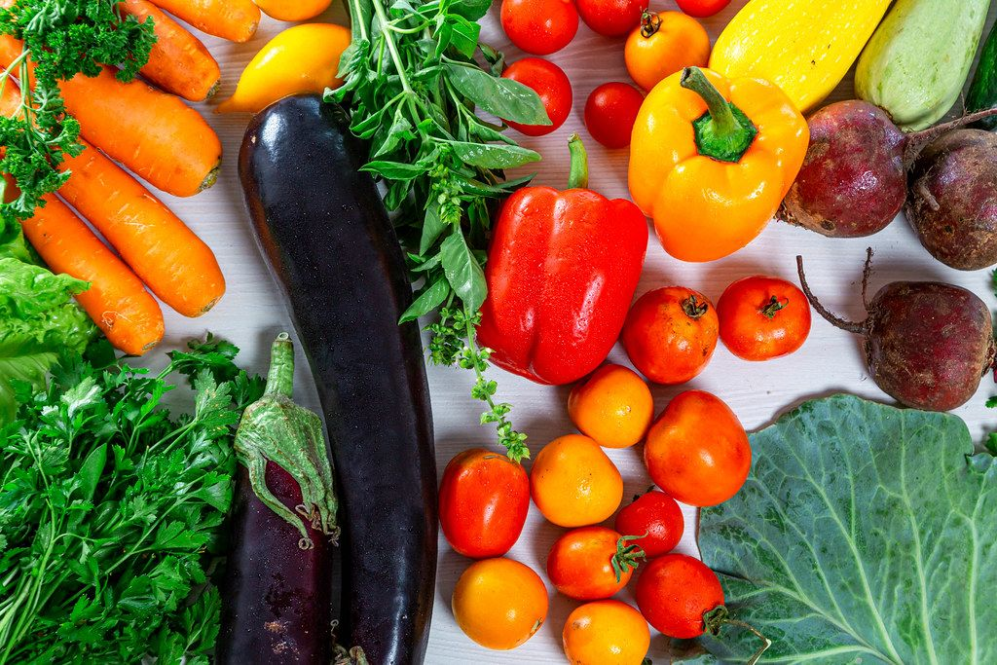


Fresh Fruit & Vegetable Program Overview with
FANS Implementation Site Questions
Notes:
This training provides guidance on the program requirements of the FFVP. Please review each slide thoroughly and if you have any questions, please contact Ty Guthrie at Ty.Guthrie@FDACS.gov, Rick Parks at Richard.Parks@fdacs.gov or your assigned Program Implementation/Sponsor Representative.

Slide 2
FFVP Goals
A USDA program that focuses on creating healthier school environment by:
  Introducing school children to a variety of produce that they otherwise might not have had the opportunity to sample;
  Expanding the variety of fruits & vegetables children experience;
  Increasing children’s fruit & vegetable consumption; &
  Making a difference in children’s diets.
*Resource Alert: Fresh Fruits and Vegetable Program - A Handbook for Schools | Food and Nutrition Service (usda.gov)
Notes:
This is a United States Department of Agriculture (USDA) program that focuses on creating healthier school environments by providing healthy food choices during the school during times other than school lunch, and breakfast and afterschool snack as applicable. Thew FFVP program makes a difference in children’s exposure to fresh fruits and vegetables and impacts their present and future health.
The FFVP shows children that fresh fruits and vegetables are healthy and tasty alternatives to snacks high in fat, sugar, or salt.

Slide 3
Which schools can participate?
Be an elementary school…that:
  Participates in the NSLP &
  Is certified free & reduced-price student meal benefits at or above 50 percent.
  Note: Approved FFVP participation sites are representative of the highest percentages of free & reduced-price meal benefits. (Qualifying does not ensure approval.)
  Schools completing an annual FFVP application.
Notes:
Read Slide

Slide 4
Who can receive a fruit/vegetable “snack”?
All children who are enrolled in a participating school (K-5, K-8, PreK-5, etc.).
Teachers directly responsible for the Nutrition Education & serving the fruit/vegetable snack.
Note:
  Students do have the option of not participating.
  Snacks cannot be used as a reward or withheld as part of a discipline procedure.
Notes:
Read Slide
Not intended for the general teacher population, other adults in the school, or community residents.

Slide 5
FFVP Funding
The amount of funds for each student is ~$50-$75/school/year.
FFVP funds cannot be moved from one school to another.
No more than 10% of funds can be used for Admin costs.
Funds are dispersed twice a year:
  July 1 – September 30
  October 1 – June 30
Please note that sponsors not able to use all allocated funds from the July allocation, are asked to please notify the State Agency as soon as possible so those funds will be added to the October allocation upon USDA’s approval.
See page 5 of USDA’s FFVP Handbook for more funding details.
Notes:
Read Slide
Sponsors not able to use all allocated funds from the July allocation, please notify the State Agency as soon as possible so those funds will be added to the October allocation upon USDA’s approval.

Slide 6
When can fruits & vegetables be served?
Prior to the end of the school day.
Any time other than lunch & breakfast service times.
Once a day or staged multiple times.
During classroom nutrition education activities.
Plan FFVP service at least 2 days per week.
Notes:
During the school day. What does that look like?:
Cannot be after the school day ends and should not be during or in conjunction with students’ access to their lunch and breakfast service times.
May serve once a day for smaller schools or multiple times during the day for larger schools or schools with several buildings on campus.
May plan and offer staggered times and/or locations to help ensure students have access to their FFVP “snack” times.

Slide 7
Where can fruits & vegetables be served?
School Food Service can deliver to:
  Classrooms, Hallways or designated Outside Areas
  Pre-staged, centrally located kiosks
Student pick-up:
  Classroom representatives (2 students) pick-up from School Food Services
When determining distribution & service options, consider:
  Building design
  Grade levels & maturity of students
  Time required for preparation, delivery & service
  Clean-up & garbage concerns
  Staffing needs
Notes:
The most successful distribution areas are places where children can easily consume the fruits/vegetables. Most commonly seen are classroom settings when the teacher can provide the FFVP snack in conjunction with the nutrition education component.
Read through Slide

Slide 8
Costs:
Operational
Operational Costs - means the cost associated with running the FFVP service.
Examples include:
Purchasing fruits, vegetables & low-fat dips.
Nonfood supplies: bowls, trays, baskets, bins, & cleaning supplies.
Salary/fringe benefits of kitchen staff.
*Most of the FFVP funds must go toward purchasing fresh fruits & vegetables.
Notes:
Please note, while ready-made produce trays or pre-packaged portions are allowable, these items bring added convenience but also added expense. Consider a mix of bulk produce purchases and convenience items considering any added staff time, knife skills and/or available equipment for in-house processing and preparation of planned portions.
Read/review Slide as needed

Slide 9
Costs:
Administrative
Administrative Costs – means cost associated with organizing & administering the program.
Examples include:
Purchasing or leasing of equipment (up to 10%).
Salaries & benefits for administrative staff.
*All large equipment purchases need written justification & prior state agency approval.
Notes:
Read Slide

Slide 10
What may be offered as a fruit or vegetable?
As the program name indicates, FFVP introduces children to new & different fresh fruits & vegetables.
May offer small portion of low-fat dip (salad dressing or yogurt-based) with vegetables.
Fresh vegetables (not canned, frozen, dried or otherwise processed) that are cooked, must be limited to once‐a‐week & must always include a nutrition education lesson related to the prepared item.
Notes:
Read Slide
The FFVP introduces children to new and different fresh fruits and vegetables, like kiwi, star fruit, pomegranate, rutabaga, and kohlrabi.

Slide 11
What may not be offered?
ₓ Processed (canned, frozen, dried) fruits & vegetable
ₓ Fruit or vegetable juices & smoothies
ₓ Fruit snacks, strips, drops, & leathers
ₓ Carbonated fruit, flavored infused fruits, jellied fruit.
ₓ Nuts, trail mix
ₓ Dip for fruits & excess amounts for vegetables
Notes:
Items shown on the slide are from USDA and is intended to be a guide of items that cannot be offered.
Many of the foods in the list on the slide are nutritious but also common items and do not adhere to the program goal of introducing children to new and different varieties of fresh fruits and vegetables.
Most non‐food items, except those allowed under administrative/operational costs, are also not allowed.
If you have any questions about which fruits and vegetables to purchase for the FFVP, contact FNW for guidance and technical assistance before making purchases.

Slide 12
Best Practices
(continued)
Procurement
Follow state/local purchasing procedures.
Buy “Fresh from Florida” when able.
Purchase from local stores, growers, & farmers’ markets.
Support Farm-to-School projects & follow “Buy American” when applicable.
Train assigned food service staff on proper ways to receive, wash, prepare, serve & store fresh fruits & vegetables.
*Resource Alert: Best Practices for Handling Fresh Produce in Schools | Food and Nutrition Service (usda.gov).
Notes:
Read Slide

Slide 13
Best Practices
Menu Planning & Portions
Purchase pre-cut and/or whole produce items & prepare “grab & go” portions.
Suggested portion: ¼ cup to ½ cup.
May offer a “taste” portion for new items.
Serve the same “type” but different variety of fruits or vegetables:
  Different apples, oranges, melons.
  Different tomatoes, carrots, leafy greens.
Make offerings appealing & fun.
*Resource Alert: Fruit & Vegetable Quick Reference Crediting & Portion Guide (fdacs.gov)
Notes:
Read Slide

Slide 14
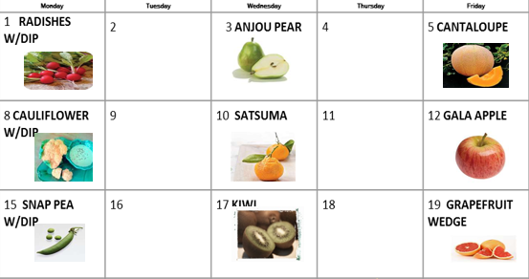
Best Practices
(continued)
1
Develop, promote & follow a centralized, monthly menu to help ensure:
  Consistency & weekly success
  A variety of items are offered
  Vendors can plan for orders
  Ease of coordination with planned Nutrition Education activities
Notes:
Read /review Slide

Slide 15
Best Practices
(continued)
2
Since leftovers cannot be taken home by anyone, consider:
Consistently encouraging students to be “good tasters” & “trying new foods” as part of the Nutrition Education activities.
Offering extra portions to any student who requests it.
Increasing the planned portion size or adjusting amount ordered.
Reminding teachers/staff providing the FFVP that they may participate in tasting.
Using any leftover items once per week to re-serve items properly handled, documented & returned to food service for storage.
Notes:
Read Slide

Slide 16
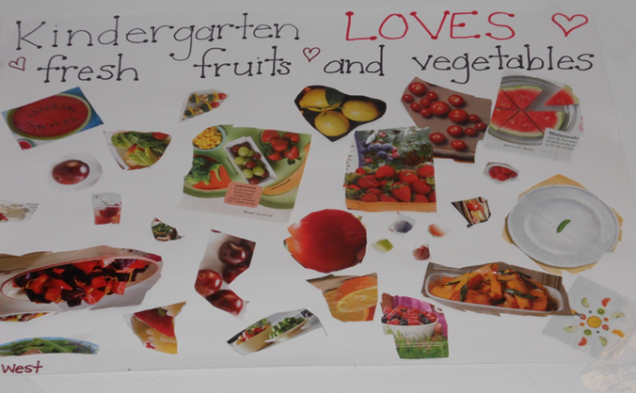
Best Practices
(continued)
3
Enhance FFVP Nutrition Education efforts & promote Healthy School Meals environment by:
Incorporating student created posters, art projects, & trivia/nutrition education resources.
Adding writing and reading projects, story problems, geography, & experiments.
Including health & fitness activities.
Having staff or FFVP community partners dress up as a food character or “Nutrition Detective”.
Notes:
Engage and enhance nutrition related activities and promoting a healthy school meals environment can involve everyone on campus.
Read Slide
Having staff or FFVP community partners dress up as a food character or “Nutrition Detective” can help bring attention to featured FFVP fruits and vegetables with a self-created “Nutrition Detective” character to search for good tasters and promote nutrition “nuggets” and enhance nutrition education activities.

Slide 17
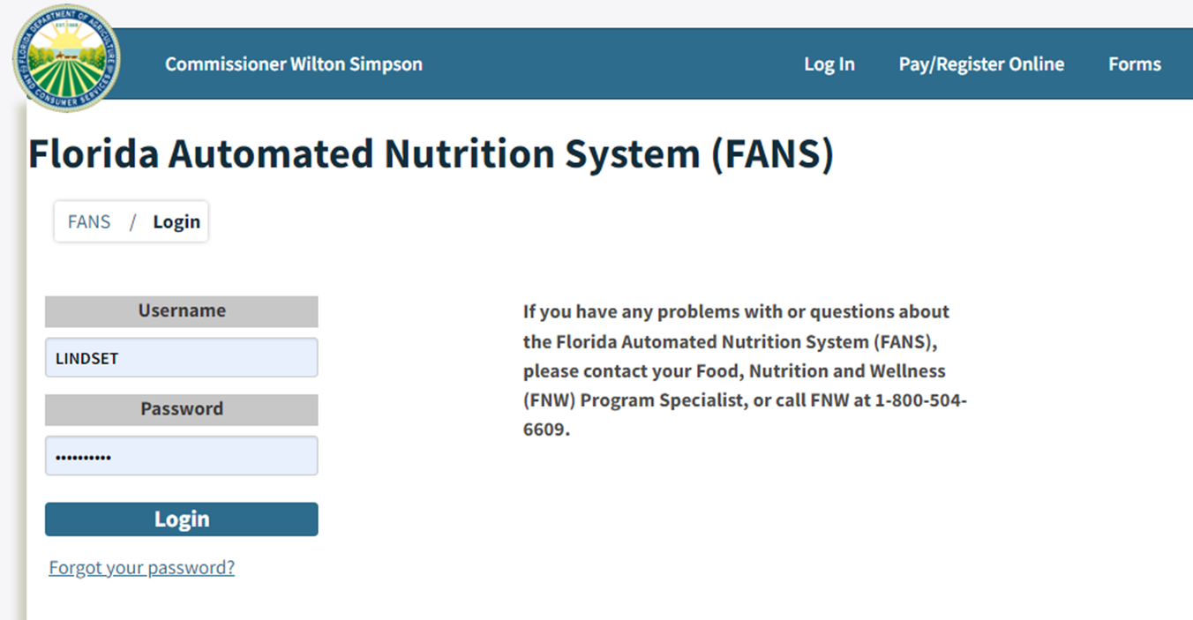
Best Practices
(continued)
4
FANS Application & Claims
As needed, complete state agency FFVP & FANS related trainings.
Complete FFVP Sponsor Module & Site Applications.
Maintain FANS Users & User’s Rights accordingly.
File Claims within 30 Days of the end of the previous month.
  Note: A combined May/June NSLP Claim requires a combined FFVP for May/June.
Notes:
Read Slide

Slide 18
Best Practices
(continued)
5
Claims & Recordkeeping
The recordkeeping requirements for FFVP are like all other Child Nutrition Programs.
Follow set procedures when submitting claims for reimbursement.
Use the monthly FFVP Reimbursement Claim form.
The claim form should identify monthly FFVP school purchases.
Approved sites are responsible for ensuring all claims are accurate, appropriate & only include allowable expenses.
Maintain accurate FFVP records for three (3) years plus the current year.
  Records must be kept longer if your school has any unresolved audit deficiencies.
Notes:
Read Slide

Slide 19
Best Practices
(continued)
6
Monitoring & Recordkeeping
Program oversight/monitoring is critical is needed to ensure FFVP is operating properly in participating schools, especially those new to the program.
Schools & the state agency should:
Review claims for reimbursement to ensure expenditures are appropriate prior to providing reimbursement.
Ensure the majority of funds are used to purchase fresh produce.
Confirm any equipment purchases are reviewed & prorated.
Ensure labor costs & all other non‐food costs are minimal.
Furthermore, the state agency should:
Ensure FFVP schools are reviewed as part of the School Meals Administrative Review process, or other oversight or monitoring activity related to the School Lunch or School Breakfast Programs.
Make efforts to contact schools not scheduled for oversight activity to ensure that the Program is being implemented according to the statute & guidance issued by FNS.
Notes:
Read Slide

Slide 20
Best Practices
(continued)
7
Recordkeeping & Organization
A success Child Nutrition can be characterized by several attributes. Some of these include:
Having Standard Operating Procedures (SOPs) on file.
Completing training for staff on performance expectations & established SOPs.
Being organized & keeping files that contain:
  Policies & Procedures
  Site application & contact information for each participating school
  Invoices & Purchase Order information
  Monthly Claims
  Vendor/Local Supplier/Farm Contact information
Notes:
Read Slide

Slide 21
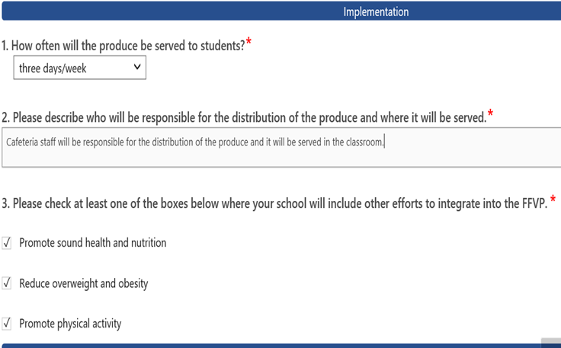
FFVP FANS Site Application
Questions/Implementation
Notes:
The FFVP application in FANS is site based when it comes to program implementation questions for each site.
Implementation Questions 1 through 3 are show on this screen and must be answered before proceeding to the next section and includes drop down question box, fill in the blank/free form text and check box items.
Read Slide

Slide 22
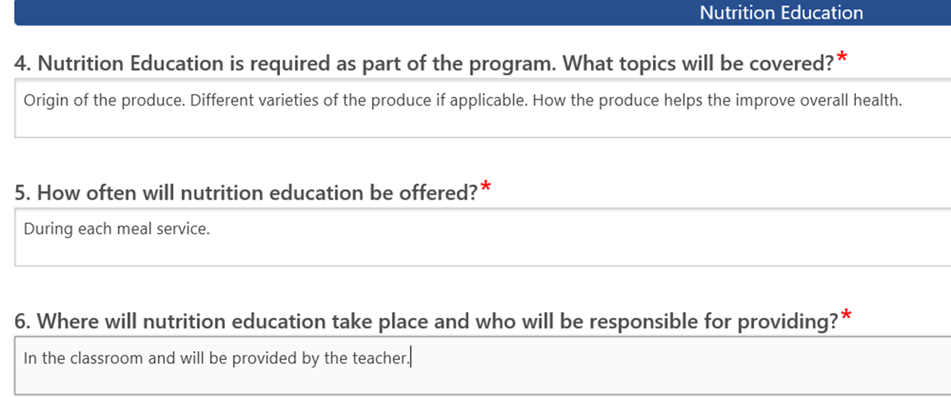
FFVP FANS Site Application
Questions/Implementation
Notes:
Implementation Questions 4-6 are fill in the blank/free form and are required and related to Nutrition Education activities programs must think through. Updates can be made at anytime as program needs and resources change or become available.
Read Slide

Slide 23
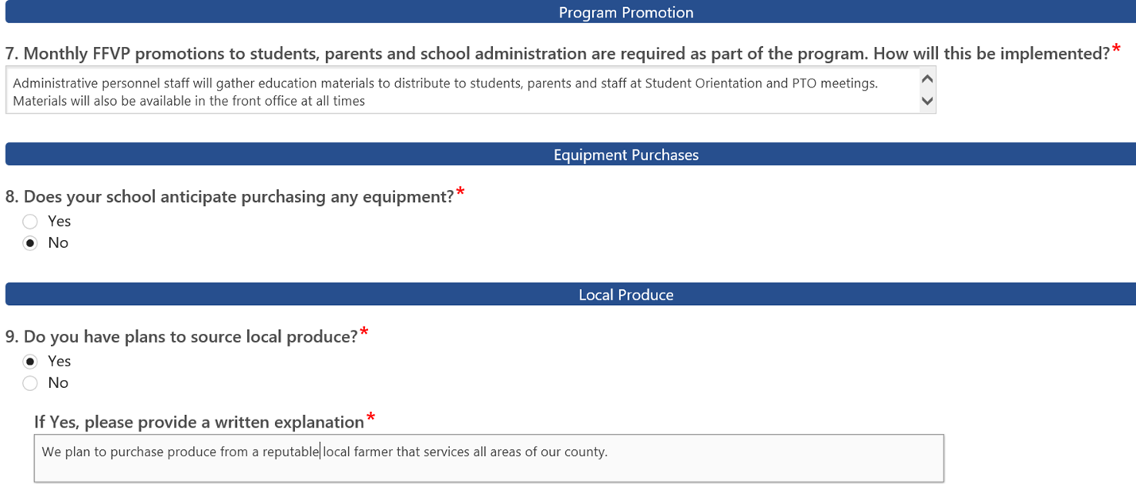
FFVP FANS Site Application-
Questions/Implementation
Notes:
Implementation Questions 7-9 are fill in the blank/free form and are required and related to program promotion, any anticipated equipment needs, and purchasing produce resources.
All modules should be submitted and will show on the assigned Program Eligibility Team Representative’s dashboard to review and approve.

Slide 24
Additional Resources
Web Pages:
FDACS FFVP Website
USDA FFVP Website
MyPlate Materials
FDACS Vegetable Subgroups Listing
FNW Contacts:
InfoFNW@fdacs.gov
Assigned Program Eligibility Team Member
Main Phone Line: 850-617-7400
Notes:
Additional resources are provided on this slide as hyperlinks accessible for reviewing program materials and developing a list of possible fruit/vegetable menu items to offer.
FNW contact for additional information is provided as well.

Slide 25
Conclusion slide
Notes:
This concludes this presentation. Please contact our office for any additional questions or needs and thank for your time to attend/review the FFVP materials.
For additional questions or needs, please contact Ty Guthrie at Ty.Guthrie@FDACS.gov, Rick Parks at Richard.Parks@fdacs.gov or your assigned Program Implementation/Sponsor Representative.

