Slide 1
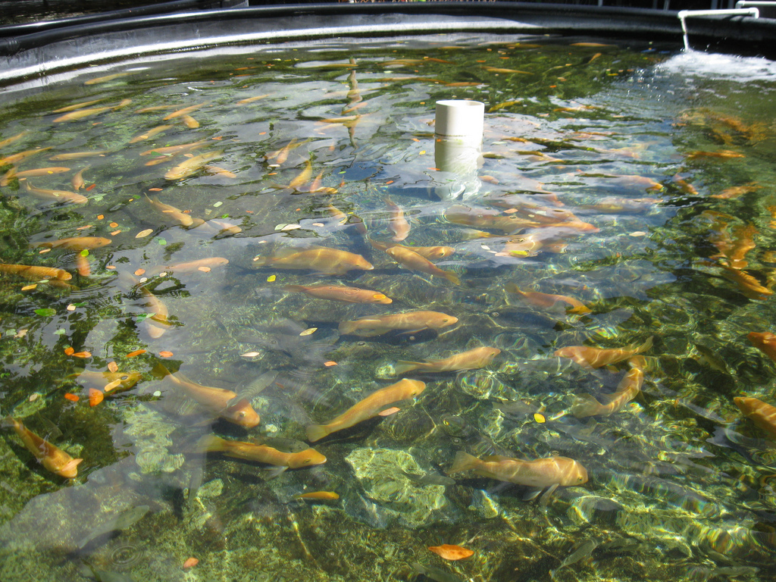

Introduction to aquaculture for students
Introduction to Aquaculture
for Students
Produced by the Division of Aquaculture - 2017
Notes:
Ask people to define aquaculture
Ask people what they think of when they think of aquaculture

Slide 2
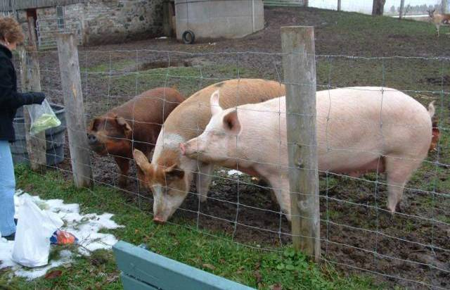
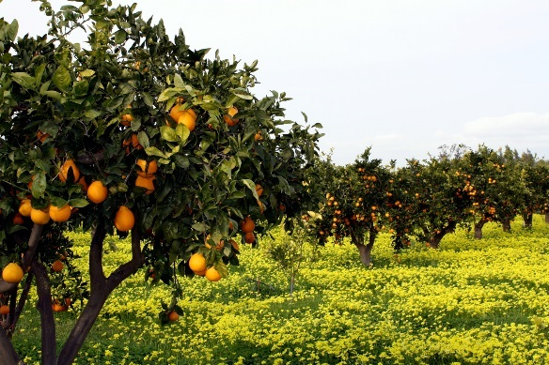
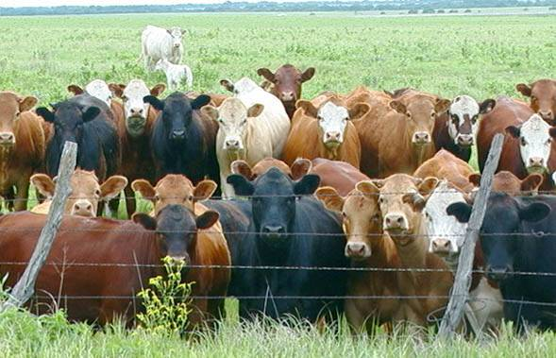
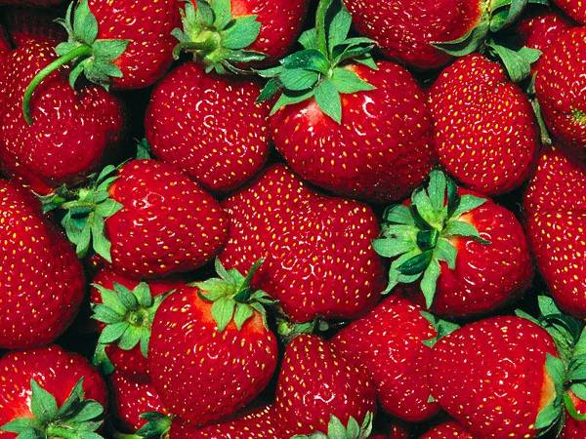
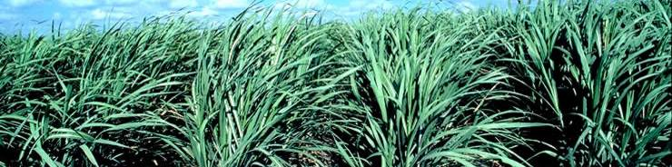
What is agriculture?
Agriculture is the process of producing food, feed, fiber and other goods by the systematic raising of plants and animals.
Notes:
Ask people to define aquaculture
Ask people what they think of when they think of aquaculture

Slide 3
What is aquaculture?
Culturing aquatic plants and animals
Agriculture in water
  Production science
  Monoculture (sometimes polyculture)
Conservation and recreational fisheries management
  Restoring depleted species
  Supplemental stocking to increase population
Notes:
Ask people to define aquaculture
Ask people what they think of when they think of aquaculture

Slide 4
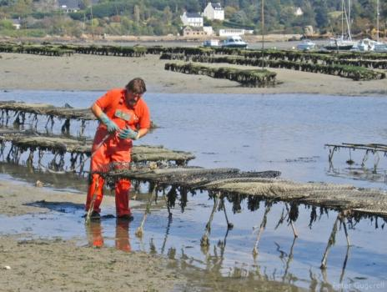
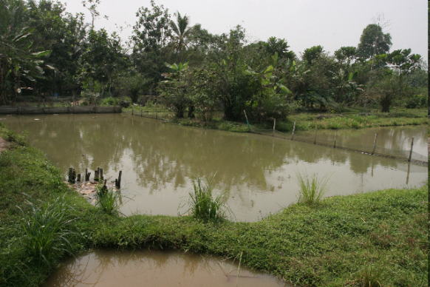
Main categories of aquaculture
Extensive
  Little control over system
  Little technology
  Ancient origins
  Limited by environment / food
  Examples: Oysters, tilapia
Notes:
Talk about benefits and problems

Slide 5
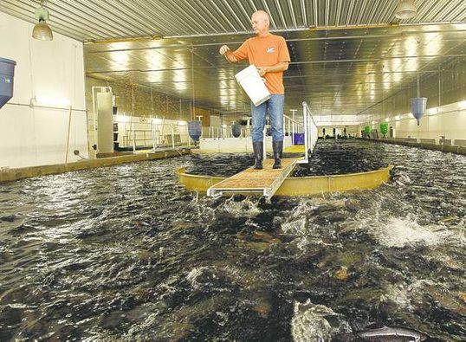
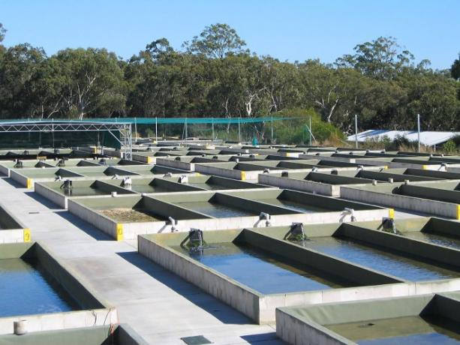
Main categories of aquaculture
Intensive
  Highly controlled systems
    Produce large quantities of fish in a small area
    Very efficient production method
  Limited by density and water quality

Slide 6
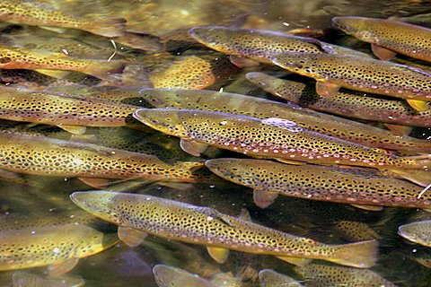
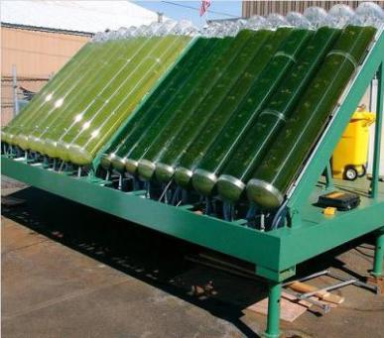
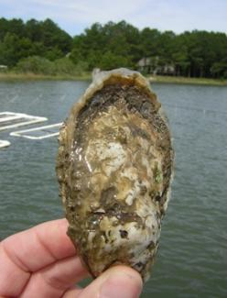
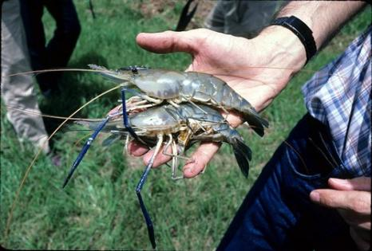
Examples of modern aquaculture
Fish species
Crustaceans
Shellfish
Algae (food and biofuels)
rainbow trout
algae
oyster
freshwater prawns
Auburn University
Notes:
Tilapia
FW shrimp – Macrobrachium rosenbergii

Slide 7
Why is aquaculture needed?
Increasing human population = increasing protein demand
Wild fisheries limited/declining
Increasing societal demands for seafood (health benefits)
Growth efficiency: fish vs. terrestrial animals
Conservation
Fisheries enhancement

Slide 8
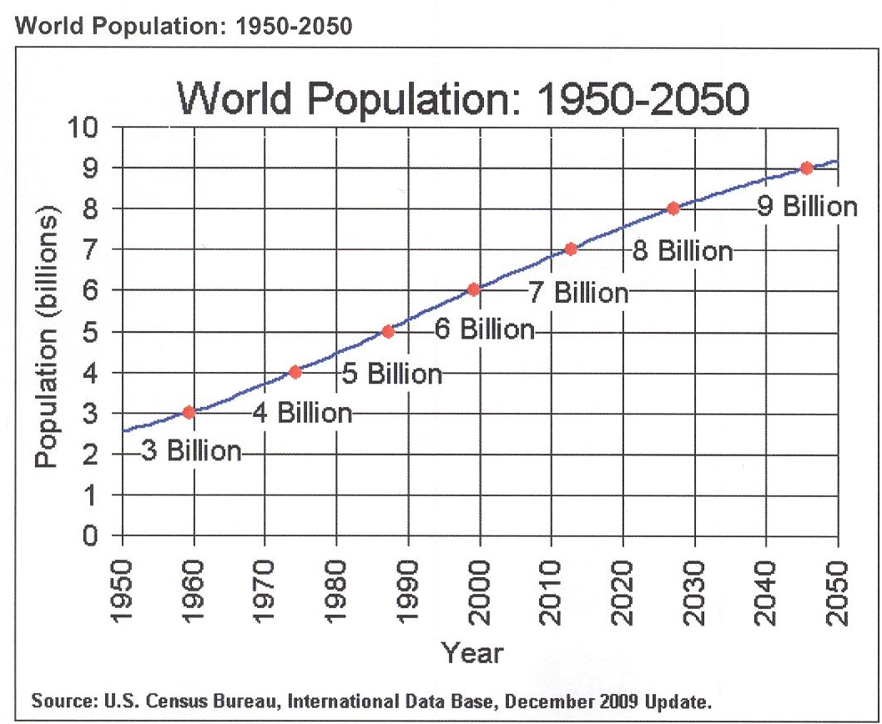
Global Population Growth
Global Population Growth
We are here.
500 million metric tons protein per year
Notes:
The U.S. Census Bureau predicts that the world’s population will reach over 9 billion people by the year 2050. We would need 5 x 10^8 metric tons of lean protein per year to provide the world’s population their daily recommended amount of protein (ca. 1 x 10^8 more than today). Needless to say, that number is a bit troubling. We already know that few places on the planet are actually capable of consuming the USDA recommended levels of protein. If we want to feed the world, we have a long road ahead.
8

Slide 9
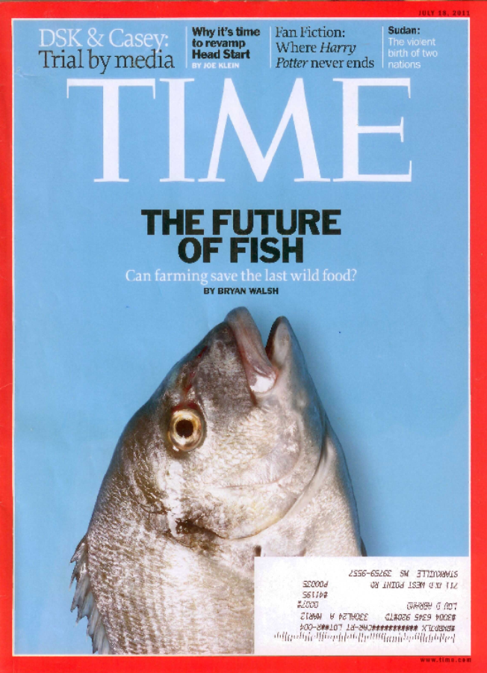
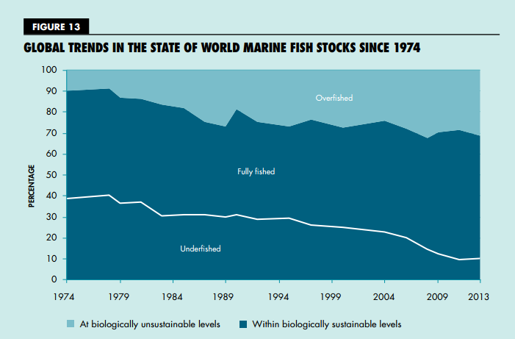
Wild fisheries maximized.
Wild fisheries: yield maximized
Fish are the last wild food
Global consumption of fish is greater than what the oceans can provide
Maximum Sustainable Yield = 90 million tons per year
Aquaculture is rapidly growing to meet this supply shortage
90% of wild fisheries are at maximum harvest or greater
Figure from: FAO 2016

Slide 10
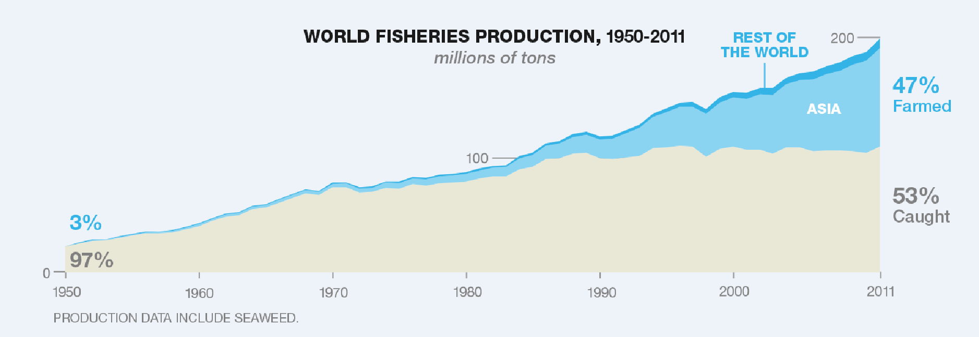
Problem: Capture fisheries at maximum harvest rate
Aquaculture has met the increased demand for fish products.
In 1950, 97% of fish were caught from the ocean.
Wild harvest has not increased for 30 years
Today, only 50% of fish are caught from the ocean.
Figure from: FAO 2016
Notes:
FAO 2008 Report
Aquaculture accounted for 47% of all food fish supplied to world in 2006
Fish protein accounts for 15% of avg per captia animal protein intake

Slide 11
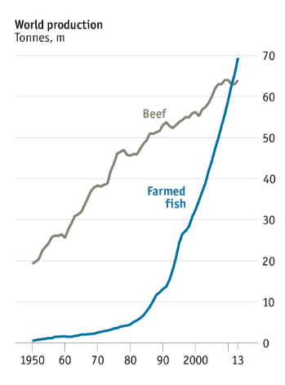
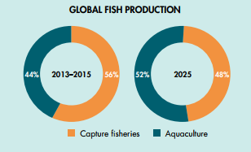
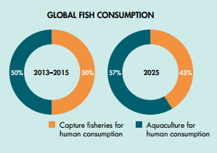
Aquaculture will soon be the norm
Figure from: FAO 2016
By 2025, aquaculture will be the primary source of fish production and consumption worldwide!
To put fish farming growth in context, as of 2013 more fish is farmed globally than beef each year!
Figure from: FAO 2014
Notes:
FAO 2008 Report
Aquaculture accounted for 47% of all food fish supplied to world in 2006
Fish protein accounts for 15% of avg per captia animal protein intake

Slide 12
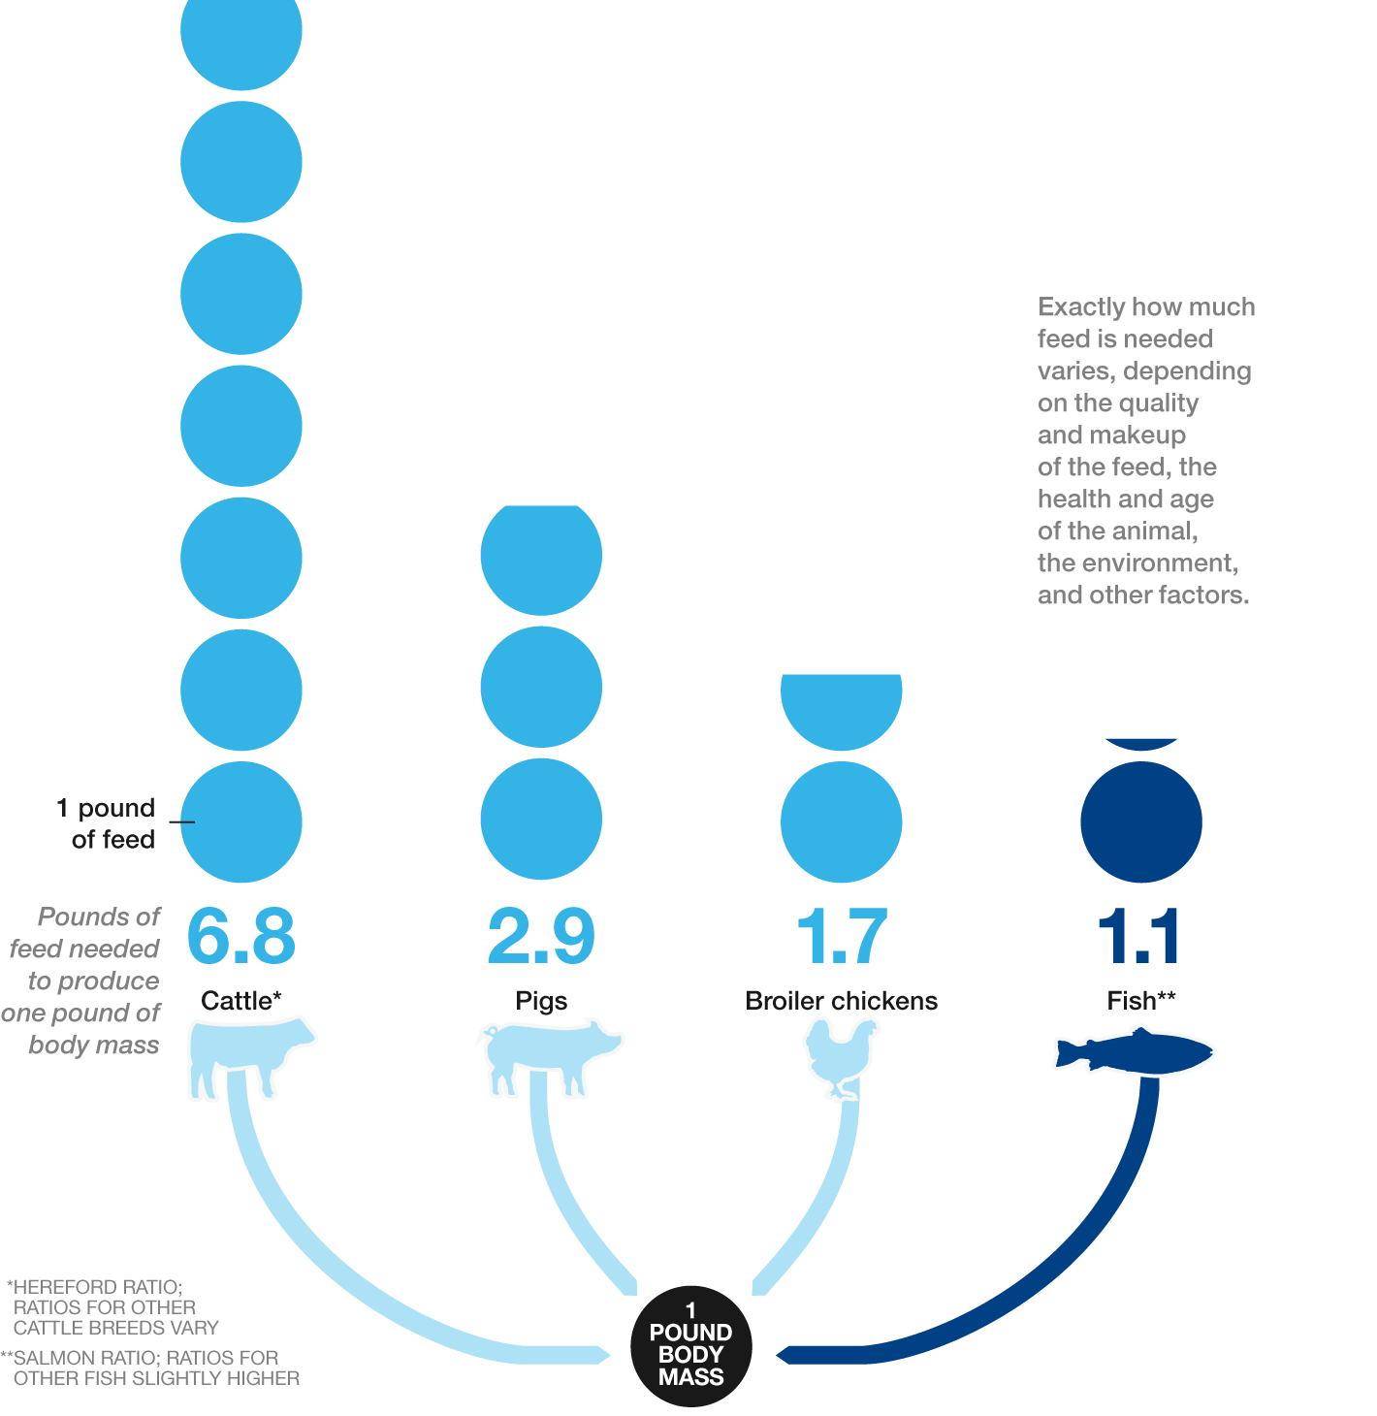
Feed conversion ratios
Fish have much lower Feed Conversion Ratios (FCR) than terrestrial livestock, making them much more efficient and sustainable than terrestrial animals.
~7 lb. feed produces 1 lb. meat.
1.1 lb. feed produces 1 lb. meat.
Figure Credit: Malcolm Beveridge, WorldFish; Rodney Hill, University of Idaho; Robert Swick, University of New England, Australia

Slide 13
Do you know your cultured fishes?
(Half time quiz!)

Slide 14
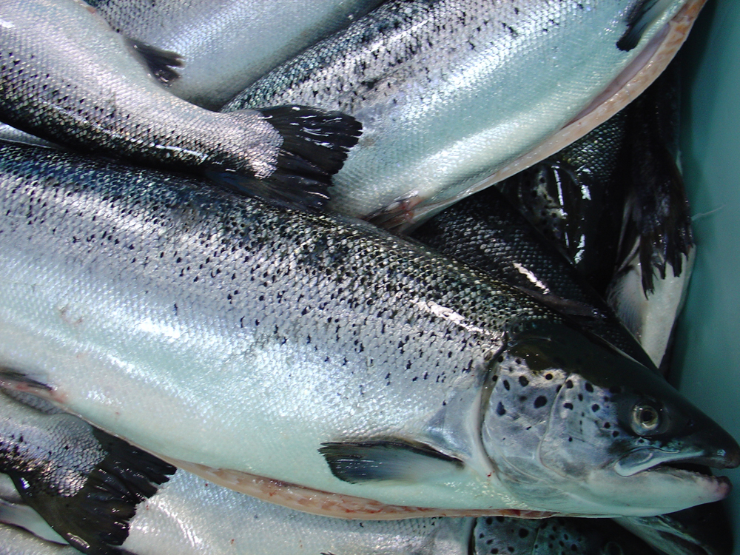
Salmon
Atlantic Salmon
Notes:
salmon

Slide 15
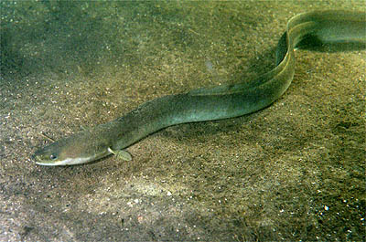
Eel
American Eel
Notes:
American eel

Slide 16
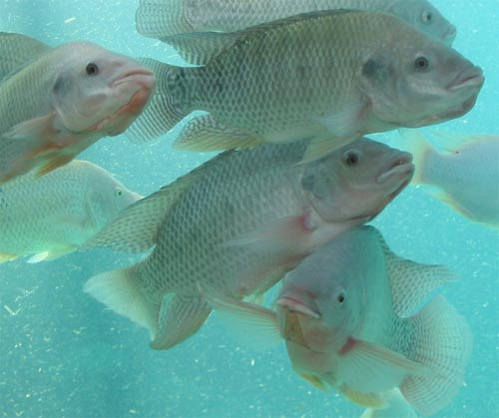
Tilapia
Tilapia
Notes:
tilapia

Slide 17
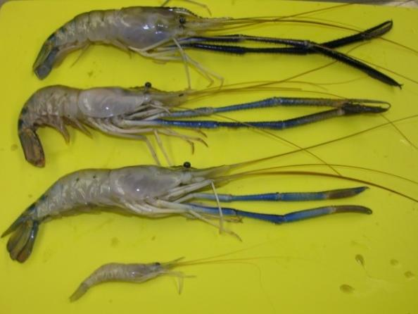
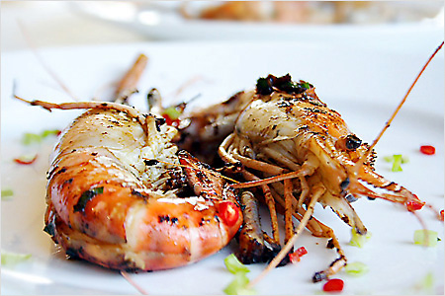
Freshwater prawn
Freshwater prawn are huge (8-10” long at harvest)!
This is a large marine shrimp!
Freshwater Prawn
Notes:
Freshwater prawn

Slide 18
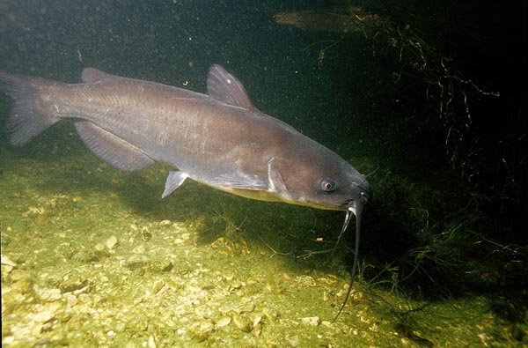
Catfish
Catfish
Notes:
Catfish

Slide 19
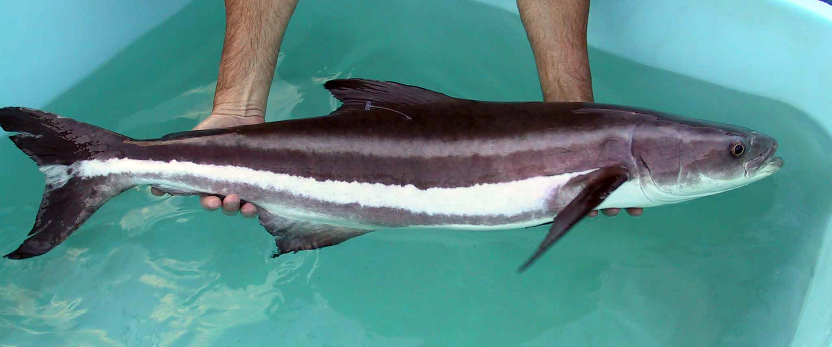
Cobia
Cobia
Notes:
Cobia

Slide 20
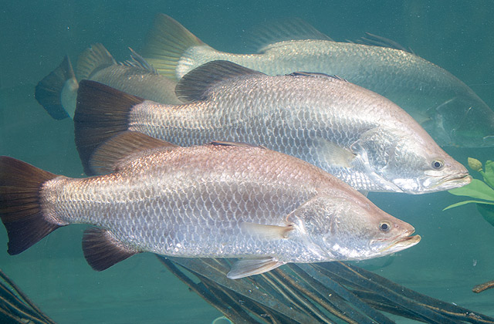
Seabass
Sea Bass
Notes:
Seabass

Slide 21
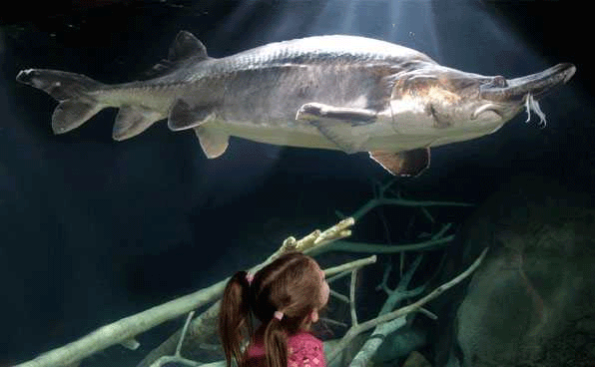
Stugeon
Sturgeon
Notes:
Sturgeon

Slide 22
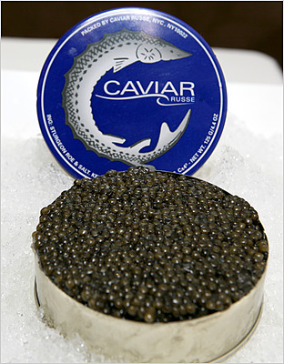
sturgeon

Slide 23
Aquaculture production examples:
Broodstock maintenance (pond/tank)
Production and collection of fertilized eggs
Hatching of eggs
Culture and feeding of fry
Grow-out to market size
Handling and shipping of fish
Baby fish are referred to as “fry”!

Slide 24
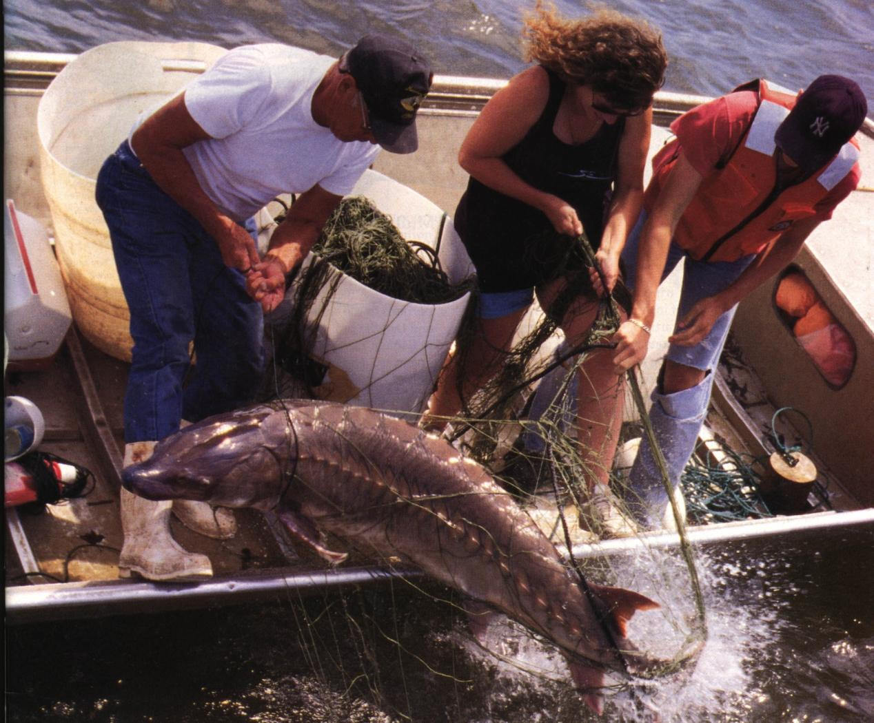
Collecting Broodstock
Collecting Broodstock

Slide 25
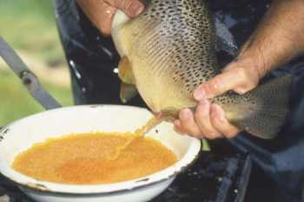
Stripping eggs from female for fertilization.
Stripping eggs from female for fertilization.

Slide 26
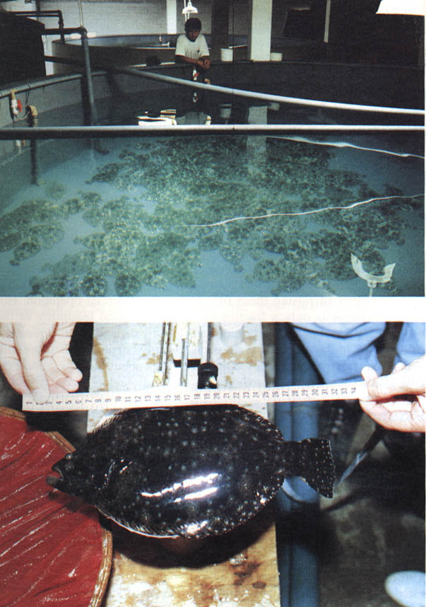
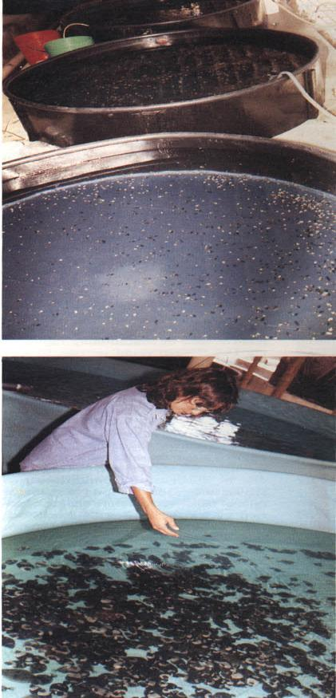
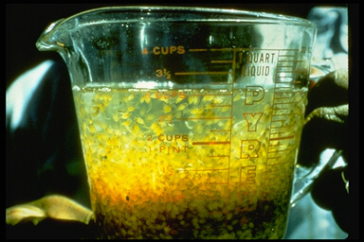
Flounder Hatchery
Flounder Hatchery
Eggs
Broodstock
Nursery

Slide 27
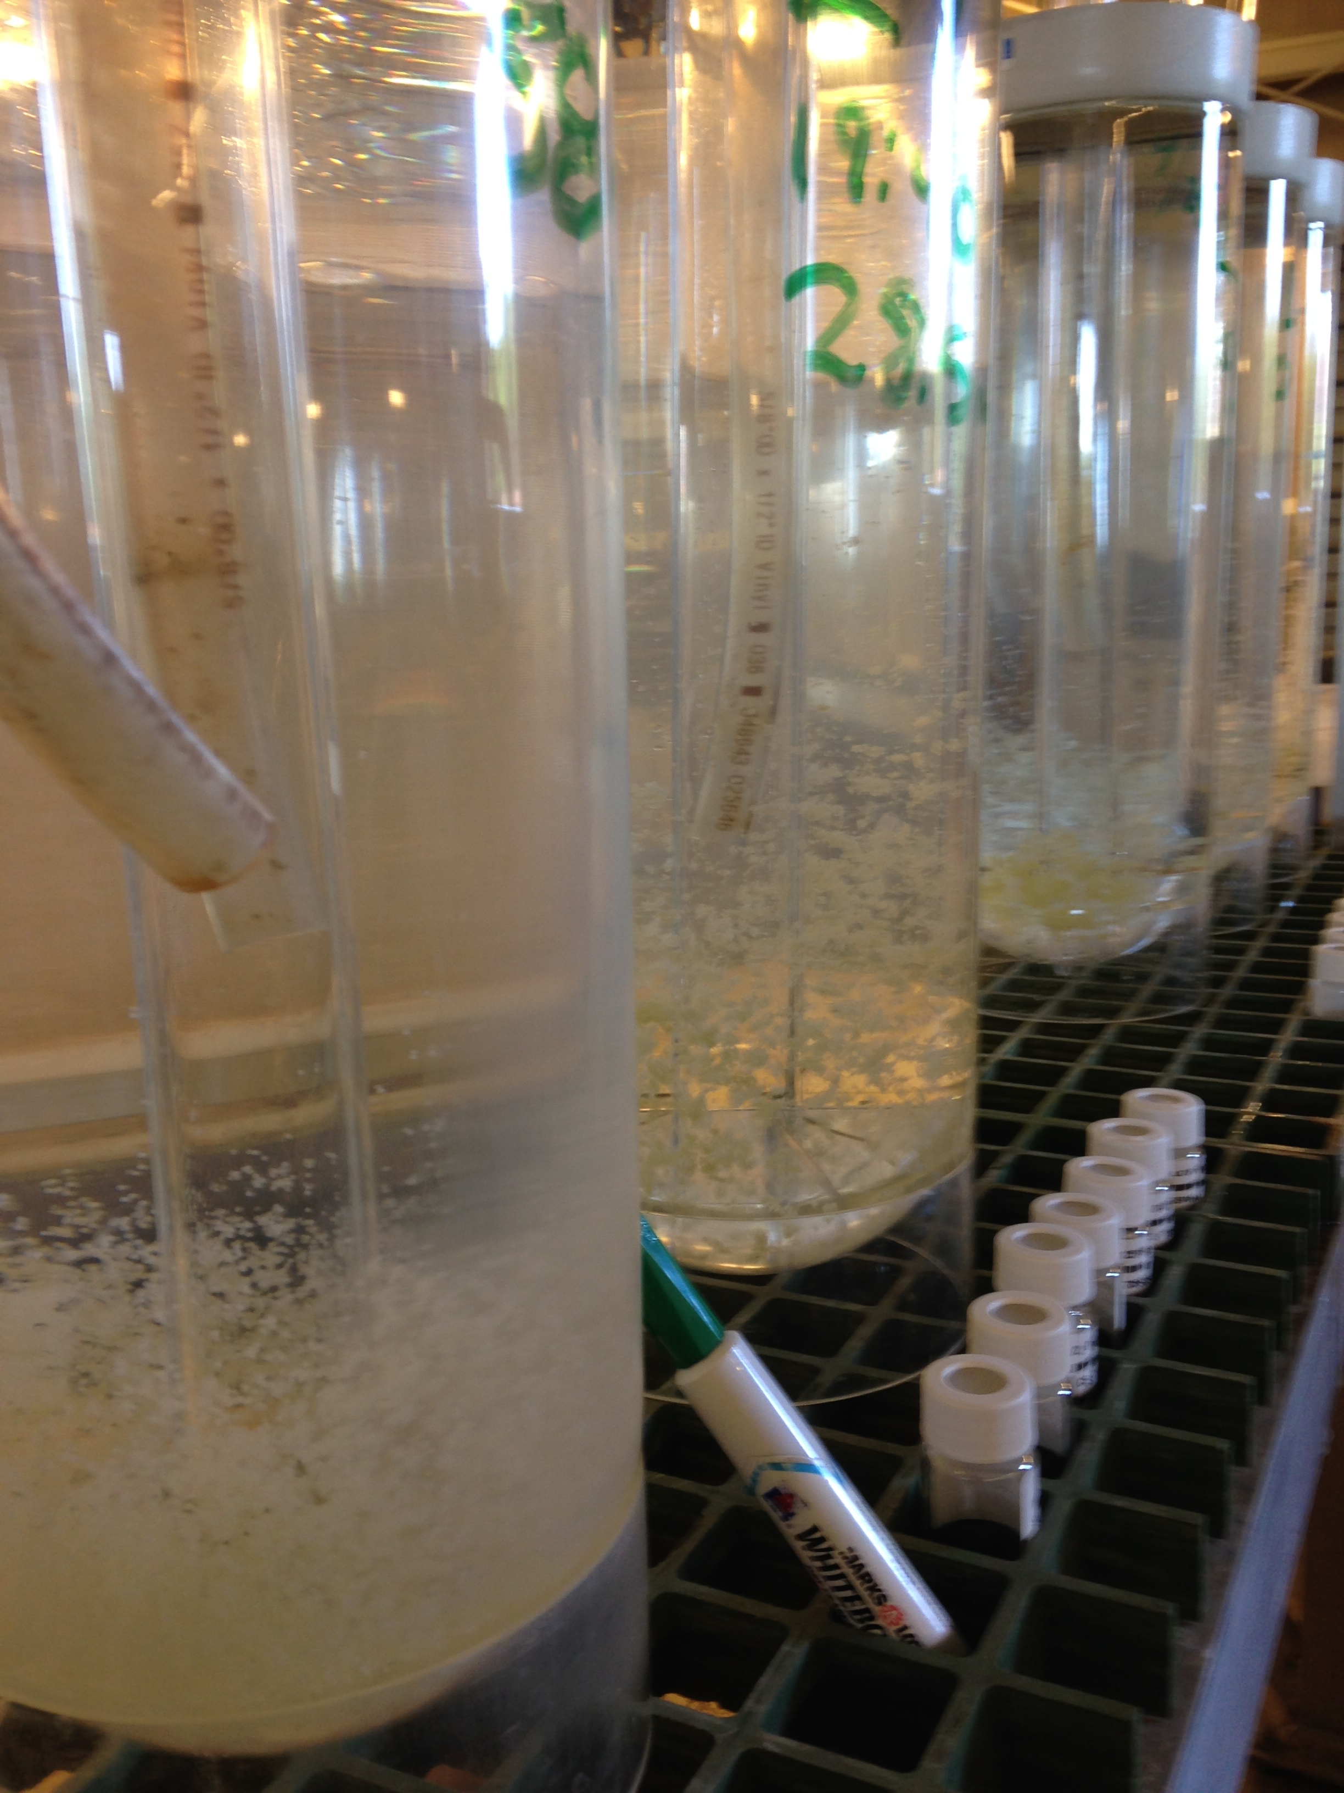
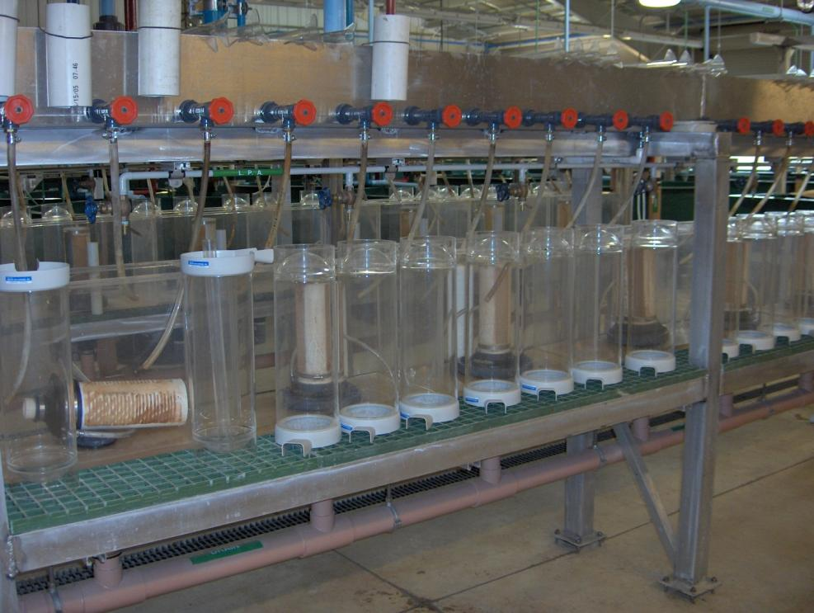
Incubation and hatching of eggs in controlled hatching jars.

Slide 28
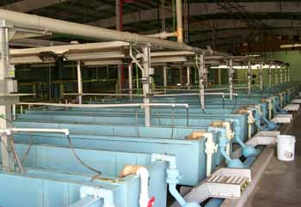
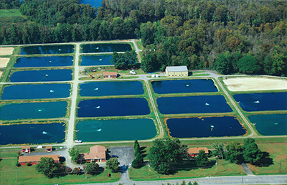
Nursery and Growout
TANKS
PONDS

Slide 29
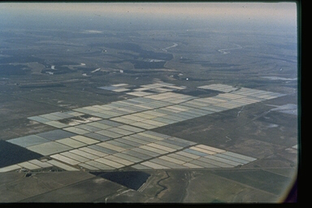
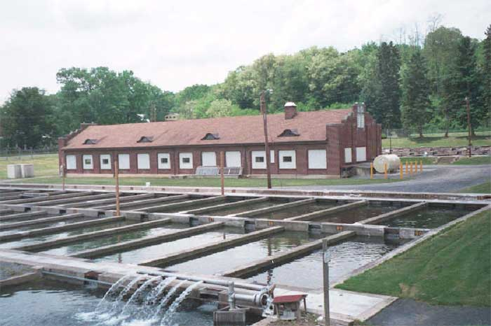
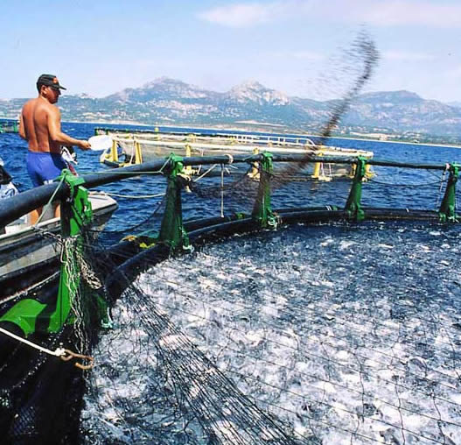
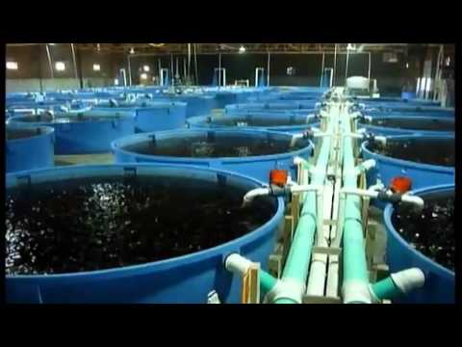
Productio units
POND
RACEWAY
SEA PEN
TANK
CAGE

Slide 30
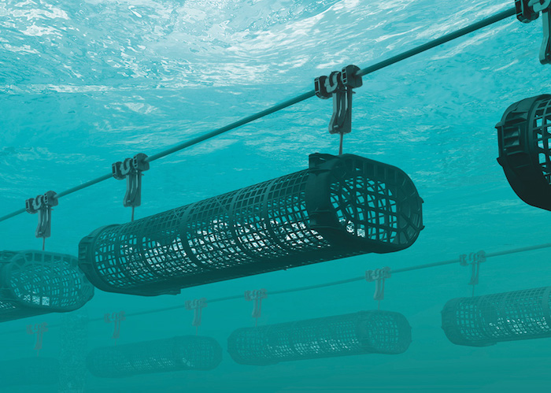
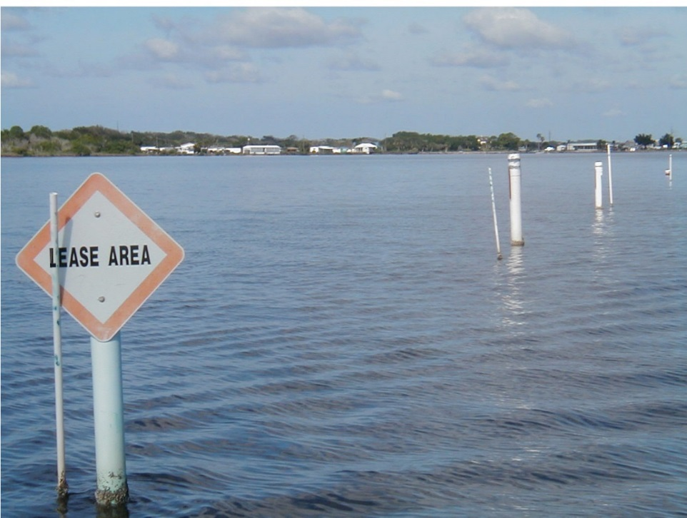
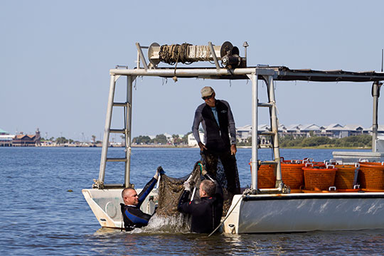
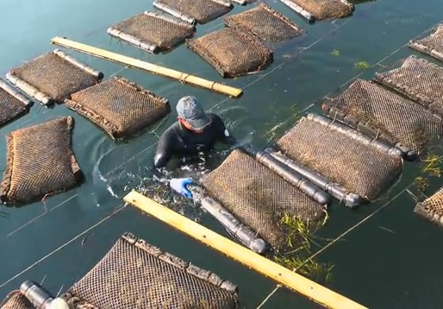
SHELLFISH AQUACULTURE IN OPEN WATER
PON
SHELLFISH AQUACULTURE IN OPEN WATER
Photo credit: University of Florida IFAS Shellfish Aquaculture Extension

Slide 31
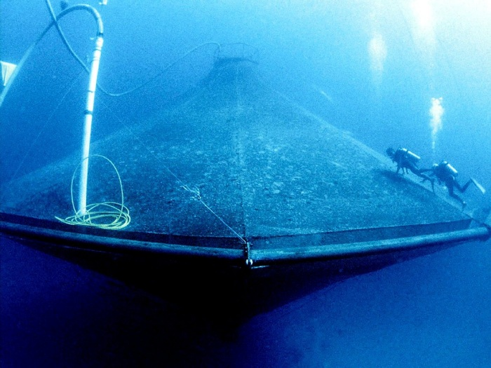


Offshore cage culture
OFFSHORE CAGE CULTURE
Photo credit: Monterey bay Aquarium

Slide 32



Medical Research
Medical Research
Aquatic organisms commonly used as vertebrate models for a wide-variety of medial research.
Genomes mapped, enabling gene function studies.
Danio rerio zebrafish
Oryzias latipes
medaka

Slide 33




Aquaponics
Indoor fish culture+ hydroponics = Aquaponics

Slide 34




Fish transport
Harvest and Transport to Market
Photo credit: Brain Skerry, National Geographic
Photo credit: USDA

Slide 35
Careers in Aquaculture
Current and Continued High Demand for College Graduates (B.S. and M.S. levels)
Hatcheries for stocking (public and private)
Commercial production for food or pond stocking
  Tanks/Ponds/Raceways/Cages
  Endless diversity and production techniques
Consulting
  Water quality
  Engineering
  Nutrition and Disease
  Product sales
Public aquariums
Research
Teaching
Administration (federal and state positions)

Slide 36

Aquaculture in Florida
Let’s take a look at the many different aquaculture products that come from Florida.
~750 commercial farms
2013 sales: $77.9 million
Products with the highest value of sales.
      1) Ornamental fish (#1 in the nation!)
      2) Shellfish (clams and oysters)
      3) Alligators
      4) Aquatic plants

Slide 37









Aquaculture in Florida
Blue Tang
Angelfish
Golden Damsel
Ornamental fish produced in Florida...hundreds of marine and freshwater species! Too many to name them all!
Swordtail
Clownfish
Bala Shark
Flame tetra
Lemon Yellow Cichlid
Yellow Tang

Slide 38






Aquaculture in Florida
Examples of food fish produced in Florida
Tilapia
Catfish
Pompano
Cobia
Hybrid Striped Bass
Sturgeon

Slide 39



Shellfish Aquaculture in Florida
Clams
Oysters
Sunray Venus
Considered the most sustainable protein source on the planet, shellfish remove detrimental nutrients from the coastal waters where they are grown and provide habitat to dozens of juvenile fish and invertebrate species.

Slide 40


Shrimp Aquaculture in Florida
Marine shrimp are grown quickly and sustainably in large,
in-door tank facilities.

Slide 41



Alligator Aquaculture in Florida
Alligators are a major aquaculture product in Florida.

Slide 42



Aquatic Plant Aquaculture in Florida
Dozens of aquatic plants species are grown in the state.

Slide 43


Aquaponics in Florida
Aquaponics is the symbiotic cultivation of plants and aquatic animals.
Plants can be grown using the nutrient rich water from aquatic animal waste.
In turn, the plants return much needed oxygen to the water, allowing the animals to thrive.

Slide 44




Aquaculture Education
Aquaculture is growing at a rapid pace, and aquaculture education plays a key role in the future of the industry and the future of food production globally.
There is an increasing demand for skilled aquaculture professionals in the U.S.A. and globally.
Education plays a vital role in preparing young adults for the innovations of tomorrow.

Slide 45
Conclusions
Conclusions
For questions about this presentation or aquaculture in Florida please contact the Division at:
Tallahassee Office: (850) 617-7600
Bartow Office: (863) 578-1870
Email: aquaculture_web@FreshFromFlorida.com
Website: FreshFromFlorida.com

