Slide 1
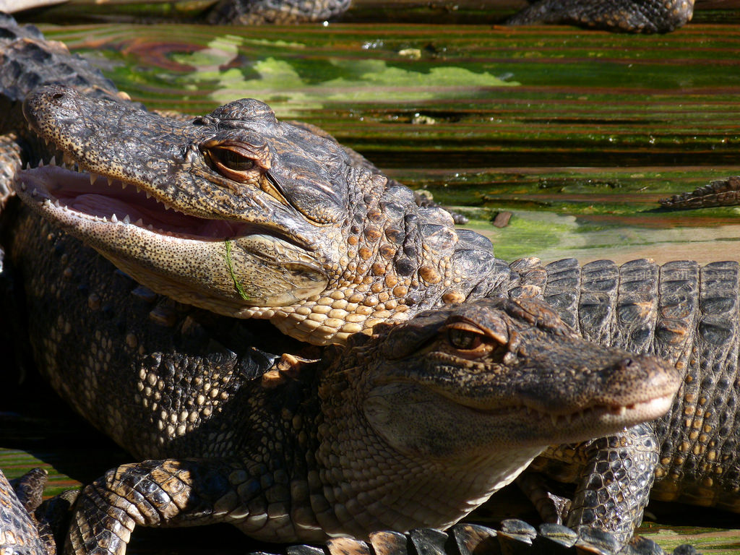

Florida Aquaculture Reptiles
Florida Aquaculture Reptiles
Produced by the Division of Aquaculture - 2017
Notes:
Ask people to define aquaculture
Ask people what they think of when they think of aquaculture

Slide 2
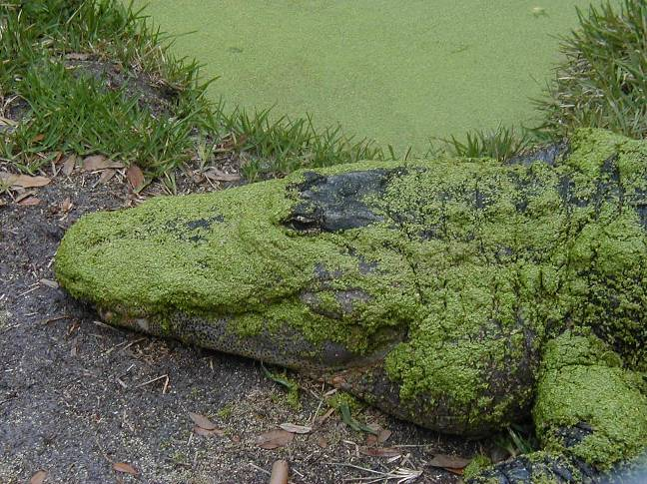
Introduction
This presentation will cover…..
  History of Alligators farms in Florida
  Reptile aquaculture in the U.S.
  Reptile aquaculture in Florida
    Alligator culture
    Turtle culture
Notes:
Ask people to define aquaculture
Ask people what they think of when they think of aquaculture

Slide 3
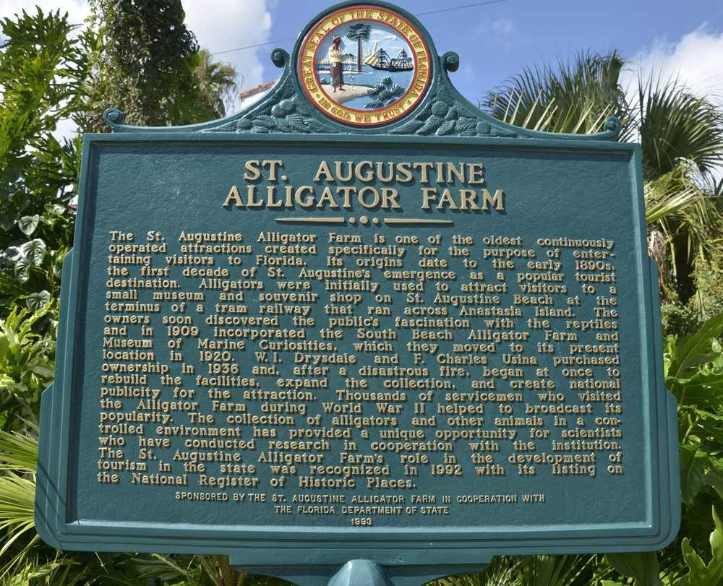

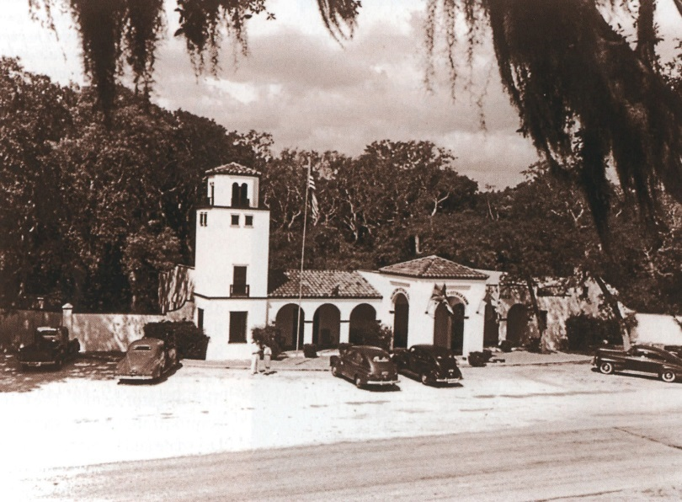
History of Alligator Farms in Florida
Alligators have been hunted for their leather and meat for centuries.
Alligator leather was used to make boots for confederate troops during the civil war.
First commercial alligator farm in Florida opened in 1891!
Notes:
Ask people to define aquaculture
Ask people what they think of when they think of aquaculture

Slide 4
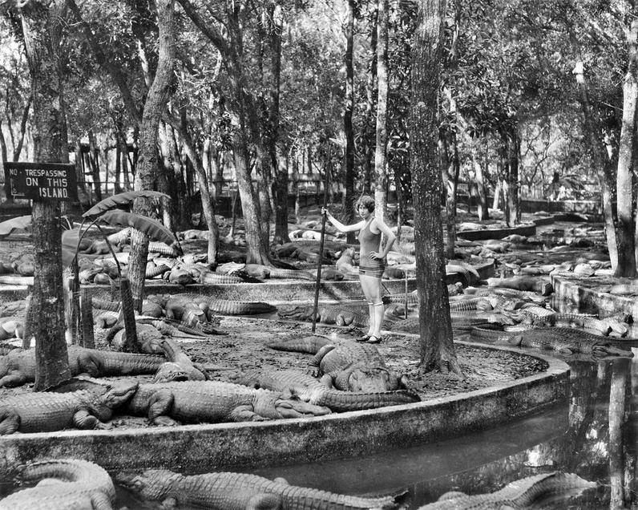
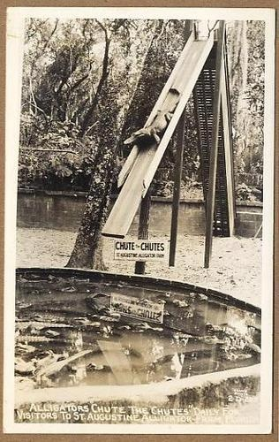
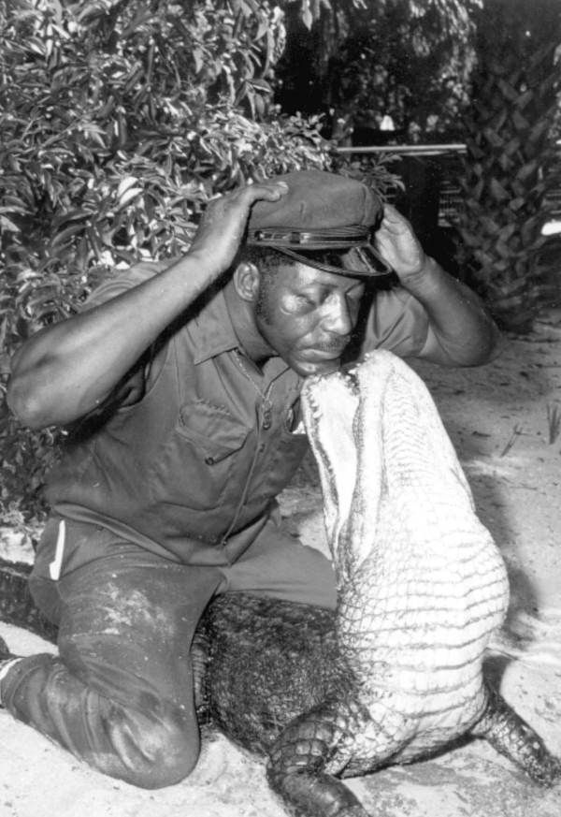
History of Alligator Farms in Florida
At the turn of the 20th century, the farm became a tourist hotspot.
Yes, that’s a
gator slide!
Notes:
Ask people to define aquaculture
Ask people what they think of when they think of aquaculture

Slide 5
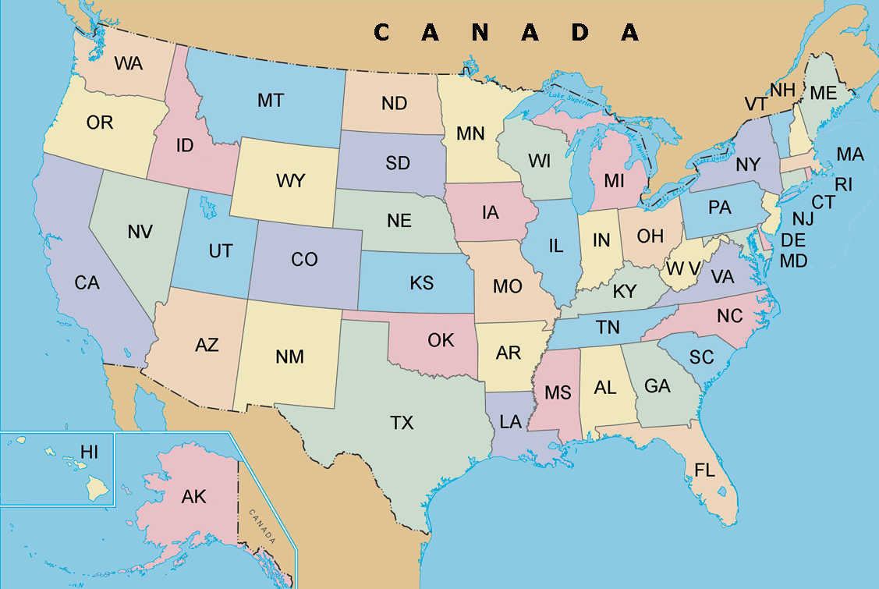
Reptile Aquaculture in the U.S.
(data from NASS Census of Aquaculture 2013)
Primarily Alligator and Turtles
  33 alligator farms
    314,000 whole alligators sold
    644,000 hides sold (Avg. $32/lb!)
    1.15 million lbs. of meat produced
    $62 million annual sales!
Turtle Farms in U.S.
17
1
Alligator Farms in U.S.
1
6
2
  78 turtles farms
    3.5 million whole turtles sold
    $8.6 million annual sales
17
5
25
1
10
26
Notes:
Ask people to define aquaculture
Ask people what they think of when they think of aquaculture

Slide 6
Alligator Aquaculture in Florida
Value of Florida Industry
$8,566,584 in 2015
  80% of value from hide sales
  20% of value from meat sales
2009 economic recession drastically reduced hide demand
Production in Florida Industry
21,696 alligators harvested in 2015
  115,460 ft. of hide for leather
  188,942 lbs. of meat
Data from: Florida Fish and Wildlife Conservation Commission: Alligator Mgt. Team
Notes:
Ask people to define aquaculture
Ask people what they think of when they think of aquaculture

Slide 7
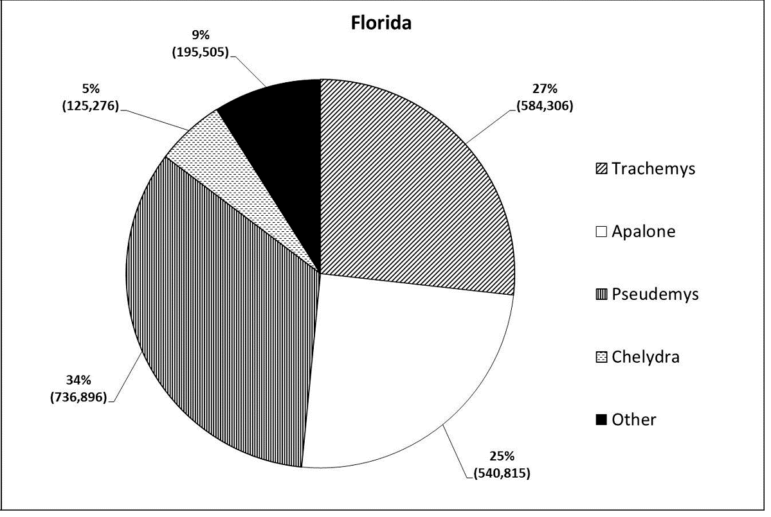
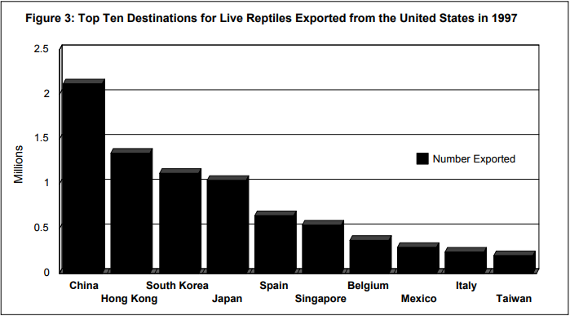
Turtle Aquaculture in Florida
Value of Florida Industry (2013)
$3,073,000 sales
26 farms in Florida
822,000 whole turtles sold
~1,079,000 turtle eggs sold
Sliders
Softshell
Cooters
Snapping
From: Mali et al. 2014
Where are all these turtles exported to?
China purchases a large majority of U.S. exports
Data from: USFWS: International Wildlife Trade Program – 1997
Notes:
Ask people to define aquaculture
Ask people what they think of when they think of aquaculture

Slide 8
Alligator Sustainable Use Management Program
Endangered Species Listing
Listed as endangered in 1967
  Only ~700,000 in wild
Populations began recovering
  1977: endangered →threatened
  1987: removed from threatened list
  Currently, 2-3 million alligators in U.S.
  1.25 million in Florida!
The Fish and Wildlife Conservation Commission permits collection of a specific number of alligator eggs annually (<2% annual recruitment).
Farms grow & harvest alligators sustainably, removing pressures from wild populations.
Notes:
Ask people to define aquaculture
Ask people what they think of when they think of aquaculture

Slide 9
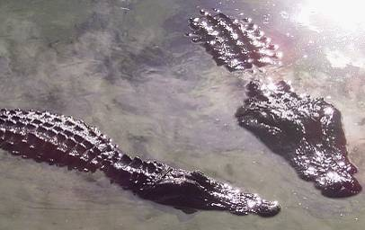
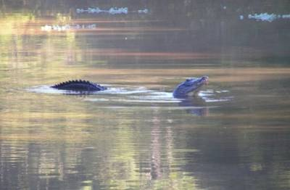
Alligator Aquaculture Methods
Alligators breed from May-August
  Females rarely grow larger than 9 ft.
  Males can reach 16 ft.!
Male
Female
During courtship, alligators communicate by bellowing with their head and tail out of the water.
Notes:
Ask people to define aquaculture
Ask people what they think of when they think of aquaculture

Slide 10
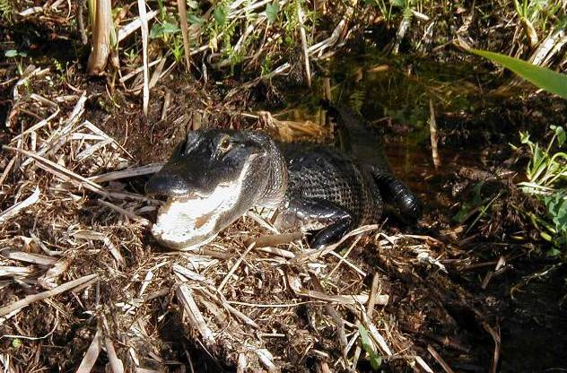
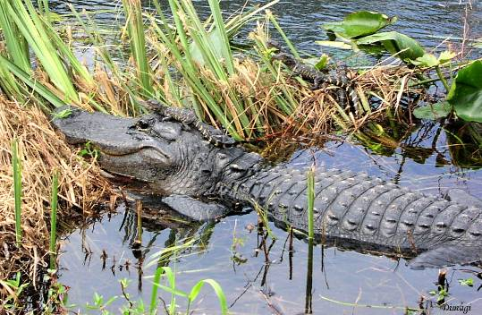
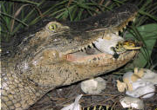
Alligator Aquaculture Methods
Nesting begins in June and July.
Females deposit 20-60 eggs and defend the nest until the young hatch.
Eggs hatch after about 65 days
Female alligators carry & protect young from predators
Hatchlings communicate by grunting and peeping
Notes:
Ask people to define aquaculture
Ask people what they think of when they think of aquaculture

Slide 11
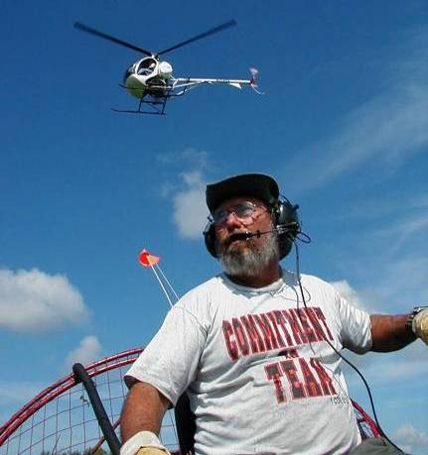
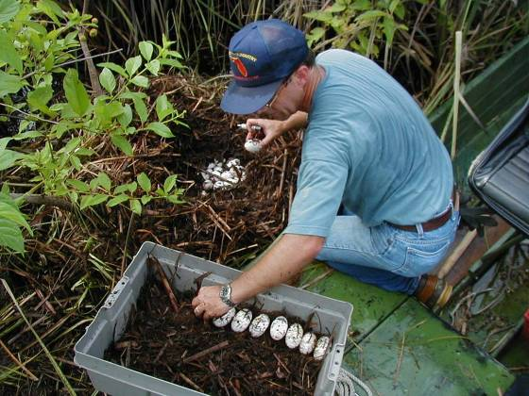
Alligator Egg Collection
Alligator eggs are collected from the wild during the nesting season and hatched on farms.
Eggs are carefully marked and removed from the nest.
The helicopter pilot spots nests
and directs the airboat captain to
the nest.
The eggs are marked so they are not rotated, which can damage the developing
alligator during incubation.
Notes:
Ask people to define aquaculture
Ask people what they think of when they think of aquaculture

Slide 12
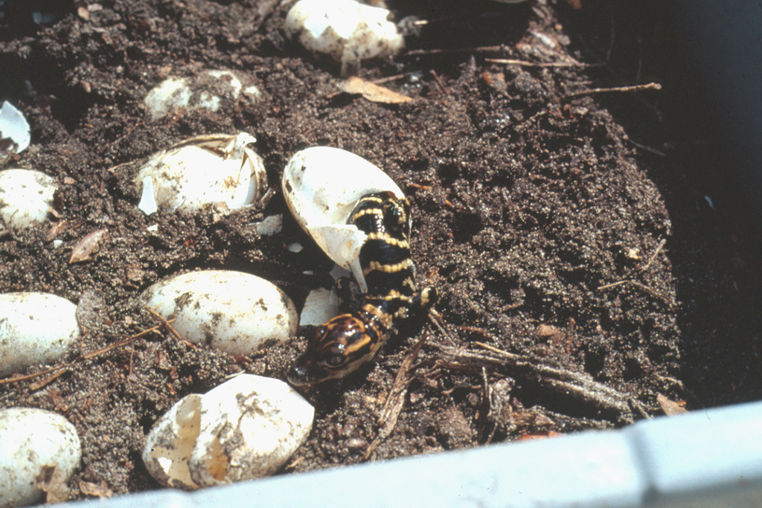
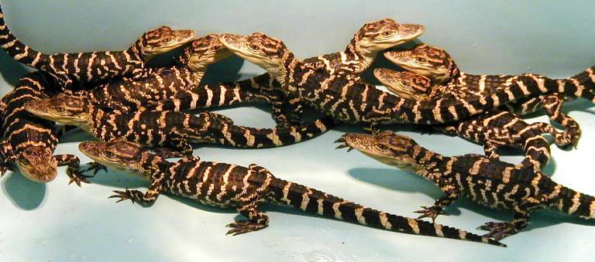
Alligator Aquaculture Methods
Eggs are incubated at 88°F-90°F
Hatching success is 50-90%
Alligators will reach harvest size (4 ft. length) in 14 months!
Did you know?
The sex of alligator hatchlings is determined by the incubation temperature!
Below 86°F will produce females.
Above 93°F will produce males.
Notes:
Ask people to define aquaculture
Ask people what they think of when they think of aquaculture

Slide 13
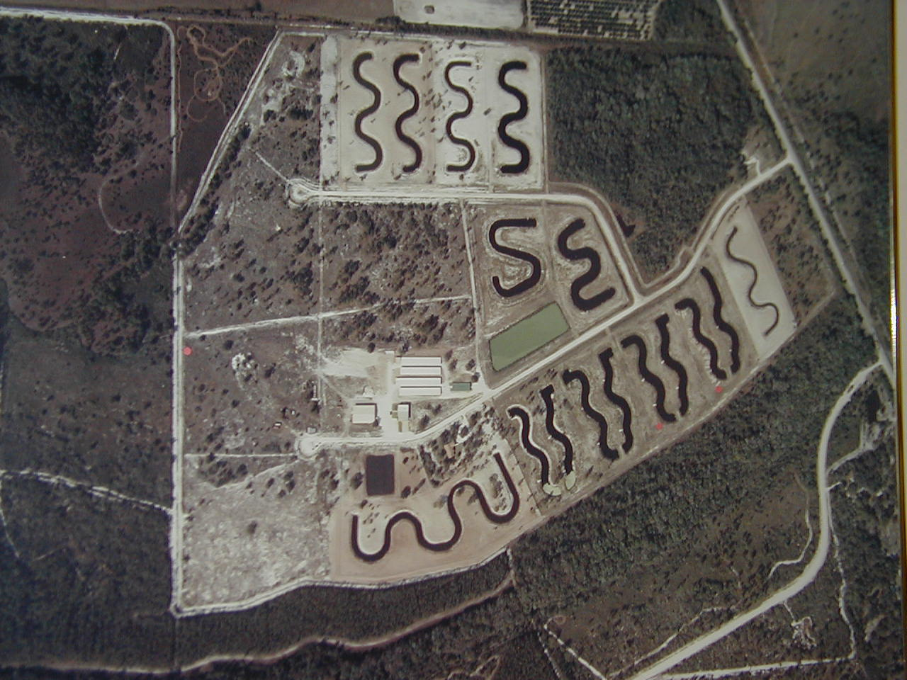
Gator farm
Aerial photo of outdoor alligator farm
Why are the ponds curvy?
Maximizes bank area for basking alligators
Notes:
Ask people to define aquaculture
Ask people what they think of when they think of aquaculture

Slide 14
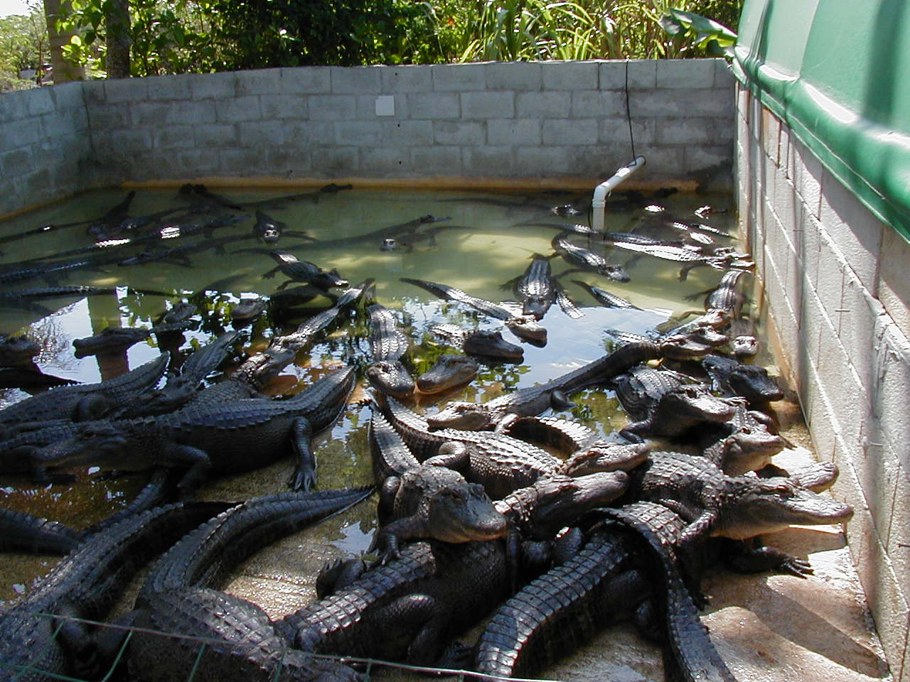
Gator containment pen
Alligators are also farmed in concrete buildings. Most have removable roofs for warmer weather.
These alligators have are at a harvestable size.
Notes:
Ask people to define aquaculture
Ask people what they think of when they think of aquaculture

Slide 15
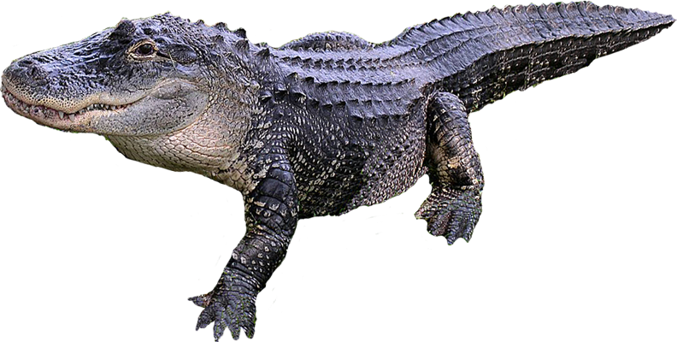
Alligator products
Alligator Products
Head: Mounted for taxidermy display.
Tail: Meat
Back and Belly Hide: Used for making boots, shoes, briefcases, purses, belts and wallets.

Slide 16
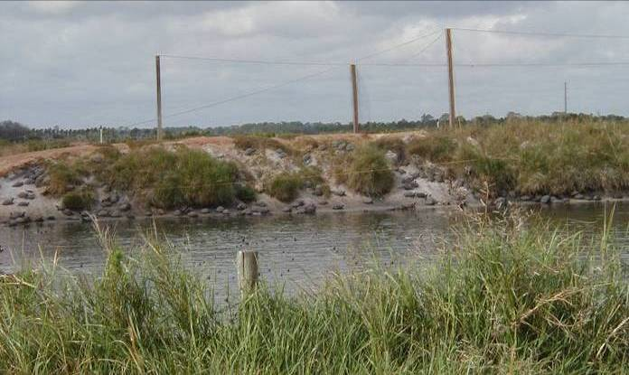
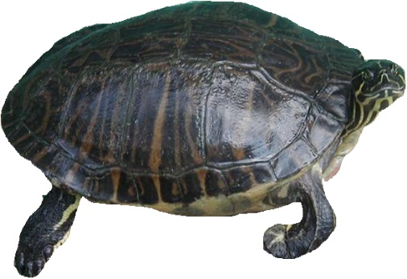
Turtle Aquaculture Methods
Nesting season begins in late March and lasts most of the summer.
Eggs are collected daily and washed with chlorine and dipped in antibiotics to prevent salmonella infections.
Pond sliders and cooters are the most common turtle species farmed in Florida
Turtle ponds have sandy banks, perfect for turtle nests.
Notes:
Ask people to define aquaculture
Ask people what they think of when they think of aquaculture

Slide 17
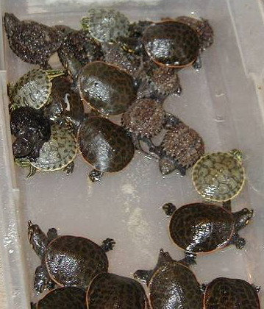
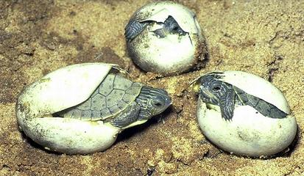
Turtle Aquaculture Methods
Eggs are incubated for 60 days at 80-85 °F.
  Temperature control is critical during incubation.
    Low temperatures can result in no growth.
    High temperatures can result in metabolic stress.
Hatching rates are between 80-90%.
Snapping
Slider
Softshell
Turtle ponds have sandy banks, perfect for turtle nests.
Notes:
Ask people to define aquaculture
Ask people what they think of when they think of aquaculture

Slide 18
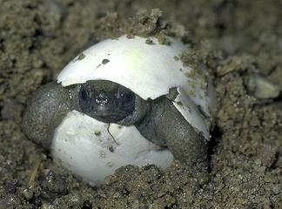
Why is temperature so important?
Just like alligators and all other reptiles, turtles are ectothermic.
  That means their internal body temperature changes with the external temperature.
  As their body temperature changes so does their metabolism, which effects their feeding, growth and activity levels.
I’m not cold blooded!
Did you know?
Reptiles are not “cold-blooded”. In the summer months, their internal body temperature can be higher than humans and mammals!
Notes:
Ask people to define aquaculture
Ask people what they think of when they think of aquaculture

Slide 19
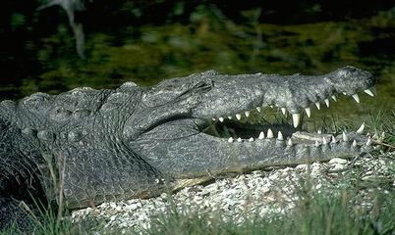
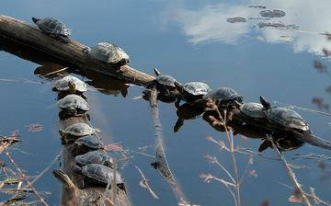
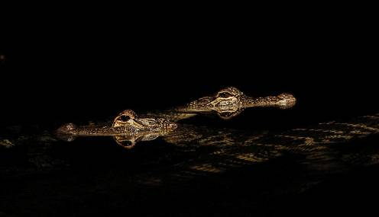
What are these reptiles doing?
Opening its mouth to cool down.
Basking in the sun to warm up and aid digestion
Retreating to the water with only their heads exposed when temperatures begin to drop to stay warm.
Notes:
Ask people to define aquaculture
Ask people what they think of when they think of aquaculture

Slide 20
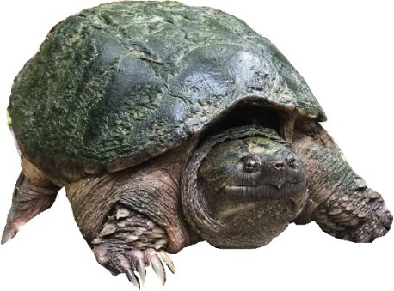

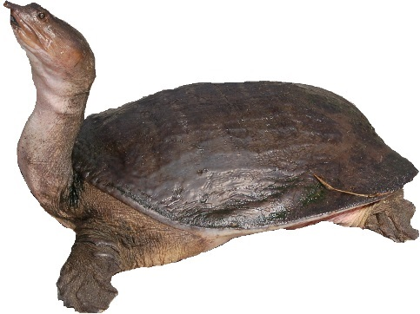
Conclusion
The U.S. Reptile aquaculture industry valued at $71 million annually.
Florida has the most turtle farms and second most alligator farms in the nation!
Reptile aquaculture is sustainable and a win-win for Florida!
  Captive production of turtles and alligators satisfies economic demand for their products while also conserving wild populations.
Notes:
Ask people to define aquaculture
Ask people what they think of when they think of aquaculture

Slide 21
Conclusion
Conclusion
For questions about this presentation or aquaculture in Florida please contact the Division at:
Tallahassee Office: (850) 617-7600
Bartow Office: (863) 578-1870
Email: aquaculture_web@FreshFromFlorida.com
Website: FreshFromFlorida.com

