Slide 1
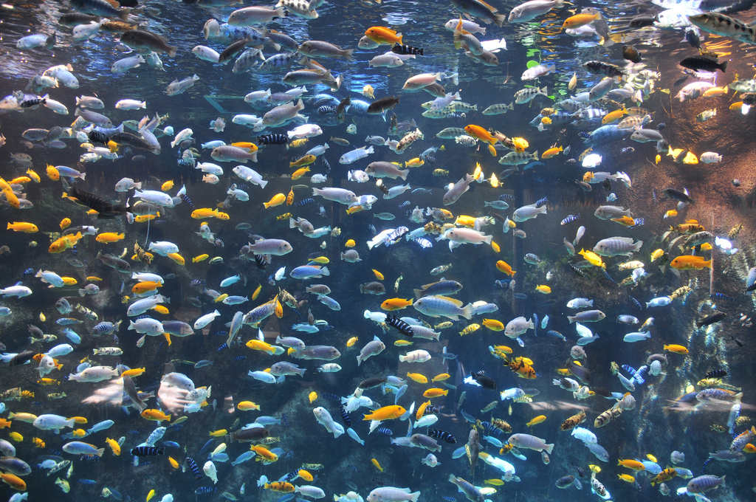

Florida Aquaculture
Ornamental Fish
Florida Aquaculture
Ornamental Fish
Produced by the Division of Aquaculture - 2017
Notes:
Ask people to define aquaculture
Ask people what they think of when they think of aquaculture

Slide 2
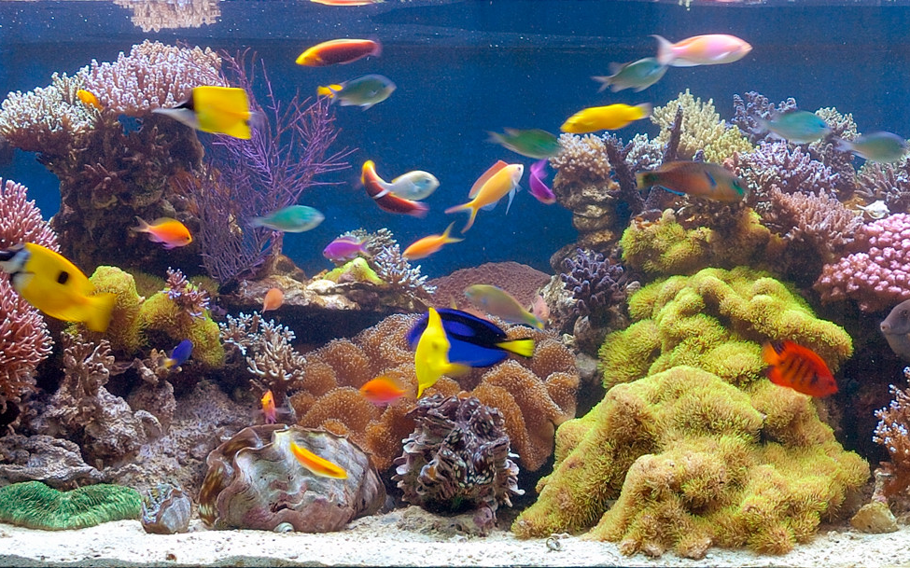
Introduction
This presentation will cover…..
  Ornamental fish sources
  The ornamental aquaculture economy
  Florida’s ornamental industry
  Types of ornamentals
    Live bearers
    Egg layers
    Marine
  Ornamental Research
Notes:
Ask people to define aquaculture
Ask people what they think of when they think of aquaculture

Slide 3
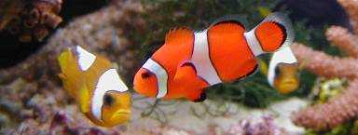
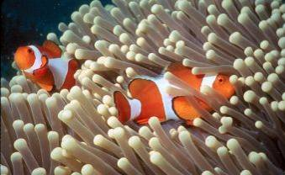
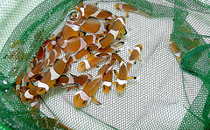
Where do aquarium fish come from?
Some are collected from the wild…
Some are from farms…
Notes:
Ask people to define aquaculture
Ask people what they think of when they think of aquaculture

Slide 4
Where do aquarium fish come from?
Freshwater
90% aquacultured
10% wild capture
Saltwater
2% aquacultured
98% wild capture
Most freshwater ornamentals are sustainable
Most saltwater ornamentals are not sustainable
Notes:
Ask people to define aquaculture
Ask people what they think of when they think of aquaculture

Slide 5
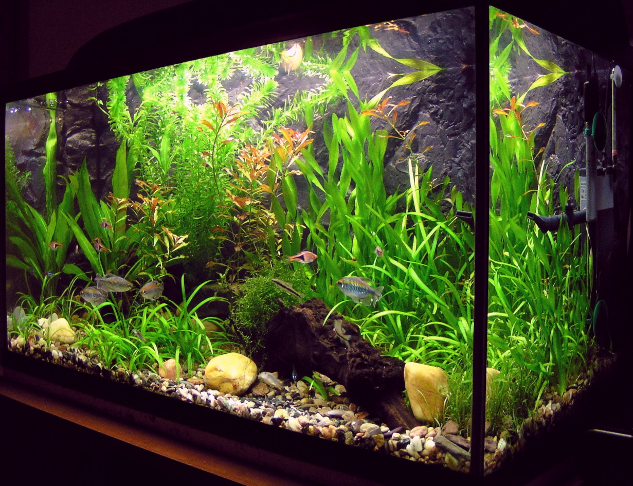
Do you have a freshwater aquarium at home?
If you do, odds are you the fish in your tank were produced by an aquaculture farm in Florida!
Notes:
Ask people to define aquaculture
Ask people what they think of when they think of aquaculture

Slide 6
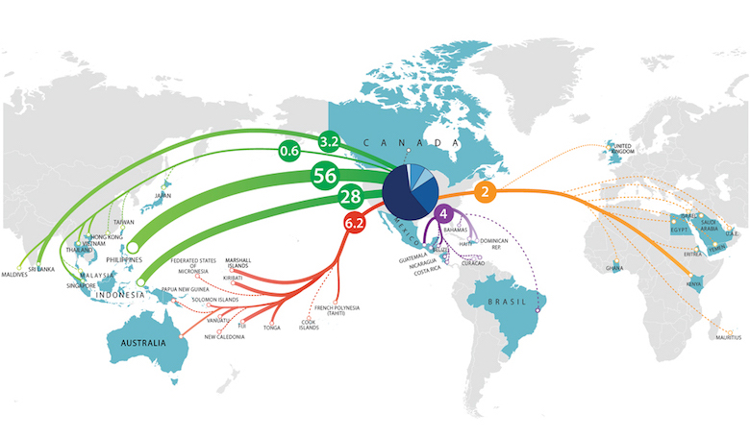
Where does the U.S. import fish from?
88% from SE Asia
2% from Africa/Europe
4% from Central and South America
6% from South Pacific
Photo credit: Andrew Rhyne, Roger Williams University
Photo credit: Andrew Rhyne
Notes:
Ask people to define aquaculture
Ask people what they think of when they think of aquaculture

Slide 7
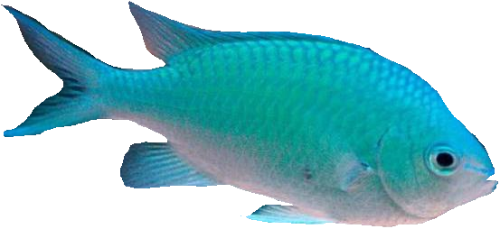
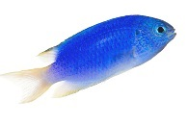
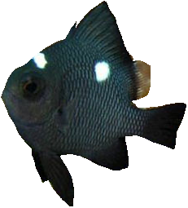
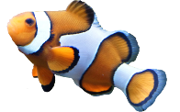
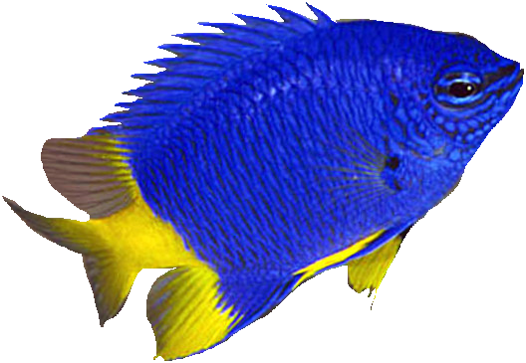
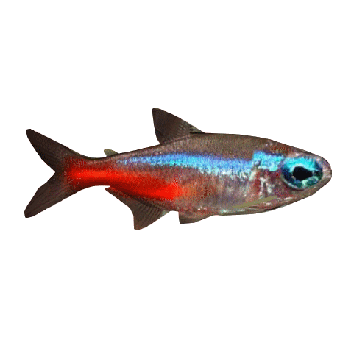
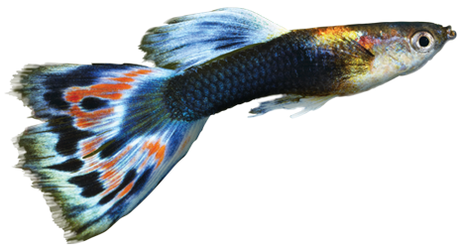
Top Ornamental Suppliers
Top 5 Marine Species
Green Chromis
Blue Damselfish
Threespot Dascyllus
Clownfish
Yellowtail Damselfish
57% of global supply comes from SE Asia
2,500 species in aquarium industry
60% are freshwater species
30 species represent a large majority of global trade value
Clownfish are one of the few marine species commonly produced in captivity!
Neon tetras and guppies represent 25% of the global market by volume!
Notes:
Ask people to define aquaculture
Ask people what they think of when they think of aquaculture

Slide 8
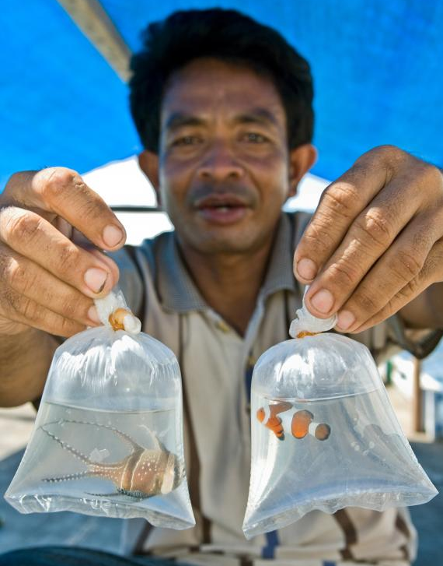
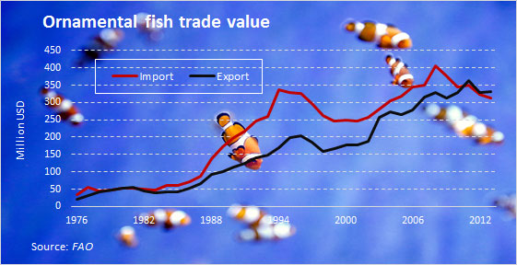
The Global Aquaculture Industry
Aquarium trade is a growing sector of aquaculture.
High demand for aquacultured species – reduce wild capture
Global annual sales = $342 million (FAO 2010)
Global exports increasing ~6.2% annually since 2000.
Notes:
Ask people to define aquaculture
Ask people what they think of when they think of aquaculture

Slide 9
U.S. Ornamental Industry
285 farms in U.S.
2013 sales = $ 41.5 million
Koi farms = 52% of U.S. farms
Yet Koi only represent 1% of fish produced
Why is that? Numerous small farms
Notes:
Ask people to define aquaculture
Ask people what they think of when they think of aquaculture

Slide 10
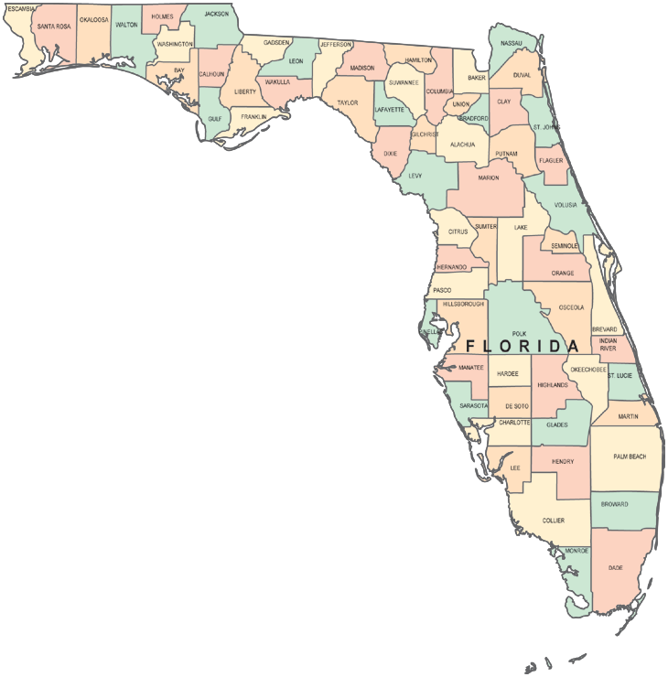



Florida’s Ornamental Industry
Florida is by far the biggest ornamental producer in the nation!
127 farms in Florida (2013) – 45% of U.S. industry!
2013 sales in Florida = $ 27 million
95% of ornamentals produced in U.S. come from Florida
  Over 800 varieties of freshwater fish produced
Why Florida?
Warm climate ideal for tropical fish
Proximity to ports and airports
Local infrastructure – feed/supplies
Most farms are in Hillsborough, Polk and Dade counties
Notes:
Ask people to define aquaculture
Ask people what they think of when they think of aquaculture

Slide 11
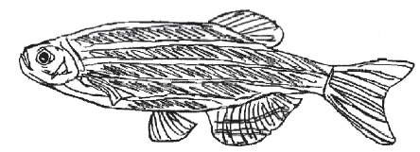
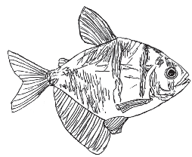
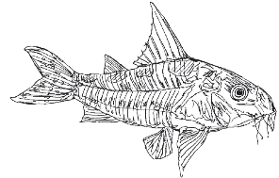
Commonly Cultured Freshwater Fish Groups
Minnows
Family: Cyprinidae
Over 2000 species
Common Species in FL
Barbs
Danios
Goldfish
Koi
Rasboras
Freshwater sharks
Reproduction:
Egg layers/Broadcast spawner
Feeding: Omnivore
Tetras
Family: Characidae
Over 900 species
Common Species in FL
Neon tetra
Black tetra
Pacu
Lemon tetra
Mexican tetra
Firehead tetra
Reproduction:
Egg layers/Broadcast spawner
Feeding: Omnivore
Armored Catfish
Family: Callichthyidae
Over 130 species
Common Species in FL
Leopard corydora
Bronze corydora
Panda corydora
Hoplo catfish
Tons of color variants
Reproduction:
Adhesive eggs/bubble nests
Feeding: Insectivore
zebra danio
black tetra
leopard corydora
Photo credit: UF-IFAS Publication Circular #54
Photos from: UF/IFAS Circular 54
Notes:
Ask people to define aquaculture
Ask people what they think of when they think of aquaculture

Slide 12
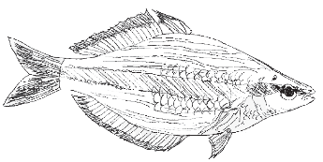
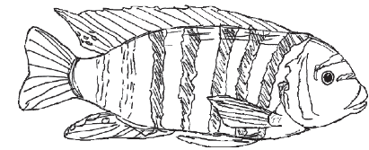
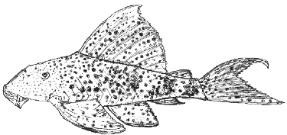
Commonly Cultured Freshwater Fish Groups
Suckermouth Catfish
Family: Loricariidae
Over 550 species
Common Species in FL
Common pleco
Bristle-nose pleco
Sailfin pleco
Reproduction:
Adhesive eggs/Male guards eggs
Feeding: Algae/insects
Rainbowfishes
Family: Melanotaeniidae etc.
53 species in 6 genera
Common Species in FL
Red rainbowfish
Australian rainbowfish
Boeseman’s rainbowfish
Neon dwarf rainbowfish
Reproduction:
Adhesive eggs/broadcast spawner
Feeding: Insects/Crustaceans
Cichlids
Family: Callichthyidae
Over 1500 species
Common Species in FL
Angelfish
Discus
Oscar
Jewel cichilid
Mbuna cichilid
Kribs cichilid
Reproduction:
Parental care/mouth brooders
Feeding: Very diverse
banded rainbowfish
zebra cichilid
Pleco catfish
banded rainbowfish
zebra cichilid
Photo credit: UF-IFAS Publication Circular #54
Photos from: UF/IFAS Circular 54
Notes:
Ask people to define aquaculture
Ask people what they think of when they think of aquaculture

Slide 13
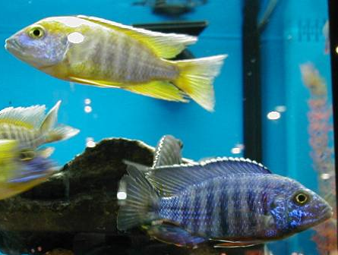
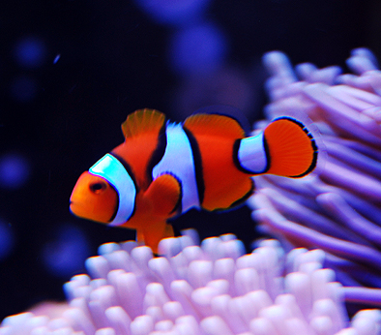
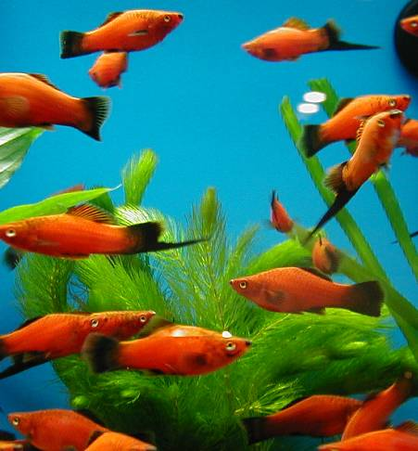
Types of Ornamentals
Ornamental fish are often divided by culture methods
3 main groups
  Freshwater Egglayer e.g. Cichilids
  Marine Species
  e.g. clownfish
  Freshwater Livebearers
  e.g. Swordtails
Notes:
Talk about benefits and problems

Slide 14
Ornamental Production in Florida
(2013 Aquaculture Census)
In contrast, live bearers represent 54% of the industry by volume, but only 10% of total value.
Marine fish only represent 0.4% of the industry by volume, yet represent 25% of total value!
Notes:
Talk about benefits and problems

Slide 15
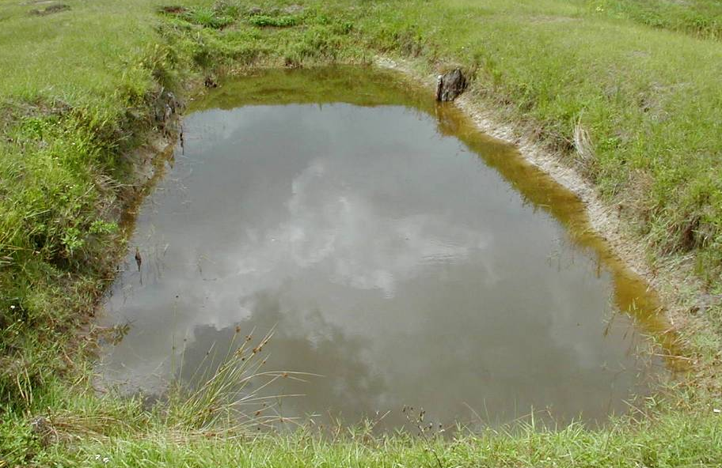
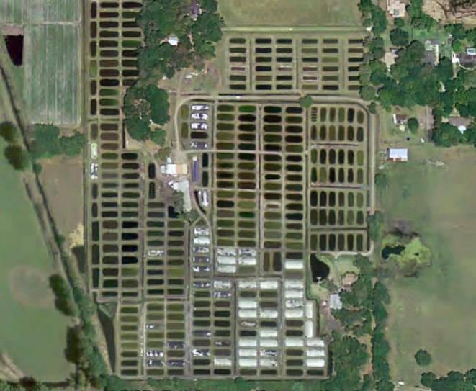
Livebearer Culture Techniques
Typical livebearer farm has 50-300+ small (~1/10th acre) earthen ponds
  Spawning occurs naturally in ponds
  Natural pond productivity feeds fish (fertilizer often added)
  Supplemental feeding rates vary
    Depends on species, time of year and pond conditions

Slide 16
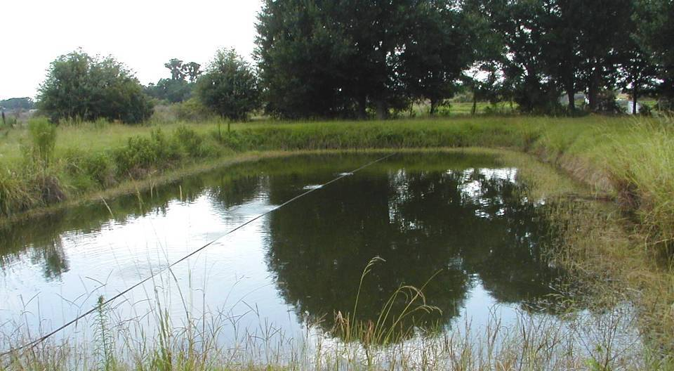
Livebearer Culture Techniques
Supplemental aeration decreases stress and improves pond productivity.

Slide 17
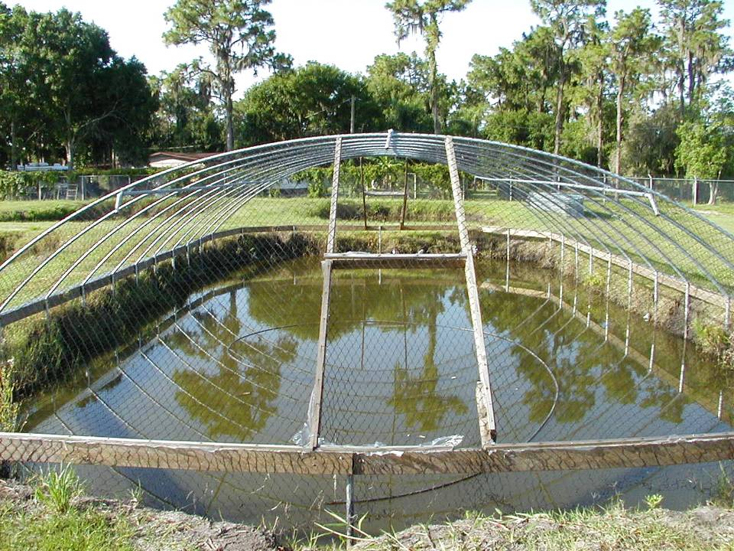
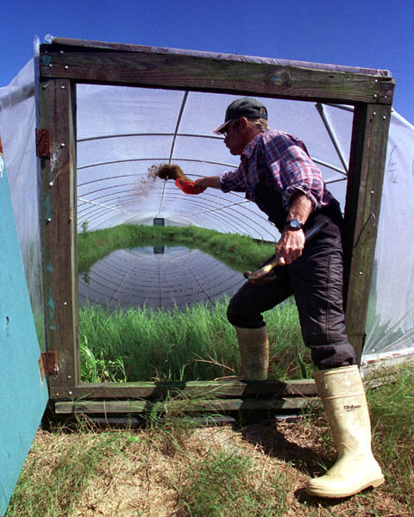
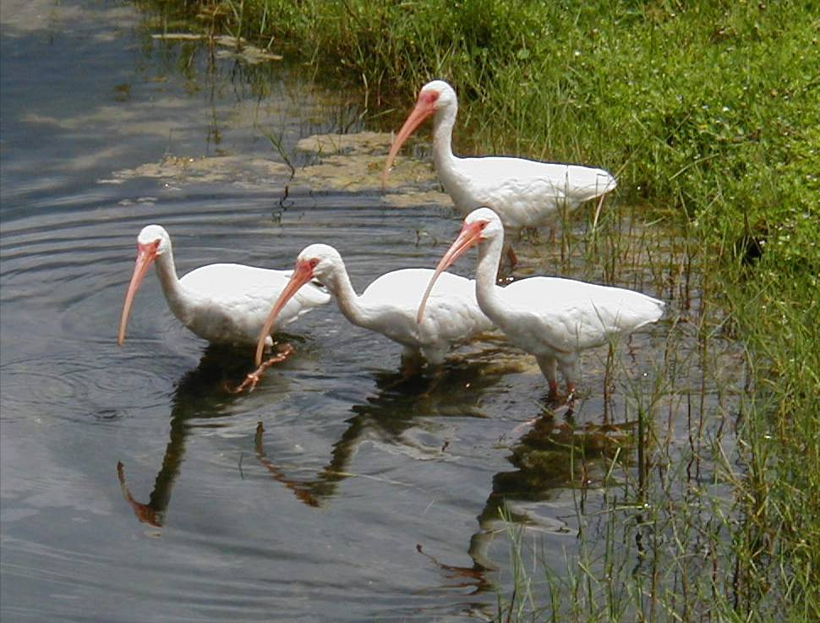
Livebearer Culture Techniques
This metal frame with netting protects fish from birds and provides a frame for winter cover.
Mine!
Mine!
Mine!
Mine!
Some ponds are covered with plastic during the winter to keep water temperatures warm.
Some ponds are covered with nets to protect fish from bird predation.

Slide 18
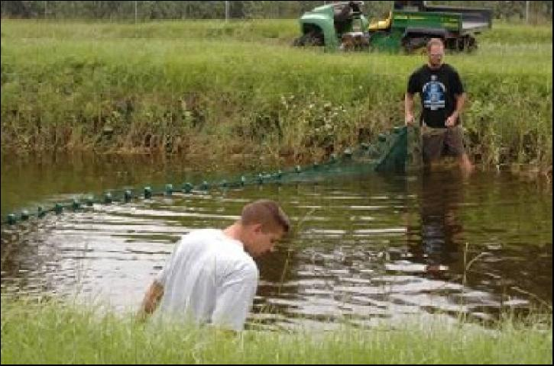
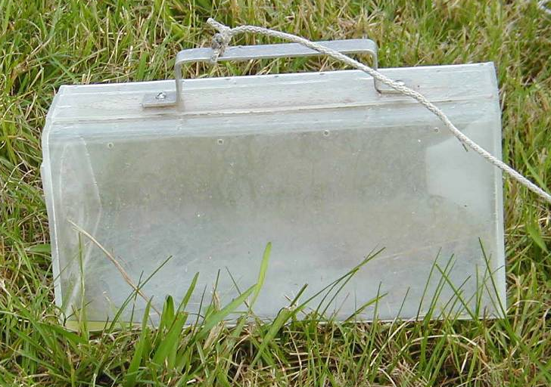
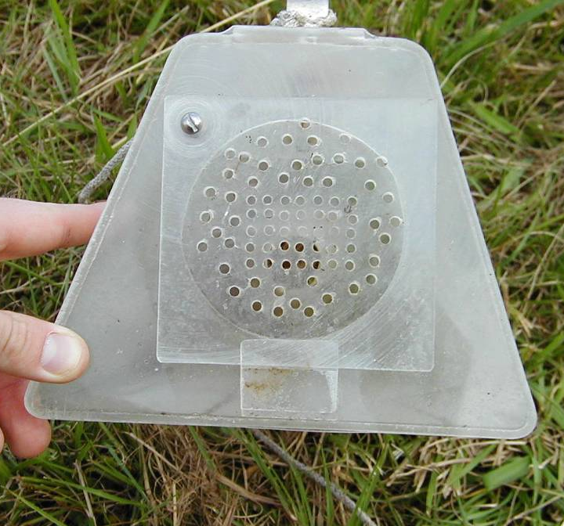
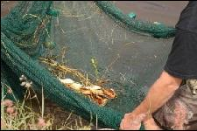
Livebearer Culture Techniques
Harvest involves trapping or seine netting ponds.
Fish enter trap through funnel entrance
They are removed through a trap door.
Some ponds are harvested all at once with a seine net.

Slide 19
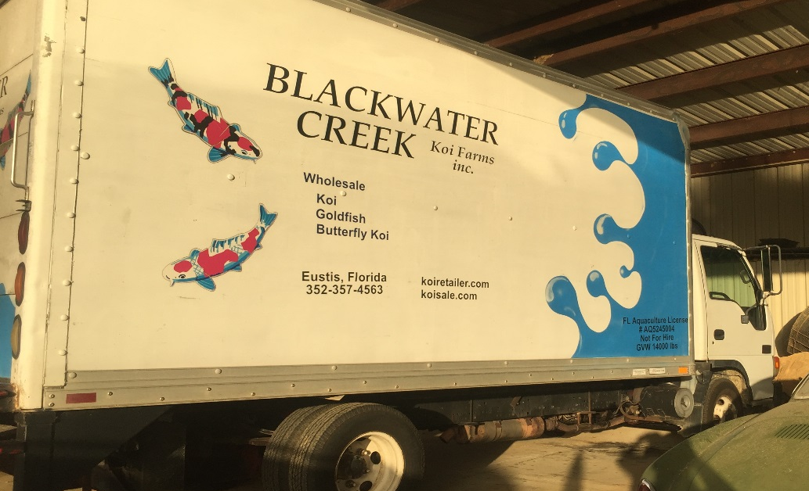
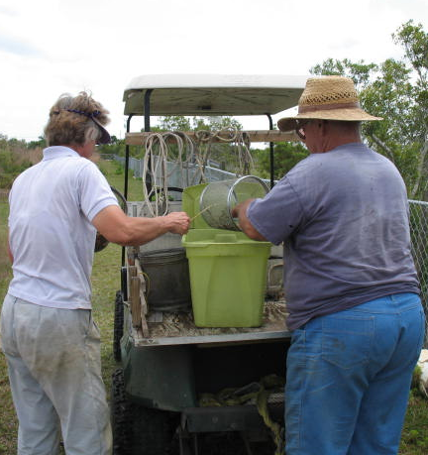
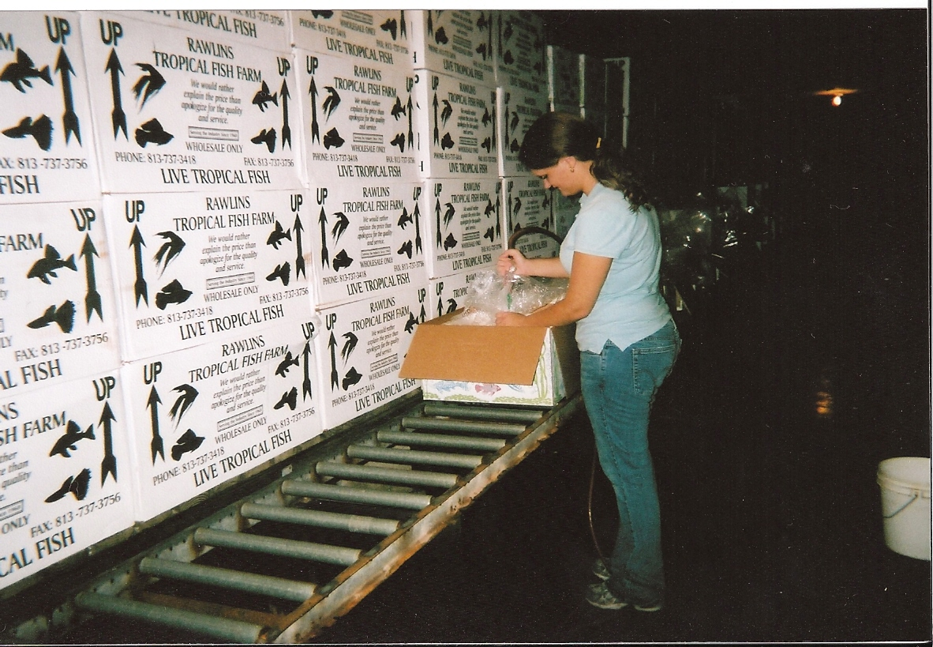
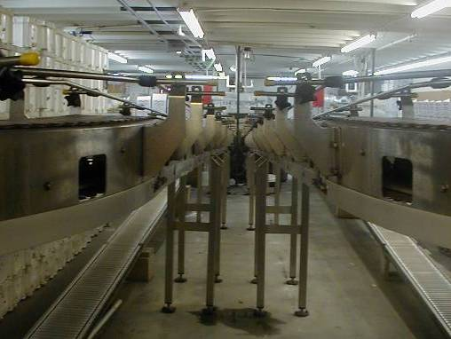
Livebearer Culture Techniques
Fish are “graded” or sorted by size as they grow to a marketable size.
When ready to be sold, fish are sorted, packed and shipped.
Tropical fish are the #1 air cargo item passing through Tampa International Airport!
Fish are placed in plastic bag with water and oxygen, then placed in insulted boxes for shipping.
Commercial fish grader

Slide 20
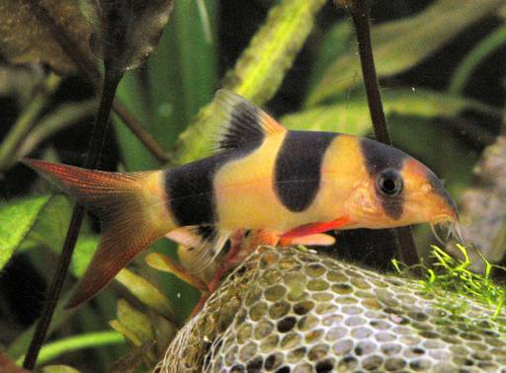
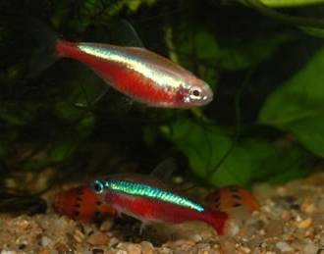
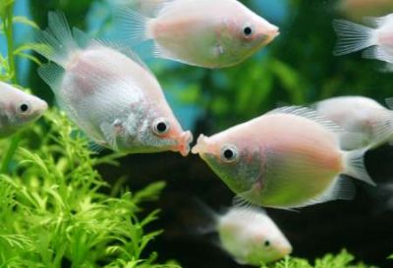
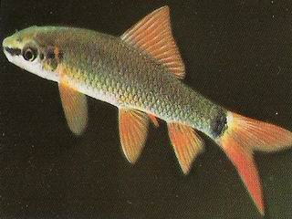
Egglayers Culture
Almost 70% of land used for tropical fish culture in Florida is for egglayers.
61% of U.S. tropical sales are from egg-laying, freshwater ornamental species.
Clown Loach
Neon Tetras
Kissing Gouramies
Rainbow Shark

Slide 21
Egglayers Culture
There are hundreds of egg laying species cultured in Florida.
Production methods vary by species or group of fish.
Clown Loach
Neon Tetras
Kissing Gouramies
Rainbow Shark

Slide 22
Cichlid Culture Techniques
African cichlids are a great egglayer example.
Florida is the #1 producer of cichlids in the world!
African cichlid are highly diverse, with 2000-3000 species globally.

Slide 23
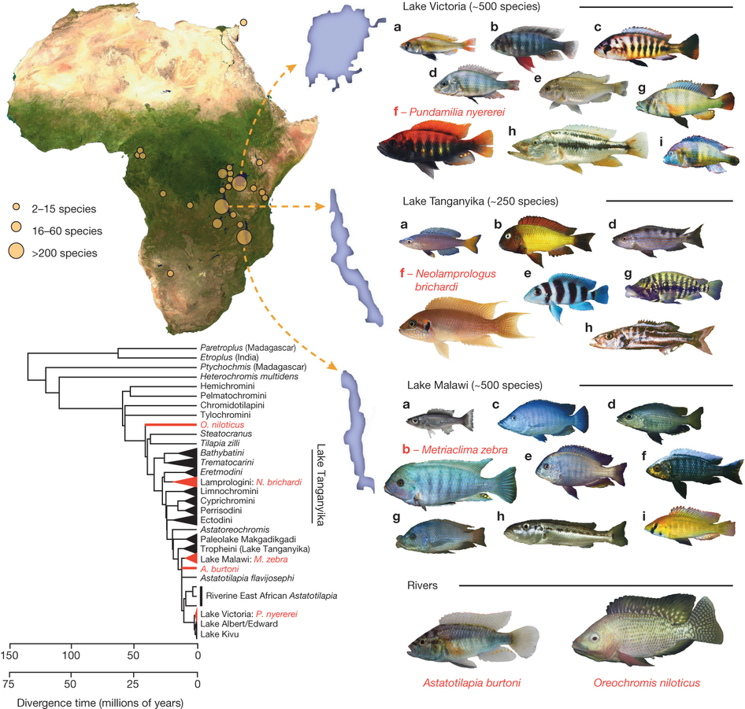
Cichlid Culture Techniques
Most ornamental cichilids originate from 3 African lakes, Victoria, Tanganyika and Malawi.
Figure from: Brawand et al. 2014

Slide 24
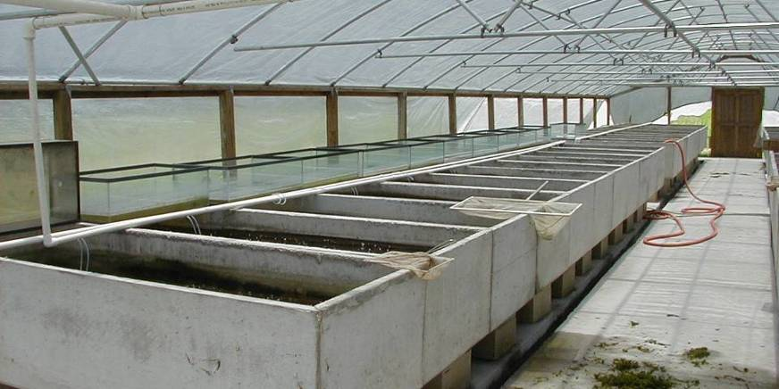
Cichlid Culture Techniques
A typical culture system for cichlids uses concrete, glass or plastic tanks.
This farm uses burial vaults as tanks for raising cichlids!

Slide 25
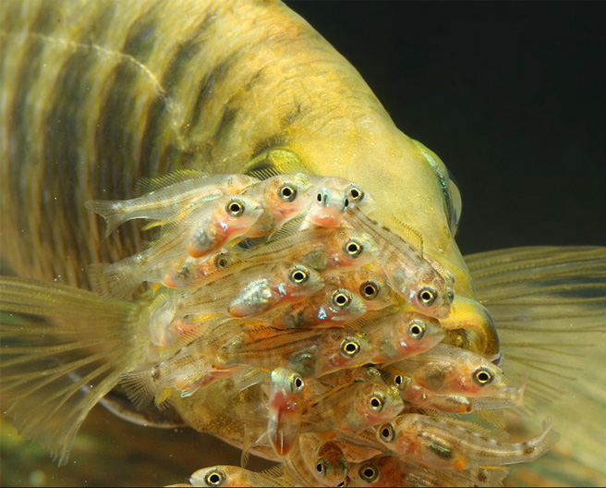
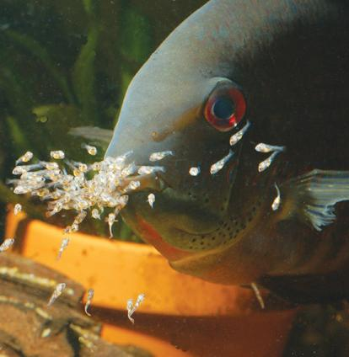
Did you know?
Most cichlids are mouthbrooders!
Adults hold their eggs and LIVE young in their mouths until they are large enough to swim freely!

Slide 26
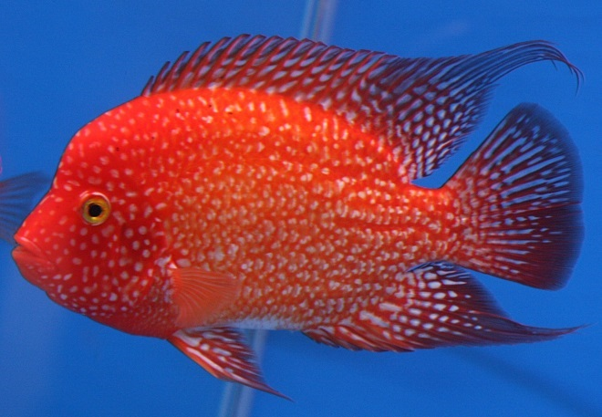
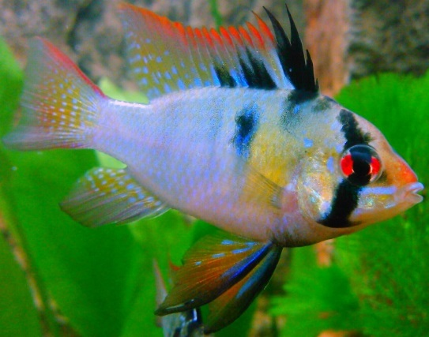

Cichlid Culture Techniques
Why are cichlids so colorful?
While cichlids are naturally colorful fish, decades of artificial breeding have produced some amazing color variants!
  Cichlids often randomly produce color variants.
  Breeders artificially select vibrant colors, which over time become a distinct new line

Slide 27

Cichlid Breeding Techniques
Through artificial selection, lite colored individuals are selected as new breeders.
After several generations of selection, captive Midas cichlids are vibrantly colored!
Wild Midas cichlid aren’t very colorful.
Figure from: Henning et al. 2013

Slide 28

Cichlid Culture Techniques
The diversity of shape and coloration found in cichlids makes them very valuable, freshwater fish.
Wholesale prices range from $2 to $30 per fish!!

Slide 29






Marine Culture Techniques
Primarily clownfish, corals and live rock are cultured in Florida.
What about blennies?!
Seahorses too!
Don’t forget shrimp!

Slide 30



Clownfish Culture
Clownfish are relatively easy to spawn in captivity.
Male and females pair-off and are monogamous during breeding.
Both parents guard the eggs during incubation.
Once hatched, larvae are moved to a nursery tank for grow-out to a marketable size.
Clownfish eggs are adhesive and cling well to clay pots.

Slide 31




Can you name that clownfish?
Blue-eye clarkii?
Teardrop cinnamon?
Mis-bar False Percula?
Saddleback?

Slide 32



Coral Culture
Many saltwater aquarium stores produce their own corals.
Small pieces from a living coral are transplanted onto a new substrate and grown to market size.
Hard corals can also produced this way, but take longer to grow.
Lots of frags can be made from a few large parent corals
Coral fragments or “frags”
Parent coral

Slide 33



Live Rock Culture
Live rock is simply porous rock, often limestone, that is cured in a marine environment.
“Curing” is the process of base rock being colonized by thousands of marine algae and invertebrates.
Base Rock
Live Rock
Live rock can be cured in an aquarium system.

Slide 34






Live Rock Culture
Live rock can also be produced in the open ocean.
Divers collect cured rock.
Live rock is loaded onto a boat.
Base rock is placed on leased ocean sites and left to cure naturally.
Live rock is then held in a greenhouse for further curing or
until ready for market.

Slide 35


Ornamental Aquaculture Research
Aquaculture scientists are continuously learning how to breed new species in captivity.
Current research is focused on…
  Larval rearing techniques
  Larval feeding preferences
  Captive reproduction of marine species
  Optimization of marine algae
  culture
Photo Credit: UF IFAS File Photos – photographer Tyler Jones.
Blue tangs were produced in captivity for the first time last year at the Tropical Aquaculture Laboratory in Florida!
Photo Credit: UF IFAS File Photos

Slide 36



Conclusion
Florida is the largest ornamental producer in the U.S.
Researchers are continuously refining culture methods and increasing productivity throughout the state.
Ornamental aquaculture is sustainable and conserves marine ecosystems by reducing wild capture.

Slide 37
Conclusion
Conclusion
For questions about this presentation or aquaculture in Florida please contact the Division at:
Tallahassee Office: (850) 617-7600
Bartow Office: (863) 578-1870
Email: aquaculture_web@FreshFromFlorida.com
Website: FreshFromFlorida.com

