Slide 1
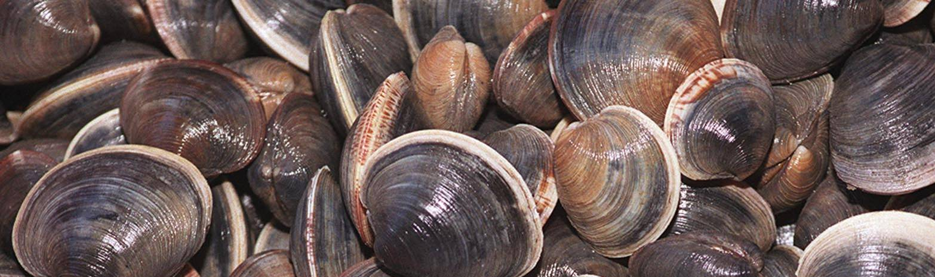
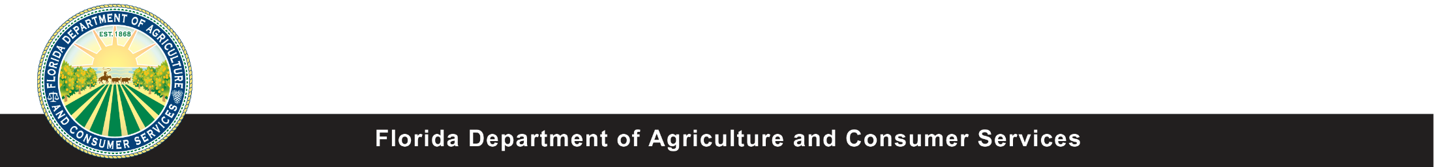
Florida Aquaculture
Marine Bivalves
Florida Aquaculture
Marine Bivalves
Produced by the Division of Aquaculture - 2017
Notes:
Ask people to define aquaculture
Ask people what they think of when they think of aquaculture

Slide 2
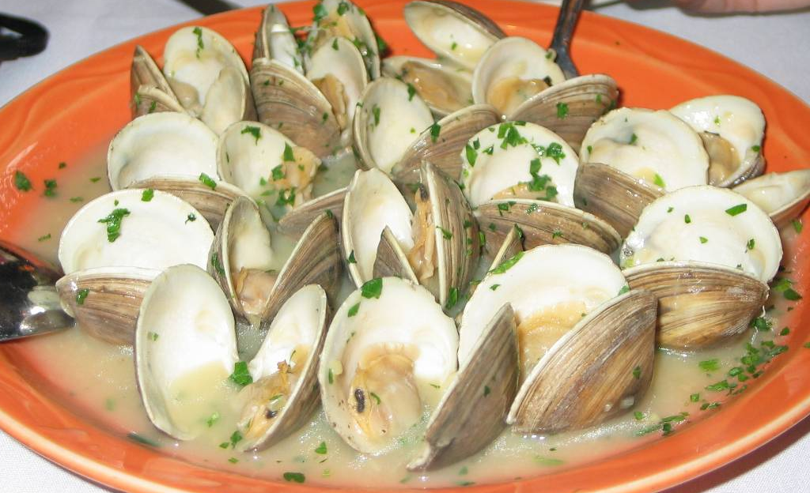
Introduction
This presentation will cover…..
  The marine bivalve aquaculture economy
  Florida’s marine bivalve industry
  Environmental benefits
  Clam aquaculture methods
    Hatchery
    Nursery
    Grow-out
    Harvest and processing
  Oyster aquaculture
  Research priorities
Notes:
Ask people to define aquaculture
Ask people what they think of when they think of aquaculture

Slide 3
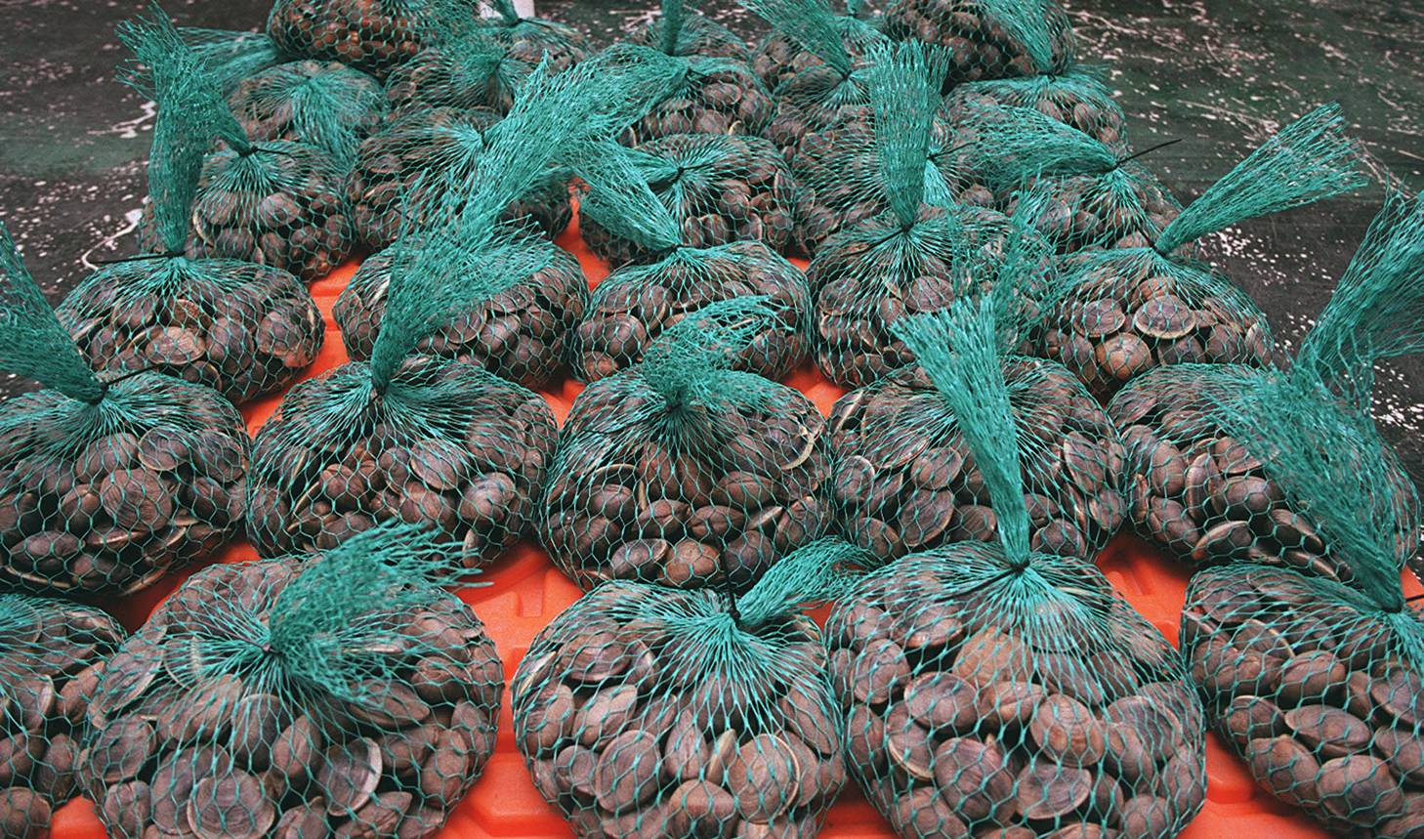
Did you know?
Clams rank #2 in Florida Aquaculture sales!
Which aquaculture product is #1?
Notes:
Ask people to define aquaculture
Ask people what they think of when they think of aquaculture

Slide 4
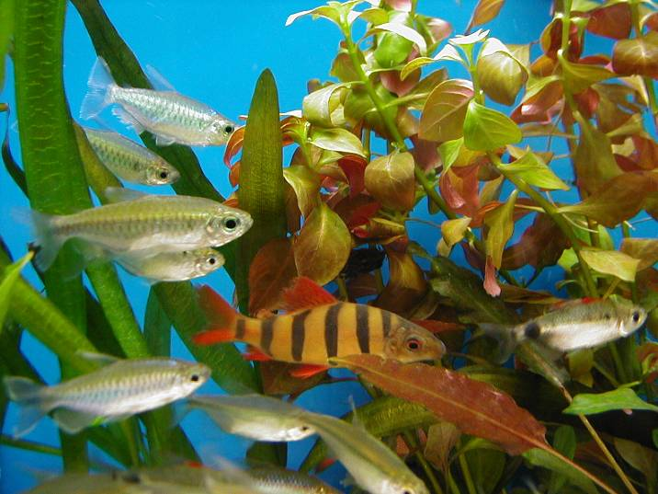
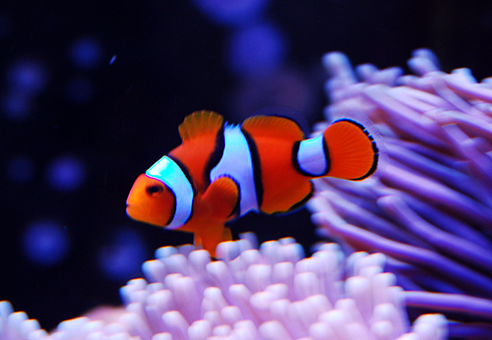
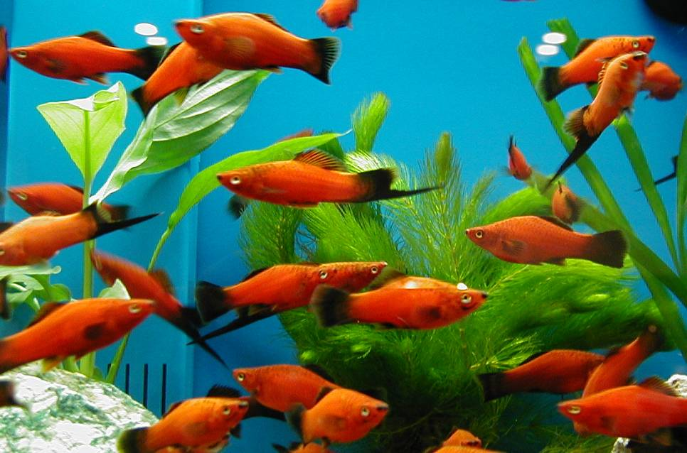
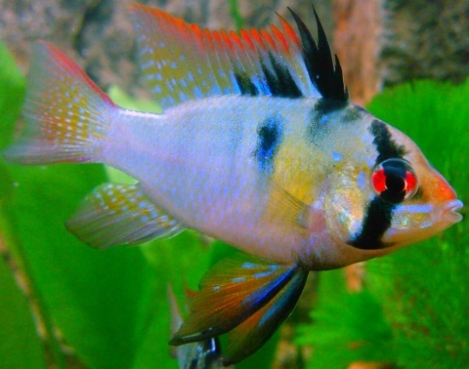
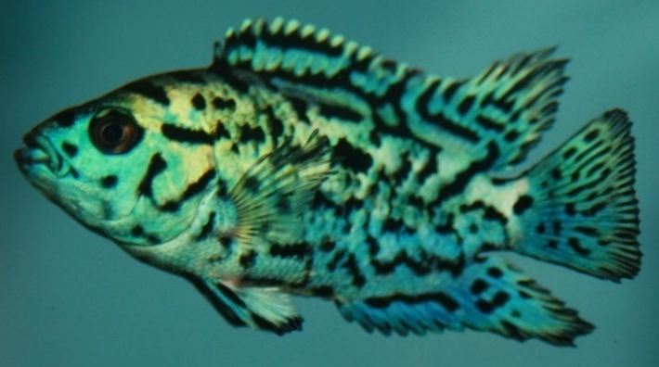
Ornamental Fish are #1
Valued at $27.3 million in 2012!
Notes:
Ask people to define aquaculture
Ask people what they think of when they think of aquaculture

Slide 5
Marine Bivalve Aquaculture
In 2013, 34 million pounds of mollusks were grown globally!
Molluscs are the #1 Mariculture product in the world!
Notes:
Ask people to define aquaculture
Ask people what they think of when they think of aquaculture

Slide 6
What is Mariculture?
Mariculture is a specialized branch of aquaculture that produces aquatic products in the open ocean.
Mariculture can be divided into 3 main categories
  Fish
  Molluscs
  Plants/Seaweed
  Let’s see some examples of Mariculture in the next slides…..
Notes:
Ask people to define aquaculture
Ask people what they think of when they think of aquaculture

Slide 7
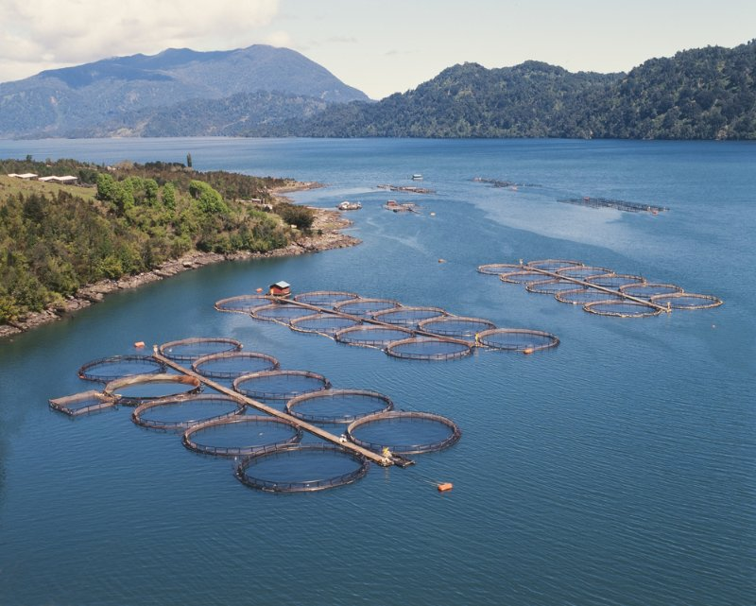
maricutlure
This is a typical net-pen salmon farm in Chile
A single net pen can be up to 105 ft wide, 33 ft deep and hold 90,000 salmon!
Notes:
Ask people to define aquaculture
Ask people what they think of when they think of aquaculture

Slide 8
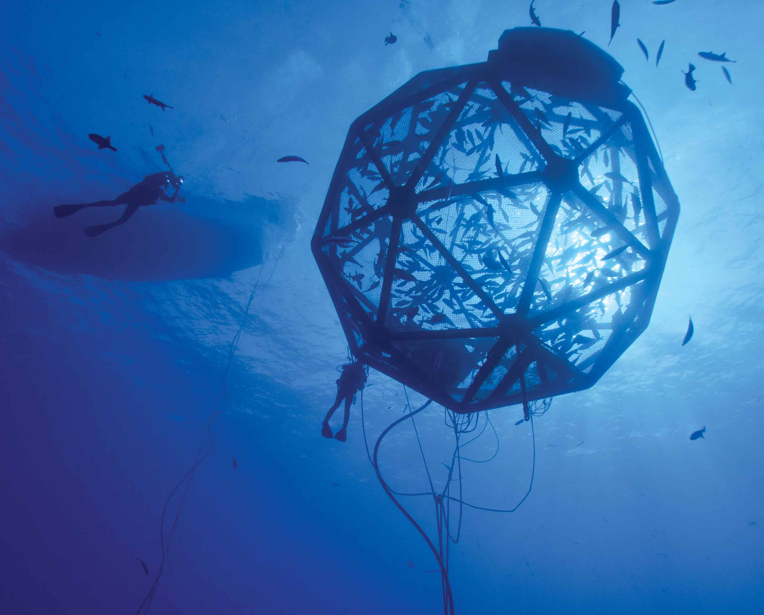
maricutlure
These submersible ocean cages are an example of a new mariculture fish production method. It can be raised or lower for access, and some travel the ocean in a giant circle to prevent environmental impacts.
Notes:
Ask people to define aquaculture
Ask people what they think of when they think of aquaculture

Slide 9
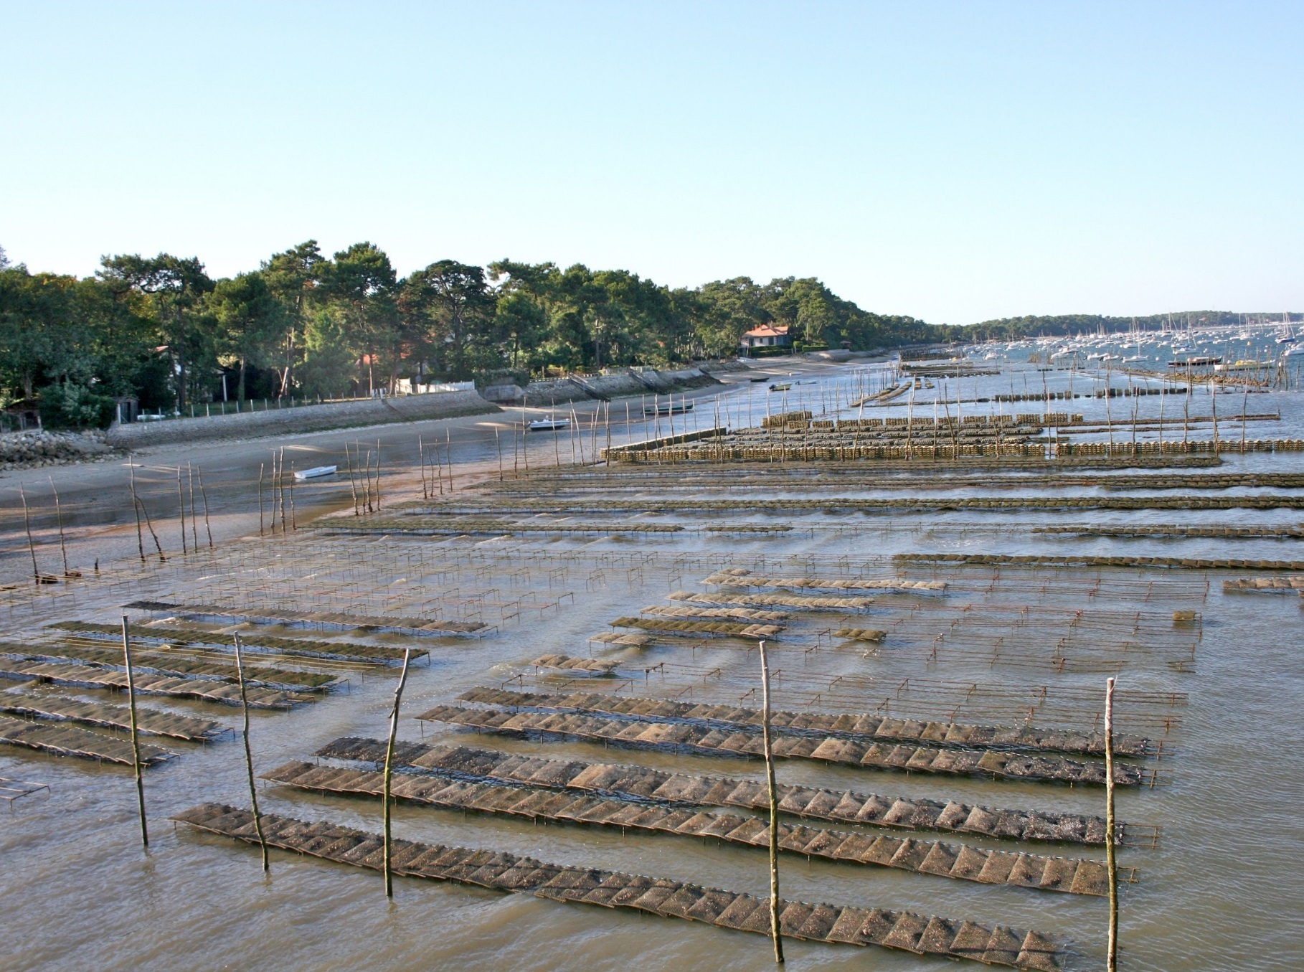
maricutlure
This is a large oyster farm along the southern coast of France.
Each one of these floating cages can hold hundreds of oysters
Notes:
Ask people to define aquaculture
Ask people what they think of when they think of aquaculture

Slide 10
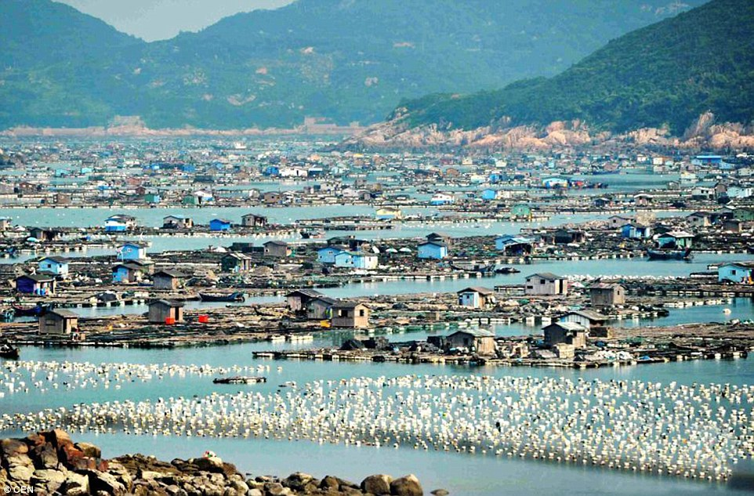
maricutlure
The “Floating city” in Luoyuan Bay, in southeastern China.
Photo credit: Imaginechina/corbis 2010
These high-density mariculture sites produce products from all 3 types of mariculture in this single area.
Notes:
Ask people to define aquaculture
Ask people what they think of when they think of aquaculture

Slide 11
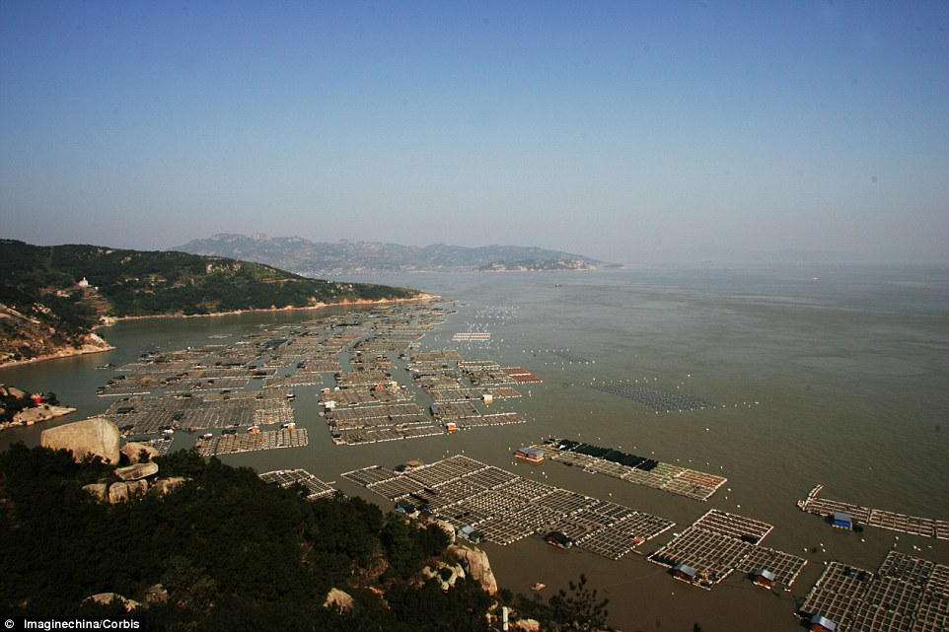
maricutlure
These “floating cities” produce mainly shellfish, seaweed and fish.
In the past decade, they have become so popular that these “cities” have tourism and hotels!
Notes:
Ask people to define aquaculture
Ask people what they think of when they think of aquaculture

Slide 12
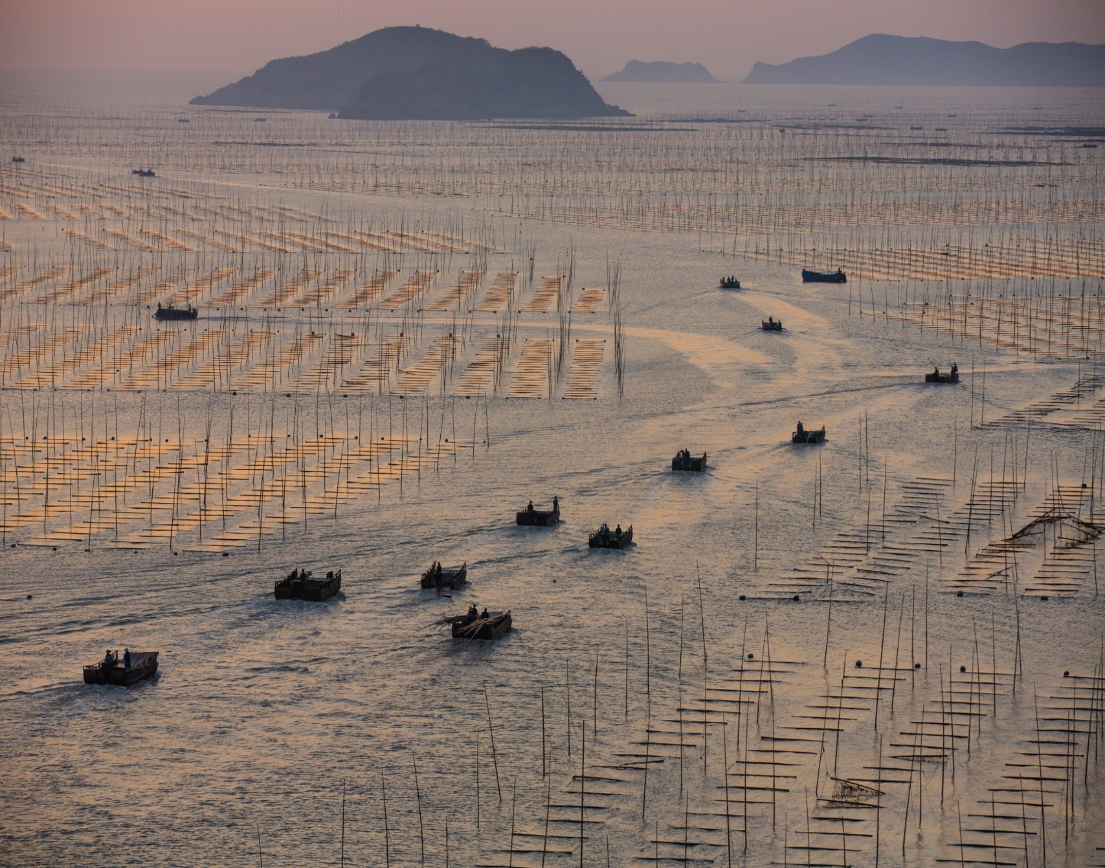
maricutlure
This is a large seaweed farm in Japan.
While not very popular in the U.S., nori or seaweed is a staple of east Asian cuisine.
~60 million pounds are produced annually worldwide.
Photo credit: George Steinmetz, NGM
Notes:
Ask people to define aquaculture
Ask people what they think of when they think of aquaculture

Slide 13
Global Bivalve Aquaculture Industry
China produces a vast majority of the worlds mollusks.
Notes:
Ask people to define aquaculture
Ask people what they think of when they think of aquaculture

Slide 14
U.S. Bivalve Aquaculture Industry
Notes:
Ask people to define aquaculture
Ask people what they think of when they think of aquaculture

Slide 15
U.S. Mollusk Industry
Mollusk aquaculture in the U.S. increased 368% from 1998-2013, and continues to expand today!
Notes:
Ask people to define aquaculture
Ask people what they think of when they think of aquaculture

Slide 16
Florida Shellfish Aquaculture Industry
Shellfish aquaculture in Florida is dominated by hard clams (98% of sales in 2013).
Oyster aquaculture, in response to declining wild-stocks and advancing culture technologies, is increasing annually.
Notes:
Ask people to define aquaculture
Ask people what they think of when they think of aquaculture

Slide 17
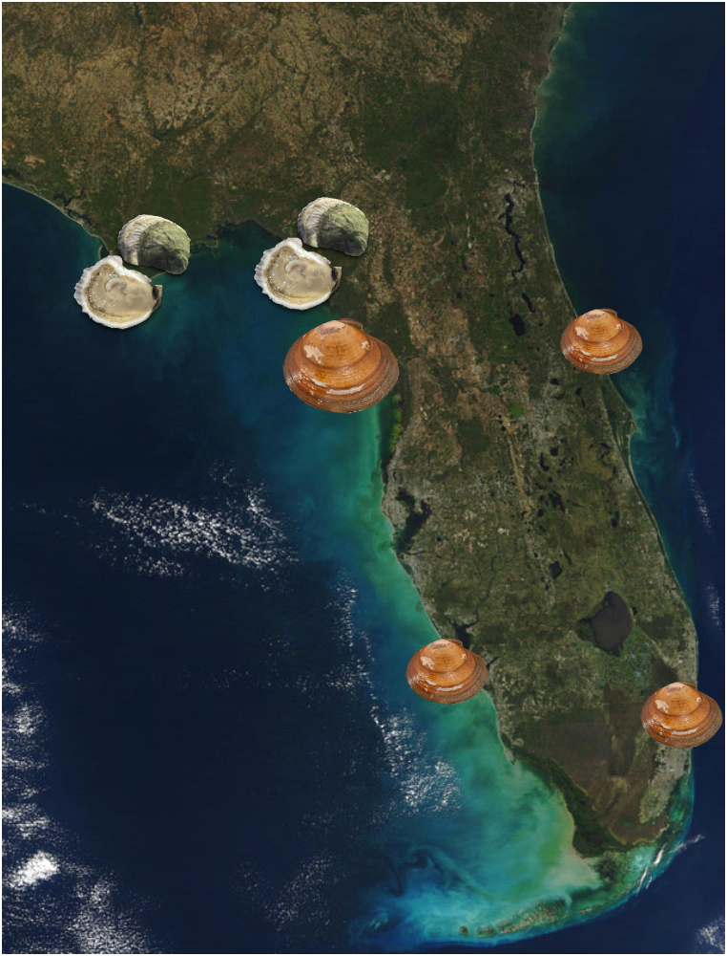
Florida Shellfish Aquaculture Industry
Where are shellfish cultured in Florida?
  The Big Bend region is a hotspot for oyster culture
  Cedar Key produces a vast majority of clams in the state.
  The SW and East coasts produce clams and oysters also.
Notes:
Ask people to define aquaculture
Ask people what they think of when they think of aquaculture

Slide 18
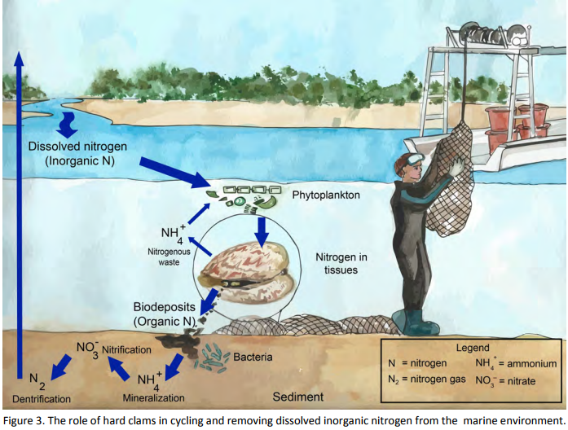
Ecosystem Benefits of Shellfish Aquaculture
Shellfish are living water filters
  They feed by pumping water through their gills and remove particles that are edible.
  Through filtering, shellfish clean the water and also remove harmful nitrogen, phosphorus and carbon from the environment.
    ~550 million gallons of seawater are filtered each day in Florida by aquacultured clams alone!
    In 2012, annual clam harvest removed 25,000 lb of nitrogen and 760,000 lb of carbon, a value of $99,680!
Figure From: Barker et al. 2015; “Green Clams”
Notes:
Ask people to define aquaculture
Ask people what they think of when they think of aquaculture

Slide 19
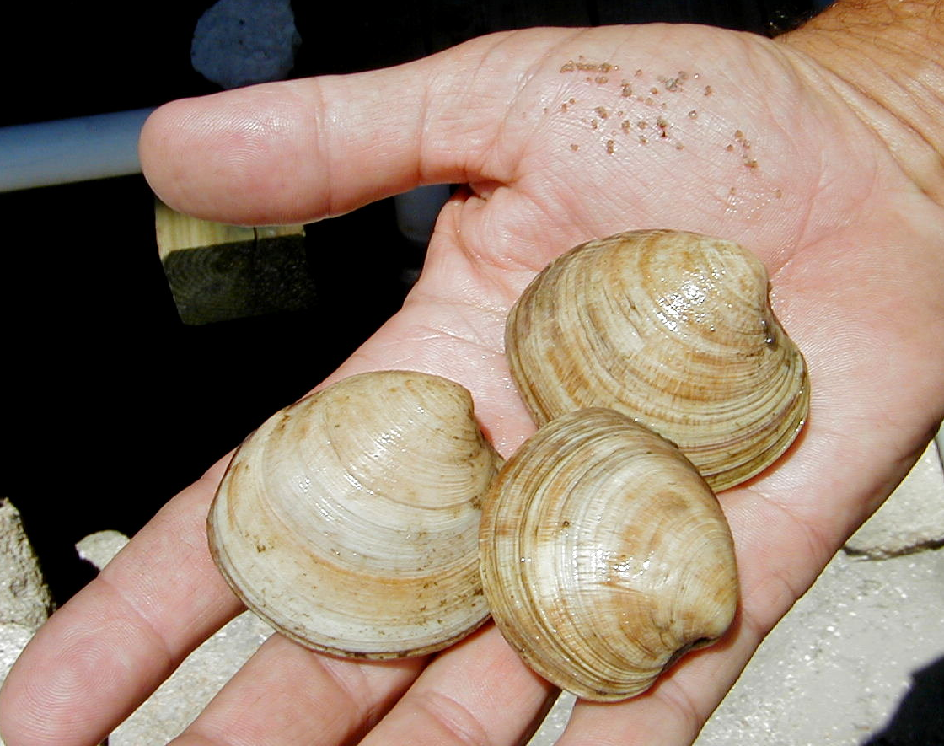
Shellfish Aquaculture Methods
Shellfish Aquaculture Methods
TINY seed
Harvest size adults
How do we get clams from seed to adults in ~14 months?!
Notes:
Ask people to define aquaculture
Ask people what they think of when they think of aquaculture

Slide 20
Shellfish Aquaculture Methods
Shellfish Aquaculture Methods
Three main phases of production
For this presentation, let’s focus on hard clam production
Hatchery
Fertilization
Nursery
FLUSPY?
Growout
Placed in ocean on lease sites
Grown to market size (~1”)
Grown to 1 mm
Spawning
Recirculating tanks
Fed algae
Grown to ~4-6mm
We will talk about a FLUPSY in a few slides…
Notes:
Ask people to define aquaculture
Ask people what they think of when they think of aquaculture

Slide 21
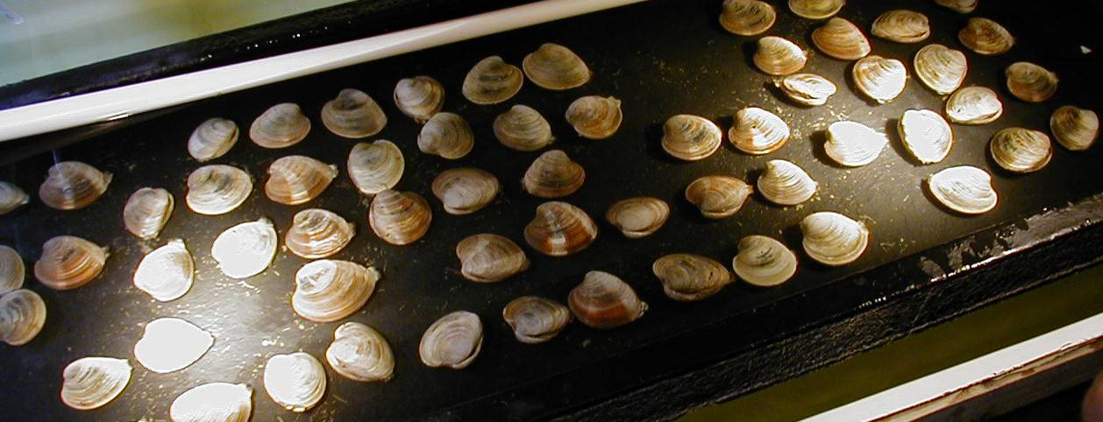
Hard Clam: Nursery Phase
Hard Clam: Hatchery Phase
“Broodstock” are simply sexually mature, adult clams that are used for spawning.
At the beginning of the spawn, male and female broodstock clams are organized together in the same tray.
Notes:
Ask people to define aquaculture
Ask people what they think of when they think of aquaculture

Slide 22
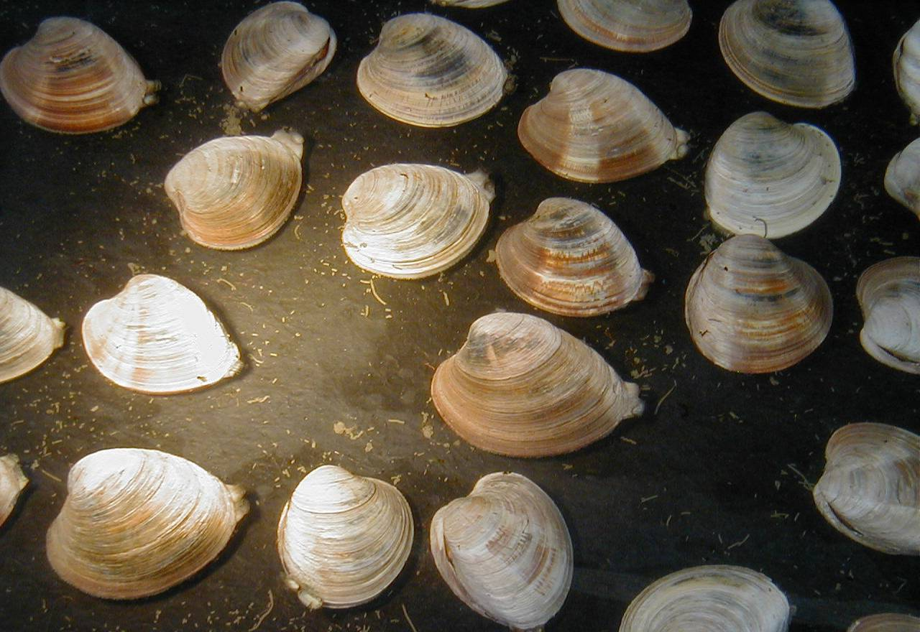
Hard Clam: Nursery Phase
Hard Clam: Hatchery Phase
The water temperature is elevated above 79º F to induce the release of gametes (sperm of the males is released first which then triggers the release of eggs by the females).
Notes:
Ask people to define aquaculture
Ask people what they think of when they think of aquaculture

Slide 23
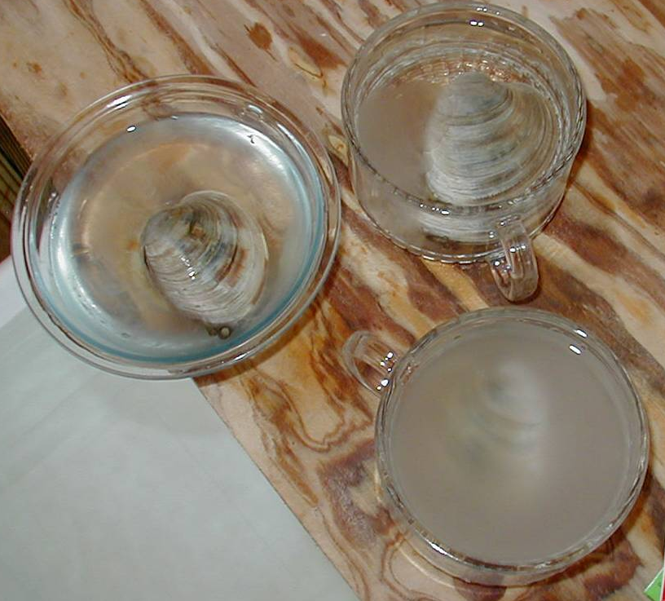
Hard Clam: hatchery Phase
Hard Clam: Hatchery Phase
“Gametes” are either sperm for males or eggs for females.
As soon as the clams begin releasing their gametes they are removed from the tray and isolated in their own containers. Then it can be determined whether they are males or females.
Notes:
Ask people to define aquaculture
Ask people what they think of when they think of aquaculture

Slide 24


How can we tell the difference between the gametes of the male and the female?
How can we tell the difference between the gametes of the male and the female?
Female gametes are off-white, kind of yellowish in color and they have a grainy appearance.
Male gametes are white in color and they have a smooth, milky appearance.
Now let’s see if YOU can tell the difference!!
Notes:
Ask people to define aquaculture
Ask people what they think of when they think of aquaculture

Slide 25
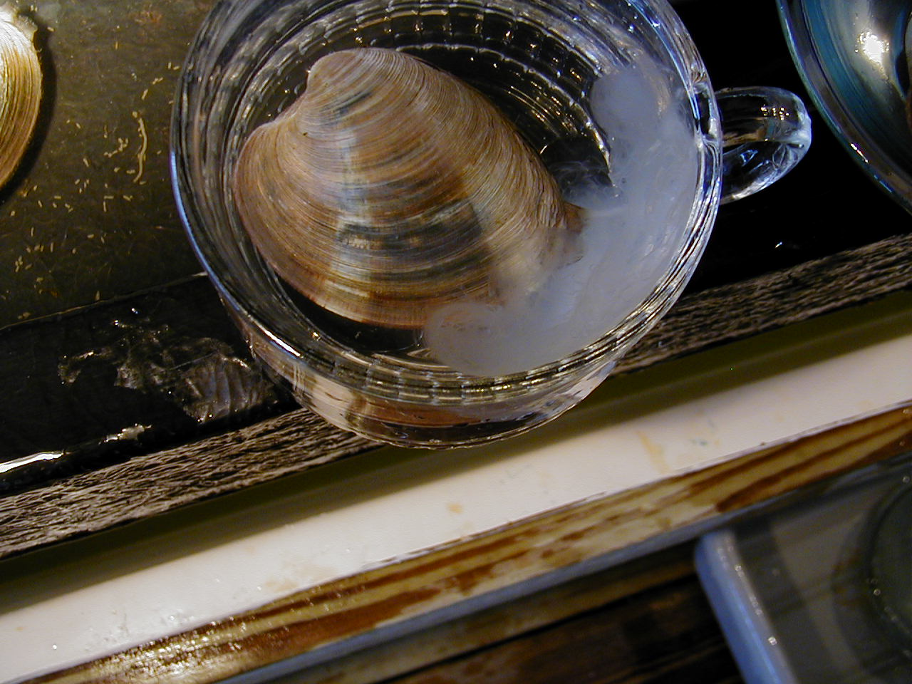
spawning
Is this a male or female clam?
Notes:
Ask people to define aquaculture
Ask people what they think of when they think of aquaculture

Slide 26
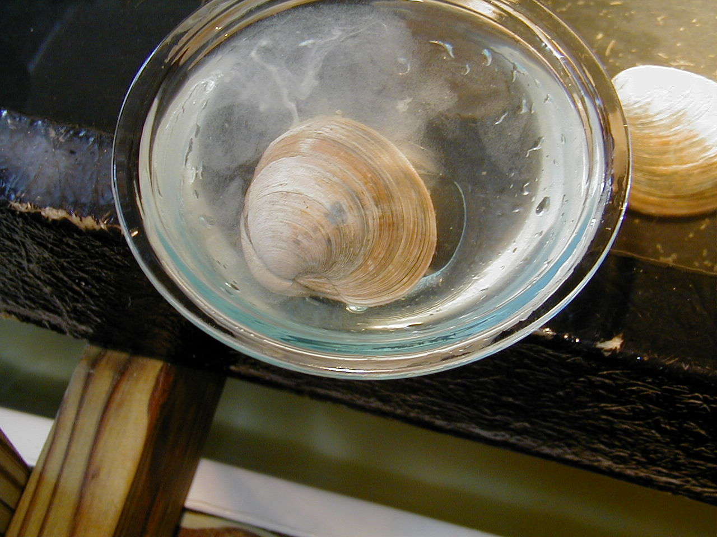
spawning
What about this clam?
Is it different than the one you just saw?
Notes:
Ask people to define aquaculture
Ask people what they think of when they think of aquaculture

Slide 27
spawning
While female eggs appear grainy and translucent.
Notice the male sperm is cloudy and uniform.
If you said this is a male…
If you said this is a female…
you are correct!!
correct again!!
Notes:
Ask people to define aquaculture
Ask people what they think of when they think of aquaculture

Slide 28
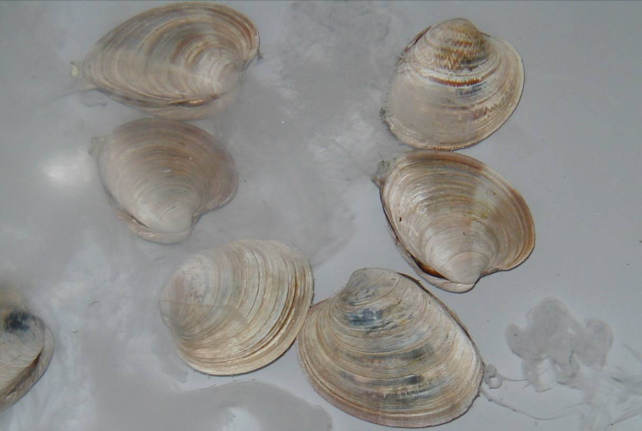
spawning
Once the males are determined they are removed from the tray and grouped in a separate container with all other males, where they continue releasing gametes into the water.
Notes:
Ask people to define aquaculture
Ask people what they think of when they think of aquaculture

Slide 29
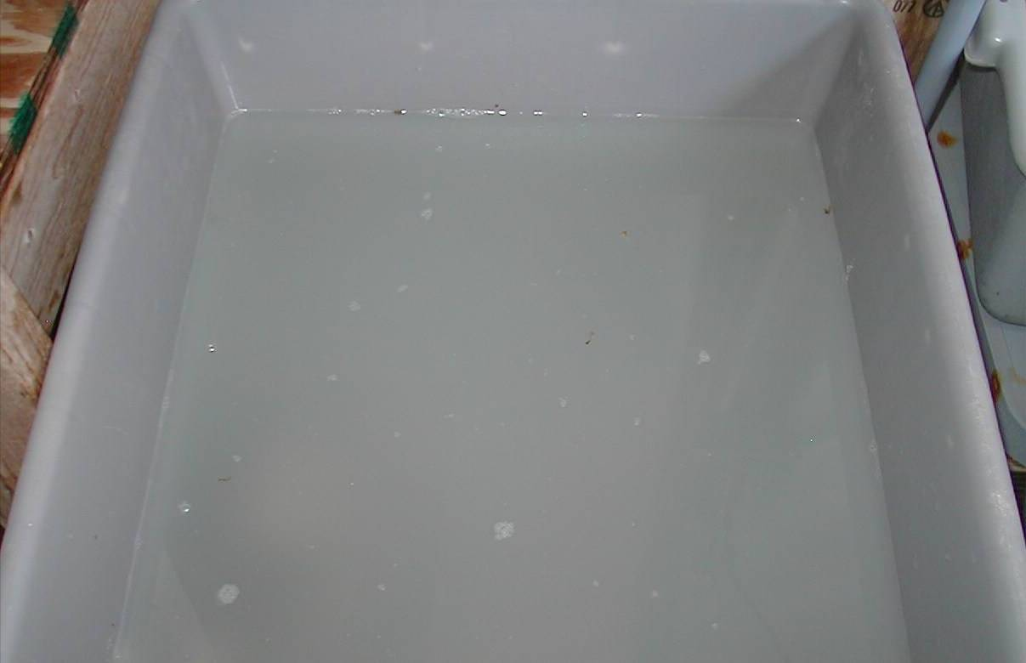
spawning
As the males continue to release their gametes the water takes on a cloudy, milky appearance.

Slide 30
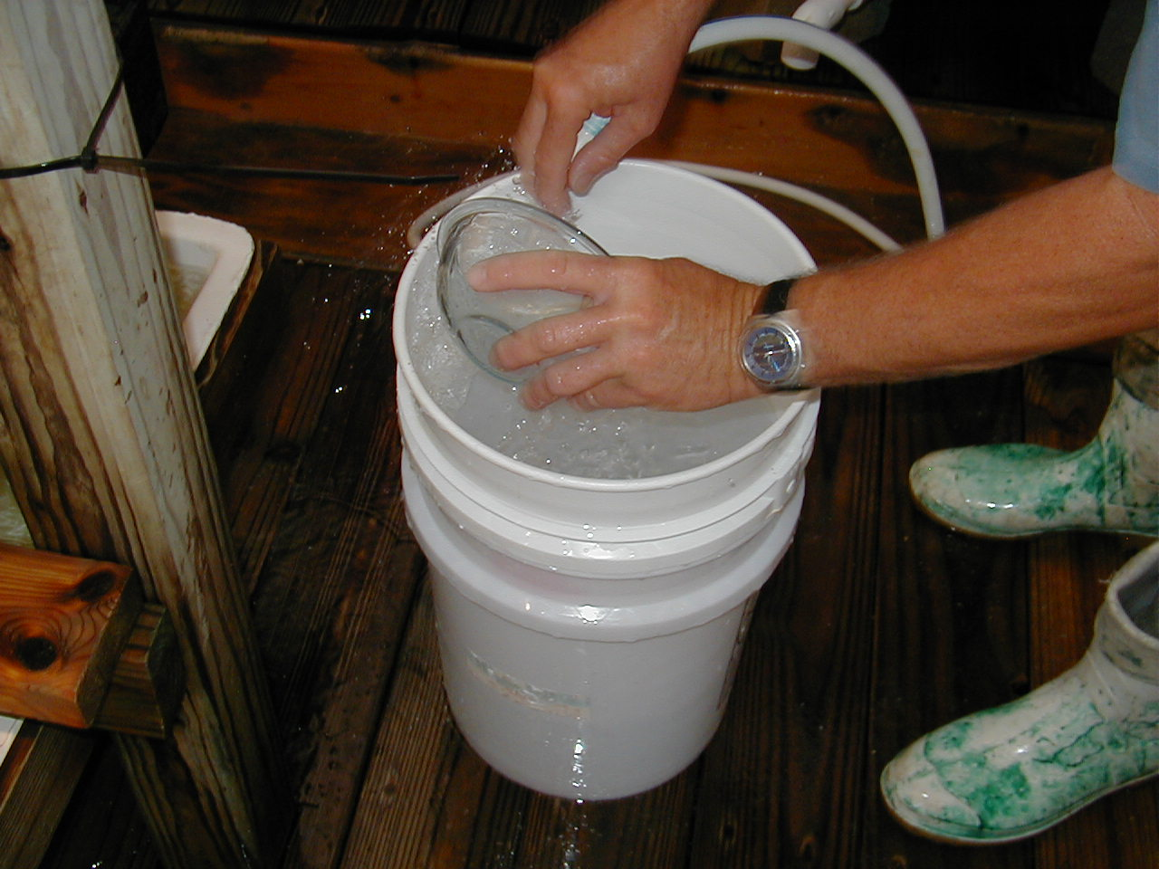
spawning
With the male clams set aside, the eggs from every female are collected in a small container.

Slide 31
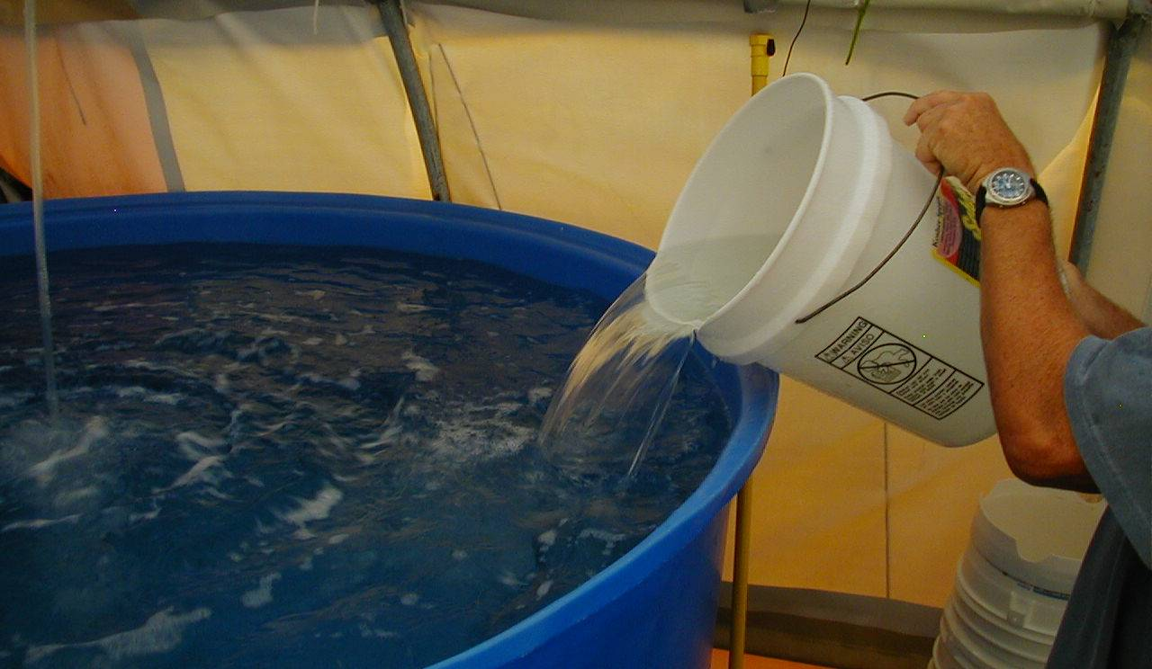
spawning
All eggs are then transferred to a large circular growing tank where the water is well aerated and moving.

Slide 32
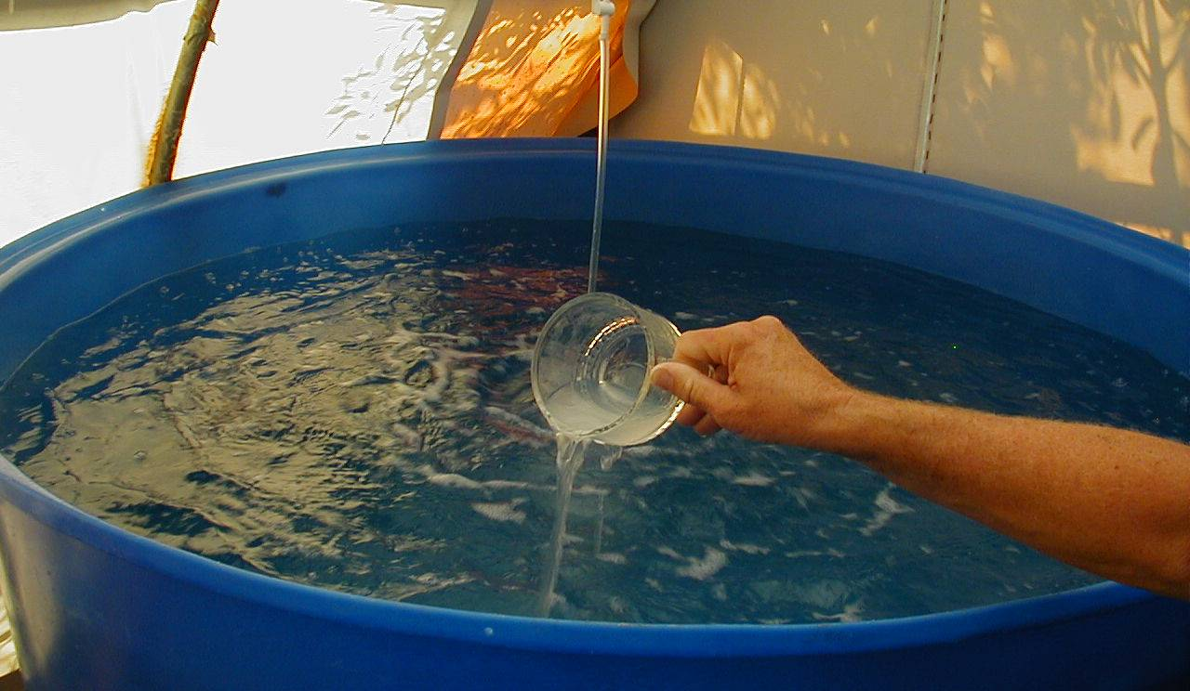
spawning
The male gametes are then added to the water, where they will mix with the eggs, resulting in fertilization and the production of clam larvae.

Slide 33
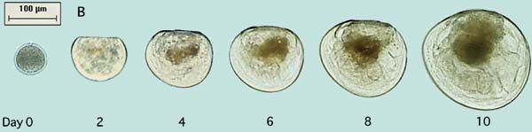
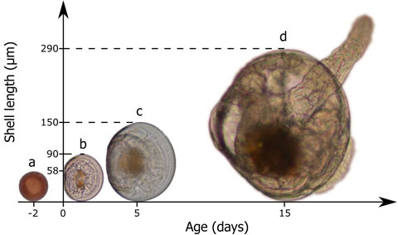
Larval clams
Even at 15 days old, clams are <0.01 inches long!
From: FAO Tech. Paper #471.
From: Oliva et al. 2014.
Larval clams are difficult to see with the naked eye when they’re only days old so it’s best to view them under a microscope.

Slide 34
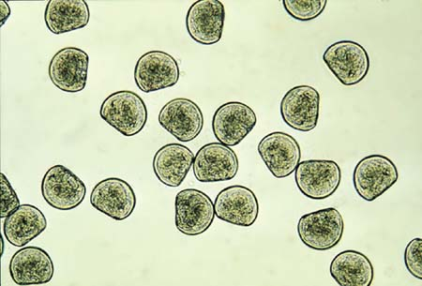
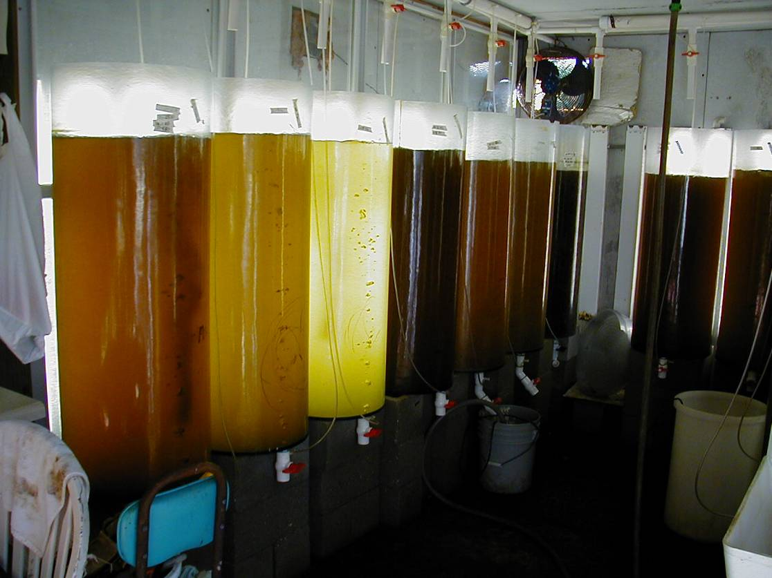
Larval clams
Clam larvae are fed with algae…
Photo credit: FAO Tech. Paper #471
…which is cultured on site in large tanks.

Slide 35
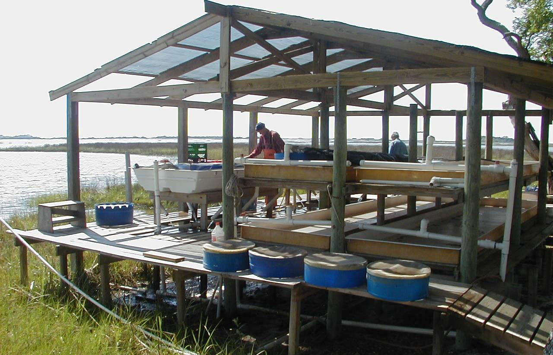
Hard Clam: Nursery Phase
Instead of stocking larval clams straight onto lease sites, clams are grown to a larger size (~4-6mm) in controlled conditions to improve survival and growth.

Slide 36
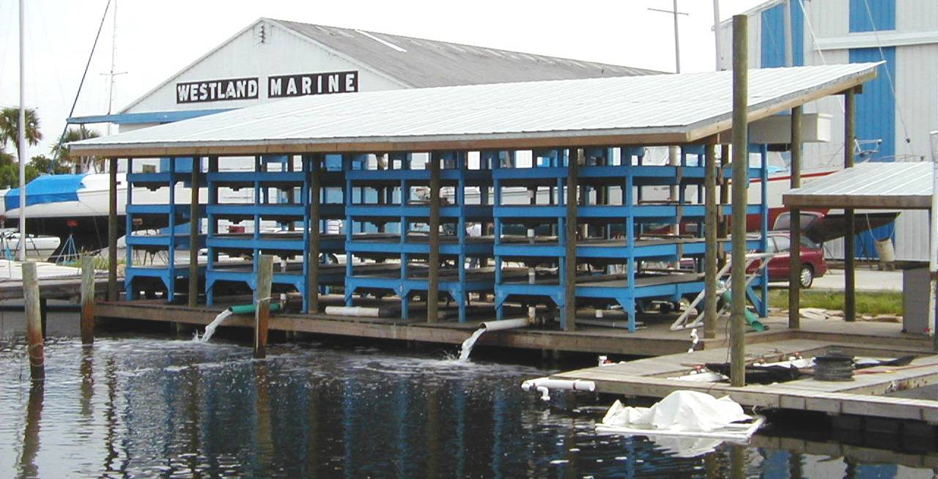
FLUPSY
FLUPSY – FLoating UPweller System
FLUPSY is a common nursery production method.
Utilize raw seawater to grow clams by “upwelling” water through clam tanks.
When larval (seed) clams reach ~1 mm in size they are moved to a flow through nursery setting where they can grow more rapidly.

Slide 37
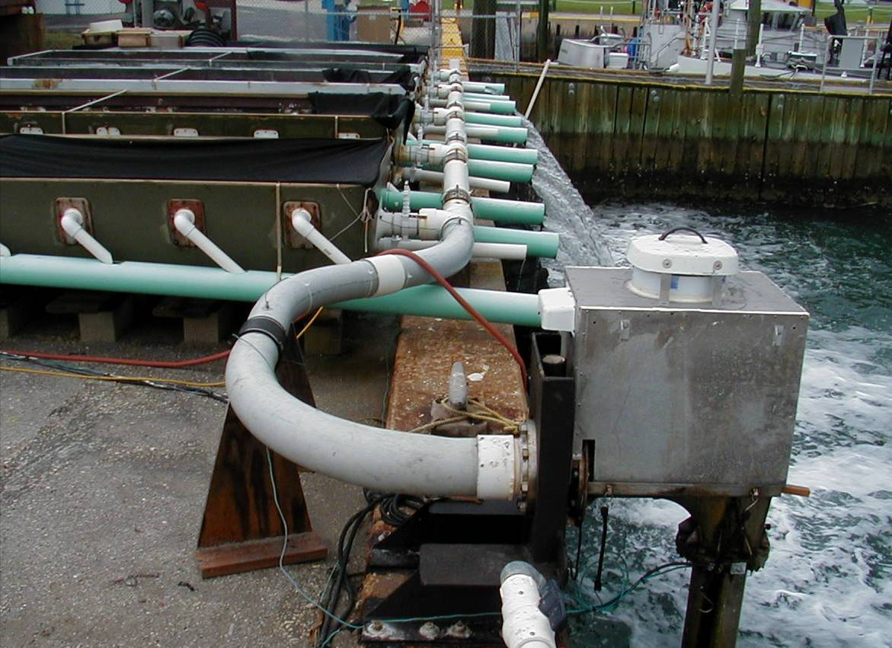
FLUPSY
“Flow-through”
system
Used water returns to ocean
Water travels through tanks
Fresh seawater in
The intake and flow-through of fresh seawater serves as a food source, allows for adequate oxygen and removes waste.

Slide 38
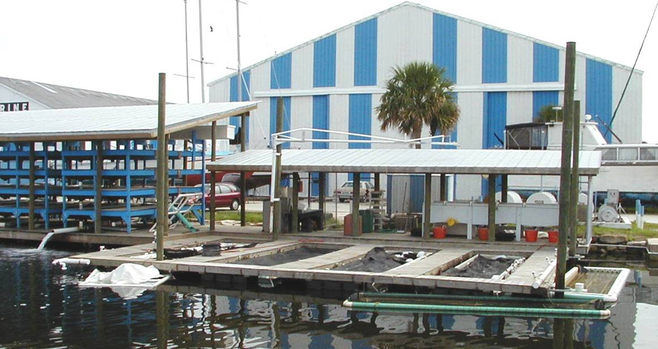
FLUPSY
nursery upwellers
nursery downweller
Depending on the size of the clams, the flow of water can either be pulled down (downwellers) or forced up (upwellers) through the clam seed.
Downwellers are for small seed
Upwellers are for larger seed

Slide 39
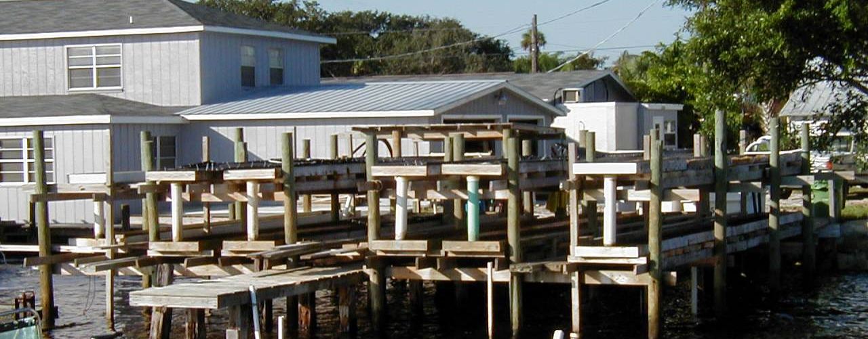
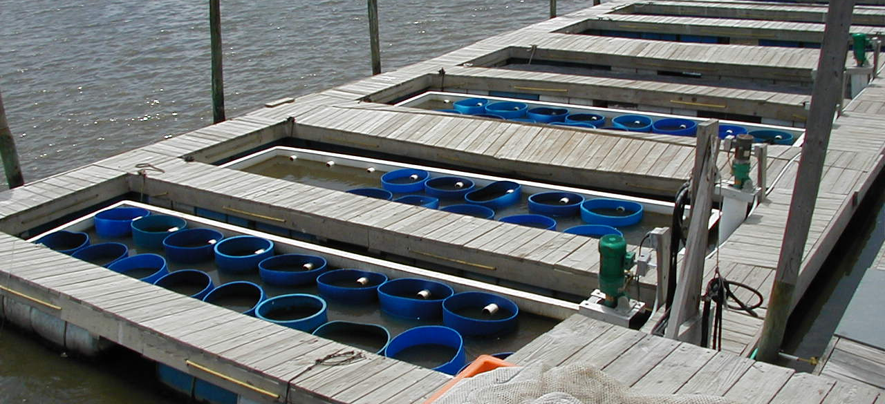
FLUPSY
Which nursery system type is this?
Downweller
What about this system?
Upweller

Slide 40
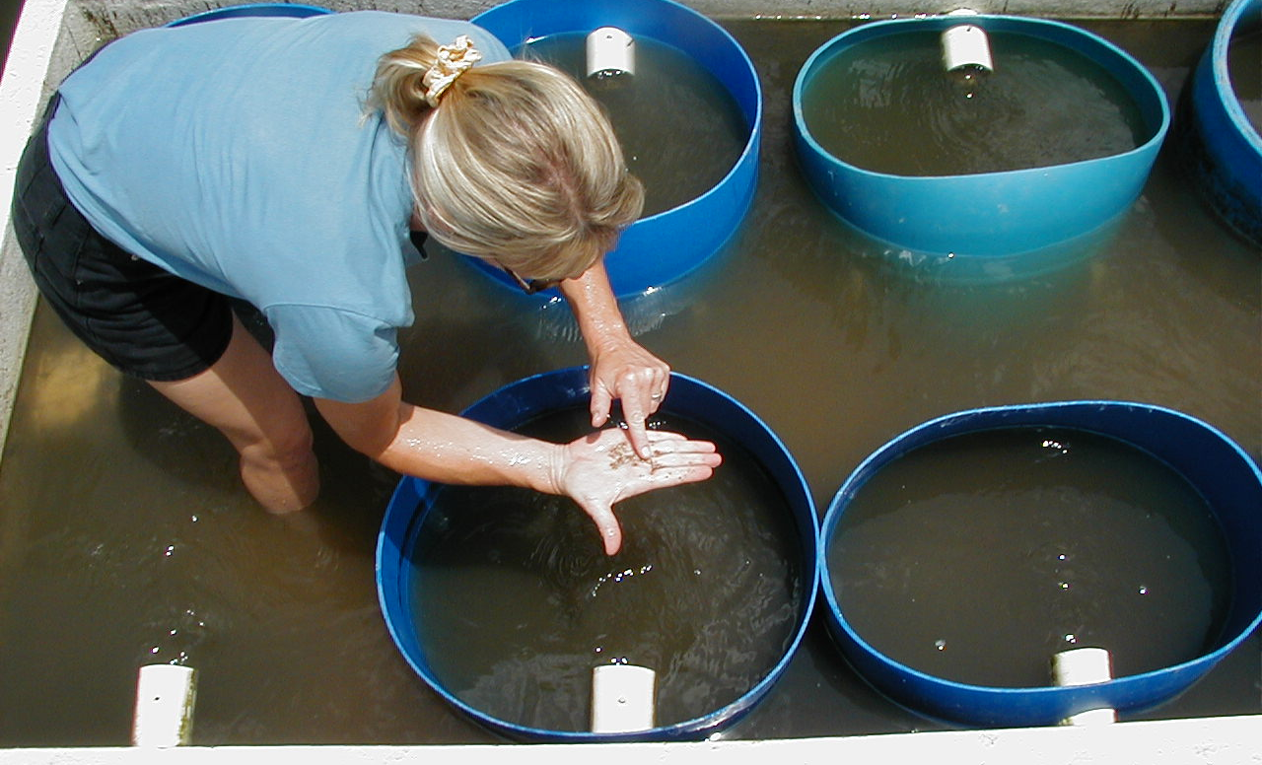
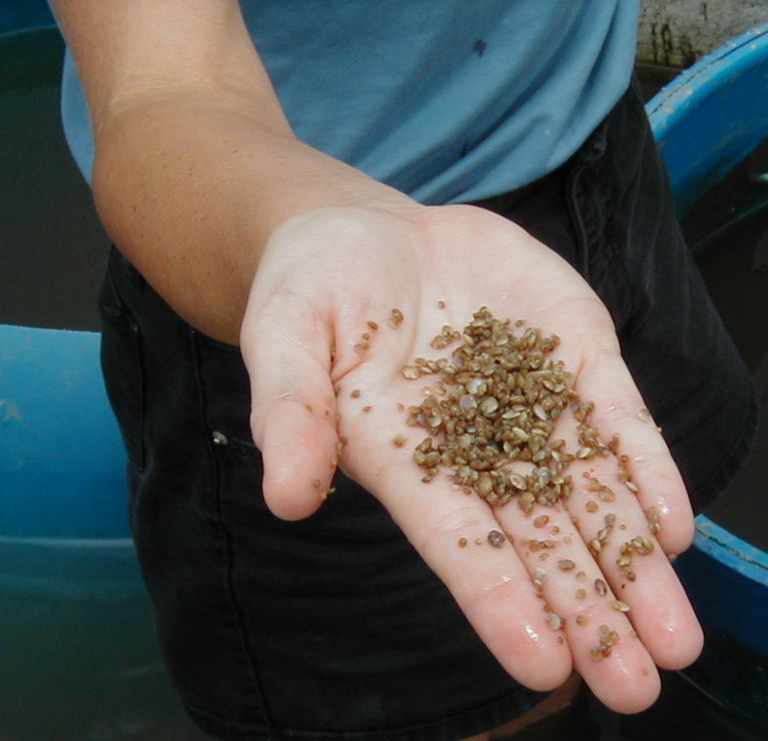
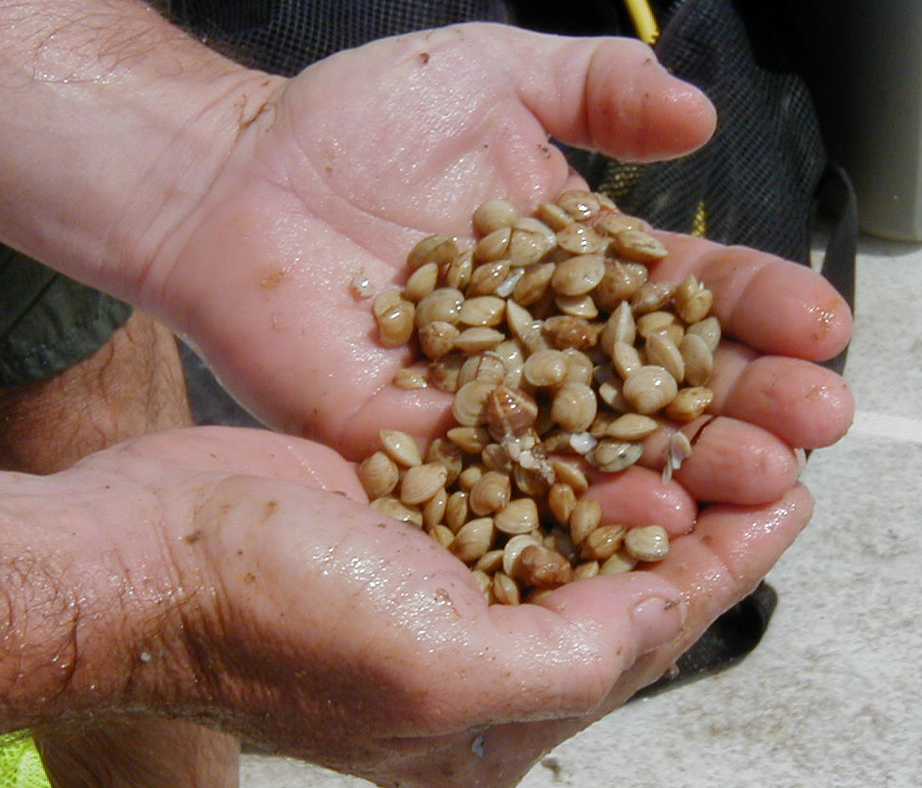
Clam seed size
Small seed at start of nursery phase
Large seed at end of nursery phase
Seed growth during the nursery phase

Slide 41
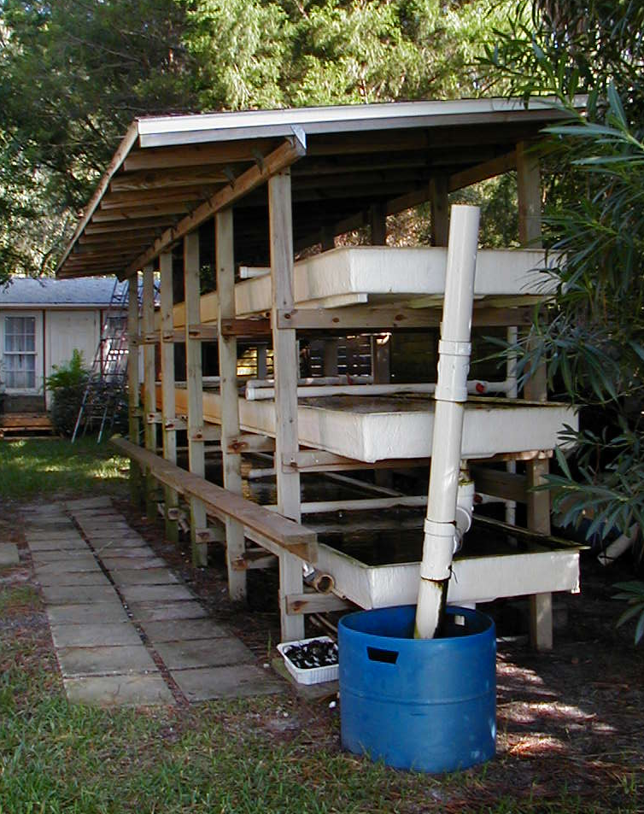
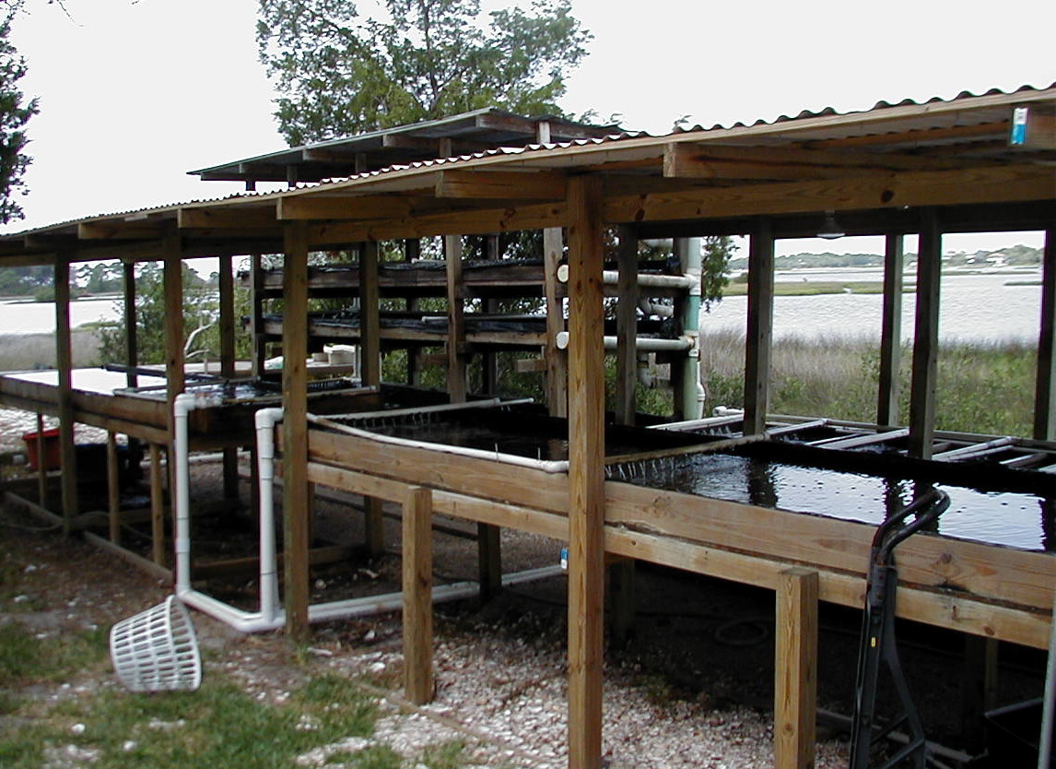
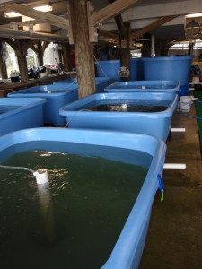
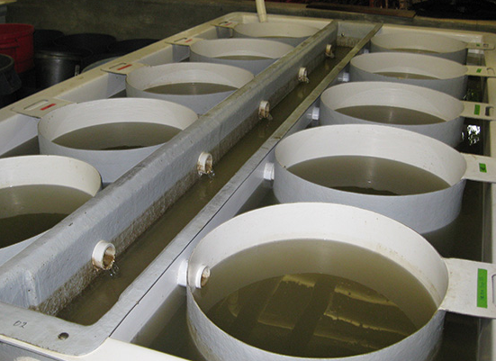
Upland systems
These two systems are flow through and utilize raw seawater
These two are recirculating and utilize filtered seawater
Land based nursery systems
More costly to operate
More control over water quality and feeding
Improved survival and growth
Photo credits: Auburn University, Dolphin Island Shellfish Lab.

Slide 42
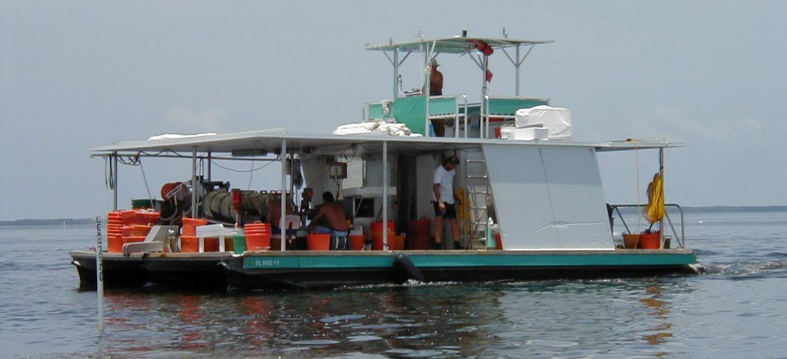
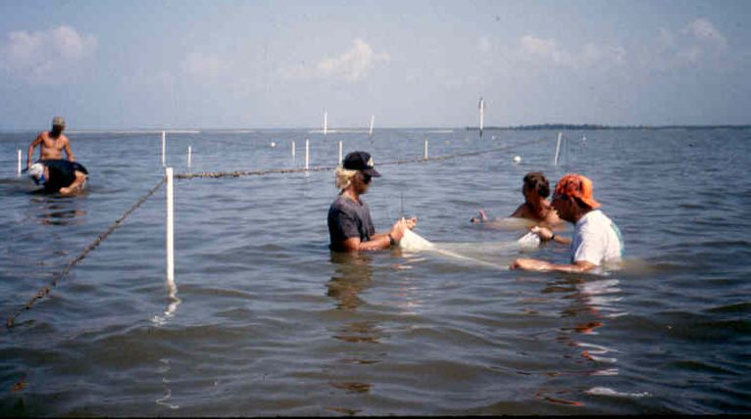
Hard Clam: Grow out
Once clams reach a certain size (~4-6 mm) they are placed in fine mesh bags and planted in areas called Submerged Land Leases.

Slide 43
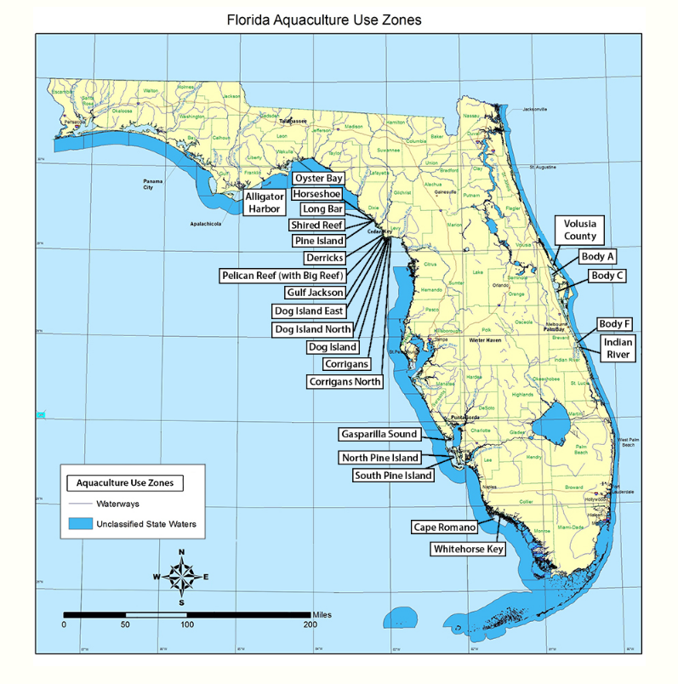
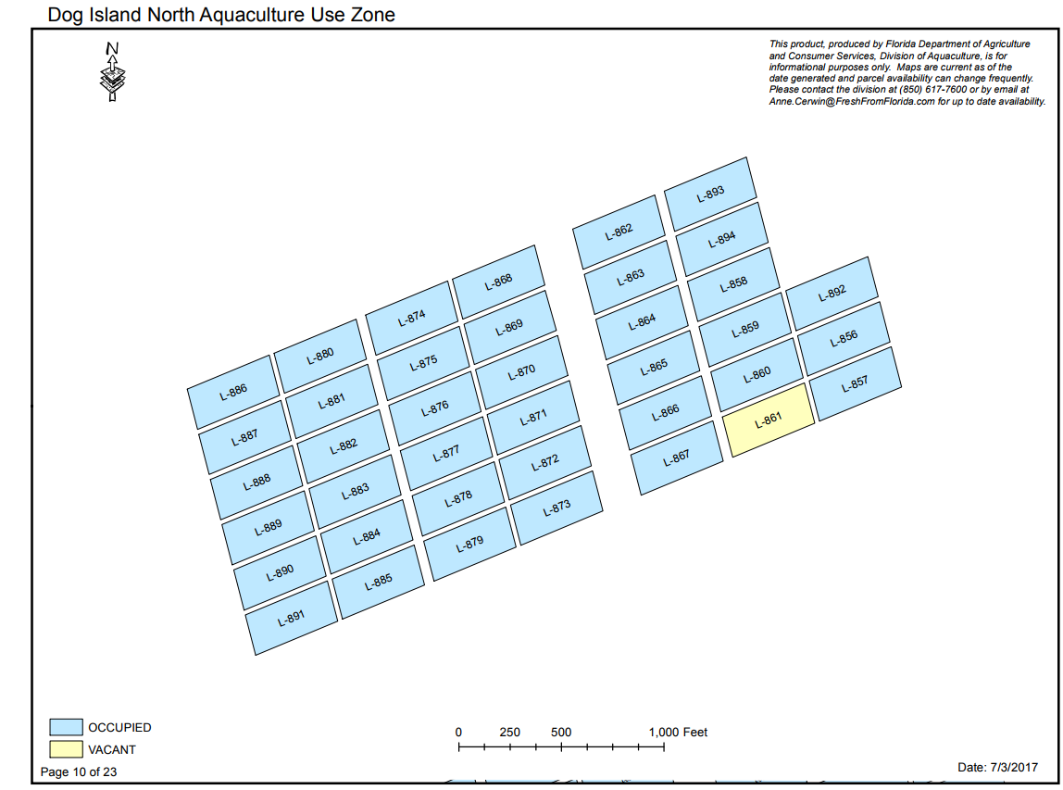
Hard Clam: Grow out
Submerged land leases are lands owned by the State of Florida so aquaculturists must obtain permission from the State to farm their clams on a lease.
Submerged land leases are public lands and available to anyone interested in applying.
Aquaculture use zones (AUZ) are areas with predetermined lease sites grouped into a single area often containing dozens of parcels or lease sites

Slide 44
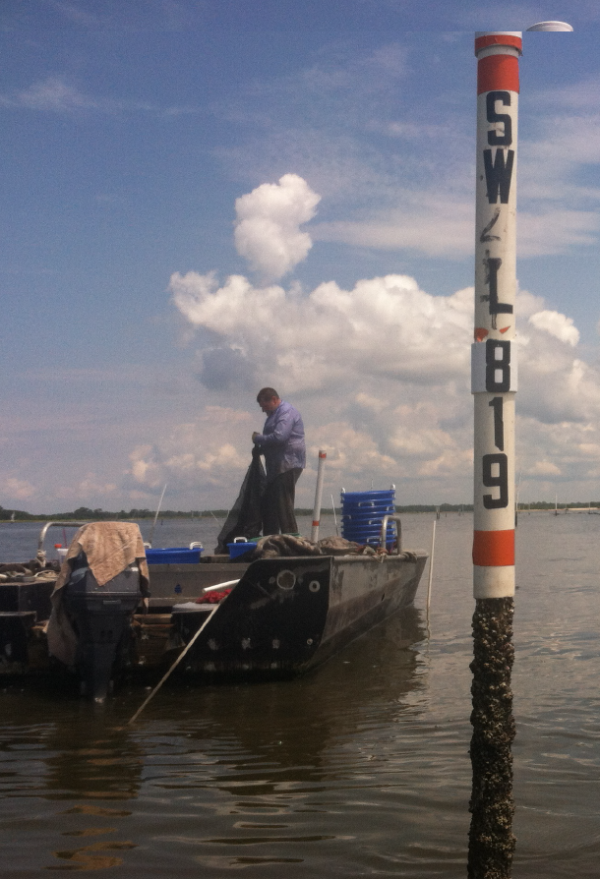


Hard Clam: Grow out
Lease holders must mark their leases to ensure navigational safety, provide area ID and deter the general public from entering the culture areas.

Slide 45


Hard Clam: Grow out
Clams are placed in mesh bags on the bottom of lease sites to finish growing to harvest size (~1” shell length).
Bags are aligned in rows and staked to the bottom.
Clams prefer sandy bottoms with a continuous flow of nutrient rich water.
To protect from predators, clams bags are covered with various net types.

Slide 46


Hard Clam: Grow out
True or false?
You will get in really big trouble if you are not a lease holder and you are caught in possession of cultured clams or harvesting clams from a specific lease site.
TRUE - It is against the law for anyone other than the lease holder to harvest cultured clams from lease areas.

Slide 47

Hard Clam: Harvest
The final step of clam culture is harvest and processing for market.

Slide 48


Hard Clam: Harvest
Depending on the location of a lease area, the mean tide can range anywhere from 1 to 6 feet.
Clam farmers spend hours in the water working their leases, sometimes using snorkels or SCUBA gear.
At low tide in more shallow lease sites, farmers can work their leases simply by wading.

Slide 49


Hard Clam: Harvest
Once clams are harvested from lease sites they are loaded onto boats and taken directly to special certified processing facilities where they are prepared for final sale.

Slide 50

Processing
Washing Tumbler used to clean clams
Direction of clams
The tumbling action is combined with a pressure washer to knock barnacles and other crusts off the shells, break open dead clams and thoroughly rinse off the shellstock.

Slide 51

Processing
Various clam sizes
Large
Medium
Small
After tumbling, clams are graded by their various sizes using an opposed roller sorter. Mesh bags catch clams as they fall out.

Slide 52

Processing
Clams are named according to their size.
Littleneck clams are the most valuable of the various sizes of cultured clams available. Other size clams include middle neck, top neck, cherrystone, and pasta clams.

Slide 53


Oyster Aquaculture Methods
Similar to clams, oysters have a three phase production system. The key difference is in the grow-out phase.
Clams are grown on the bottom in bags.
Oysters are most-often grown in the water-column (at surface) in floating cages or baskets.
  In Florida, 2 culture methods dominate the industry
    Floating cages
    Australian longline
Longline
Floating cages
Photo credit: The Associated Press
Photo credit: Seapa Oyster Baskets Inc.

Slide 54


Floating Cage Method
Photo credit: Go Deep Shellfish Aqua Inc.
Floating cages are tied together end-to-end and attached between 2 pylons. Cages can be flipped to expose oyster to air for cleaning or water for growth.
Photo credit: The Associated Press

Slide 55

Longline Method
Photo credit: Seapa Oyster Baskets Inc.
Similar to a clothes line, oyster baskets are hung along a cable that keeps the oyster near the surface of the water. The baskets can be raised above the water for cleaning or fully submerged for protection against storms.
Photo credit: The Associated Press

Slide 56

Research Priorities
As a relatively new form of aquaculture in Florida, shellfish culture techniques are continuously being refined.
Current shellfish research is focused on:
Production of triploid oysters
  Triploid oyster are sterile and cannot reproduce.
  Because they do not reproduce, extra energy is put into growth.
  Triploid oysters grow faster, produce more meat per oyster and are disease resistant!
Photo credit: The Associated Press

Slide 57

Research Priorities
As a relatively new form of aquaculture in Florida, shellfish culture techniques are continuously being refined.
Current shellfish research is focused on:
Refining Sunray Venus spawning and nursery phases
  The sunray venus is a native clam that is being developed for the aquaculture industry.
  Shows a lot of promise along Florida’s western and southern coasts.
  Demand for seed currently surpasses hatchery supply.
  Unique product to Florida with high market value!
Photo credit: The Associated Press

Slide 58

Research Priorities
As a relatively new form of aquaculture in Florida, shellfish culture techniques are continuously being refined.
Current shellfish research is focused on:
Understanding the impact of harmful algal blooms on shellfish, and developing management strategies to minimize their impact of aquaculture operations.
  During red tide events, shellfish accumulate toxins in their tissues which is dangerous to humans if consumed.
  Red tide closes shellfish harvest areas annually along the southwestern coast of Florida.
  Researchers are working on ways to rapidly detect this toxic, predict and monitor the toxins uptake by shellfish, and reduce red tide’s economic impact in southwestern Florida.
Photo Credit: P. Schmidt, Charlotte Sun
Photo credit: The Associated Press

Slide 59



Conclusions
Florida is #4 in the nation for shellfish aquaculture!
The state’s shellfish industry has ~$ 20 million in sales annually!
Hard clams are the main product in Florida.
Oyster aquaculture farms are increasing in number each year.
Shellfish aquaculture is sustainable, benefiting Florida’s environment and the economy!
Photo Credit: P. Schmidt, Charlotte Sun
Photo credit: The Associated Press

Slide 60
Conclusion
Conclusion
For questions about this presentation or aquaculture in Florida please contact the Division at:
Tallahassee Office: (850) 617-7600
Bartow Office: (863) 578-1870
Email: aquaculture_web@FreshFromFlorida.com
Website: FreshFromFlorida.com

