Slide 1
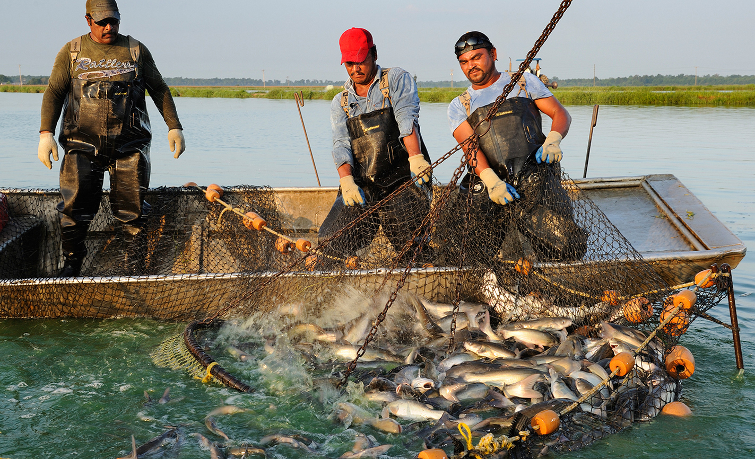

Florida aquaculture food fish
Florida Aquaculture Food Fish
Photo credit: Brain Skerry, National Geographic
Produced by the Division of Aquaculture - 2017
Notes:
Ask people to define aquaculture
Ask people what they think of when they think of aquaculture

Slide 2
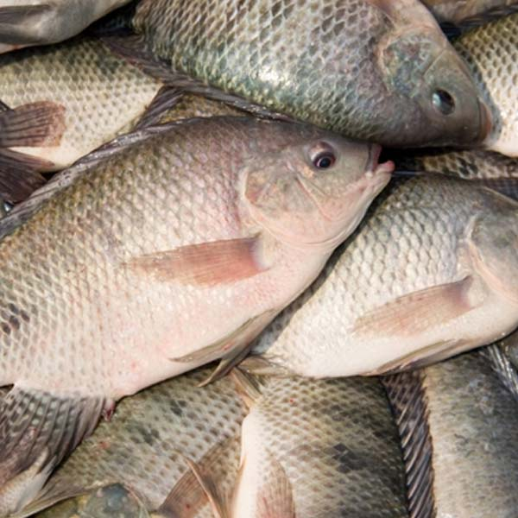
Introduction
This presentation will cover…..
  Where food fish come from
  Global food fish industry
  U.S. food fish industry
  Florida’s food fish industry
  Common production methods
    Catfish pond culture
    Marine shrimp breeding
Notes:
Ask people to define aquaculture
Ask people what they think of when they think of aquaculture

Slide 3
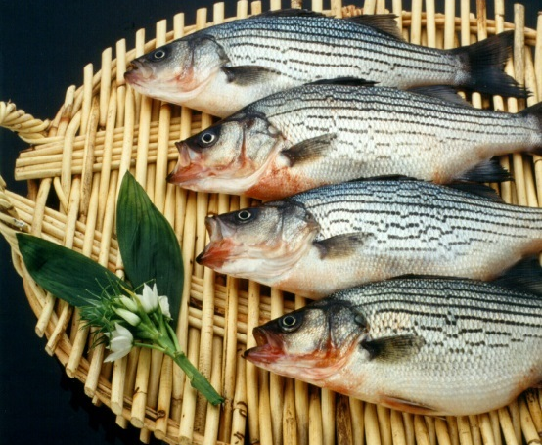
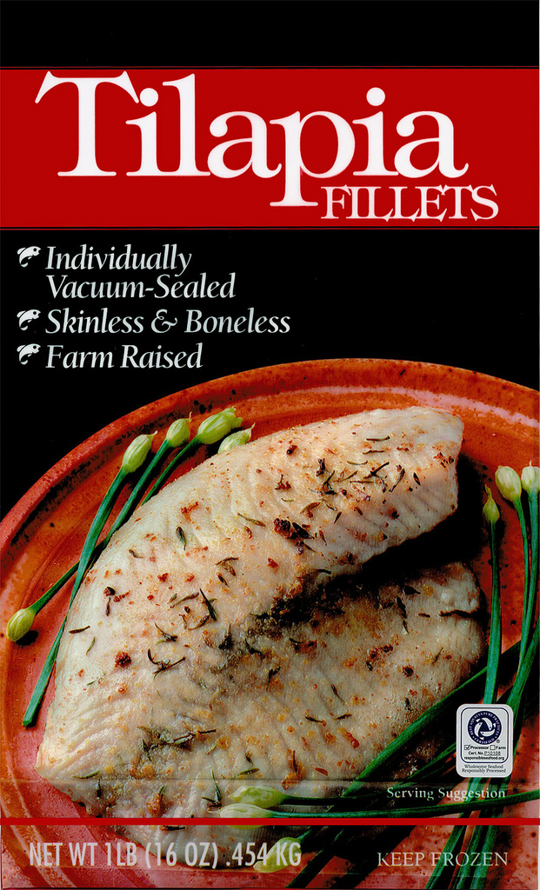
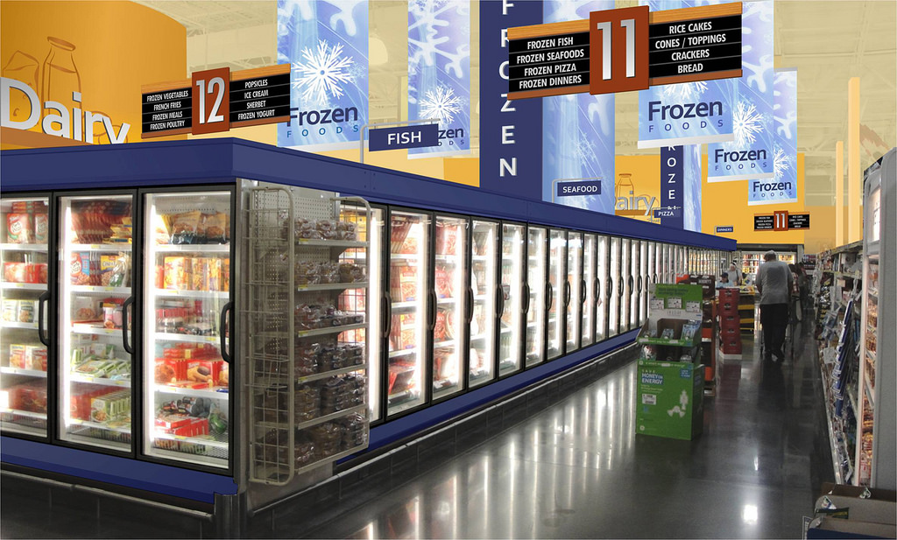
Where do food fish come from?
If you said grocery store, you are not alone.
Many people forget that their food has a history before arriving in a neat frozen package at your local store.
Notes:
Ask people to define aquaculture
Ask people what they think of when they think of aquaculture

Slide 4
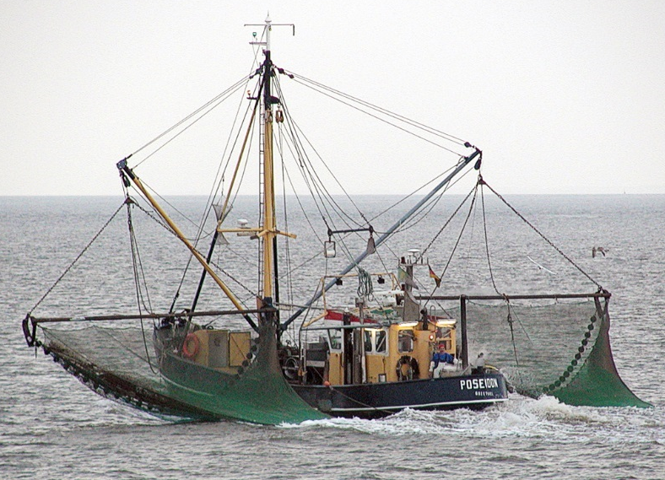
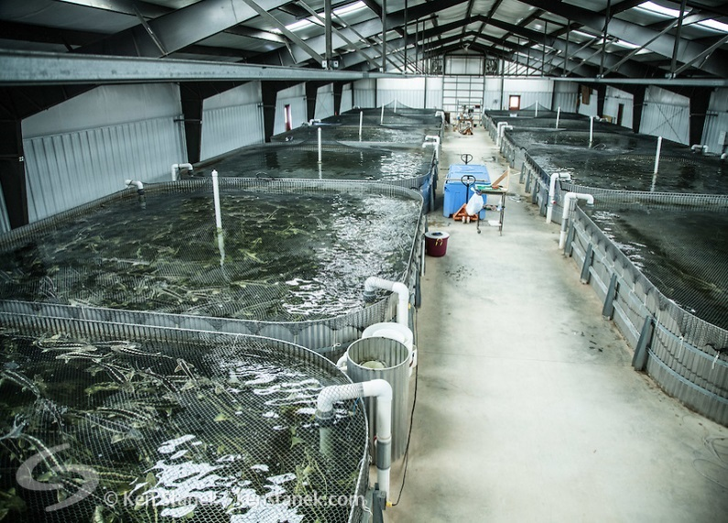
Where do food fish come from?
Wild capture from:
Oceans
Lakes
Rivers
Aquaculture Farms
Ponds
Tanks
Pens
No matter where you are in the world, the fish you consume are either captured from the wild or produced at an aquaculture farm.
Notes:
Ask people to define aquaculture
Ask people what they think of when they think of aquaculture

Slide 5
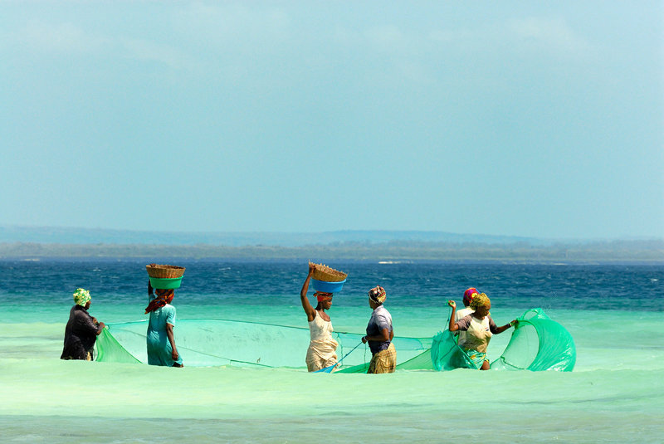
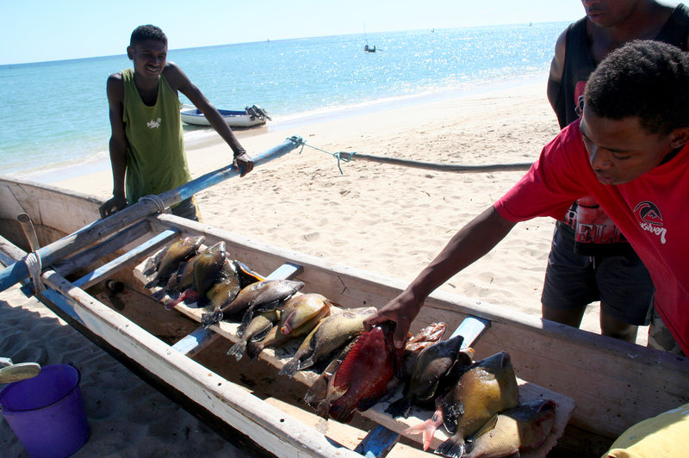
Brief History of Food Fish
Fishing has always been a critical food source for humans worldwide.
Even today, some 1 billion people worldwide depend on fish as their primary source of protein (meat)(FAO 2000).
However, as the world’s population increases the oceans alone cannot sustain the demand for food fish….
Photo credit: Michael D. Kock/Nature
Photo Credit: Christopher Golden/ Harvard T.H. Chan School of Public Health
Notes:
Ask people to define aquaculture
Ask people what they think of when they think of aquaculture

Slide 6
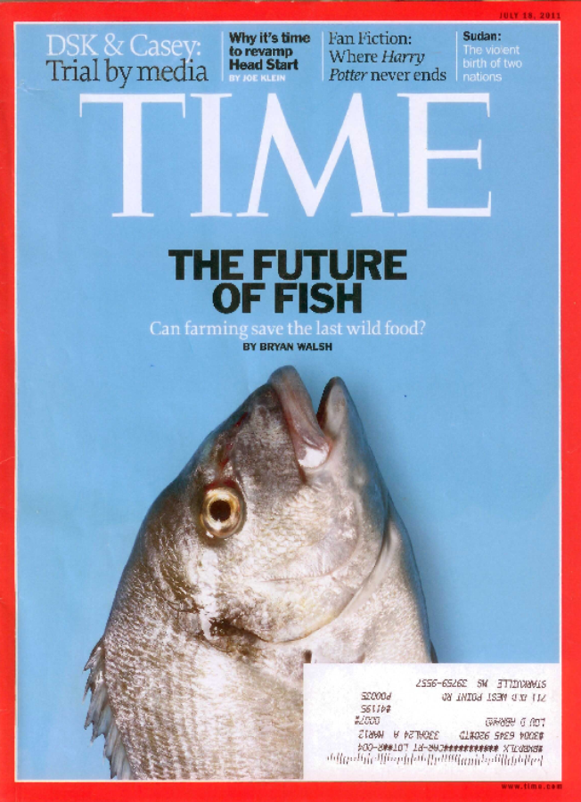
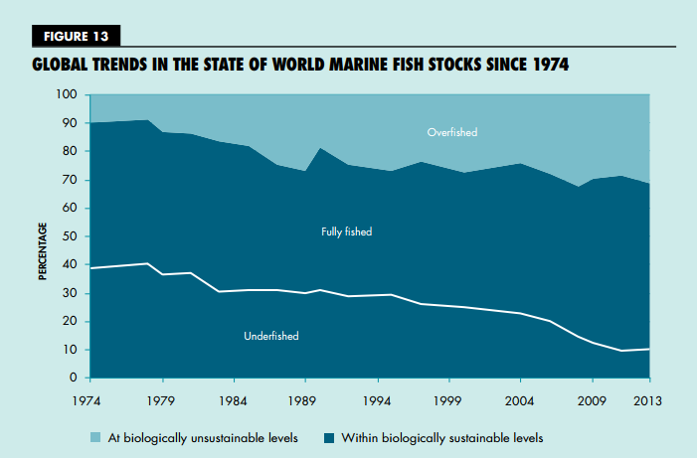
Wild fisheries max
Wild fisheries: Yield maximized
Fish are the last wild food.
Global consumption of fish greater than what the oceans can provide .
Maximum Sustainable Yield = 90 million tons per year
Aquaculture is rapidly growing to meet this supply shortage.
Aquaculture is the most efficient form of animal agriculture.
90% of wild fisheries are at maximum harvest or greater
Figure from: FAO 2016

Slide 7
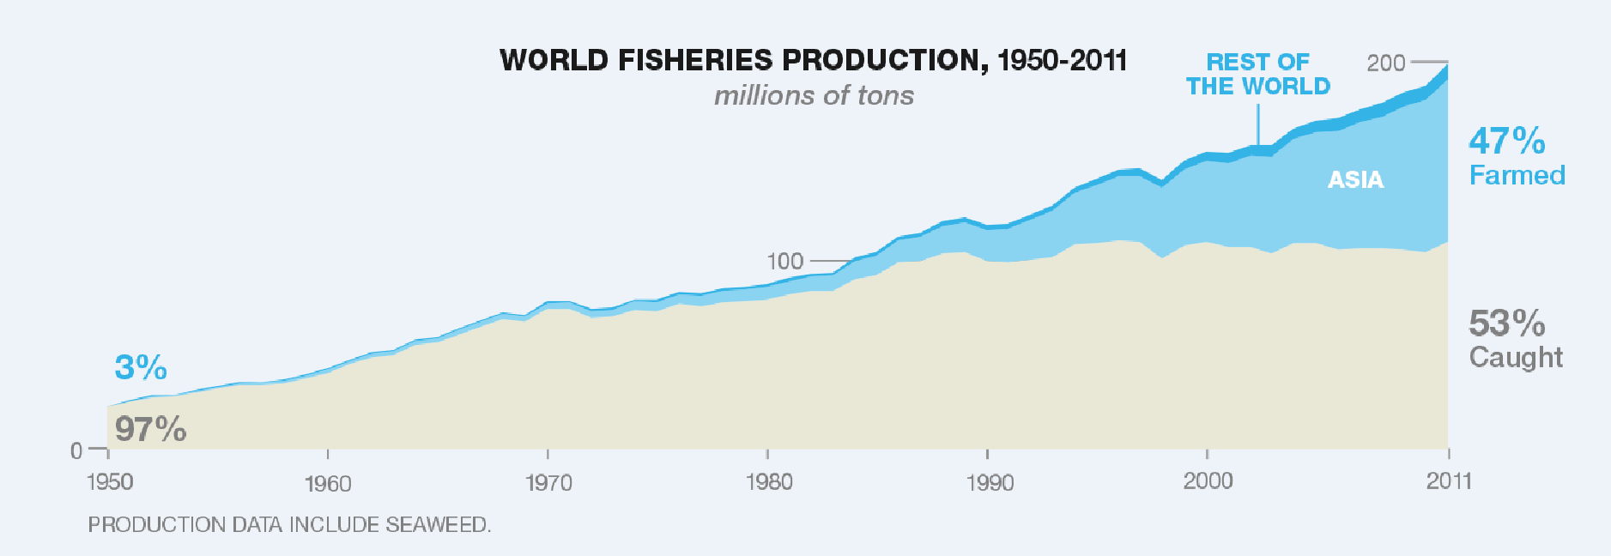
Problem: capture fisheries at maximum harvest rate
Aquaculture has met the increased demand for fish products.
In 1950, 97% of fish were caught from the ocean.
Wild harvest has not increased for 30 years
Today, only 50% of fish are caught from the ocean.
Figure from: FAO 2016
Notes:
FAO 2008 Report
Aquaculture accounted for 47% of all food fish supplied to world in 2006
Fish protein accounts for 15% of avg per captia animal protein intake

Slide 8
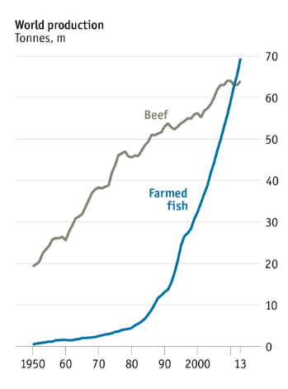
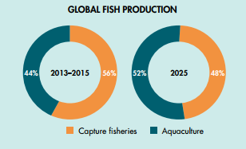
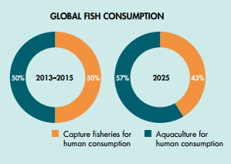
Aquaculture will soon be the norm
Figure from: FAO 2016
By 2025, aquaculture will be the primary source of fish production and consumption worldwide!
To put fish farming growth in context, as of 2013 more fish is farmed globally than beef each year!
Figure from: FAO 2014
Notes:
FAO 2008 Report
Aquaculture accounted for 47% of all food fish supplied to world in 2006
Fish protein accounts for 15% of avg per captia animal protein intake

Slide 9
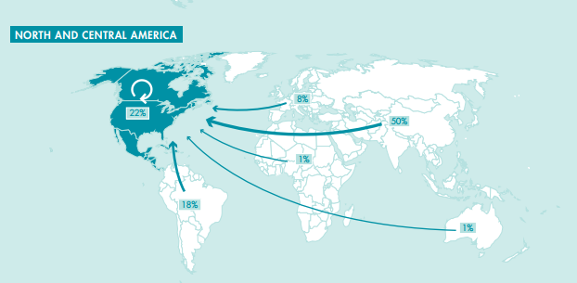
Where do our food fish come from?
22% domestic production
50% from Asia
Figure from: FAO 2016
Nearly 80% of seafood is imported into the U.S., resulting in a $14 billion dollar trade deficit, second only to the U.S. oil deficit.
Photo credit: Andrew Rhyne
Notes:
Ask people to define aquaculture
Ask people what they think of when they think of aquaculture

Slide 10
Top Food Fish Produced Globally
Six of the top 10 are carp!
While most of these species aren’t popular in the U.S., they are a staple food source for SE Asia, China and India.
That’s a lot of zeros…..
  49.3 BILLION pounds of the six major carp species are produced annually!
Notes:
Ask people to define aquaculture
Ask people what they think of when they think of aquaculture

Slide 11
Top Food Fish Produced Globally
China produces 62% of the world’s food fish, more than all other nations combined.
  60.1% of inland food fish
  94% of inland crustaceans
    Primarily shrimp
    USA is #3!
  83% of mollusks
Notes:
Ask people to define aquaculture
Ask people what they think of when they think of aquaculture

Slide 12
U.S. Food Fish Industry
Food fish are the primary product cultured in the U.S.
  71% of industry in 1998
  53% of industry in 2013
  Although, market share has declined by 18% in 15 years, production has increased 6%.
Notes:
Ask people to define aquaculture
Ask people what they think of when they think of aquaculture

Slide 13
U.S. Food Fish Industry
Top Annual Food Fish Sales by State (Census 2013)
  Florida represents ~5% of the U.S. food fish industry
Mississippi is still the #1 food fish producer in the U.S., although sales have declined by 30% since 1998.
Why have sales declined? International import competition
Notes:
Ask people to define aquaculture
Ask people what they think of when they think of aquaculture

Slide 14
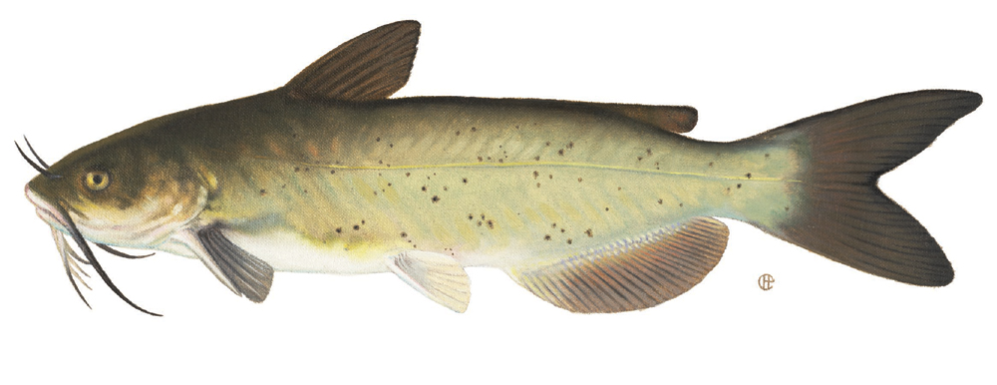
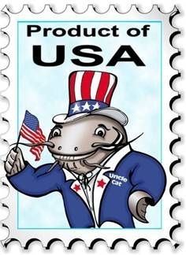
What’s the #1 food fish produced in the U.S.?
Channel catfish
Notes:
Ask people to define aquaculture
Ask people what they think of when they think of aquaculture

Slide 15
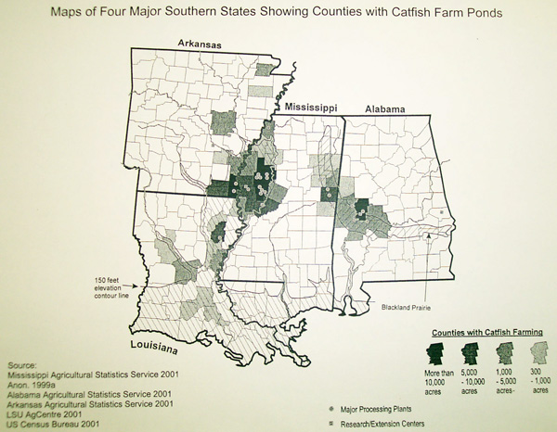
Where are catfish produced in the U.S.?
Mississippi Delta
Black Prairie
Notes:
Ask people to define aquaculture
Ask people what they think of when they think of aquaculture

Slide 16

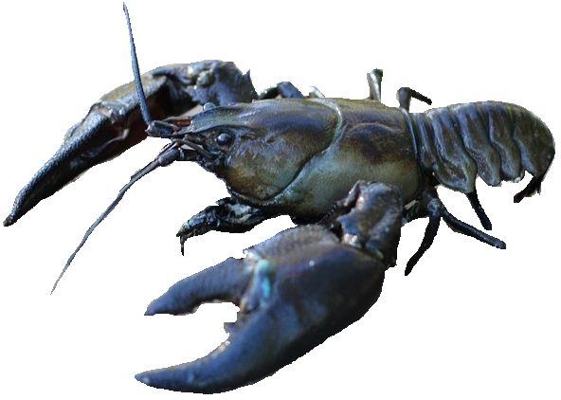
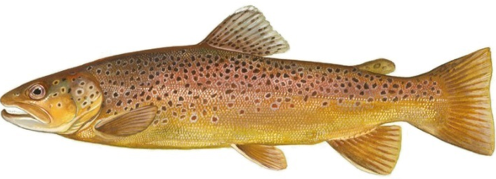
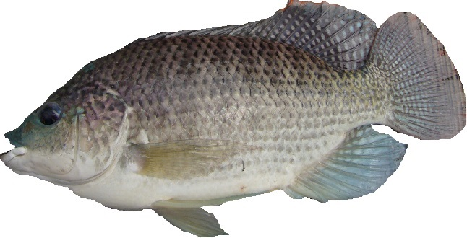
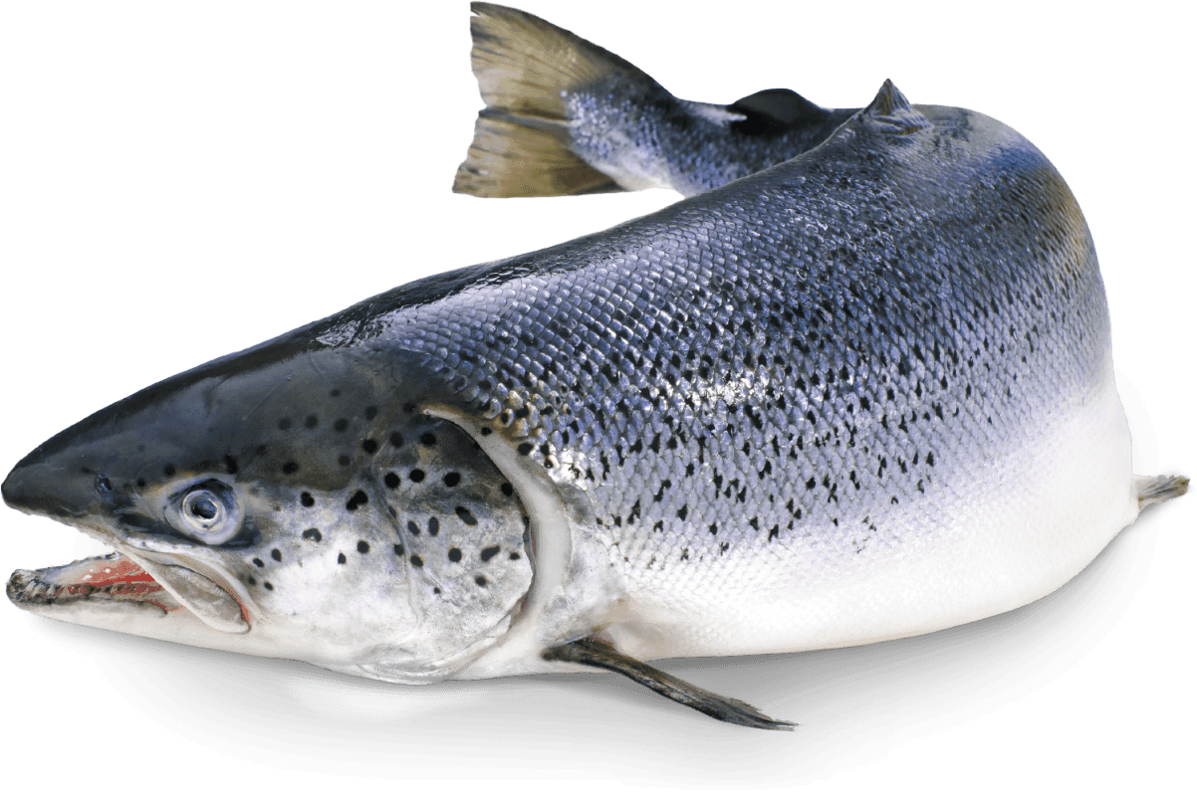
U.S. Food Fish Industry
Catfish
Crawfish
Trout
Catfish represent ~75% of the industry.
Salmon
Tilapia
Notes:
Ask people to define aquaculture
Ask people what they think of when they think of aquaculture

Slide 17
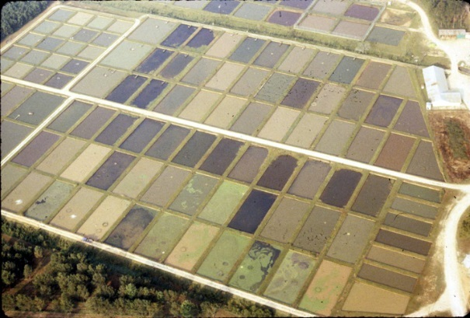
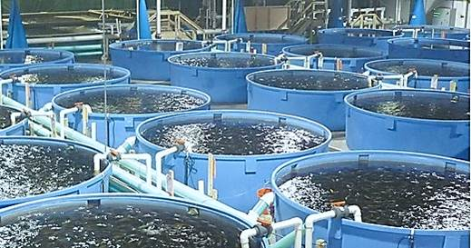
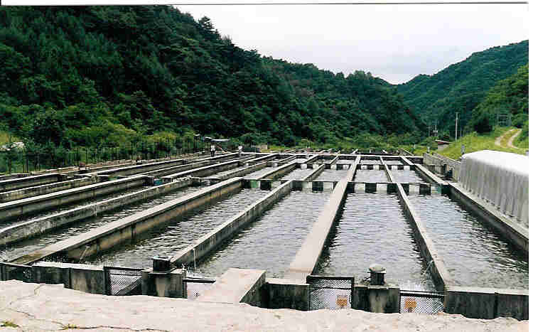
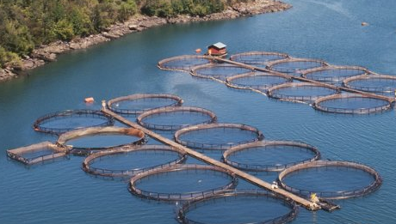

How are these species produced?
Ponds
Tanks
Catfish
Crawfish
Photo credit: Auburn University
Raceways
Sea Pens
Trout
Salmon
Tilapia
Notes:
Ask people to define aquaculture
Ask people what they think of when they think of aquaculture

Slide 18
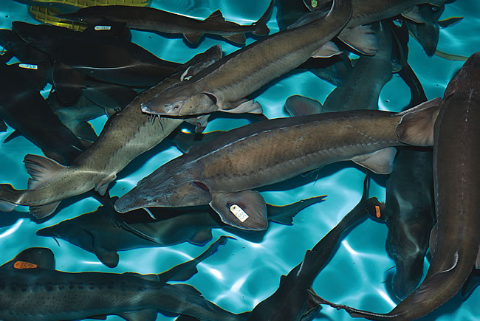
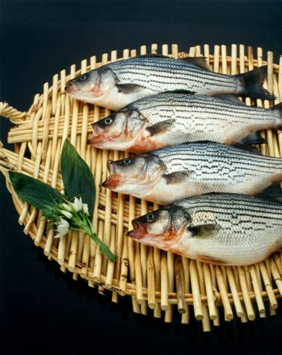
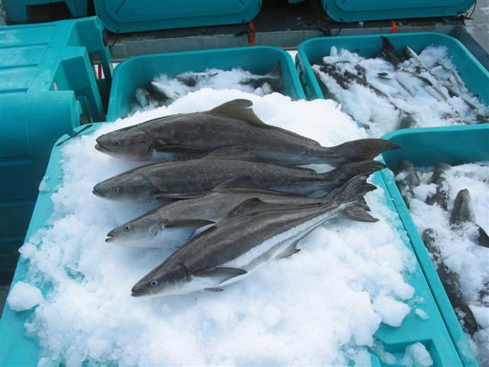
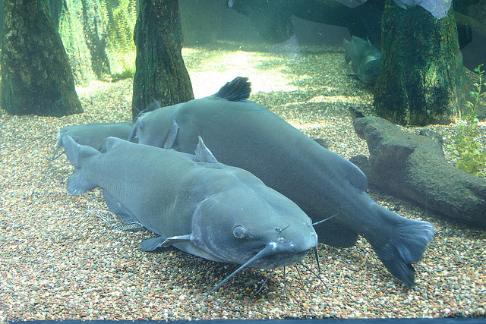
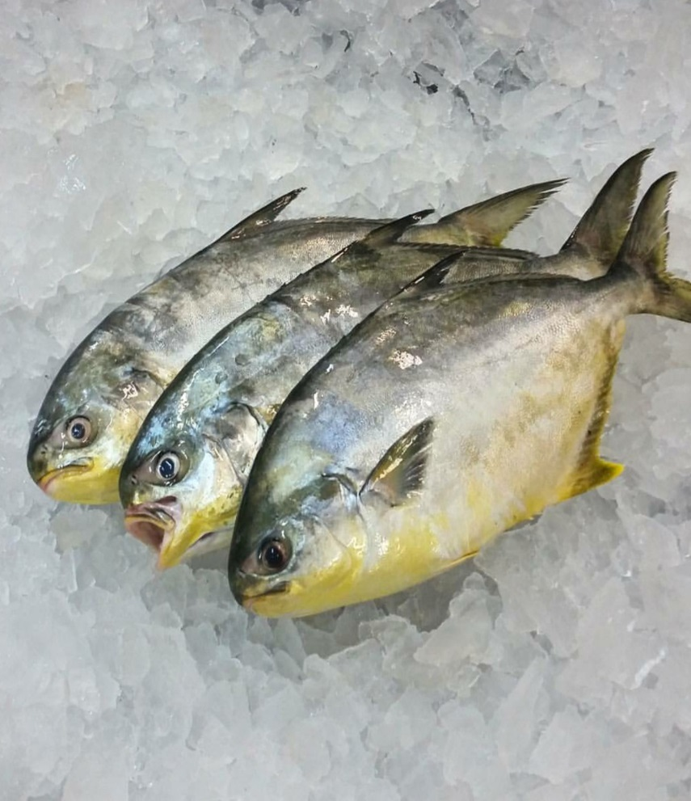
Food Fish Aquaculture in Florida
Food fish species produced in Florida
Tilapia
Catfish
Pompano
Cobia
Hybrid Striped Bass
Sturgeon

Slide 19
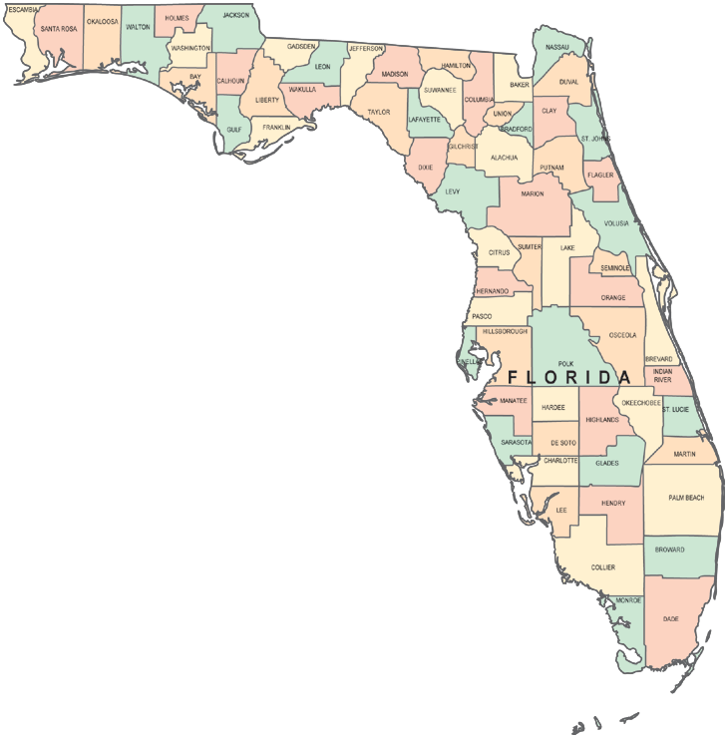
Florida’s Food Fish Industry
49 farms in Florida (2005)
2013 sales in Florida = $ 19.9 million (including shrimp)
  3.6 million excluding shrimp
While shrimp are technically not fish, they’re included because they are the major aquaculture food product in Florida!
Florida is 2nd in the nation in shrimp production sales!
And the shrimp industry is rapidly growing in the state, with seven farms in 2005 and 20 in 2013!
Notes:
Ask people to define aquaculture
Ask people what they think of when they think of aquaculture

Slide 20
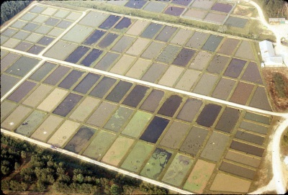
Culture Methods in Florida
Food fish are primarily produced in either ponds or recirculating tanks throughout the state
  Pond species
    Catfish
    Tilapia
    Shrimp
  Recirculating tank species
    Hybrid striped bass
    Tilapia
    Shrimp
    Sturgeon
Why are two different methods used for tilapia and shrimp?
Ponds
Production method is determined by size of farm, capital investment and annual production goals.
Most food fish can be aquacultured in a variety of ways depending on the environment and farmer’s goals.
Tanks
Notes:
Ask people to define aquaculture
Ask people what they think of when they think of aquaculture

Slide 21

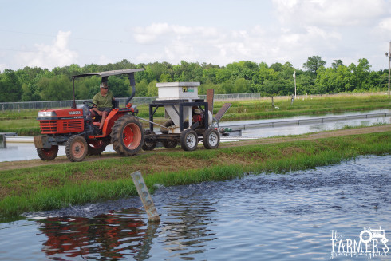
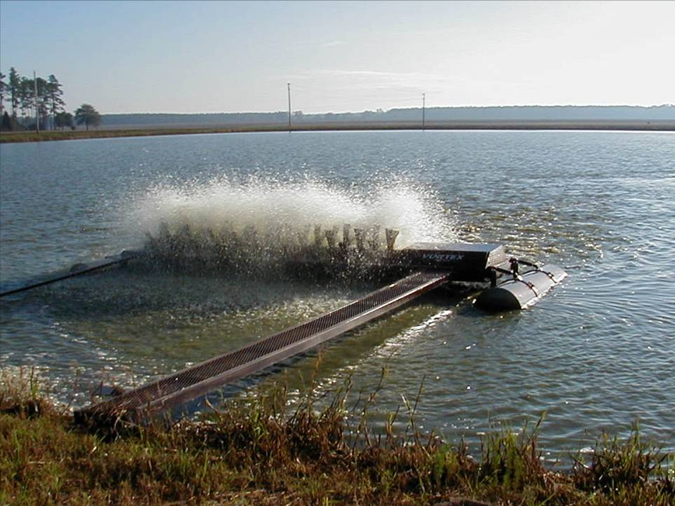
Pond Culture Methods
We will focus on catfish culture for this section….
Ponds vary in size (generally 10 acres each) depending on the ponds purpose.
  Broodstock (spawning adults) and larvae ponds are smaller.
  Grow-out ponds are larger.
  Fish are fed by a air power spreader that shoots feed across the pond surface.
Paddlewheel aerators increase oxygen concentrations in ponds
Photo credit: University of Arkansas Pine Bluff
Notes:
Ask people to define aquaculture
Ask people what they think of when they think of aquaculture

Slide 22
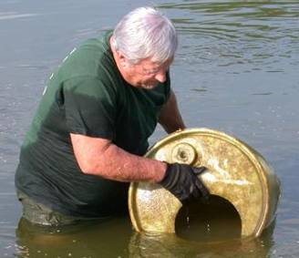
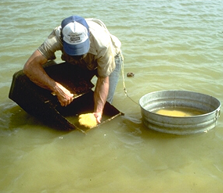
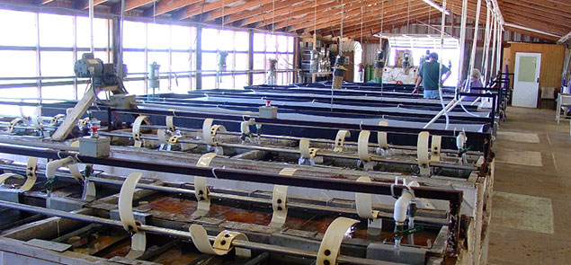
Catfish Culture Methods
Catfish spawning and larval rearing techniques
1. Spawning containers are placed into broodstock ponds.
2. Female lays egg mass in container.
3. Farmer collects the egg mass.
4. Eggs are hatched in trough tanks with paddles that mimics male parental care.
Photo credit: University of Arkansas Pine Bluff
Notes:
Ask people to define aquaculture
Ask people what they think of when they think of aquaculture

Slide 23
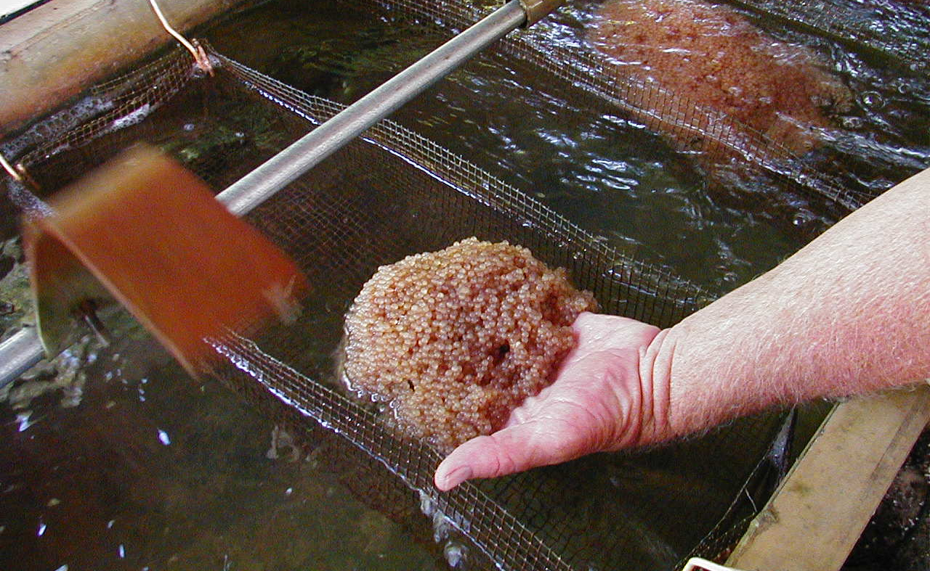
Did you know?
Catfish lay adhesive egg masses that stick together in a large clump.
In nature, the eggs stick to woody debris in the cavity where spawning occurs. After females lay the egg mass, males guard the nest and keep the eggs clean by slowly fanning his tail across them.
Photo credit: University of Arkansas Pine Bluff
Notes:
Ask people to define aquaculture
Ask people what they think of when they think of aquaculture

Slide 24
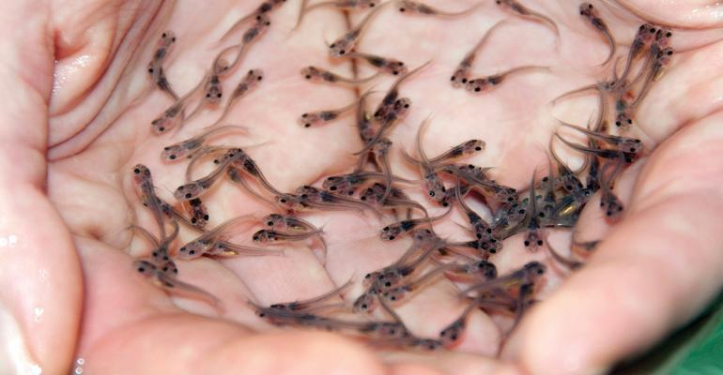
Catfish Culture Methods
Catfish fry or larvae are raised indoors until they absorb their yolk-sac. They are then stocked into grow-out ponds.
Catfish fry ready for pond stocking.
Photo credit: Mississippi State University Extenion Service
Photo credit: University of Arkansas Pine Bluff
Notes:
Ask people to define aquaculture
Ask people what they think of when they think of aquaculture

Slide 25
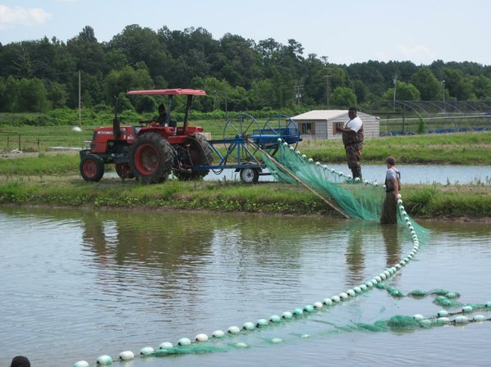
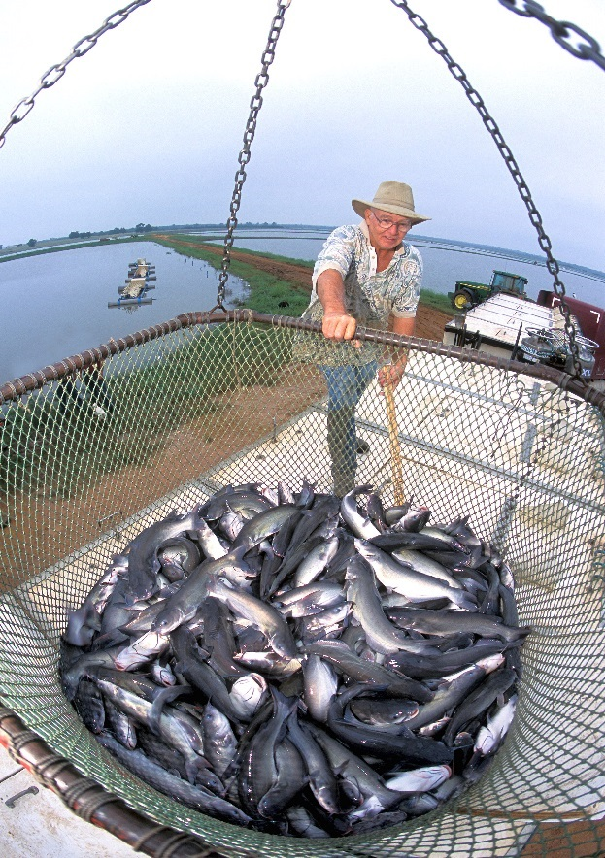
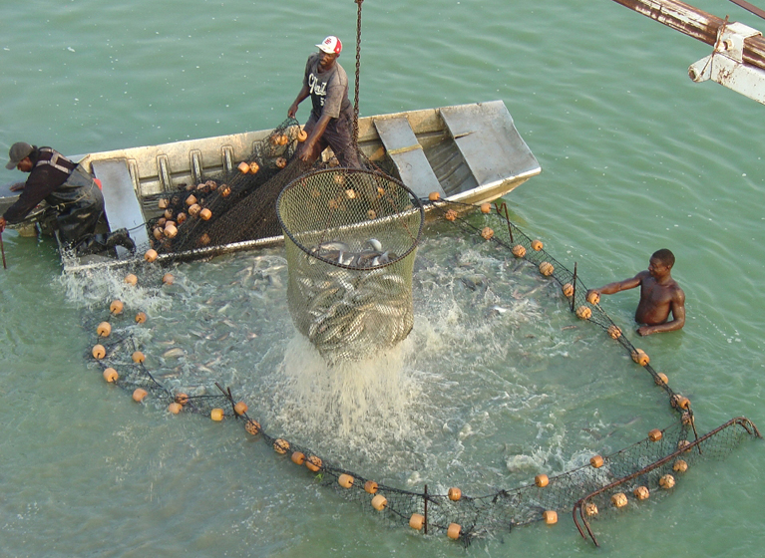
Catfish Culture Methods
After about 15 - 18 months of growth, catfish are ready to be harvested.
The seine net is reduced in size until catfish can be scooped up in a large basket on a crane.
Photo credit: University of Arkansas Pine Bluff
Harvest starts by running a seine net across the pond, crowding the catfish into a confined area.
Photo credit: USDA
The basket is then dumped into tanks on a hauling truck, and fish are transported to a processing plant.
Photo credit: Jim Steebey
Photo credit: University of Arkansas Pine Bluff
Notes:
Ask people to define aquaculture
Ask people what they think of when they think of aquaculture

Slide 26
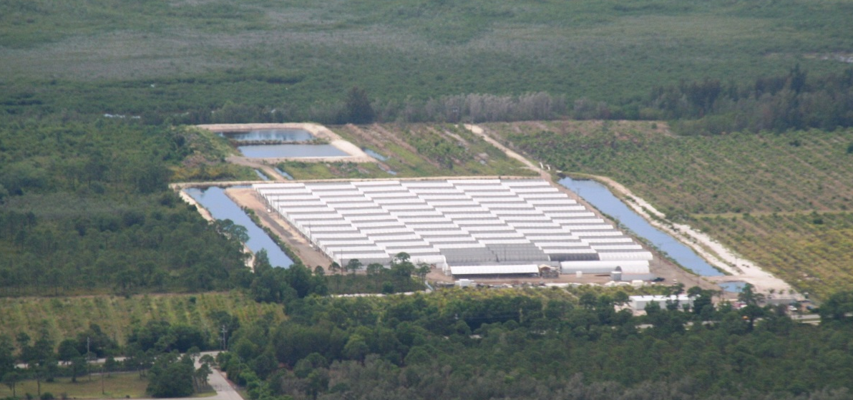
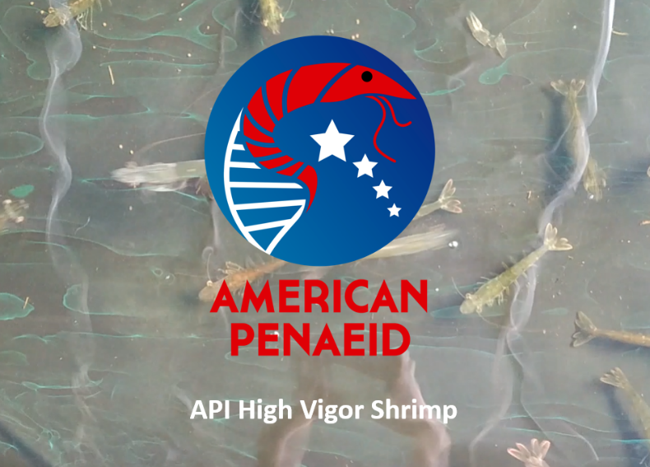
Marine Shrimp Breeding Facility
Marine Shrimp Breeding Facility
Marine shrimp aquaculture is rapidly growing in the U.S. and Florida.
While growing out shrimp from larvae to harvestable adults is relatively simple, spawning marine shrimp is not.
A large breeding facility in southwest Florida provides post-larvae shrimp to farms all over the world.
Photo credit: University of Arkansas Pine Bluff
Notes:
Ask people to define aquaculture
Ask people what they think of when they think of aquaculture

Slide 27
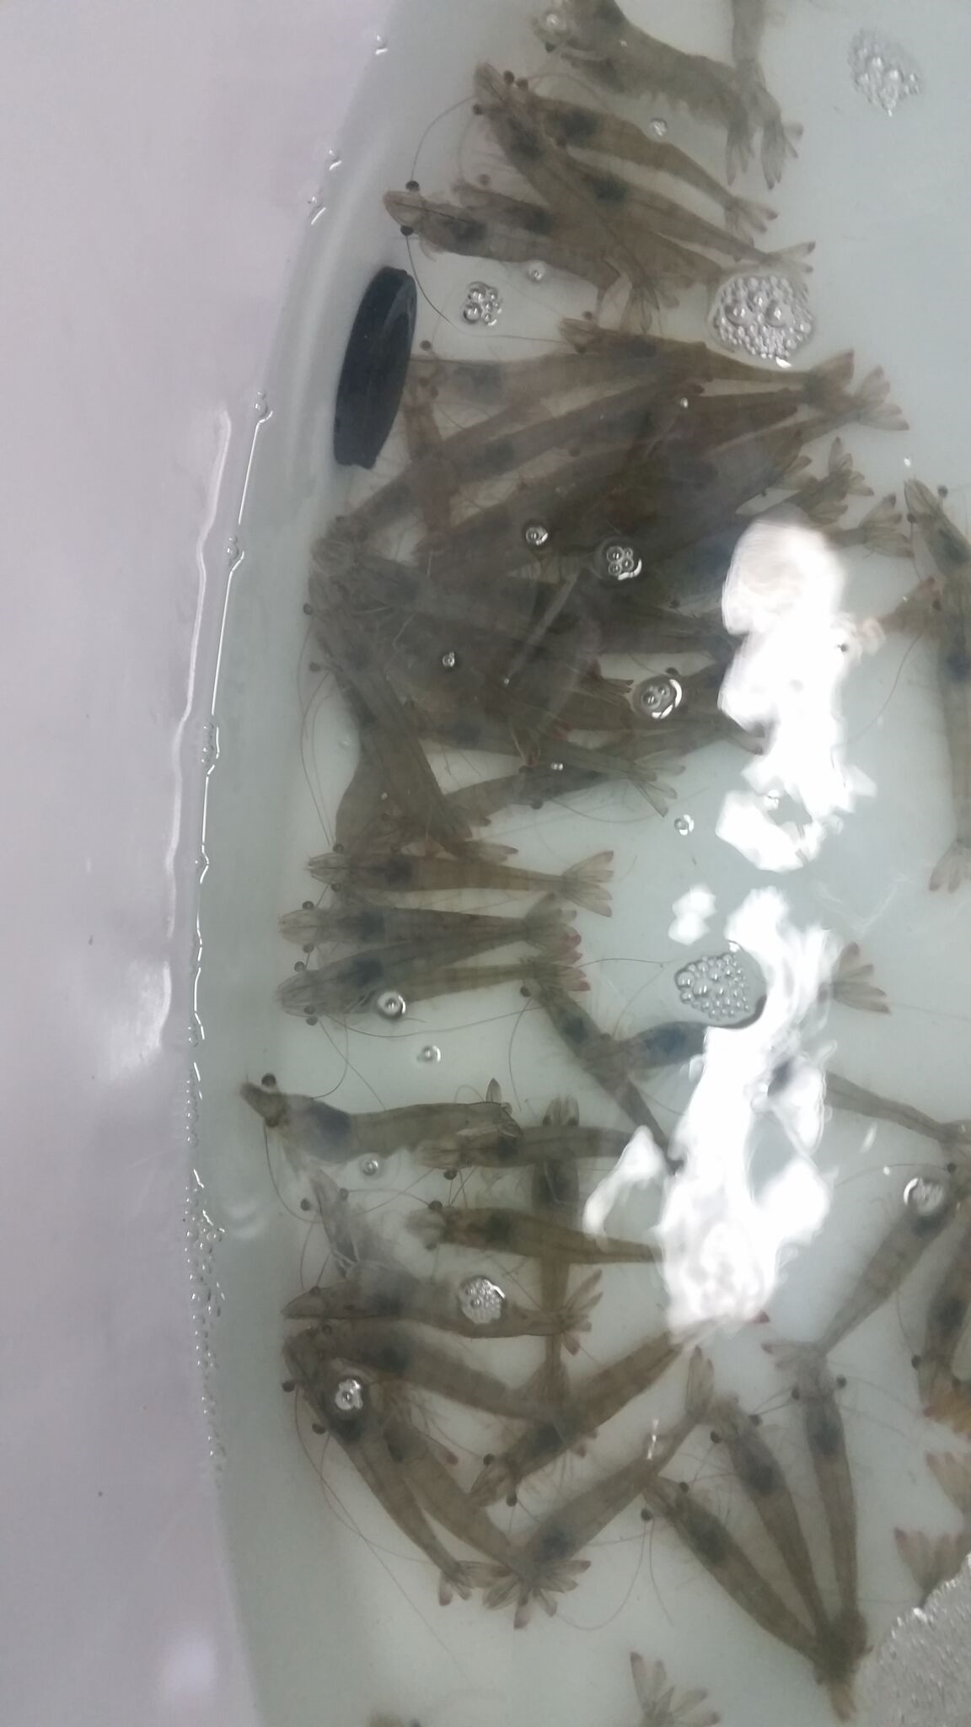
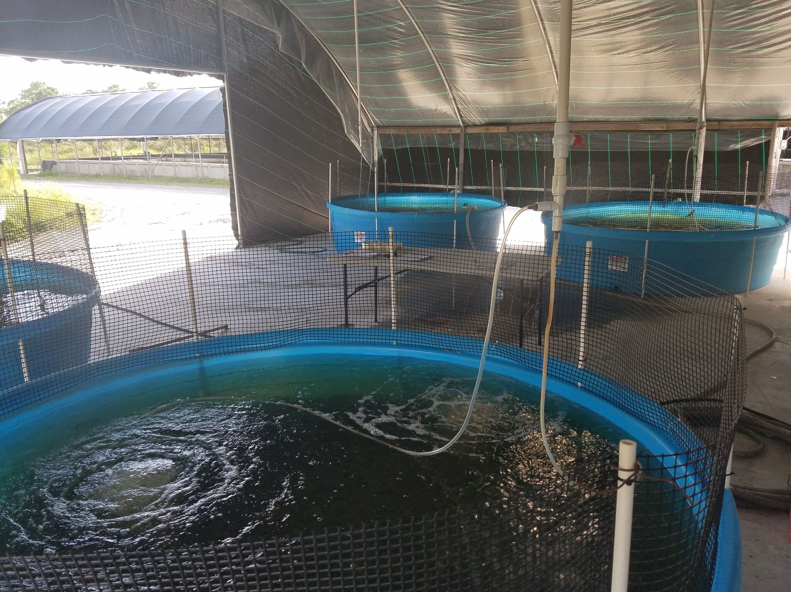
Marine Shrimp Breeding Facility
Marine shrimp are very susceptible to disease.
  Biosecurity and genetic resistance are critical to the success of shrimp farms.
  Shrimp need to be USDA certified specific-pathogen-free (SPF).
    Which mean they are guaranteed to be 100% disease free.
  A shrimp breeding facility must be indoors and fully biosecure to protect valuable broodstock.
The facility in south Florida is producing 250,000 breeder pairs per year, which are then used by other farms to produce millions of shrimp for the aquaculture industry!
Marine Shrimp Breeding Center in St. James City, FL
Photo credit: University of Arkansas Pine Bluff
Notes:
Ask people to define aquaculture
Ask people what they think of when they think of aquaculture

Slide 28
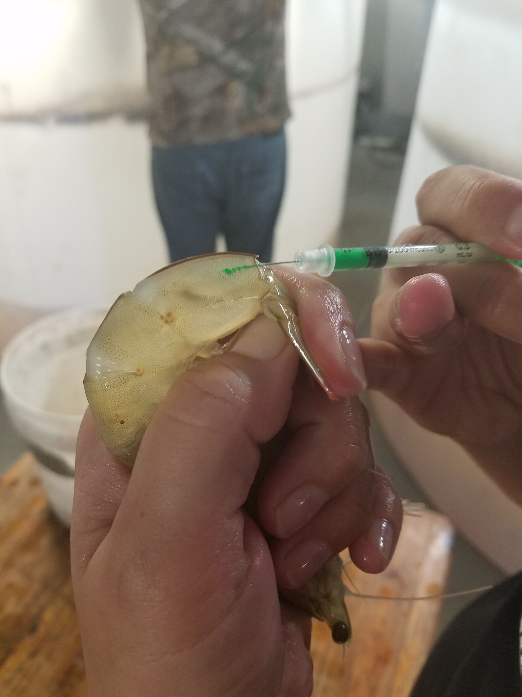
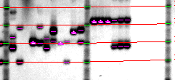
Genetic Breeding Program
Genetic Breeding Program
The facility utilizes DNA selection to identify families and parents;
Minimize inbreeding by analyzing DNA markers; and
Requires years of genetic and aquaculture expertise.
DNA Selection Facility
Marine Shrimp Breeding Center in St. James City, FL
Genetic marker injection
Photo credit: University of Arkansas Pine Bluff
Notes:
Ask people to define aquaculture
Ask people what they think of when they think of aquaculture

Slide 29

Disease Challenge Program
Disease Challenge Program
Disease Challenges Facility
Shrimp are exposed to three common diseases in a contained system.
Survivors from these challenges with the best growth rates are then used to produce next generation of shrimp.
Off-spring inherit genetic resistance to diseases from parents.
Photo credit: University of Arkansas Pine Bluff
Notes:
Ask people to define aquaculture
Ask people what they think of when they think of aquaculture

Slide 30
Conclusions
    Aquaculture is a sustainable alternative to wild harvest fisheries.
    As the global population grows and demand for fish increases, aquaculture is rapidly expanding to met this protein demand.
    Shrimp, tilapia and catfish are the main food fish products in Florida.
    Florida produces a wide variety of food fish and is a hotspot for research, innovation and highly technical production methods (marine shrimp breeding).
Photo credit: University of Arkansas Pine Bluff
Notes:
Ask people to define aquaculture
Ask people what they think of when they think of aquaculture

Slide 31
Conclusion
Conclusion
For questions about this presentation or aquaculture in Florida please contact the Division at:
Tallahassee Office: (850) 617-7600
Bartow Office: (863) 578-1870
Email: aquaculture_web@FreshFromFlorida.com
Website: FreshFromFlorida.com

