Slide 1
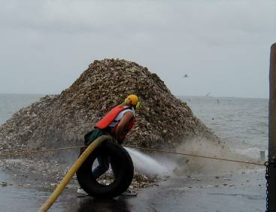
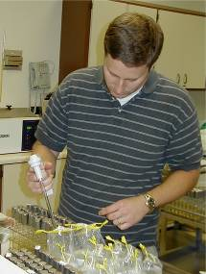
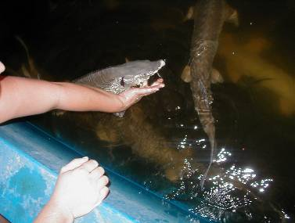
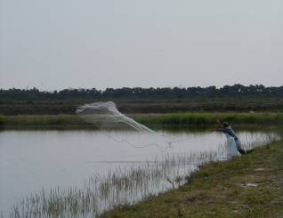
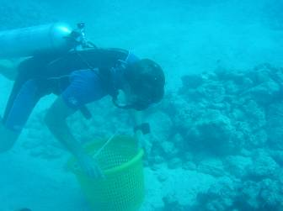
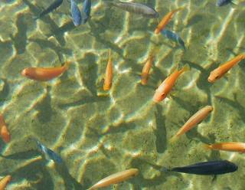

Careers in Aquaculture
Produced by the Division of Aquaculture - 2017
Notes:
Ask people to define aquaculture
Ask people what they think of when they think of aquaculture

Slide 2
careers
Commercial
Farmer
Director
Extension Agent
Biotechnology
Researcher
Law Enforcement
Aquaculture
State Inspector
Educator
Marketing
Veterinarian or
Epidemiologist
Food Safety
Hatchery Manager
Engineering
Aquarium Curator
Notes:
Ask people to define aquaculture
Ask people what they think of when they think of aquaculture

Slide 3
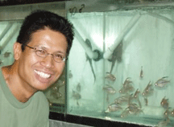
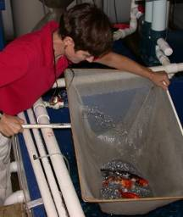
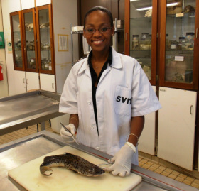
Veterinarian or Epidemiologist
Typical Education:
M.S. in Biology, D.V.M.,
Ph.D. in Biology
Notes:
Ask people to define aquaculture
Ask people what they think of when they think of aquaculture

Slide 4
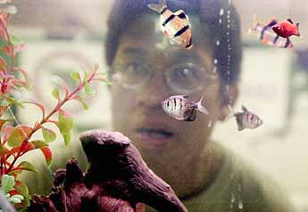
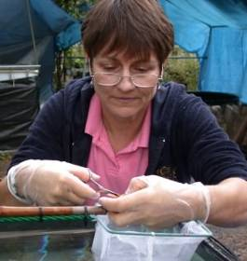
Veterinarian or Epidemiologist
Job Duties:
Disease diagnostics and treatment
Pathogen research
Assist aquaculture producers with import/export regulation
Biosecurity technical assistance
Issues aquatic animal health certificates
Notes:
Ask people to define aquaculture
Ask people what they think of when they think of aquaculture

Slide 5
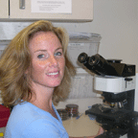
Veterinarian or Epidemiologist
What’s great about being a vet?
“New challenges everyday!”
~Dr. Kathleen Hartman
USDA APHIS
Notes:
Ask people to define aquaculture
Ask people what they think of when they think of aquaculture

Slide 6
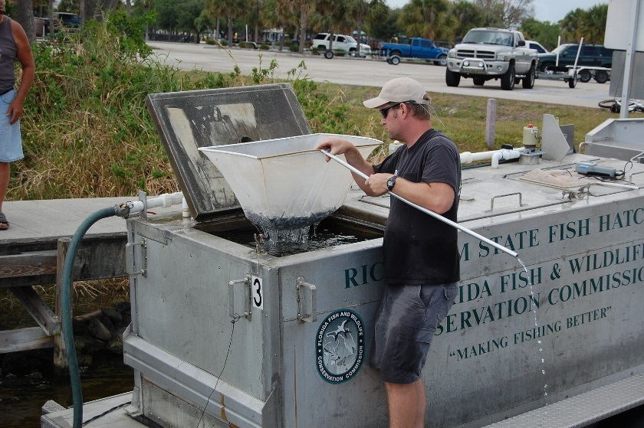
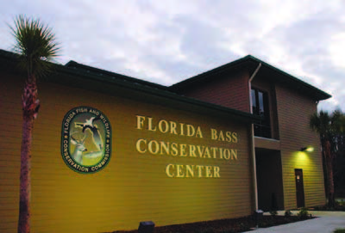
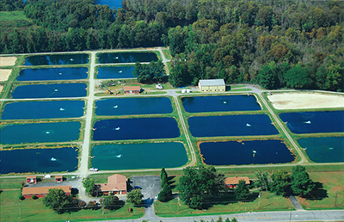
Hatchery Manager
Typical Education:
B.S. in Biology
M.S. in Biology
Notes:
Talk about benefits and problems

Slide 7
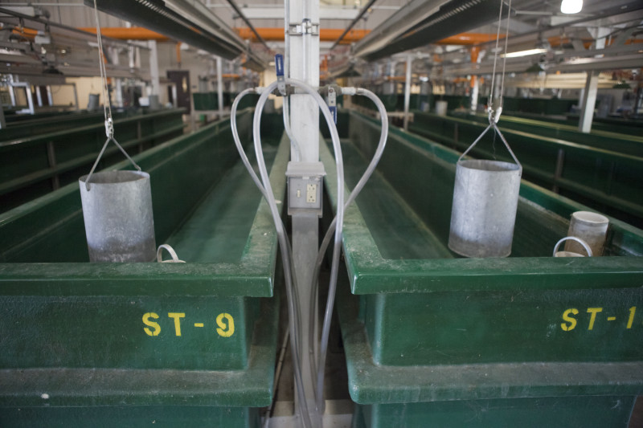
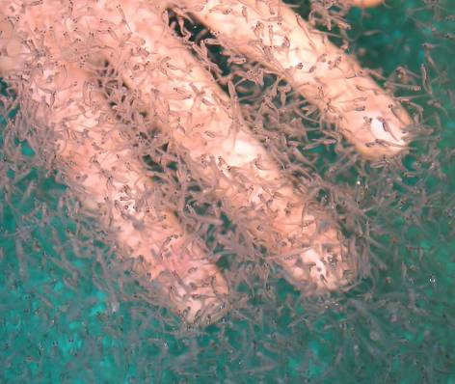
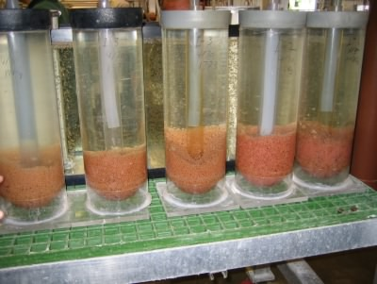
Hatchery Manager
Gamefish production
for recreation or
conservation stocking
Hatchery Skills
  Reproduction
  Larval rearing
  Disease mgt.
  Pond mgt.
  Stocking into public
  waters
Notes:
Talk about benefits and problems

Slide 8
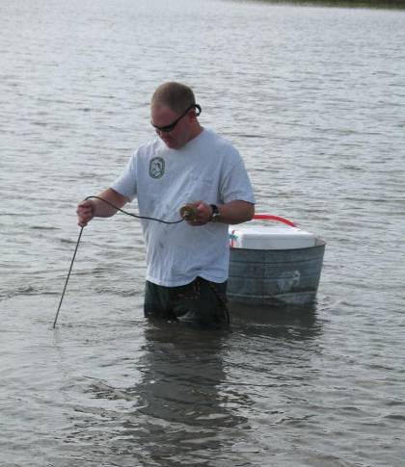
Hatchery Manager
What’s great about being a hatchery manager?
“We are constantly working with researchers in the field of fish culture to improve our understanding of fish spawning, production and nutrition.”
~Rick Stout
Florida Bass Conservation Center
Notes:
Talk about benefits and problems

Slide 9
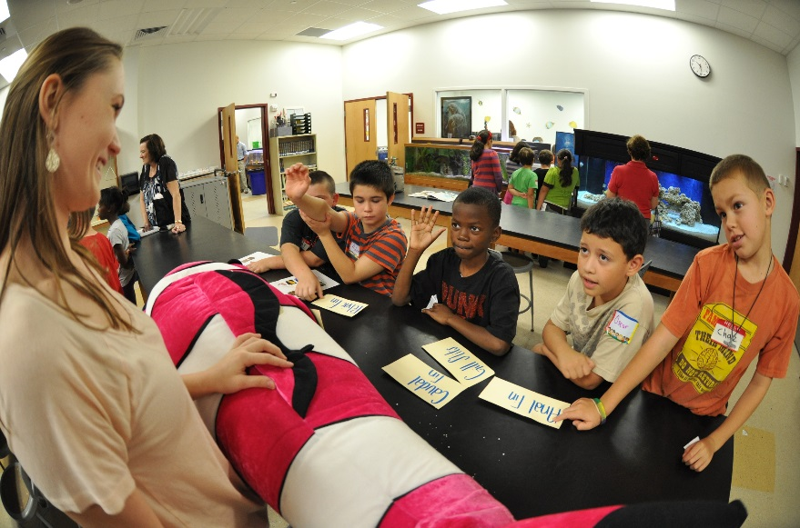
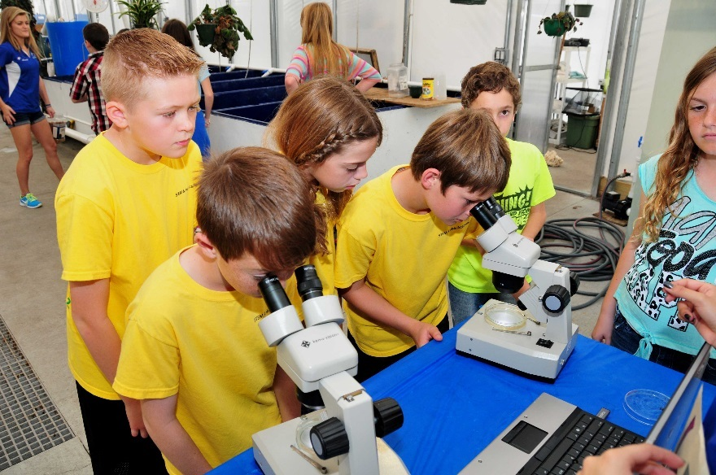
Teacher
Typical Education:
B.S. in Education
Teaching Certification
Job Duties:
Lesson plans
Teaching
Hands-on science activities
Field trips
Notes:
Talk about benefits and problems

Slide 10
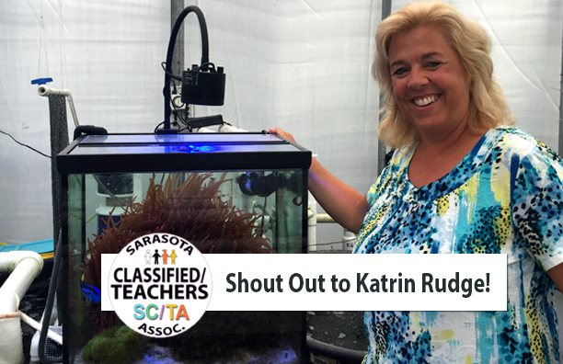
Teacher
"Seeing the magic and excitement on students' faces when they see baby clownfish hatch and develop their first stripe or a baby bamboo catshark squirming around in its egg case just before hatching after an anticipated 3 month waiting time is my reason for teaching aquaculture in a Marine science classroom."
~Katrin Rudge
Riverview High School
What’s great about being an aquaculture teacher?
Notes:
Talk about benefits and problems

Slide 11
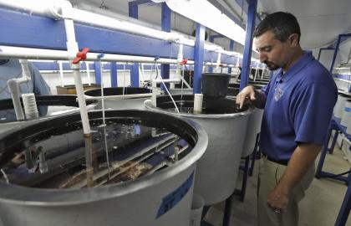
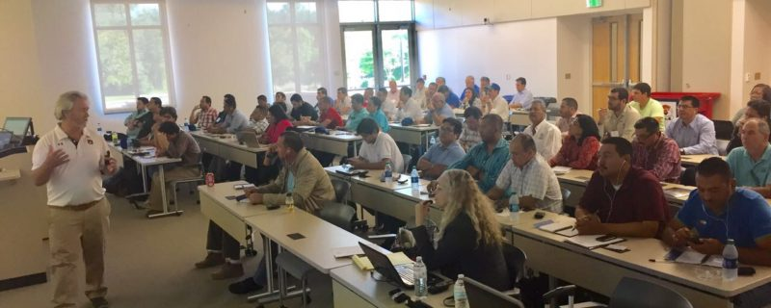
College Professor
Teaching courses in:
  Aquaculture
  Fish nutrition
  Physiology
  Disease/Health mgt.
  Ichthyology
  Agriculture
Research:
Larval culture
Nutrition
Reproduction
Biotechnology
Physiology
Genetics
Typical Education:
Ph.D in Aquaculture, Biology, Physiology, Toxicology etc.
Photo credit: Chris O'Meara
Notes:
Talk about benefits and problems

Slide 12
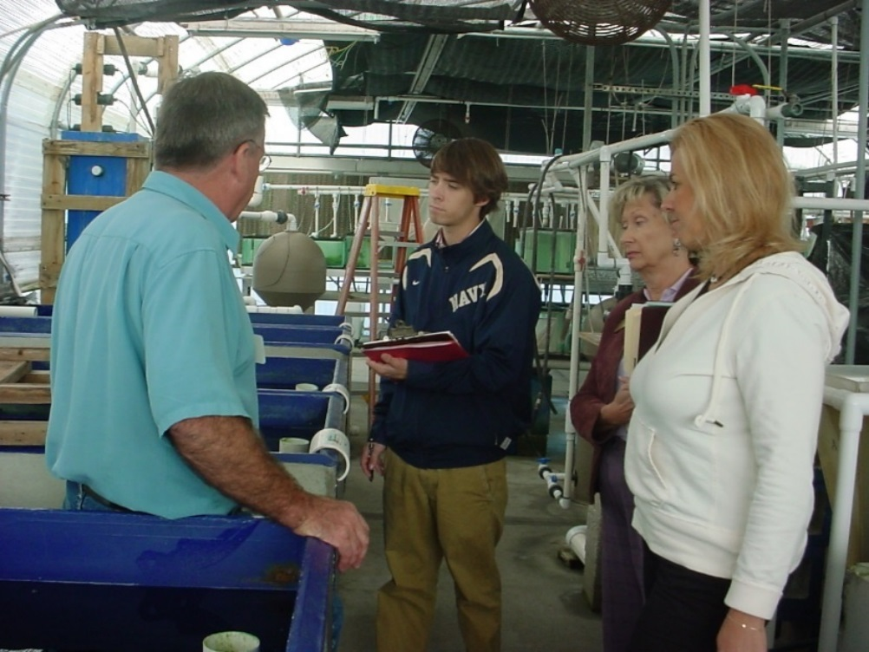
College Professor
What’s great about being an aquaculture professor?
“Variety!! I enjoy working with the students on a variety of projects including greenhouse and pond fish production. Working with the large number of industry cooperators is also a great plus. It provided the students with real world experience and enhances our program. It’s great to look back at the end of the day and see all you’ve accomplished.”
~ Dr. Craig Kasper
Hillsborough Community College
Notes:
Talk about benefits and problems

Slide 13
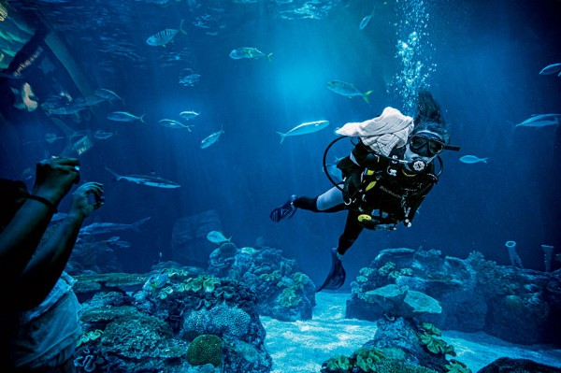
Aquarium Curator
  Typical Education:
  B.S. Aquaculture or
  Marine Biology
  3-5 yr. professional experience
  Job Duties:
  Aquarium mgt.
  Animal health
  Biosecurity
  Feeding
  Education/Outreach

Slide 14
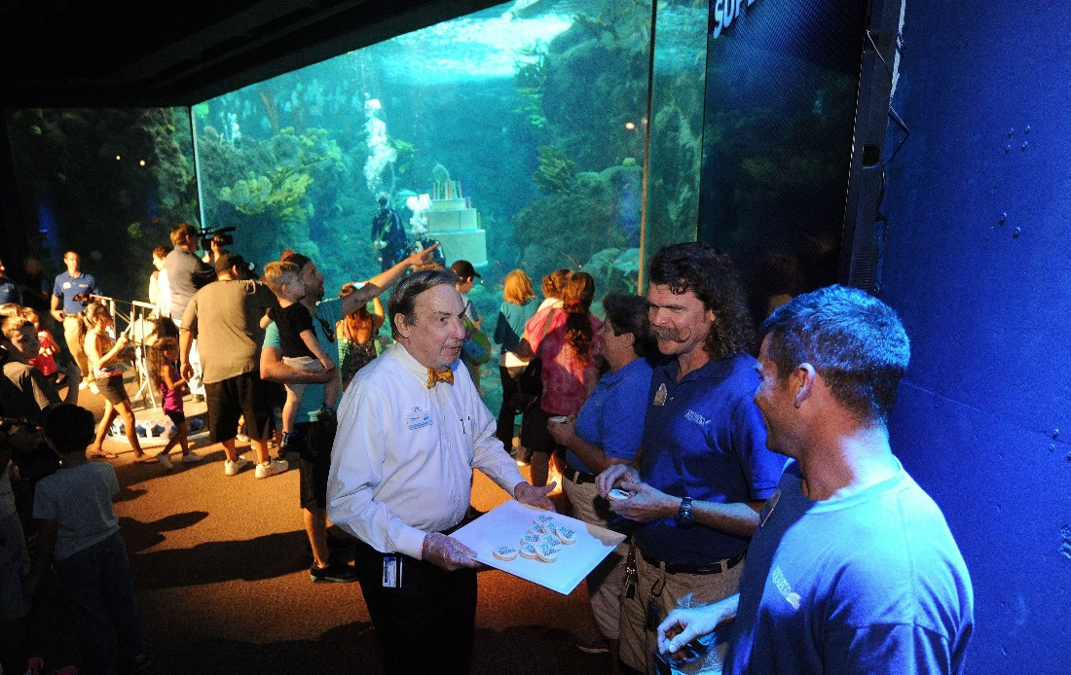
Aquarium Curator
What’s great about being an aquarium curator?
“One of my favorite responsibilities as a curator is helping connect people with wildlife. We are making strides to help vulnerable Sand Tiger Sharks through innovative reproductive science. The stories of these sharks are the tales we want our guests to take home with them. Because when the sharks win we all win, and we can work together to protect and restore our Blue Planet. ”
~ Eric Hovland
The Florida Aquarium
Photo credit: JIM REED/STAFF

Slide 15

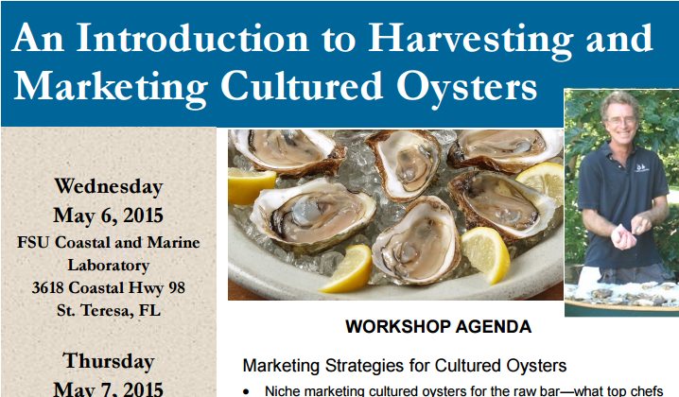
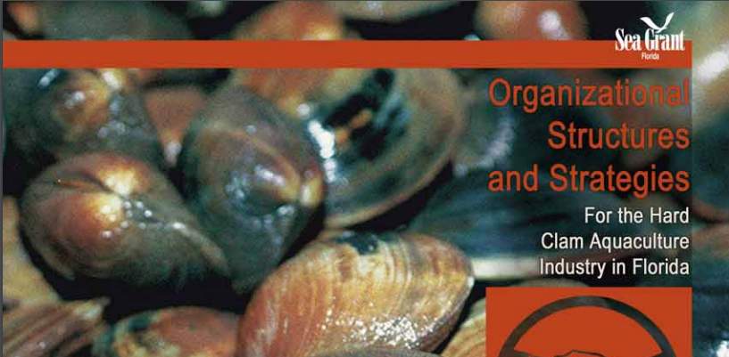
Seafood and Aquaculture Marketing
Typical Education:
B.S., M.S. or Ph.D in Economics/Marketing
Job Duties:
Development of promotional campaigns and marketing initiatives
Grant procurement
Trade events
Economic analyses
Marketing research
Consumer surveys

Slide 16
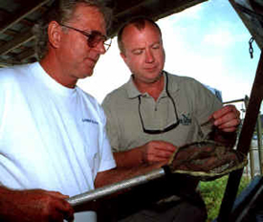
Aquaculture Marketing and Economics
What’s great about being in aquaculture marketing and economics?
“I enjoy working with people who have an interest in aquaculture as a business and helping them understand whether or not aquaculture is a good way to invest their money. Helping people make good decisions about investing in aquaculture is very rewarding.”
~ Dr. Charles Adams
University of Florida: IFAS

Slide 17
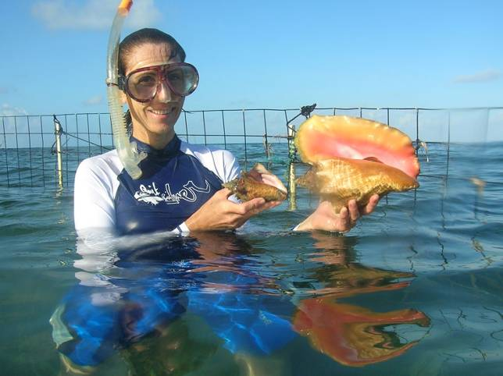
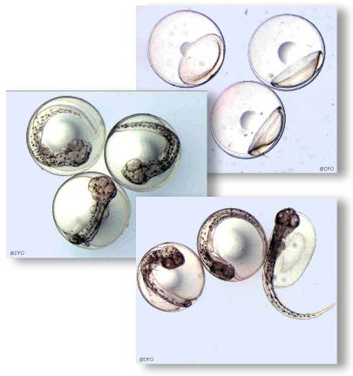
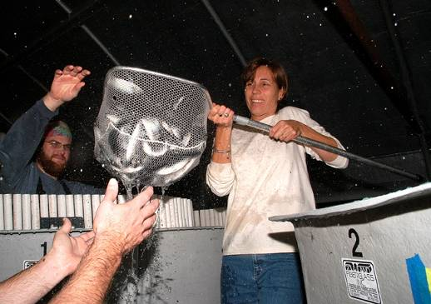
Research Director
Typical Education:
M.S. or Ph.D. Aquaculture or Marine Sciences
Job Duties:
Administration
Project and Budget Development
Project Start-ups
Proposals
Business Plans
Reports
Mentoring Graduate Students and Staff,
Field or Lab work

Slide 18
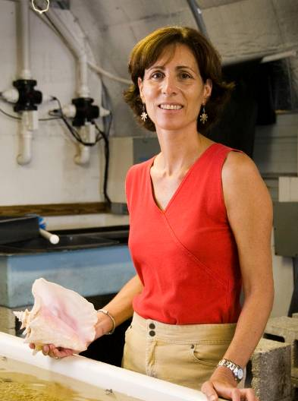
Research Director
What’s great about being in aquaculture research?
“I enjoy my job because it is a challenge and one day is never the same as the next day. The best part of my job is working with people to help make projects a success. I am involved with a lot of administration duties, but on occasion I get to go to the Caribbean to work with conservation and aquaculture of the queen conch.”
~ Dr. Megan Davis
Florida Atlantic University

Slide 19
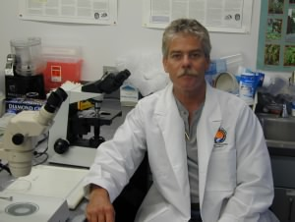
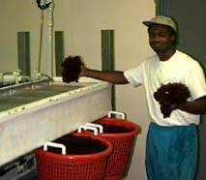
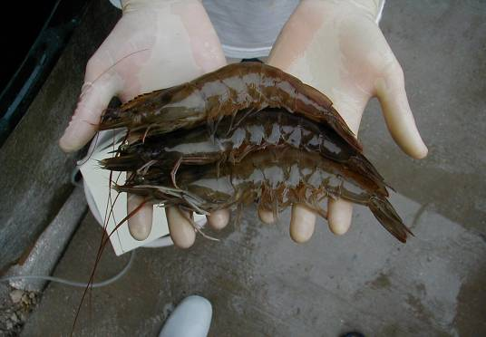
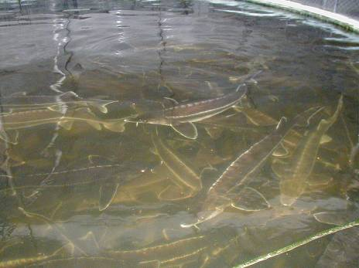
Aquaculture Researcher
Typical Education:
M.S. or Ph.D. Aquaculture or Marine Sciences
Job Duties:
Project design
Grant writing
Budget management
Data analysis
Scientific publications
Teaching/Training students
Research Areas:
  Genetics
  Disease/Health Mgt.
  Feed/Nutrition
  Reproduction
  Production techniques
  Larval rearing
  And more!

Slide 20
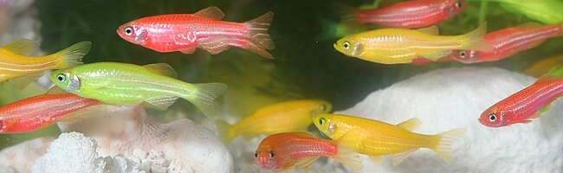
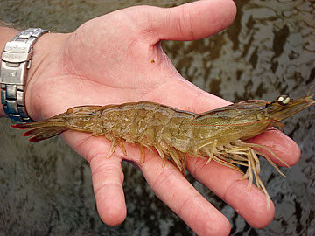
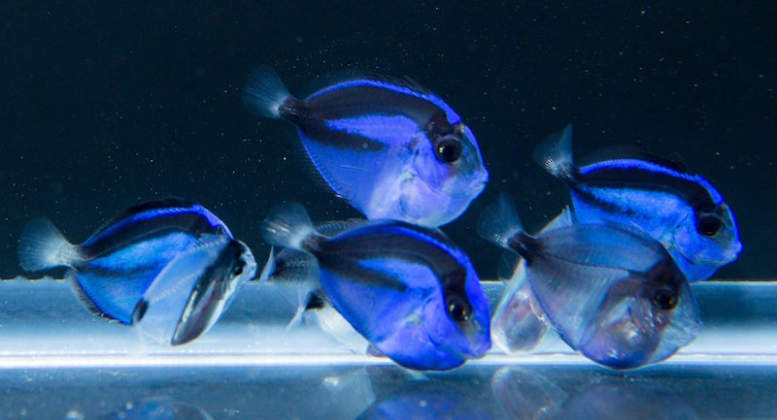
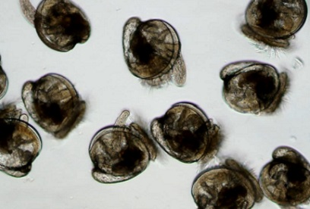
Research Examples
Developing glow-in-the-dark fish
Culturing disease-resistant shrimp
Photo Credit: Tyler Jones, UF-TAL
Producing blue tangs in captivity
Improving production of oyster larvae

Slide 21
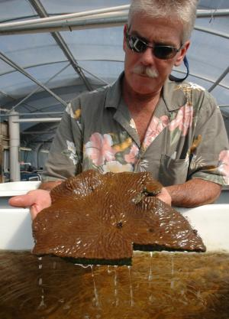
Aquaculture Researcher
What’s great about being in aquaculture research?
“I get to work with fish that I love, people that are fascinating, and solve problems. Working with a fish that no one has ever produced in a hatchery is extremely challenging and success is rewarding.”
~ Craig Watson
University of Florida
Tropical Aquaculture Laboratory

Slide 22
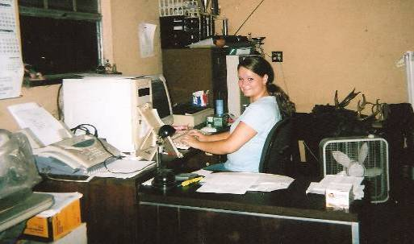
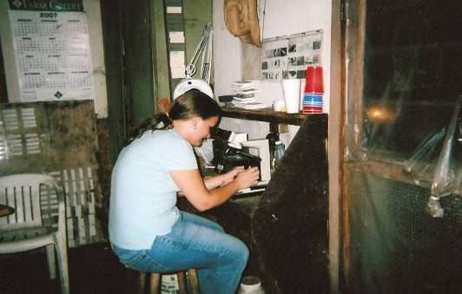
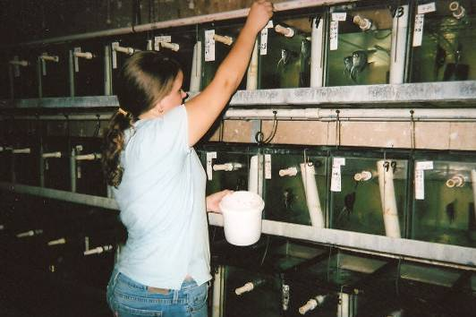
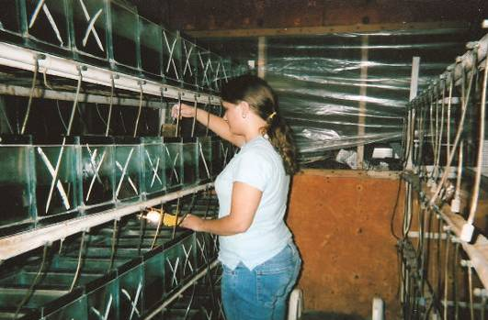
Commercial Farmer
Typical Education:
A.S., B.S. or M.S. in Aquaculture
and/or technical, on-job training
Job Duties:
Caring for fish
Water quality mgt.
Population mgt.
Facility maintenance
Biosecurity
Feeding
Harvesting
Health Assessments
Business mgt.
Marketing

Slide 23
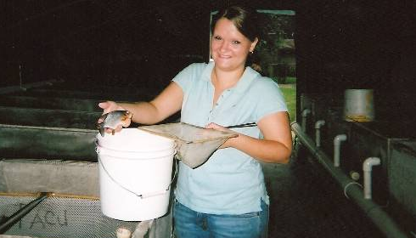
Commercial Farmer
Since the age of 7, this student has been helping with her family’s fish farm business. She enjoys working with the many varieties of fish and is happy that people will enjoy the tropical fish products the farm produces.

Slide 24
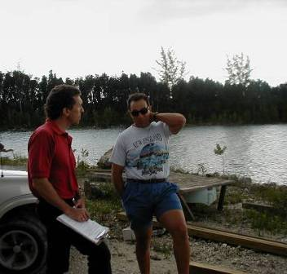
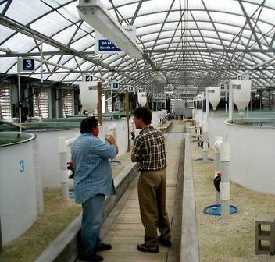
State Inspector
Typical Education:
B.S. in Aquaculture/Biology
Job Duties:
Promote the growth of aquaculture through education and outreach.
Inspect facilities to ensure compliance with Best Management Practices.

Slide 25



Extension Agent
Typical Education:
M.S. or Ph.D. in Aquaculture/Biology
Job Duties:
Aids current and future aquaculturists with all aspects of production
  Facility design
  Disease identification and treatment
  Organism reproduction
  Marketing and sales

Slide 26



Food Safety Inspector
Typical Education:
B.S. in Health and Human Services
Job Duties:
Ensure safe handling and processing of seafood and aquaculture products through inspections
Training for processors
DNA testing to verify labeling and selling of various aquatic products.

Slide 27



Law Enforcement
Fish and Wildlife or Agriculture
Typical Education:
B.S. in Biology
Game warden training
Job Duties:
Enforce fish and wildlife regulations including laws relating to harvest, possession, sale and transportation
Educate public
Patrol aquaculture submerged-land leases
Seize illegal products

Slide 28


Aquaculture Engineer
Typical Education:
B.S. or M.S. in Engineering
Experience in hydraulic, mechanical or civil engineering
Job Duties:
Designing aquaculture systems for commercial production and research facilities
Innovative design research
  Feeder systems
  Filtration systems
  Mechanical systems
  Harvest technologies
  Biotechnologies

Slide 29

Conclusion
Conclusion
Aquaculture is growing at a rapid pace, and a new generation of professionals are needed to promote the industry and meet the global demand for seafood.
The Aquaculture industry supports a wide-range of skill sets and expertise
Commercial
Farmer
Director
Extension Agent
Biotechnology
Researcher
Law Enforcement
Aquaculture
State Inspector
Educator
Marketing
Veterinarian or
Epidemiologist
Food Safety
Hatchery Manager
Engineering
Aquarium Curator
Notes:
Ask people to define aquaculture
Ask people what they think of when they think of aquaculture

Slide 30
Conclusion
Conclusion
For questions about this presentation or aquaculture in Florida please contact the Division at:
Tallahassee Office: (850) 617-7600
Bartow Office: (863) 578-1870
Email: aquaculture_web@FreshFromFlorida.com
Website: FreshFromFlorida.com

