Slide 1
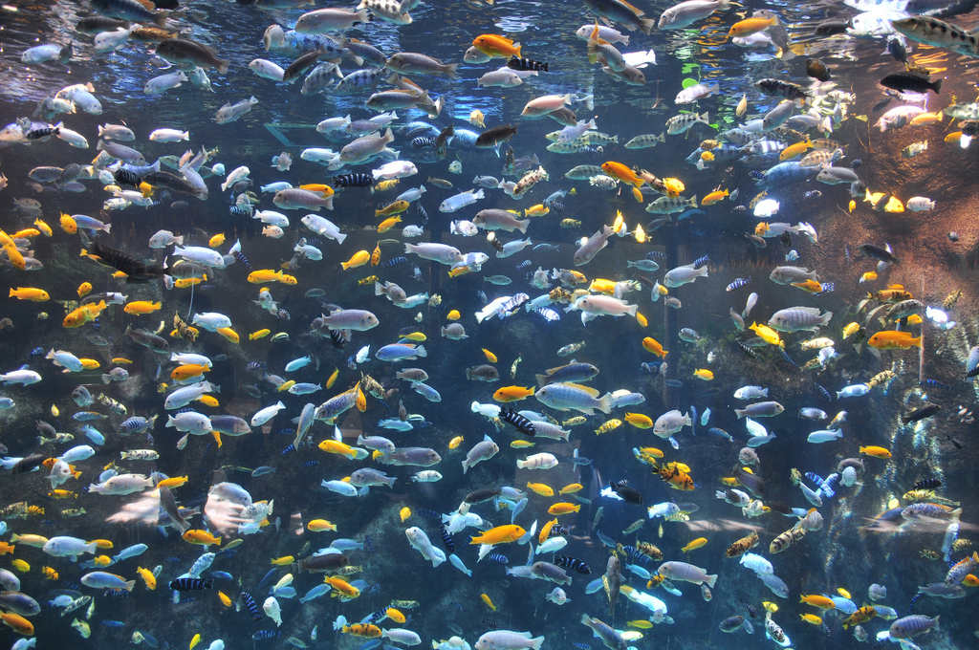
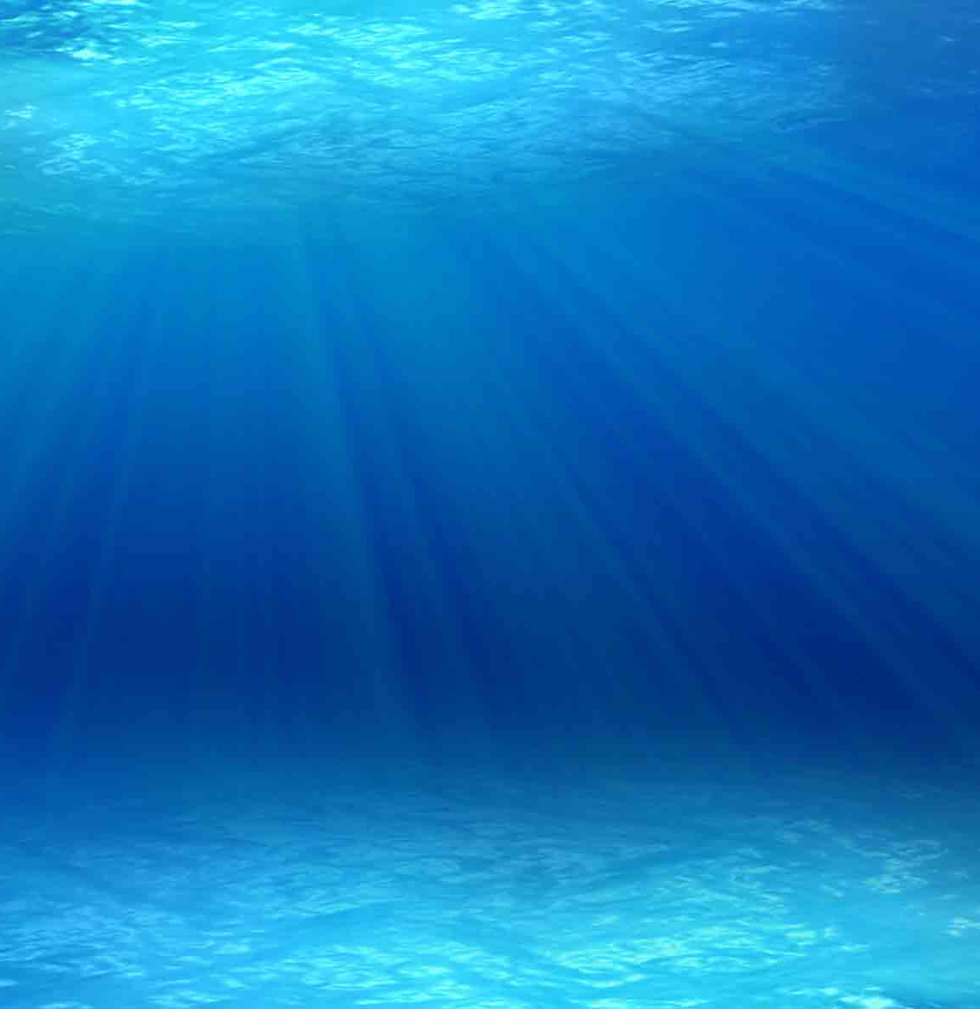

Aquaculture in the Classroom
Produced by the Division of Aquaculture - 2019

Slide 2
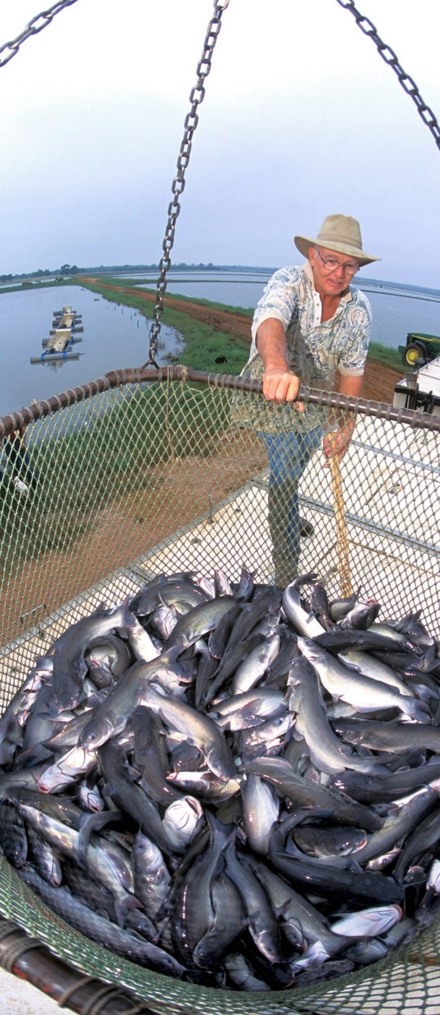
Overview
  Aquaculture 101
  Why is aquaculture needed?
  Overview of Florida's Industry
  Aquaculture in the Classroom
  Educator Resources
Photo: USDA, Stephen Ausmus

Slide 3
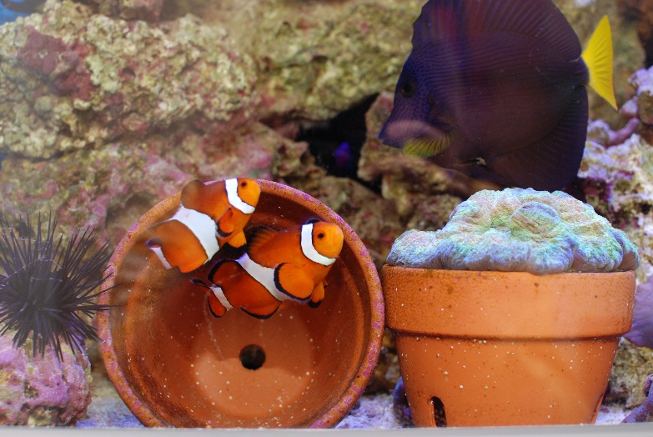
What is aquaculture?
“Fish Farming”
“Production of aquatic organisms”
Aquaculture products sold for:
  Food
  Ornamentals
  Misc.
    Medical research
    Biofuels
    Clothing (alligators)
  Conservation and
  recreational fisheries management
    Restoring depleted species
    Supplemental stocking to increase populations

Slide 4
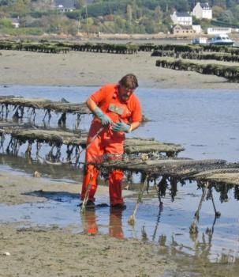
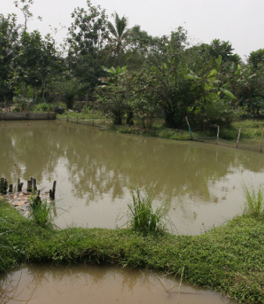
Main Categories of Aquaculture
Extensive
  Little control over system
  Little technology
  Ancient origins
  Limited by environment / food
  Examples: oysters, tilapia

Slide 5
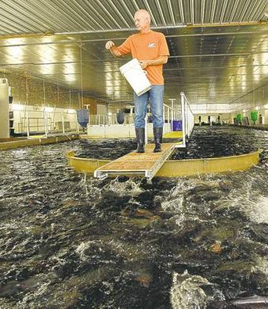
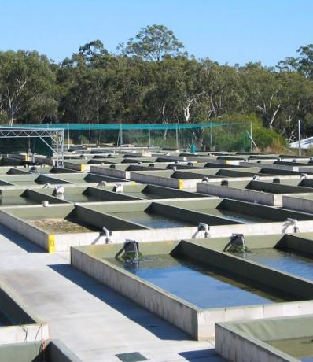
Main Categories of Aquaculture
Intensive
  Highly controlled systems
    Produce large quantities in a small area
    Very efficient production method
  Limited by density and water quality
  Examples: tilapia, shrimp

Slide 6
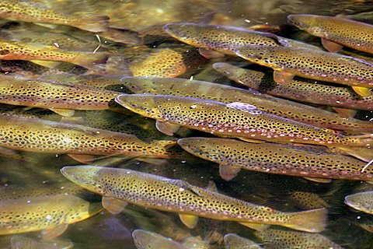
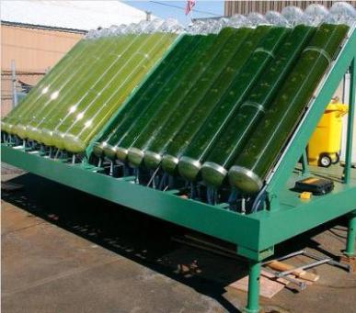
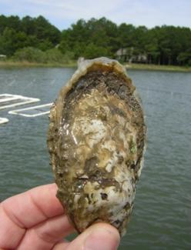
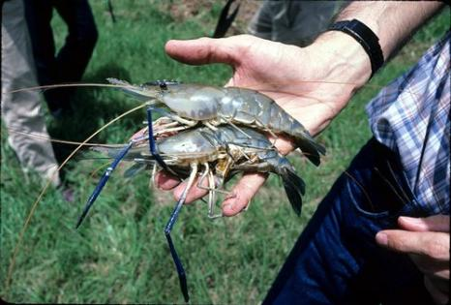
Product Types
Fish (catfish, salmon, tilapia)
Crustaceans (shrimp, crayfish)
Shellfish (oysters, clams)
Plants (seaweed, mangrove)
Algae (food and biofuels)
Misc. (Coral, live rock, bait fish, alligators)
rainbow trout
oyster
freshwater prawns
Auburn University
algae

Slide 7
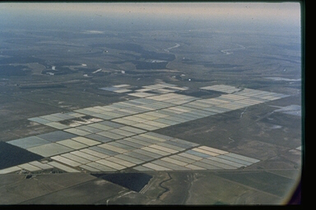
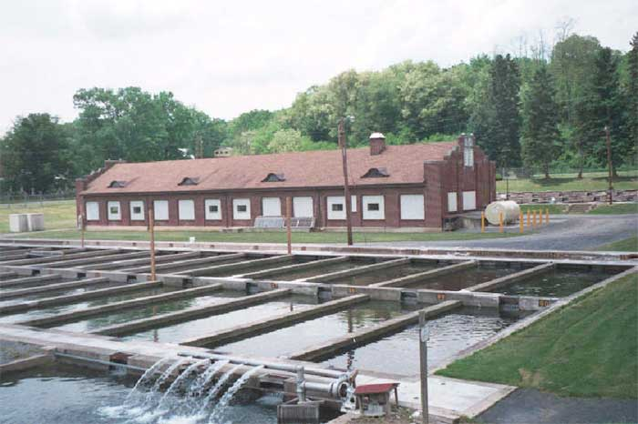
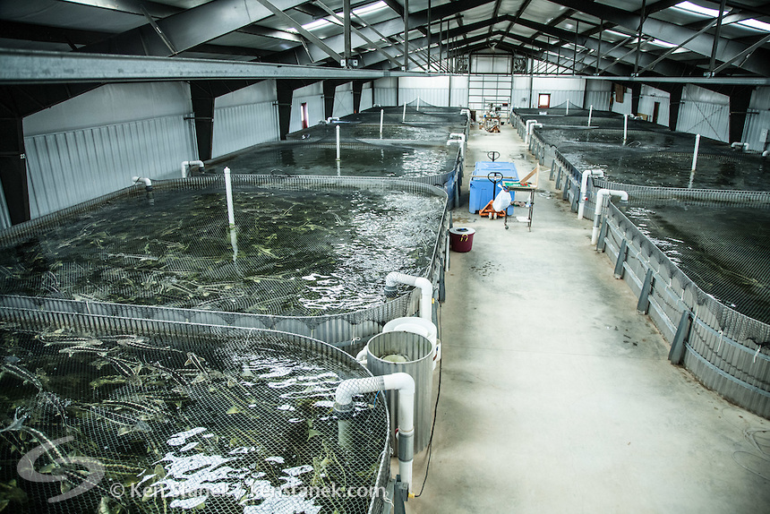
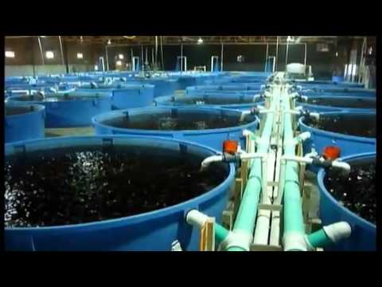
Productio units
POND
RACEWAY
TANK

Slide 8
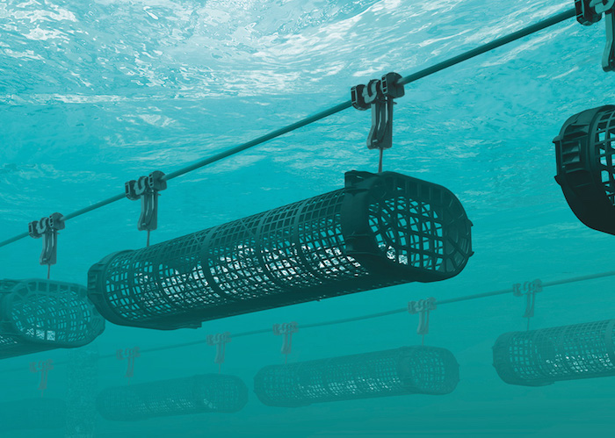
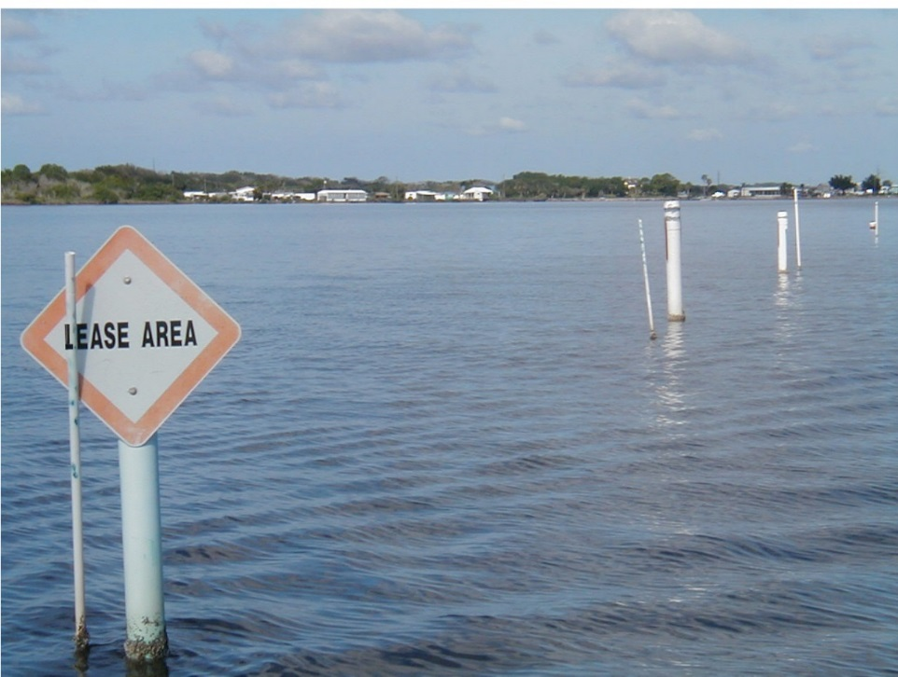
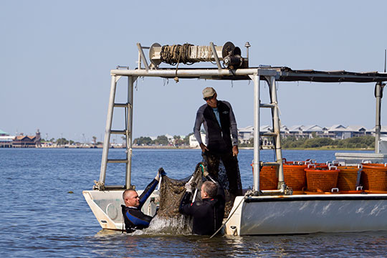
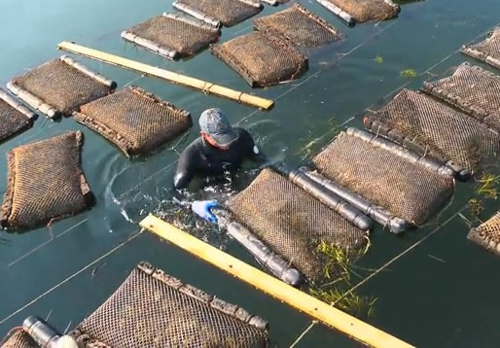
SHELLFISH AQUACULTURE IN OPEN WATER
PON
Shellfish Aquaculture in Open Water

Slide 9
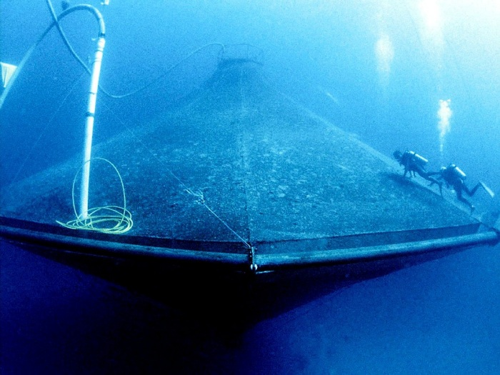
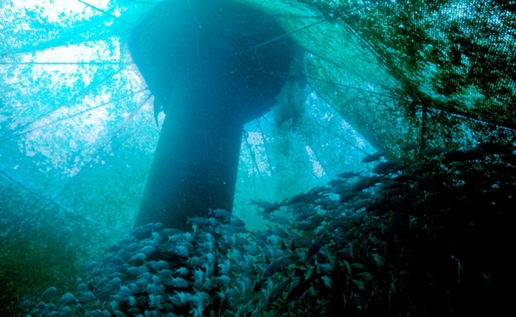
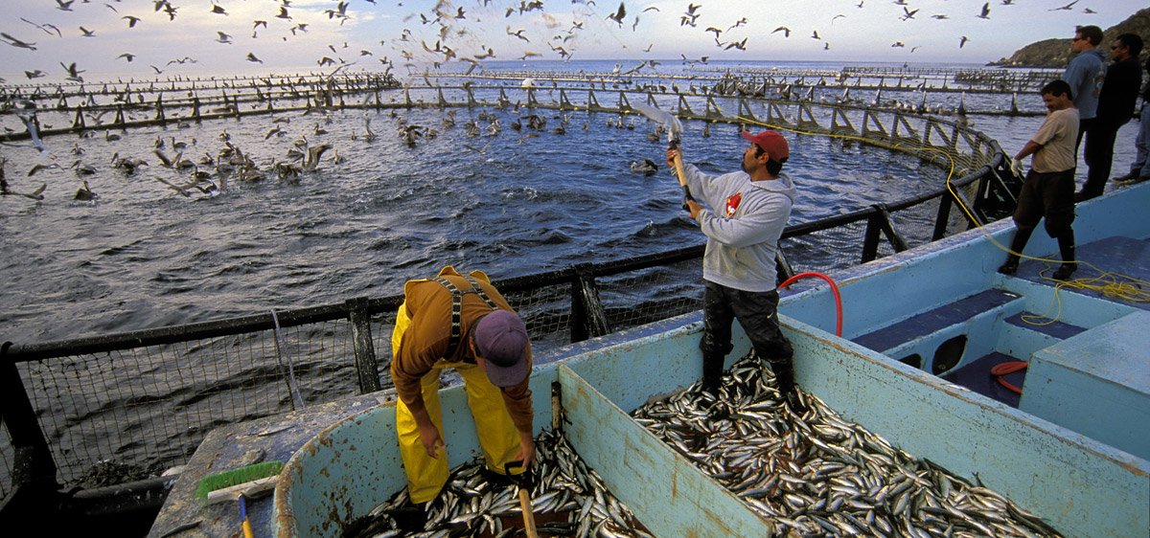
Offshore cage culture
Offshore Cage Culture

Slide 10
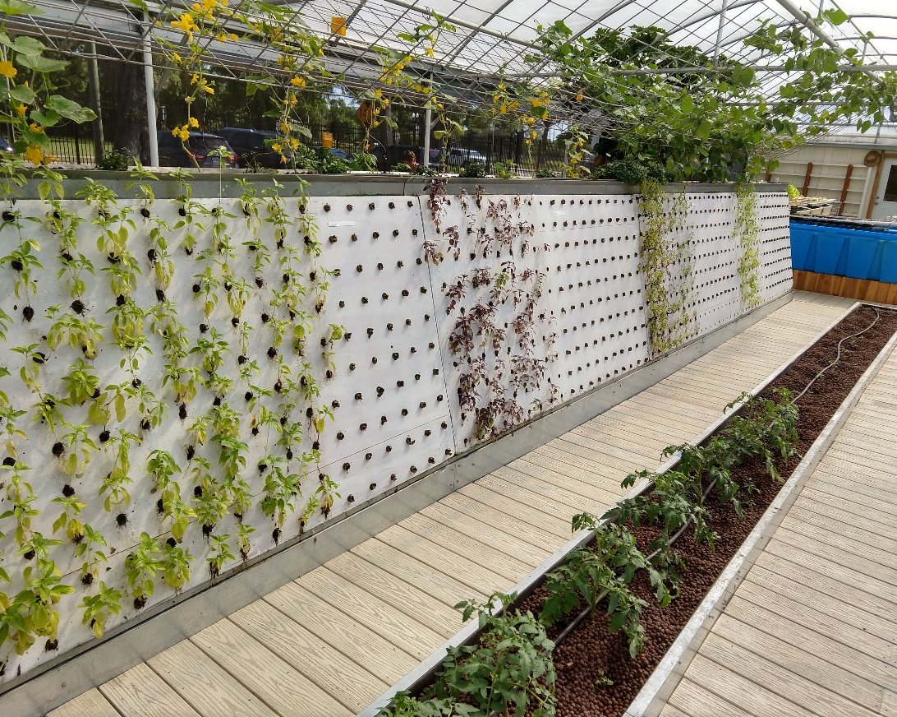
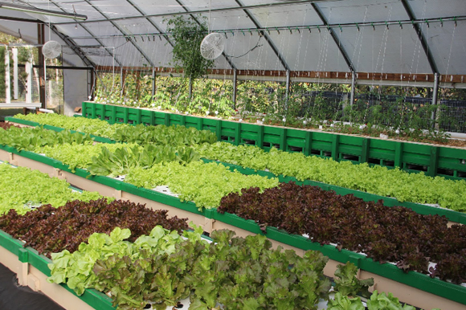
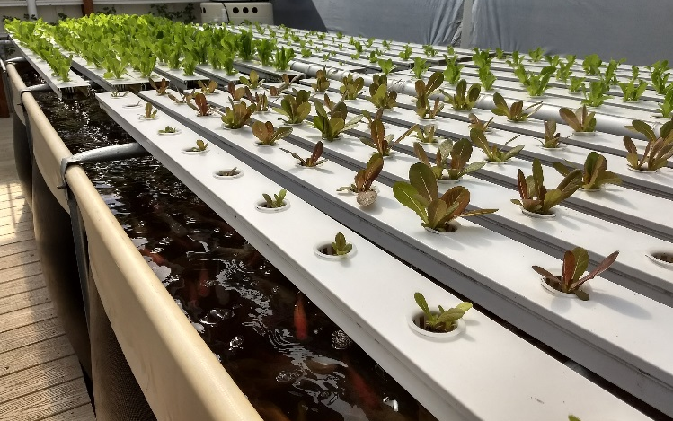
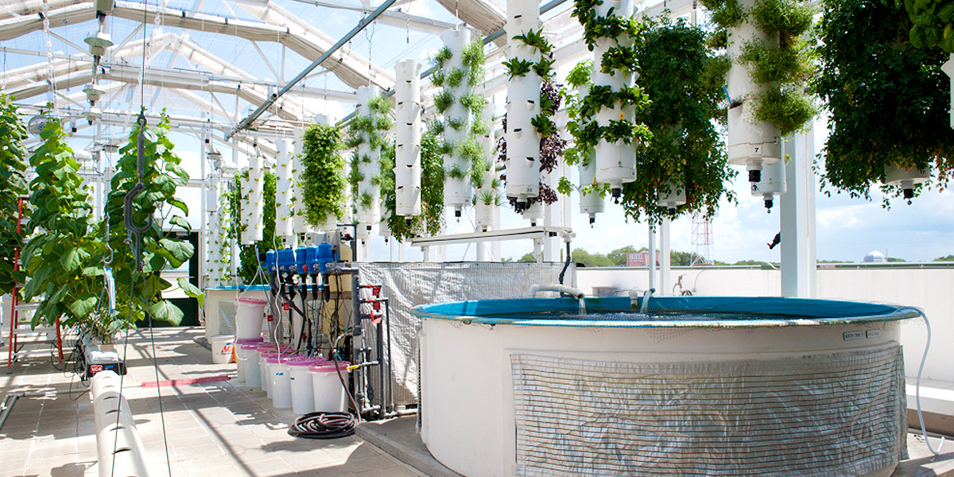
Aquaponics
Aquaponics

Slide 11
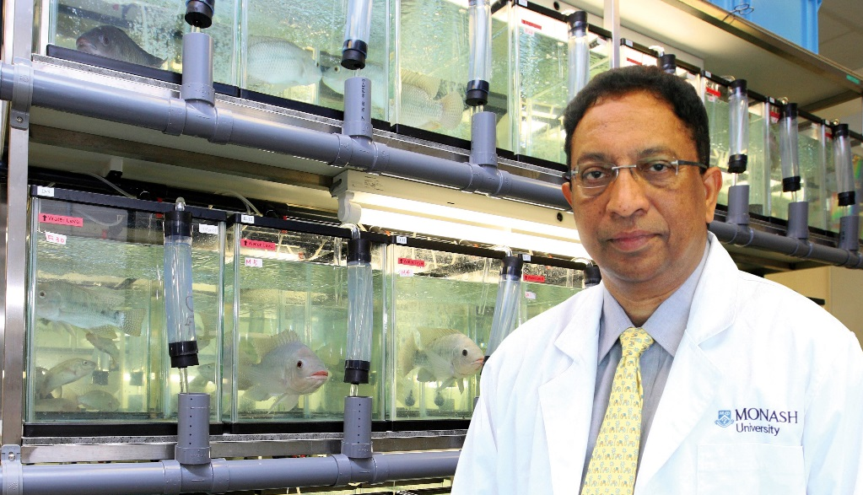
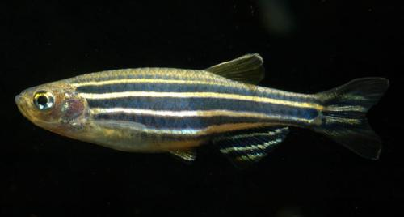
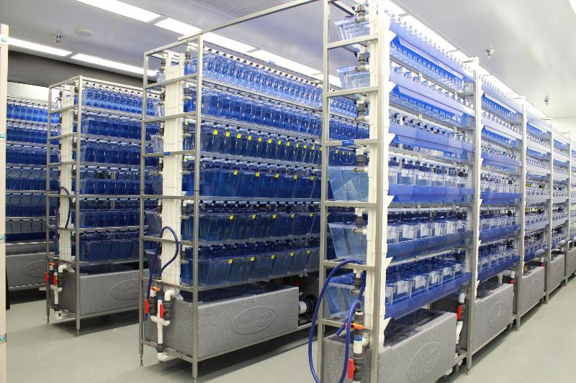
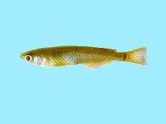
Medical Research
Medical Research

Slide 12
Neat! But why is aquaculture needed?
Increasing human population needs more and more protein.
Wild fisheries harvest is maximized.
Increasing demand for seafood (health benefits).
Environmental sustainability: fish vs. land animals.
Conservation of wild animals.
Fisheries enhancement (state fish hatcheries).

Slide 13
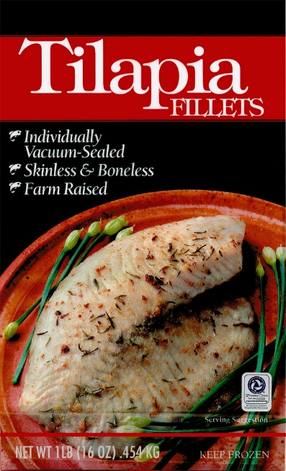
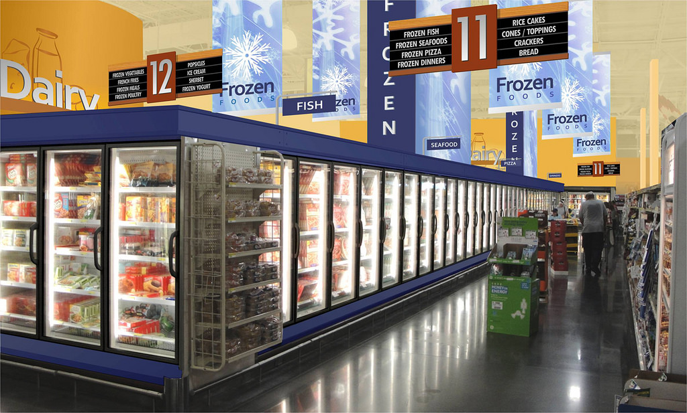
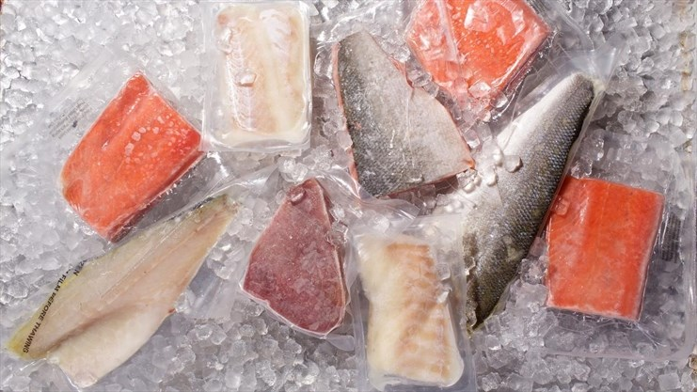
Where do food fish come from?
If you said the grocery store, you are not alone!
Many people forget that their food has a history before arriving in a neat frozen package at your local store.

Slide 14
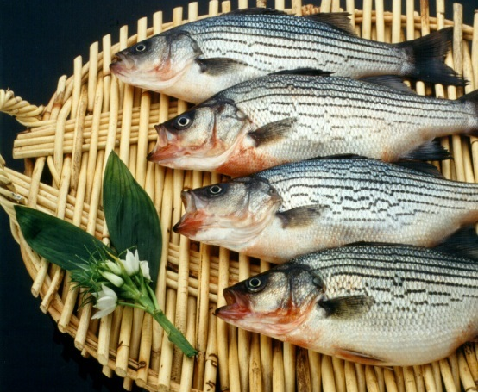
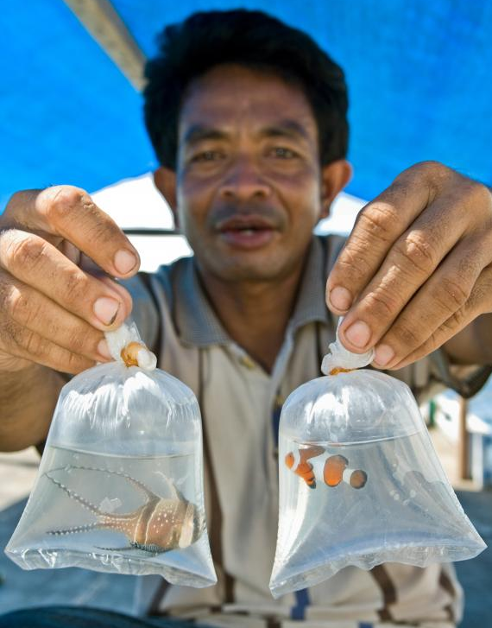
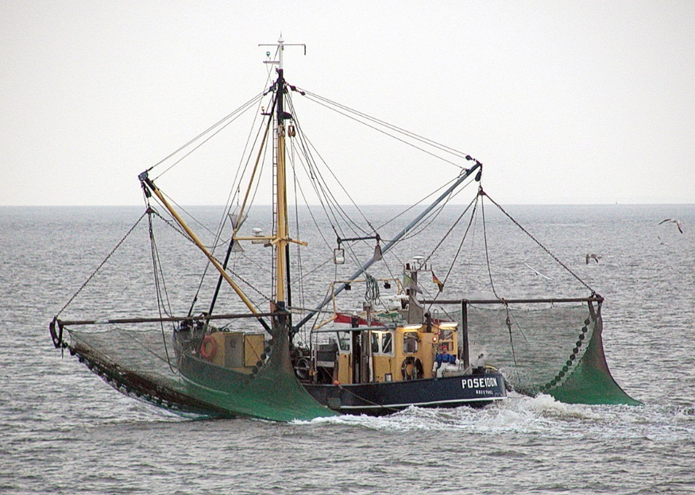
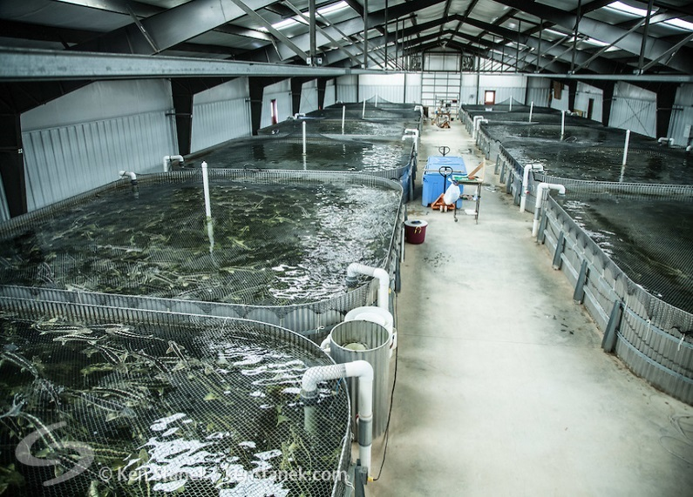
Wild capture from:
Oceans
Lakes
Rivers
Aquaculture Farms in:
Ponds
Tanks
Pens
No matter where you are in the world, aquatic animals are either captured from the wild or produced at an aquaculture farm.

Slide 15
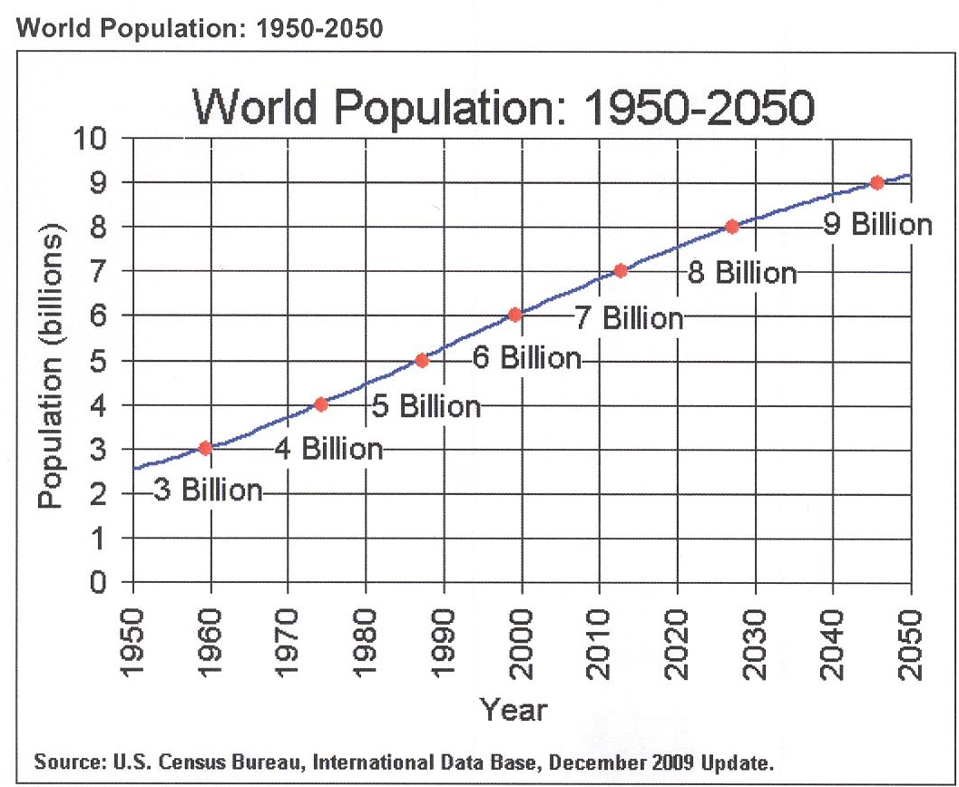
Global population growth
~170 million metric tons produced per year
~500 million metric tons protein per year required to met demand

Slide 16
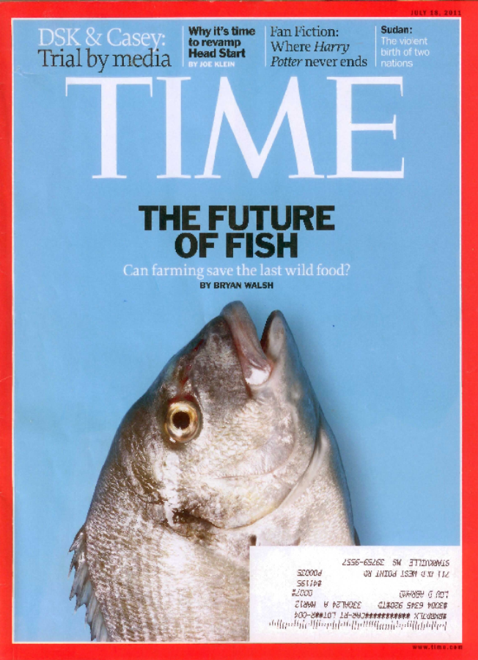
Global Population Growth
Wild fisheries yield: maximized
Fish are the last wild food - We don’t hunt cows!
Global consumption of fish is greater than what the oceans can provide.
Notes:
The U.S. Census Bureau predicts that the world’s population will reach over 9 billion people by the year 2050. We would need 5 x 10^8 metric tons of lean protein per year to provide the world’s population their daily recommended amount of protein (ca. 1 x 10^8 more than today). Needless to say, that number is a bit troubling. We already know that few places on the planet are actually capable of consuming the USDA recommended levels of protein. If we want to feed the world, we have a long road ahead.
16

Slide 17
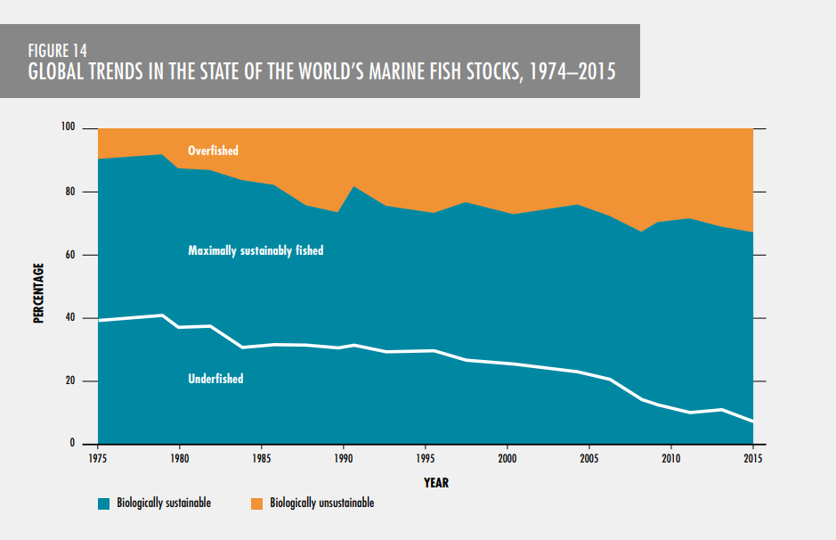
Global Population Growth
Current status of global fisheries
90% of wild fisheries are now at maximum harvest rate or greater
Figure from: FAO 2016
Notes:
The U.S. Census Bureau predicts that the world’s population will reach over 9 billion people by the year 2050. We would need 5 x 10^8 metric tons of lean protein per year to provide the world’s population their daily recommended amount of protein (ca. 1 x 10^8 more than today). Needless to say, that number is a bit troubling. We already know that few places on the planet are actually capable of consuming the USDA recommended levels of protein. If we want to feed the world, we have a long road ahead.
17

Slide 18
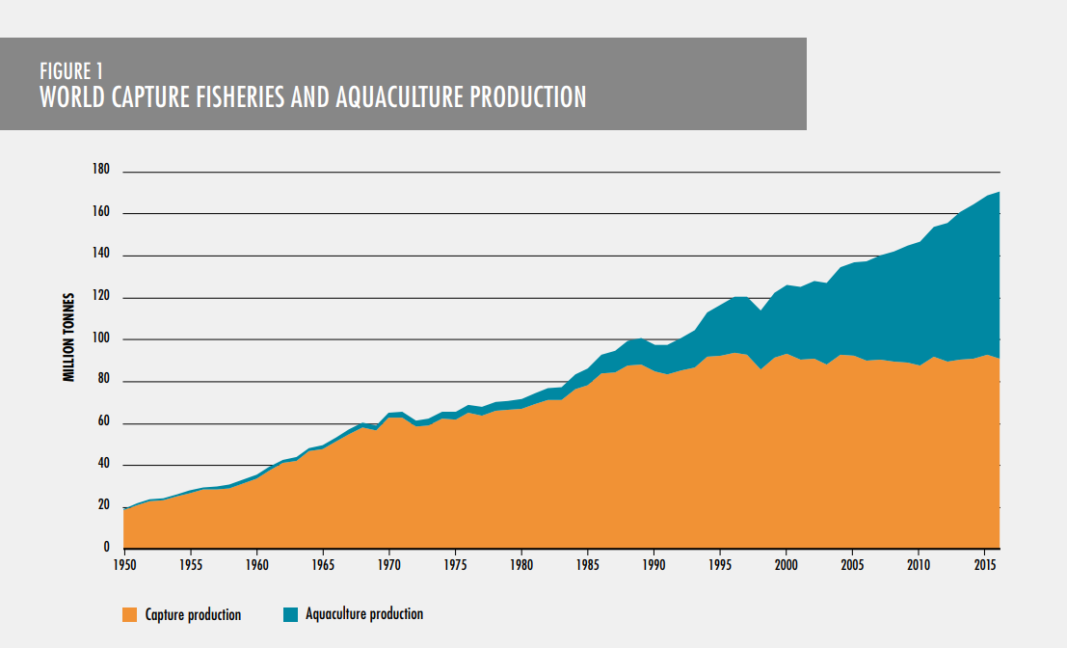
Global Population Growth
Aquaculture is rapidly growing to meet the seafood supply shortage and feed a growing population.
Aquaculture now represents 52% of global production.
In 1950, 97% of fish were caught from the ocean.
Wild harvest has not increased for 30 years.
Figure from: FAO 2016
Notes:
The U.S. Census Bureau predicts that the world’s population will reach over 9 billion people by the year 2050. We would need 5 x 10^8 metric tons of lean protein per year to provide the world’s population their daily recommended amount of protein (ca. 1 x 10^8 more than today). Needless to say, that number is a bit troubling. We already know that few places on the planet are actually capable of consuming the USDA recommended levels of protein. If we want to feed the world, we have a long road ahead.
18

Slide 19
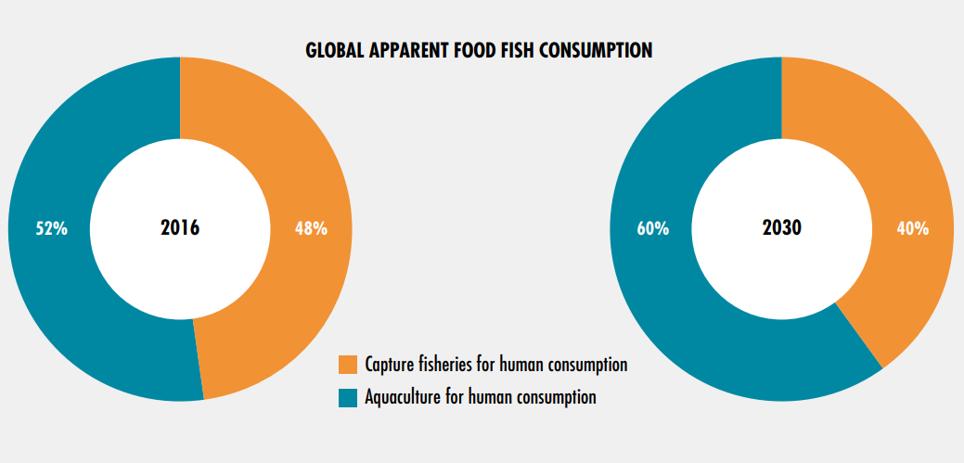
Global Population Growth
Figure from: FAO 2016
Aquaculture will continue to increase production and market share throughout the 21st century.
Notes:
The U.S. Census Bureau predicts that the world’s population will reach over 9 billion people by the year 2050. We would need 5 x 10^8 metric tons of lean protein per year to provide the world’s population their daily recommended amount of protein (ca. 1 x 10^8 more than today). Needless to say, that number is a bit troubling. We already know that few places on the planet are actually capable of consuming the USDA recommended levels of protein. If we want to feed the world, we have a long road ahead.
19

Slide 20
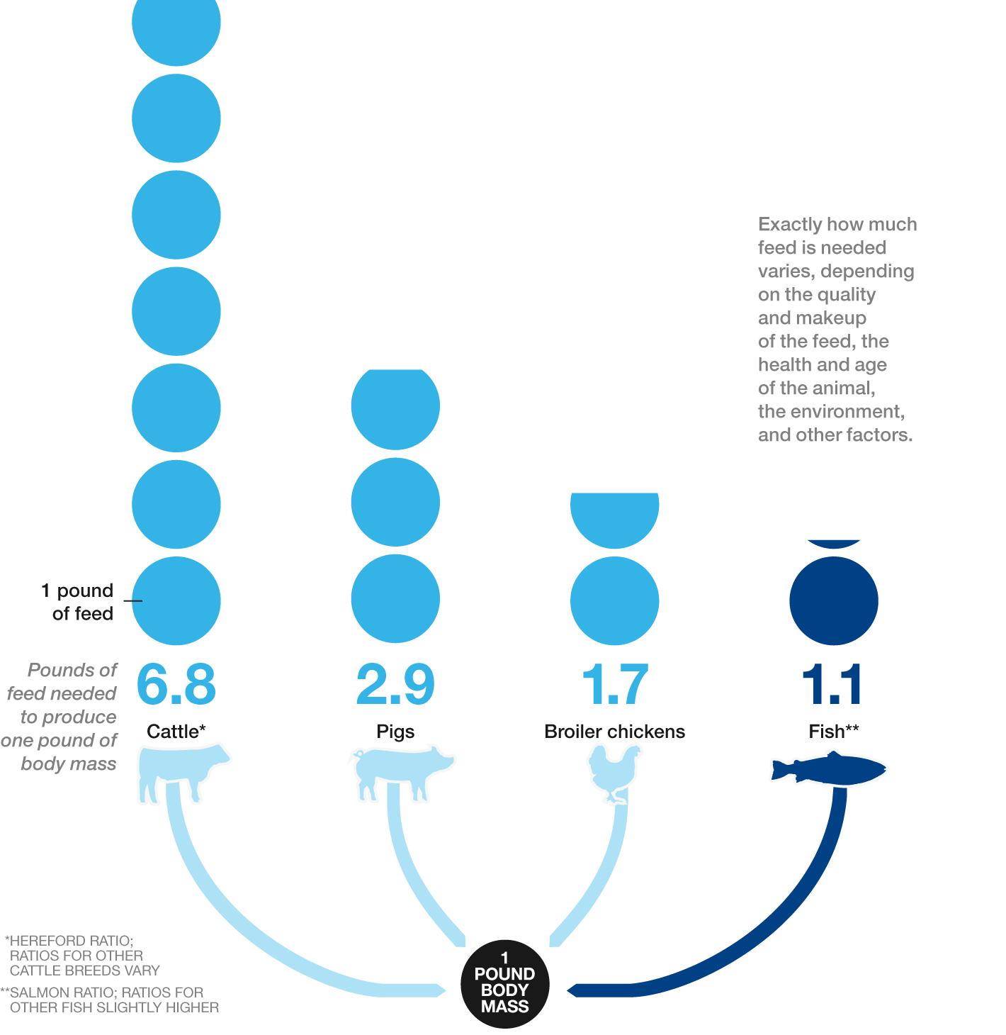
Global Population Growth
Aquaculture is the most sustainable and efficient form of animal protein production on earth.
A single ¼ lb. hamburger requires 616 gallons of freshwater to produce.
A ¼ lb. of pond raised catfish requires ~36 gallons of freshwater to produce.
~7 lb. of feed produces 1 lb. meat.
1.1 lb. of feed produces
1 lb. meat.
Figure Credit: Malcolm Beveridge, WorldFish.
Notes:
The U.S. Census Bureau predicts that the world’s population will reach over 9 billion people by the year 2050. We would need 5 x 10^8 metric tons of lean protein per year to provide the world’s population their daily recommended amount of protein (ca. 1 x 10^8 more than today). Needless to say, that number is a bit troubling. We already know that few places on the planet are actually capable of consuming the USDA recommended levels of protein. If we want to feed the world, we have a long road ahead.
20

Slide 21
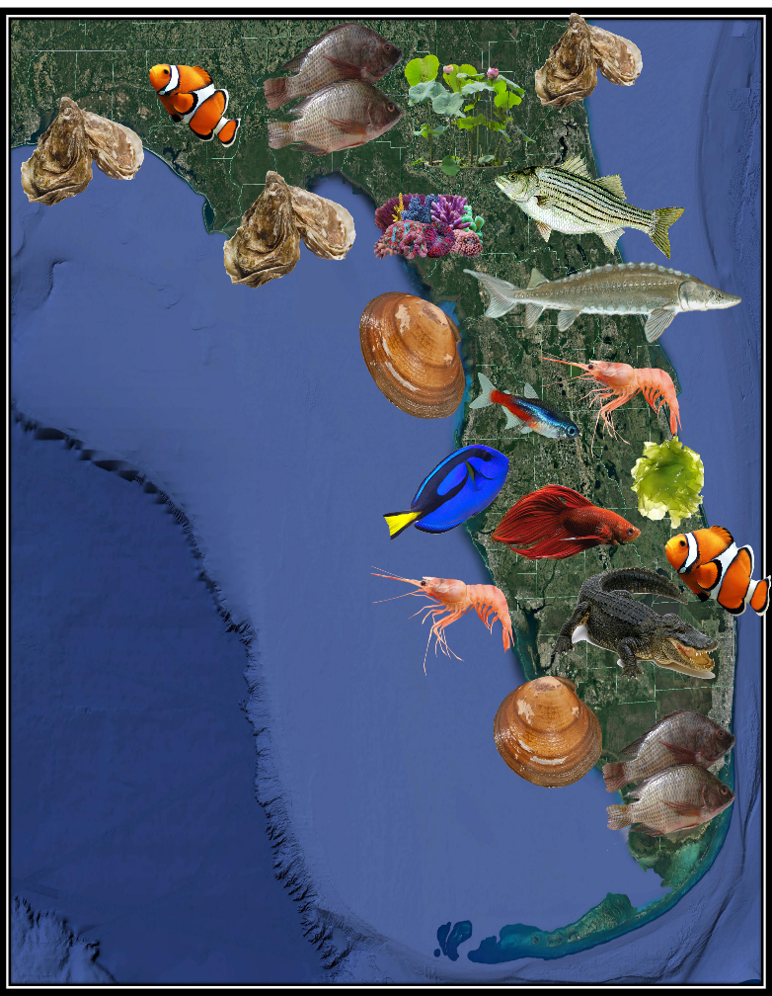
Florida’s Aquaculture Industry
2013 sales: $77.9 million
~1000 Aquaculture Certificates of Registration
~800 species in production
Products with the highest value of sales.
      Ornamental fish (#1 in the nation)
      Shellfish (#4 in the nation)
      Alligator (#2 in the nation)
      Aquatic plants (#1 in the nation)

Slide 22
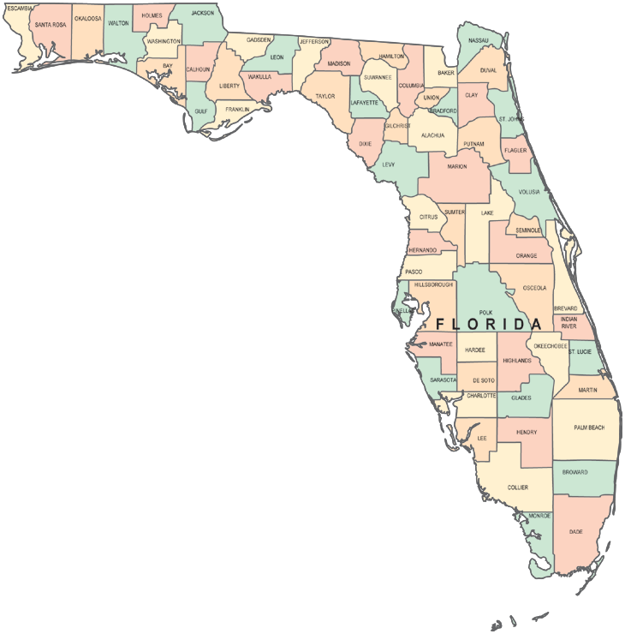
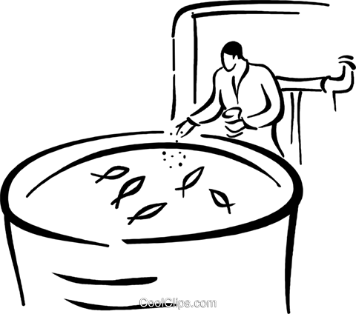

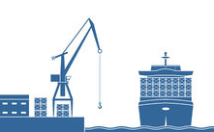
Florida’s Aquaculture Industry
Florida is by far the biggest ornamental producer in the nation!
127 farms in Florida (2013) – 45% of U.S. industry!
2013 sales in Florida = $ 27 million
95% of ornamentals produced in U.S. come from Florida
  Over 800 varieties of freshwater fish produced
Why Florida?
Warm climate ideal for tropical fish
Proximity to seaports and airports
Most farms are in Hillsborough, Polk and Dade counties

Slide 23
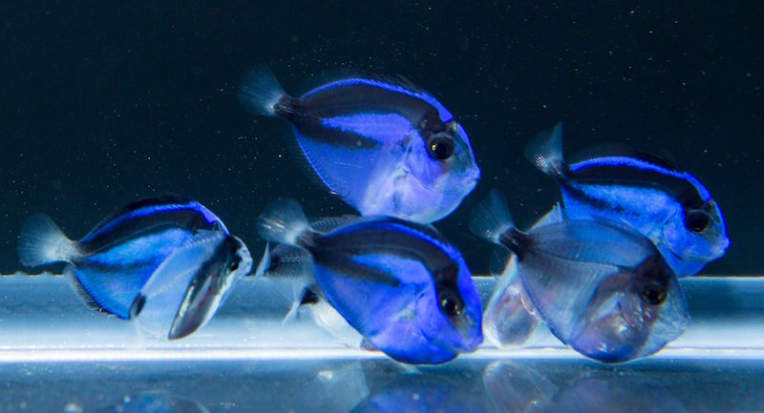
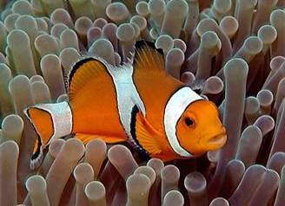


Florida Aquaculture has the greatest product diversity in the nation!
Ornamental fish

Slide 24




Florida Aquaculture has the greatest product diversity in the nation!
Ornamental fish
Food fish

Slide 25



Florida Aquaculture has the greatest product diversity in the nation!
Ornamental fish
Food fish
Shellfish

Slide 26



Florida Aquaculture has the greatest product diversity in the nation!
Ornamental fish
Food fish
Shellfish
Reptiles

Slide 27




Florida Aquaculture has the greatest product diversity in the nation!
Ornamental fish
Food fish
Shellfish
Reptiles
Aquatic Plants

Slide 28


Florida Farm Types - Ponds

Slide 29




Florida Farm Types – Recirculating Systems

Slide 30



Florida Farm Types – Shellfish

Slide 31

Shellfish Aquaculture - Benefits
As wild shellfish resources decline, interest in shellfish aquaculture has risen dramatically.
Shellfish Farms:
  Improve coastal water quality.
  Provide habitat to a variety of marine organisms.
  Provide ecosystem services (upland nutrient pollution mitigation).
  Enhance the economies and resilience of coastal communities.
~550 million gallons of seawater are filtered each day in Florida by aquacultured clams!
    Annual clam harvest removes 25,000 lb. of nitrogen and 760,000 lb. of carbon, a value of $99,680!
From: Baker et al. 2015

Slide 32


Aquaculture Education
“Aquaculture is growing at a rapid pace, and aquaculture education plays a key role in the future of food production globally.”
  Basic awareness of aquaculture is a critical need in K-12 classrooms.
  There is an increasing demand for skilled aquaculture professionals in the U.S. and globally.
  Education plays a vital role in preparing young adults for the innovations of tomorrow.

Slide 33






Why have a school aquaculture program?
Academic opportunities – many subjects!
  Aquaculture is highly diversified
  Offers a multitude educational opportunities for all ages.
  Fulfills many sunshine state education standards.
chemistry
biology
agriculture
business economics

Slide 34


Why have a school aquaculture program?
  National studies indicate that high school are lagging in biotechnology education.
  Students are engaged by hands-on lessons and training.
  Develops a sense of ownership and responsibility
  Community involvement
  Reinforces science and math, but also business management and marketing.
  “I hear and I forget. I see and I remember. I do and I understand.”

Slide 35





Steps to starting an aquaculture program…..
How does aquaculture fit into our school?
  Agriculture and science programs.
  FFA or other activity clubs
  Collaborate with multiple teachers.
  Aquaculture utilized for a variety of classes/subject fields.
Identify project partners within and beyond your school
  Other teachers or schools in the district.
  Non-profits and industry associations.
  Businesses (working farms and zoos/aquariums )
  Public agencies

Slide 36


Steps to starting an aquaculture program…..
Seek funding
  Aquaculture is often covered by science, vocational, FFA, STEM or other existing program budgets
  School fundraisers
  Donations
  Aquaculture product sales
  Grants!
Photo credit: Brandon Rutherford, CORAL Magazine, Reef2Rainforest.com
Numerous teachers fund their aquaculture programs through clownfish sales!

Slide 37


Steps to starting an aquaculture program…..
Start small!
  Large aquaculture systems can take a lot of time and resources
  Learn while you build.
  Dozens of teaching opportunities can come from a single tank!

Slide 38

Basic Aquaculture Overview
Even if you don’t want to start an aquaculture farm…
  Consider covering aquaculture in your standard curriculum.
  Informed students make informed consumers!
  Aquaculture is a powerful tool for conserving our oceans.
  Many resources are already produced and available for free through FDACS and other Florida partners.

Slide 39


FDACS’ Educator Resources
The new webpage is a one-stop-shop for resource links and information on teaching aquaculture
  Lesson plans, presentations and tests
  Videos and software
  Activity and coloring books
  Field trip opportunities
  Funding resources guide
  Technical assistance contacts
  School success stories
www.FDACS.gov/Education/Aquaculture-Educator-Resources

Slide 40



Florida Aquaculture Overview Presentations
Easy to follow aquaculture industry overview presentations.
Build for 6th-12th grade, but can be easily adapted to younger students.
Presentation Topics:
  Aquaculture in the Classroom
  Introduction to Aquaculture
  Careers in Aquaculture
  Florida Aquaculture: Food Fish
  Florida Aquaculture: Ornamental Fish
  Fish Florida Aquaculture: Reptiles
  Florida Aquaculture: Marine Bivalves

Slide 41


Resources from UF/IFAS
Teach Aquaculture
  Curriculum built by teachers for teachers.
    Activities
    Lesson plans
    Quizzes/Exams etc.
S.A.L.T. Sessions from CKHS
  Presentations
  Video series with farmers and researchers.

Slide 42


Florida Aquaculture Association Certification Program
The FAA offers a full technical training certification program!
  Approved FDOE Career and Technical Education Program for Agriculture.
    Schools receive funding for each certificate granted.
  Full curriculum, lesson plans, and final certification exam available.
  Prepares high school students a career in aquaculture.
FLAA.org/
Photo: Florida Sea Grant

Slide 43








FDACS has lots of agriculture education resources available!
Contact us, if you’d like us to send them to your school.

Slide 44
Contact Information
For questions about this presentation or aquaculture in Florida, please contact the Division at:
Tallahassee Office: (850) 617-7600
Bartow Office: (863) 578-1870
Email: Aquaculture_Web@FDACS.gov
Website: www.FDACS.gov
FDACS – P-02098 Rev. 8/20

