Slide 1
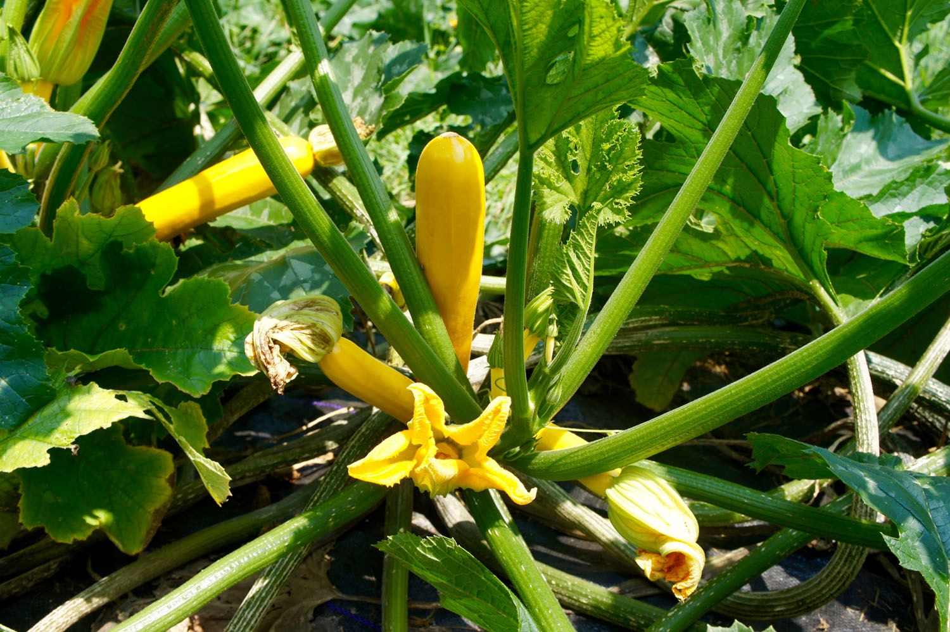
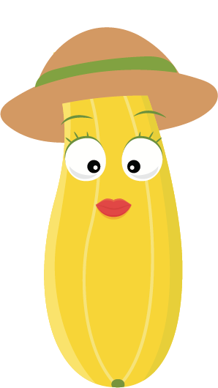
What we are learning today
Hello! I’m Yasmin
the Yellow Squash!
Together we’ll
take a journey and
learn all about
yellow squash
in Florida!

Slide 2
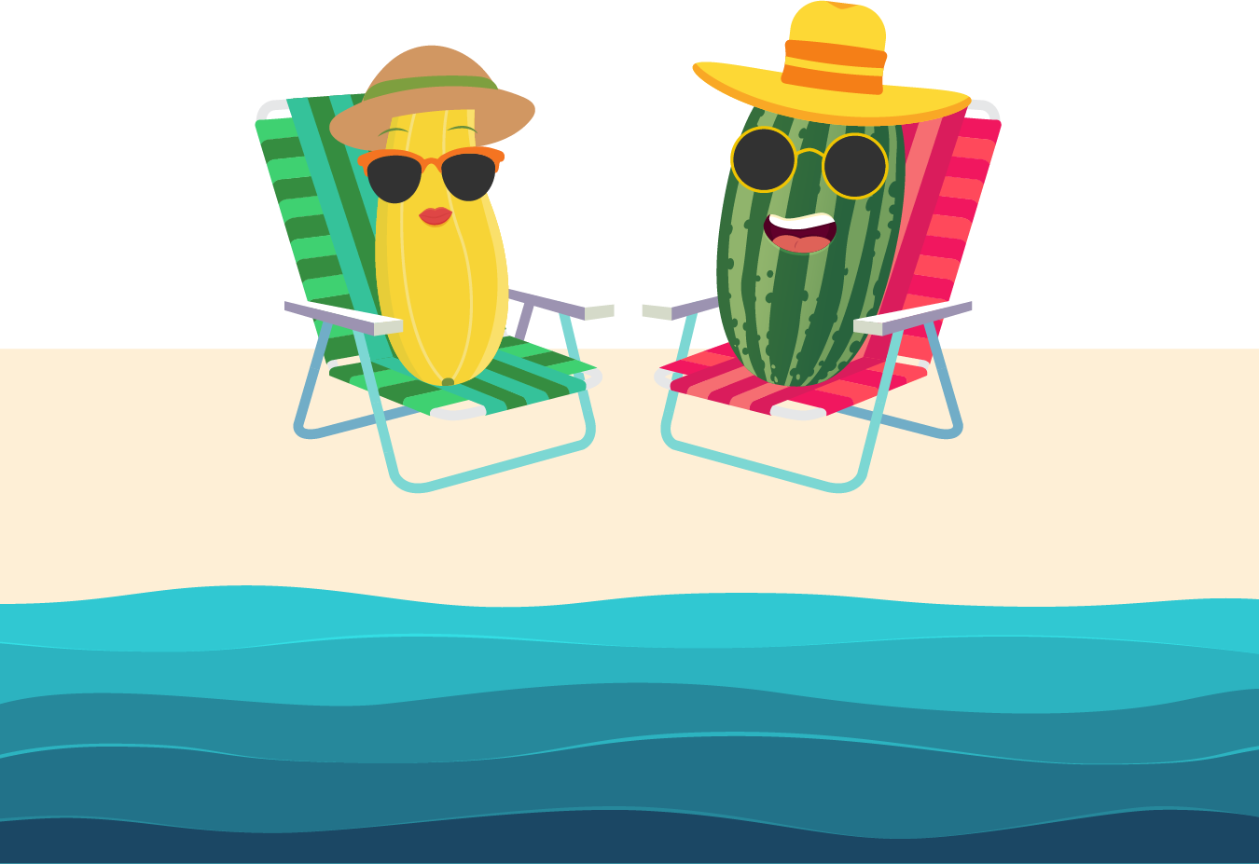
FUN FACTS
Yellow squash is
also known as a
summer squash.
Squash belong to the same family as melons and cucumbers.
Eat yellow squash with the skin on! It is packed with vitamin C.
Summer squash is picked by hand.

Slide 3

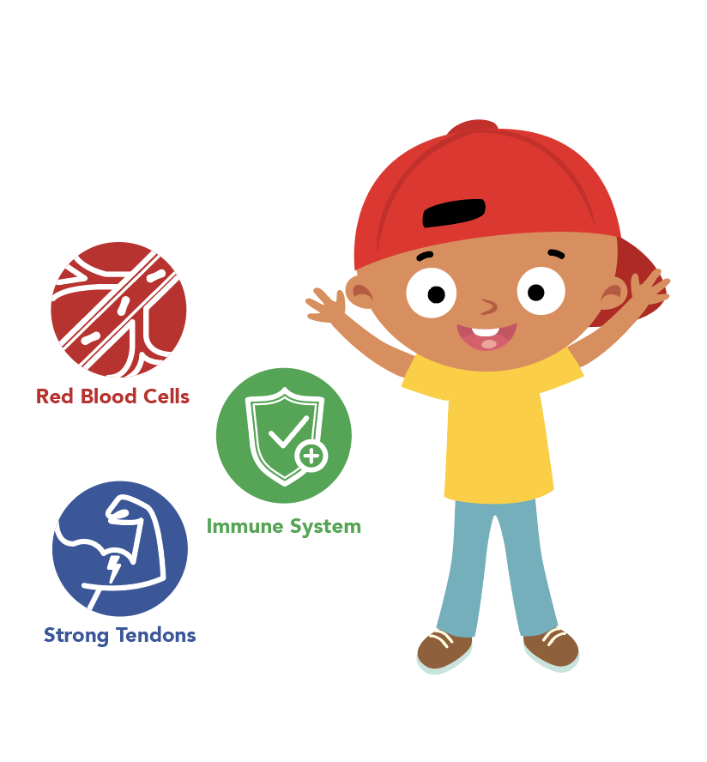
NUTRITION NUGGET
Squash is a good source of potassium, which helps to
control blood pressure.
Potassium's primary functions in the body include regulating fluid balance and controlling the electrical activity of the heart and
other muscles.

Slide 4
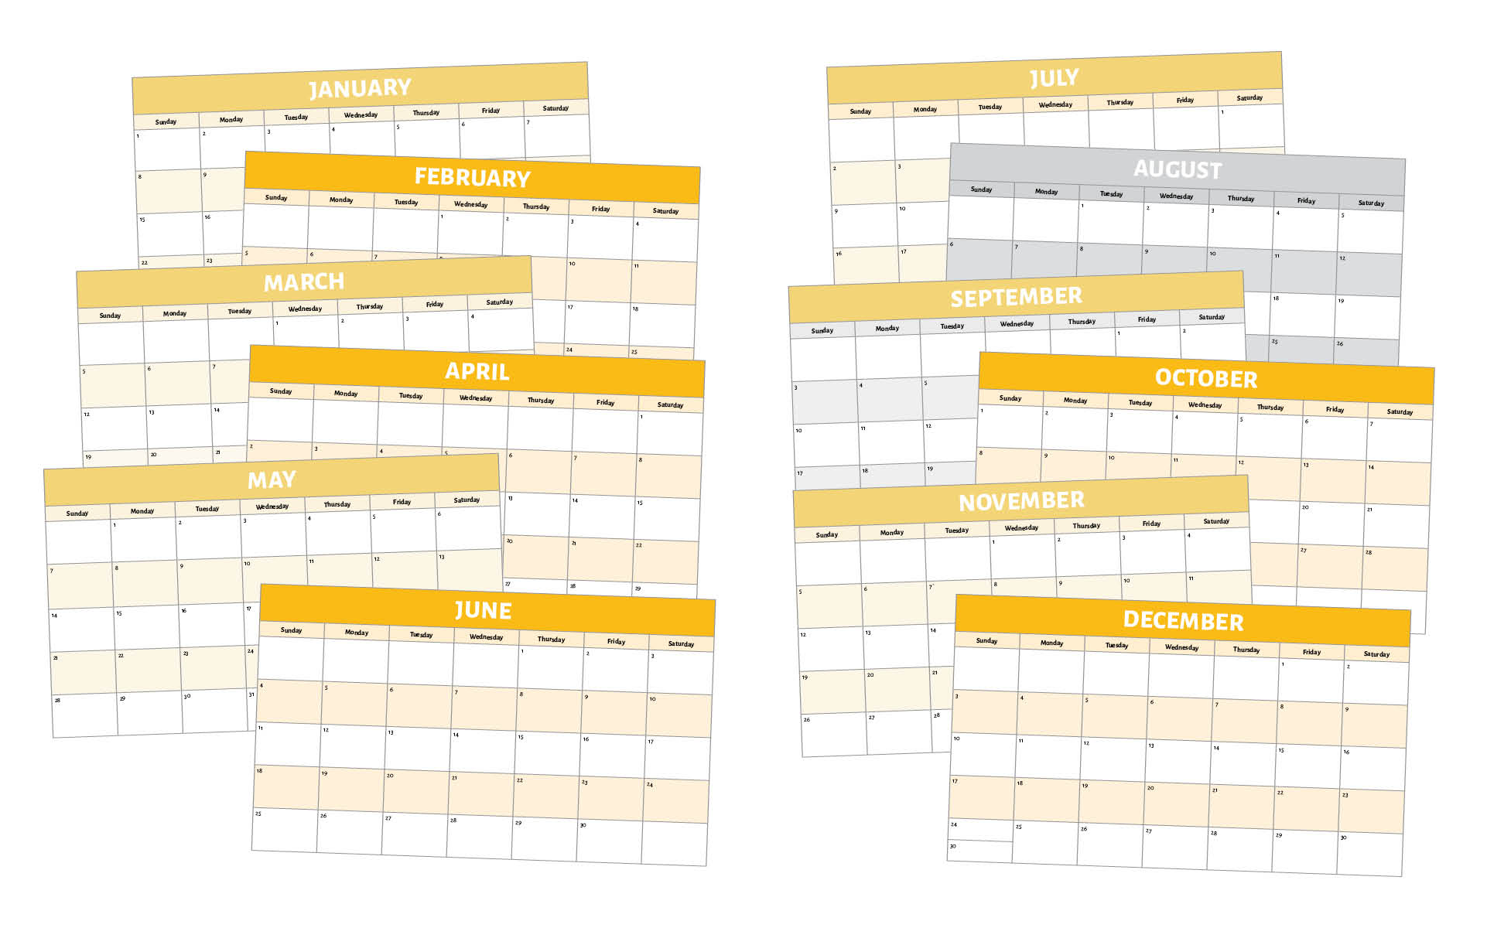

Have you tried a Florida yellow squash?
Florida yellow squash
are planted in the fall
and spring.
They are available from September through July.
Look for this logo to find Florida-grown squash!

Slide 5
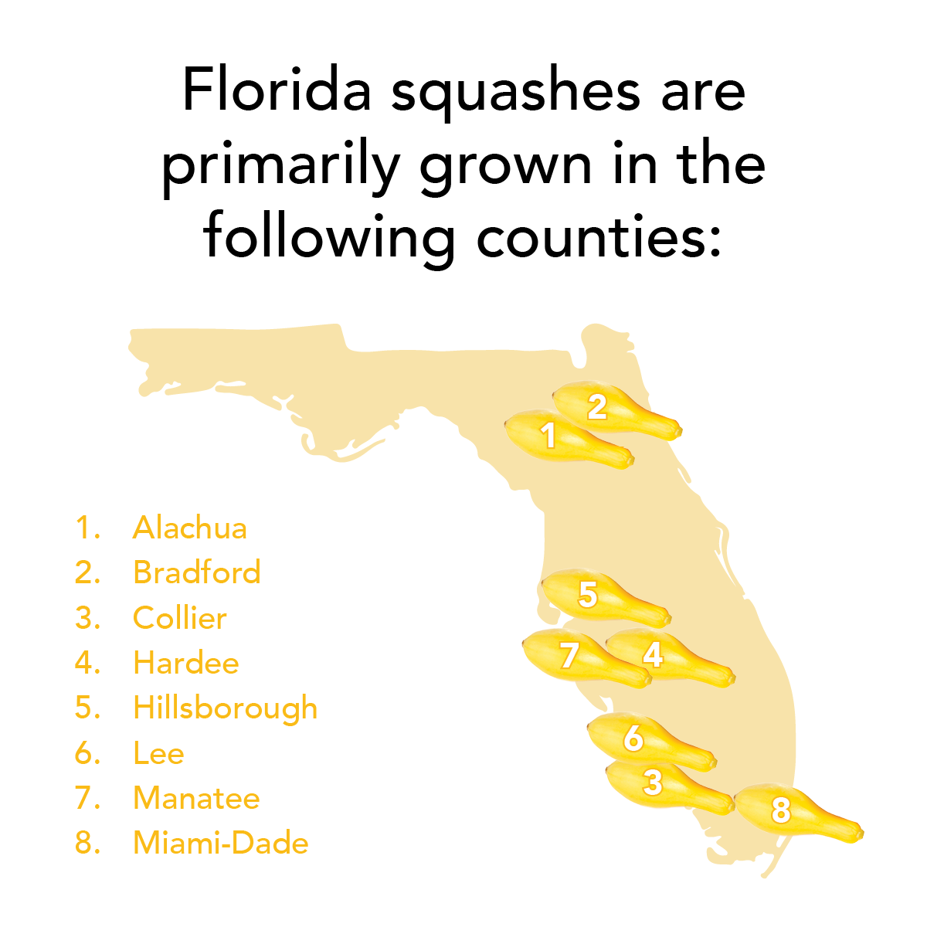
Spot it on the map
Florida is the second largest producer of squash in the nation.
Most of Florida’s yellow squash production occurs in the south.

