Slide 1
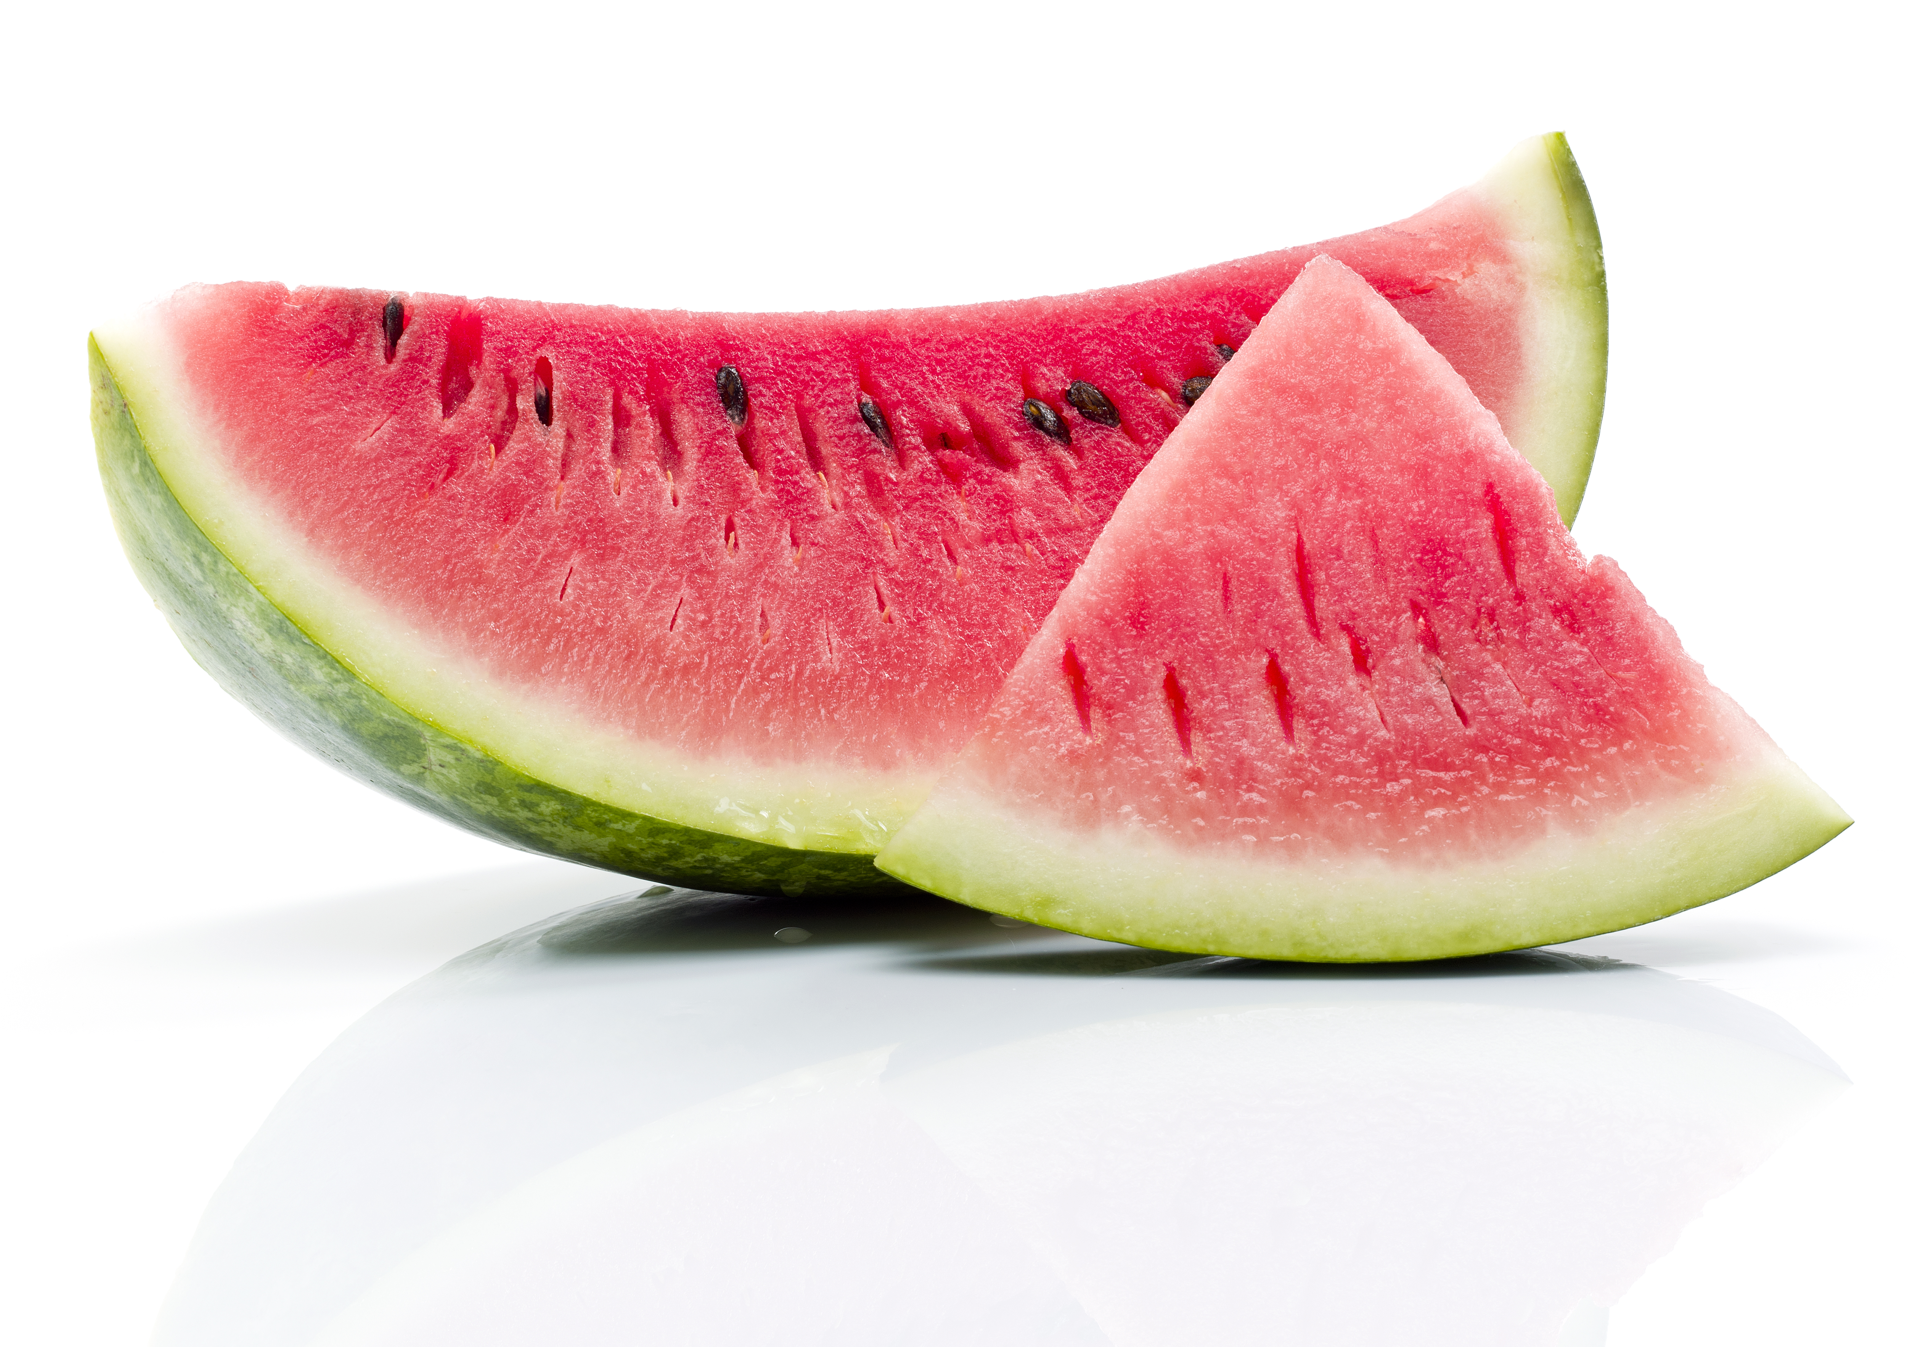
What we are learning today
It’s time to check in with the Florida Watermelon.
Let’s learn all about Florida Watermelon production!

Slide 2
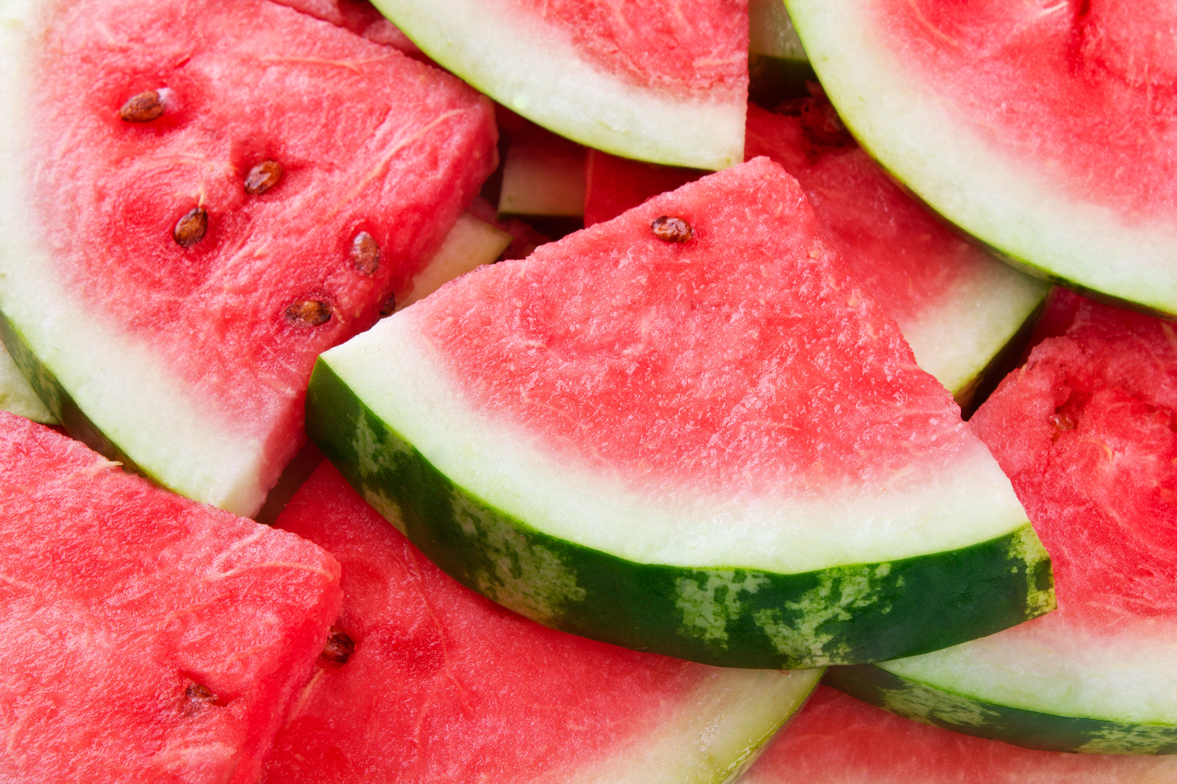
Did You Know?
Watermelons can have as many as 1,000 seeds!
You need at least 20 square feet of space to grow watermelons.

Slide 3
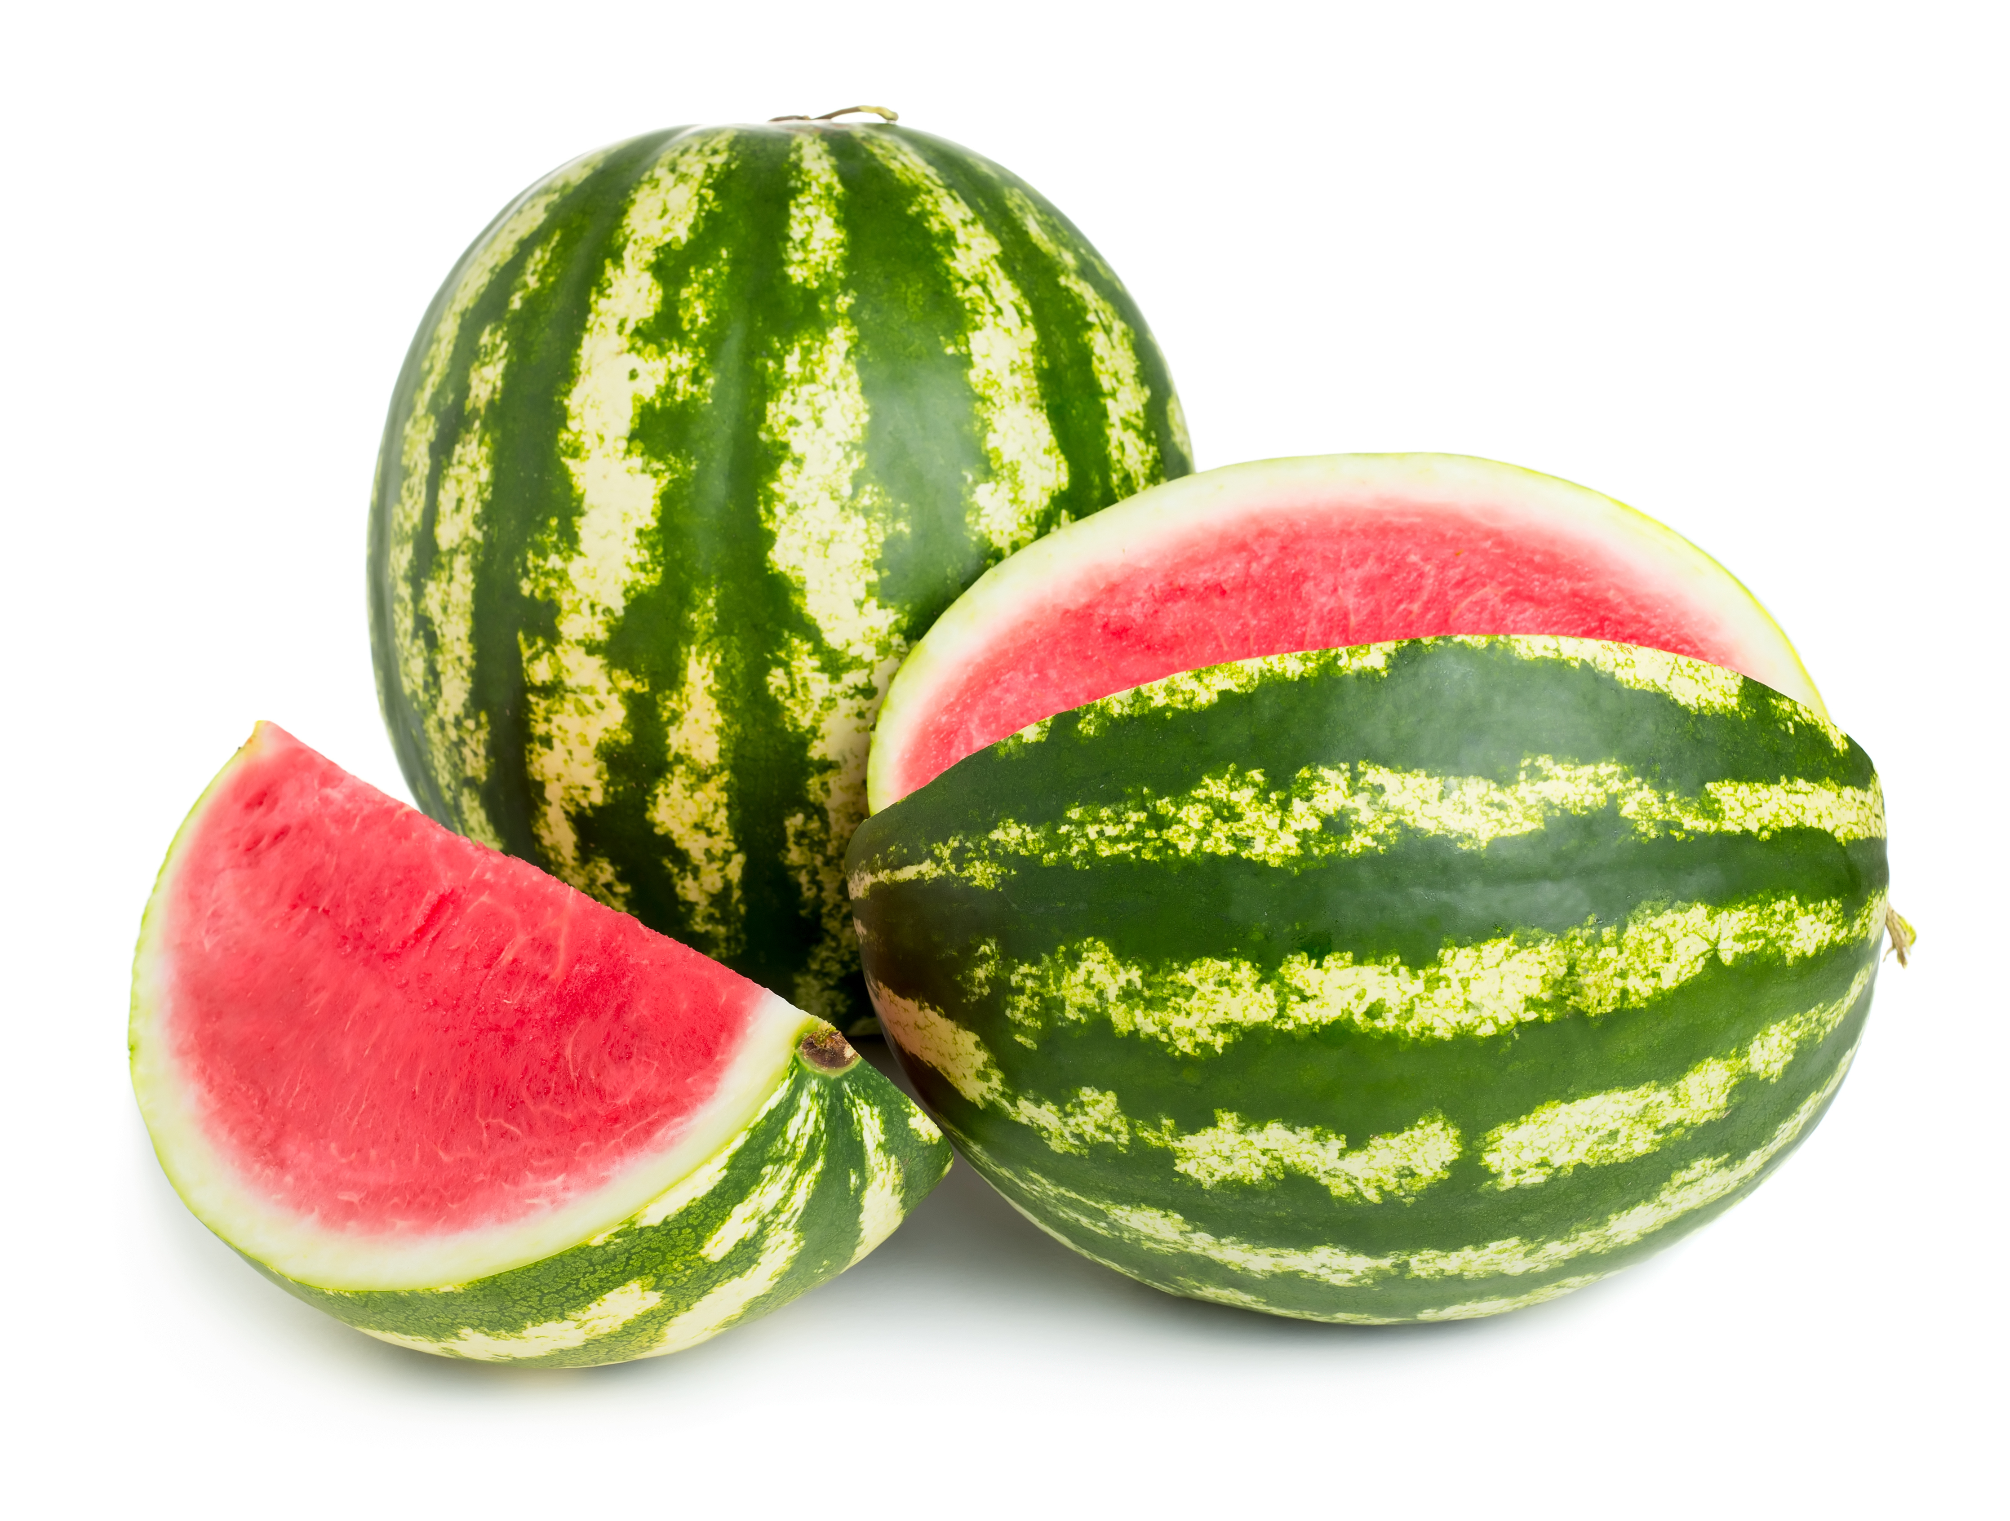
FUN FACTS
Watermelons can be different shapes, colors and sizes. They can even be square!
It takes about 3 months for a watermelon to grow!
Florida leads the United States in watermelon production!

Slide 4

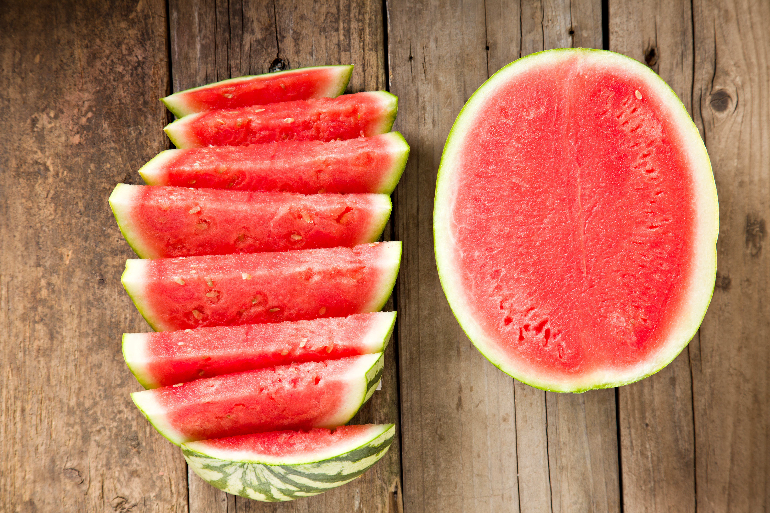
NUTRITION
NUGGET
Red watermelon is a good source of lycopene, which gives watermelon its color. Lycopene is an antioxidant that helps protect the body against heart disease, inflammation and some cancers.
Watermelon is a good source of vitamin C and contains vitamin A.
Watermelons are 92% water.
Watermelon is free of fat, sodium and cholesterol.

Slide 5
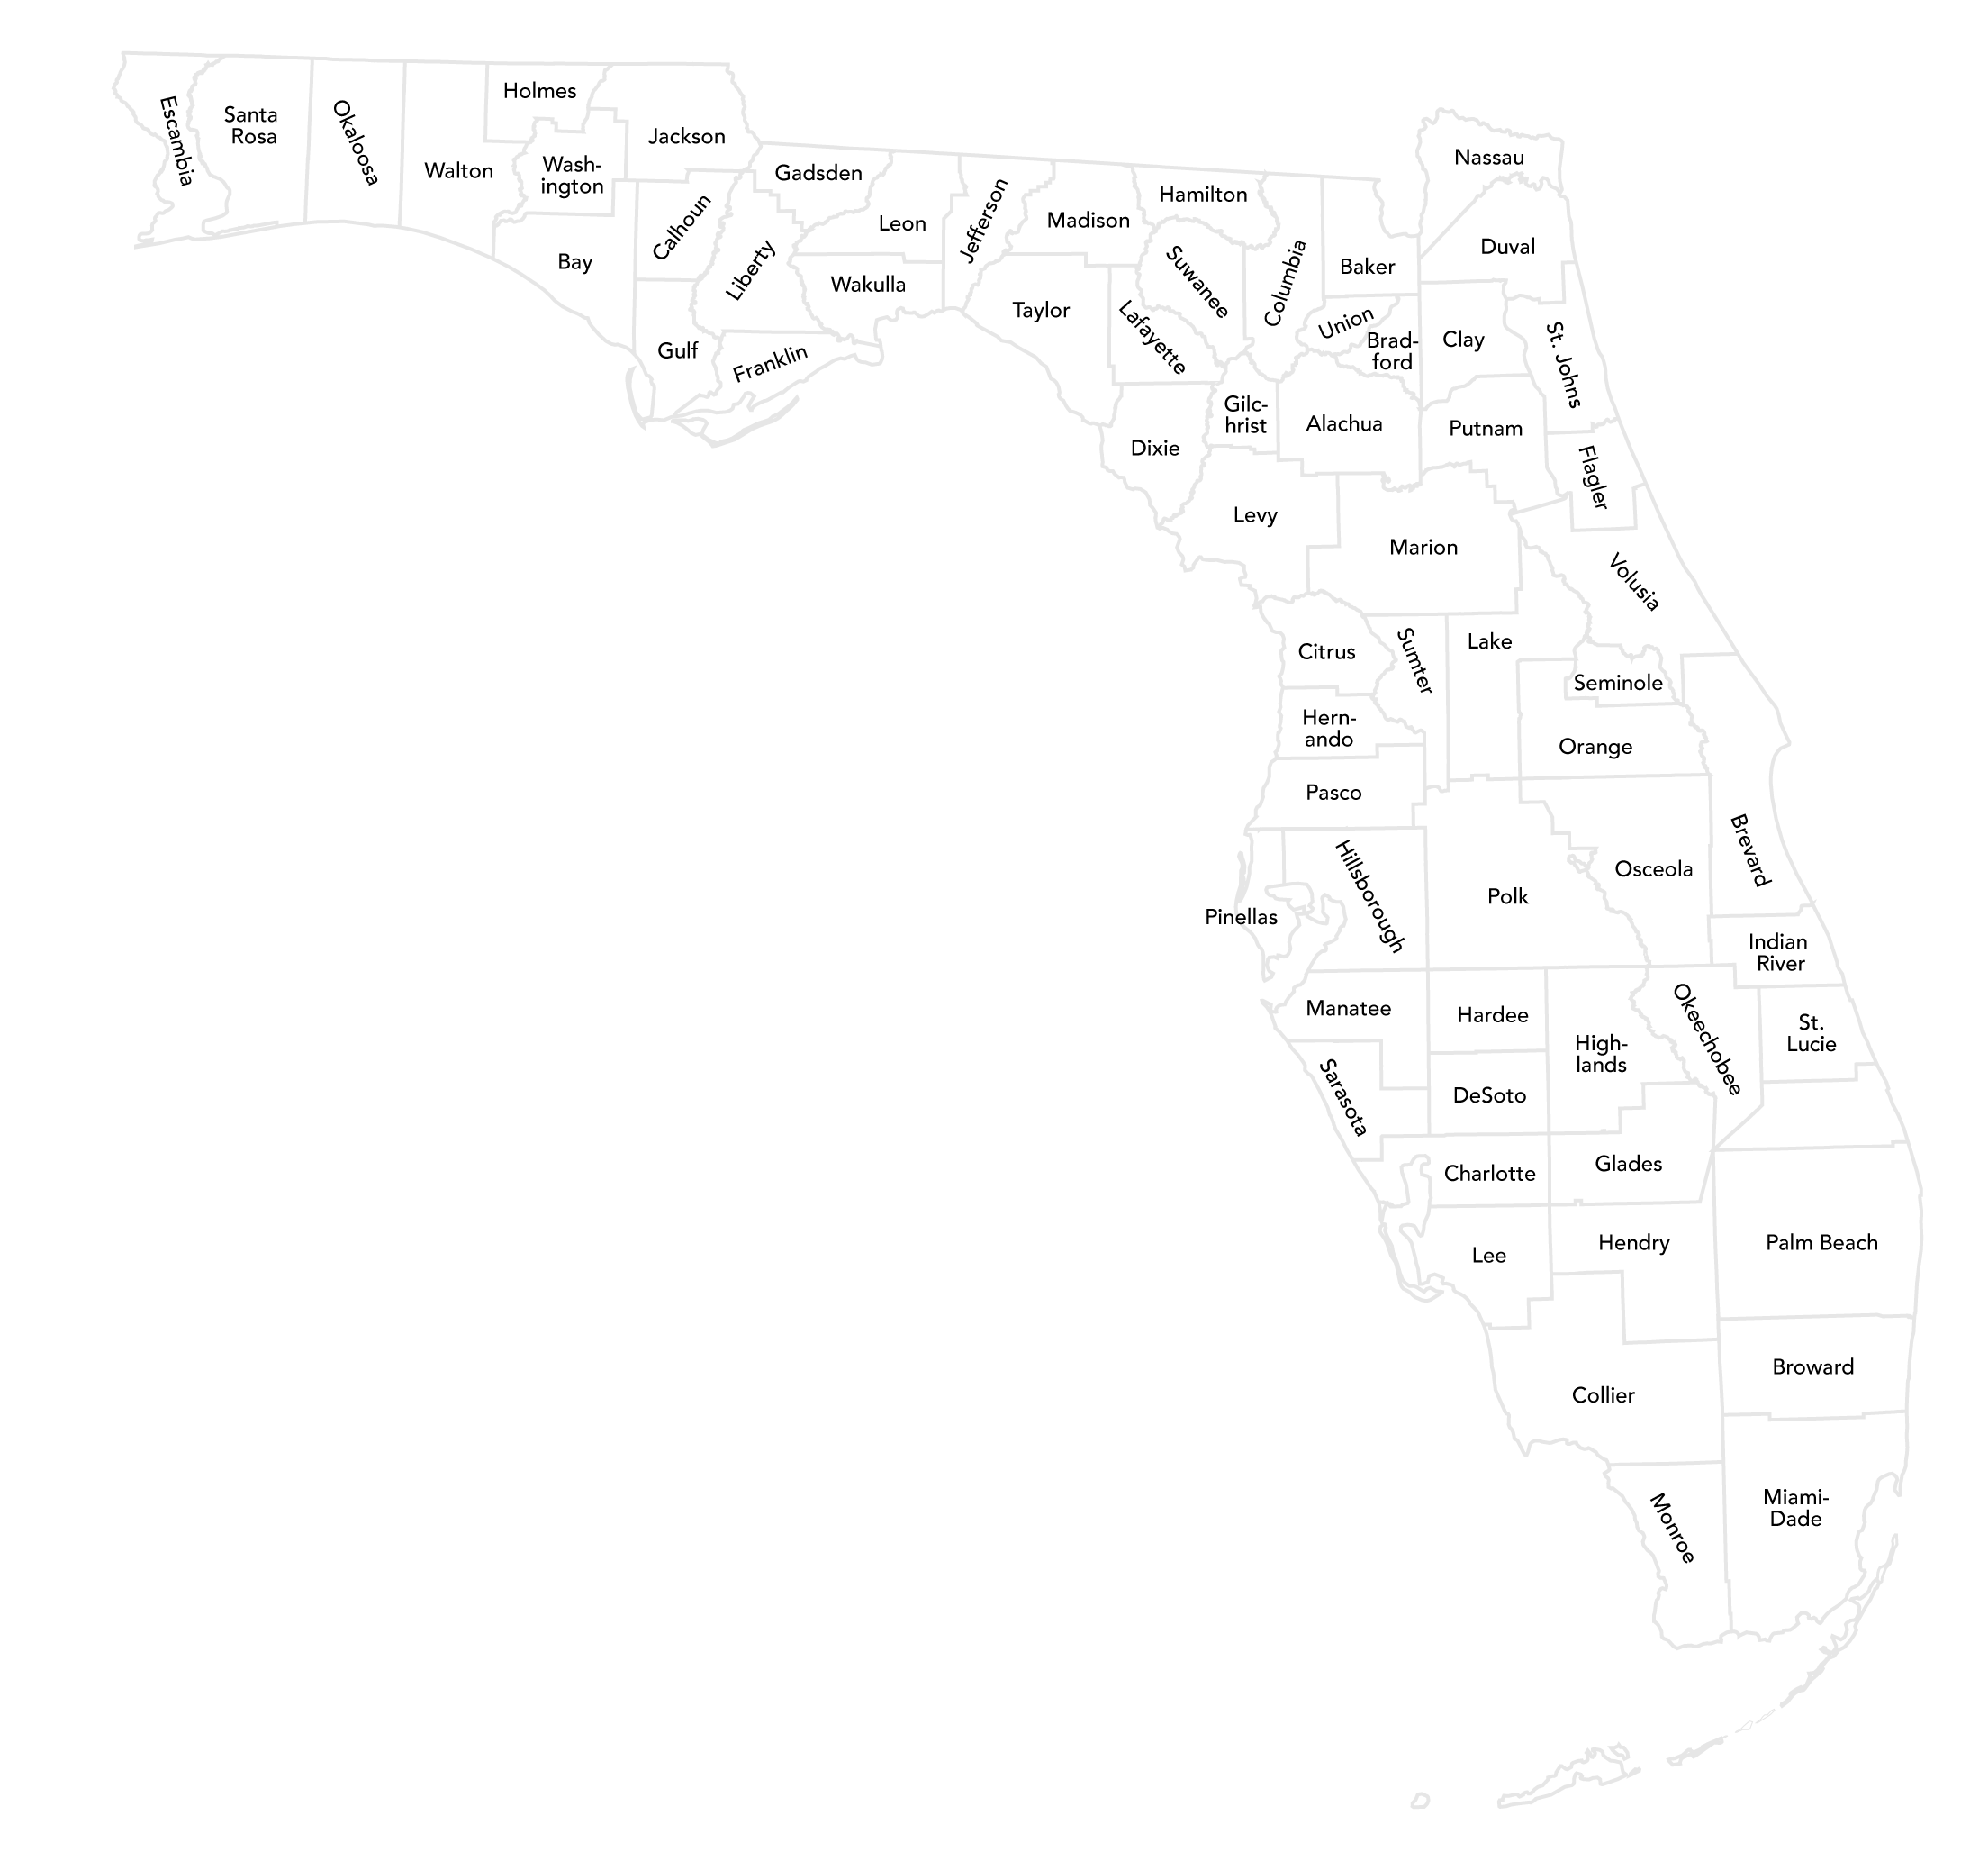
Spot it on the map
Watermelon is mostly grown in the western part of the state, from North Collier County to Columbia County.

