Slide 1
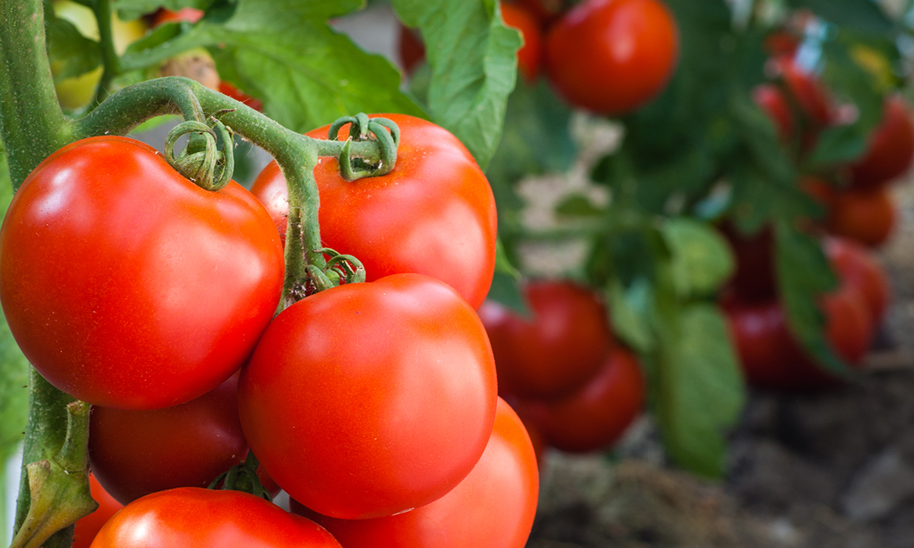

What we are learning today
Hi, I’m Tobias Tomato! Today we are going to talk about tomatoes.
Let’s discover where they grow and how
they get from the
farm to your plate!
Ready for a Tomato Tour?

Slide 2




FUN FACTS
I’m going to Canada!
Many believe that President Thomas Jefferson was the
first American to eat and
grow tomatoes.
The first major farms to grow tomatoes in the United States were right here in Manatee County, Florida.
Florida ships more than 1 BILLION pounds of fresh tomatoes all over the United States, to Canada and other countries.

Slide 3


NUTRITION NUGGET
Vitamin A: Tomatoes are a good source of vitamin A, which helps keep our hair, bones and skin healthy.
Vitamin C: Tomatoes are packed with vitamin C, which may help fight infection and keep the immune system strong.
Potassium: Tomatoes are a good source of potassium. Potassium is associated with heart health and proper nerve and muscle function.
Lycopene: Tomatoes get their reddish hue from lycopene, a phytonutrient that plays a role in chronic disease prevention

Slide 4
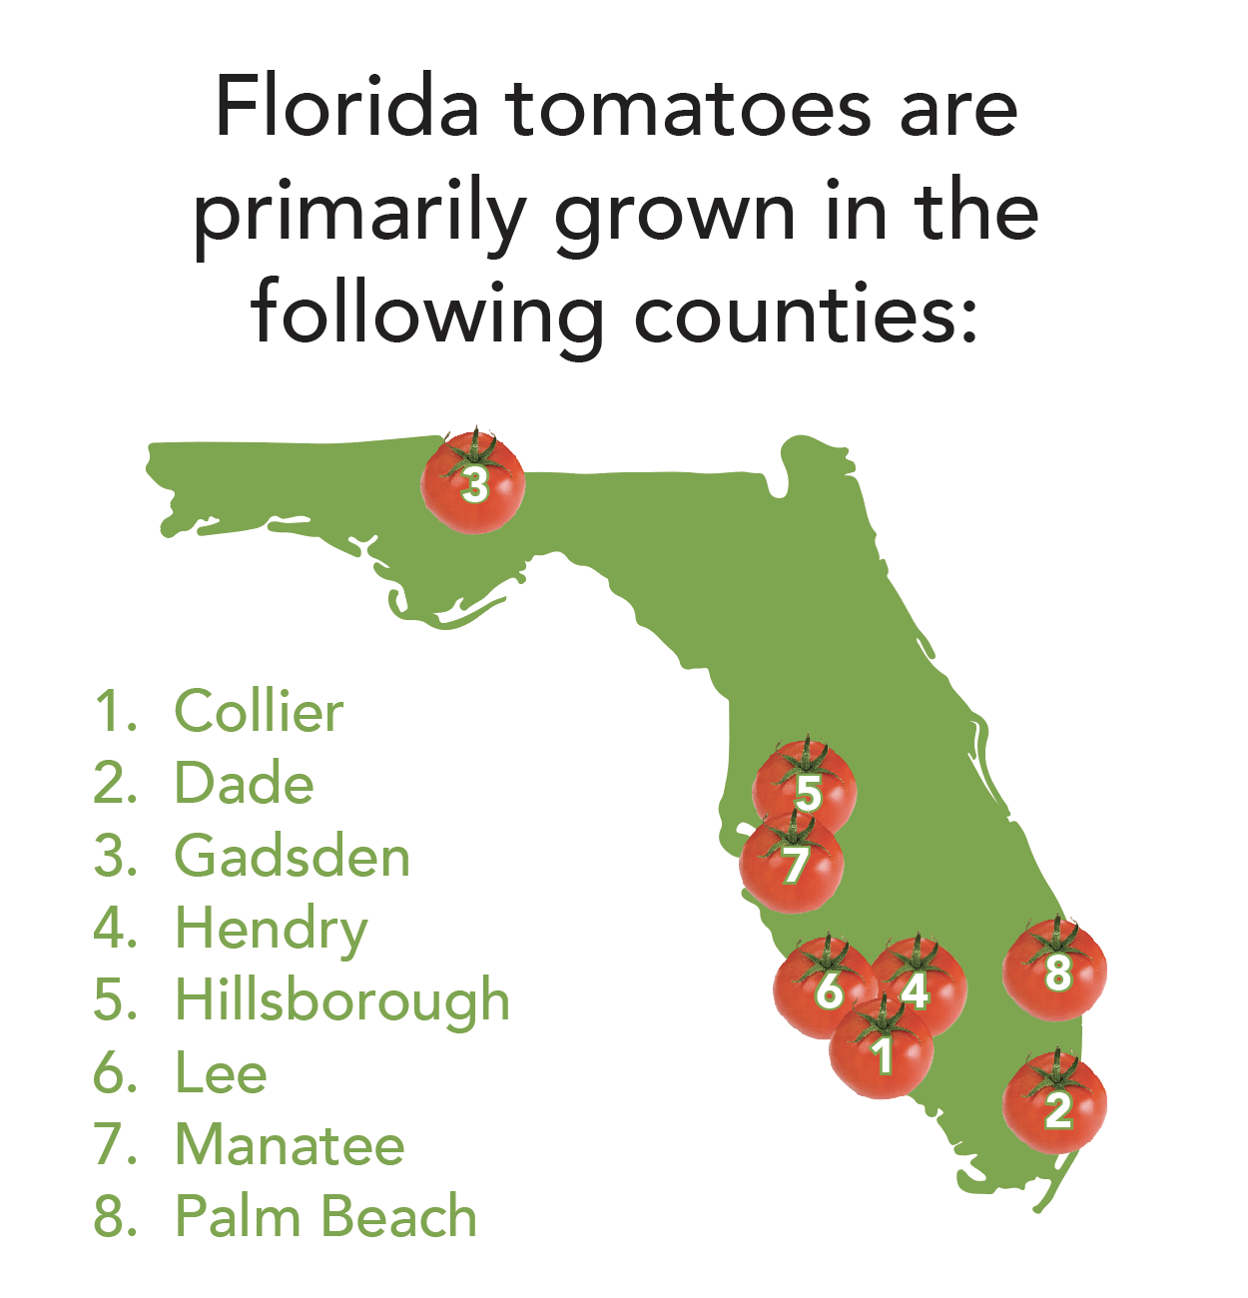
Spot it on the map
Let’s find out where tomatoes are grown
in Florida!
Did you know Florida
has 67 counties?

