Slide 1
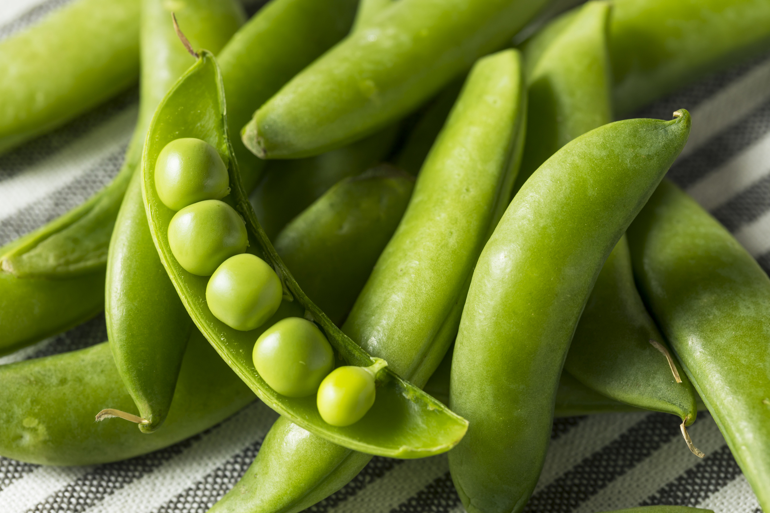
What we are learning today
Hello! Today we are going to learn about Sugar Snap Peas!

Slide 2
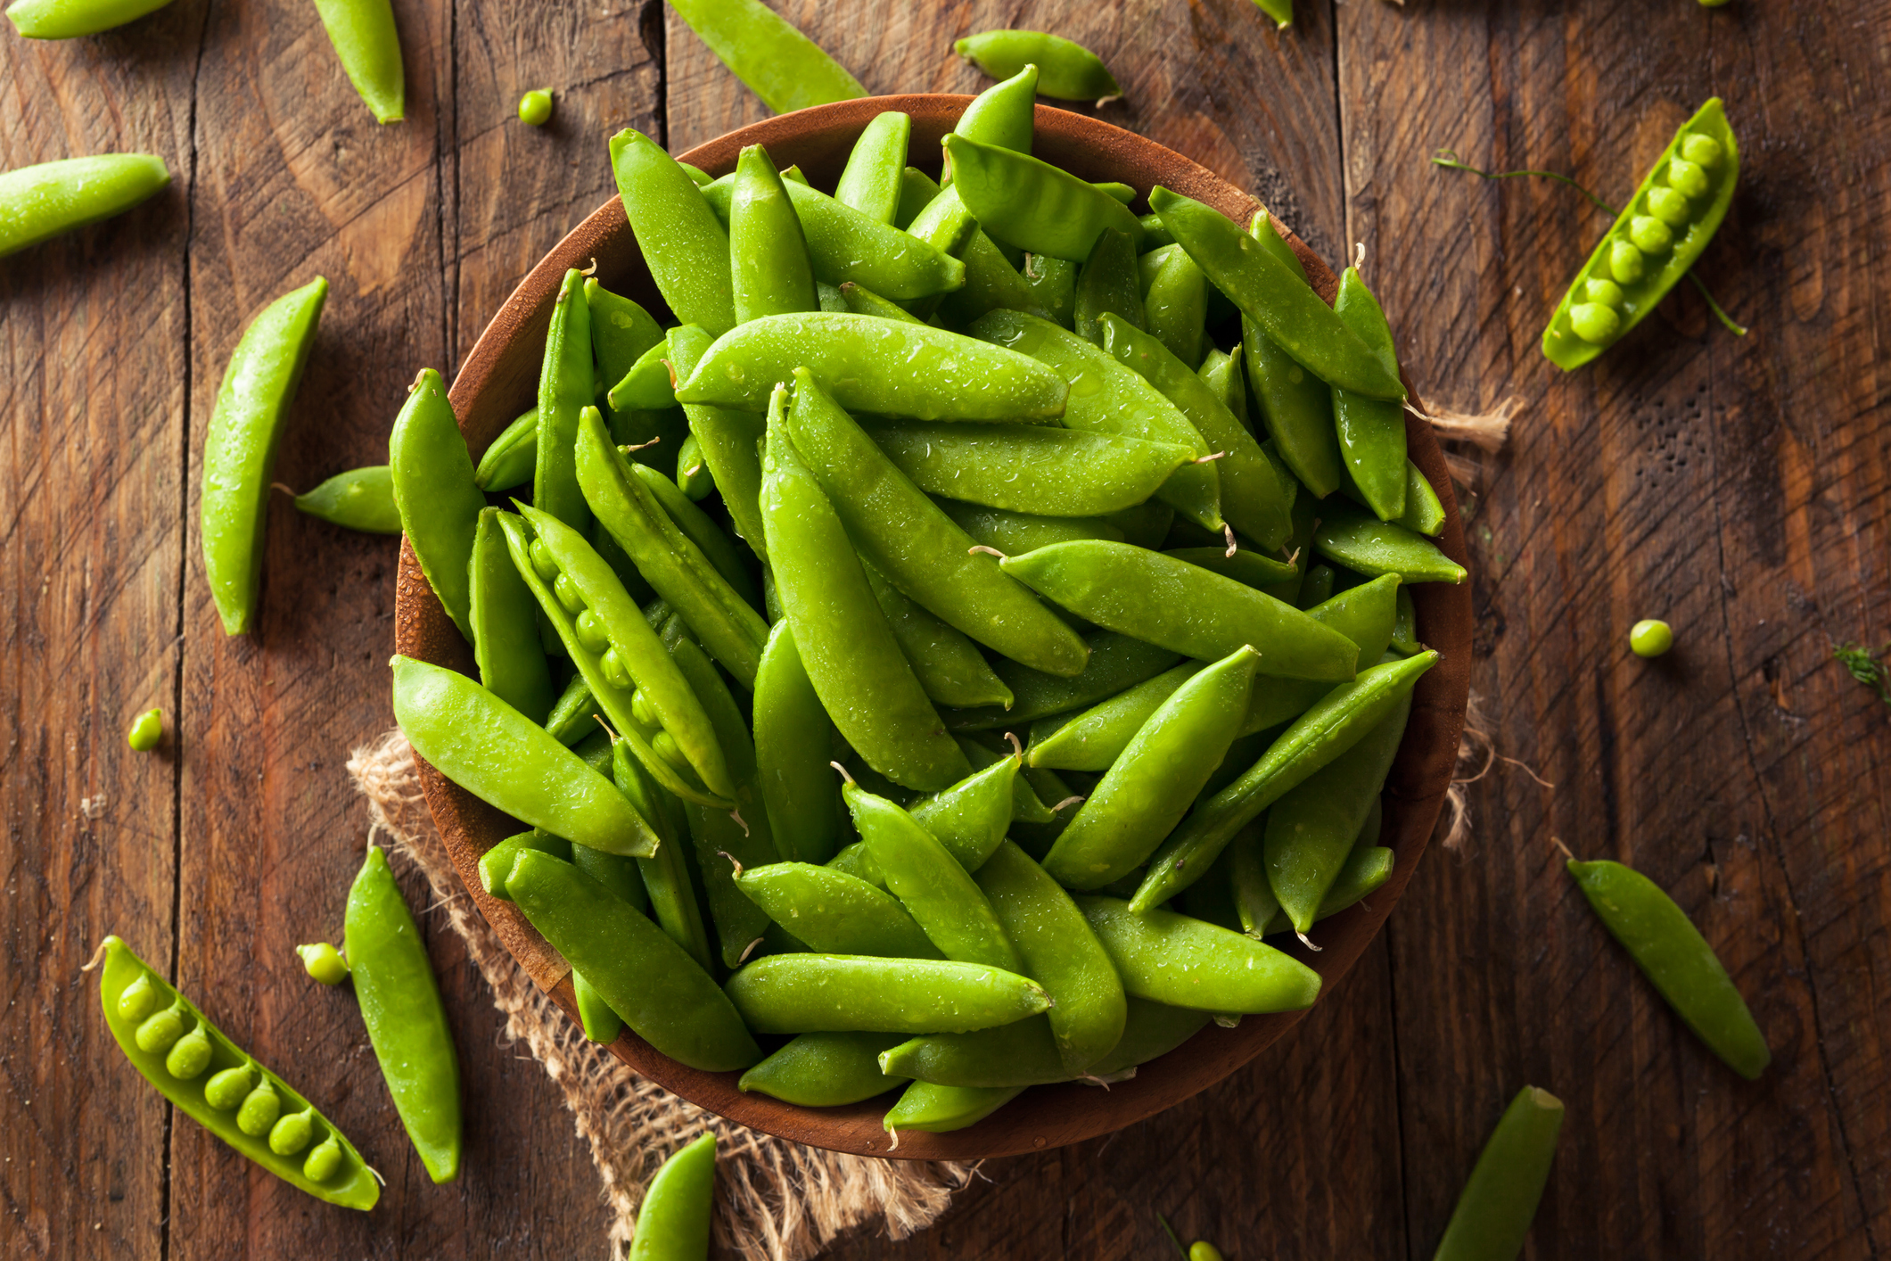
FUN FACTS
Snap Peas get their name from their sweet flavor and the “snappy” crunch they make in your mouth.
The whole pea pod is edible!
Thomas Jefferson planted more than 30 varieties of peas in his garden.

Slide 3
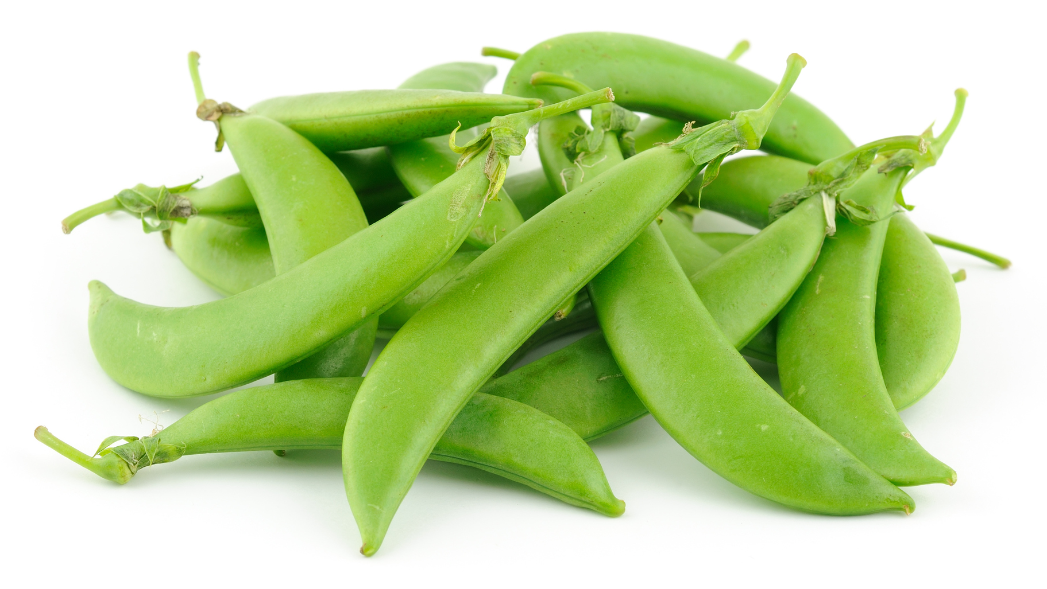
NUTRITION NUGGET
Sugar Snap Peas have Vitamin C, which keeps our body’s cells healthy and boosts our immune system. This can help us from getting sick!
Sugar Snap Peas are high in fiber, which helps us digest food and feel full. They help our heart to be healthy by lowering our blood pressure.

