Slide 1
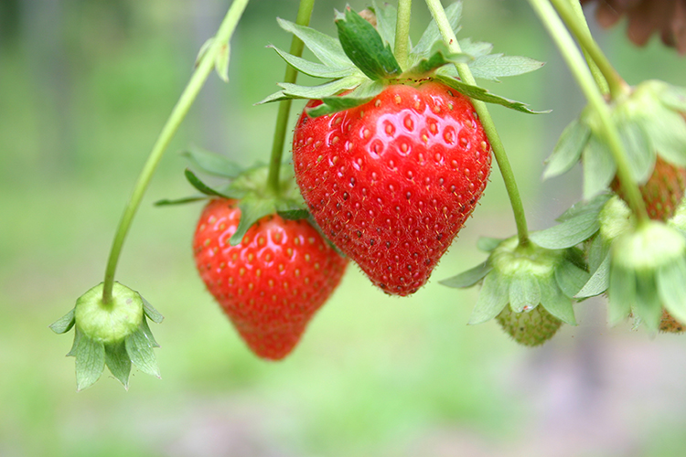

What we are learning today
Hello! I’m Susie Strawberry!
Together we’ll investigate this
tasty berry and learn
all about Florida’s strawberry industry!

Slide 2


FUN FACTS
Strawberries are a member of the rose family.
Strawberries are the only fruit that have seeds on the outside — about 200 of them.
Strawberries do not ripen after they are harvested. They’re ready to pick when most of the berry turns bright red.
A flat of strawberries typically weighs 12 pounds. On average, between 15-20 million flats of strawberries are grown in Florida each year.
That’s A LOT of strawberries!

Slide 3


NUTRITION NUGGET
Vitamin C is:
A critical component of the body's immune system.
An important antioxidant, protecting cells from damaging free radicals.
Used to make collagen, which helps heal wounds.
Able to help the body absorb iron.

Slide 4
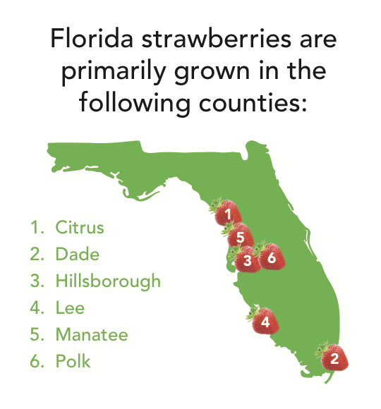

Spot it on the map
Let’s find out where strawberries are grown
in Florida!
Plant City in Hillsborough County is recognized as the “Winter Strawberry Capital of the World”

