Slide 1
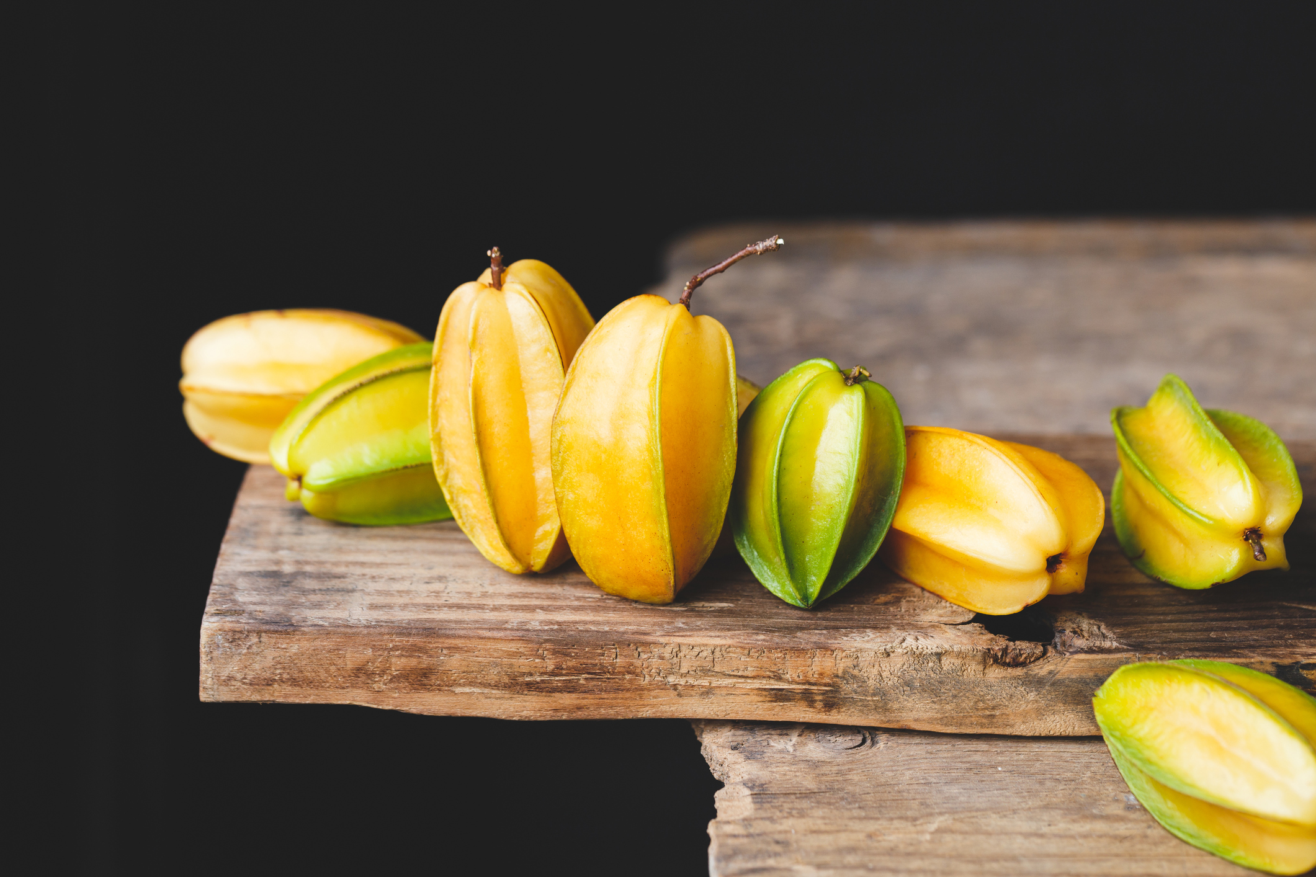
What we are learning today
Today we will be learning about Carambola, or its nickname, Star Fruit!
Who has tried a starfruit before?

Slide 2
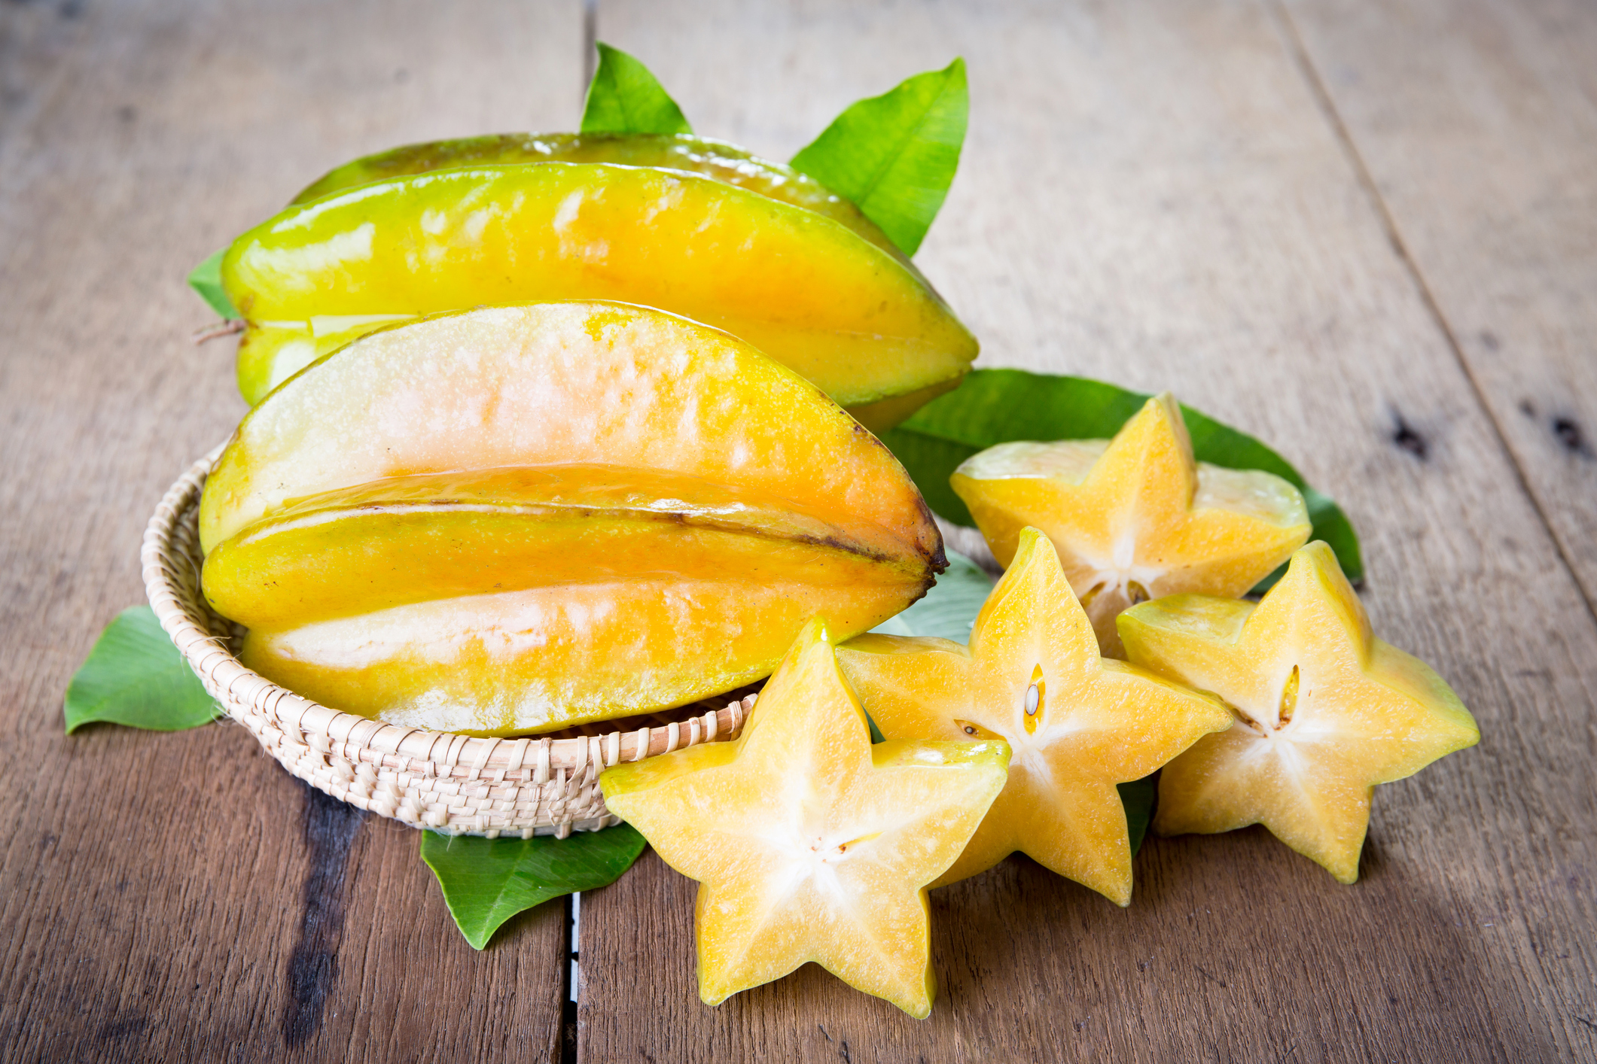
Did you know?
When cut horizontally, it appears in the shape of a star.
Star fruit is a tropical fruit, and requires high humidity and a lot of rain to grow.
You can eat all of the fruit, including the skin.

Slide 3
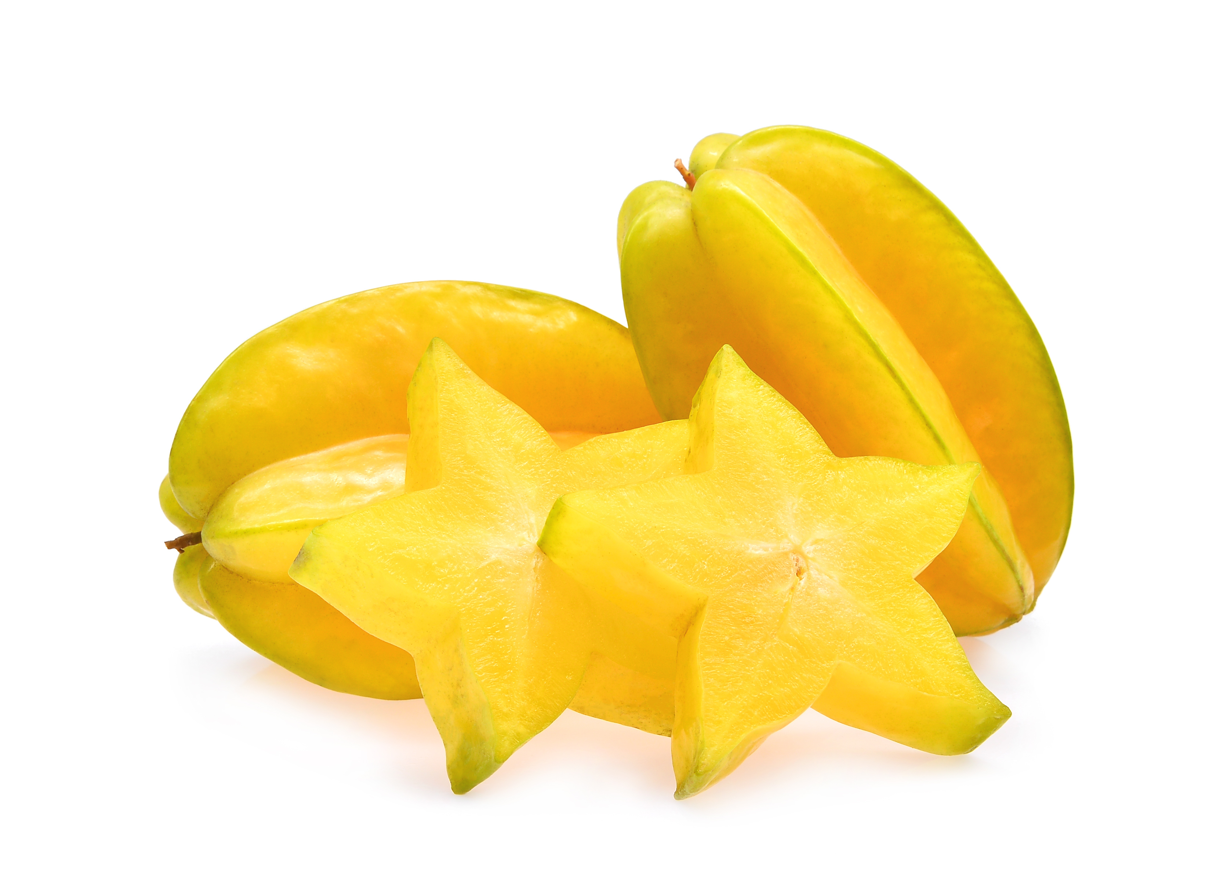
NUTRITION NUGGET
Star fruit has a lot of antioxidants and contains Vitamin C, and can help to treat infections caused by bacteria.
Starfruit is full of fiber and can help your digestive system.
Star fruit has potassium which can help control your heart rate and blood pressure.

Slide 4
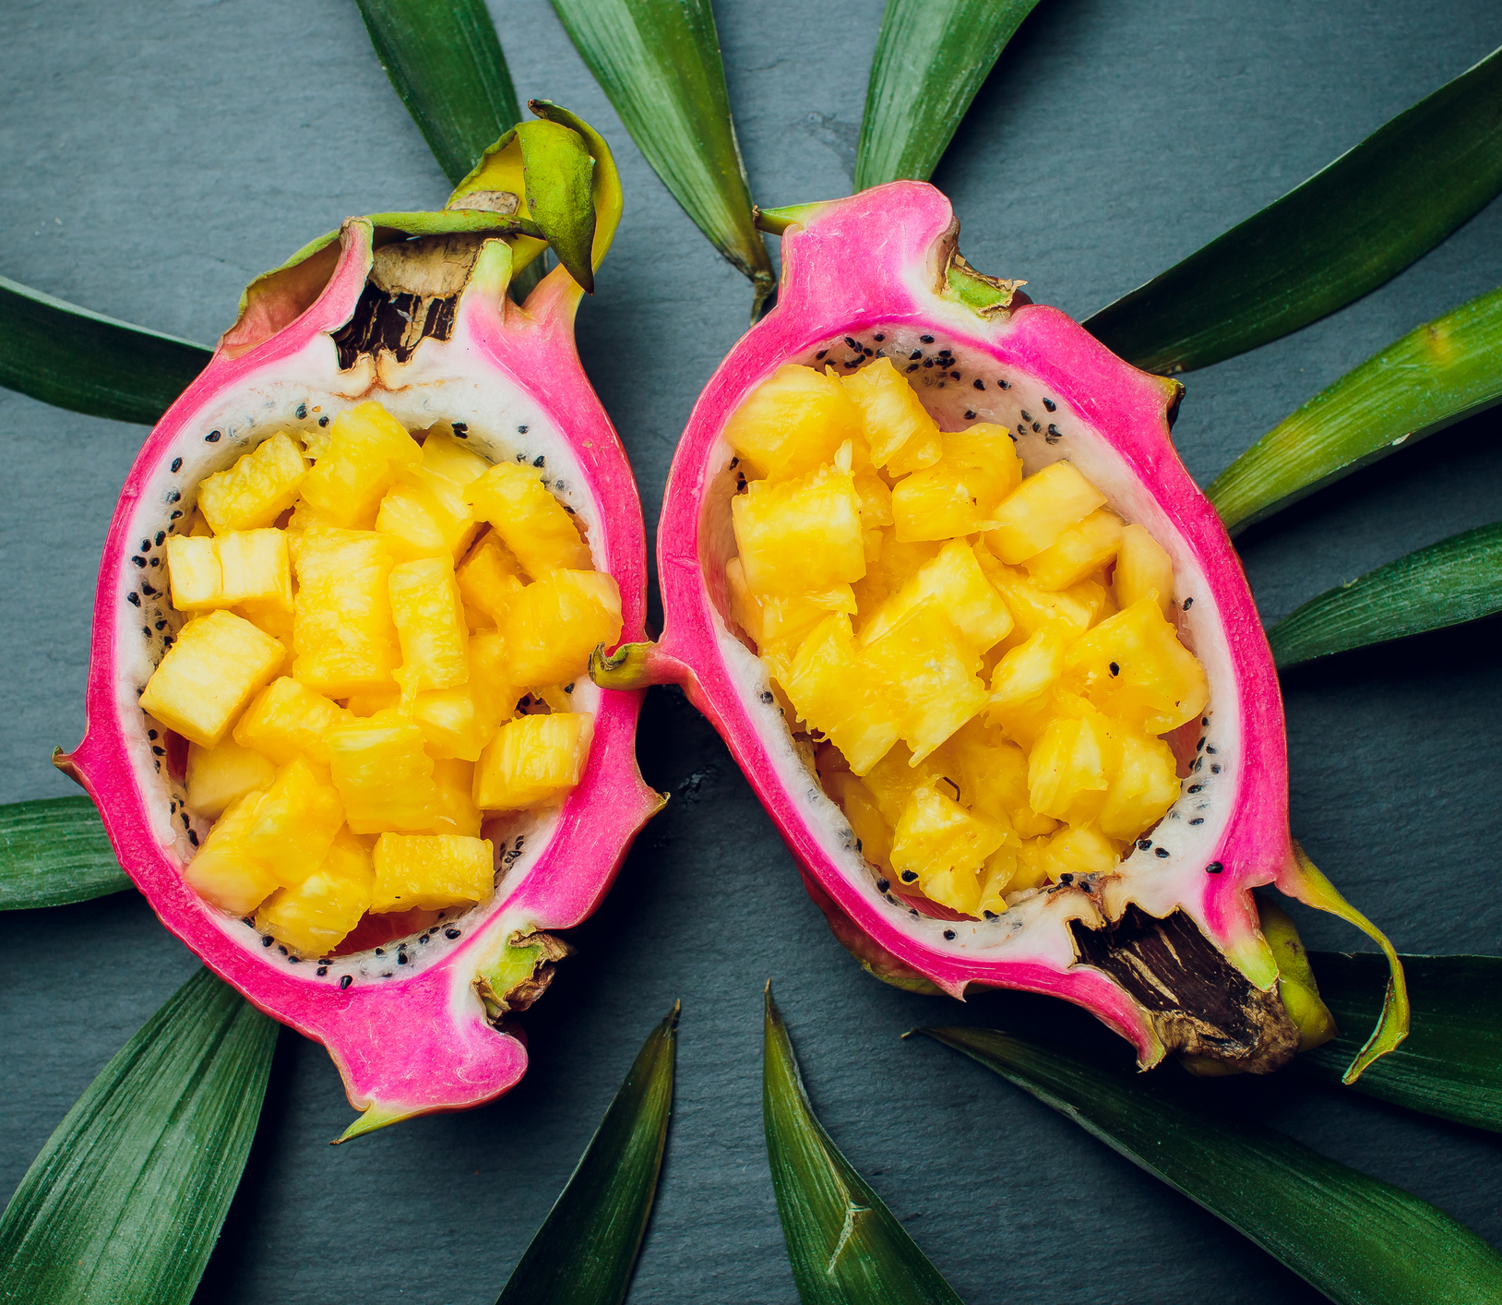
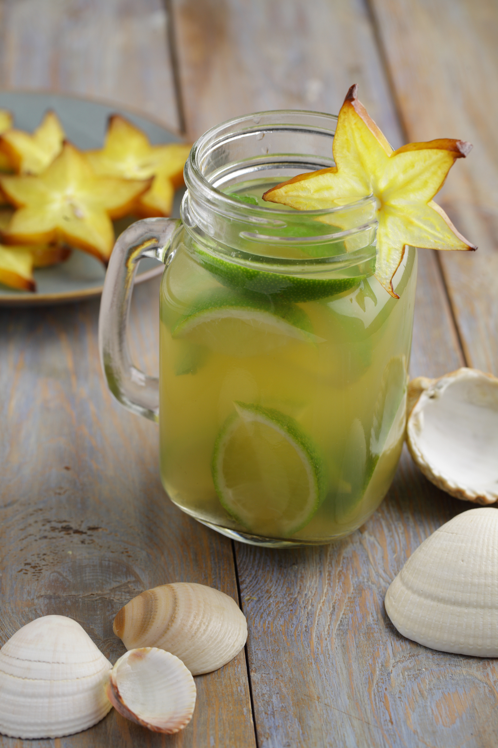
TASTY TIPS
Star fruit is best when eaten raw, but can also be made into forms of jams, jellies, and juice.
You can also try them in salads, desserts, and sauces!

Slide 5
Where does it grow?
Florida grows about 90% of the Star Fruit that comes from the United States.
It is also grown in Hawaii, Puerto Rica, Southeast Asia and Malaysia.

