Slide 1
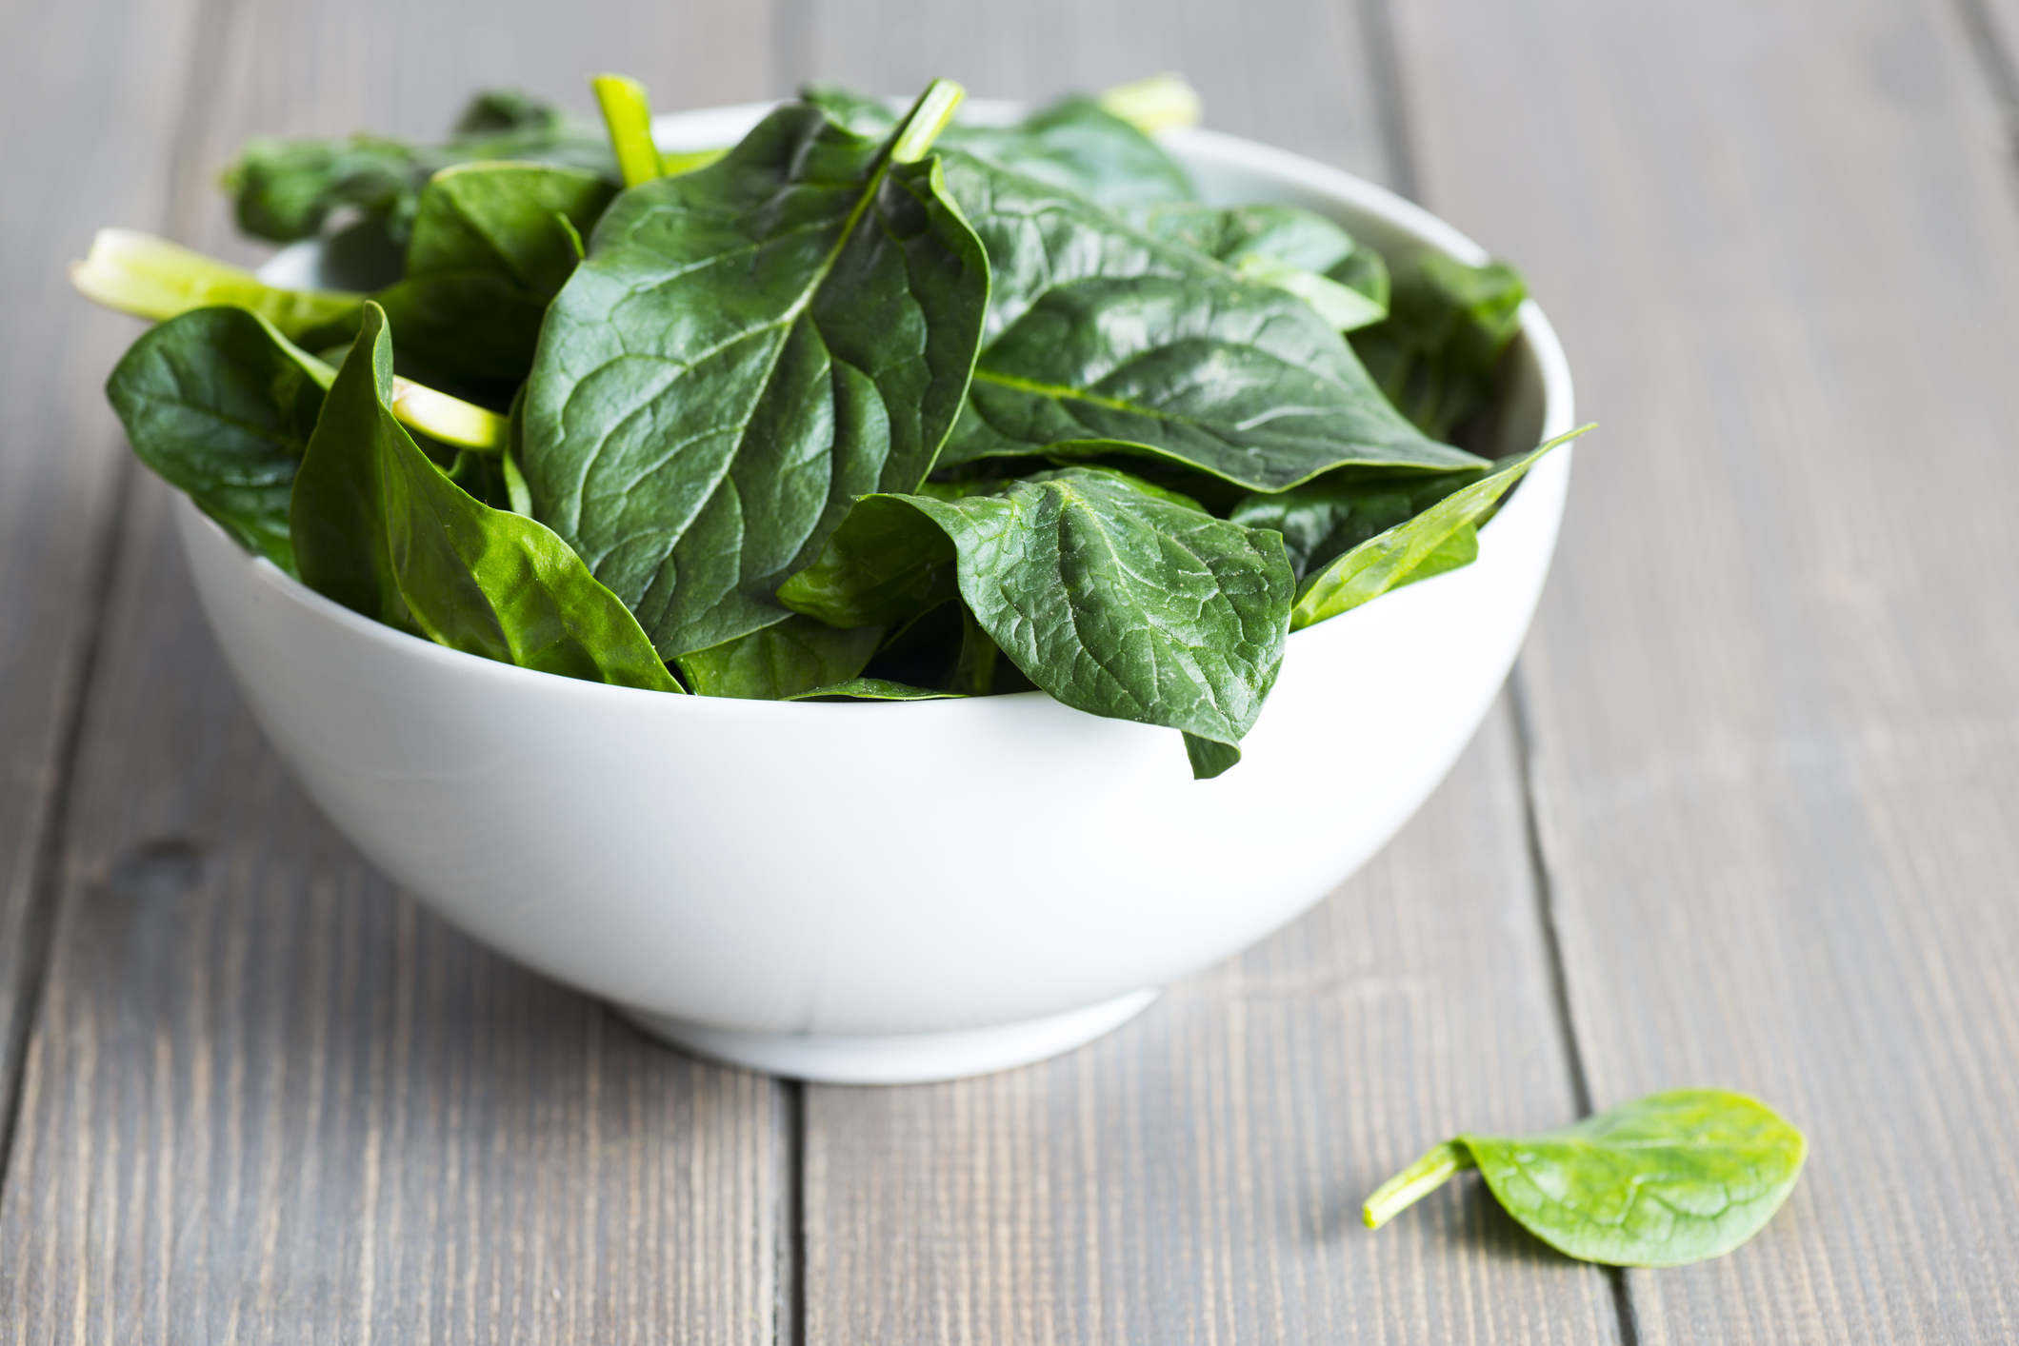
What we are learning today
Today we will be learning about Spinach!

Slide 2
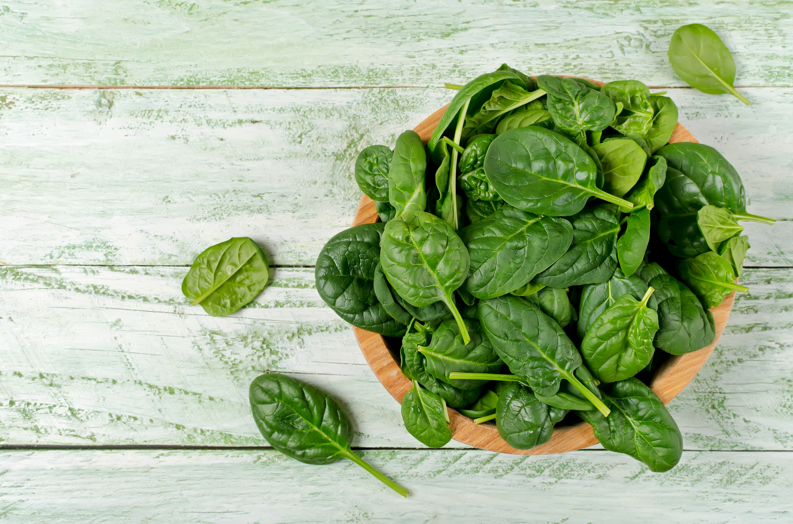
FUN FACTS
This leafy green vegetable can be eaten raw or cooked.
March 26th is National Spinach Day.
Medieval artists extracted green pigment from spinach to use as an ink or paint.

Slide 3

NUTRITION NUGGET
Popeye ate this vegetable to get strong!
  Spinach aids in strengthening muscles, boosts metabolism, and is good for eyesight.

Slide 4
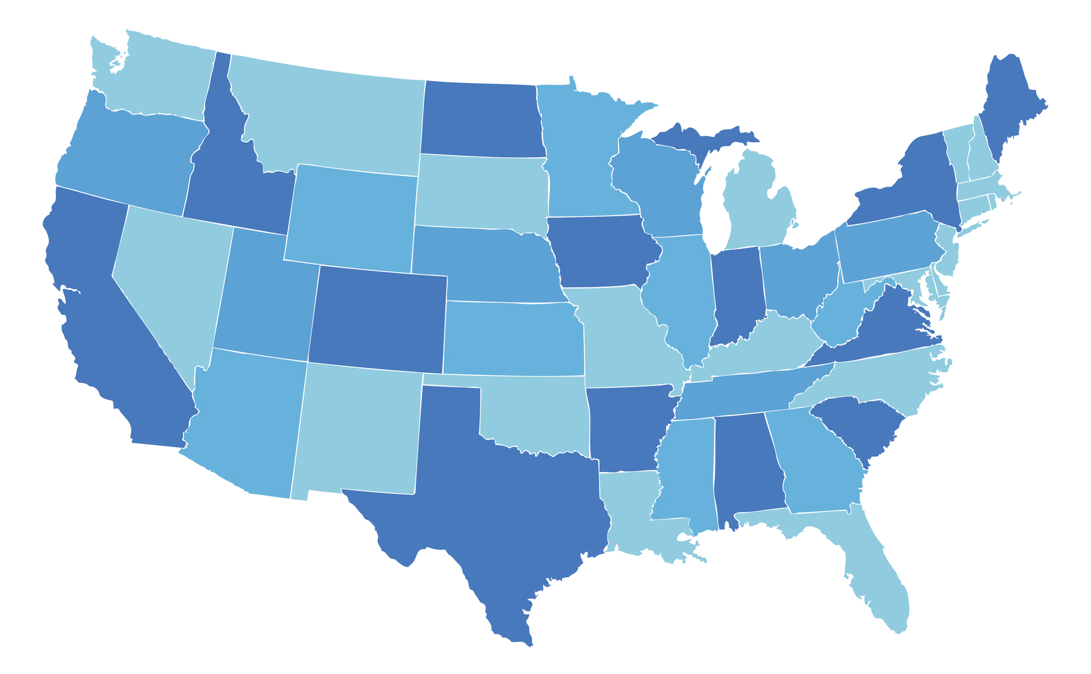
Spot it on the map
-Grown in California, Arizona, New Jersey, Texas, Colorado, Maryland, and Arkansas
California produces 74% of the fresh spinach grown in the United States.

