Slide 1
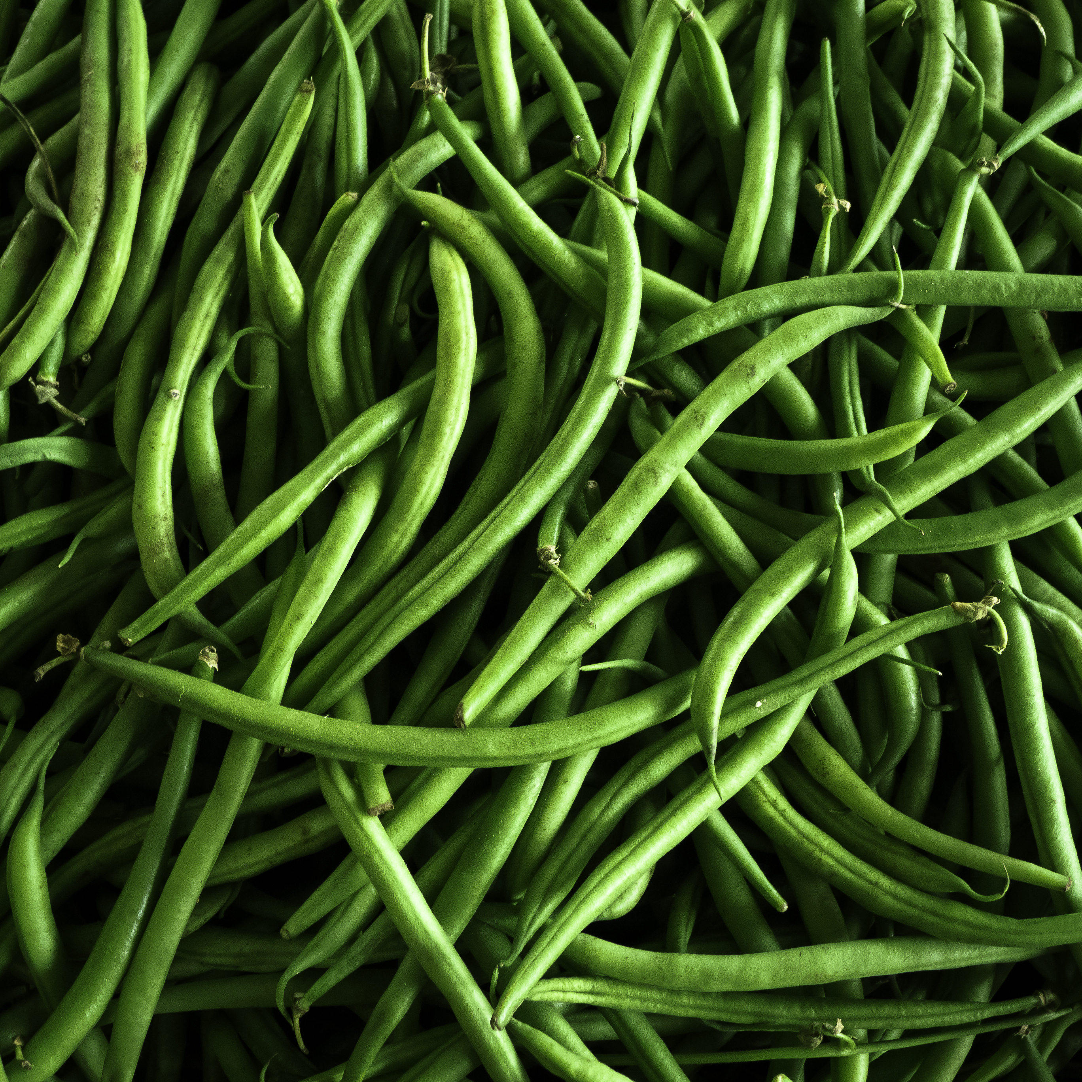
What we are learning today
It’s time to learn about the Florida Snap Bean.
Let’s learn about this awesome vegetable!
Notes:
Introduce character

Slide 2
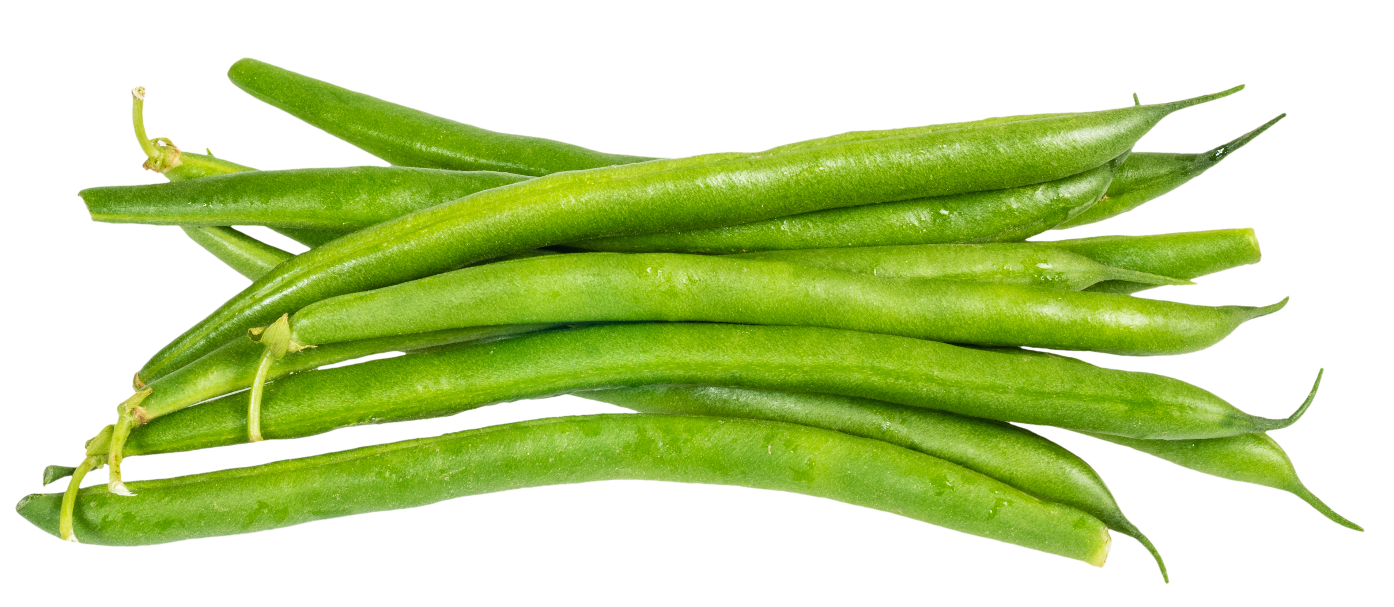
FUN FACTS
Snap beans are also known as green beans or string beans.
They are a member of the legume family, just like black beans and chickpeas.
Fresh snap beans should be crisp and “snap” in half.

Slide 3

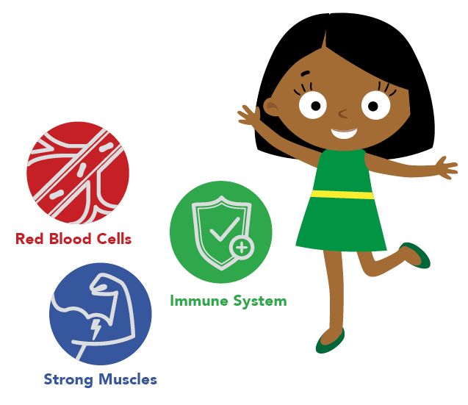
NUTRITION NUGGET
Snap beans are a good source of potassium and vitamin C.
Potassium:
Helps regulate fluids in the body
Assists with muscle contraction
Helps maintain normal blood pressure
Vitamin C
Helps prevent cell damage in the body
Plays a role in supporting the body’s immune system
Produces collagen which makes healthy cartilage, joints, skin and blood vessels

Slide 4
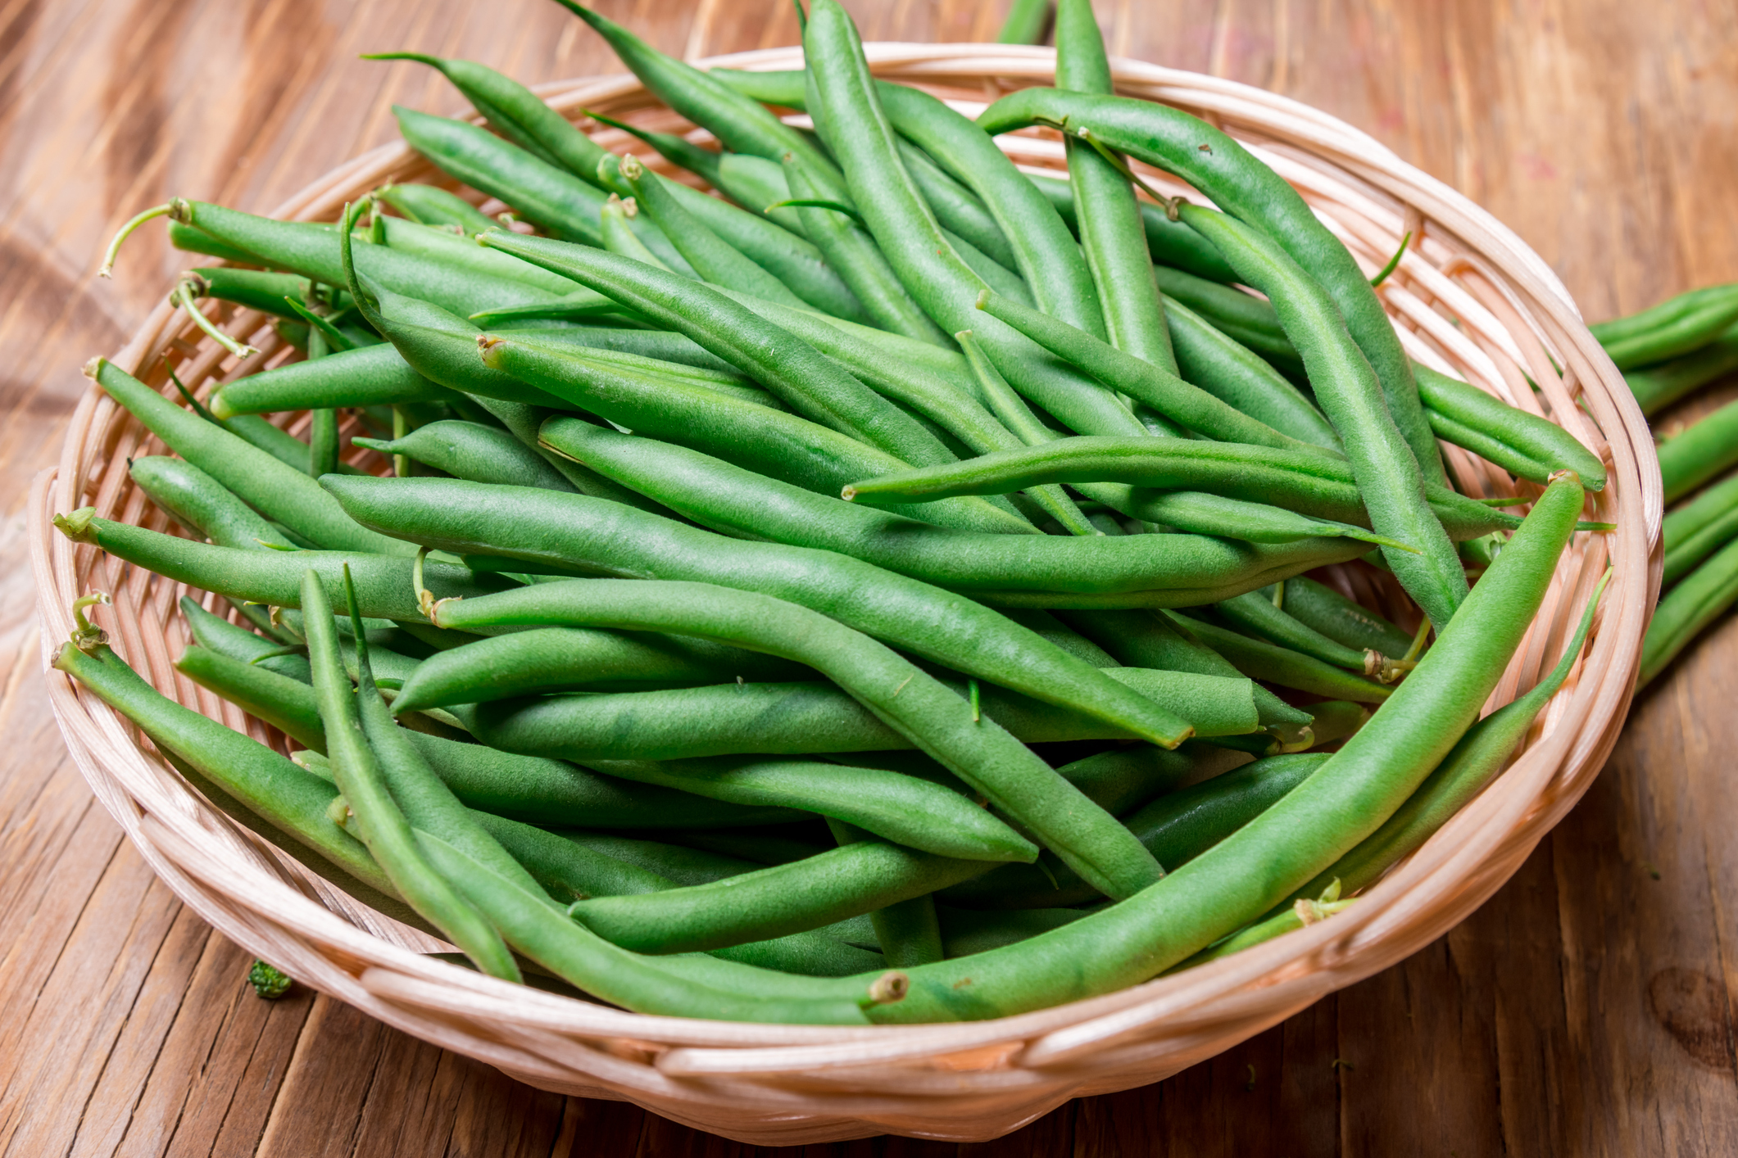
Did You Know?
Florida is the top producing snap bean state in the nation.
One quarter of all snap beans are eaten fresh. The rest are processed by canning or freezing.

