Slide 1
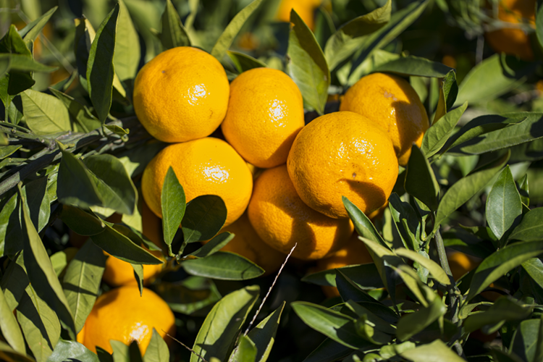

What we are learning today
Hello! I’m Sean
the Satsuma!
Together we’ll
navigate this tasty
fruit and learn all
about Florida’s
satsuma industry!

Slide 2
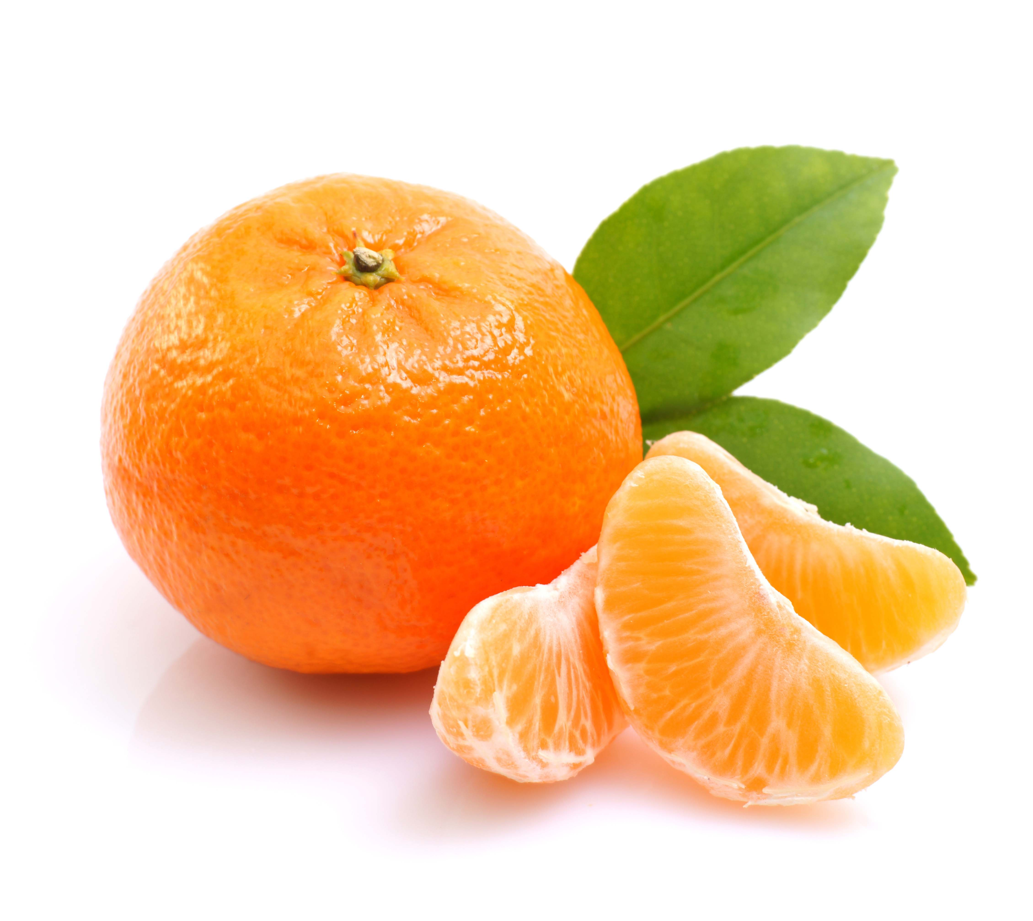
FUN FACTS
Satsumas are part of the mandarin orange family, which also includes clementine and tangerines.
The satsuma originated from the subtropical regions of China and
got it’s name from the Satsuma province
in Japan.

Slide 3


Have you tried a Florida SATSUMA?
Satsumas are known as the Christmas Orange.
Can you guess why?
Satsumas are only in season from October to December.
Look for this logo to find Florida-grown satsumas!

Slide 4

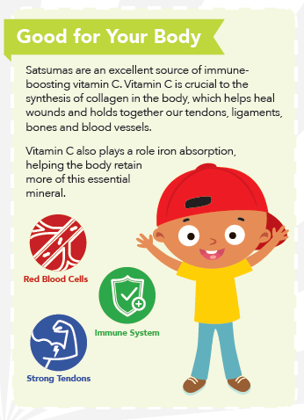
NUTRITION NUGGET
Vitamin C is:
An important antioxidant, protecting cells from damaging free radicals.
Used to make collagen, which helps heal wounds.
Able to help the body absorb iron.

Slide 5
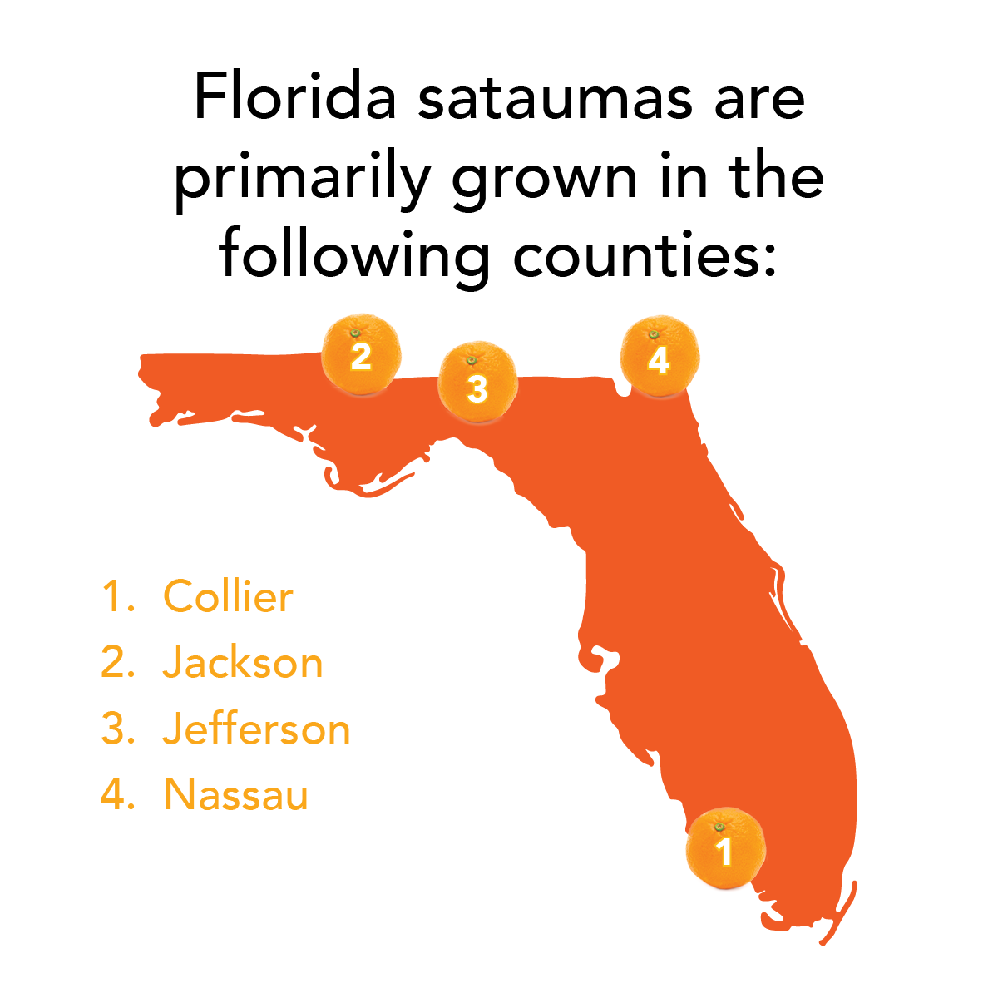
Spot it on the map
Satsumas are mostly grown in Jackson and Collier counties, but can also be found in some parts of central and northern Florida.

