Slide 1
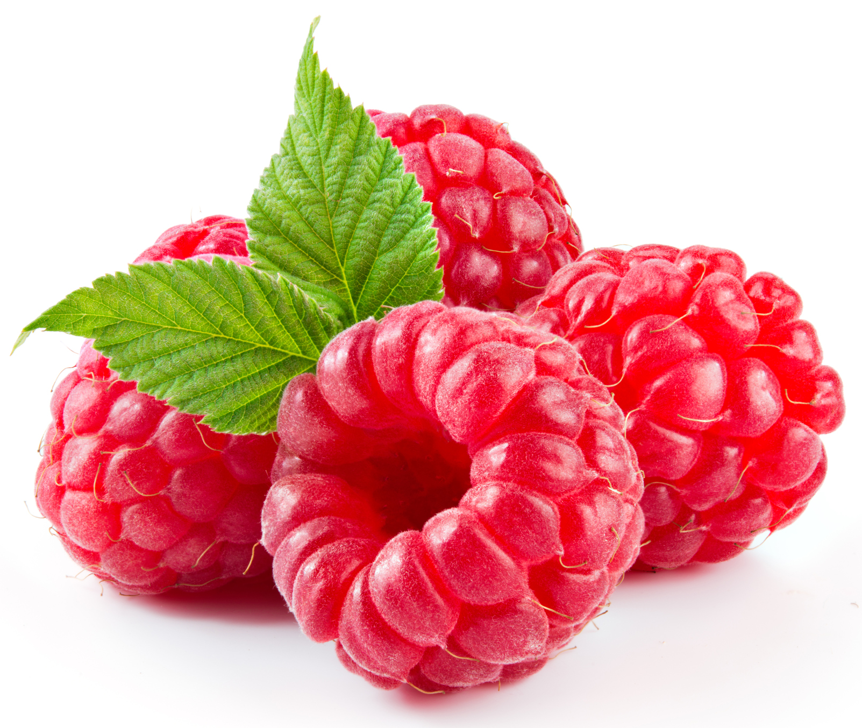
What we are learning today
To we will be learning about raspberries!
Who has tried a raspberry before?

Slide 2
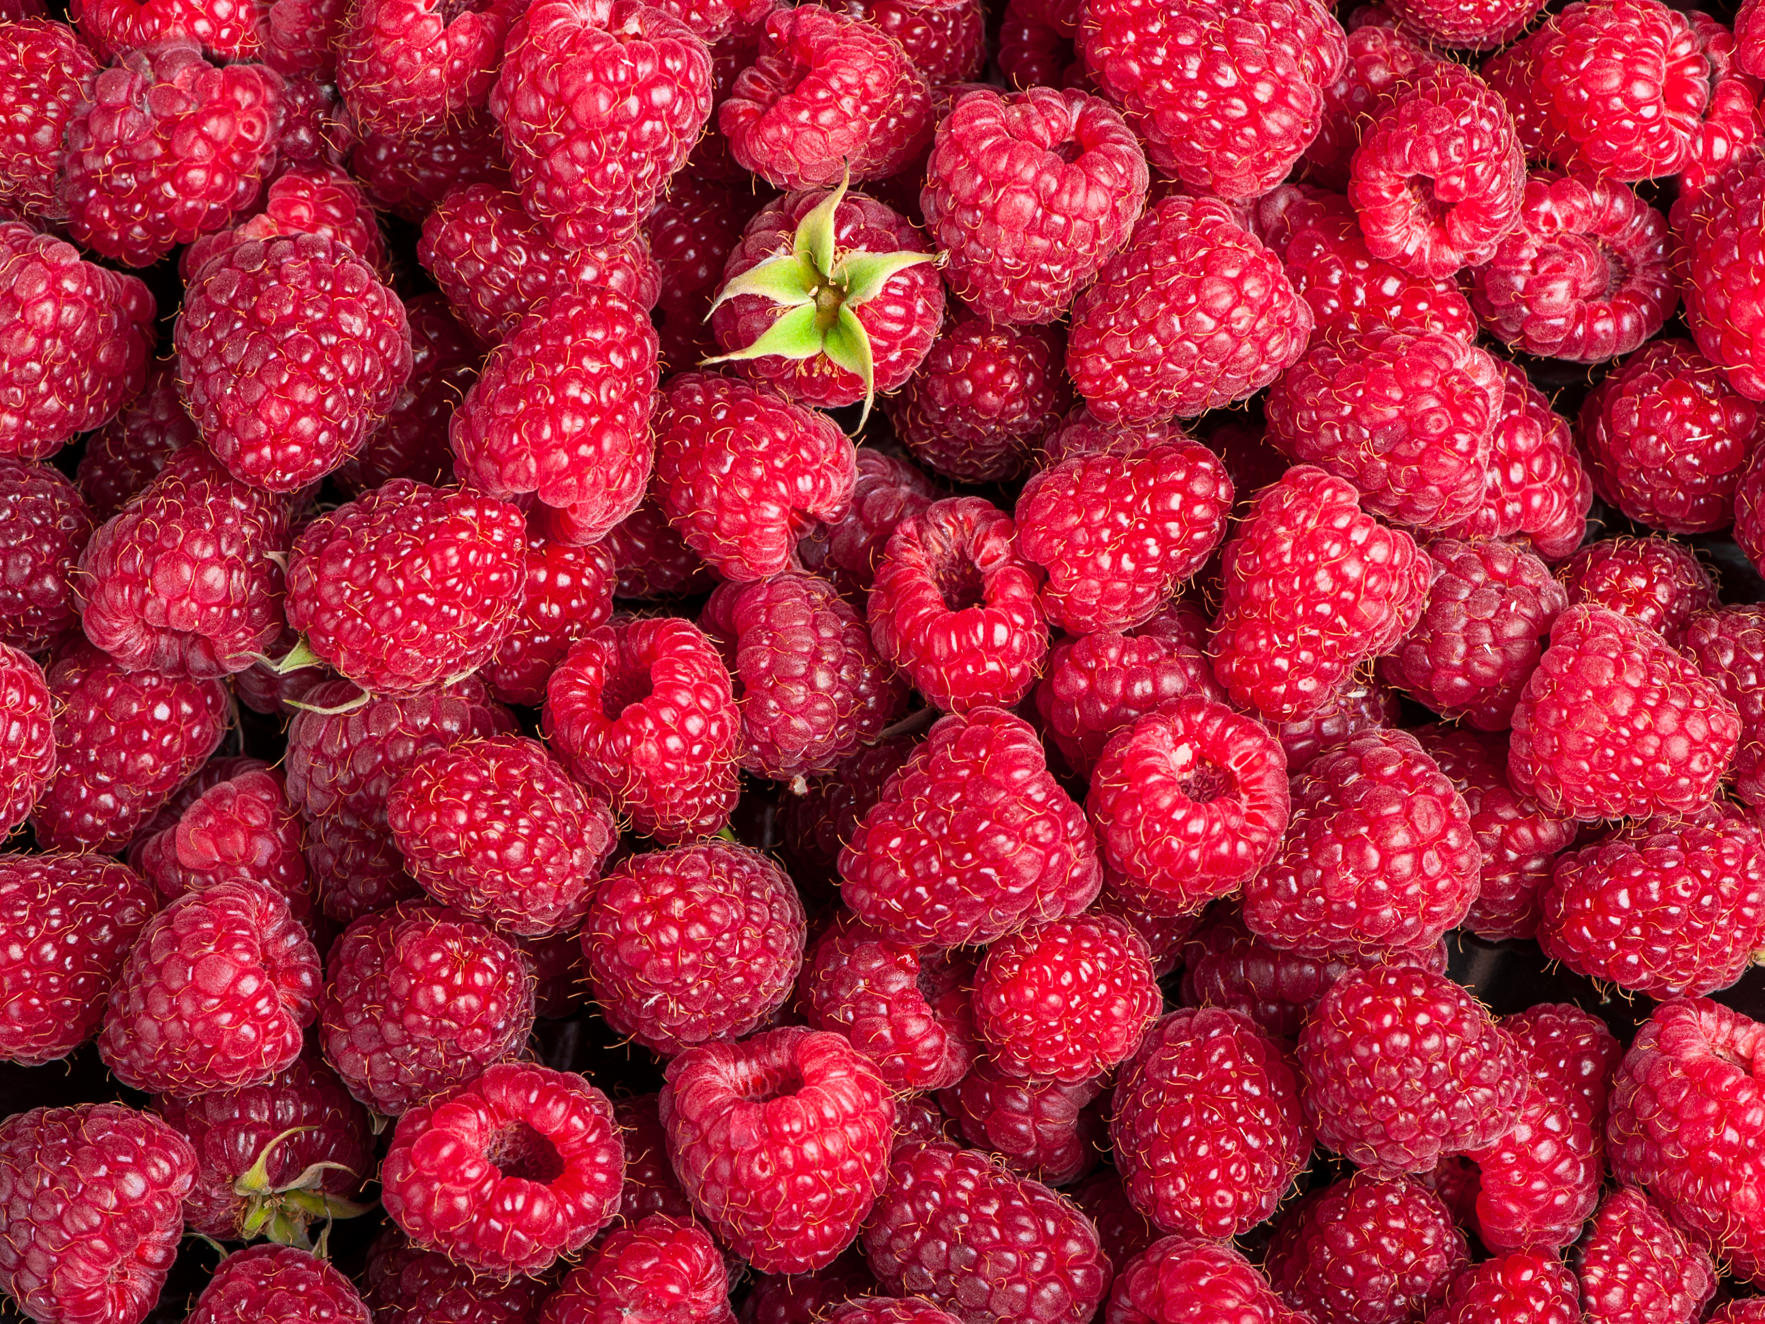
FUN FACTS
Scotland is famous for its raspberries. During the 1950s, raspberries were shuttled from Scotland to London on a train called The Raspberry Express.
There are over 200 varieties of raspberries. Most are red, but you’ll also find purple and yellow ones. The yellow ones are the most fragile, but they’re also the sweetest.
Raspberries were once a symbol for kindness.

Slide 3
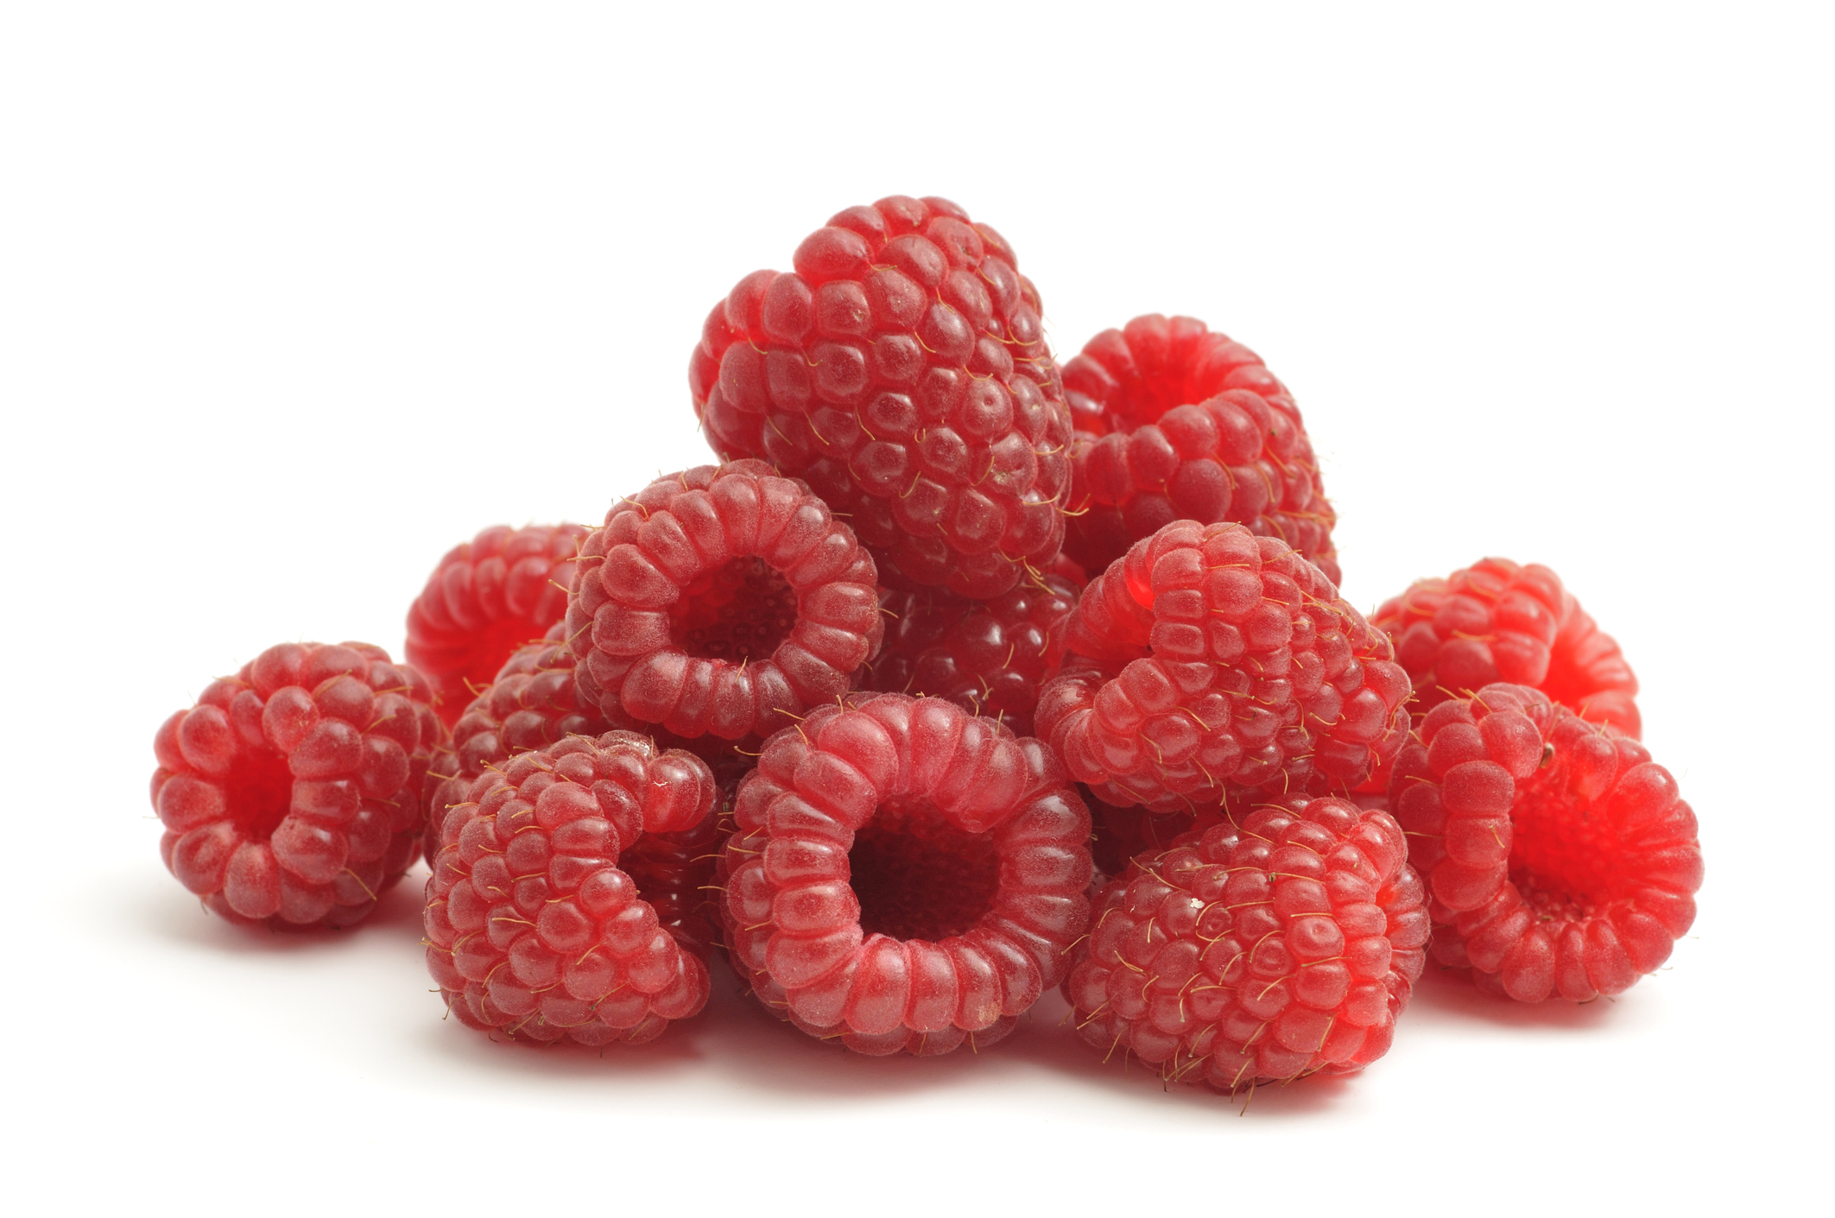
NUTRITION NUGGET
Raspberries are very healthy! They contain more vitamin C than an orange and are full of antioxidants!
Raspberries are high in fiber and can help your digestive system.

Slide 4
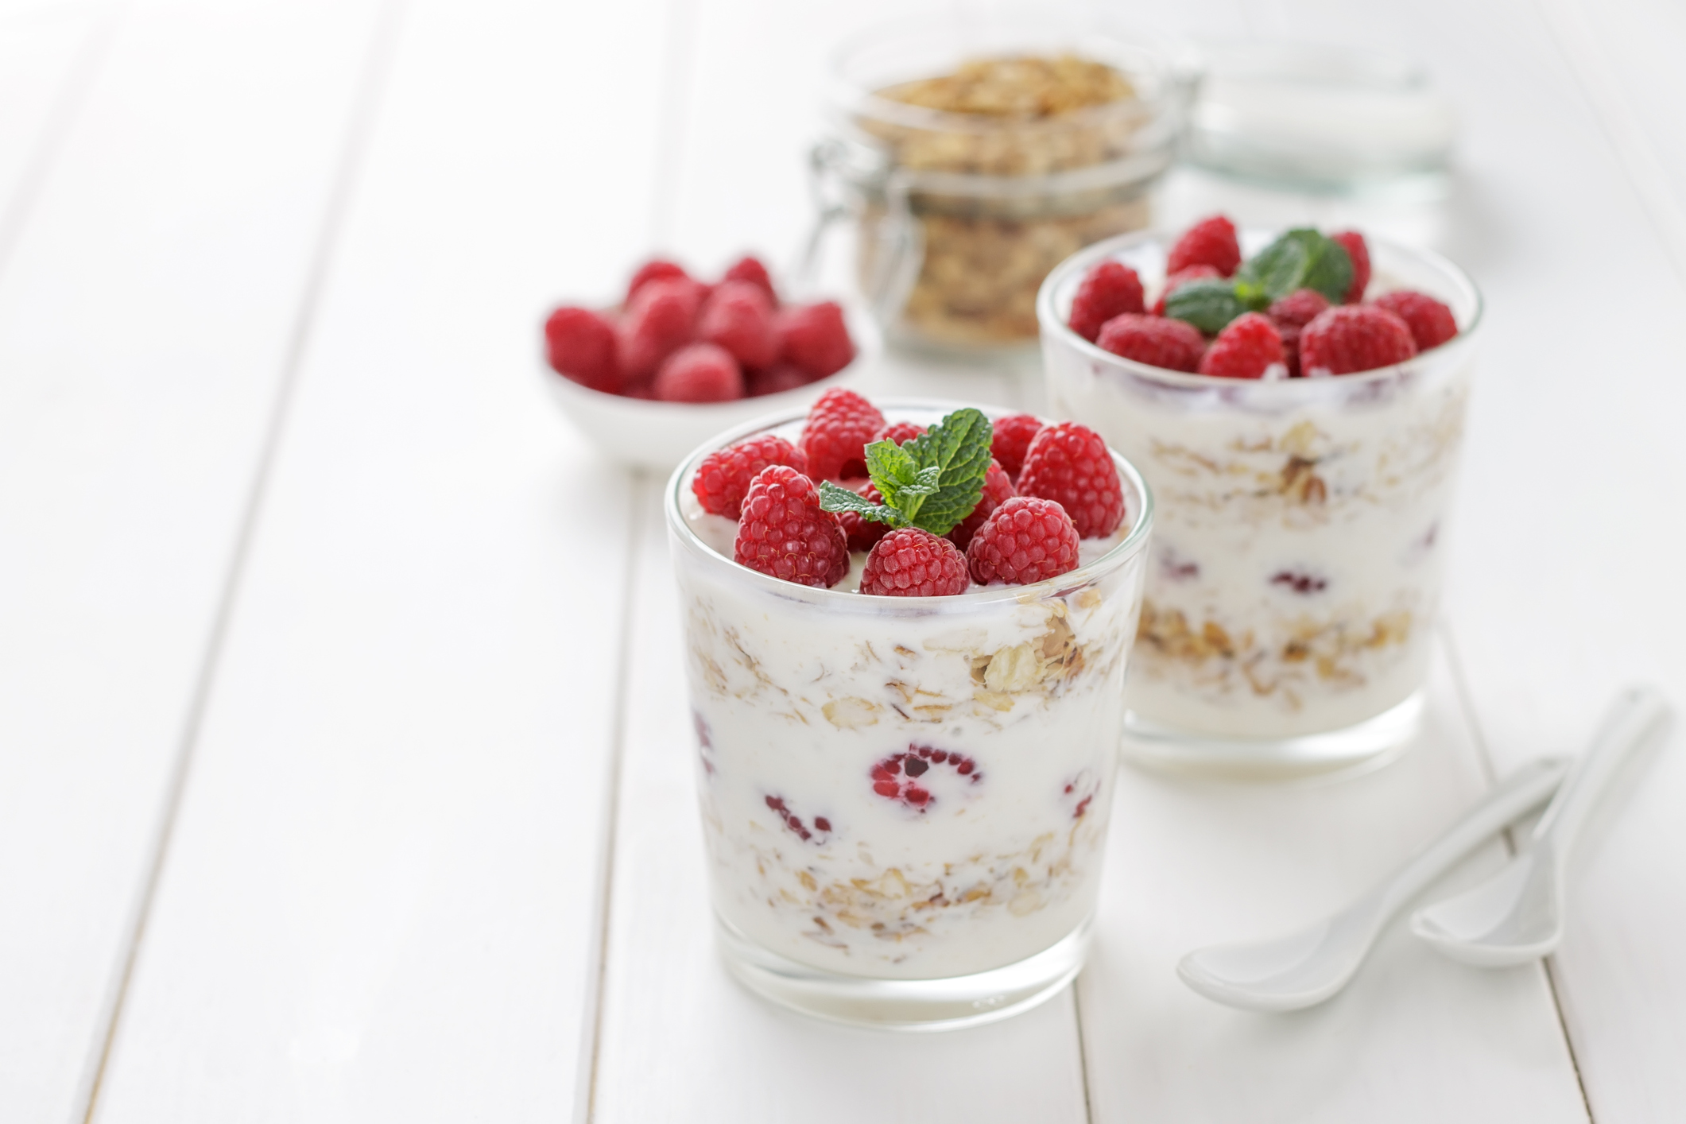
TASTY TIPS
Raspberries can be eaten fresh out of hand, added to yogurt, cereal, or smoothies, or stirred into ice cream.
Freeze them to use later or add them to salads.
Dried raspberries are delicious in baked goods.
And how about raspberry jam, which is easy to make at home.

Slide 5
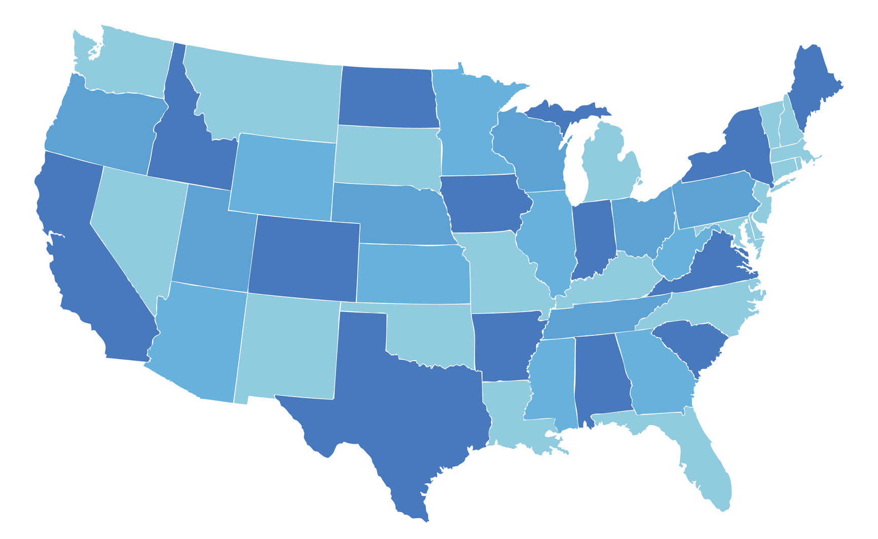
Spot it on the map
The United States is the world’s 3rd largest grower of raspberries!
Most of the raspberries that come from the United States are grown in California, Oregon and Washington.

