Slide 1
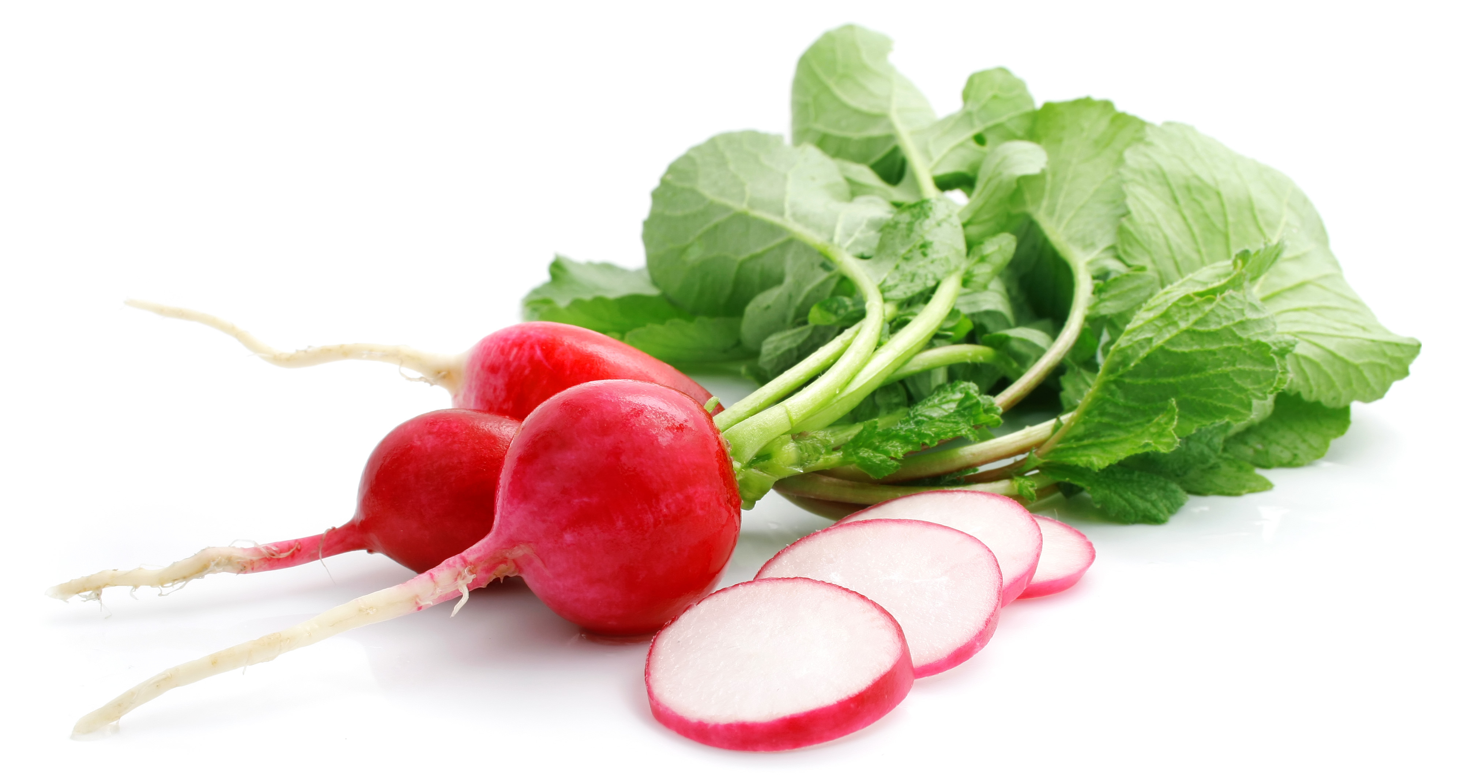
What we are learning today
Hello!
I’m Ruby the Florida Radish.
It’s time to explore the Florida grown Radish.
Join me as we observe Florida Radish production!

Slide 2
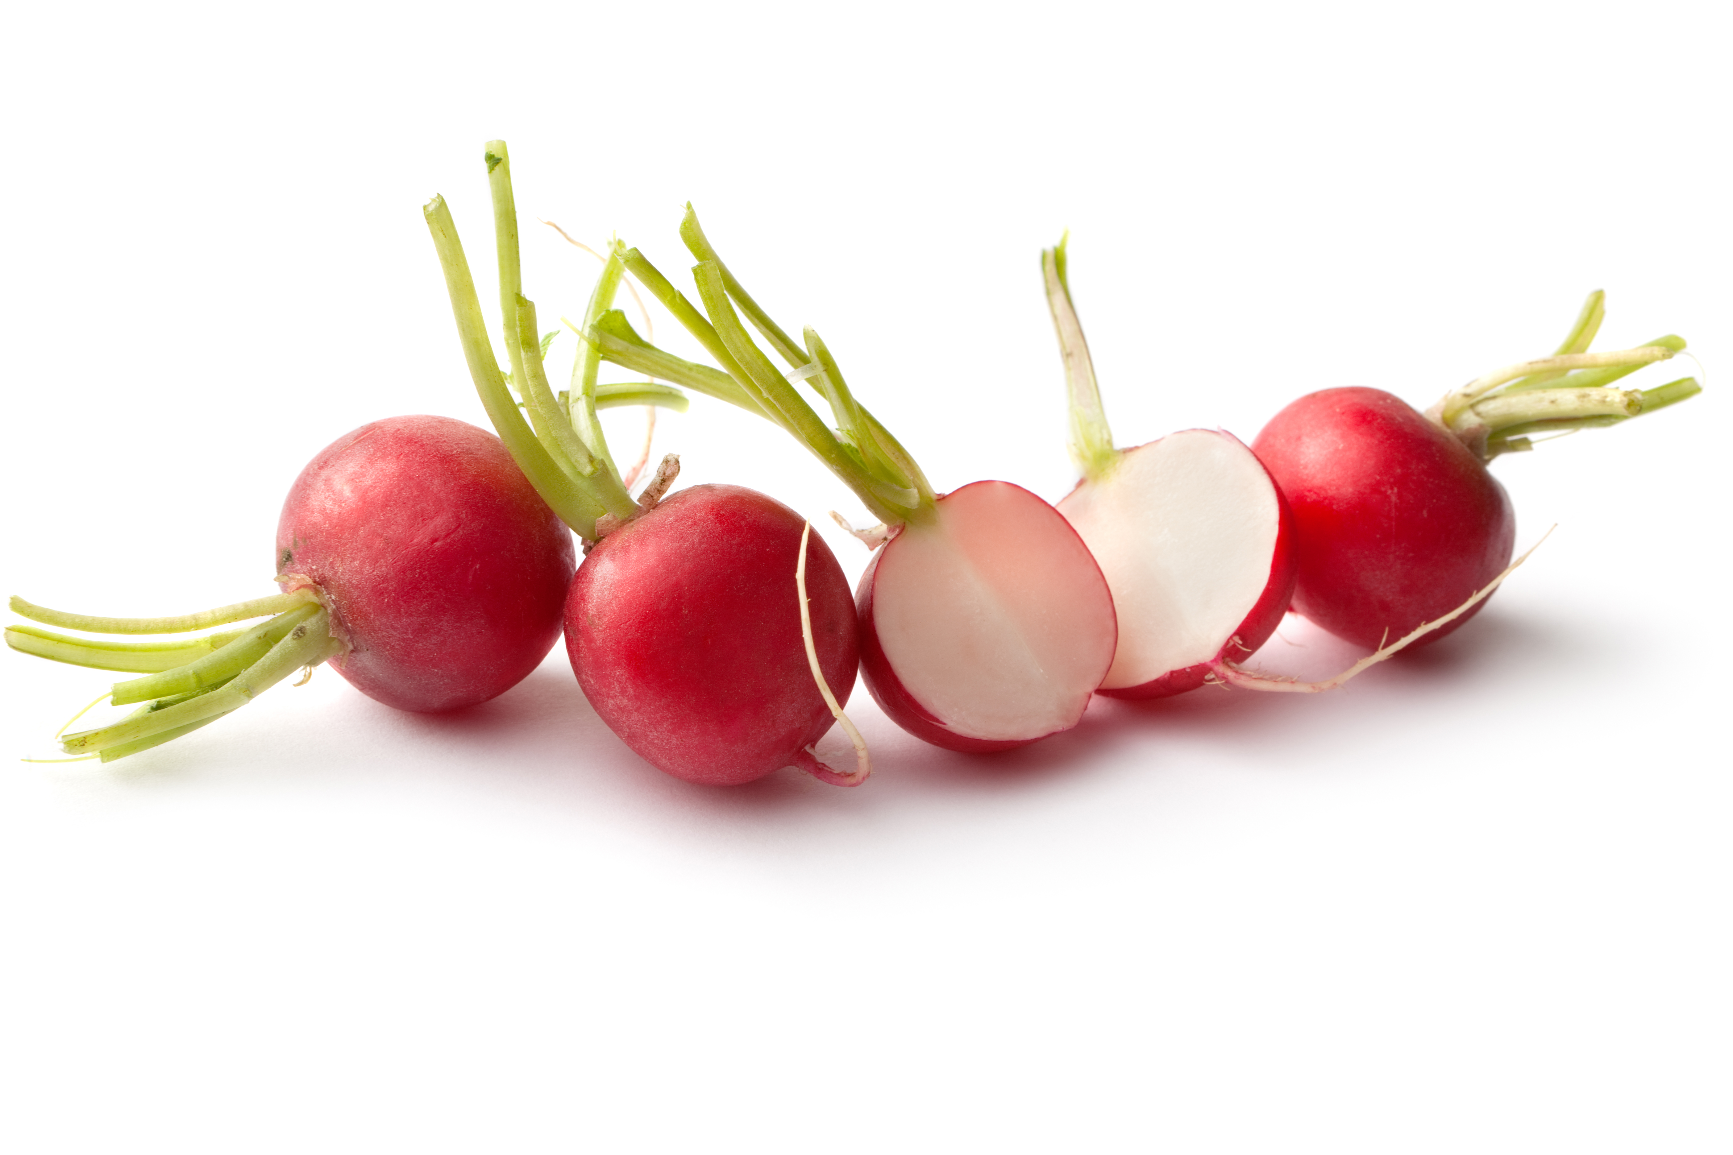
FUN FACTS
Radishes were used as money in ancient Egypt.
Once a radish gets too old, it will crack and split.
Radish comes from the Latin word radix- which means “root”.
Radishes are a healthy and nutritious root vegetable.

Slide 3
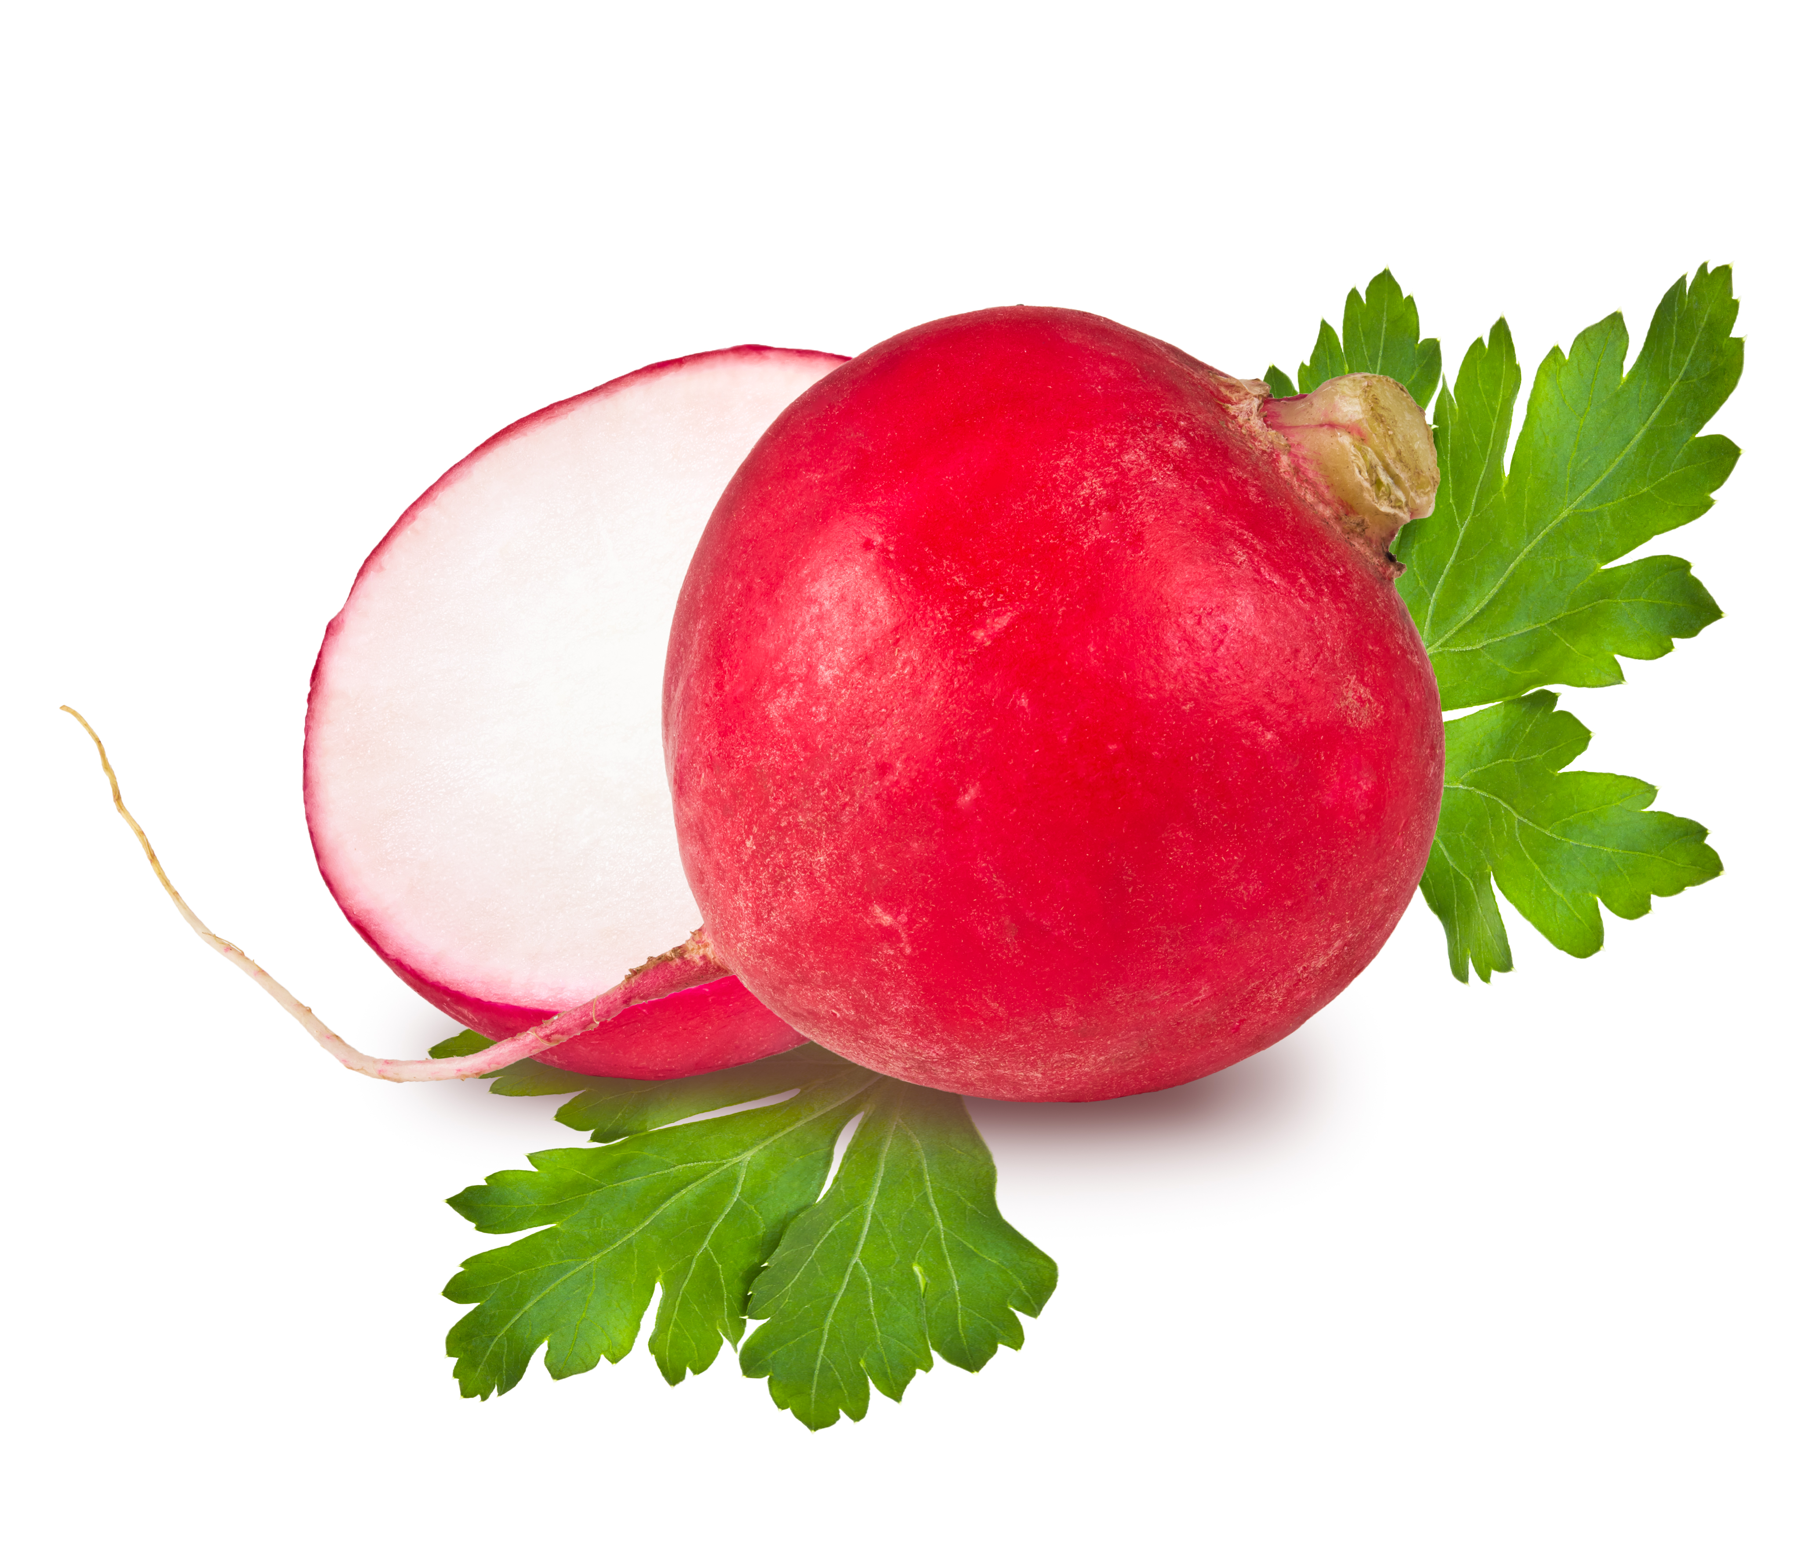
Did You Know?
Radishes are an excellent source of vitamin C!
Radishes contain fiber and potassium.

Slide 4
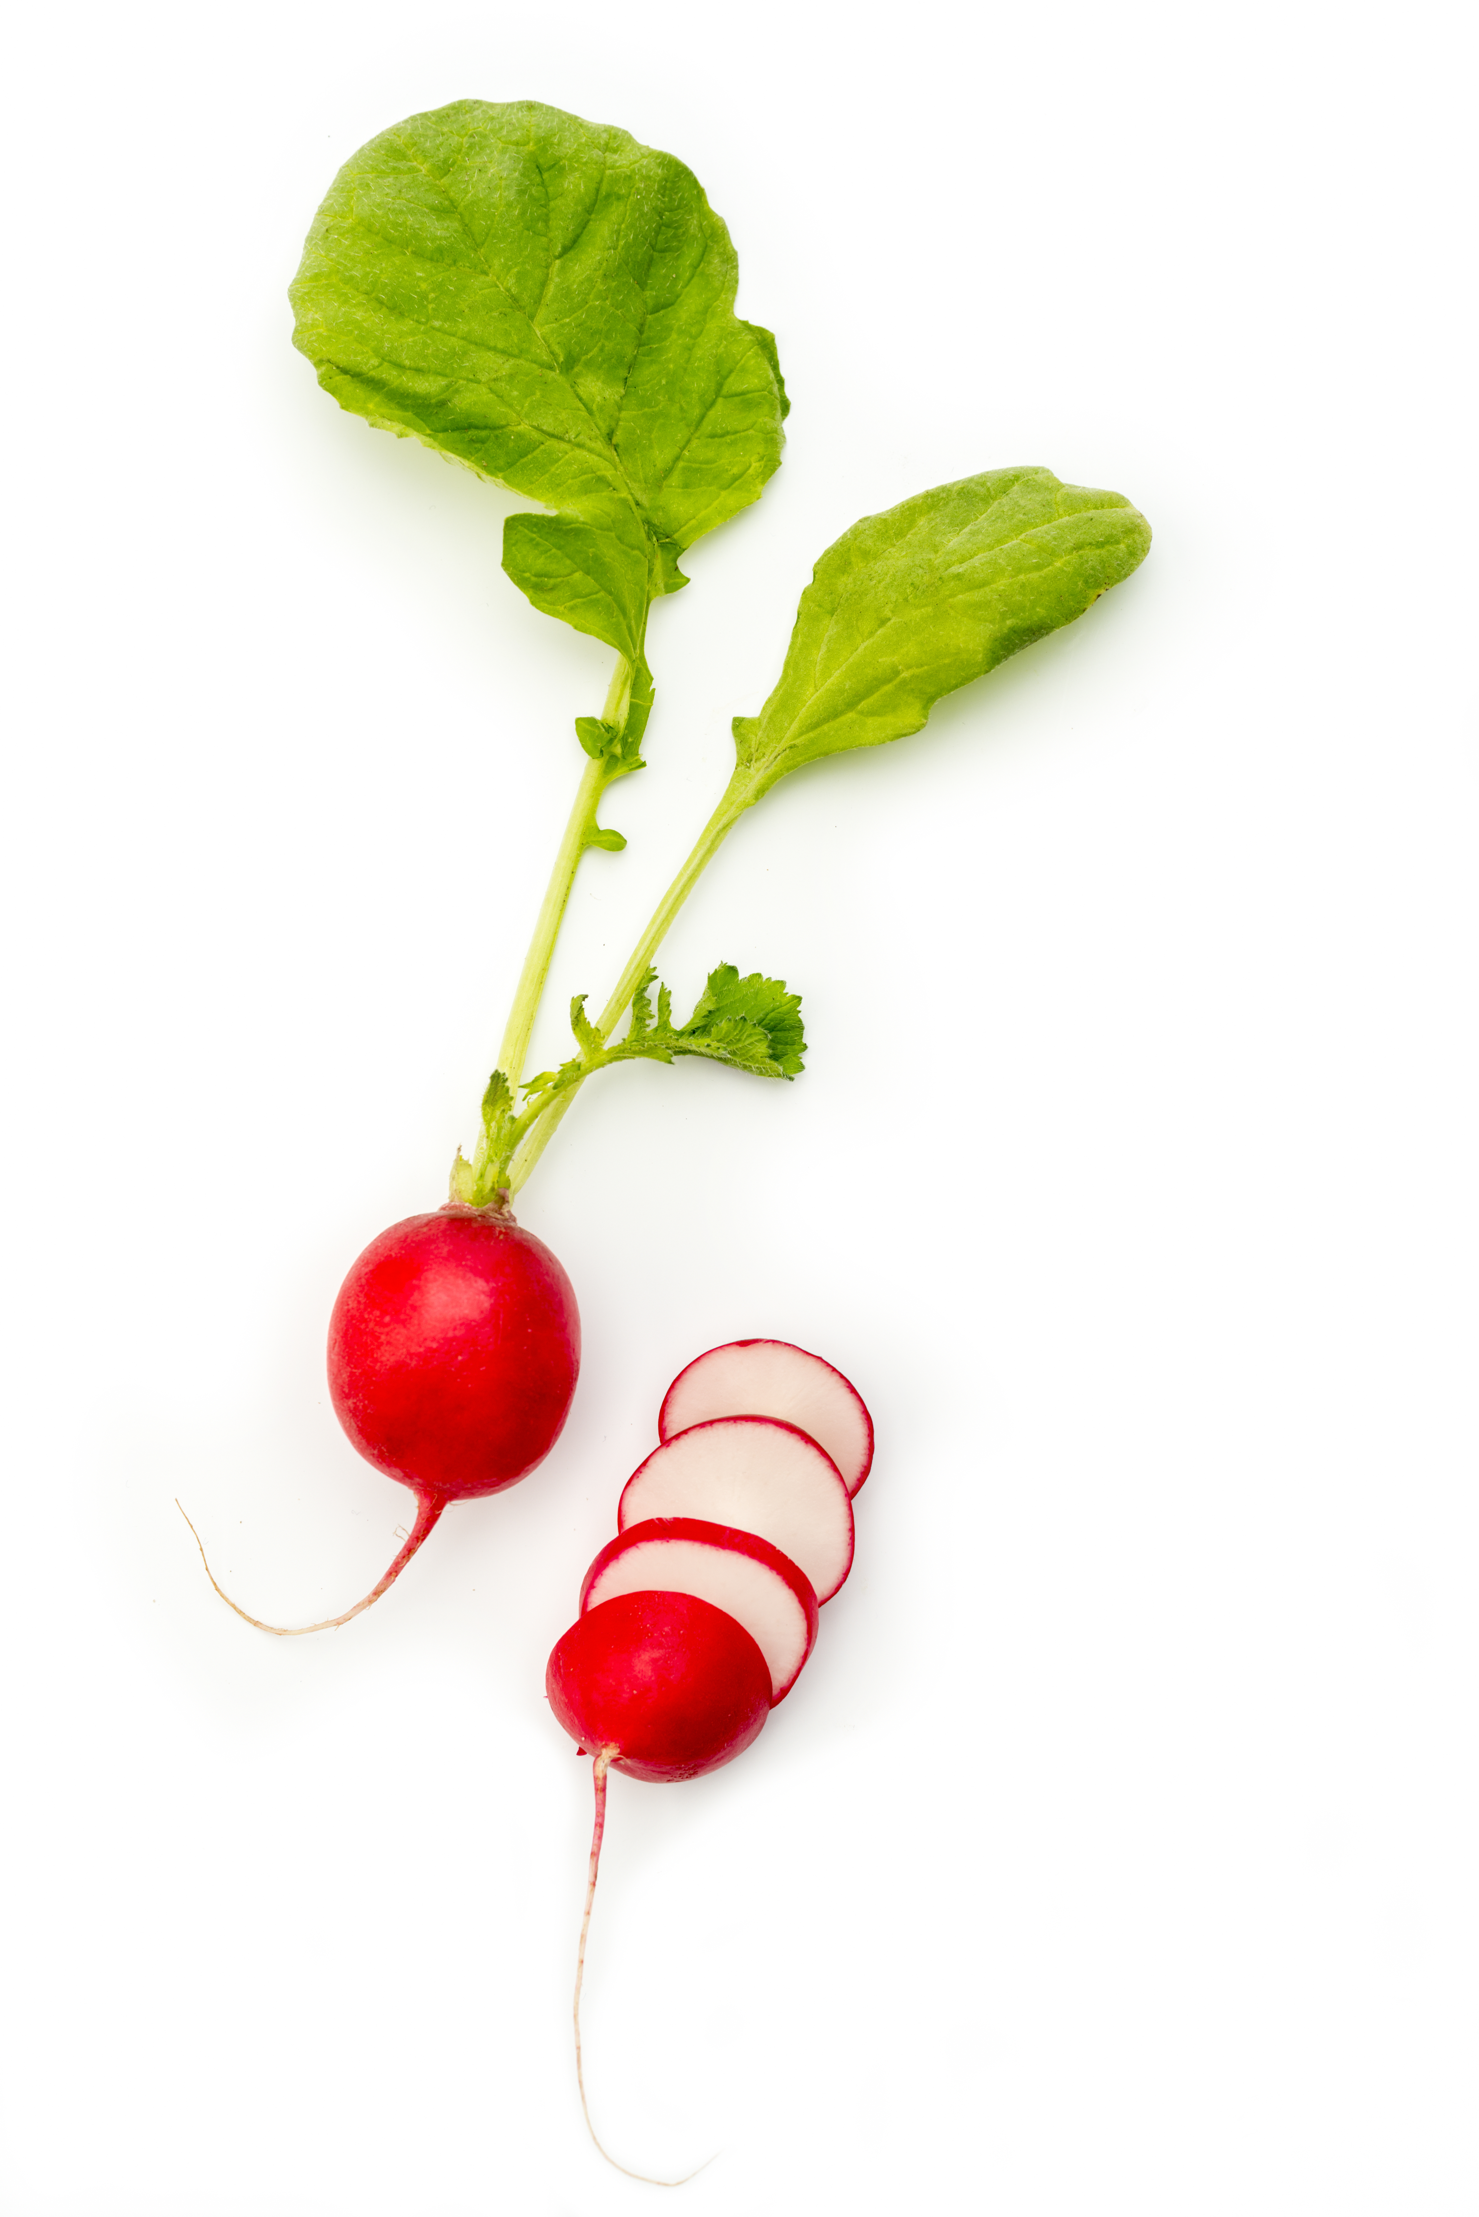
Radical
Radishes
Radishes are a healthy and nutritious root vegetable. One cup of sliced radishes has approximately 19 calories.

