Slide 1
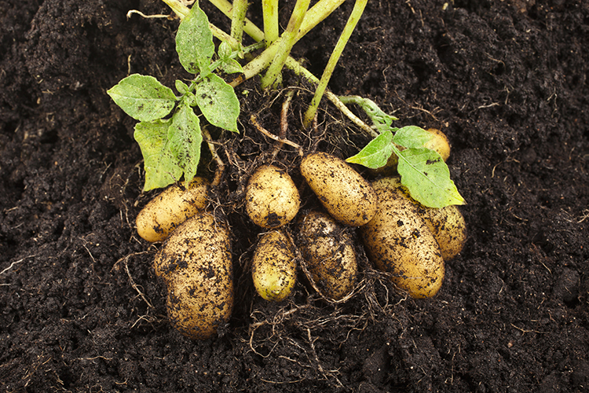

What we are learning today
Hello! I’m Potato Paul!
Together we’ll build
our knowledge about
Florida’s riveting
Potato industry.
Let’s get to work!

Slide 2

FUN FACTS
In October of 1995,
the potato became the
first vegetable grown
in space.
A spud originally referred
to the small hole a potato would be planted in, until around 1845 when the
term transferred to the
actual potato.

Slide 3


Did You Know?
We’ve struck gold!
During the Alaskan Klondike gold rush
(1897-1898), potatoes
were practically worth
their weight in gold.
Potatoes were valued
for their vitamin C, and
at the time, gold was
more plentiful than nutritious foods.

Slide 4

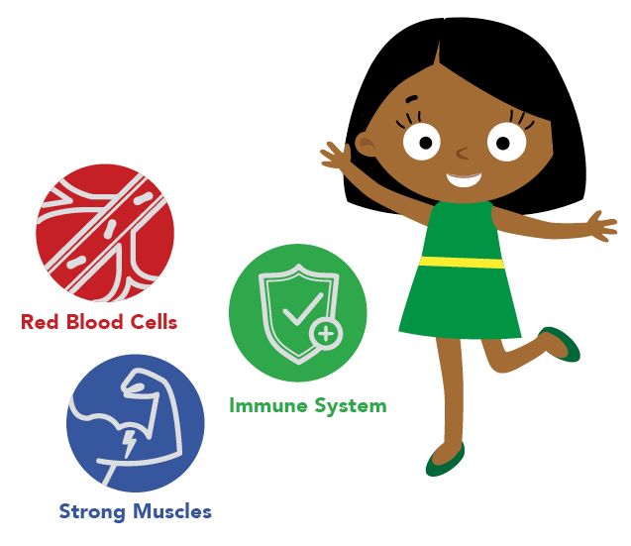
NUTRITION NUGGET
Potatoes are a good source of potassium and vitamin C.
Potassium:
Helps regulate fluids in the body
Assists with muscle contraction
Helps maintain normal blood pressure
Vitamin C
Helps prevent cell damage in the body
Plays a role in supporting the body’s immune system
Produces collagen which makes healthy cartilage, joints, skin and blood vessels

Slide 5
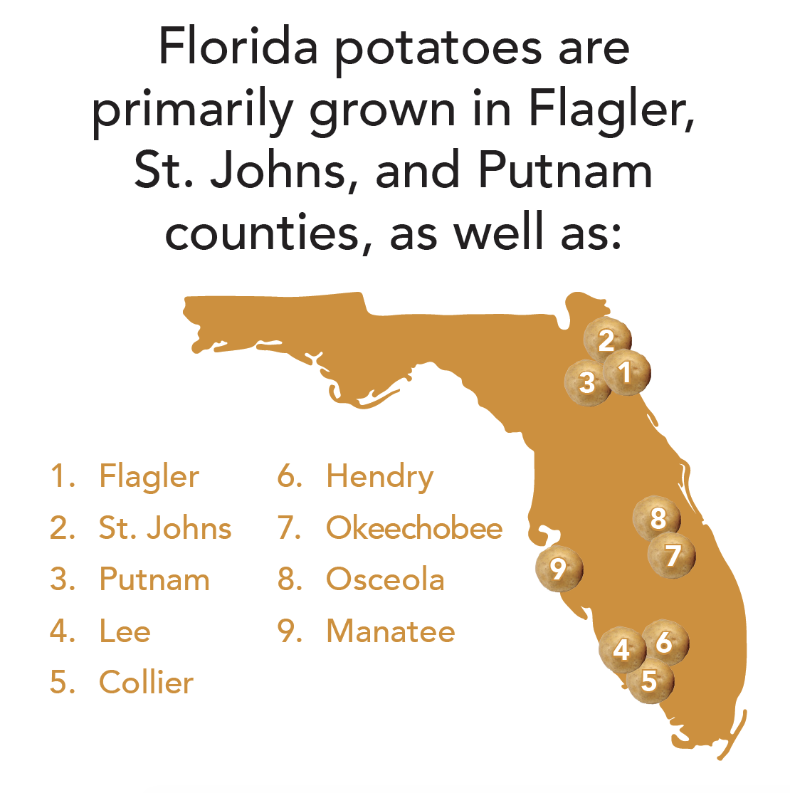
Spot it on the map
Florida is home to
several large potato growing regions.
Over 30,000 acres of
seven different types potatoes are grown in selected regions of
the state.

