Slide 1
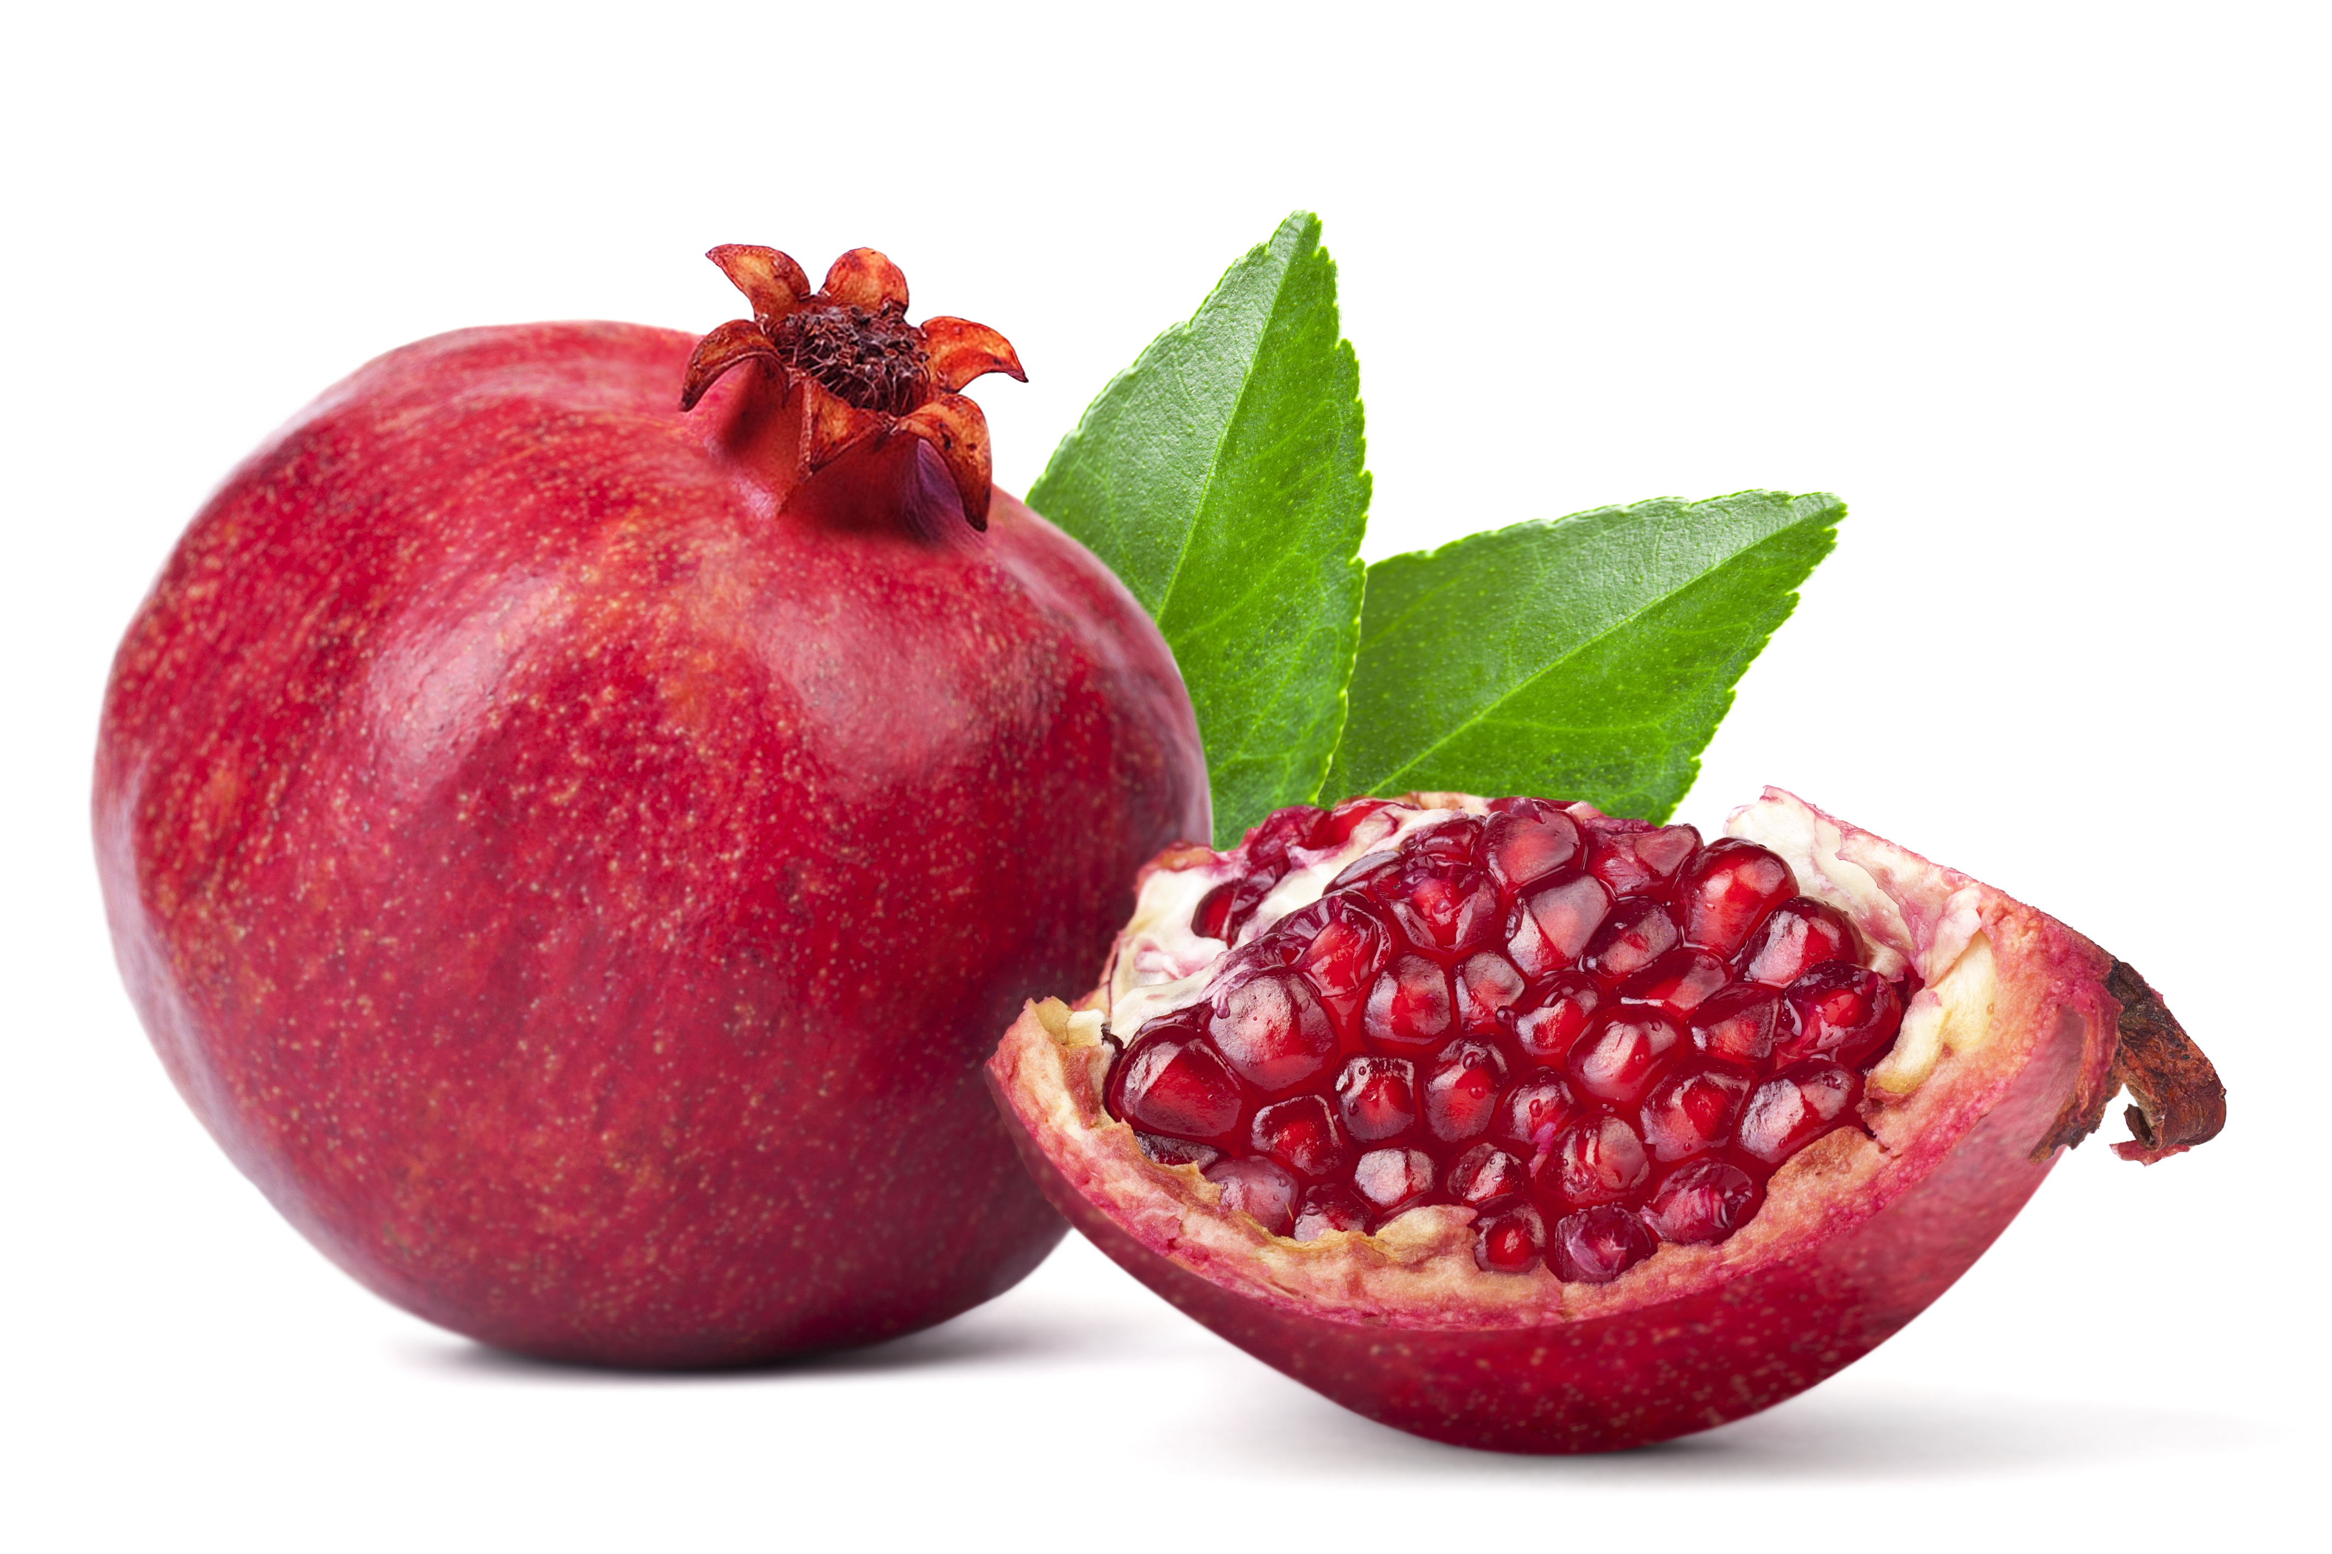
What we are learning today
Today we are going to be learning about pomegranates!

Slide 2
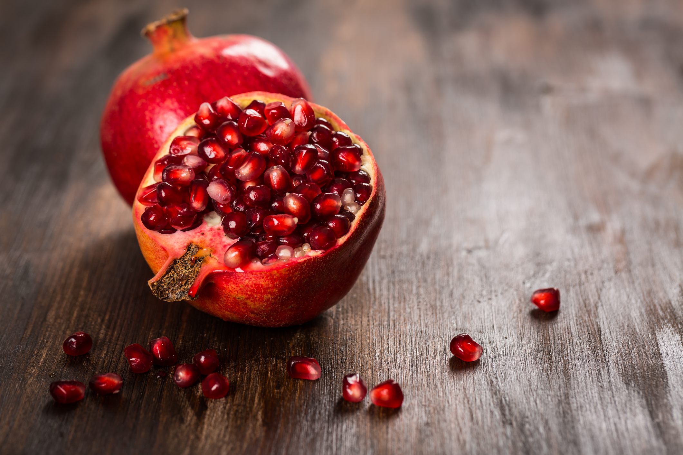
FUN FACTS
In Ancient Rome, pomegranates were crushed and used as dye.
Pomegranates belong to the berry family.
Pomegranate trees grow in hot and dry climates.
Pomegranate trees can live for more than 200 years!

Slide 3
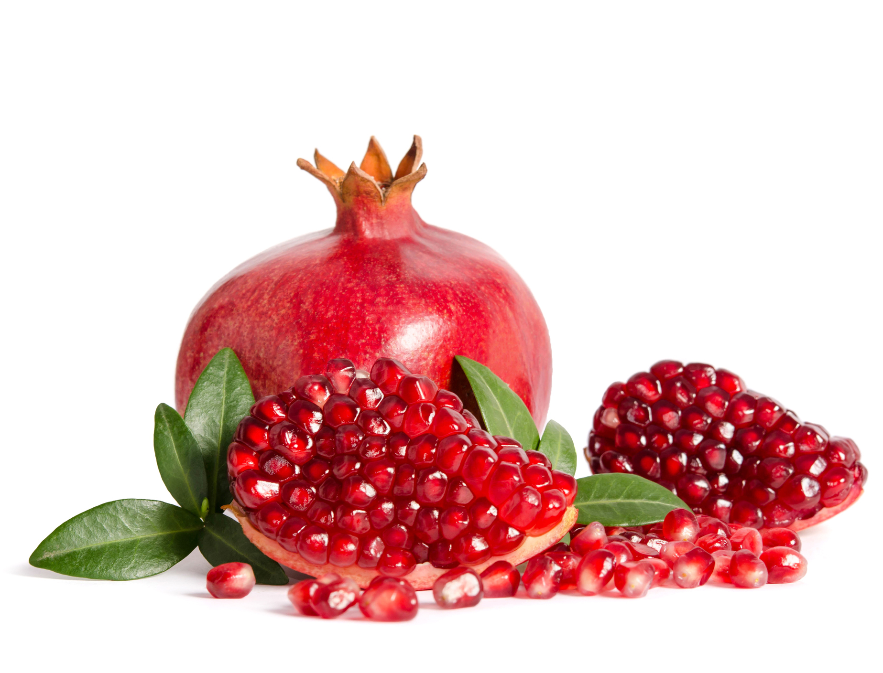
NUTRITION NUGGET
Pomegranates are called a super fruit!
They have powerful antioxidants to keep your body healthy! They can also help your digestive system and keep your heart healthy.

Slide 4

Spot it on the map
Since pomegranates thrive in a hot, dry climate, they are often grown in Arizona and California.

