Slide 1
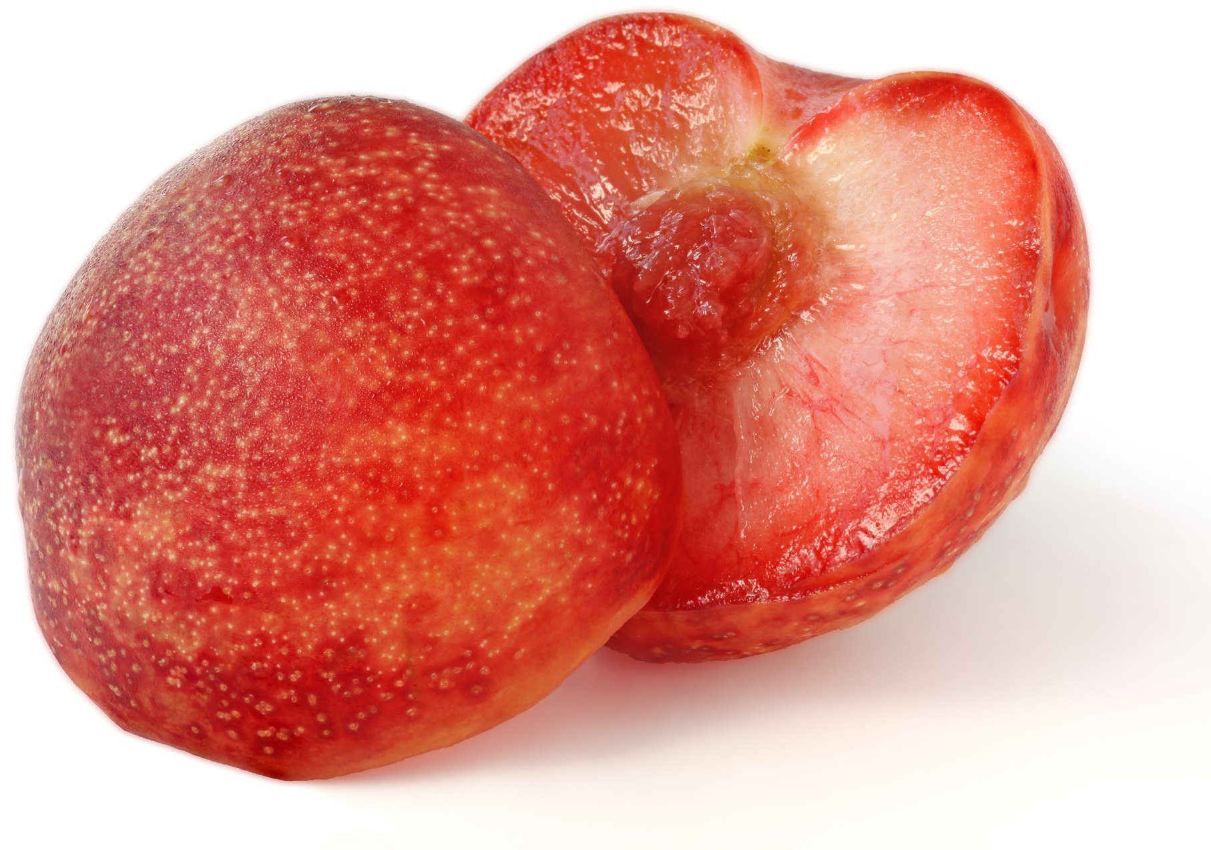
What we are learning today
Together we’ll take a journey and learn all about the Pluot!

Slide 2
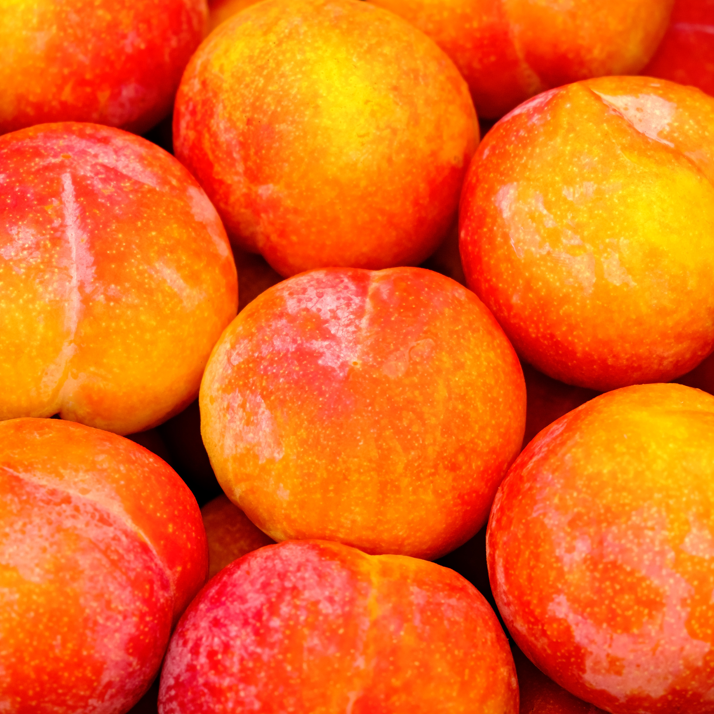
FUN FACTS
This hybrid fruit is a cross between a plum and an apricot.
Sometimes it is called “dinosaur eggs.”

Slide 3

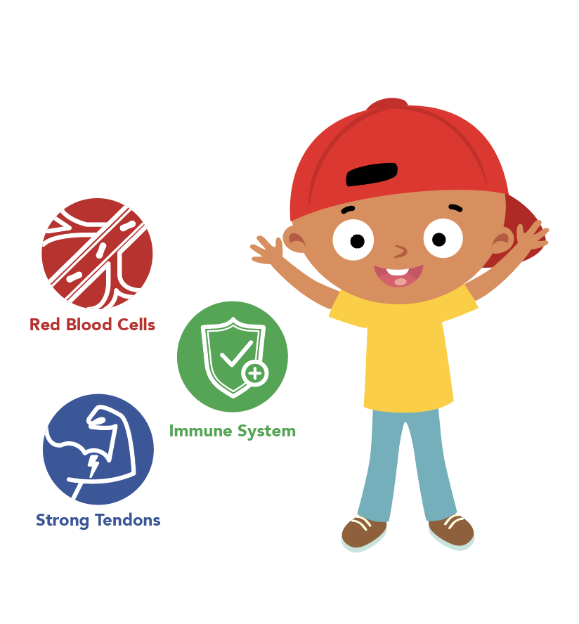
NUTRITION NUGGET
Pluots help to boost your immune system.
They can also improve your heart and helps to maintains good eysight.

Slide 4

Spot it on the map
Grown in Washington State and California.

