Slide 1
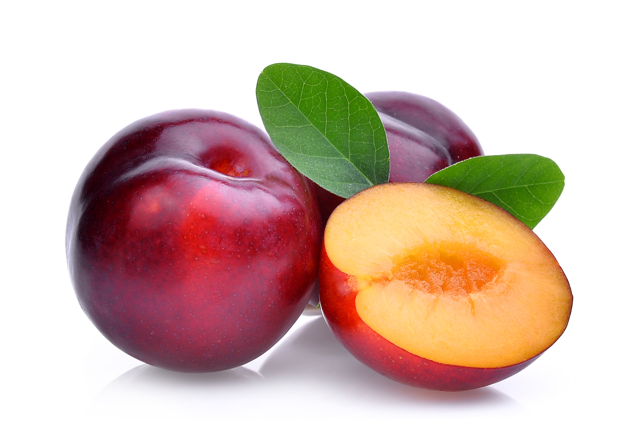
What we are learning today
Today we will be learning about Plums!
Raise your hand if you have ever had a plum!

Slide 2
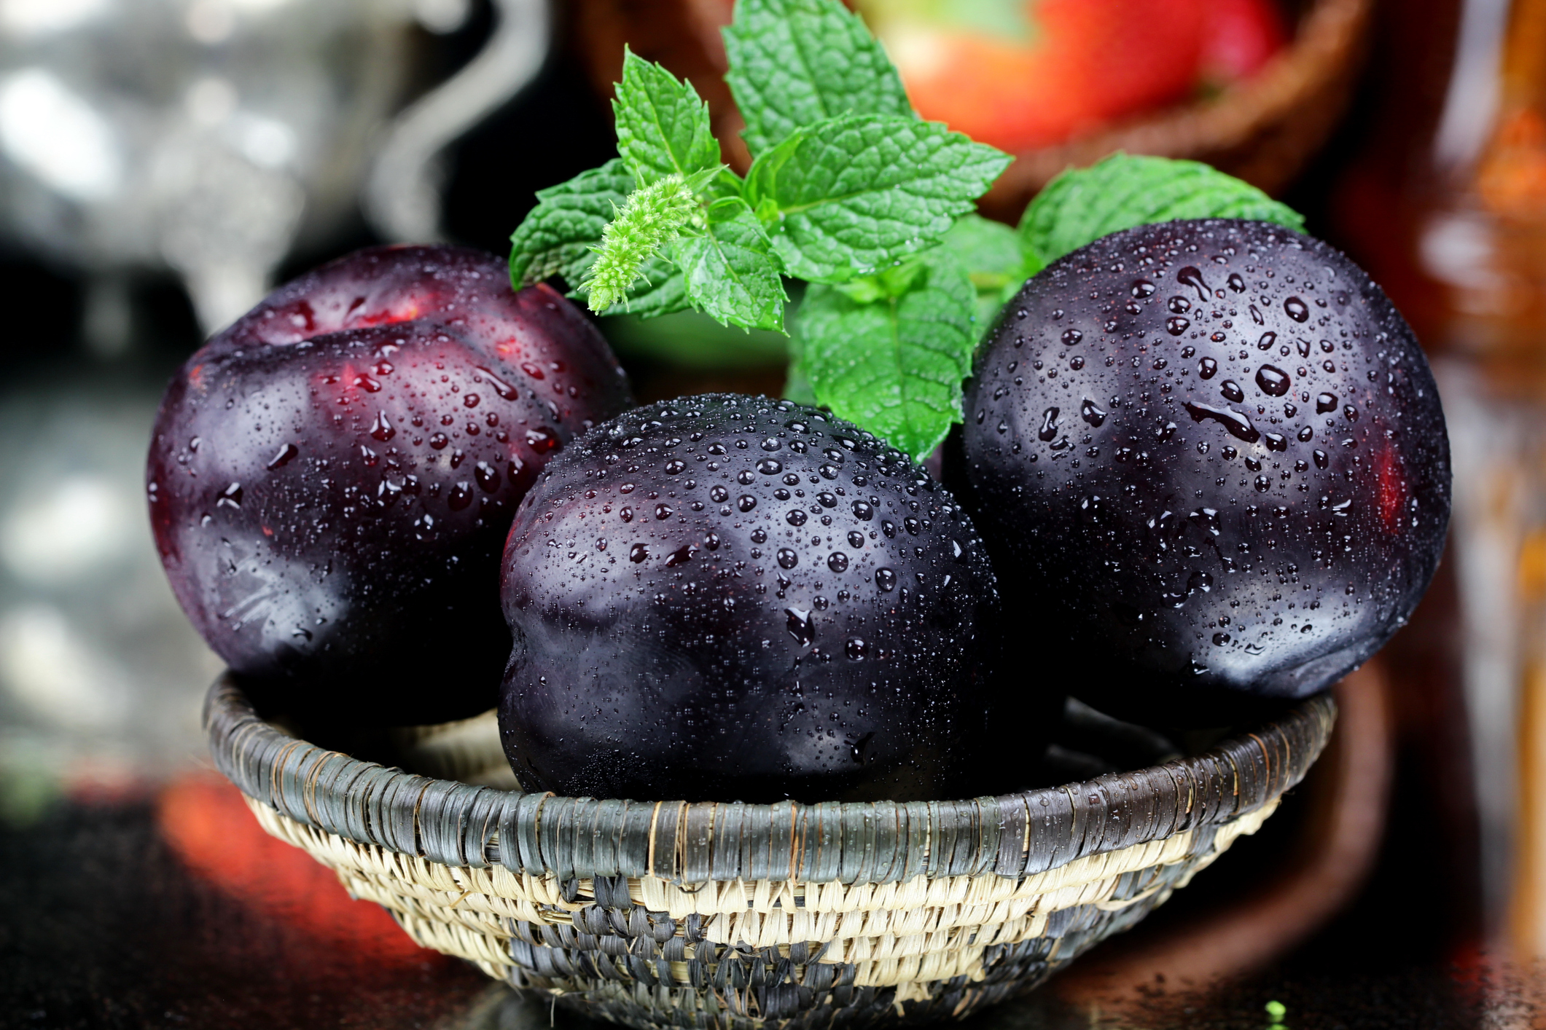
Did you know?
Plums are stone fruits. They belong to the rose family and are related to peaches, apricots, and cherries.
Production of plums start 3-5 years after planting. Productivity starts to decline after the 10th year.

Slide 3
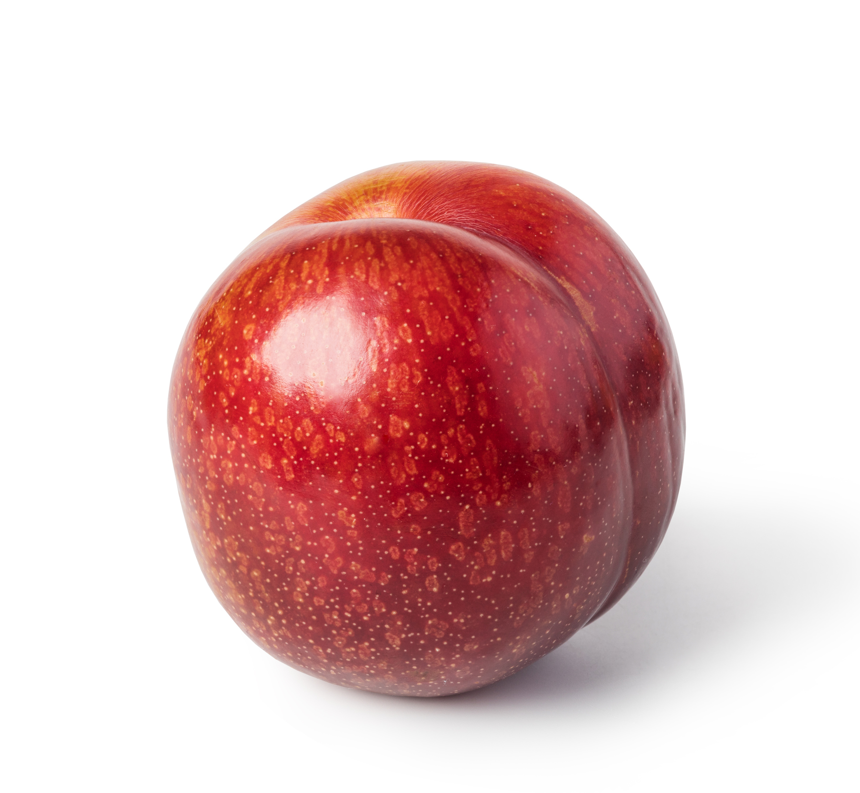
NUTRITION NUGGET
Plums are a rich source of vitamins C, Vitamin K, and dietary fibers.
Plums can help your digestive system.

Slide 4

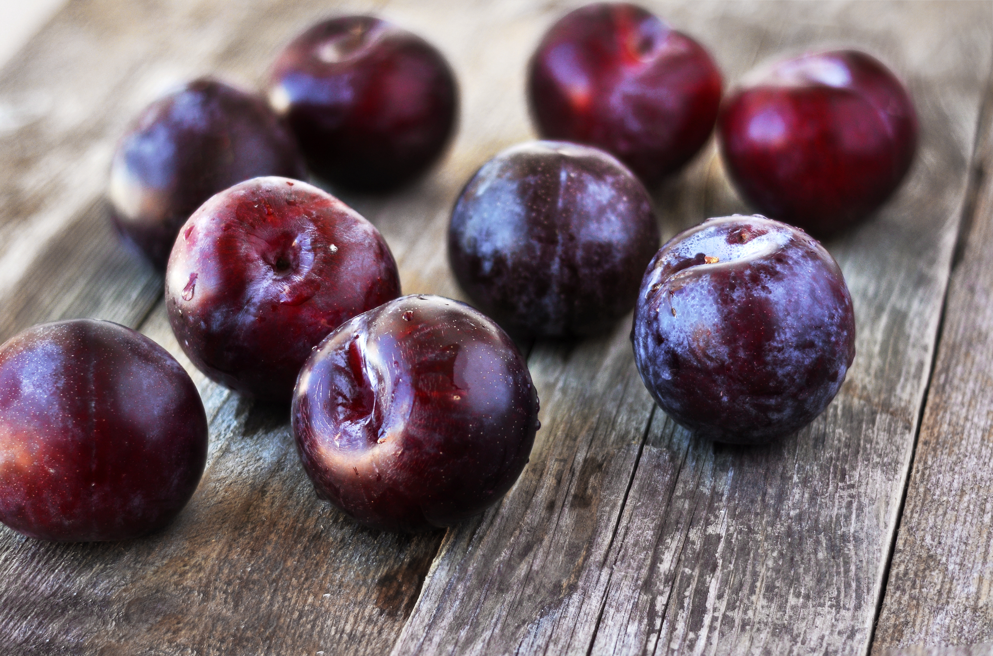
TASTY TIPS
Plums can be made into a tasty jam, jelly or marmalade!

Slide 5
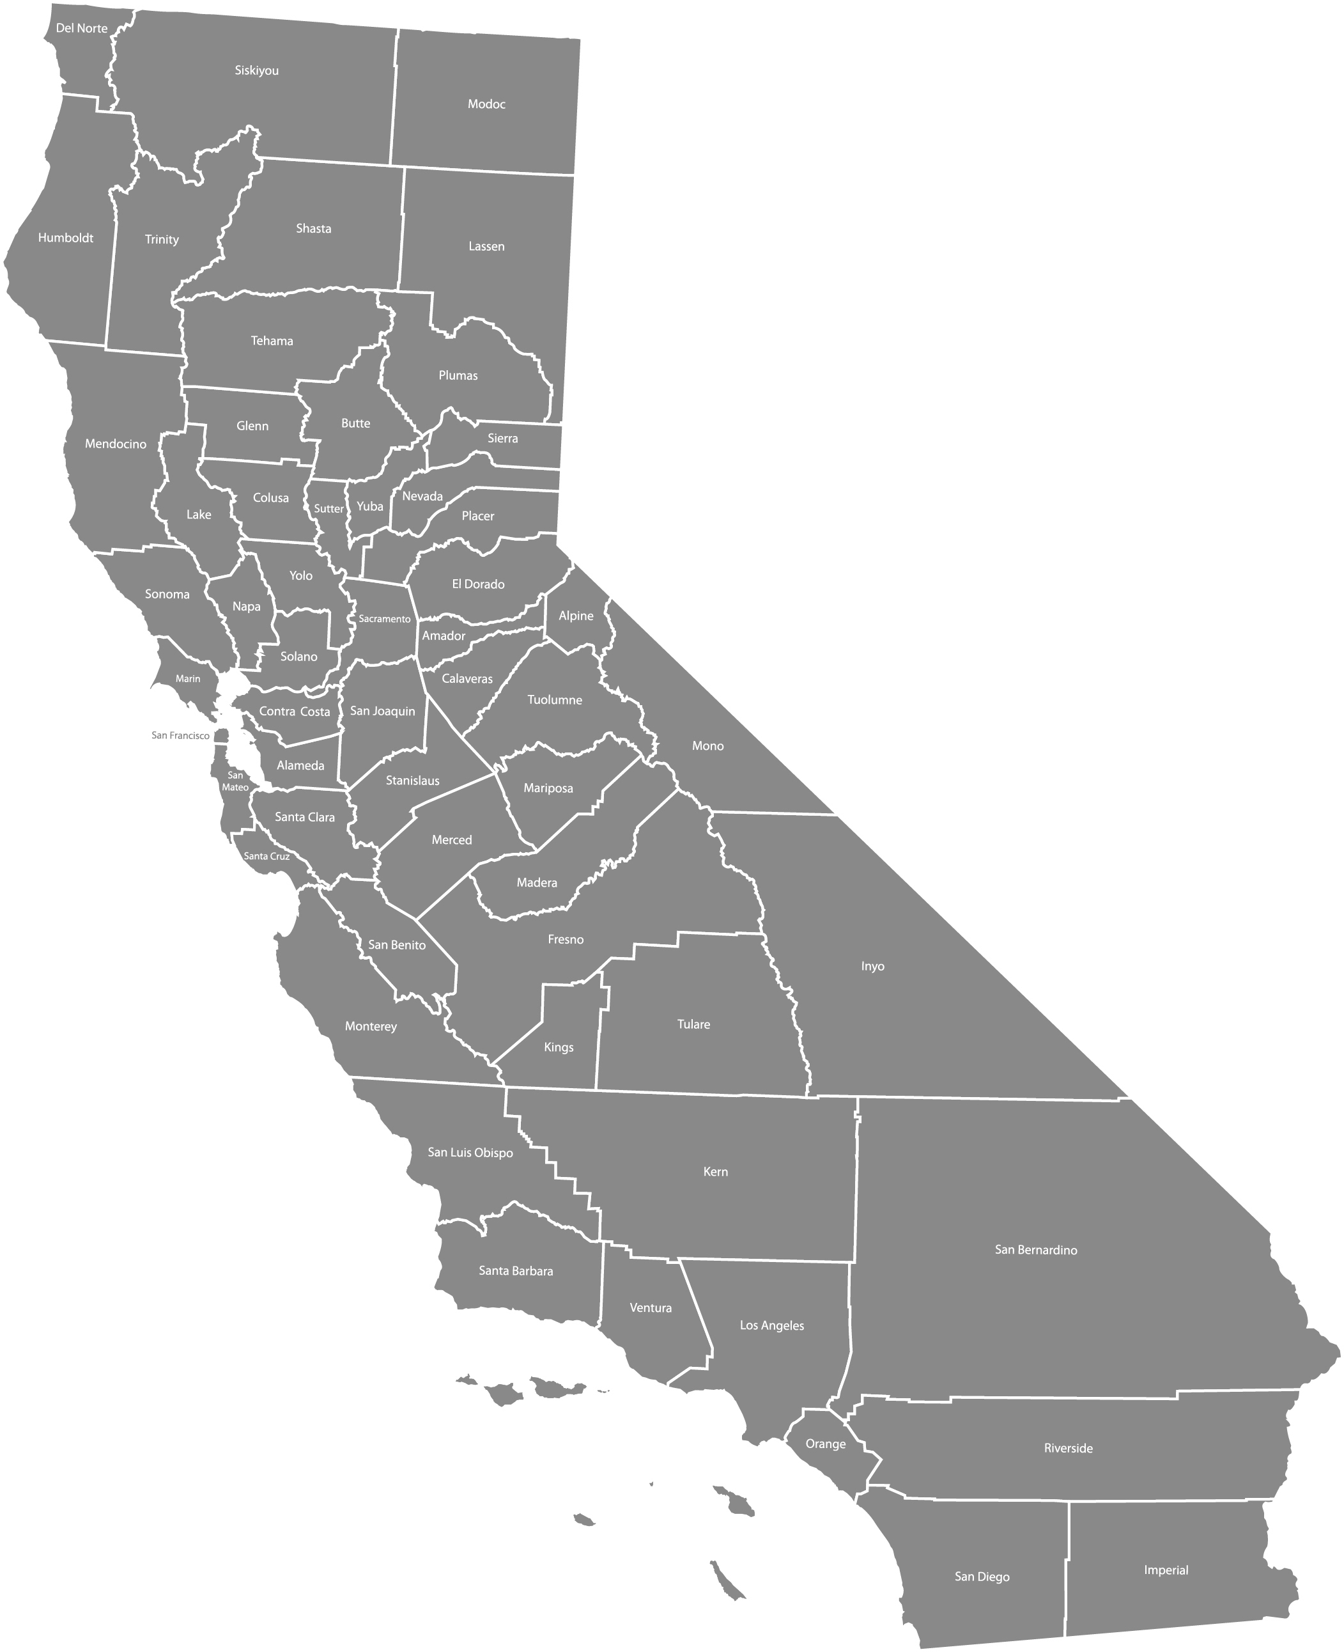
Spot it on the map
95% of all plums grown in the United States come from California.

