Slide 1
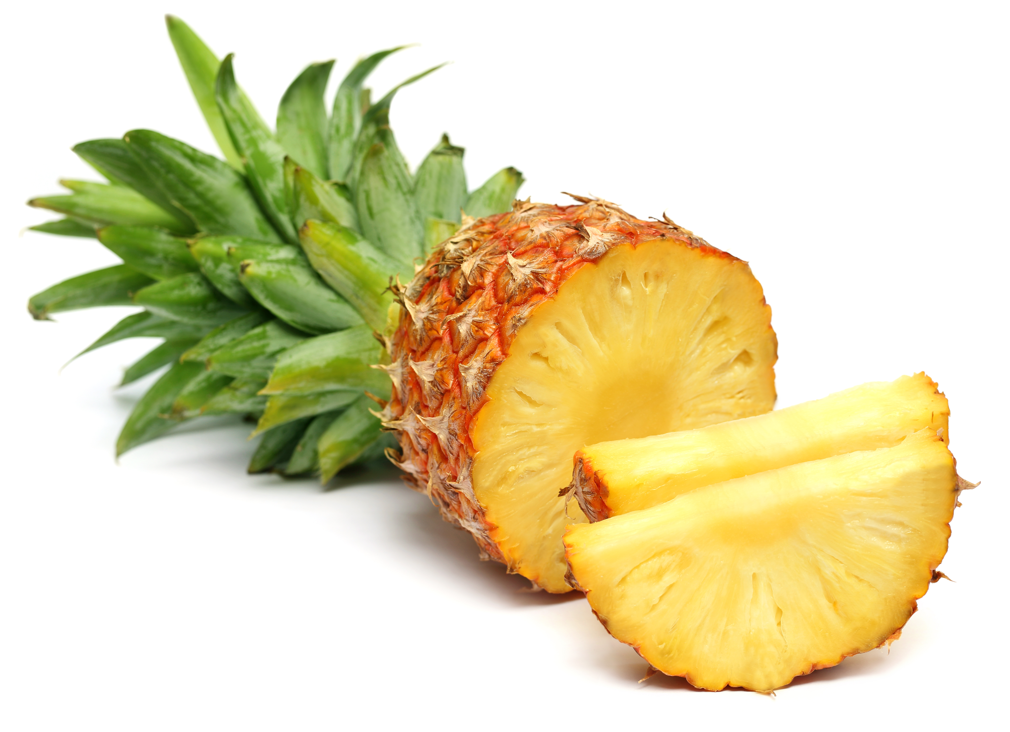
What we are learning today
Today we will learn about pineapples!

Slide 2
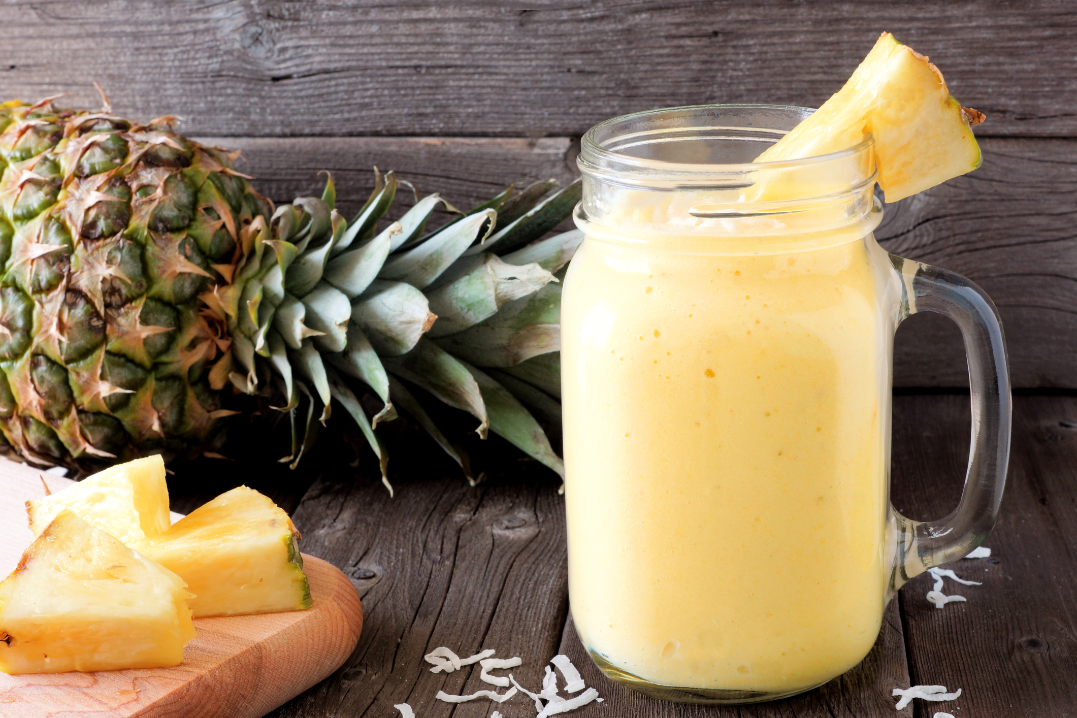
FUN FACTS
An individual pineapple can take over two years to grow.
The top of a pineapple, after cleaning and drying, can be planted in soil and a new plant will grow.

Slide 3
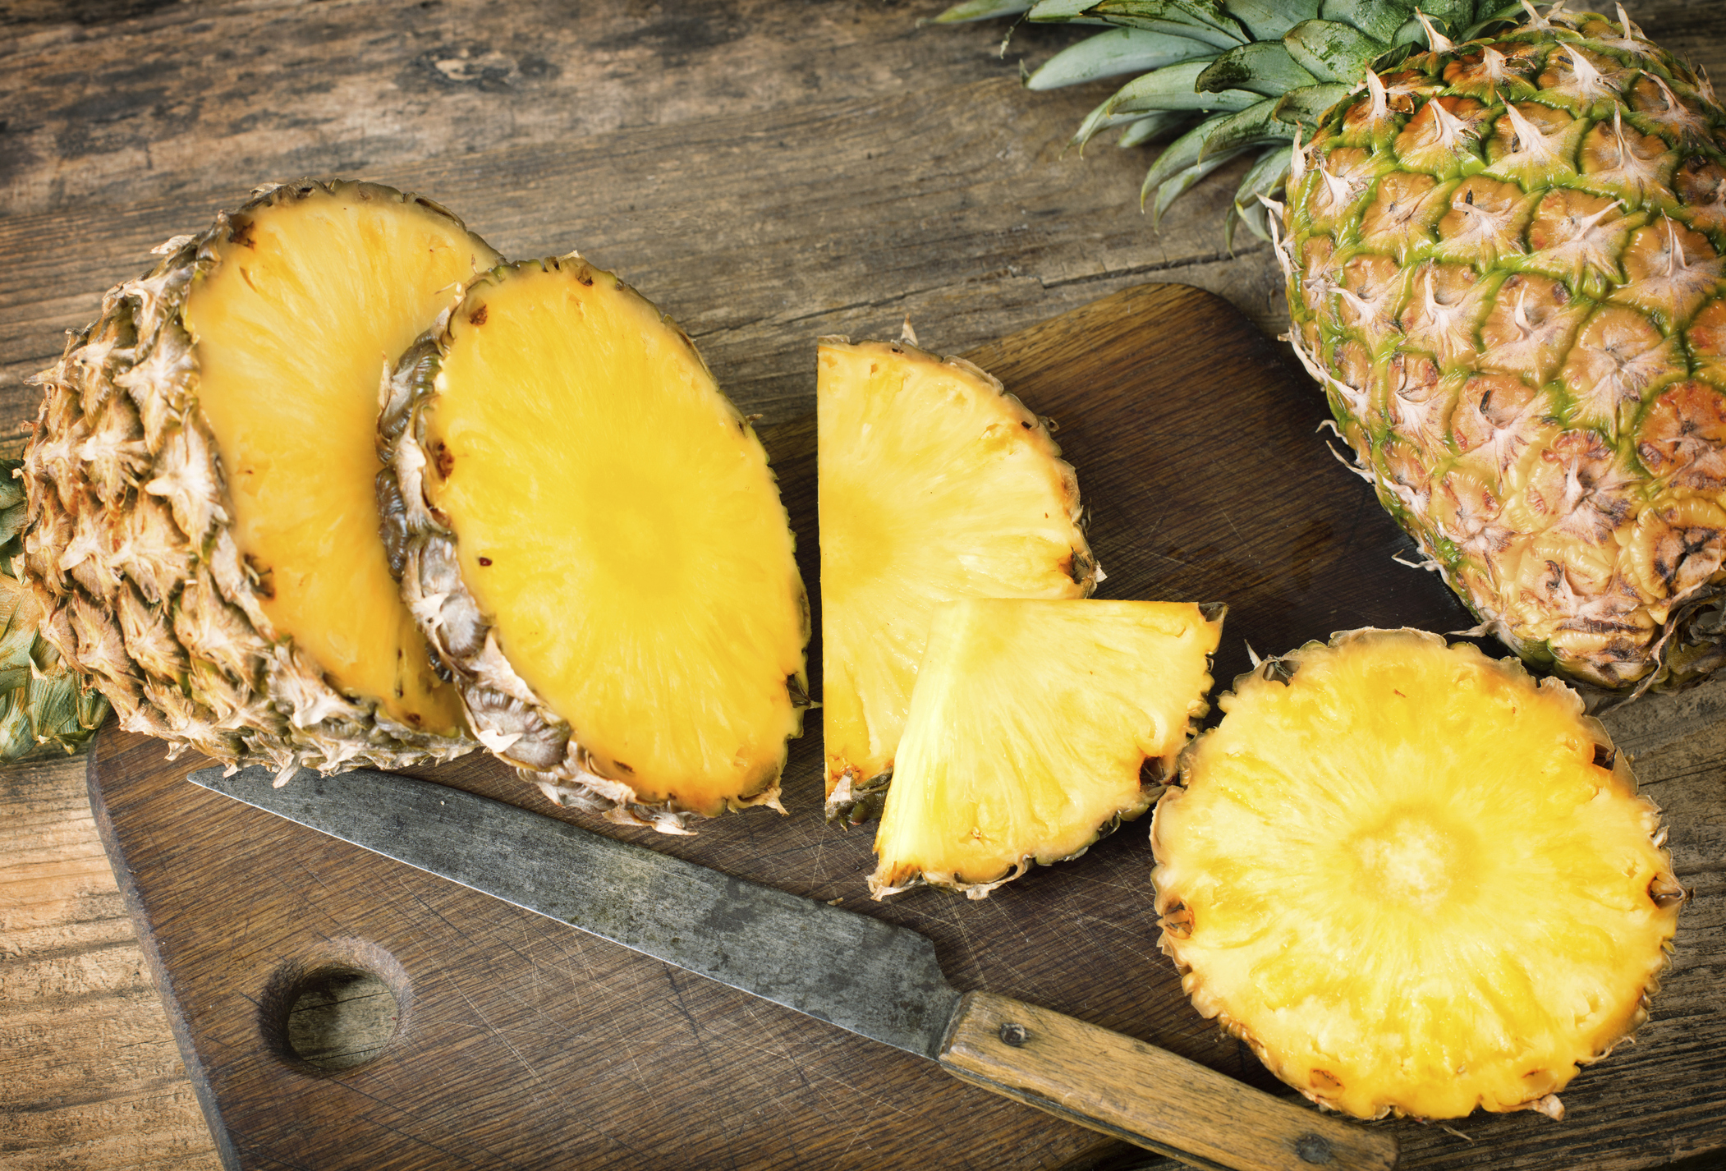
NUTRITION NUGGET
Raw pineapple is a great source of manganese and vitamin C!
They help to boost your immune system and build strong bones!

Slide 4
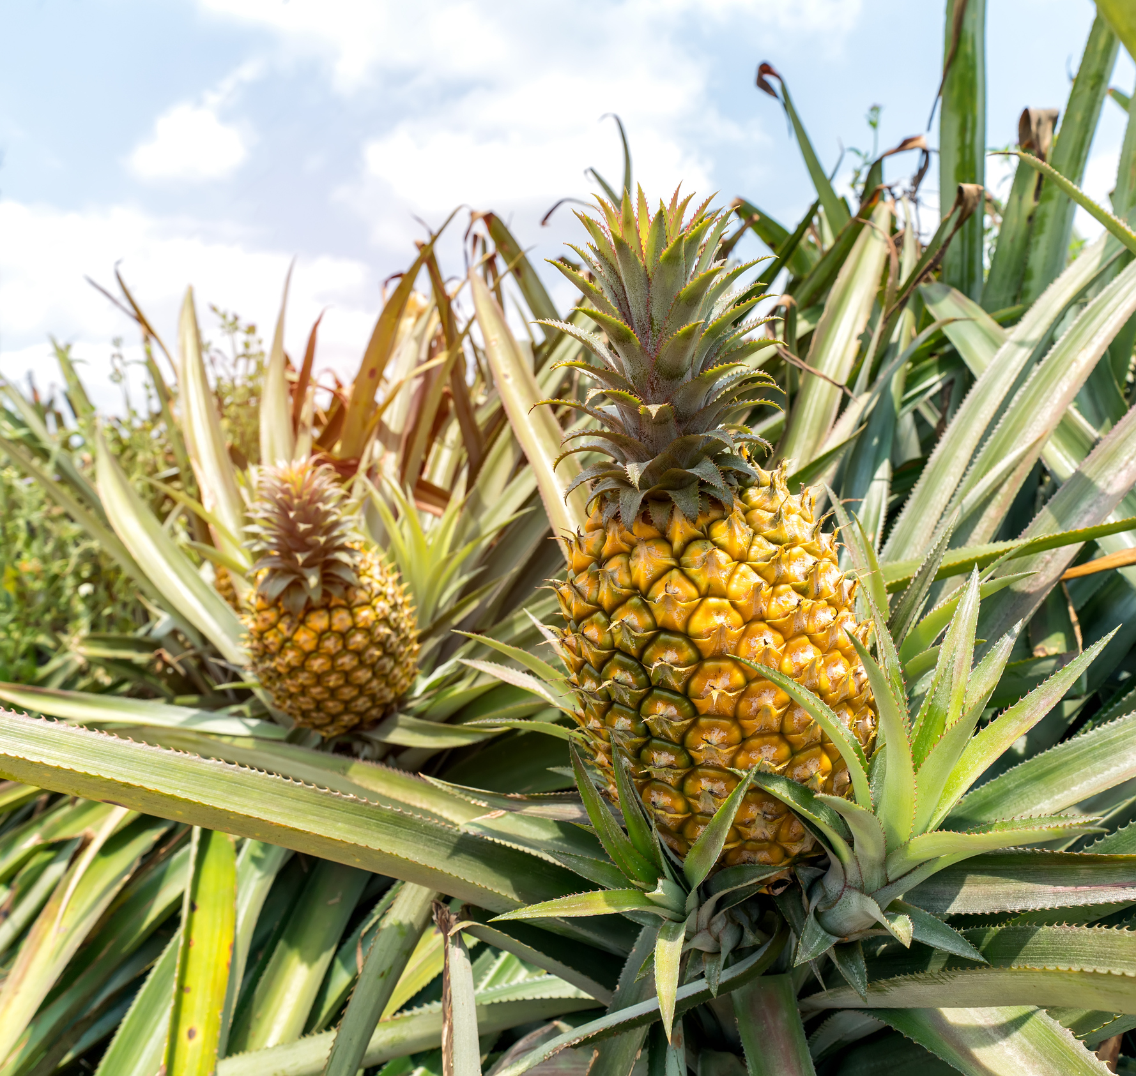
Where do pineapples grow?
Hawaii and Costa Rica are large growers of pineapples.
They are also grown in Brazil, Thailand, and the Philippines.

