Slide 1
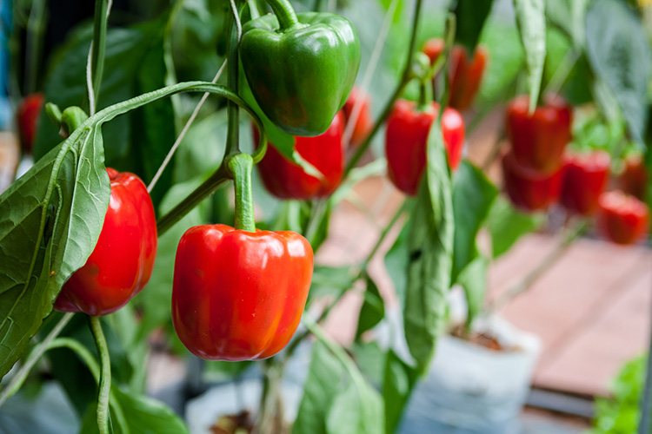

What we are learning today
Bonjour!
I’m Peter Pepper.
Join me as I paint a beautiful picture of pepper production
in Florida.
Let’s get creative!

Slide 2
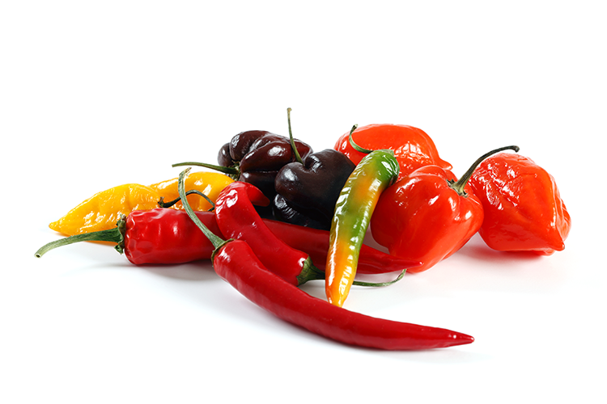
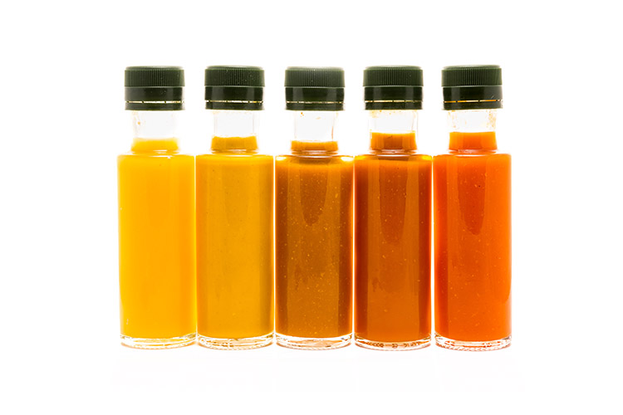
FUN FACTS
Bell pepper fields are hand-picked between two - five times a season.
Bell peppers are sweet and do not contain any casaicin, the chemical that makes hot pepper taste spicy!
Bell peppers are botanically a fruit, just like the tomato.

Slide 3
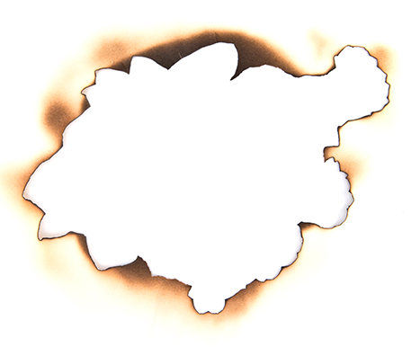
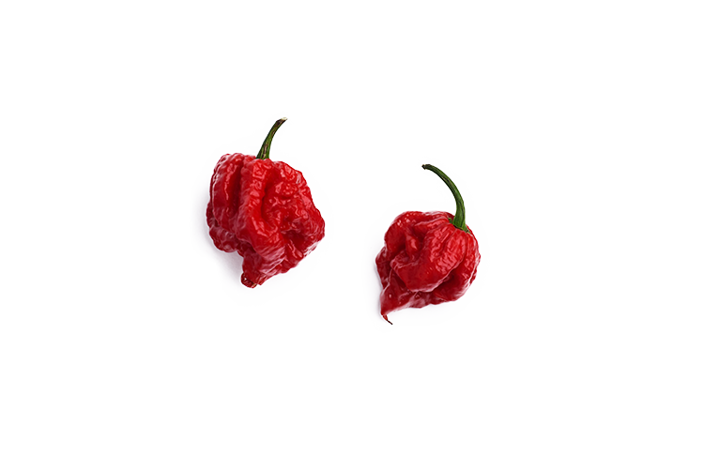
Did You Know?
We’ve struck gold!
The Carolina Reaper is the hottest chili pepper in the world!
This pepper is a cross between a Ghost Pepper and a red habanero.

Slide 4

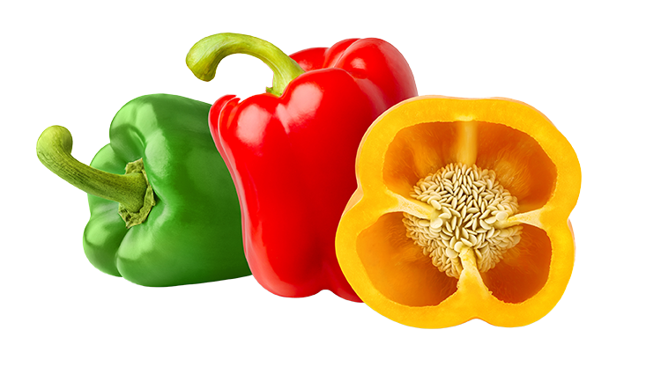
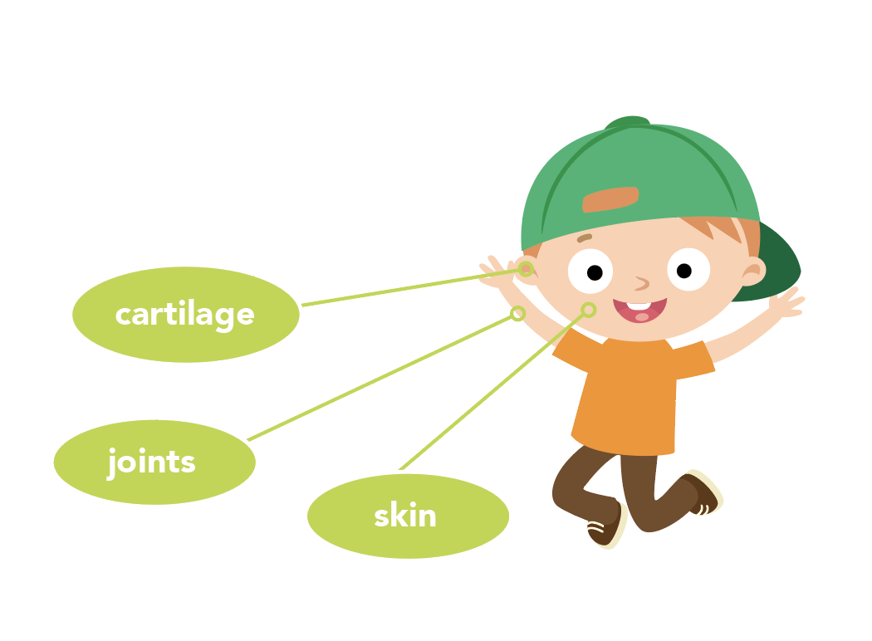
NUTRITION NUGGET
Yellow bell peppers are one of the richest dietary sources of vitamin C, which:
Plays a critical role in supporting the body’s immune system;
Is essential for the growth and repair of body tissues;
Produces collagen which makes healthy cartilage, joints, skin and blood vessels; and
Can help the body absorb iron.
Because your body cannot make vitamin C, it is essential that you eat foods that contain this vitamin every day!

Slide 5
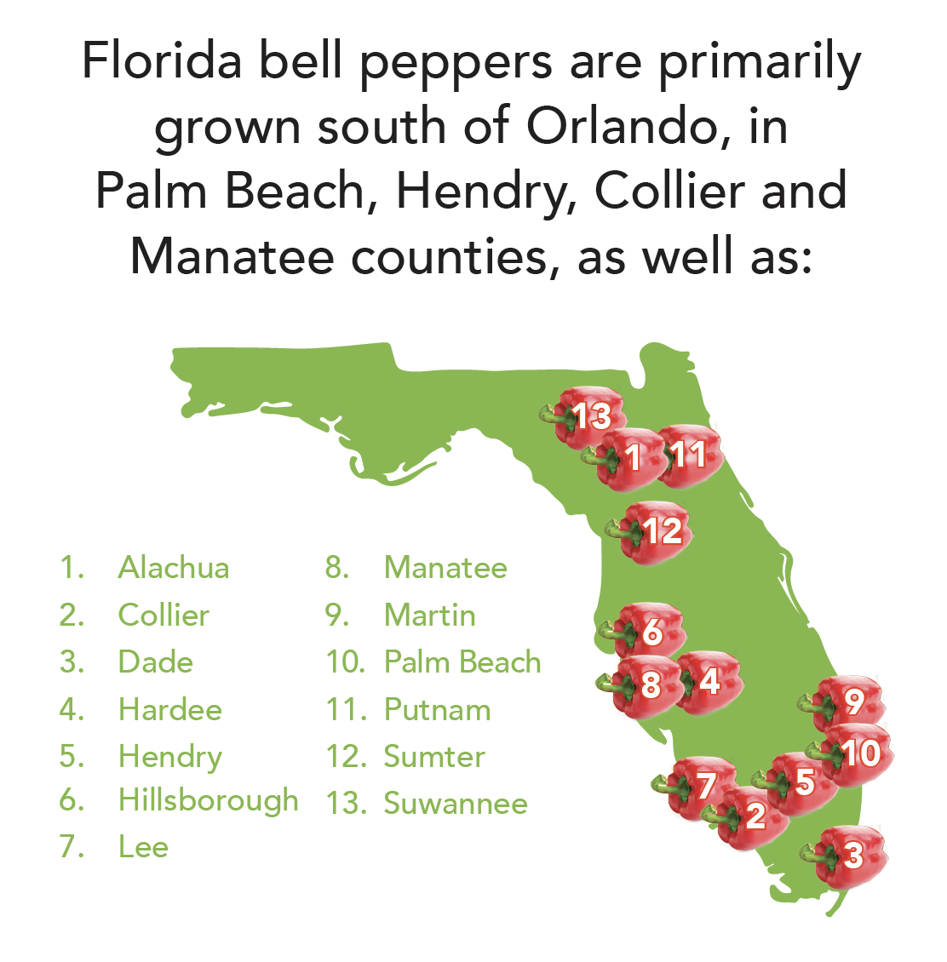
Spot it on the map
Florida is home to
several large pepper growing regions.
Nearly 12,000 acres of
bell peppers are grown
in selected regions of
the state.

