Slide 1
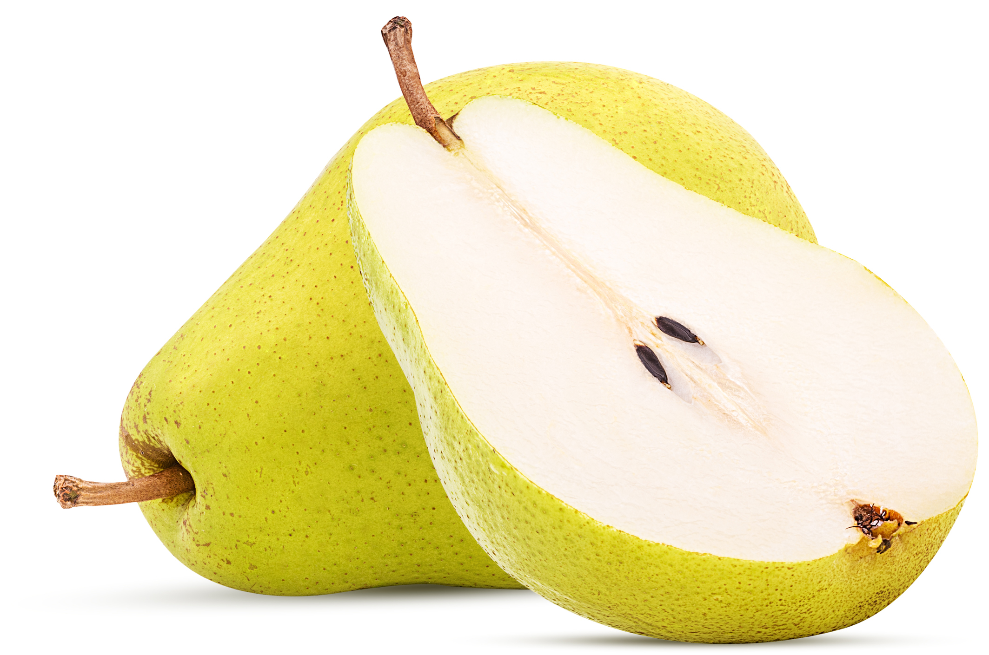
What we are learning today
Today we will learn about the pear!

Slide 2
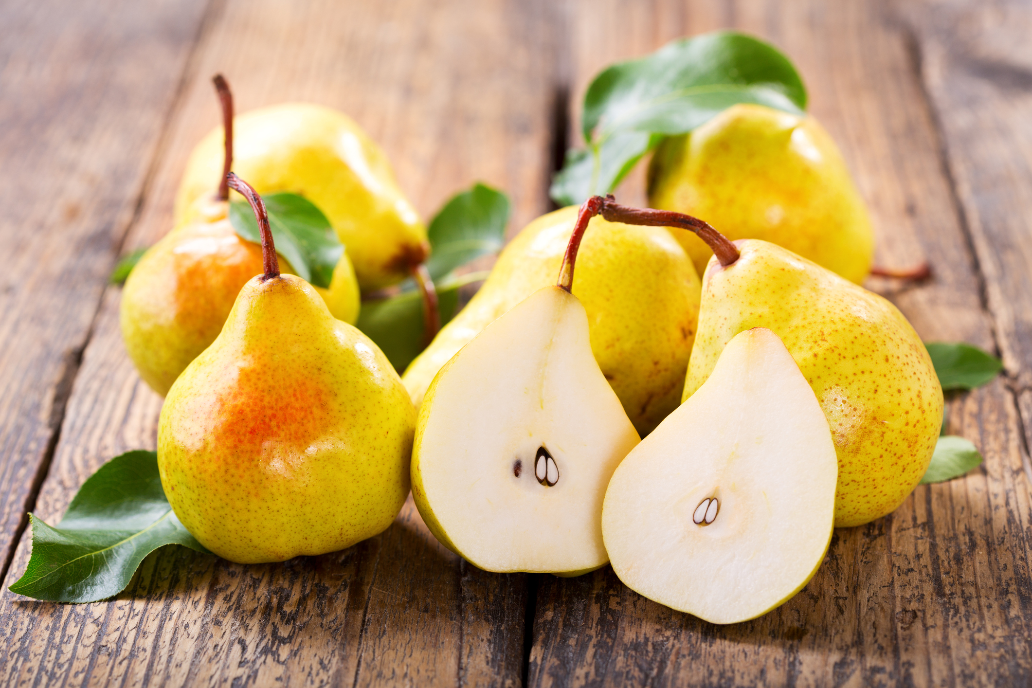
FUN FACTS
There are over 3,000 varieties of pears, including Asian pears which are round and crunchy.
Because of their long shelf life, sea voyagers would often take this fruit on trips to sea.

Slide 3
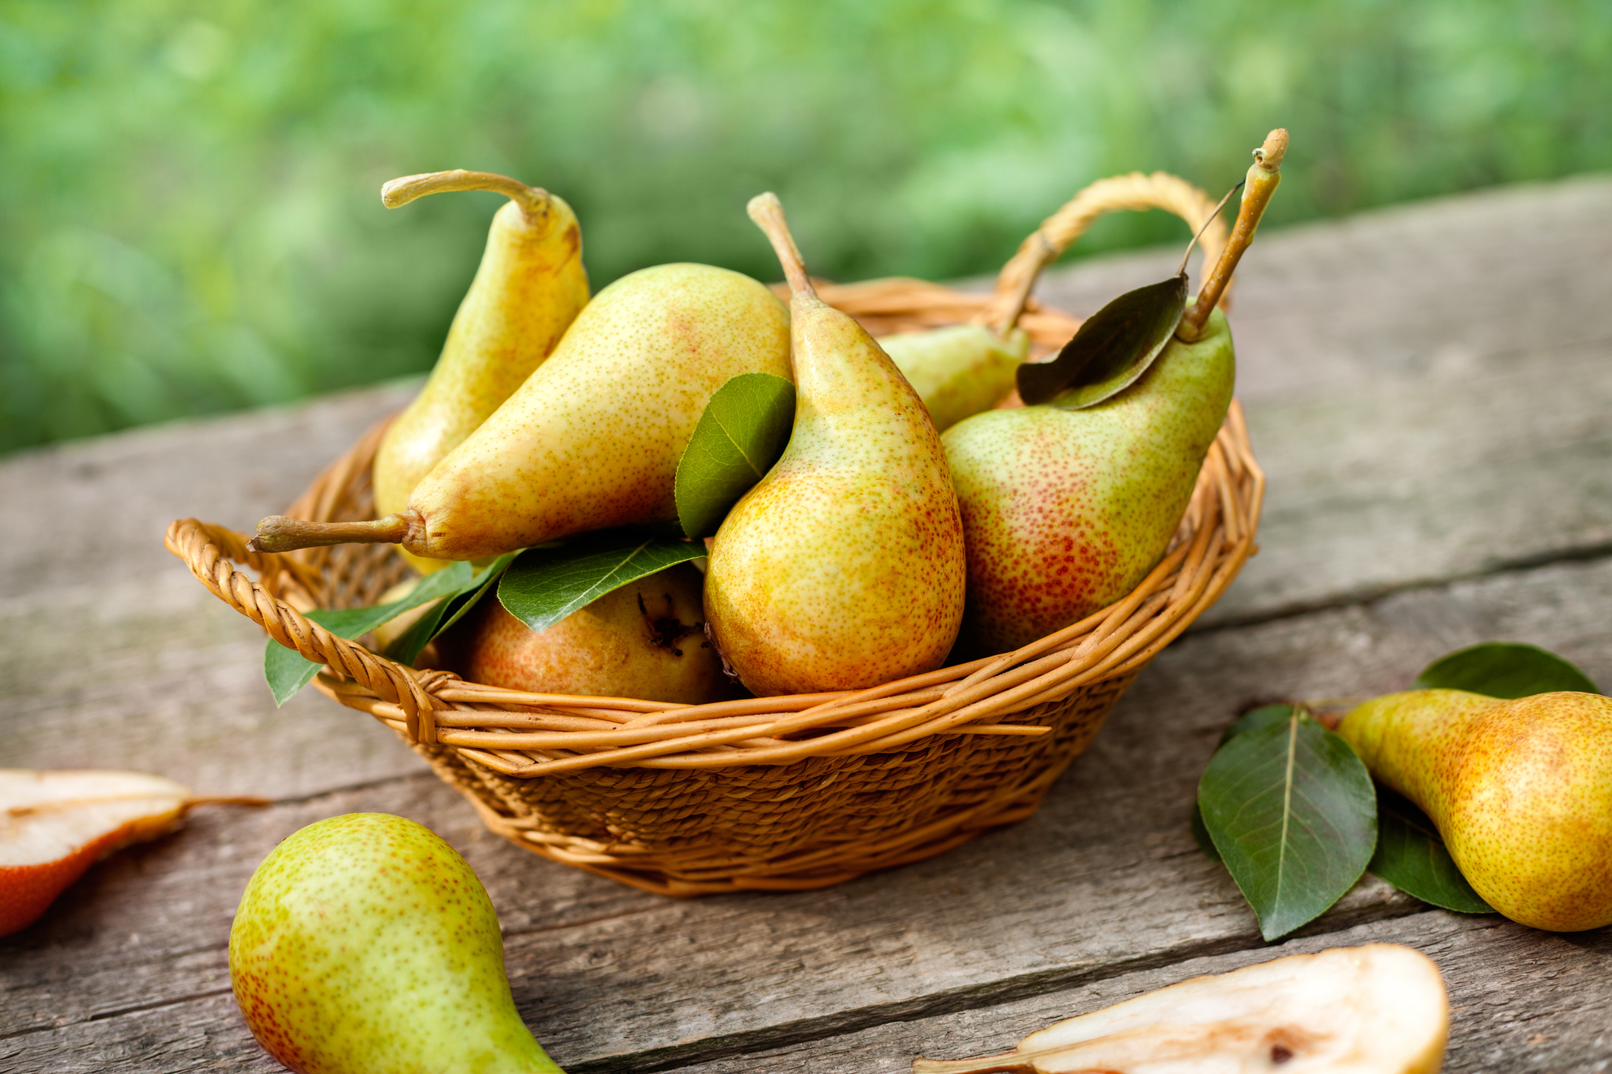
NUTRITION NUGGET
Pears are a good source of Vitamin C and fiber!
Pears have antioxidants and vitamins that are important for bone and tissue health.
Pears also have calcium and protein!

Slide 4

Spot it on the map
America is one of the largest growers of pears.
Most pears in the United States come from Oregon or Washington.

