Slide 1
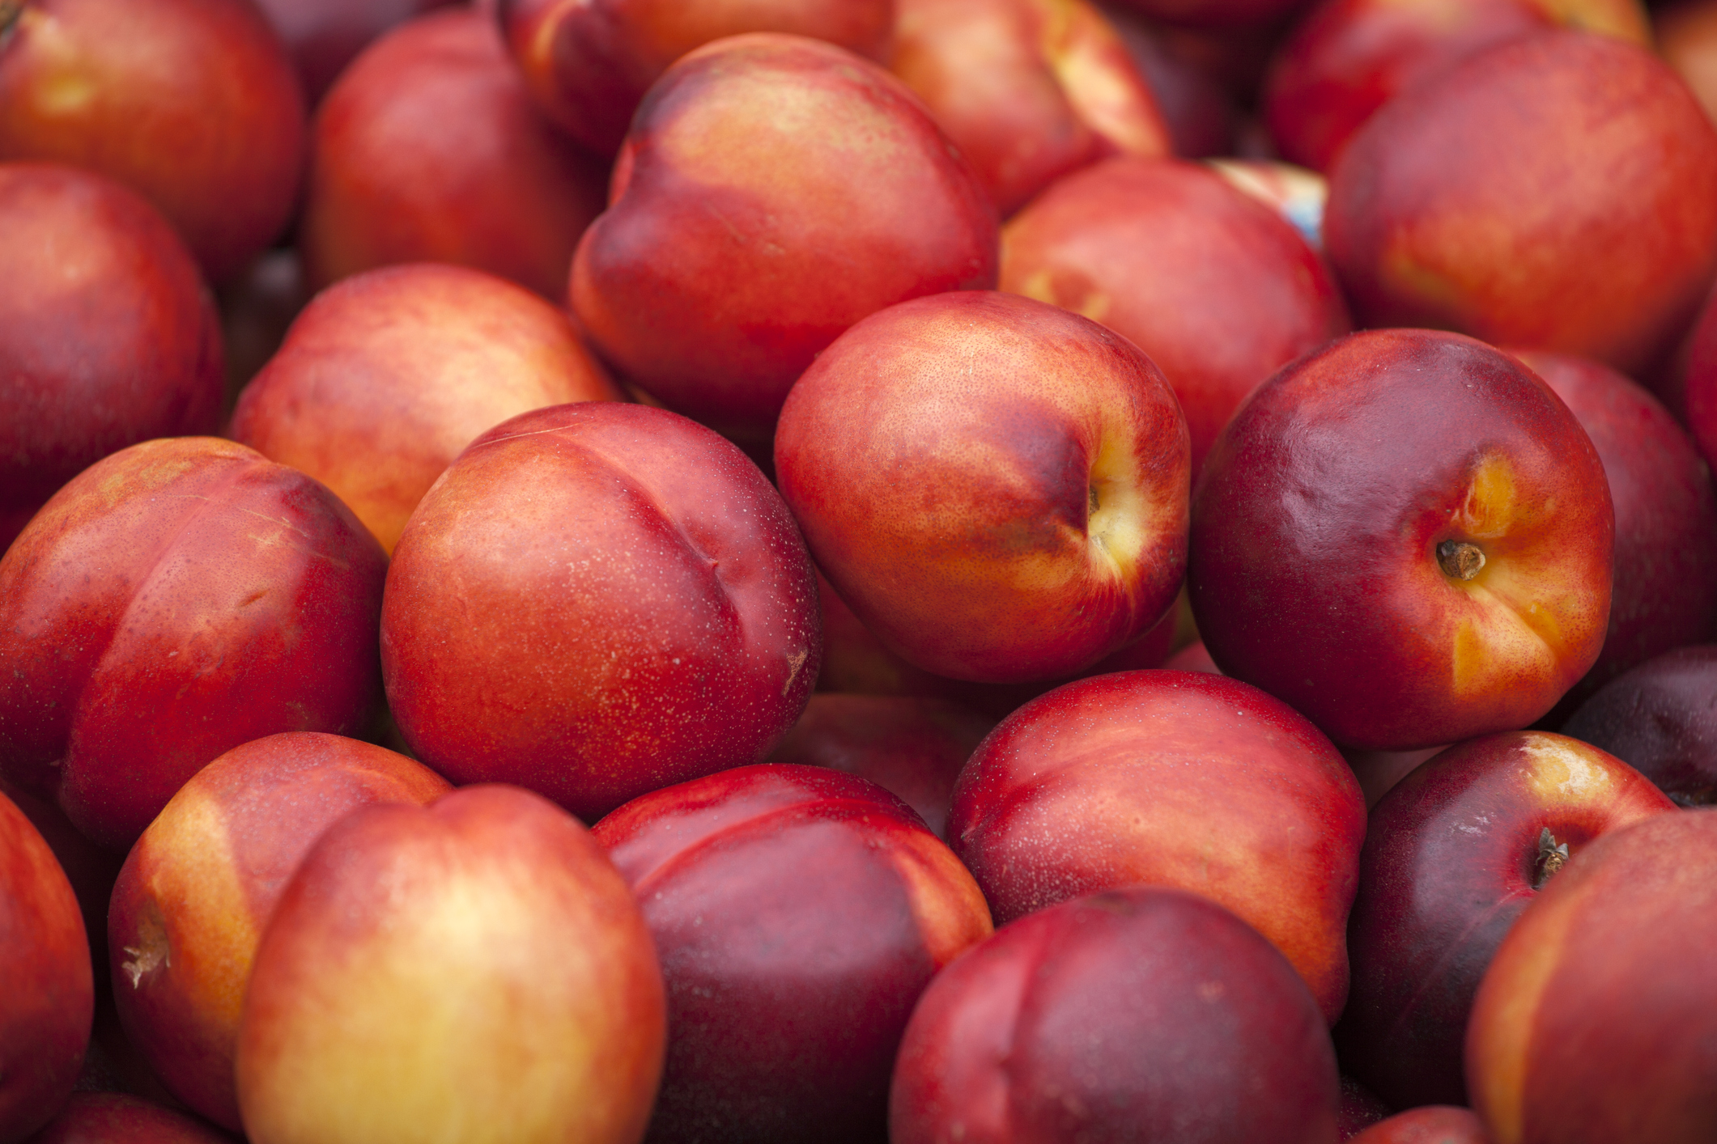
What we are learning today
Today we will be learning about the Nectarine!

Slide 2
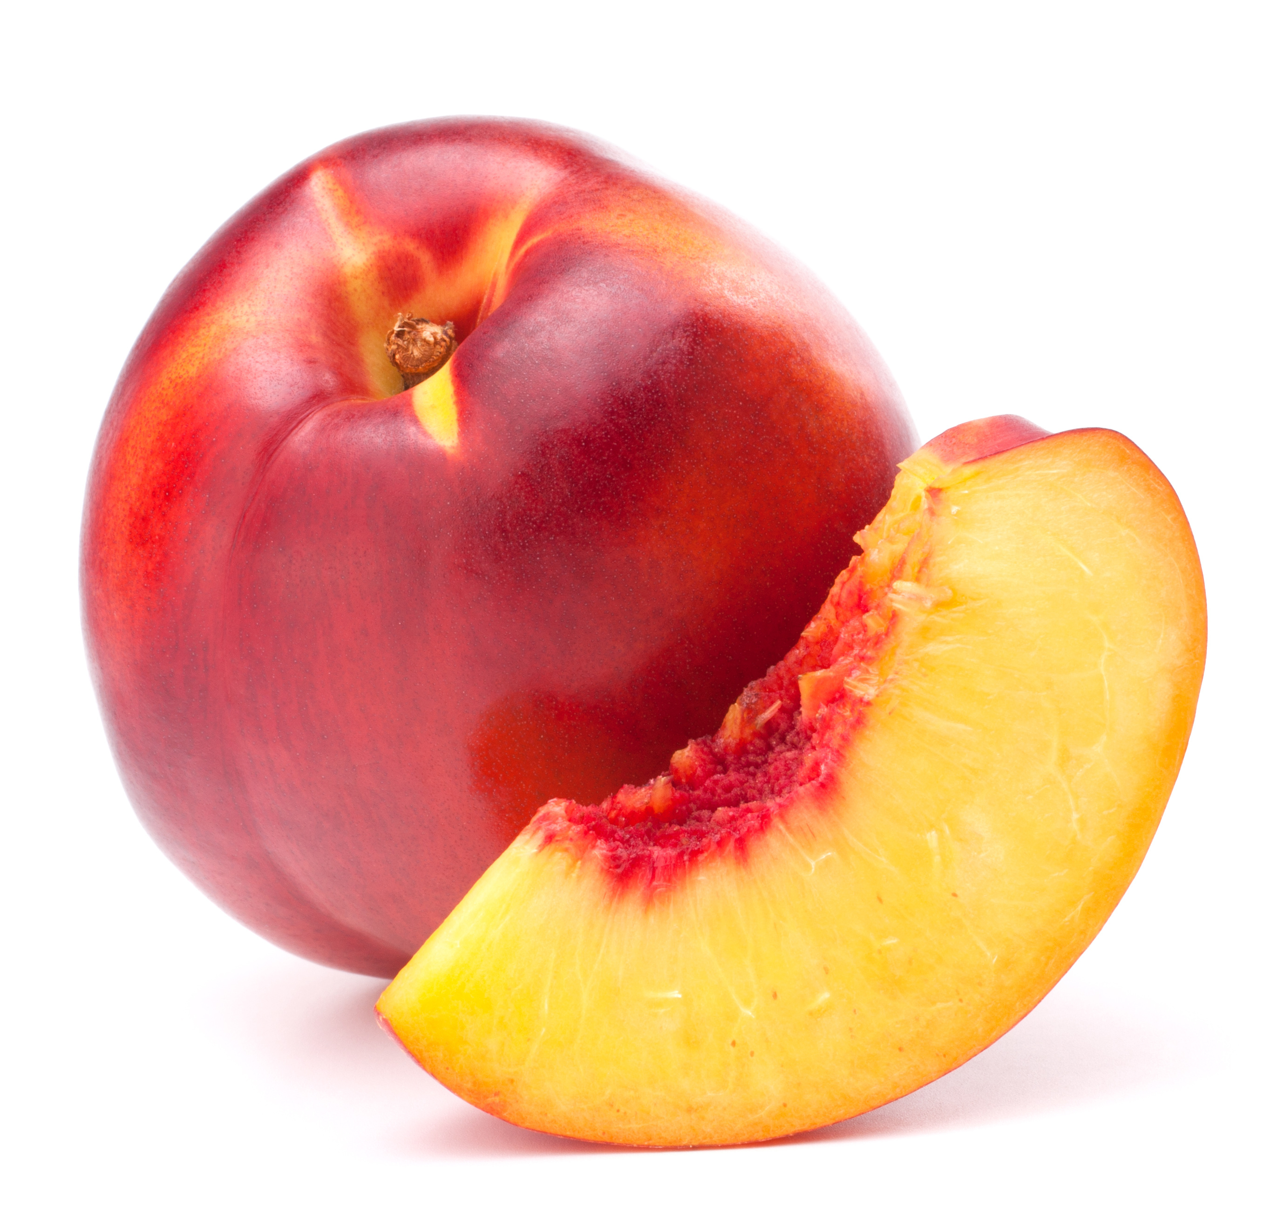
FUN FACTS
This fruit is a fuzz-free relative of the peach.
The seed is called the “pit.”
The fruit around the pit is the sweetest part of the fruit.

Slide 3

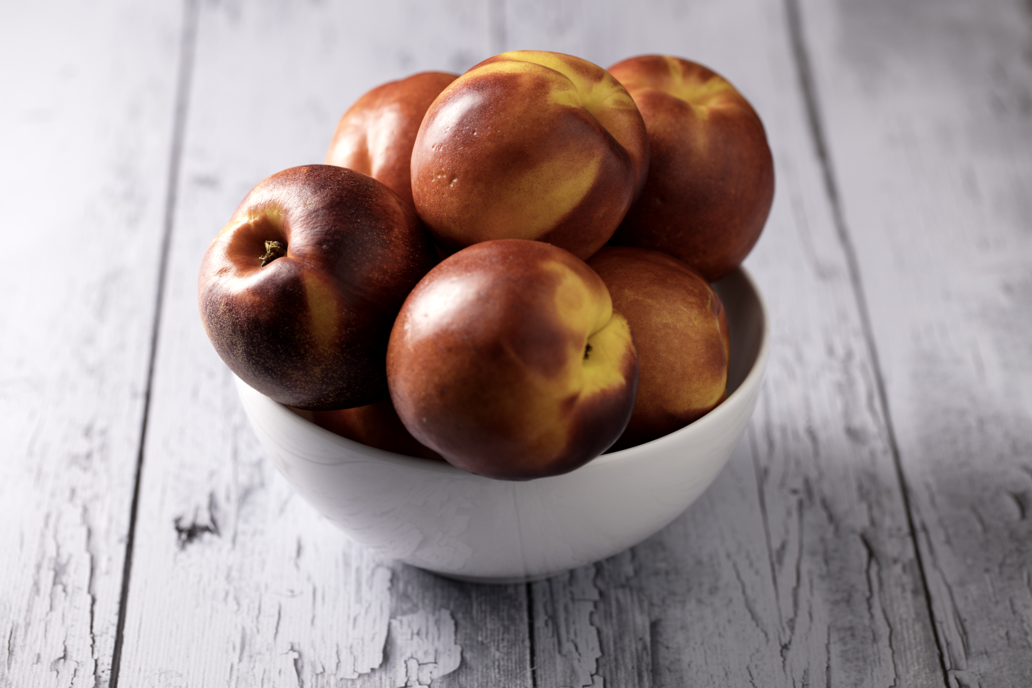
NUTRITION NUGGET
Nectarines keep us energized and our heart healthy!
Nectarines can also help to keep our skin and eyes healthy.

Slide 4
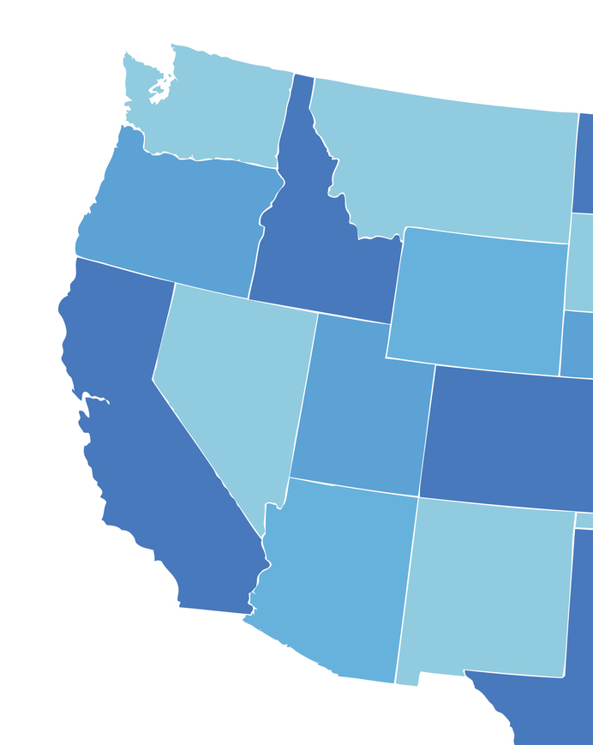
Spot it on the map
Nectarines originated
in China.
In the United States, California grows the most Nectarines.

