Slide 1

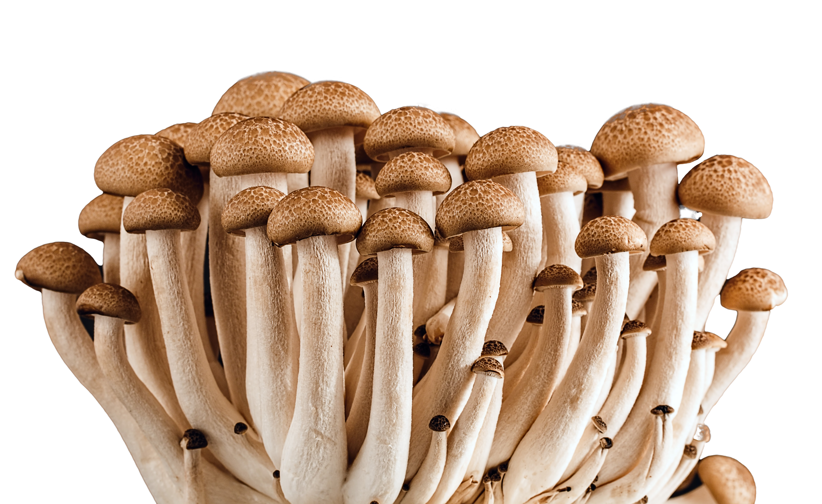
What we are learning today
Hi, I’m DJ Fun-Gi!
Are you ready to learn
all about mushrooms?
Get ready to boogie down to the fun history
of nature’s hidden treasures. Let’s jam!

Slide 2


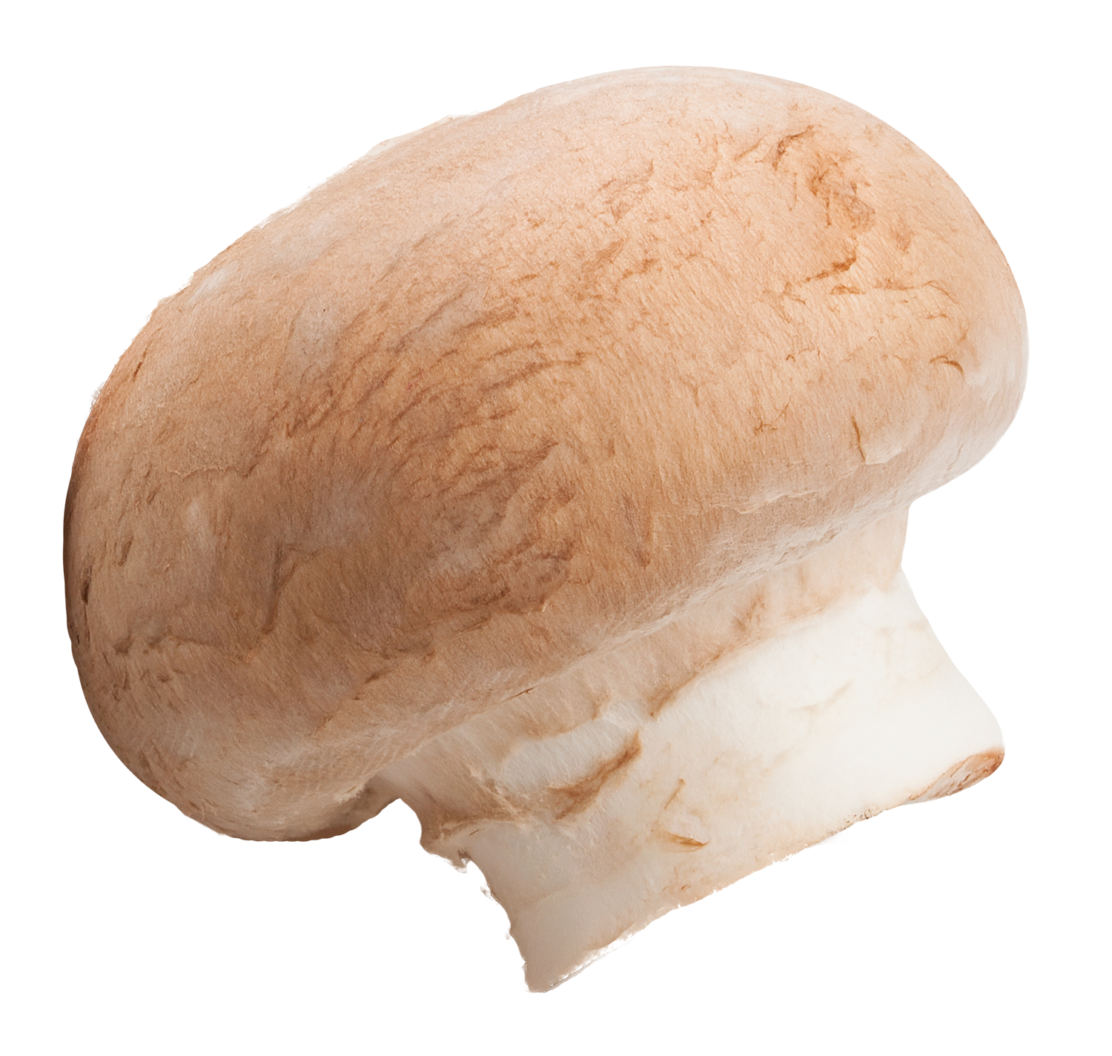
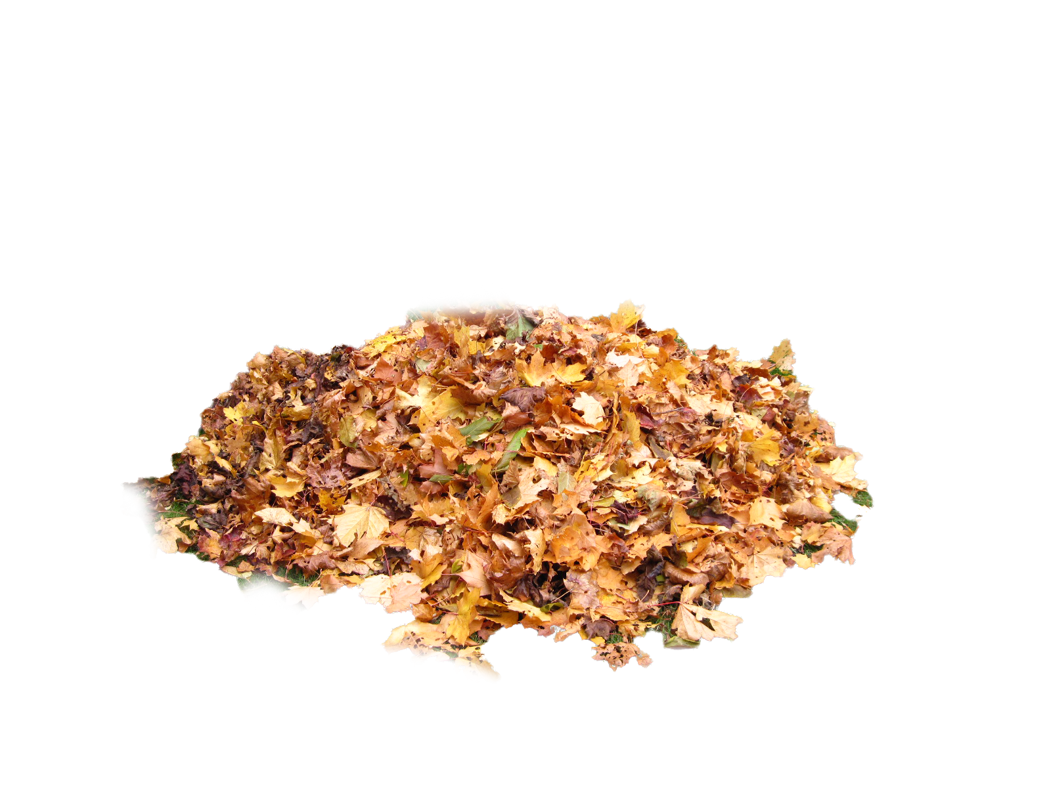
FUN FACTS
The most popular mushrooms in the United States are white buttons.
Mushrooms cannot make their own food from the sun because they do not contain chlorophyll and rely on other plants to support their growth.
Mushrooms belong to the Kingdom Fungi. They are very different from fruits and vegetables.
Florida mushrooms grow indoors and are available year-round!

Slide 3
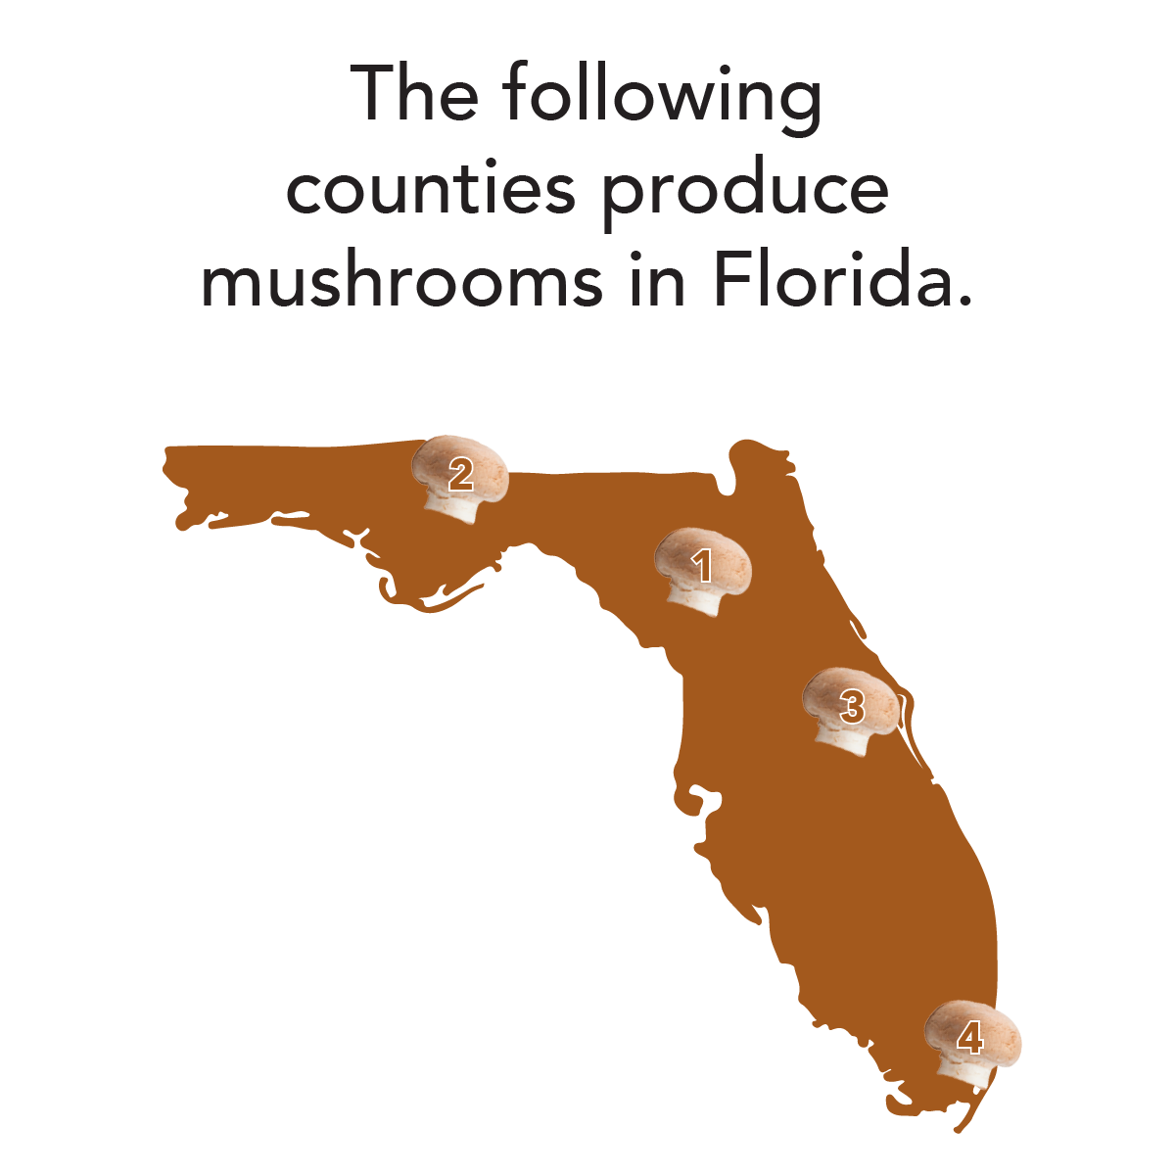
Where do
they grow?
:
Alachua, Gadsden, Orange and Miami-Dade counties produce Mushrooms
in Florida.
Can you name where these counties are on the map?

Slide 4

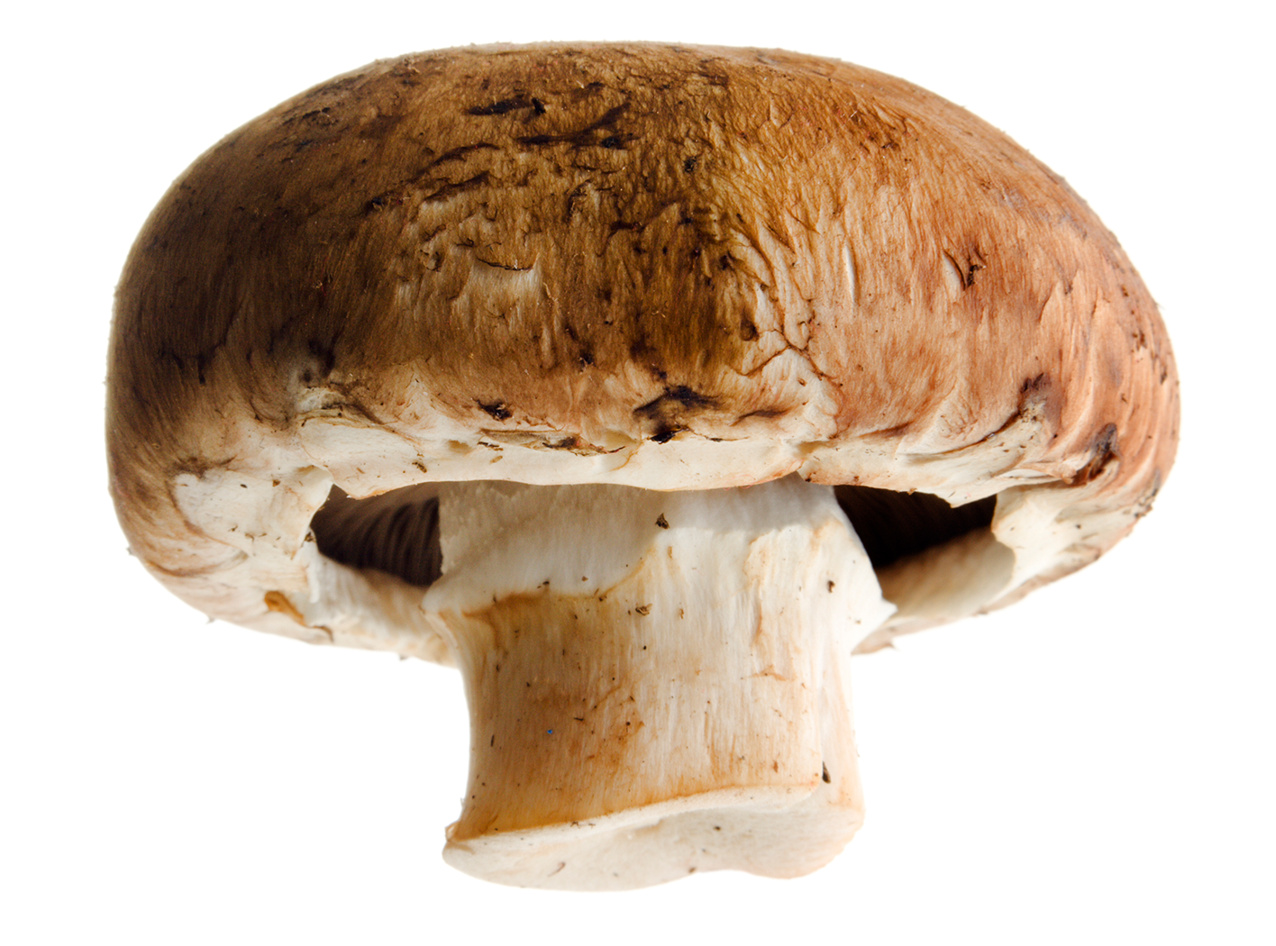
NUTRITION NUGGET
Your body can convert sunlight into vitamin D after the rays hit unprotected skin, but be careful to avoid extended exposure to sunlight without sunscreen!
Mushrooms can increase their vitamin D content if they have been exposed to UV light.
Vitamin D is known as the “sunshine” vitamin.
Vitamin D helps the body absorb calcium and phosphorus from our diet, which can keep our bones strong.

