Slide 1
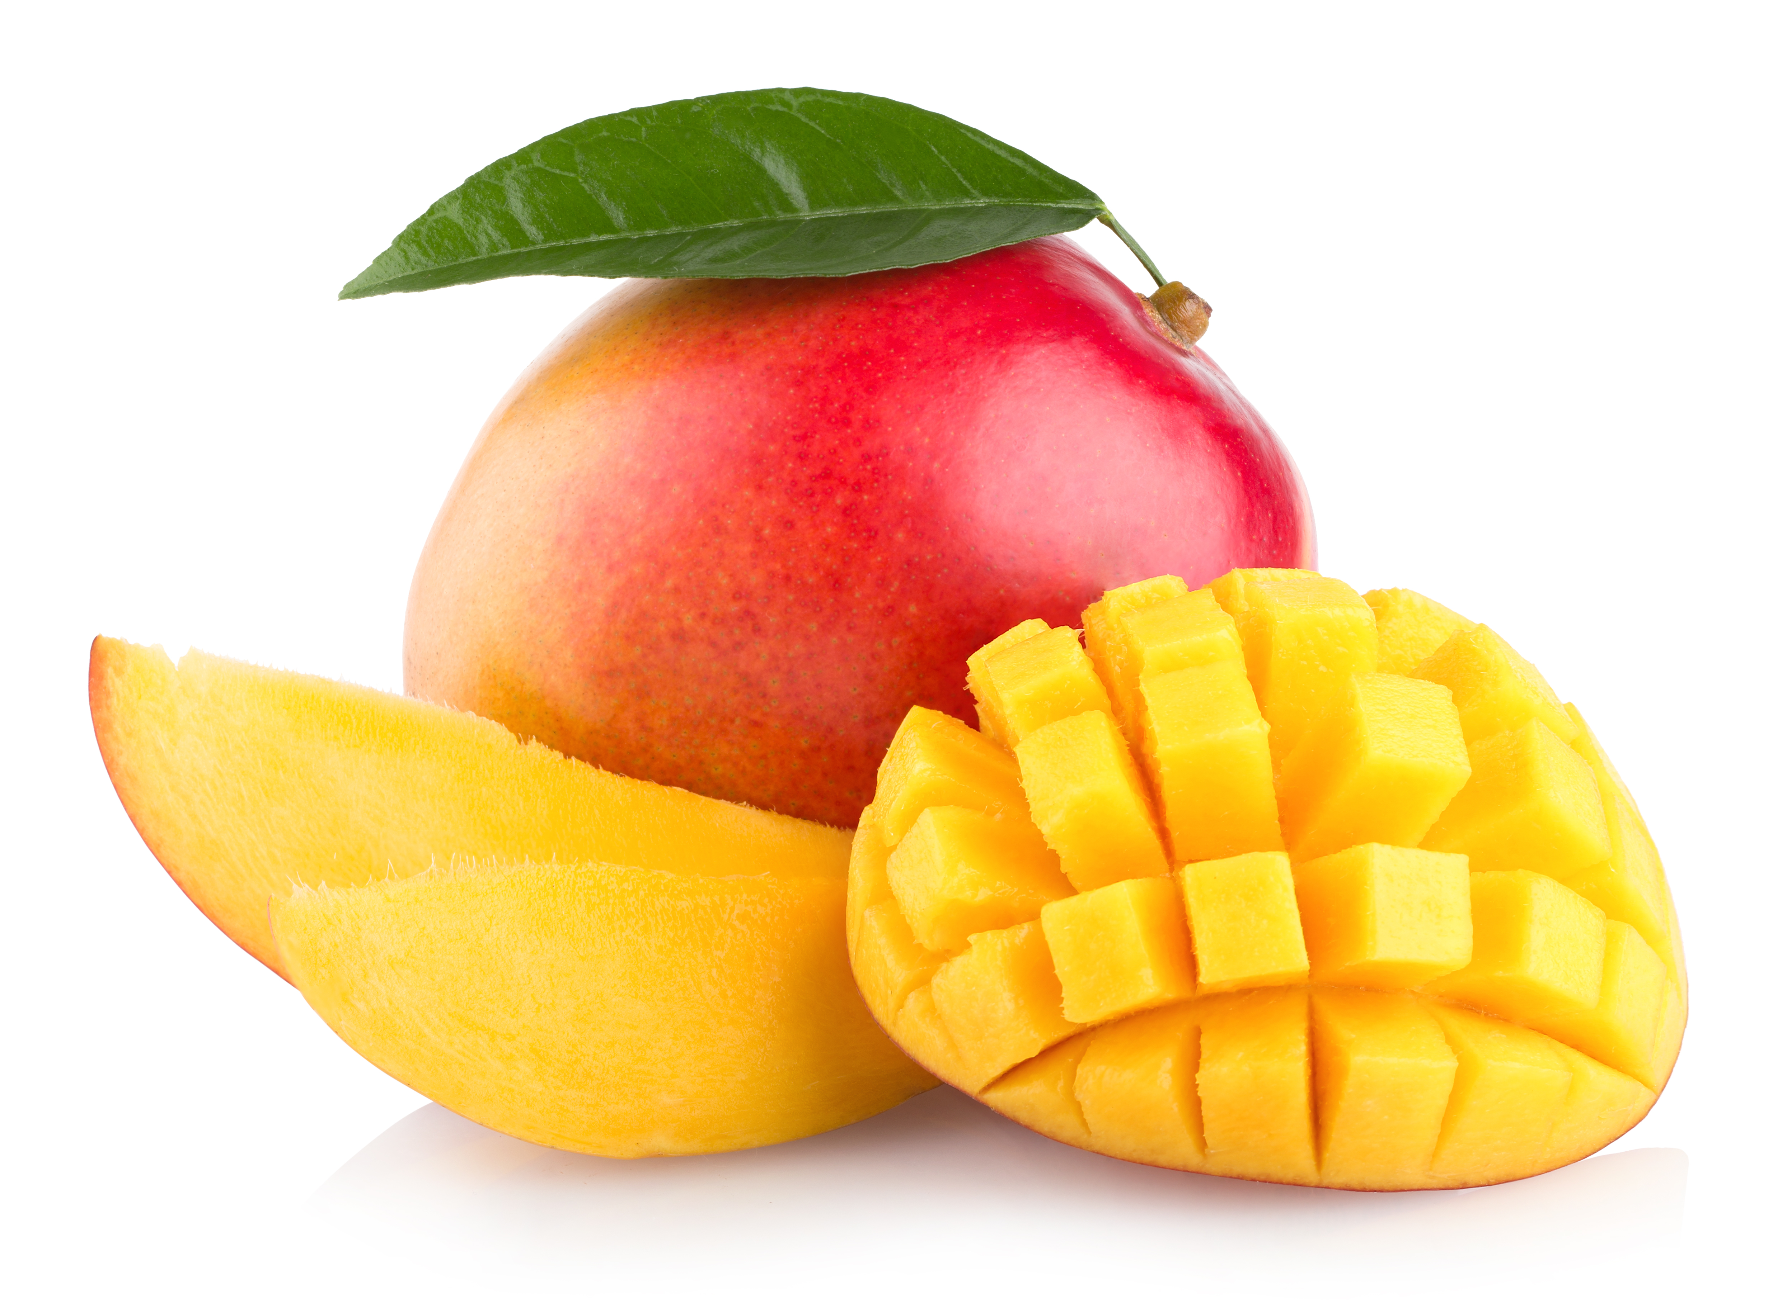
What we are learning today
Today we will be learn some awesome facts about the Mango!

Slide 2
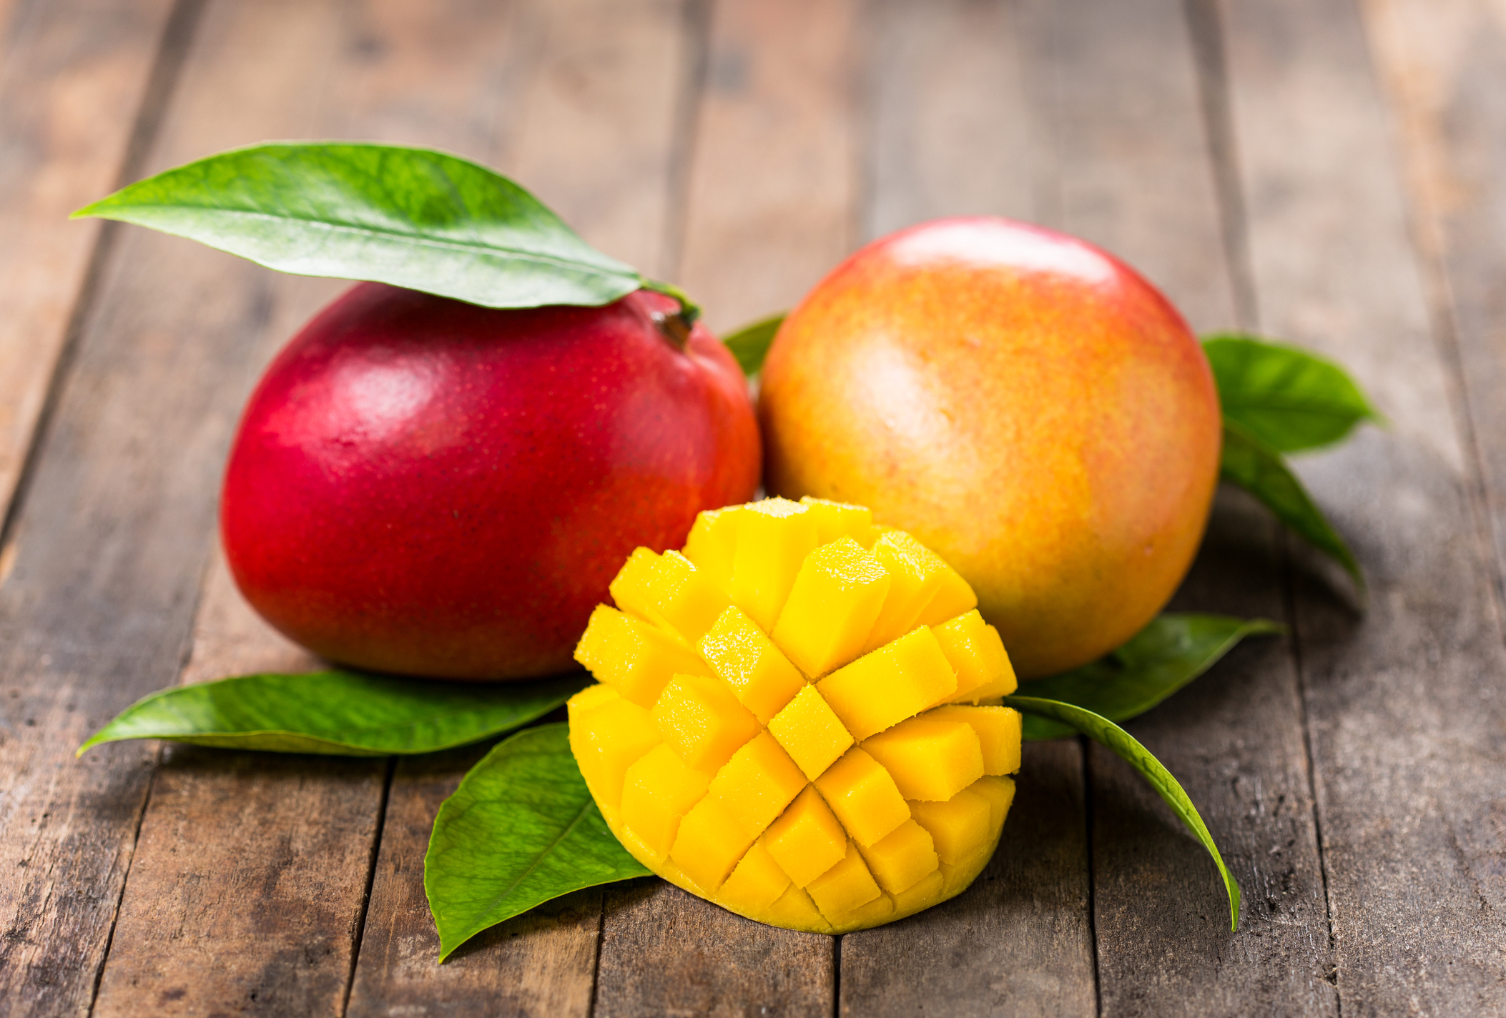
FUN FACTS
A mango tree can grow as tall as 100 feet.
The mango is a symbol of love in India, and a basket of mangos is considered a gesture of friendship.

Slide 3

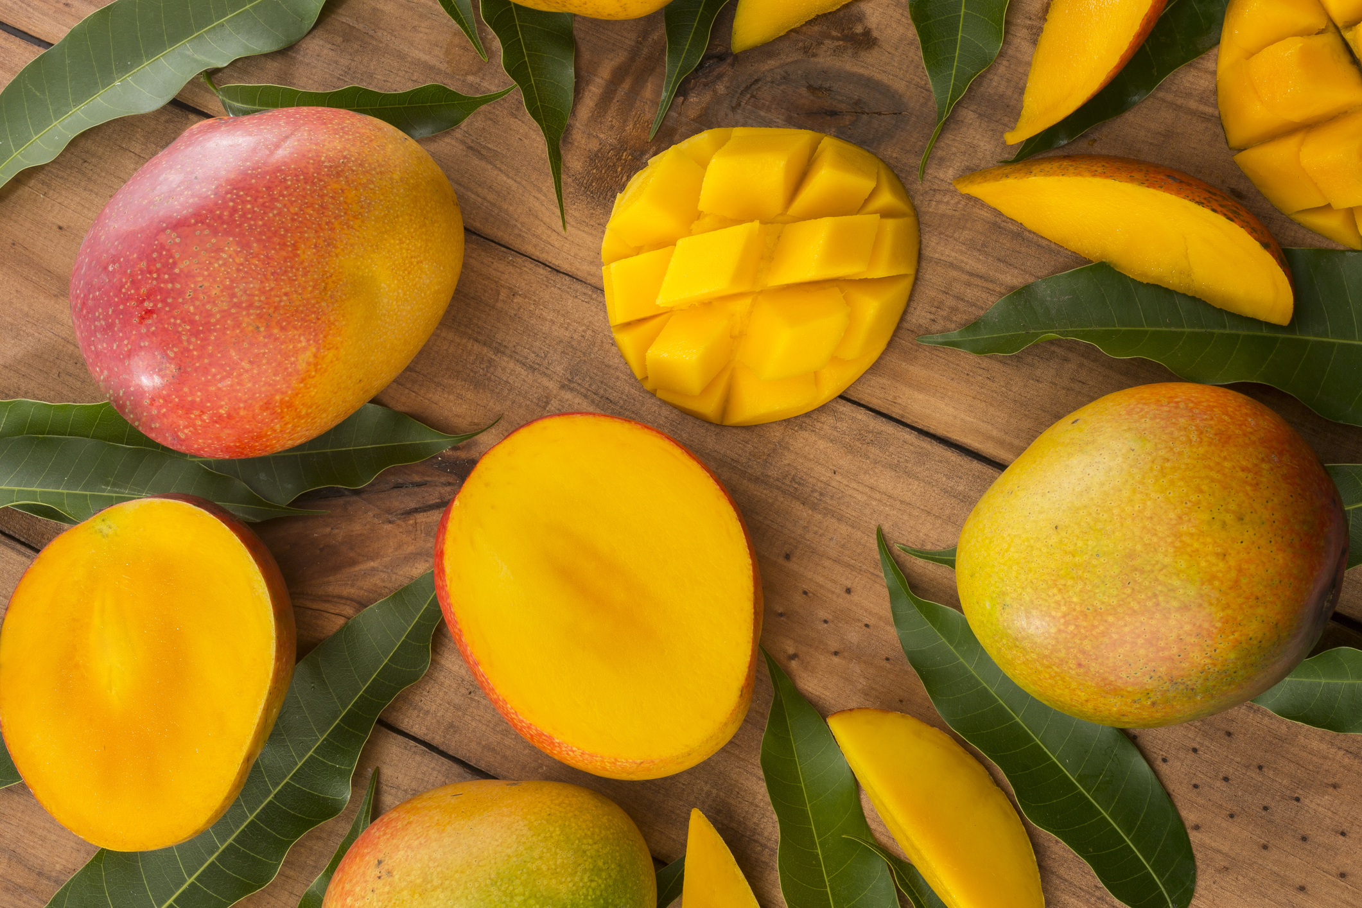
NUTRITION NUGGET
Mangos are high in fiber, vitamin C, and Vitamin A.
A one cup serving of Mango has about 100 calories.
Mango has been found to protect against certain types of cancer including colon, breast, and prostate.
Mangos help improve digestion.

Slide 4
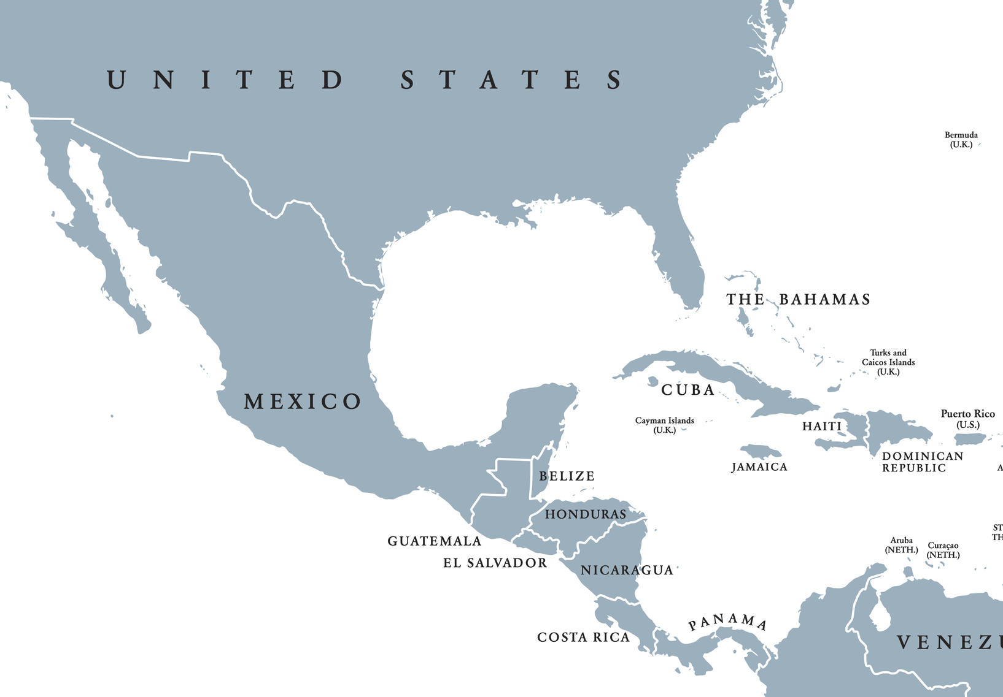
Spot it on the map
Florida is the largest producer of mango in the United States. They can also be grown in California, Hawaii and Puerto Rico. However, mango is not a main crop in the US so most of what we eat is imported from Mexico.

