Slide 1
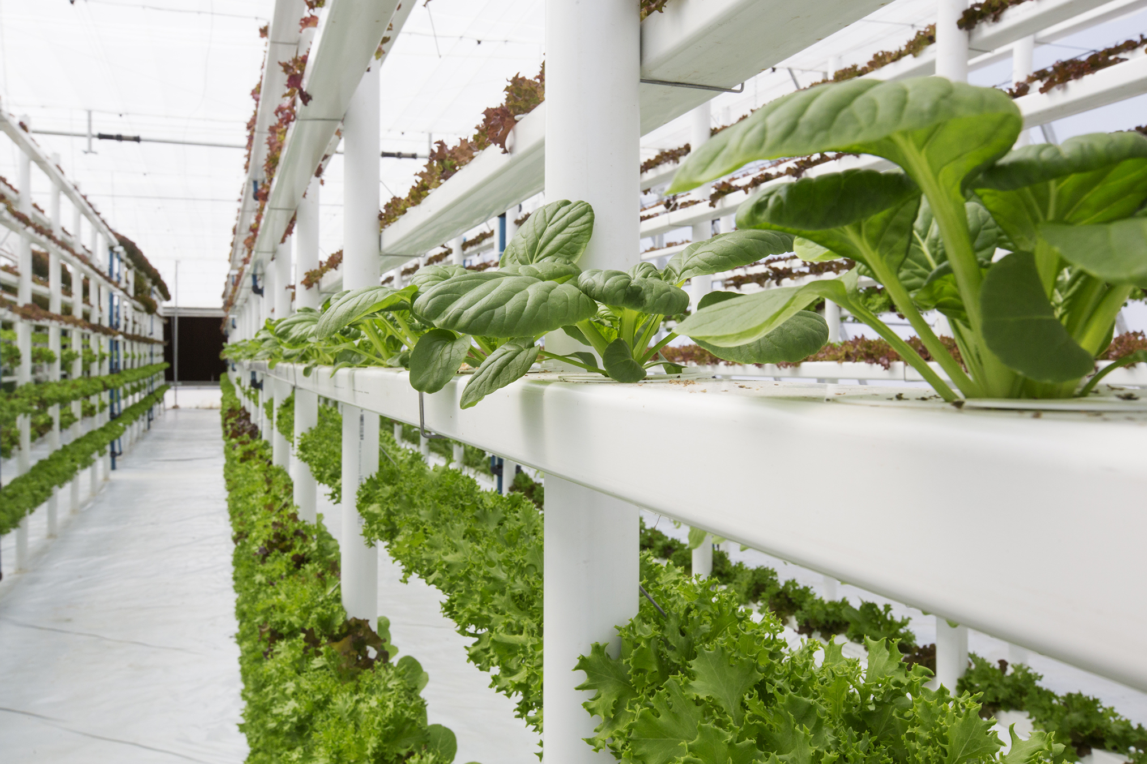

What we are learning today
Hi, I’m Lucy Lettuce!
Are you ready to learn
all about lettuce?
I don’t have any vegetable jokes yet,
so if you do,
“lettuce” know!
Let’s get reading!

Slide 2


FUN FACTS
Daisies and sunflowers share the same family as lettuce.
Lettuce was first referred to as 'rabbit food’ in the 1930s.
Lettuce is the second most popular fresh vegetable in the United States.
Notes:
Daisies and sunflowers share the same family as lettuce. (Image of lettuce librarian holding hands with a daisy and sunflower on either side)
Lettuce is the second most popular fresh vegetable in the United States.
Lettuce was first referred to as 'rabbit food’ in the 1930s.

Slide 3

NUTRITION NUGGET
Eat your salad greens!
Did you know? The greener the lettuce leaf, the more nutrients
it provides.
Dark green lettuce leaves are an excellent source of fiber and vitamins A, C and K!
Vitamin A is essential for good vision and healthy skin.
Vitamin C helps your immune system stay strong and supports healthy gums.
Vitamin K is important for bone health and blood clotting.

Slide 4
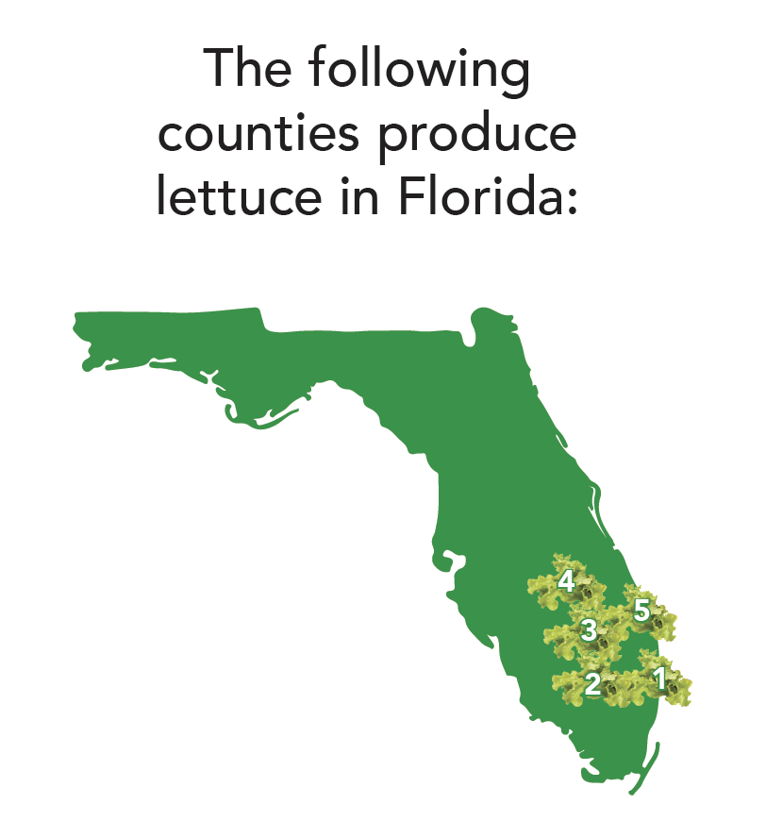
Where do
they grow?
Glades, Hendry, Martin, Okeechobee and Palm Beach counties produce Lettuce in Florida.
Notes:
Answer: Central Florida

