Slide 1
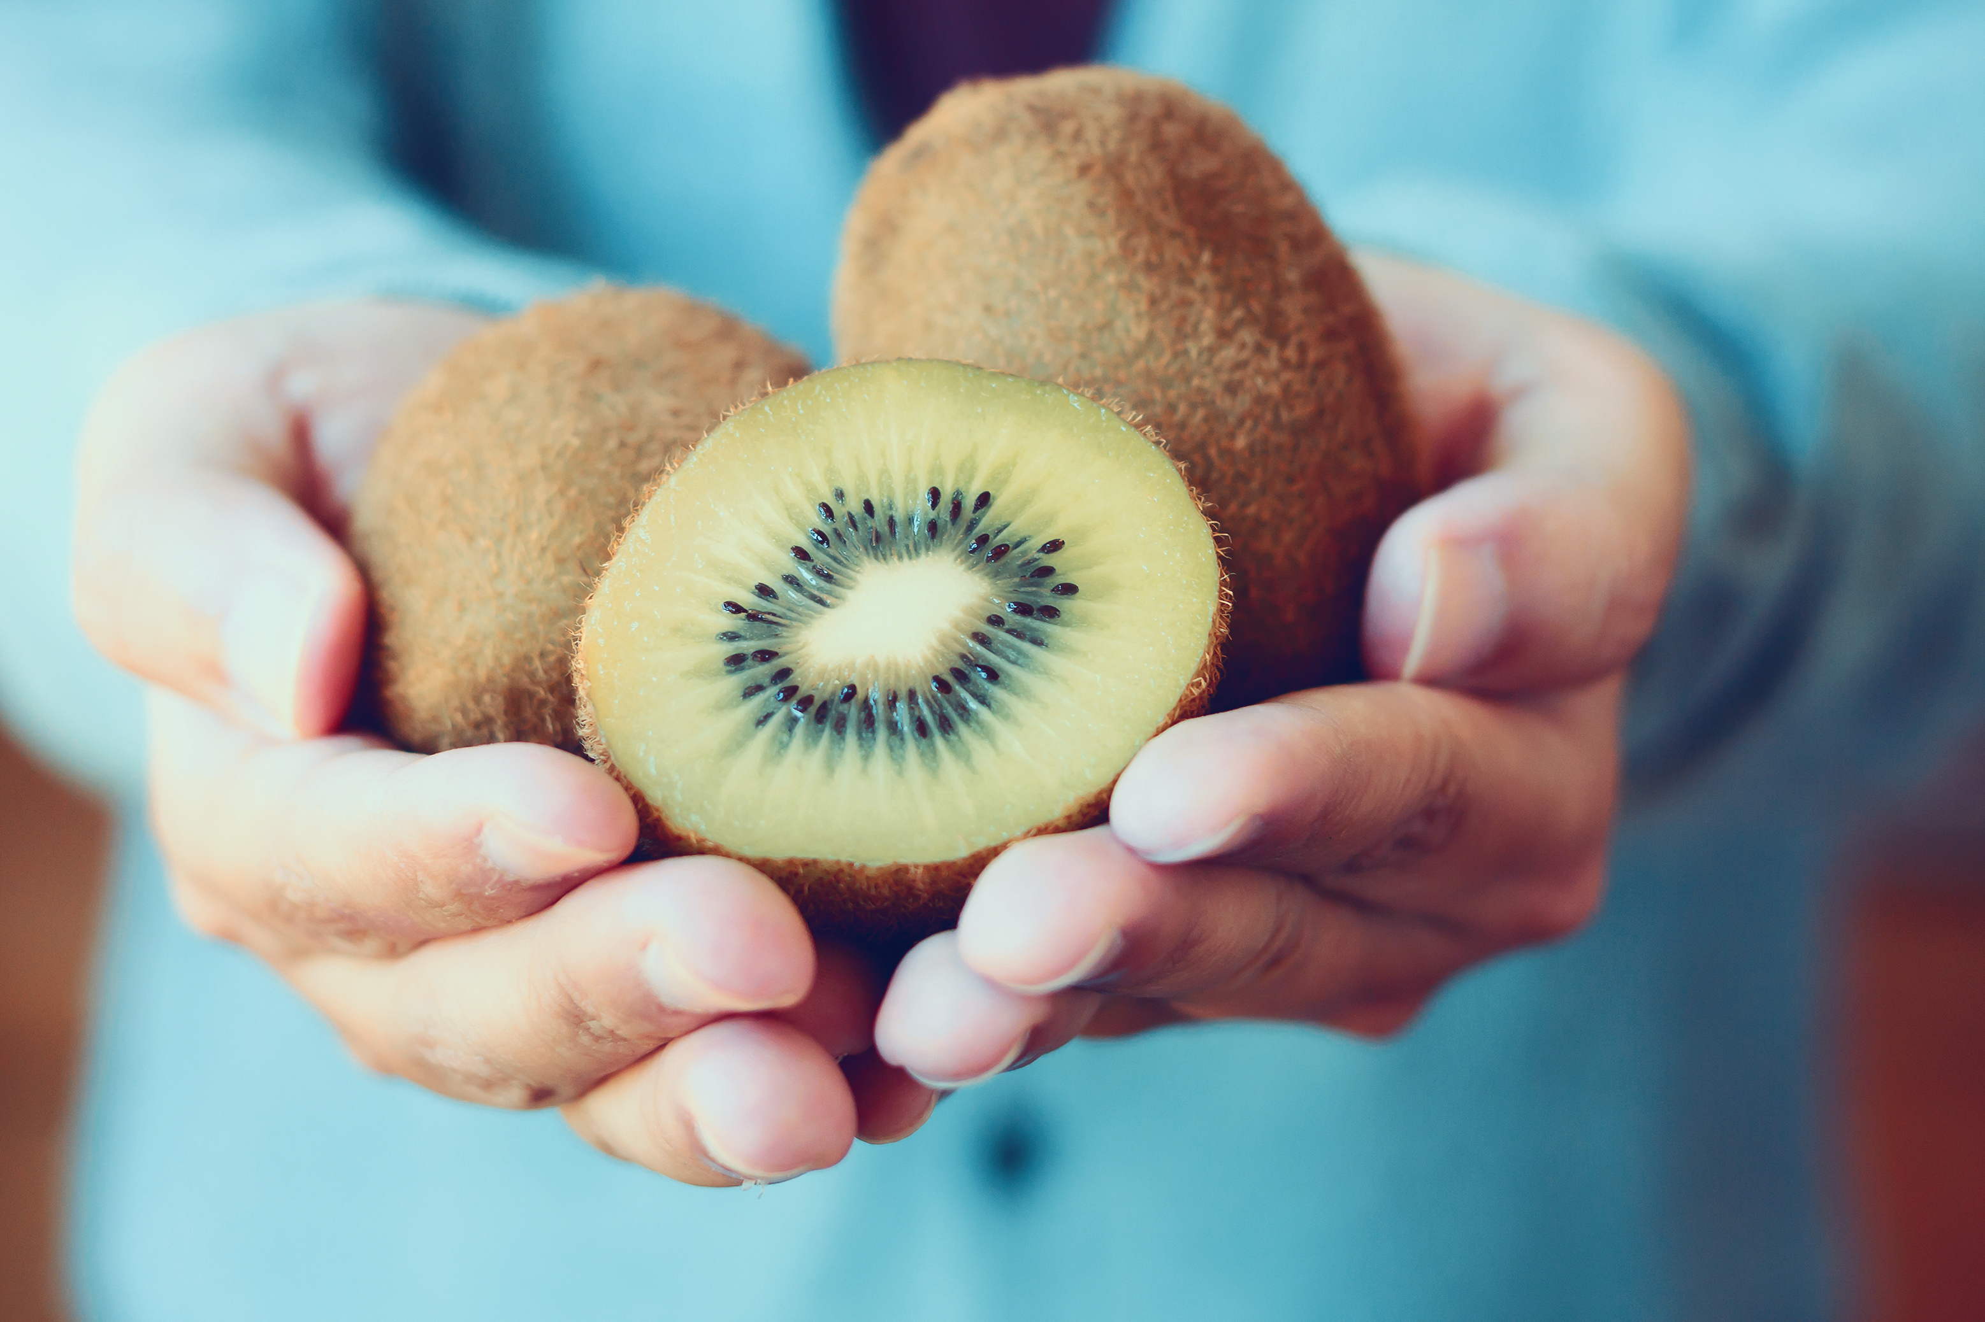
What we are learning today
Today we are going to learn about the Kiwi!

Slide 2
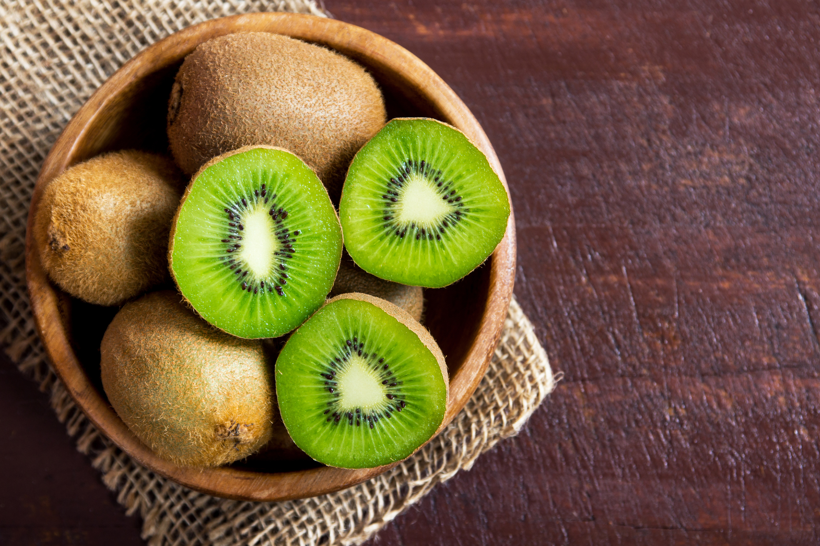
FUN FACTS
The Kiwi originated in China and was originally called the “Chinese Gooseberry.”
Eating two kiwis right before bedtime will help make you fall asleep quicker!

Slide 3
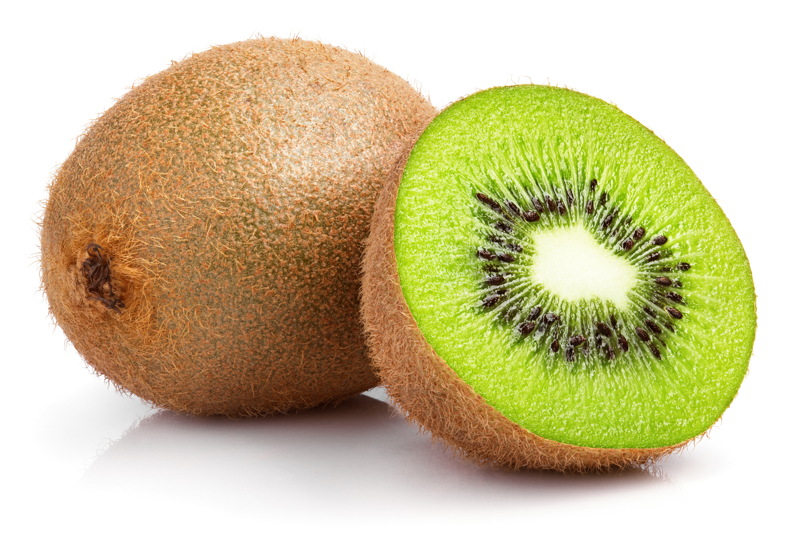
NUTRITION NUGGET
Kiwis can help boost your immune system, and have more than double the Vitamin C that is found in Oranges.
Kiwis can help reduce the symptoms of asthma.
Kiwis can help your digestive system.

Slide 4
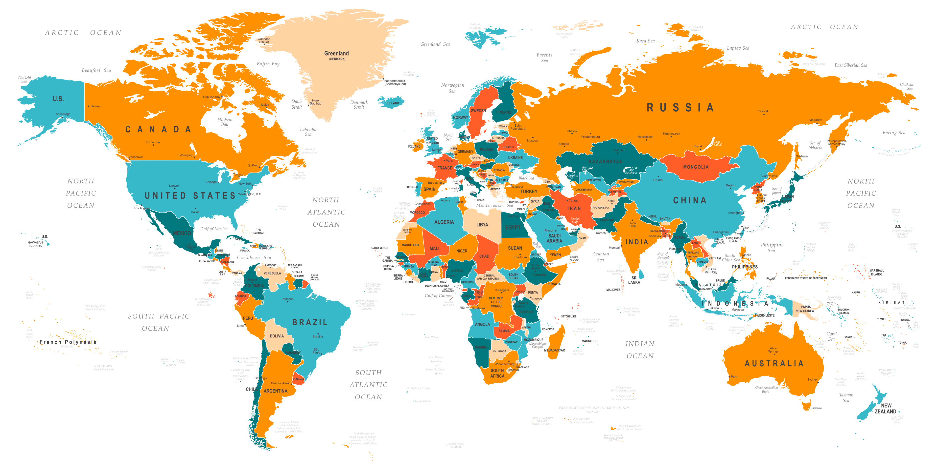
Where is Kiwi grown?
Today, most kiwis eaten in the United States come from California.
China, Italy, New Zealand and Chile also produce Kiwi.

