Slide 1
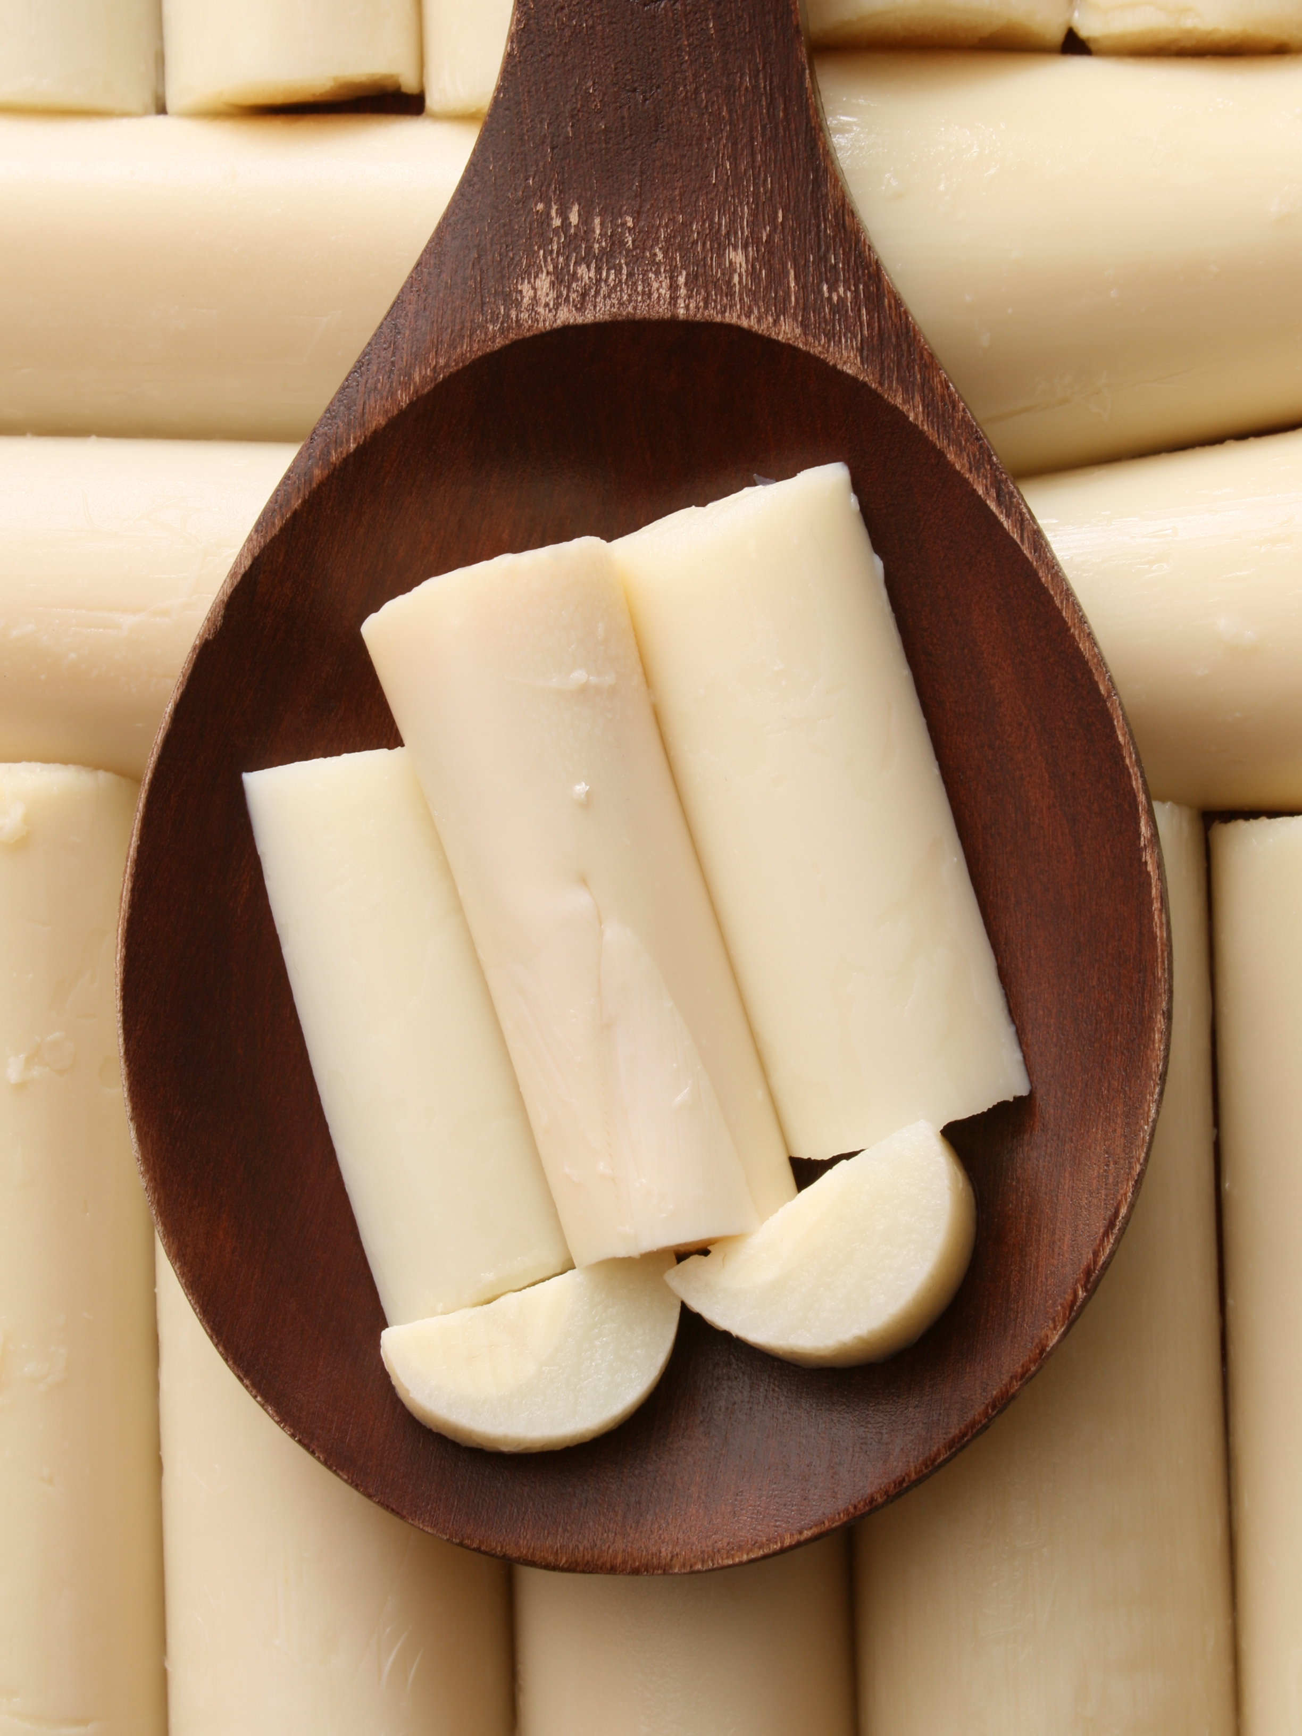
What we are learning today
Today we will be learning about the Heart of Palm!
Who has tried this vegetable before?

Slide 2
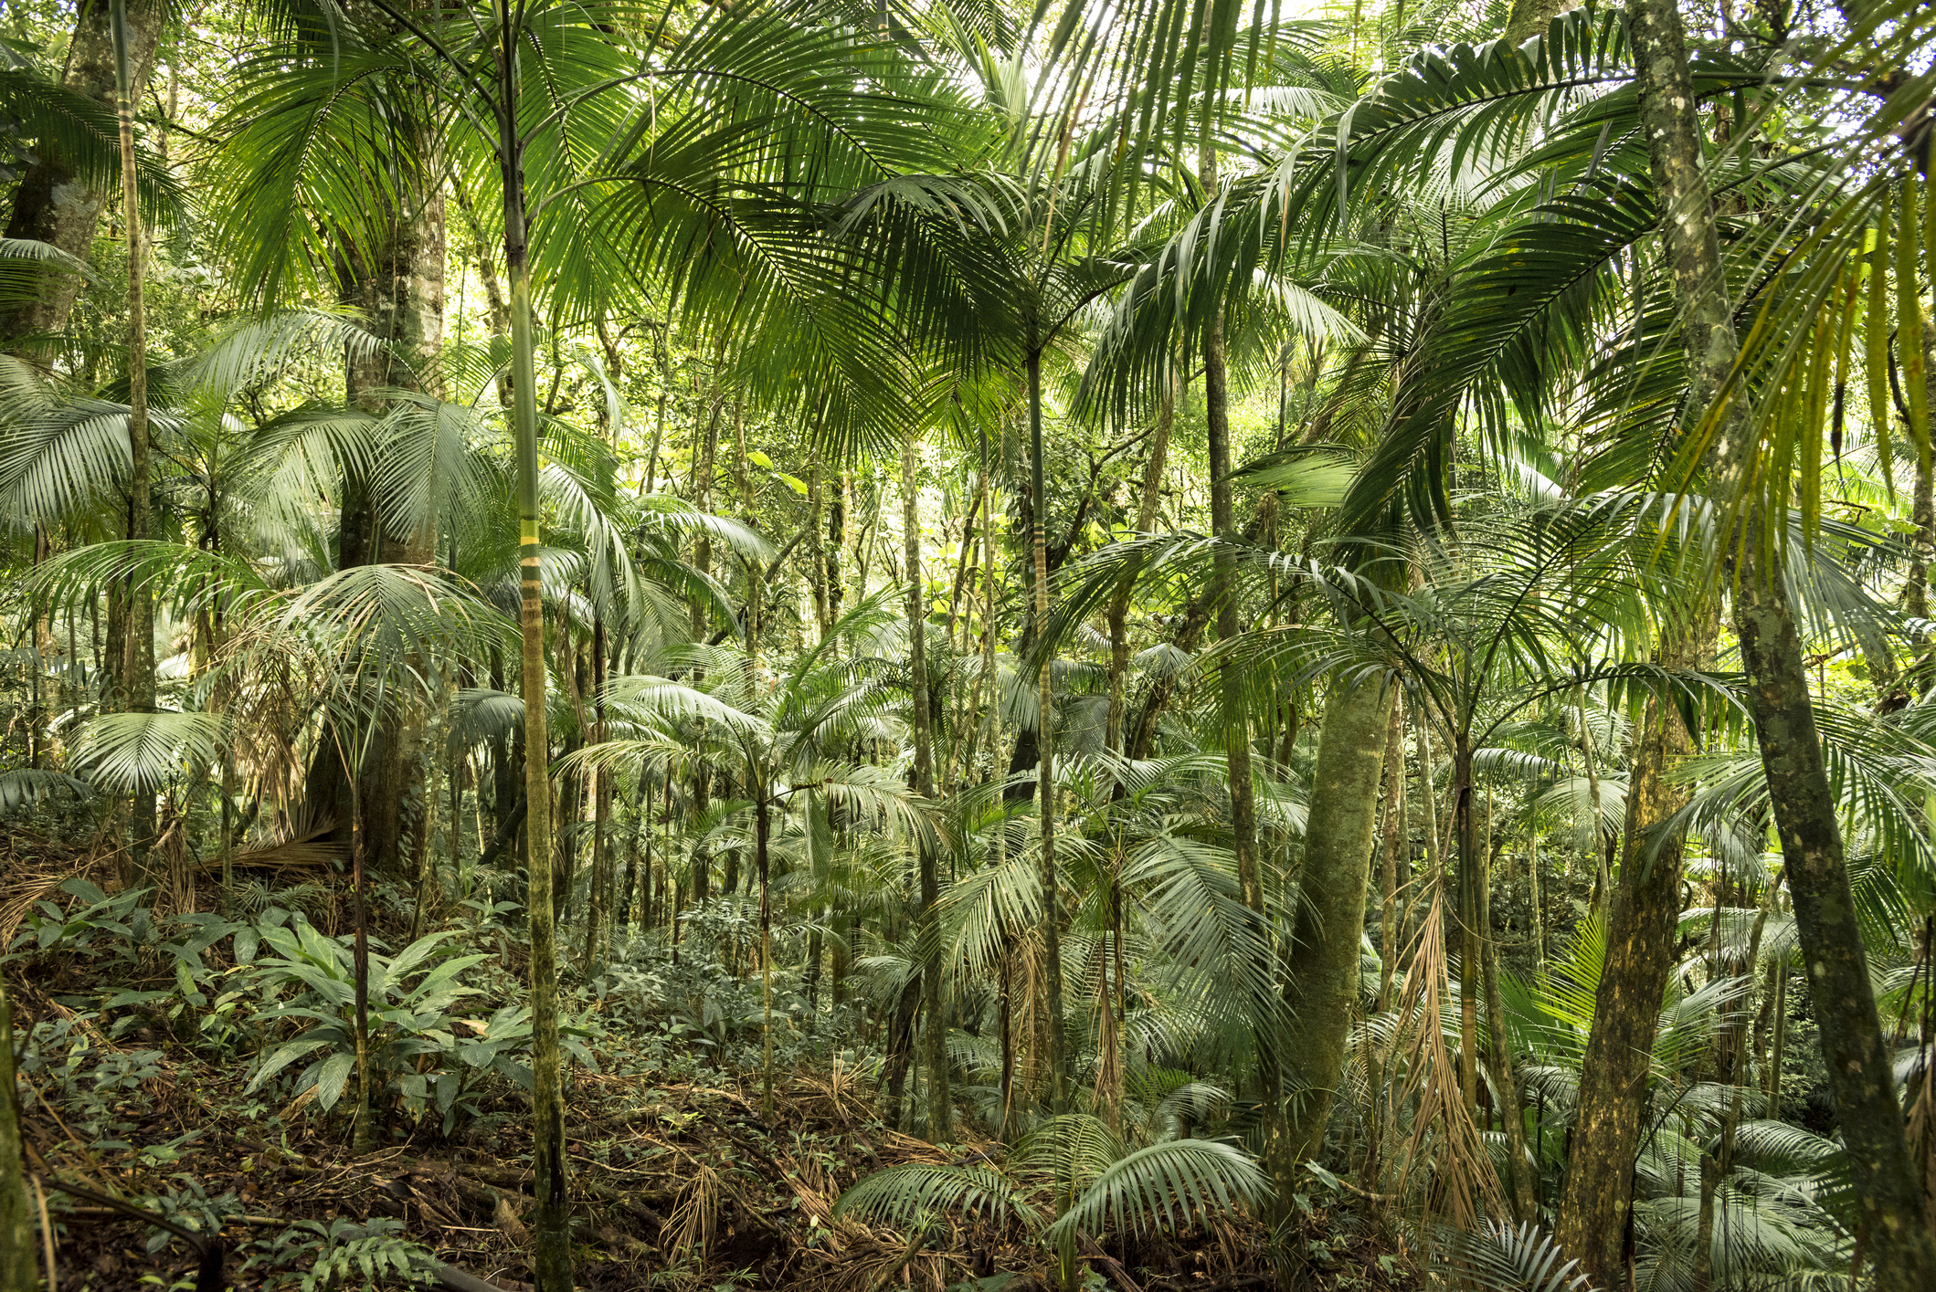
Did you know?
Hearts of Palm is a type of vegetable harvested from certain palm trees.
They are known as a tropical fruit.

Slide 3
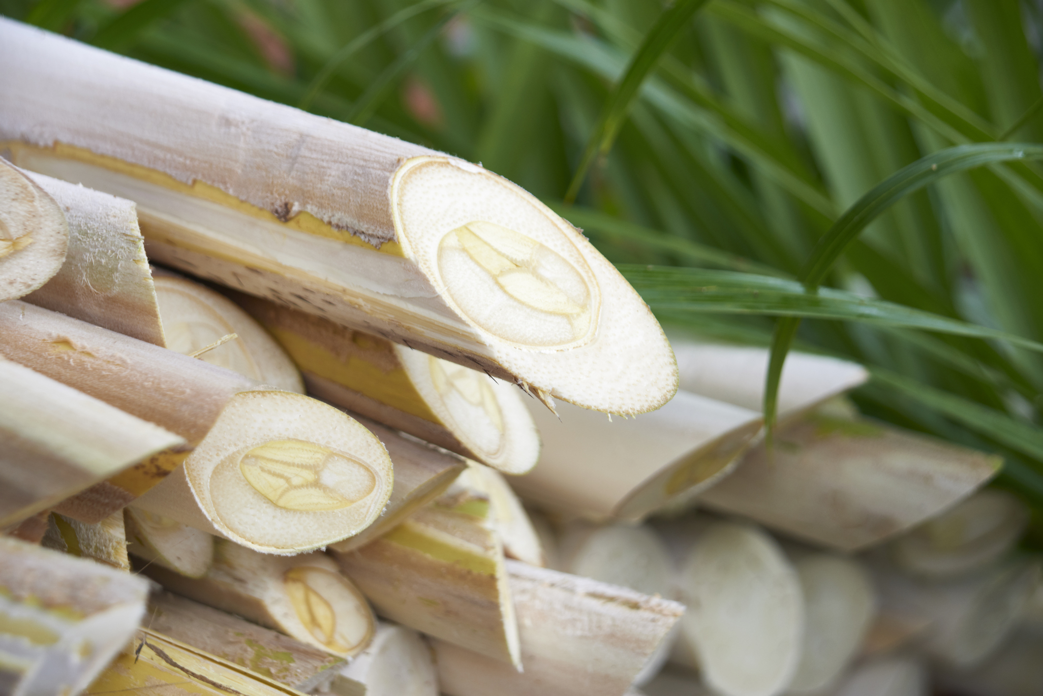
NUTRITION NUGGET
Heart of Palm contains Potassium, which keeps your heartbeat regular!
Heart of palm contains vitamin C, which is a well-known booster of the immune system.

Slide 4

TASTY TIPS
Hearts of Palm has a crisp texture. This makes it an ideal addition to salads and stir-fry meals.
They can be blended into dips, tossed on the grill, sautéed, or baked topped with your favorite cheese.

Slide 5

Spot it on the map
This vegetable is often grown in Costa Rica!

