Slide 1
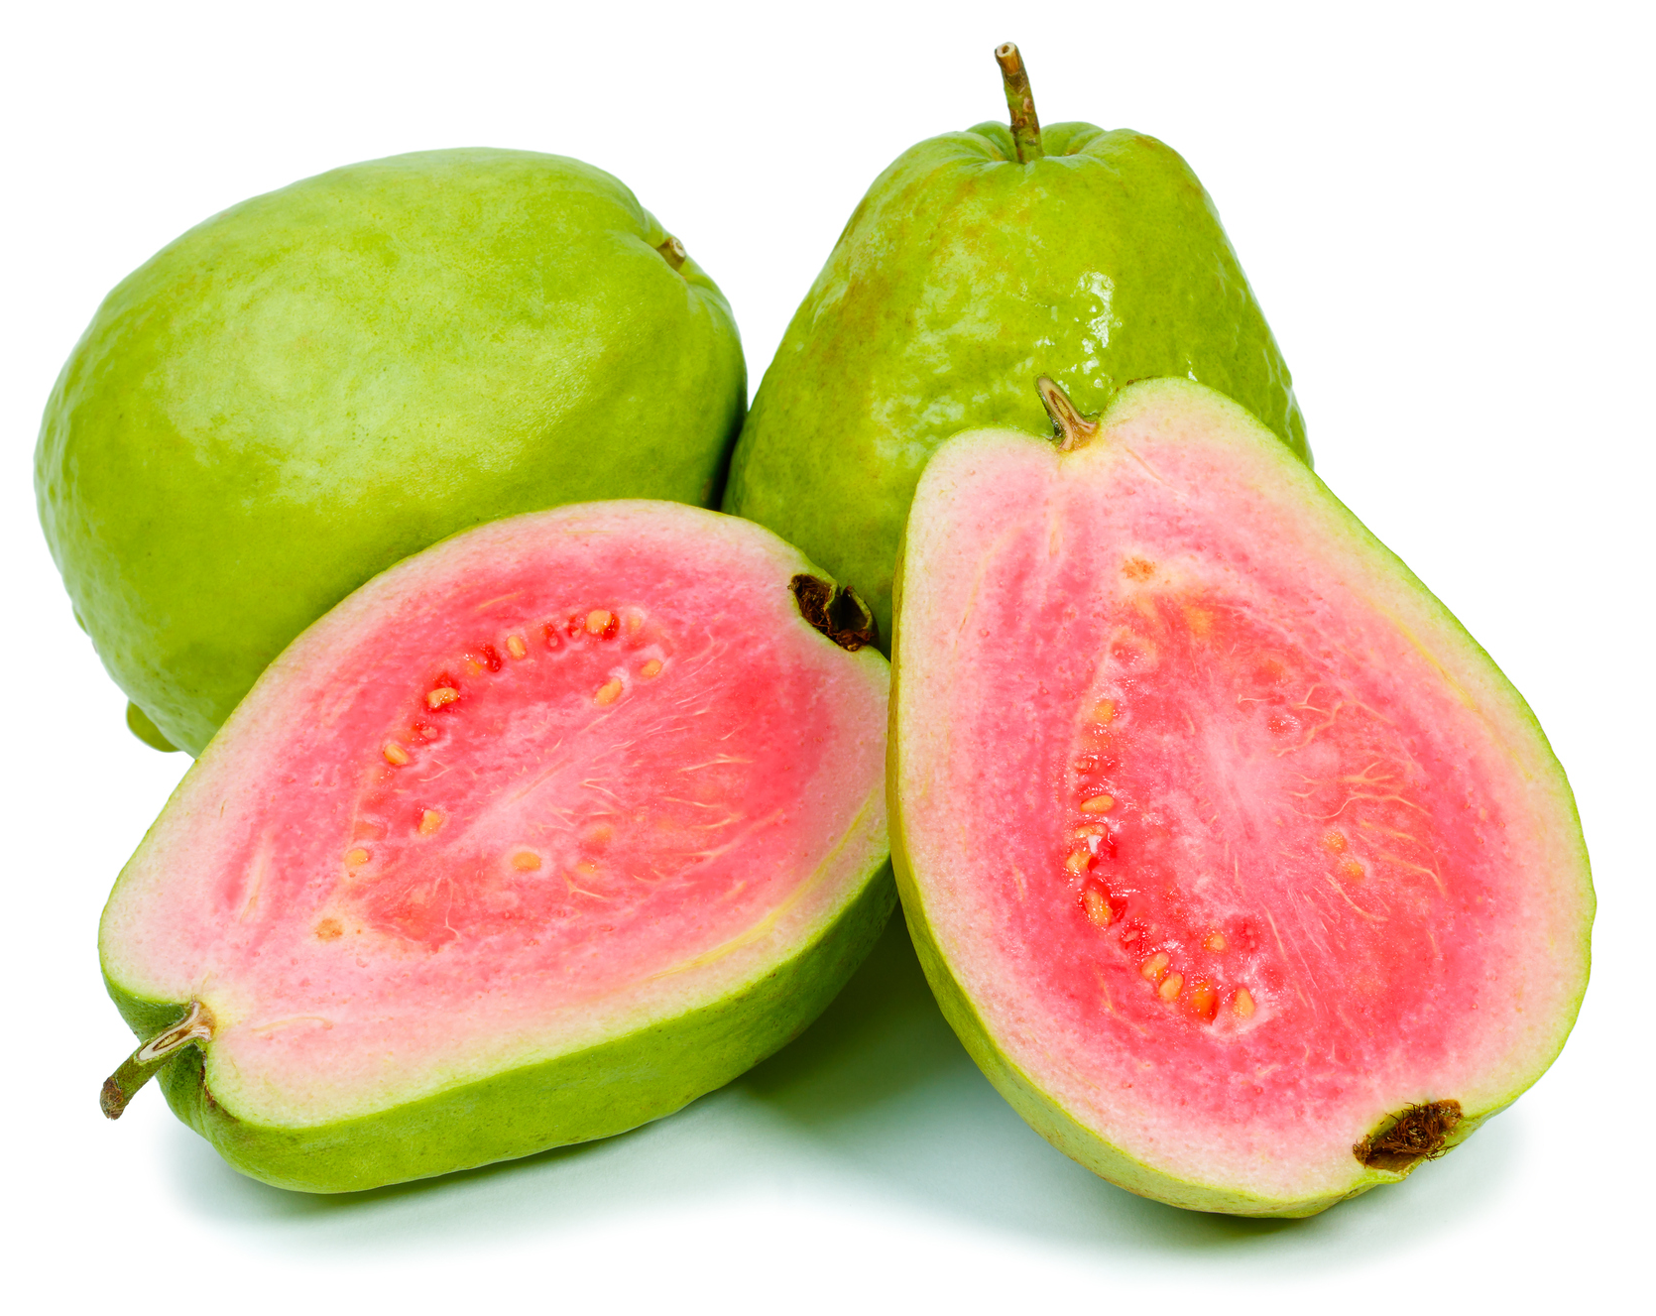
What we are learning today
Hello! Today we will learn about Guava!

Slide 2
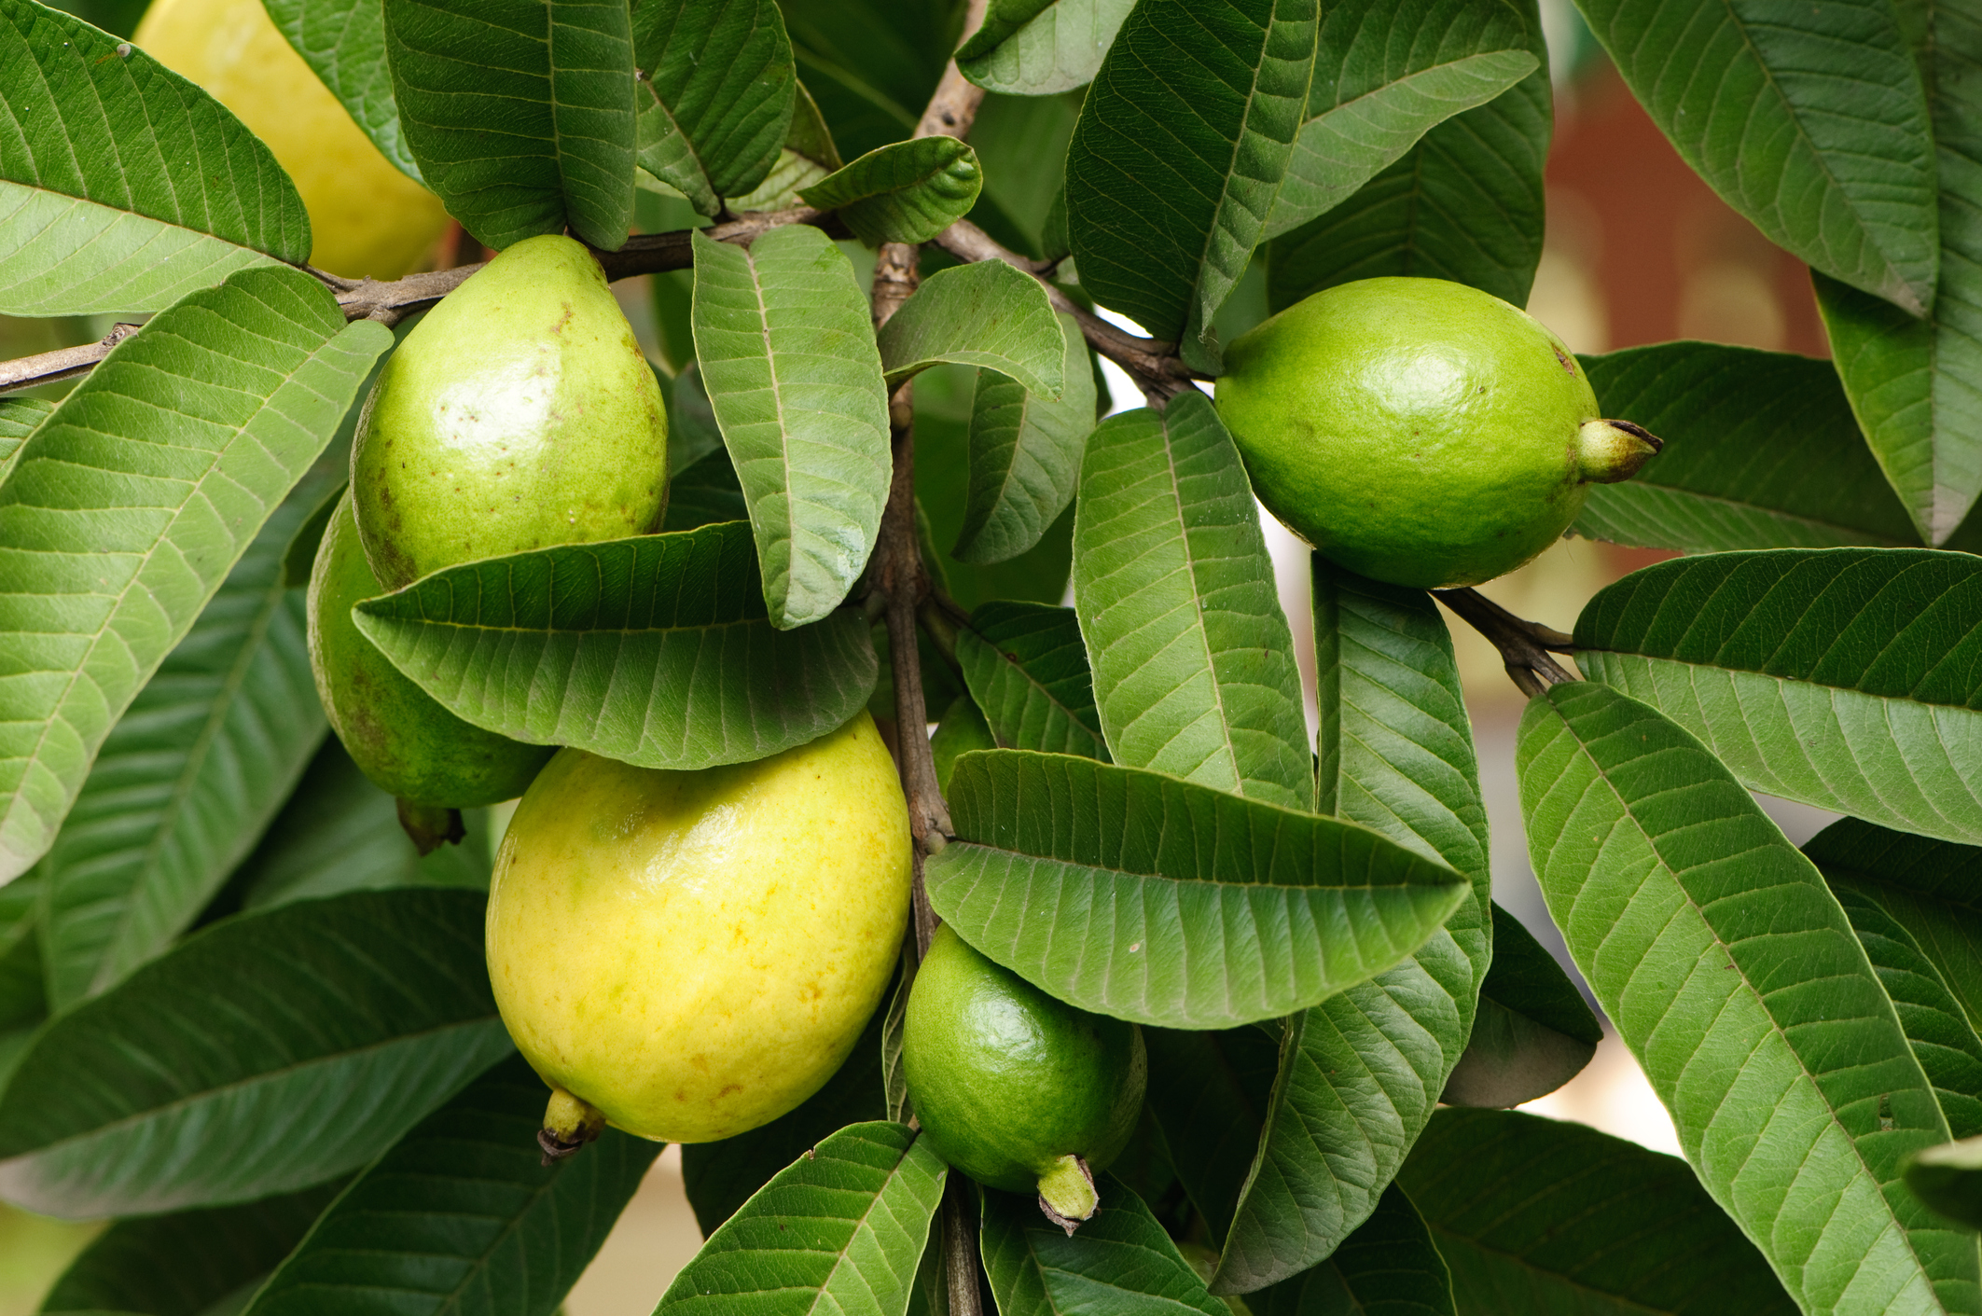
FUN FACTS
Guava is a subtropical fruit and does not like cold weather.
Guava was a favorite fruit of the Ancient Aztecs and Incas.

Slide 3


NUTRITION NUGGET
Guavas are a super fruit!
They have Vitamins, minerals and antioxidants.
Guava has Vitamin C that helps the body to fight against infection,

