Slide 1
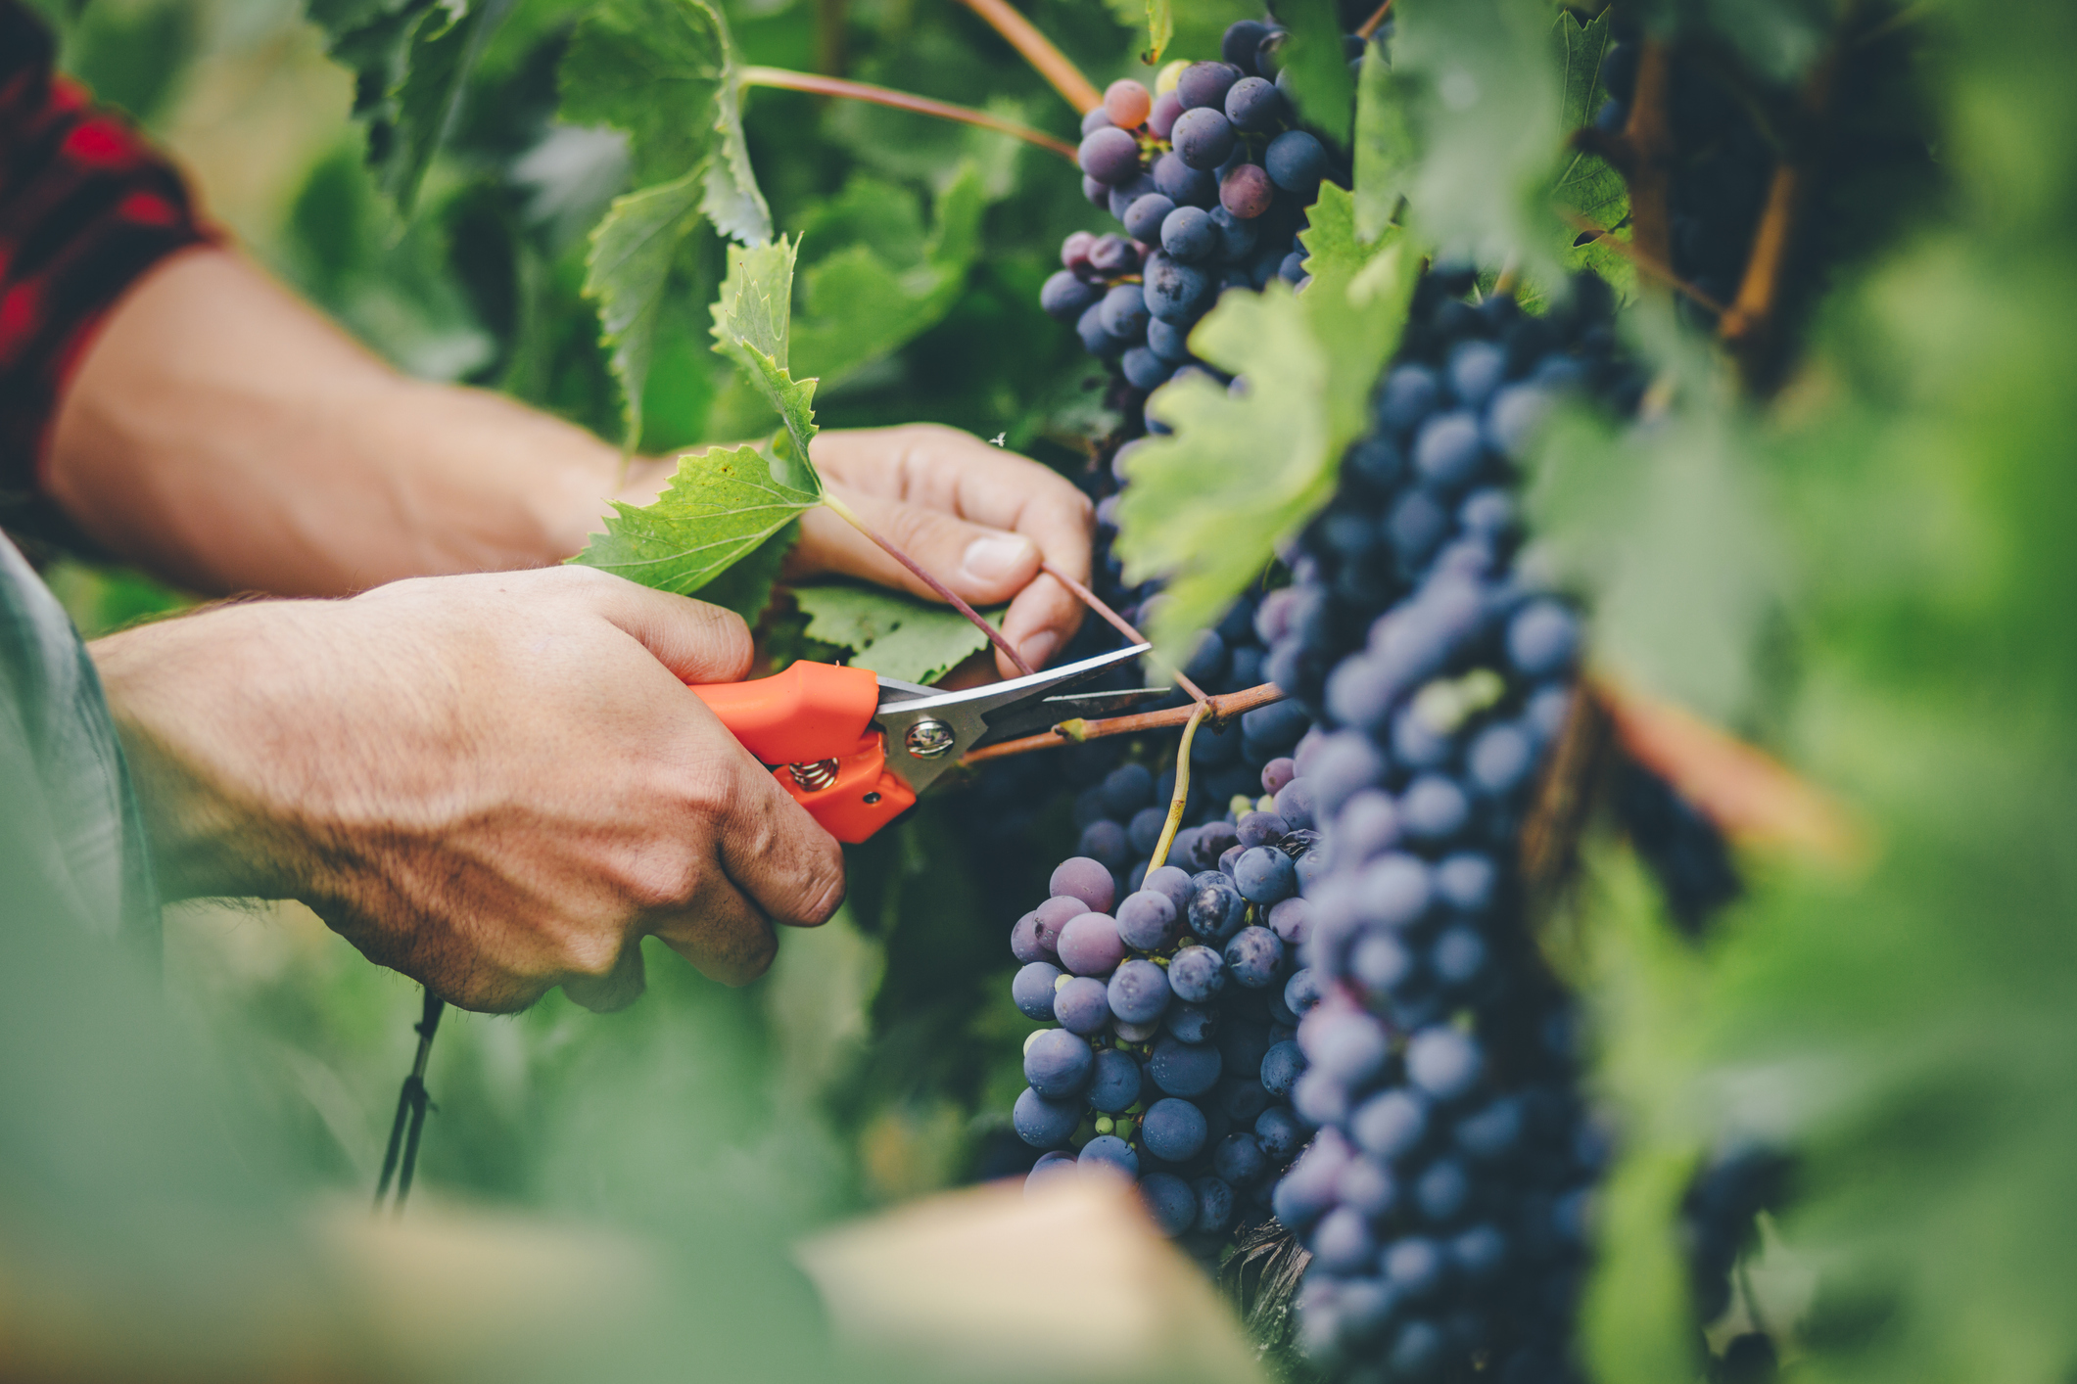
What we are learning today
Today we are going to be learning about grapes!

Slide 2
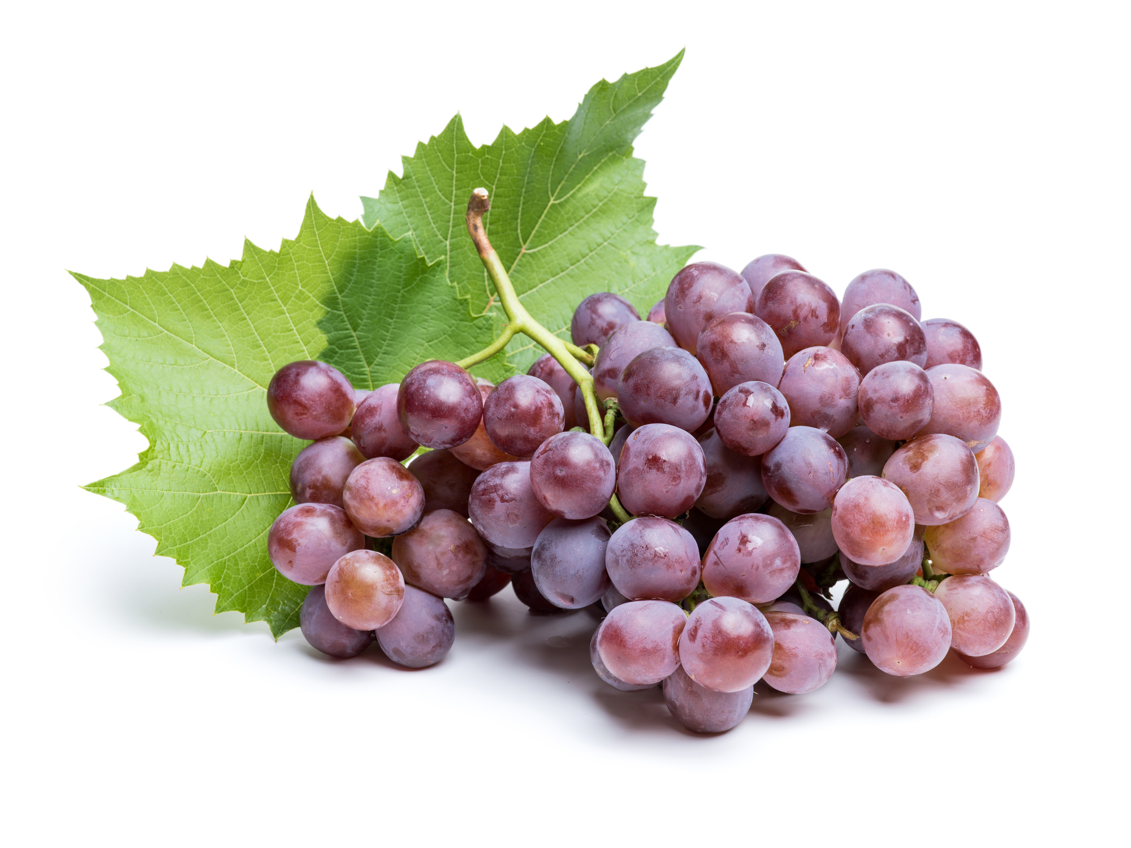
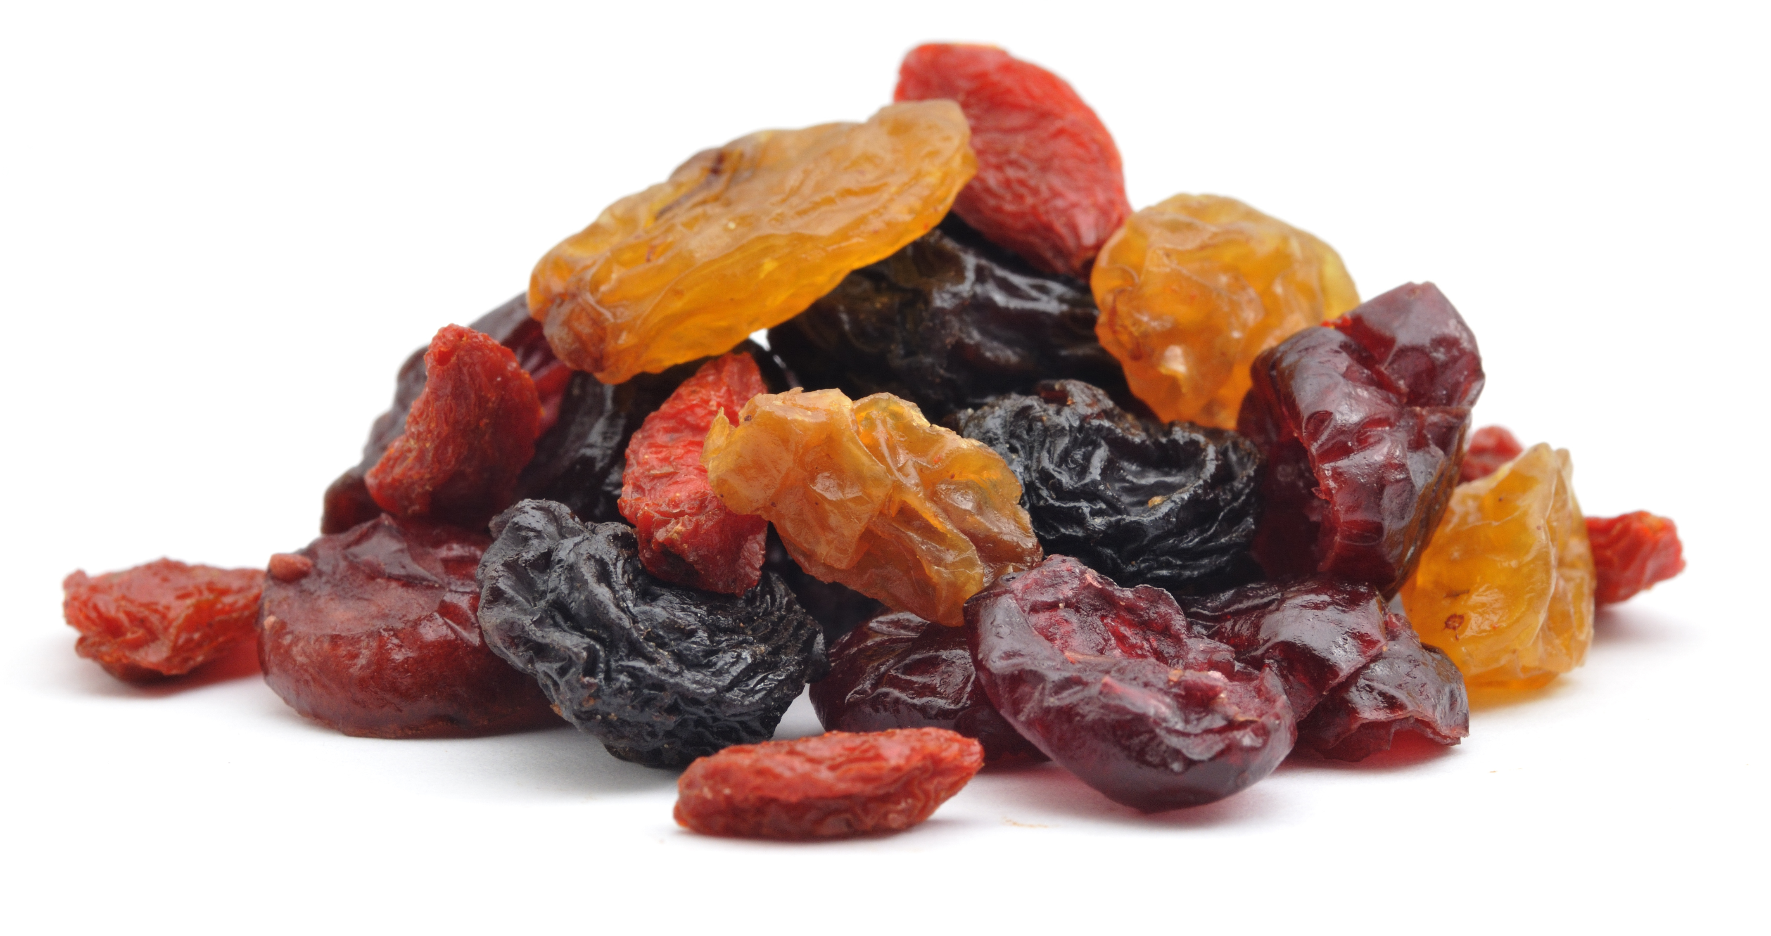
FUN FACTS
Grapes are a type of berry.
There are about 8,000 varieties of grapes.
Raisins are dried grapes.

Slide 3
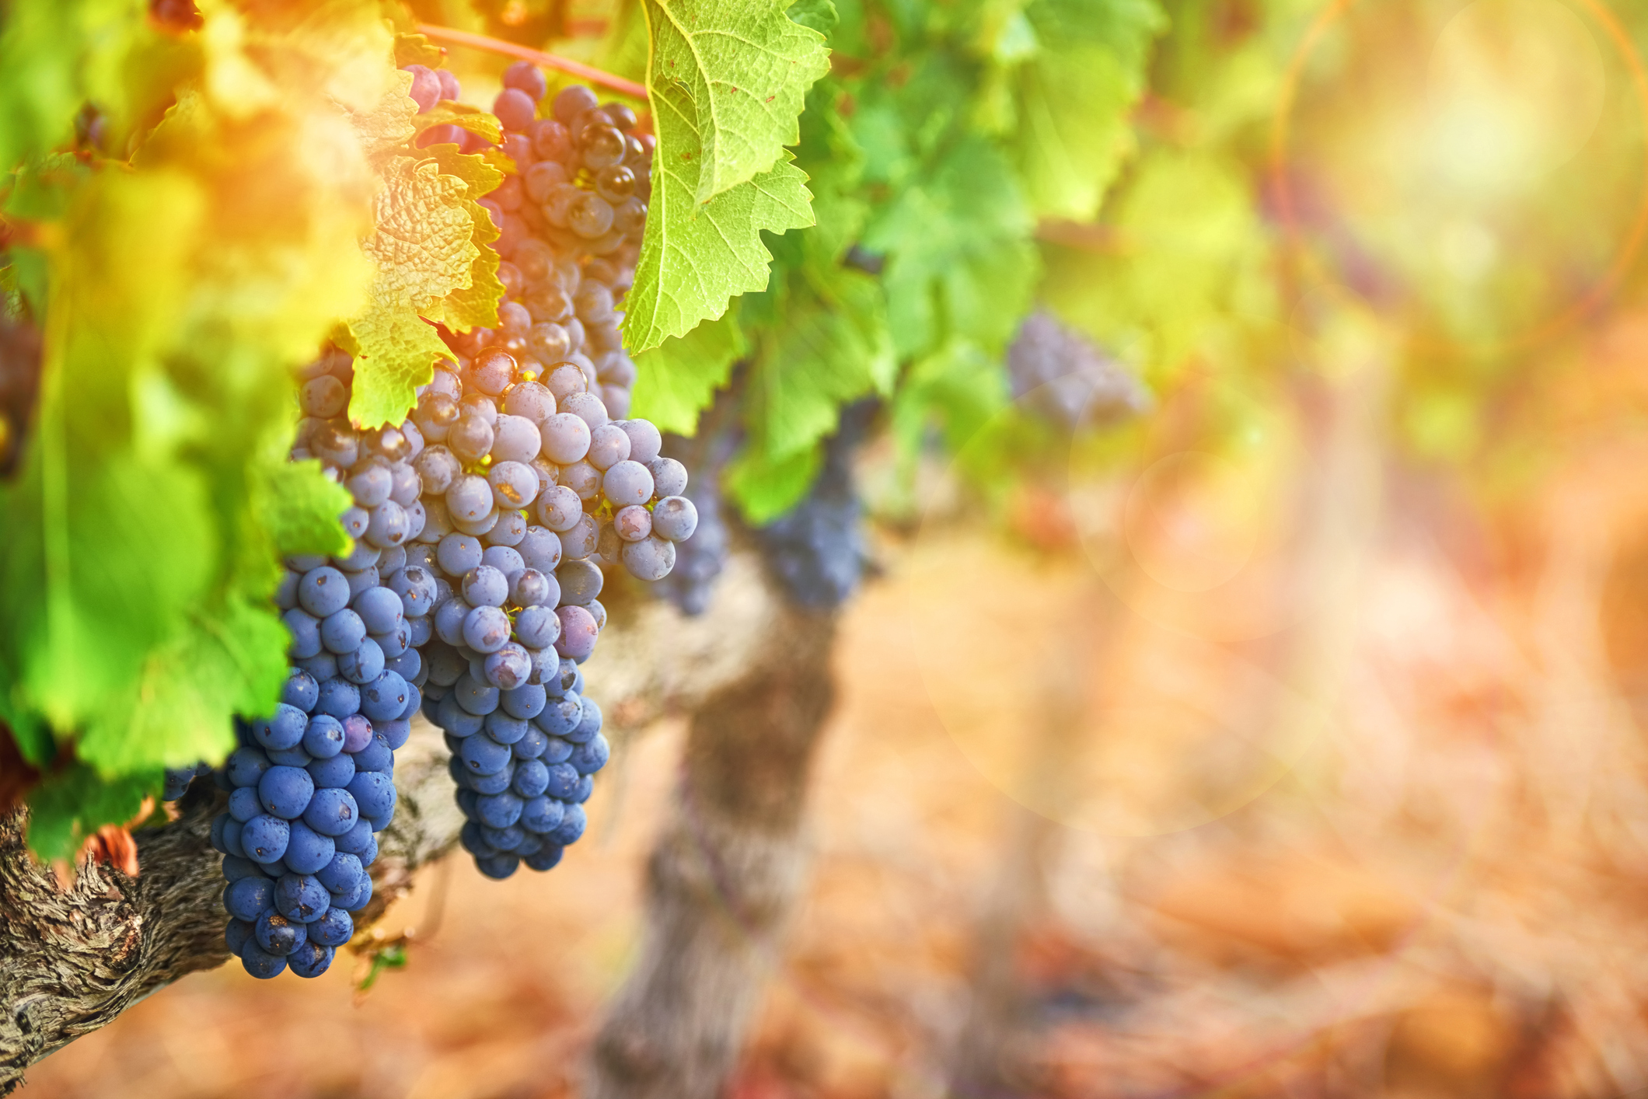
NUTRITION NUGGET
Grapes have Vitamin C, which can help in the growth of blood vessels.
Grapes have potassium and calcium, helping your heart function and your teeth and bones grow.

