Slide 1

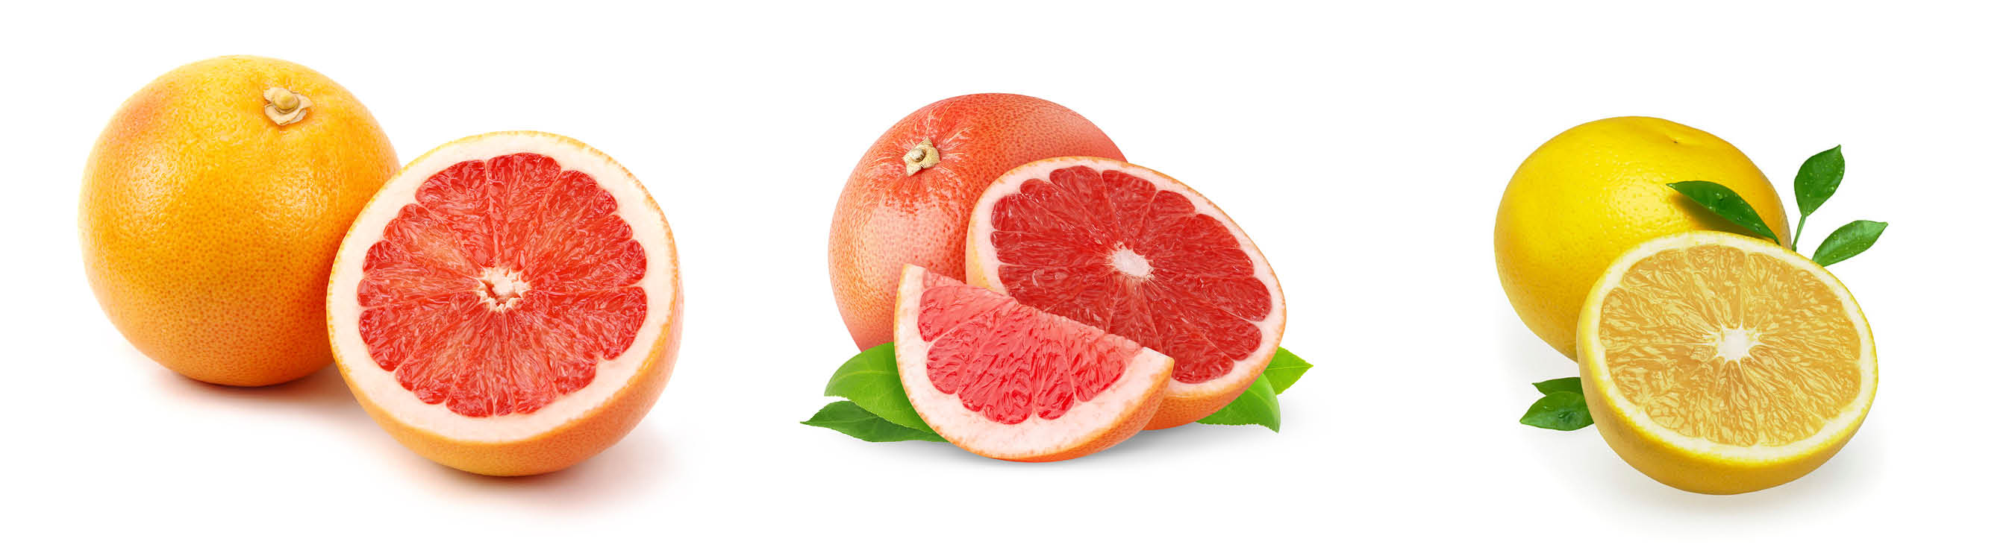
What we are learning today
Hi, I’m Gregory, and today we are going to learn more about grapefruit!
My game plan is to teach you the rich history of Florida grapefruit and how healthy it is for your body. It’s game time!
Notes:
Add Gregory and some pictures of grapefruit grove

Slide 2

Fun facts about grapefruit
Ruby Red, Flame, Thompson, Marsh and Duncan are the most common varieties of Florida grapefruit.
Fresh grapefruit season typically runs from September through June.
Florida grapefruits are some of the juiciest and sweetest grapefruits in the world.
A healthy grapefruit tree can produce up to 350 pounds of grapefruit in one season!
Ruby Red
Flame
Thompson

Slide 3


WHERE DO
THEY GROW?
Grapefruits grow best in subtropical climates and sandy soil.
Florida is the top producing state in the nation, followed by Texas and California.

Slide 4

NUTRITION NUGGET
Citrus fruits, such as grapefruit, are a great source of vitamin C!
Is essential for the growth and repair of body tissues.
Helps heal wounds and repair and maintain healthy cartilage, bones, teeth and skin.
Acts as an antioxidant, fighting free radicals in the body. This may help prevent or delay certain cancers and heart disease.
Your body cannot make vitamin C. It’s essential that you eat foods that contain this vitamin every day!

