Slide 1
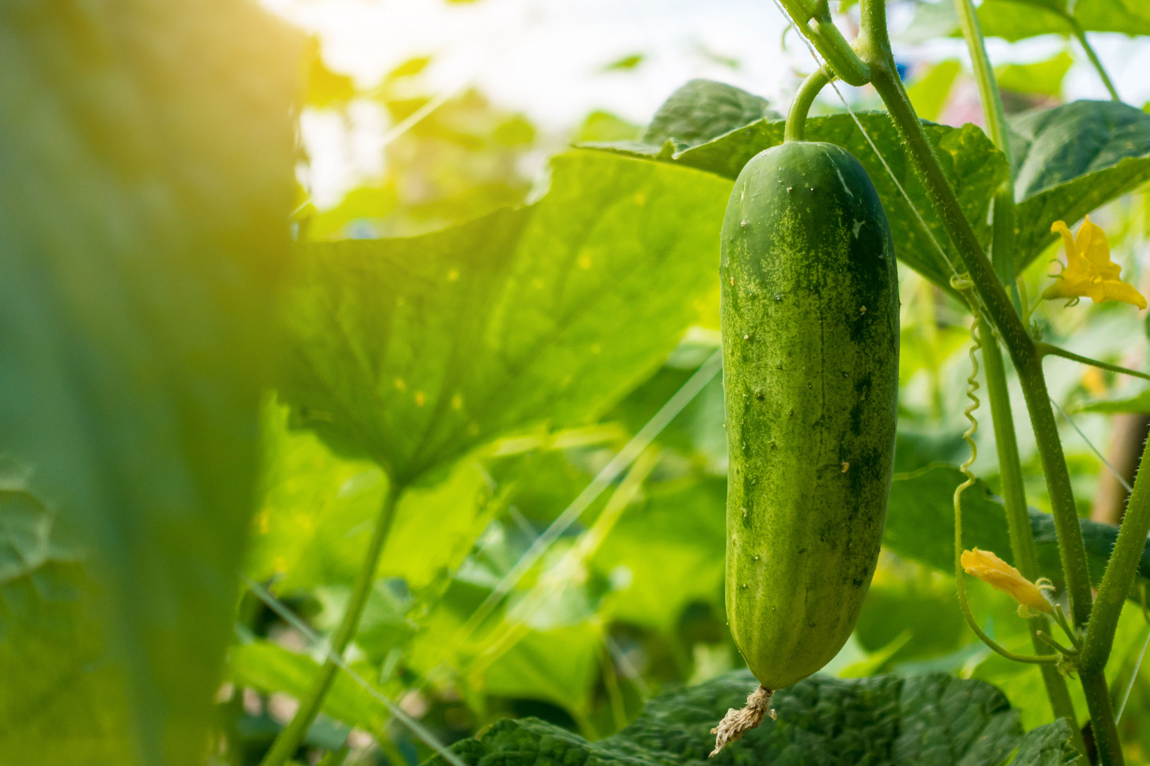
What we are learning today
Today we are going to be learning about cucumbers!

Slide 2
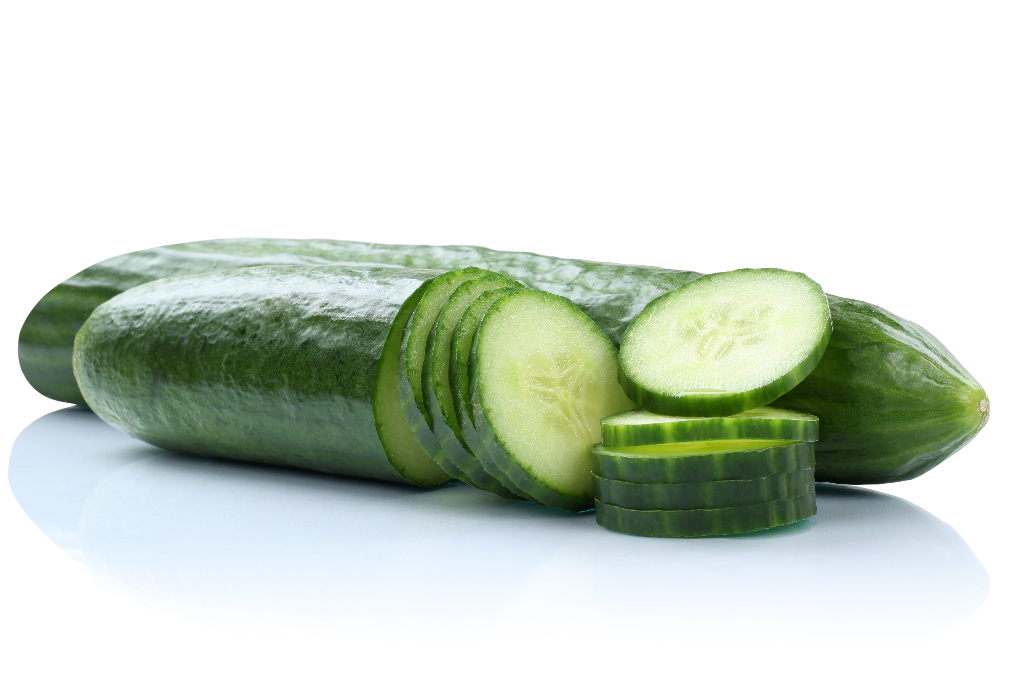
FUN FACTS
Cucumbers are 96% water.
Most of the flavor in the cucumber comes from the seeds.
The smell of cucumbers helps people relax.
The outside waxy coating on a smooth cucumber can erase ink.

Slide 3
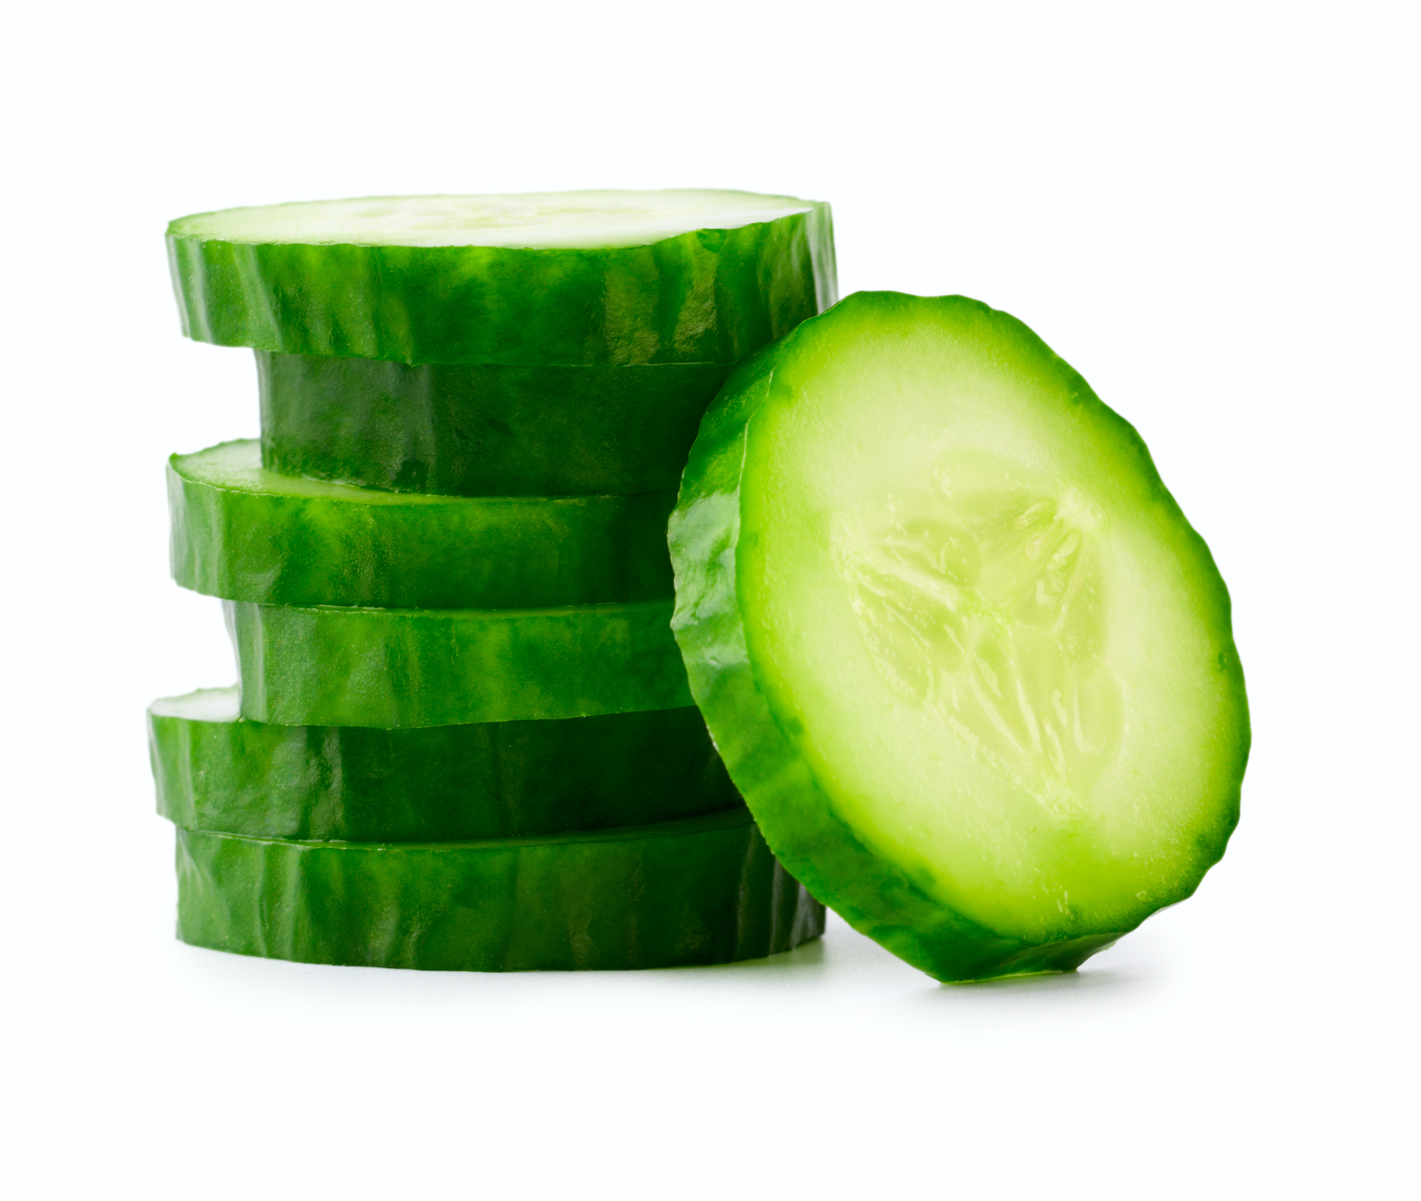
NUTRITION NUGGET
Cucumbers give you energy because they are full of Vitamin B and carbohydrates.
Cucumbers also have a lot of Vitamin C.
Since cucumbers are mostly water, they can help keep you hydrated.
Cucumbers can help sooth your skin, and reduce irritation or swelling.

Slide 4


Florida Grows cucumbers
In Florida, cucumbers have two growing seasons!
  March - May
  October - December

