Slide 1
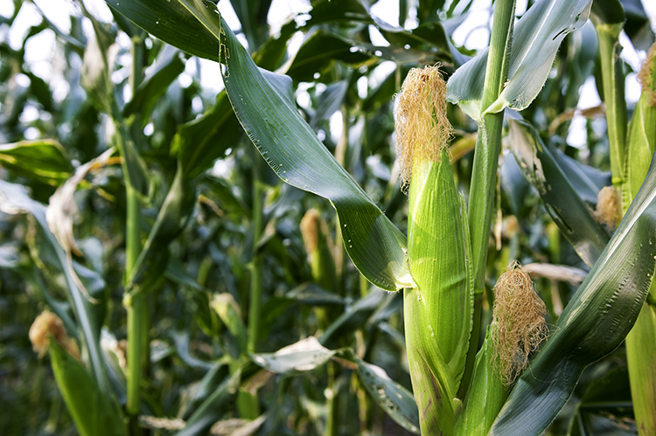

What we are learning today
I’m Carrie Sweet Corn,
this month’s star performer.
Ready to hear the
a-maize-ing story of Florida sweet corn?
Let the show begin!

Slide 2
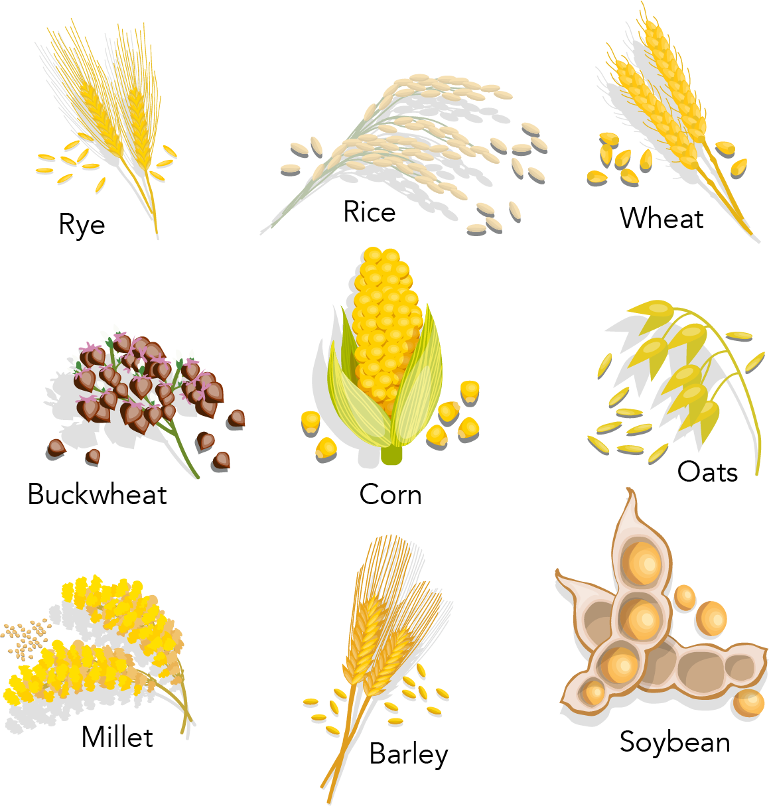
FUN FACTS
An average ear of corn has 500-1000 kernels.
Corn is a member of the cereal grass family.
One ear of corn contains about the same amount of calories as a banana.

Slide 3
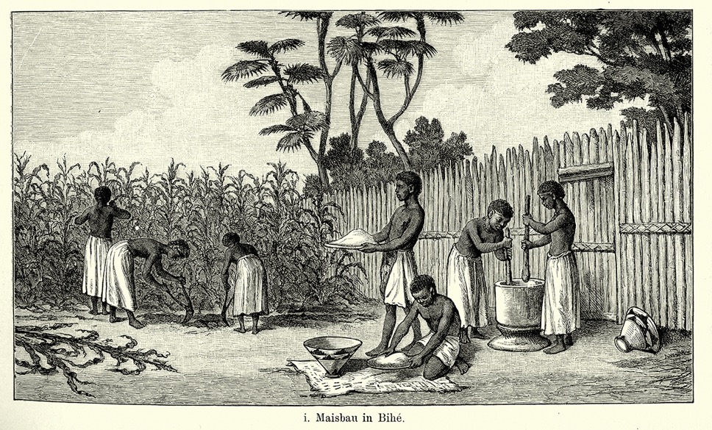

Did You Know?
Corn is a staple food crop that was initially grown in Mexico.
In many parts of the world corn is still
known as maize.
19th Century maize cultivation
in Viye, Angola.
Refer to this resource to learn more about the origin of corn.

Slide 4

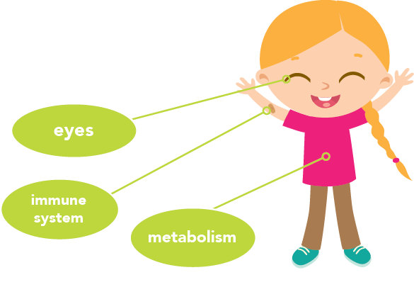
NUTRITION NUGGET
The fiber found in sweet corn helps provide fullness after meals, which can help you achieve and maintain a healthy weight.
Corn contains several B vitamins,
which are essential for:
Supporting the body's metabolism
Producing energy; and
Aiding the body in fighting disease and infection.
Corn is a good source of vitamin C, magnesium and phosphorus.
Vitamin C helps keep your immune system strong.
Magnesium plays a role in maintaining healthy bones and a healthy heart.

Slide 5
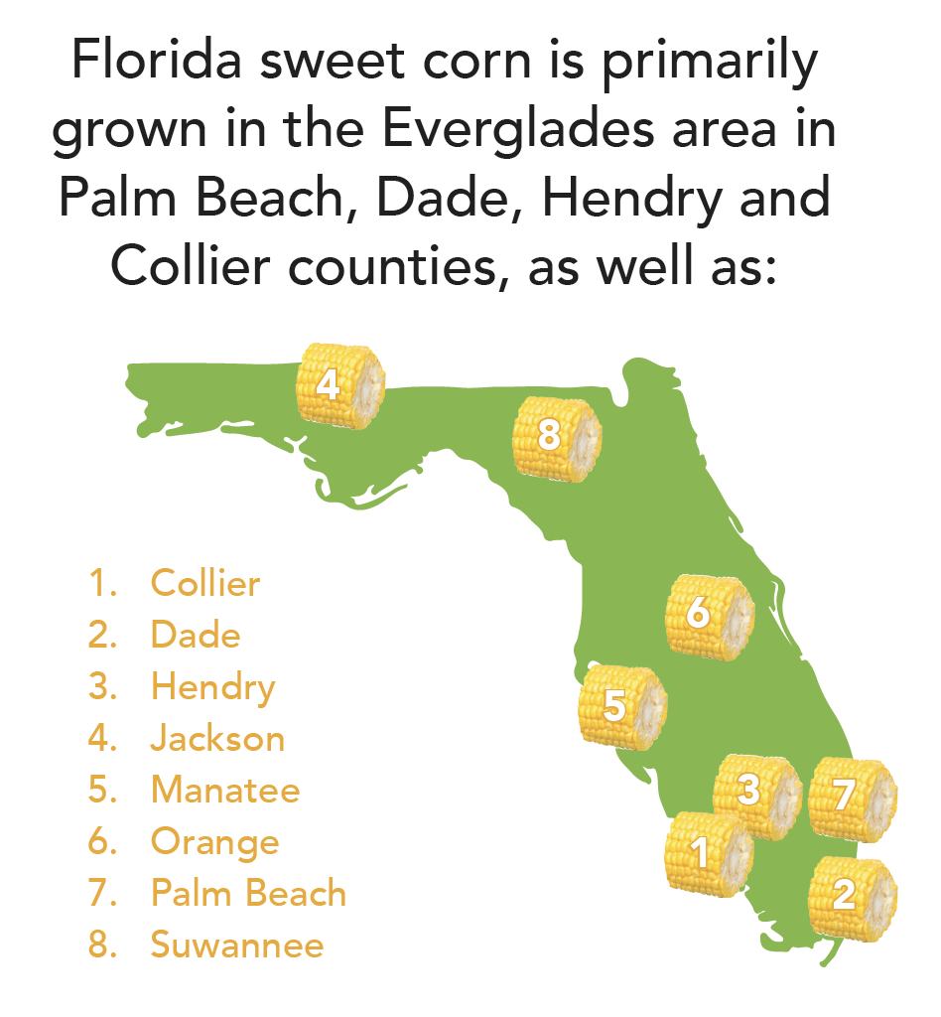
Spot it on the map
Sweet corn is the fourth major vegetable crop produced in Florida.
Nearly 40,000 acres of land are planted with sweet corn every year.

