Slide 1
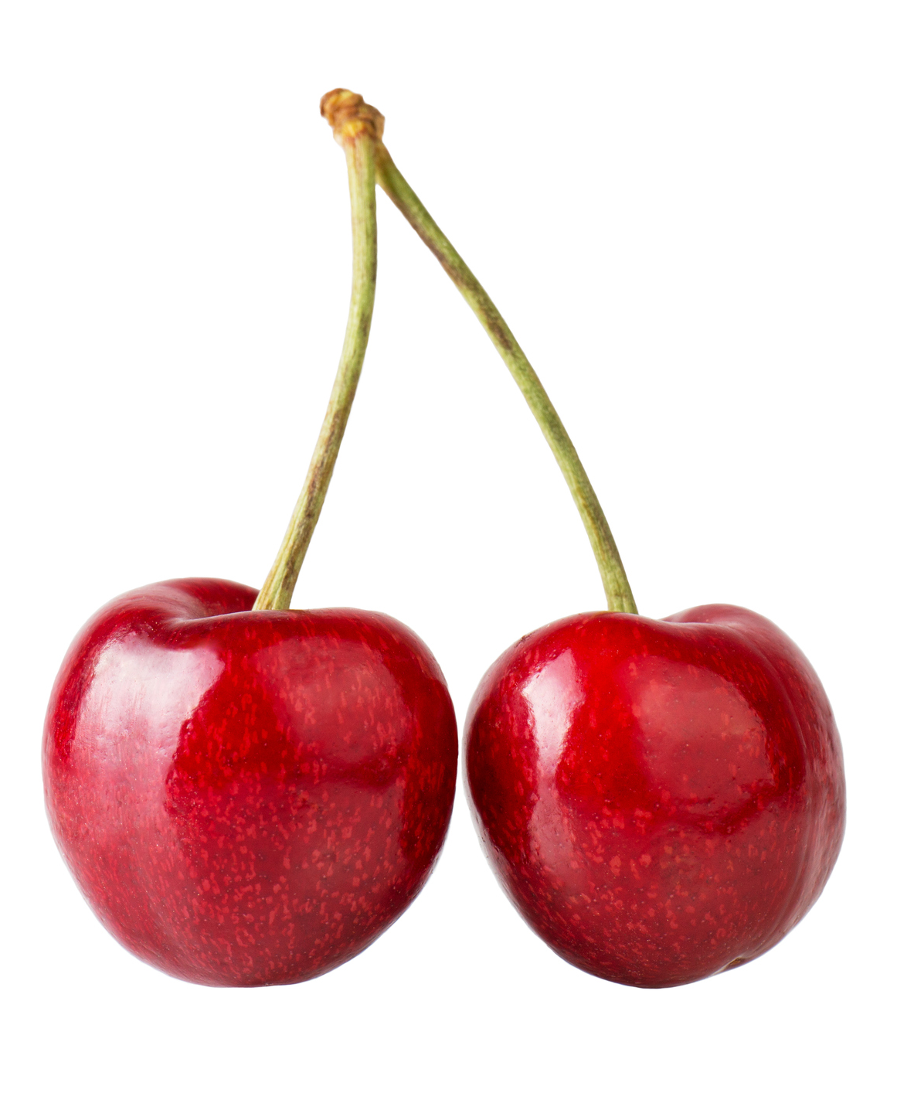
What we are learning today
Today we are going to be learning about cherries!

Slide 2
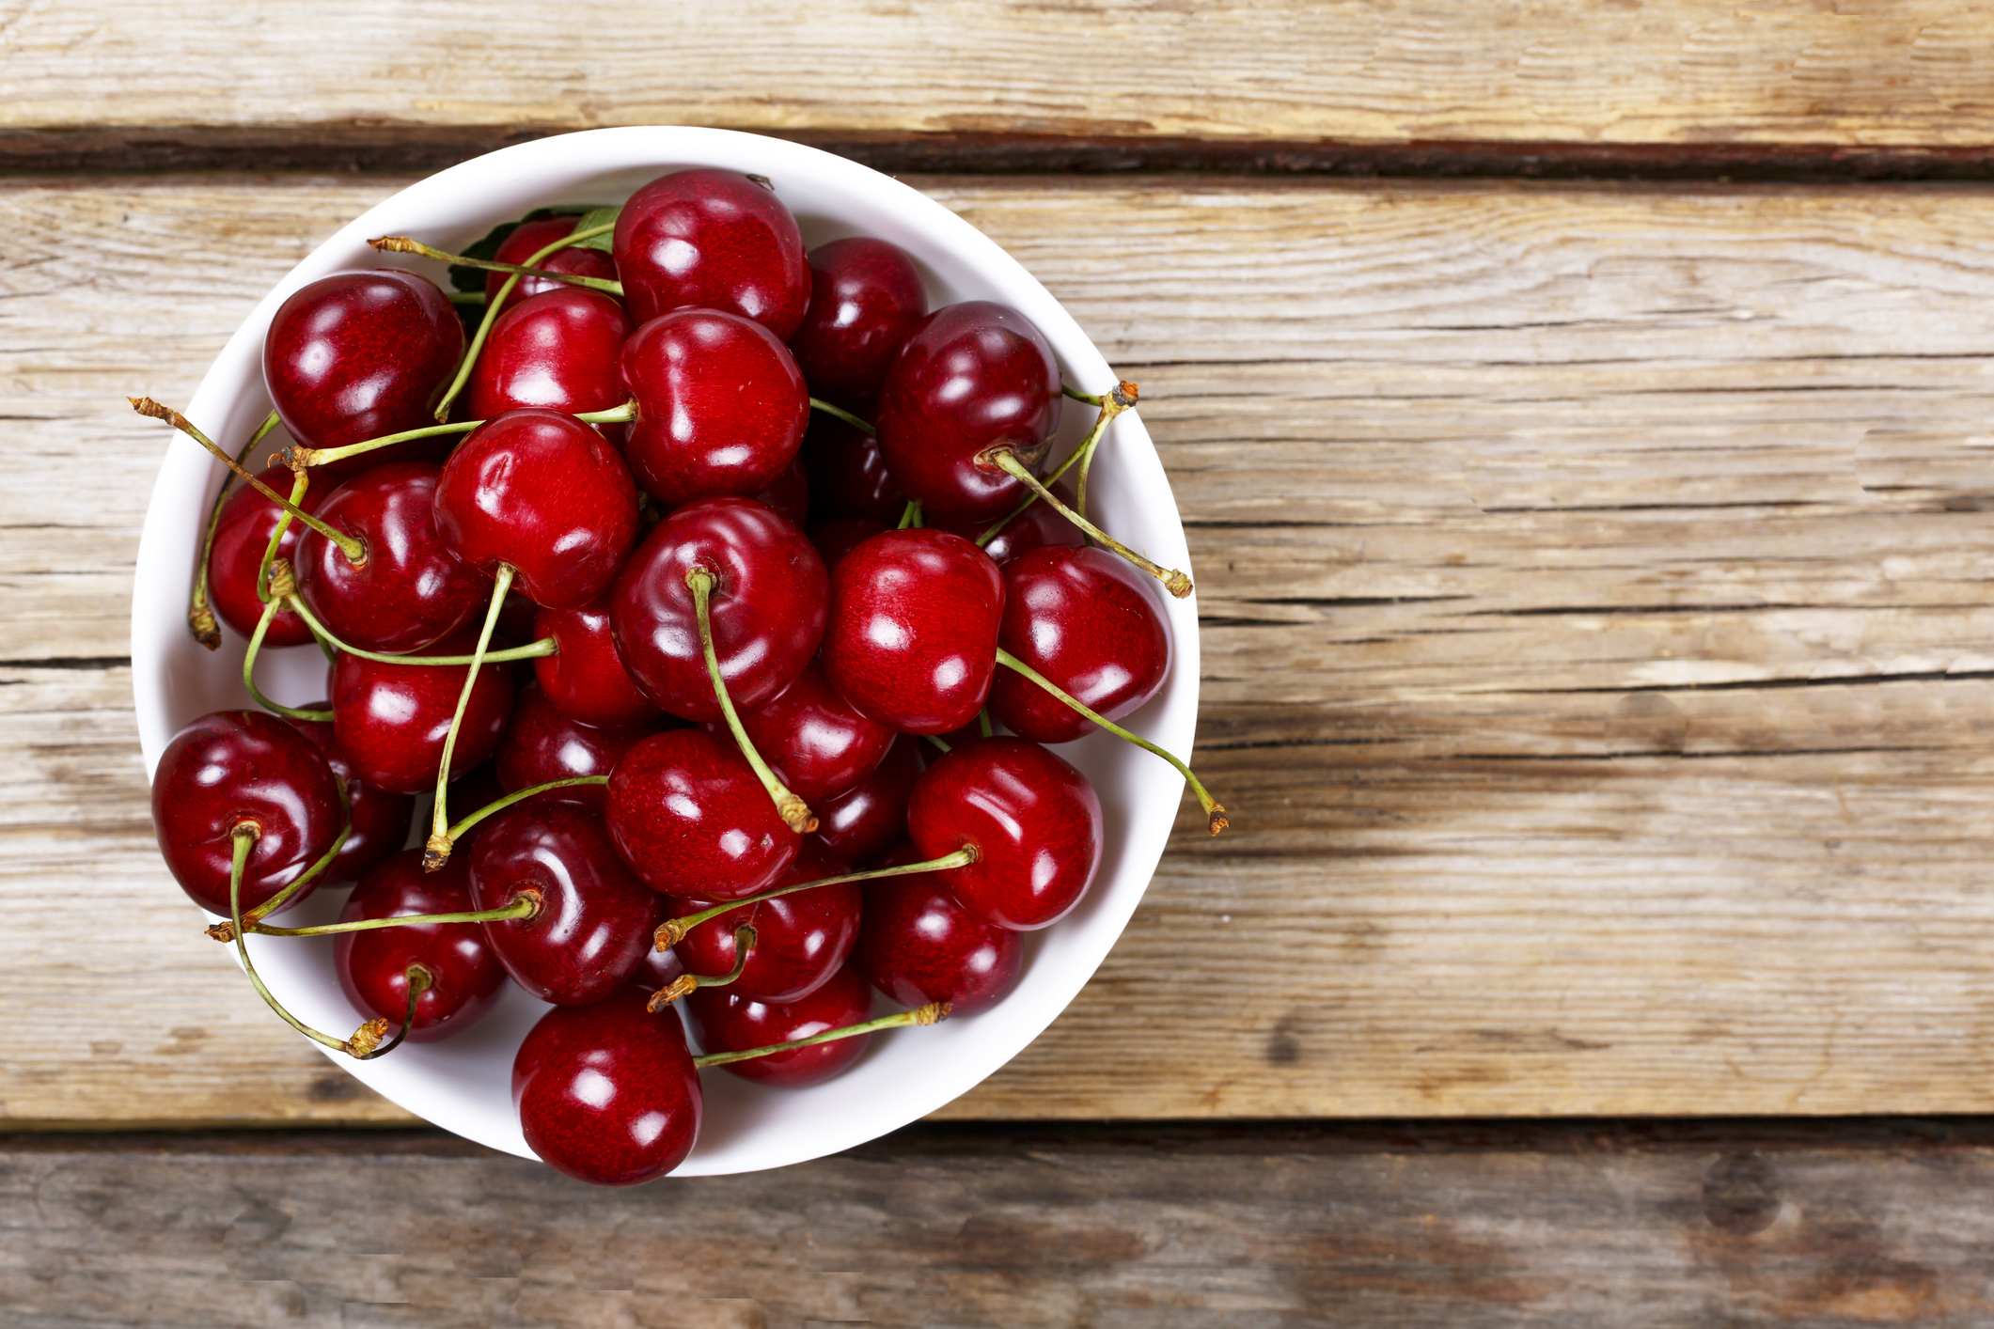
FUN FACTS
Cherries are a summer fruit that is grown on trees.
Groups of cherry trees are called orchards.
Cherries are relatives of peaches, apricots and plums.

Slide 3
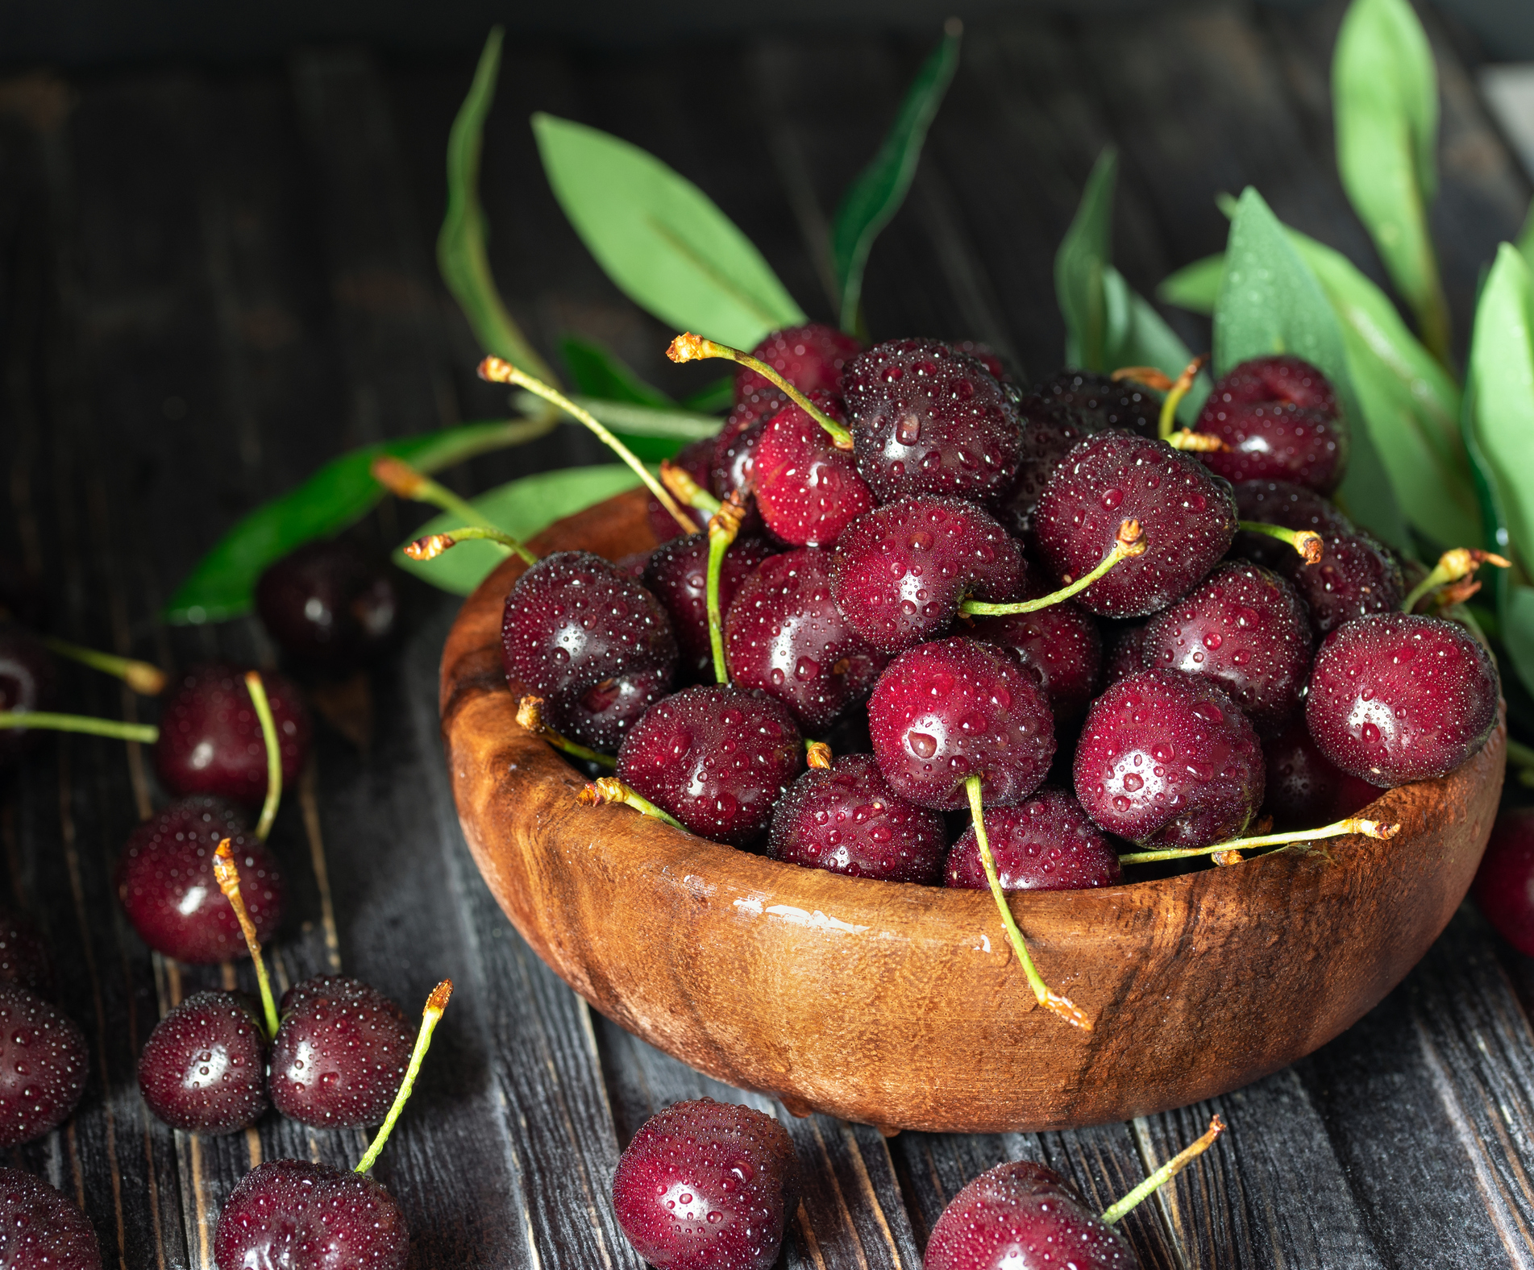
NUTRITION NUGGET
Cherries contain Vitamin C and dietary fibers.
Cherries have potassium that plays a key role in growing muscles and keeping your heart and kidneys healthy.

Slide 4

Spot it on the map
In the United States, most sweet cherries are grown in Washington, Oregon, California, Wisconsin, and Michigan.

