Slide 1

WHAT WE ARE
LEARNING TODAY
Howdy Partners!
I’m Cyrus Celery.
It’s time to saddle up and learn about Florida Celery.
Join me as we learn about Florida Celery production!

Slide 2
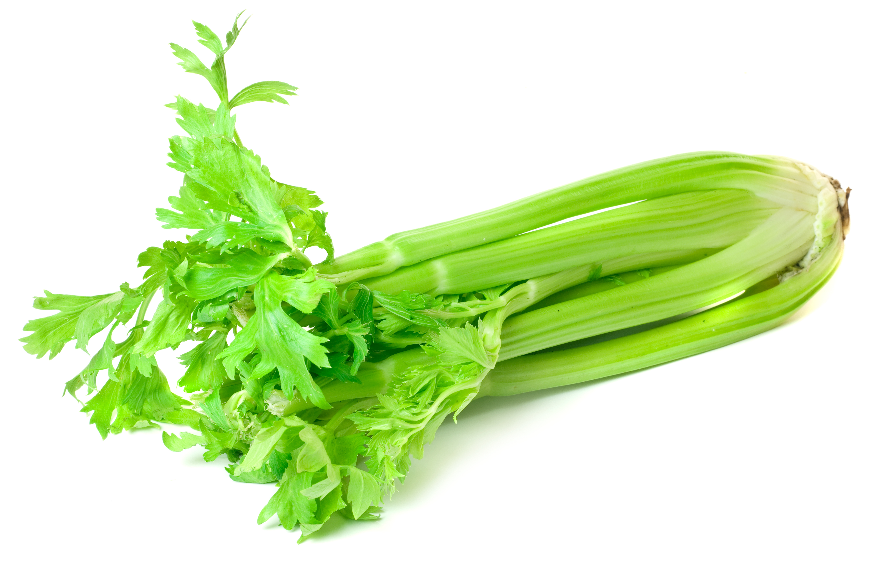
FUN FACT
Garlands made of celery leaves were found in the tomb of a pharaoh who died in 1323 BC.
Notes:
Change celery graphic?

Slide 3

FUN FACTS
Celery has vitamin K which helps transport Calcium. That helps keep your bones strong!
One celery stalk contains about five (5) calories.
Celery is high in vitamin K.
Vitamin K regulates blood clotting, assists in the transport of calcium throughout the body and decreases the risk of bone fractures.

Slide 4
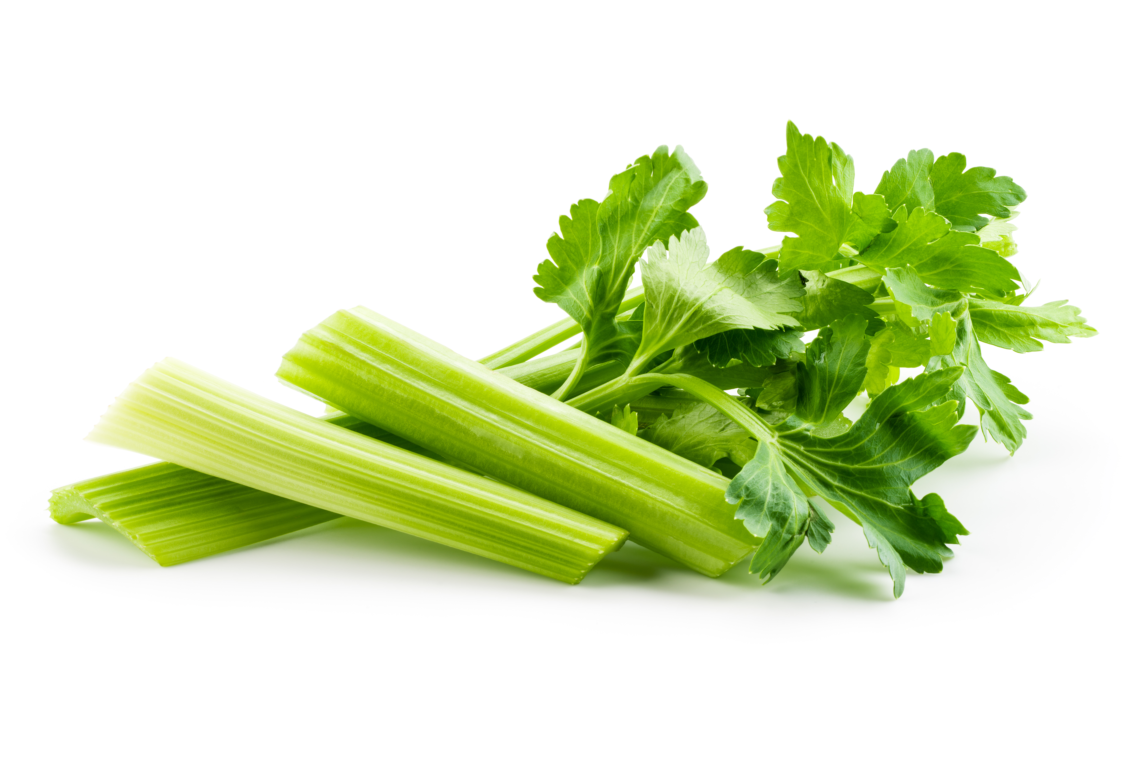
Did You Know?
Celery is related to carrots, fennel and parsley.
Celery is composed of 94% water.

Slide 5

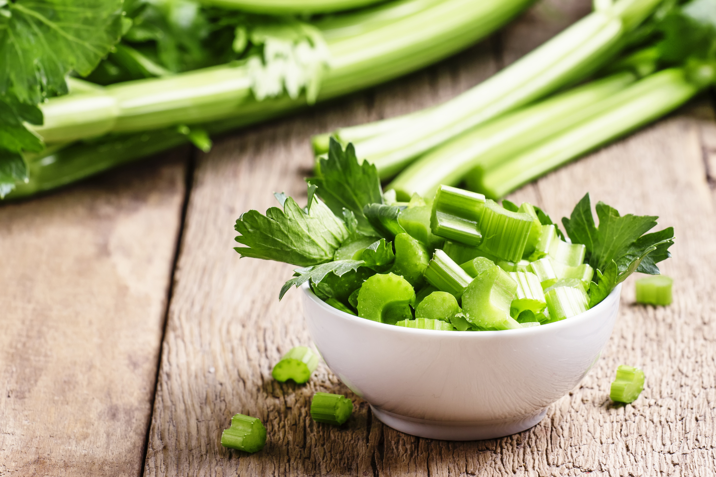
NUTRITION NUGGET
Adding more fruits and vegetables, like celery, to your diet can help prevent coronary heart disease.
Celery is an excellent source of vitamin K, folate, potassium and dietary fiber.
Vitamin K is an essential nutrient when it comes to responding to injuries. It regulates normal blood clotting.
One cup of celery only has 16 calories!
Celery can give a satisfying crunch to any meal or snack!
Notes:
Avocados are an excellent source of healthy fats, fiber, folate, potassium and vitamins C, E and K (USDA Supertracker)
These heart-healthy fats are important for a healthy nervous system and heart.
Avocados also have the highest protein content of any fruit.

