Slide 1
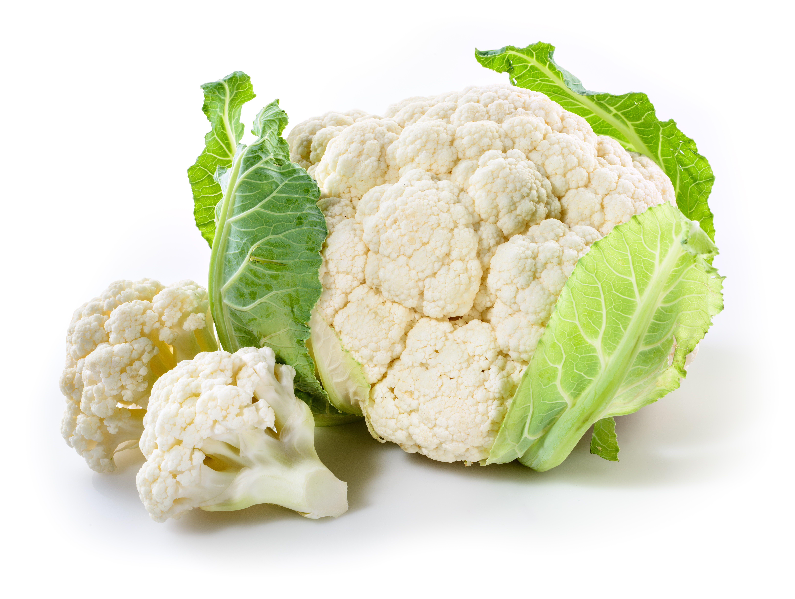
What we are learning today
Join me as we learn about Florida Cauliflower production!

Slide 2
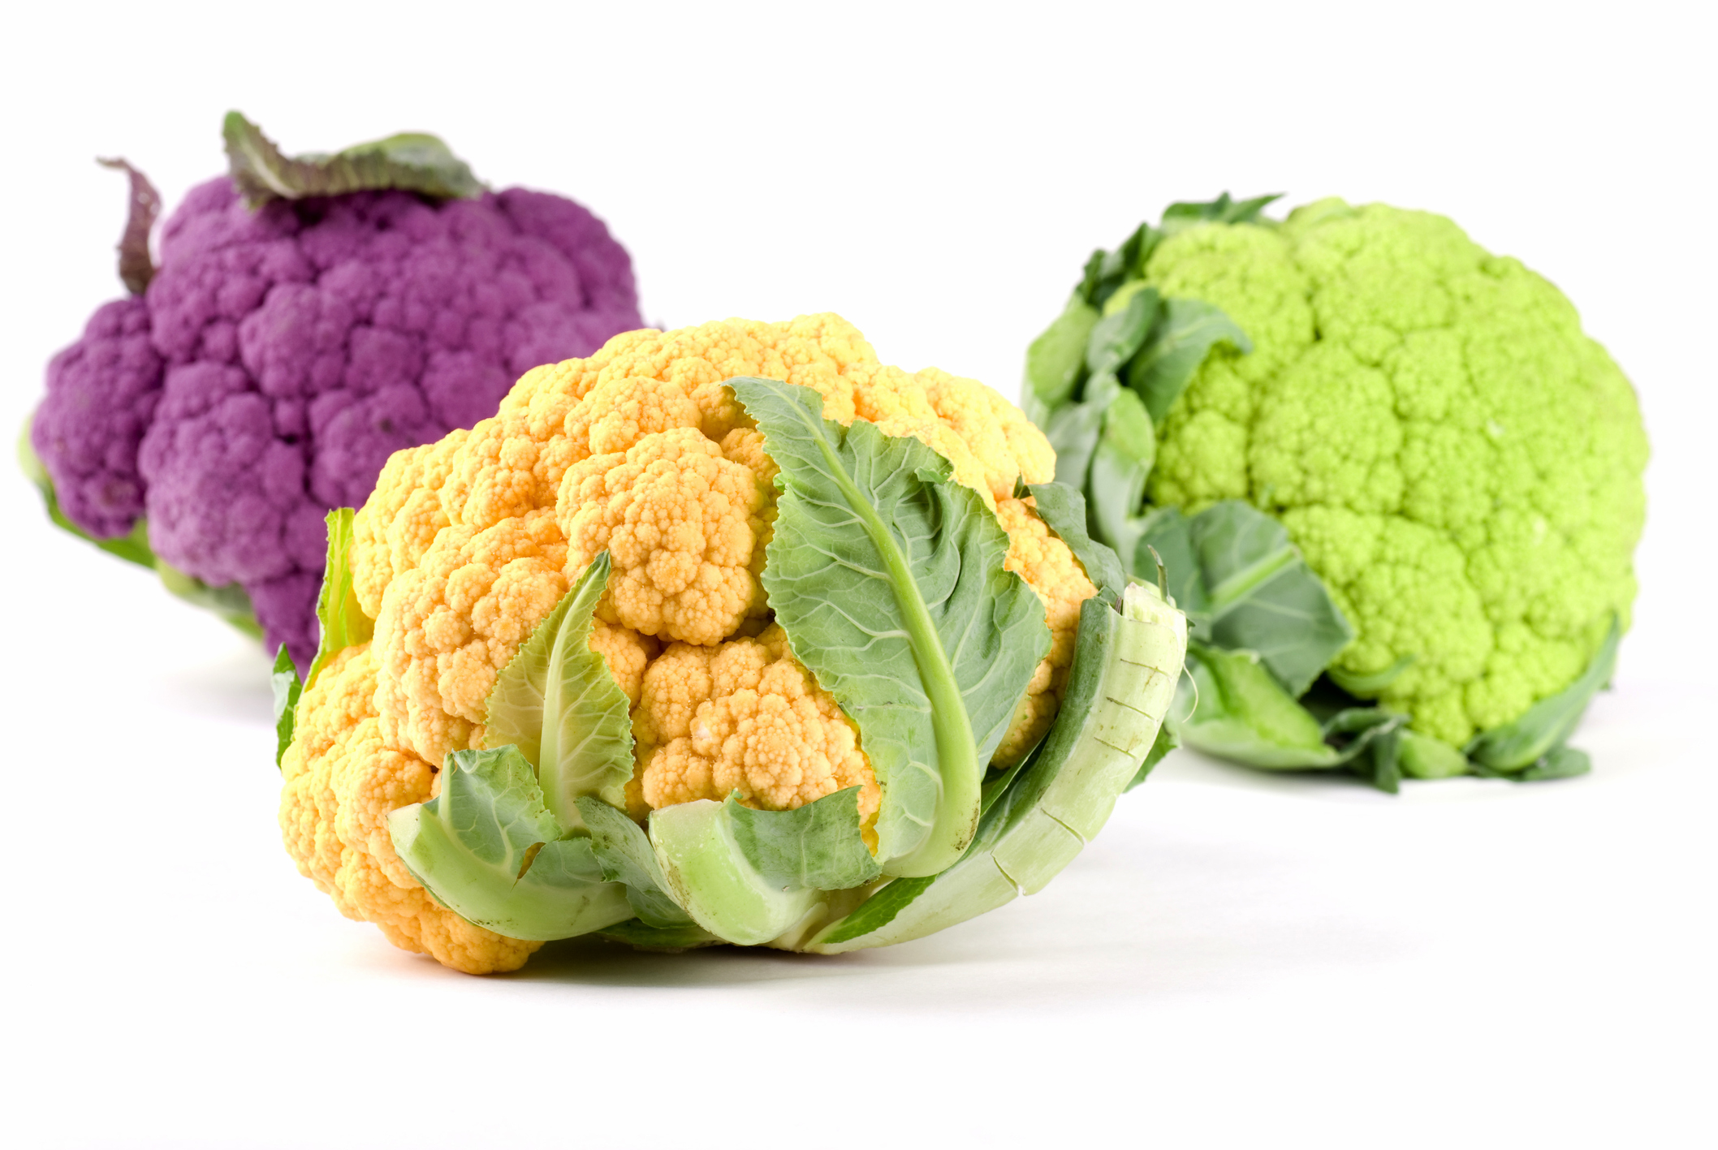
FUN FACTS
We usually eat white cauliflower, but this vegetable can also be green, yellow or purple!
Cauliflower became an important crop in the United States in 1925.
When you eat cauliflower your are eating a flower. The part we eat is the head!

Slide 3


Have you tried a Florida cauliflower?
Cauliflower’s growing season in Florida is from October to April with an abundant supply in March.
It is available from October through March.
Look for this logo to find Florida-grown Cauliflower!

Slide 4

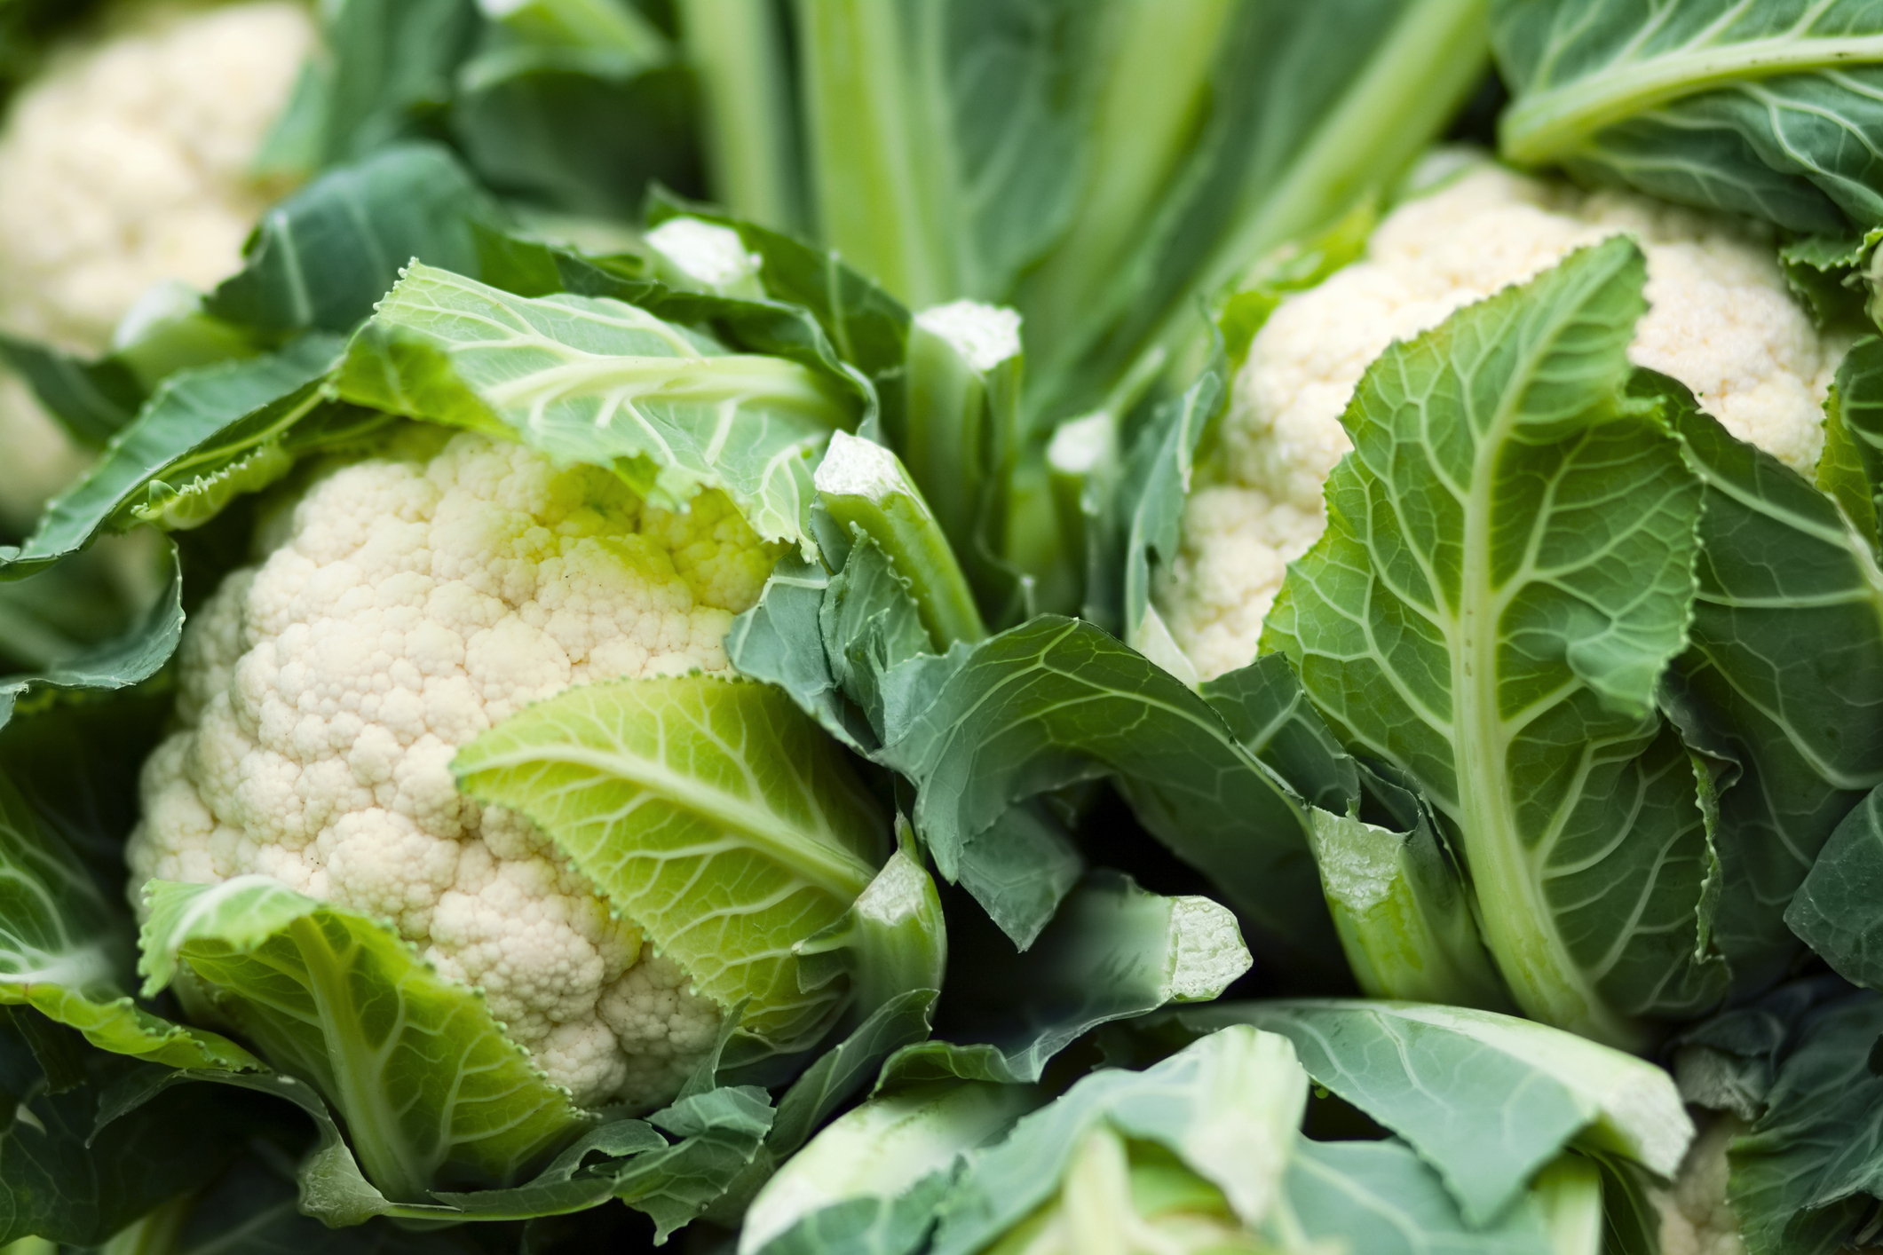
NUTRITION NUGGET
Cauliflower is full of fiber which helps with digestion and absorption of nutrients while also giving you the feeling of fullness.
Cauliflower is high in vitamin C, which is a powerful antioxidant that plays an important role in the body’s immune system.
Eating more fruits and vegetables can help lower high blood pressure.

