Slide 1
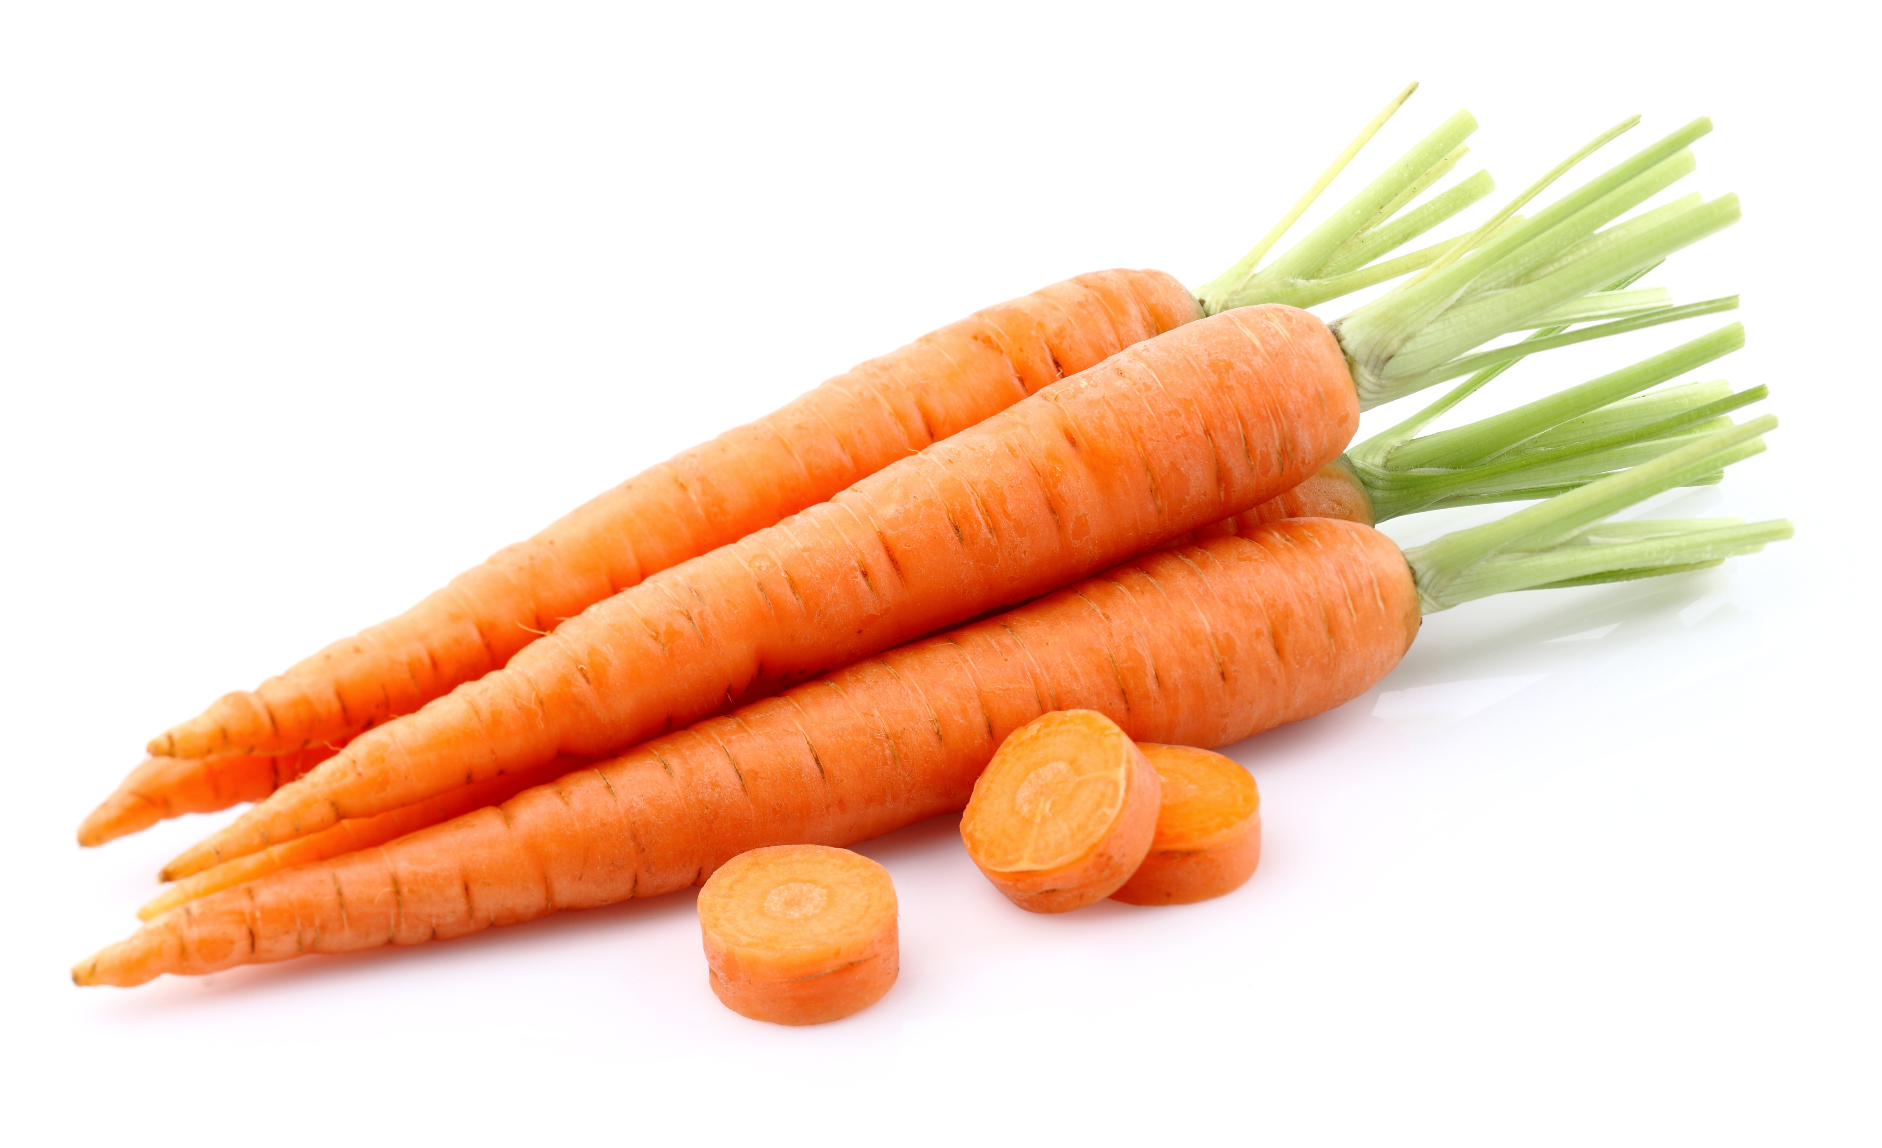
What we are learning today
Today we will be learning about Carrots!

Slide 2
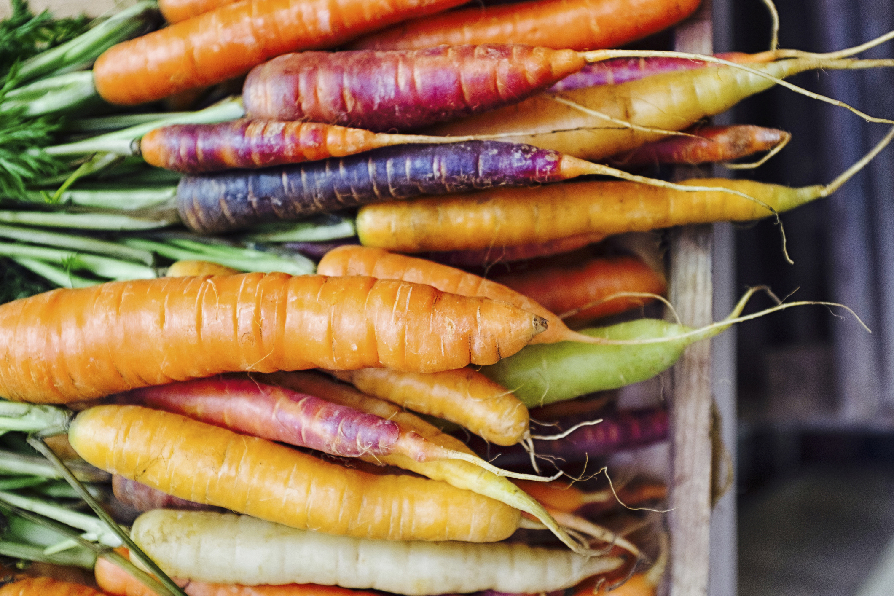
FUN FACTS
Carrots were first grown as medicine.
They can be purple, white, red, and yellow too.
Carrots are a root crop, they grow best in cool weather.

Slide 3

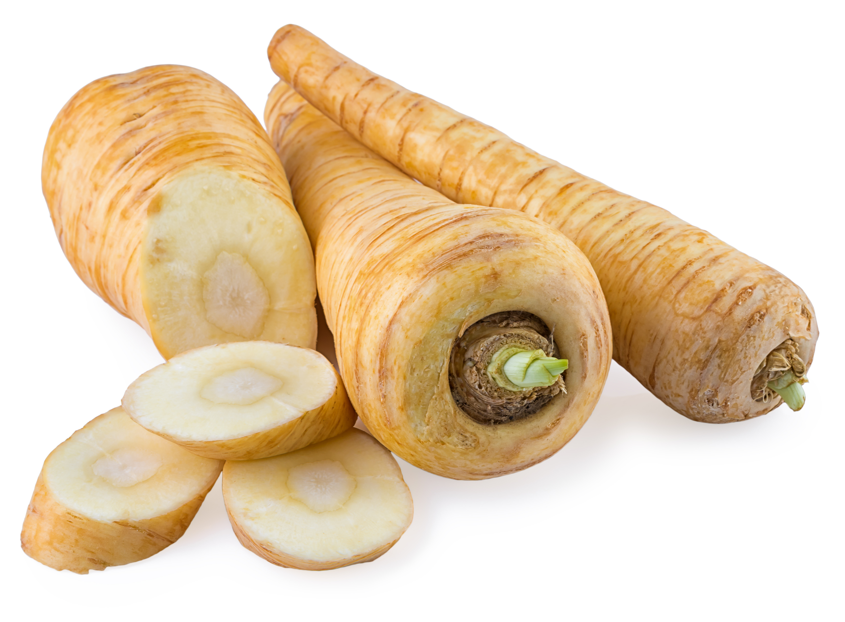
NUTRITION NUGGET
Carrots are nutritional heroes! They have many nutrients including important vitamins and minerals.
Carrots are packed with Vitamin A, helping with good vision and keeping your heart, lungs and kidneys healthy.

Slide 4
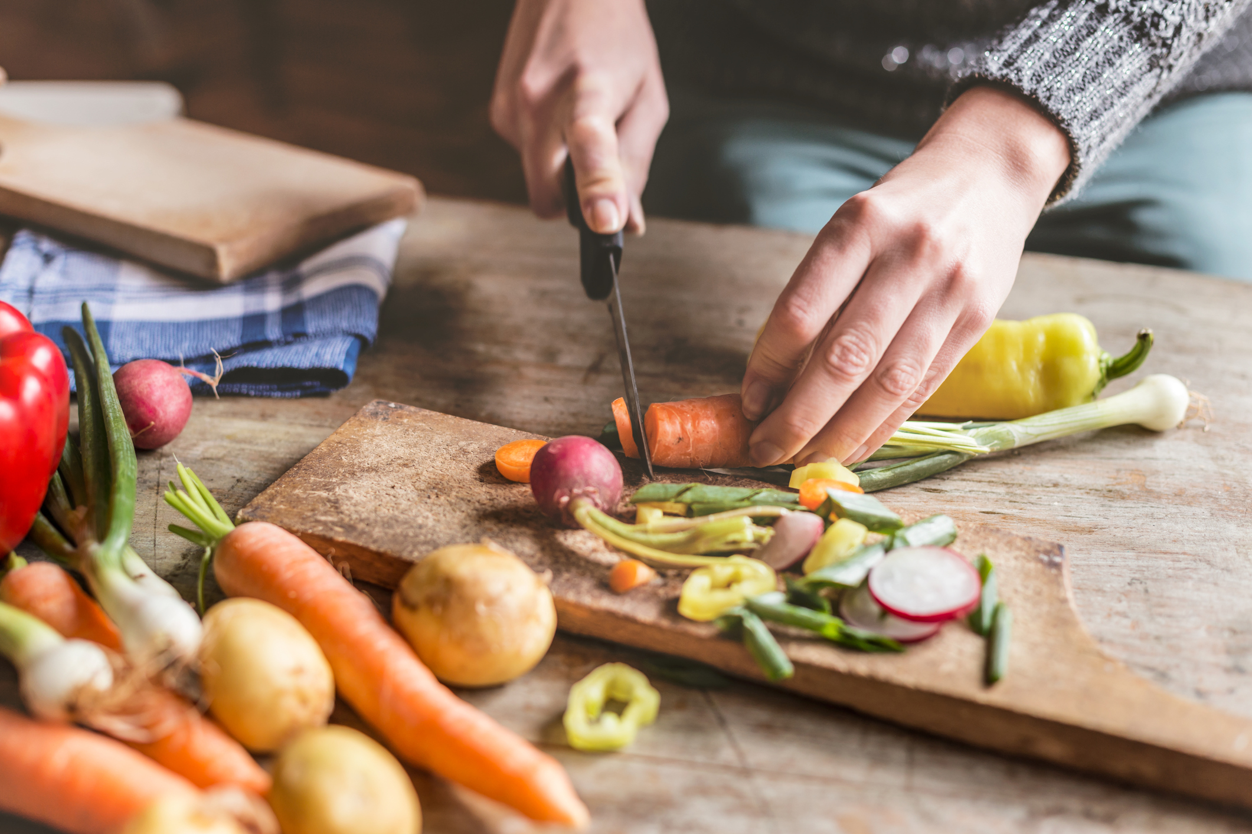
TASTY TIPS
Carrots can be eaten raw, roasted, steamed, or boiled.
They are often used in soups and stews.
Carrots can taste sweeter when cooked.

