Slide 1
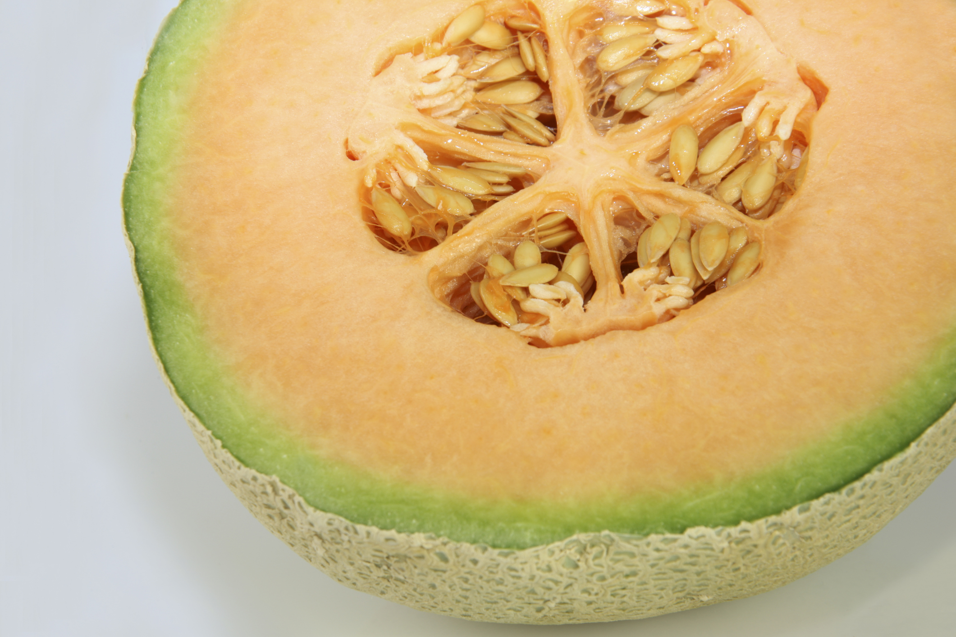
WHAT WE ARE
LEARNING TODAY
Have you ever heard of a cantaloupe? Well, we are going to learn about cantaloupes today!

Slide 2
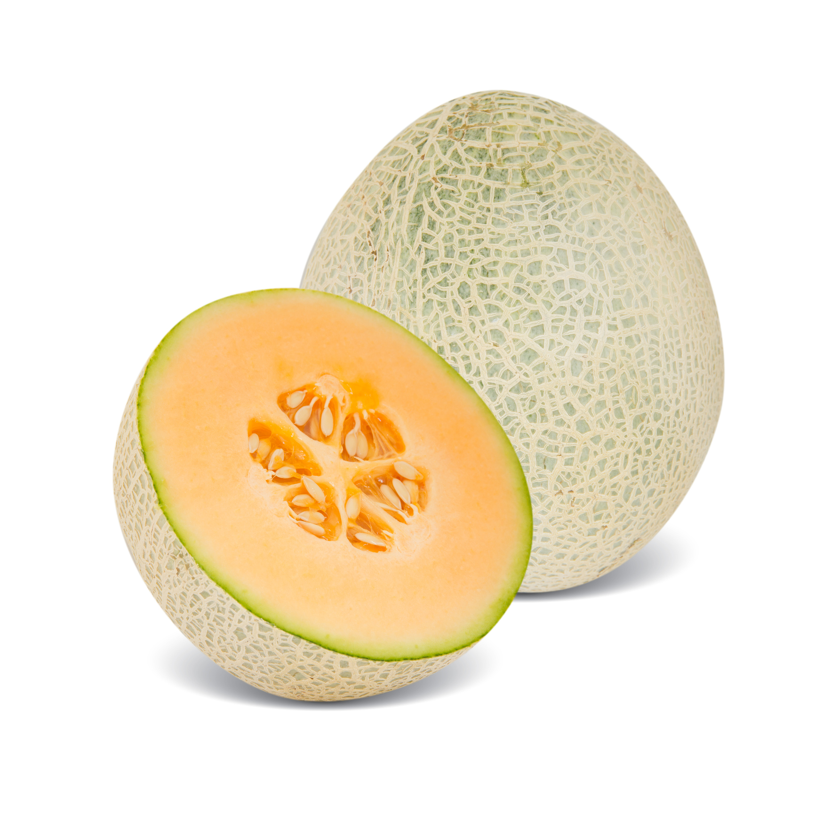
FUN FACT
Cantaloupes grow on long vines.
In Australia, cantaloupes are referred to as Rockmelons.
These fruits take 90 days to develop.
Notes:
Change celery graphic?

Slide 3

Did You Know?
Cantaloupes are part of the melon family and are related to watermelons, cucumbers and pumpkins.

Slide 4
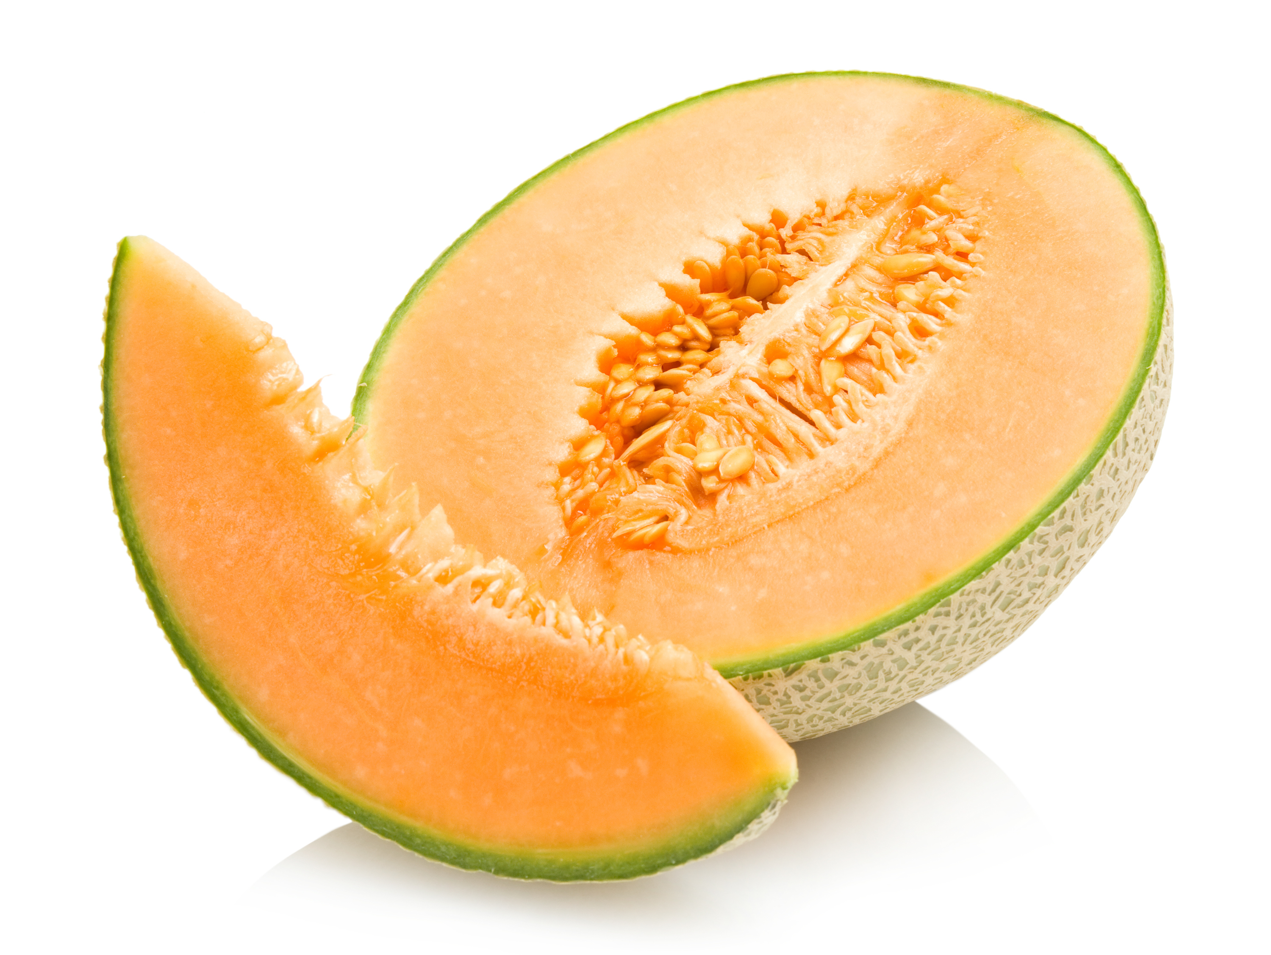
NUTRITION NUGGET
Cantaloupes are a good source of Vitamin C and Vitamin A.
This means they can help with eye sight and boost your immune system!
Notes:
Avocados are an excellent source of healthy fats, fiber, folate, potassium and vitamins C, E and K (USDA Supertracker)
These heart-healthy fats are important for a healthy nervous system and heart.
Avocados also have the highest protein content of any fruit.

