Slide 1
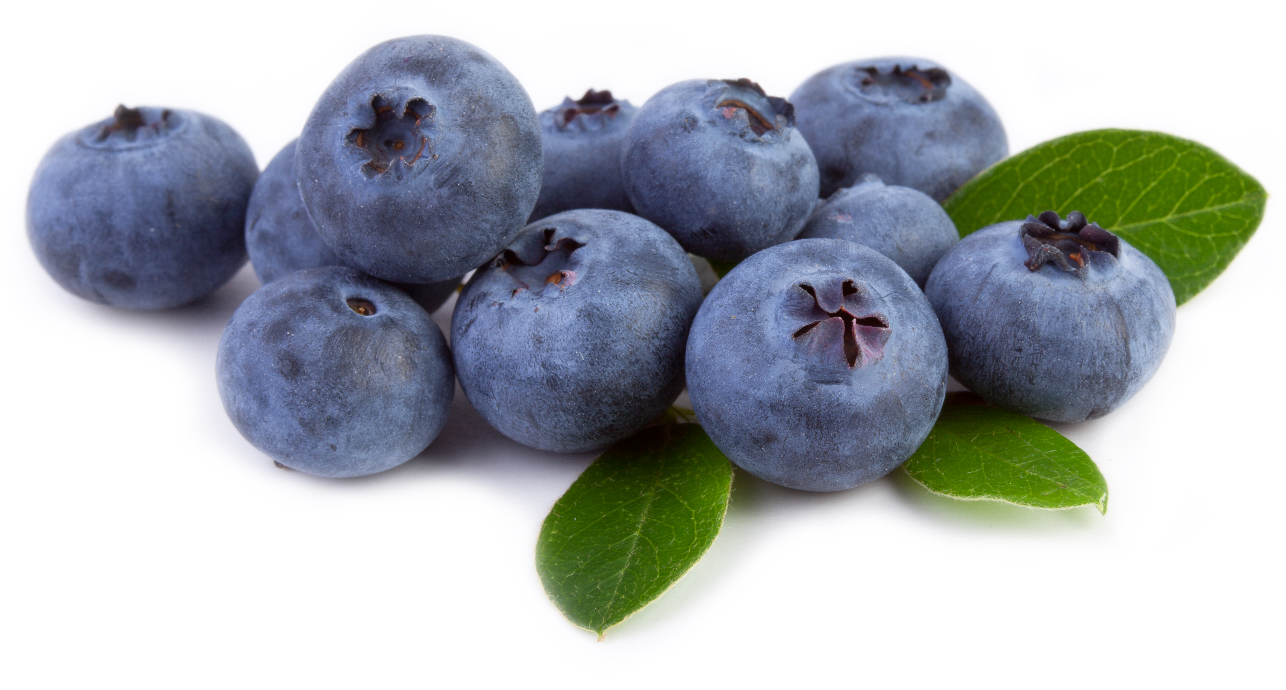

What we are learning today
Hi!
I’m Detective Barry Blueberry.
It’s time for an interrogation of the Florida Blueberry.
Join me as we investigate Florida Blueberry production!

Slide 2
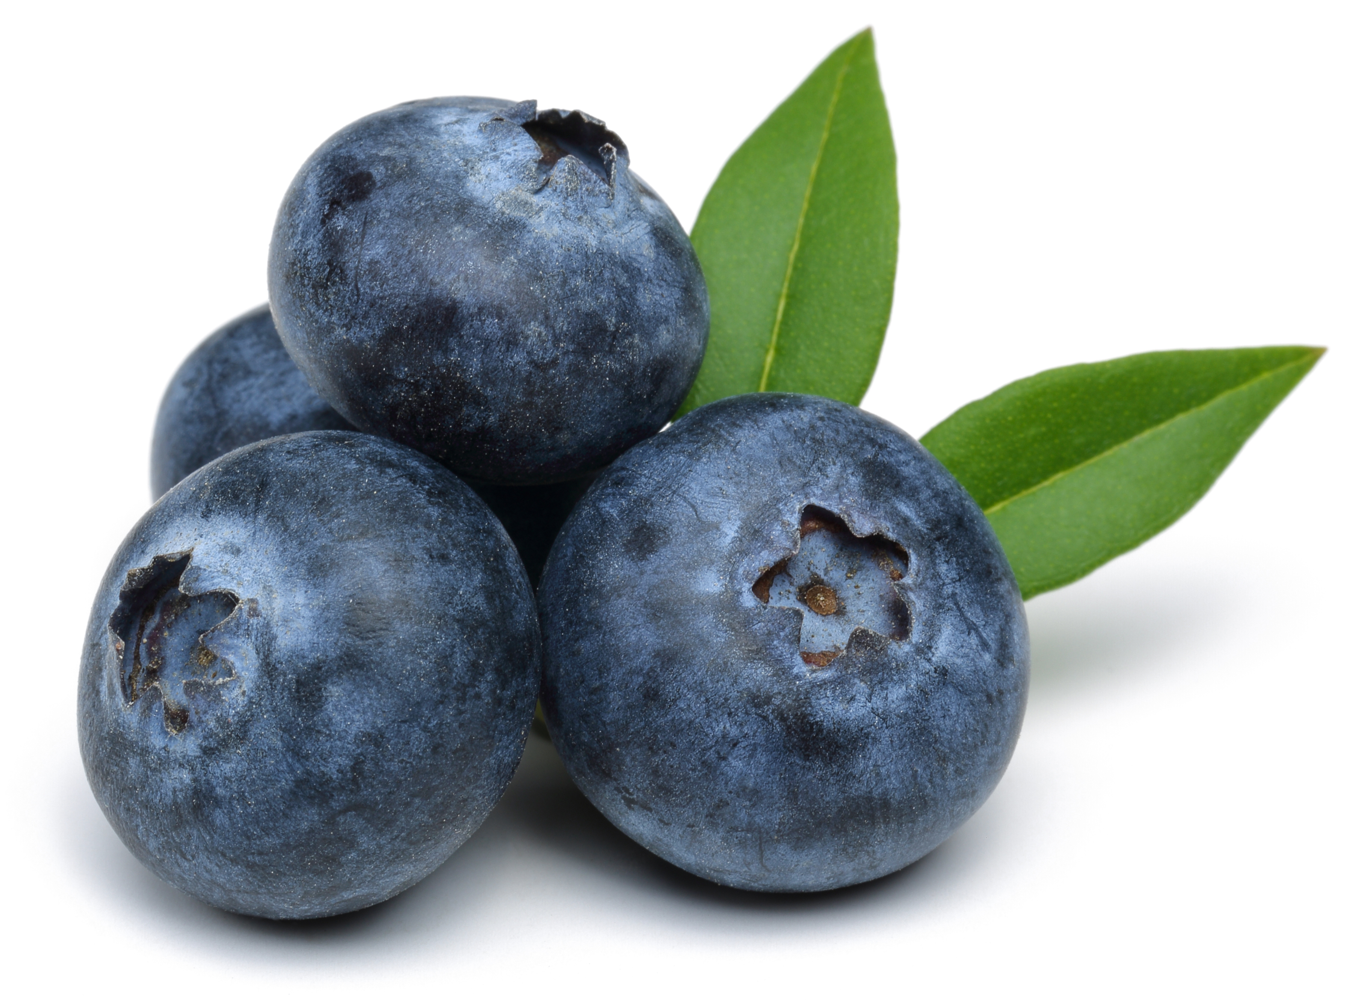
FUN FACTS
Blueberries often have a “silver” coating (an edible wax) for protection.
Blueberries grow best in sunny locations, which is why Florida is one of the top ten states for growing them.
Florida is ranked 8th in the U.S. for blueberry production.

Slide 3
Spot it on the map
Blueberries are mostly grown in these counties:
Alachua
DeSoto
Hardee
Highlands
Hillsborough
Lake
Manatee
Marion
Polk

Slide 4

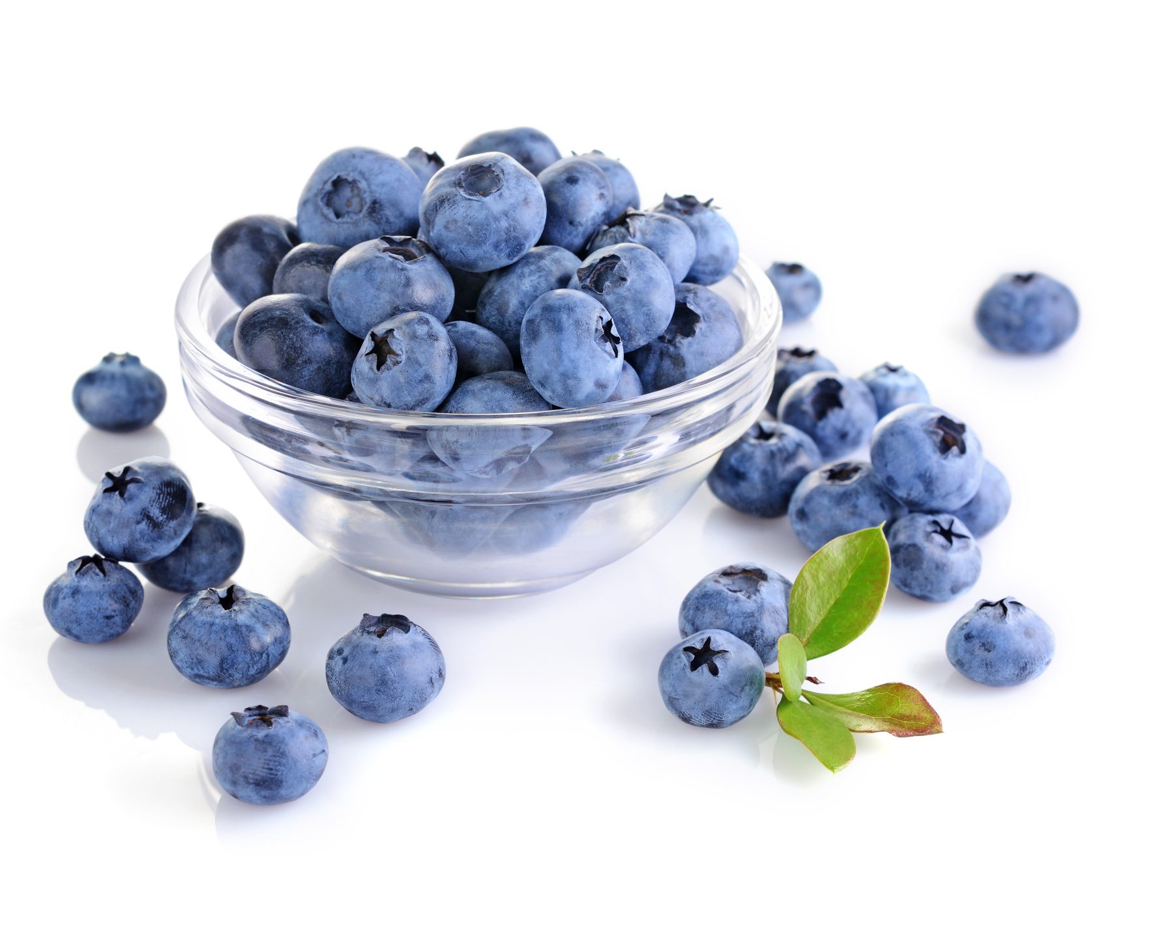
NUTRITION NUGGET
Blueberries contain more antioxidants than most other fruits and vegetables and may help to prevent damage caused by cancer, heart disease and Alzheimer’s.
Blueberries are a great source of vitamin C. A ½ cup of blueberries contains almost 25% of your daily requirement of vitamin C.
Consumption of blueberries may lower cholesterol and reduce the risk of inflammation.
One cup of blueberries has about 80 calories.

Slide 5

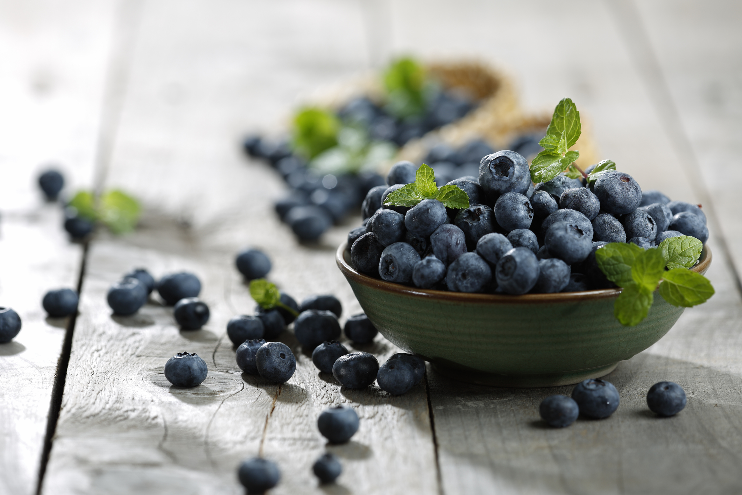
TASTY TIPS
Rinse blueberries immediately prior to eating them.
To freeze blueberries, arrange them in a single layer on a cookie sheet. Blueberries can be stored in the freezer for up to six months.
Add blueberries to batters or mixes at the last minute to prevent them from breaking.
Use frozen blueberries in smoothies.
Visit Fresh From Florida
for more tasty recipes!

