Slide 1
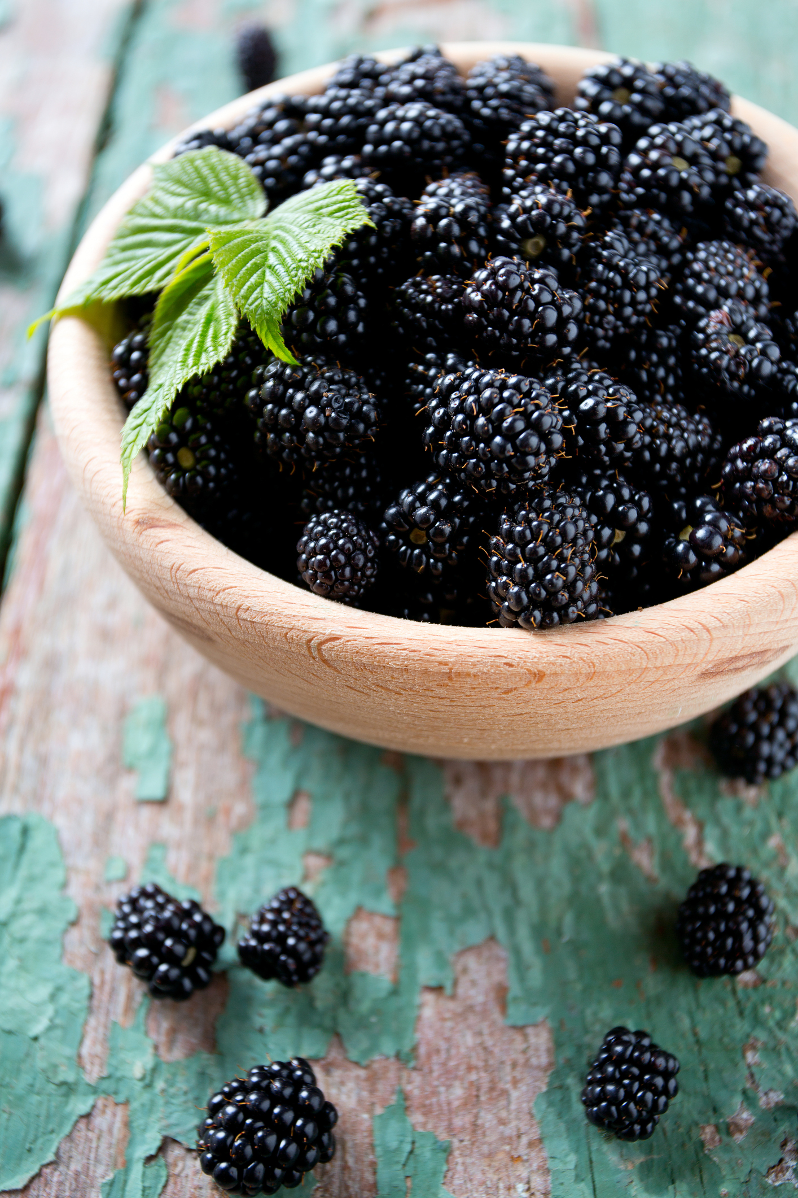
What we are learning today
Today we will be learning about the blackberry!

Slide 2
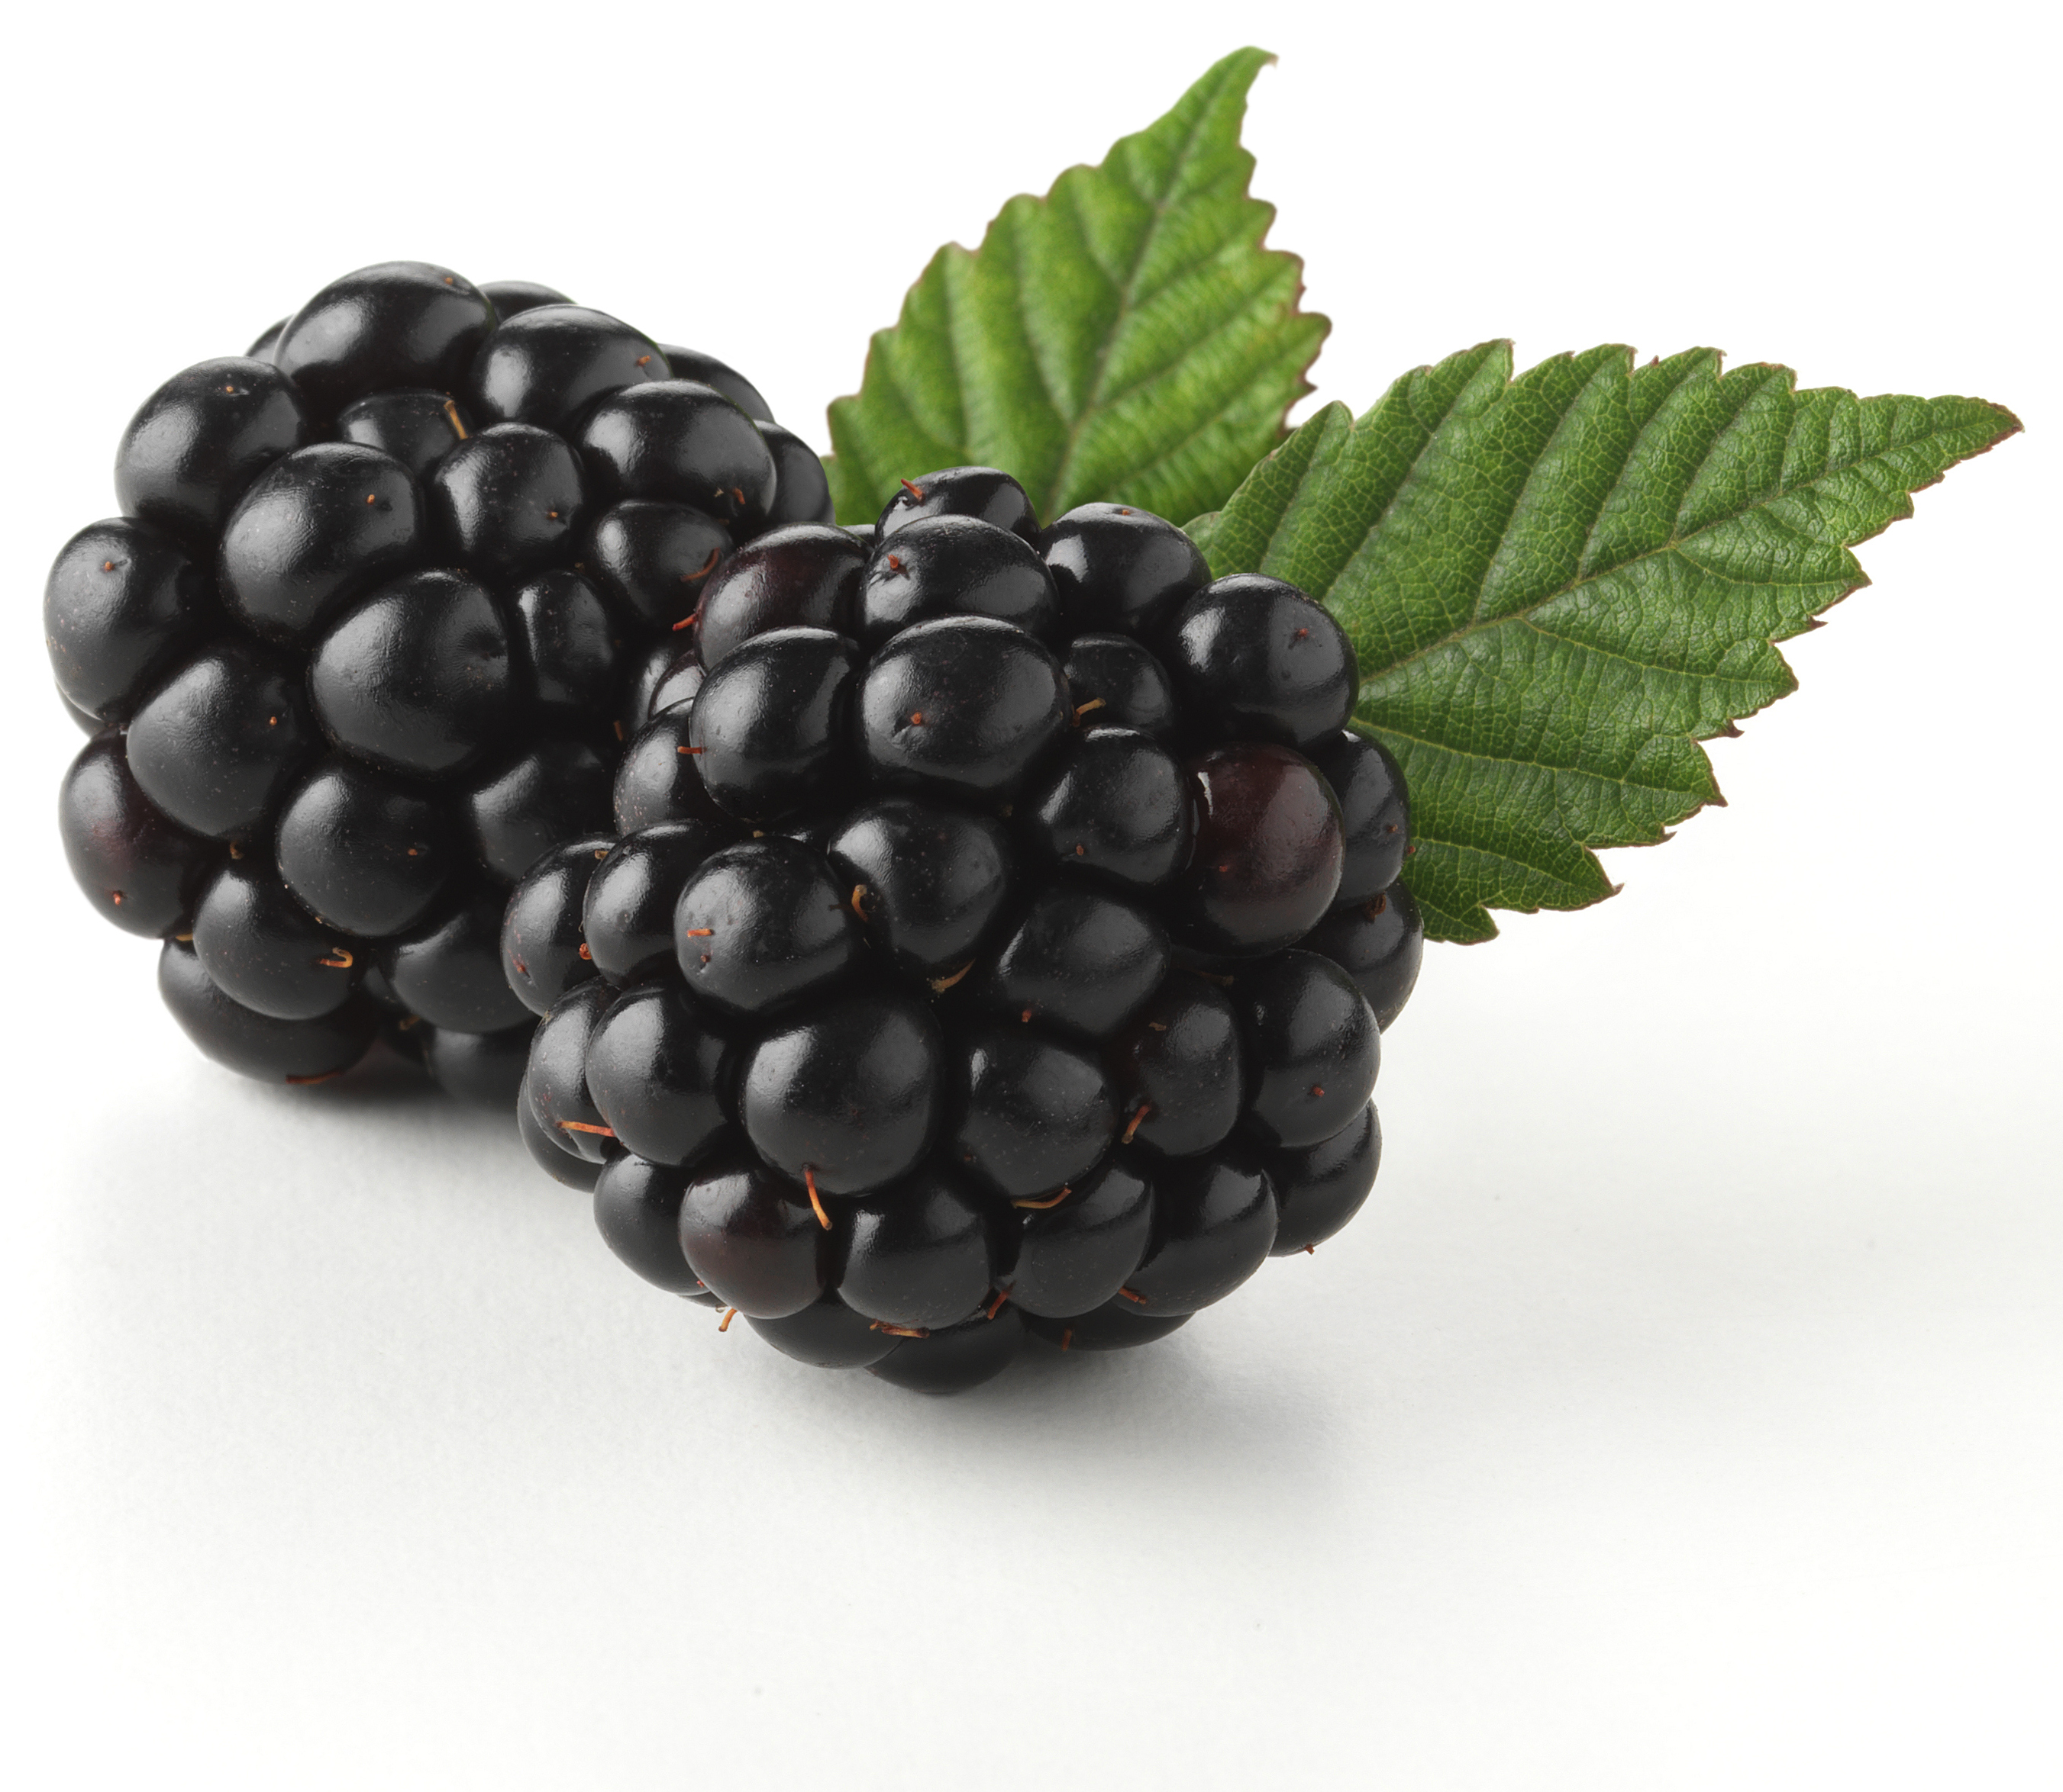
Did you know?
Blackberries can be found growing in the wild and on farms in North America and other parts of the world.
The ideal temperature for blackberry production is between 80 and 85 degrees.
The blackberry plant is called a “cane.”
Blackberries turn from green to red to black when they’re fully ripe.

Slide 3
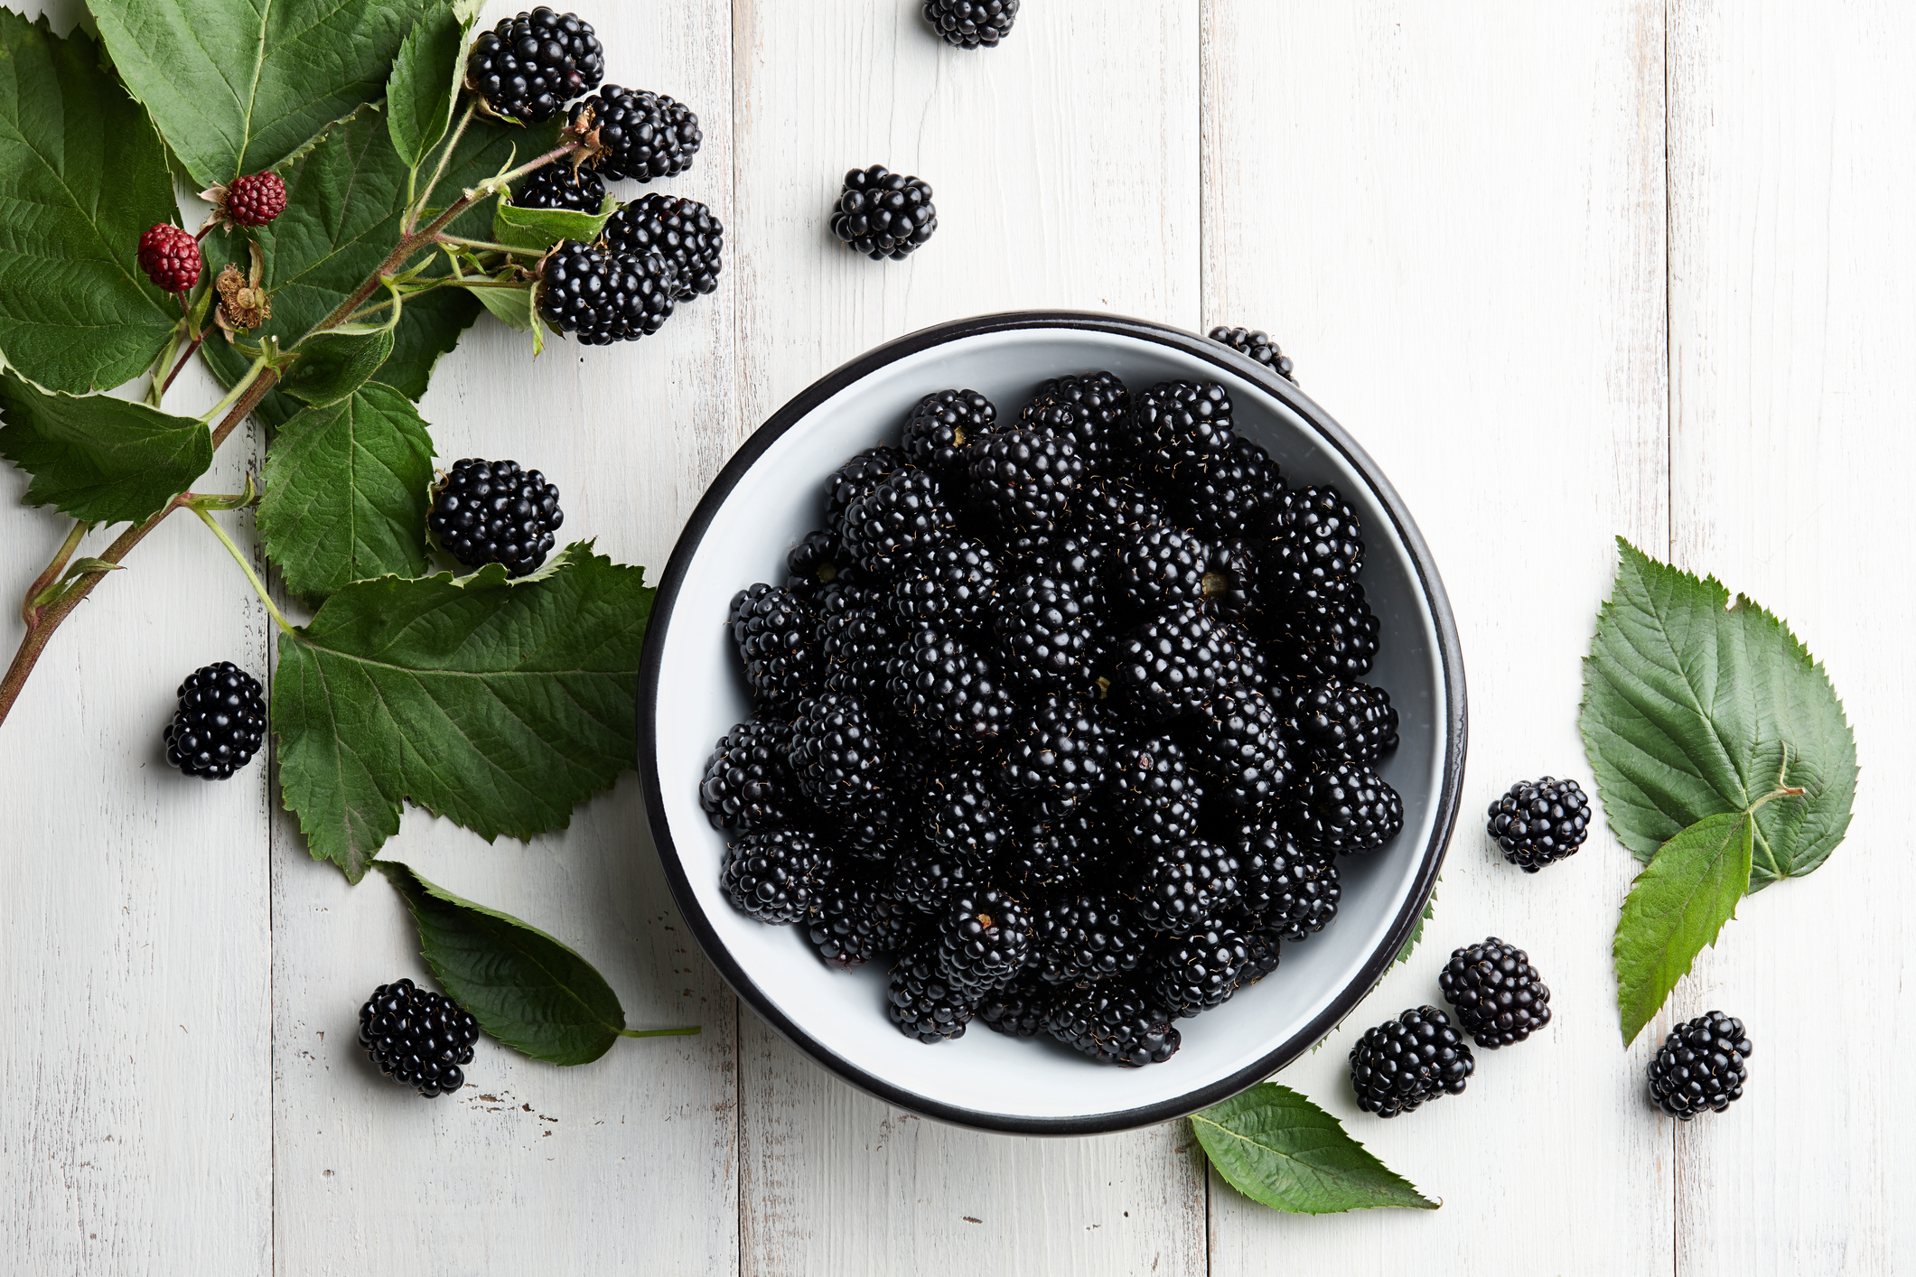
NUTRITION NUGGET
The dark color ensures blackberries have one of the highest antioxidant levels of all fruits.
Blackberries are also high in fiber.

Slide 4

TASTY TIPS
Blackberries can be eaten raw or dried.
They can be cooked in jams, pies, and muffins.

Slide 5
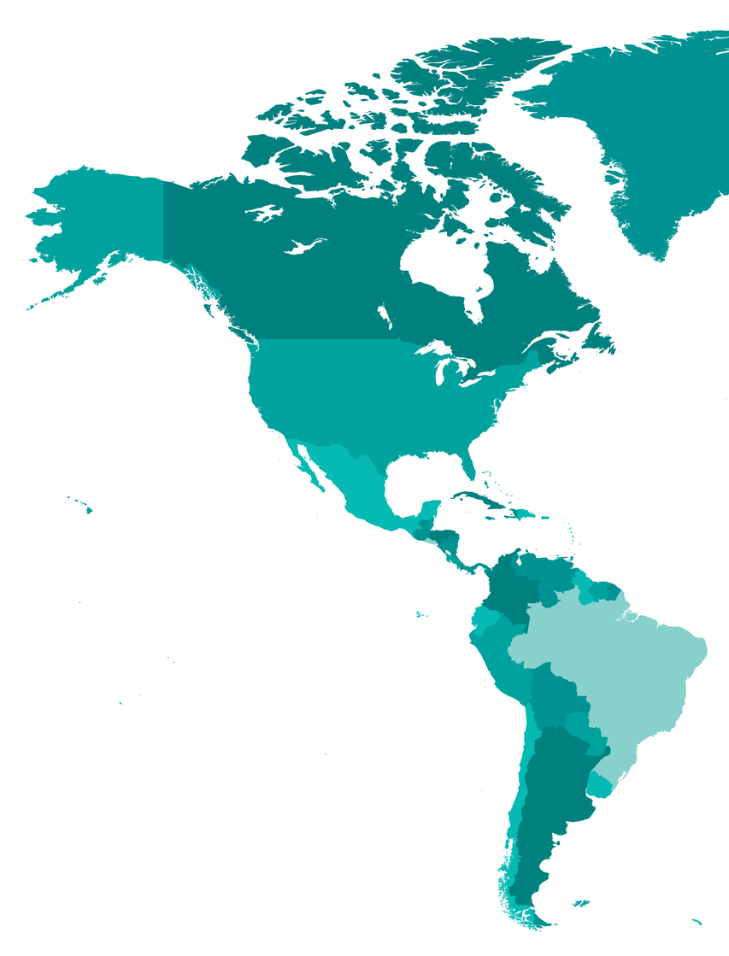
Spot it on the map
Blackberries grow wild in the Pacific Northwest where they are often considered weeds. Some types have thorns.
Most of the blackberries grown for commercial use in the United States come from Oregon.
Mexico is the world’s largest blackberry grower.

