Slide 1

What we are learning today
Hi!
I’m Ava Avocado.
While you enjoy your tasty avocado snack I’d like to share a few facts with you about the
Awesome Avocado!

Slide 2
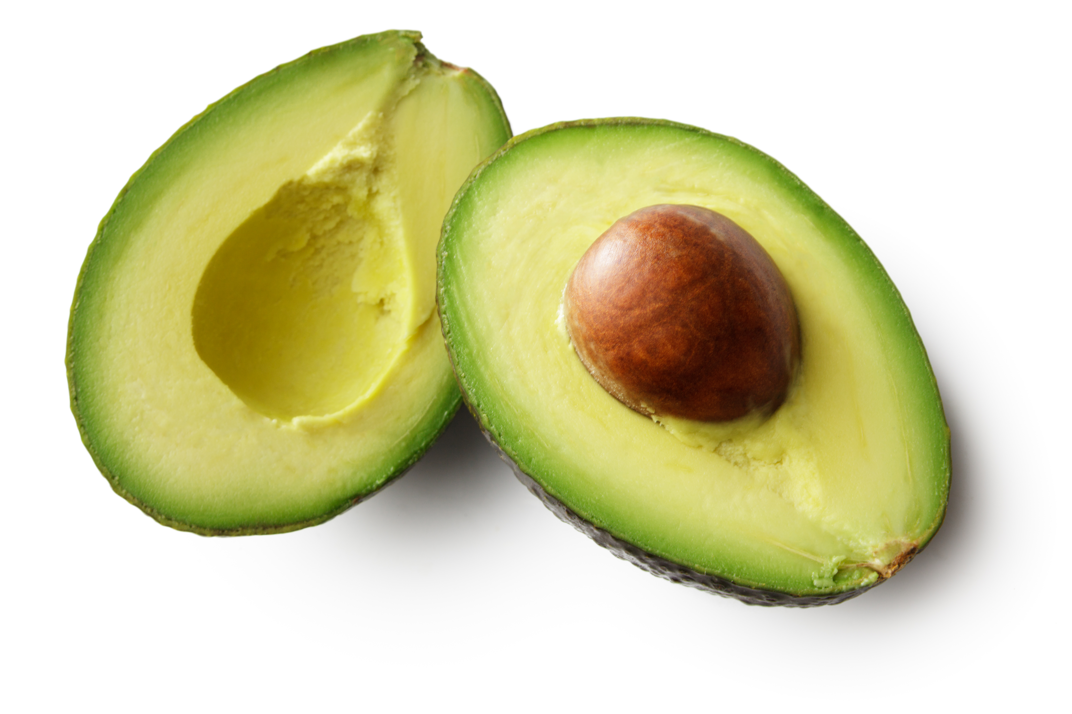
FUN FACTS
The avocado is also known as the “alligator pear” for its shape and leather-like skin.
Florida was the first state to grow avocados.
There are two types of avocados, the Florida Avocado and the Hass Avocado.

Slide 3

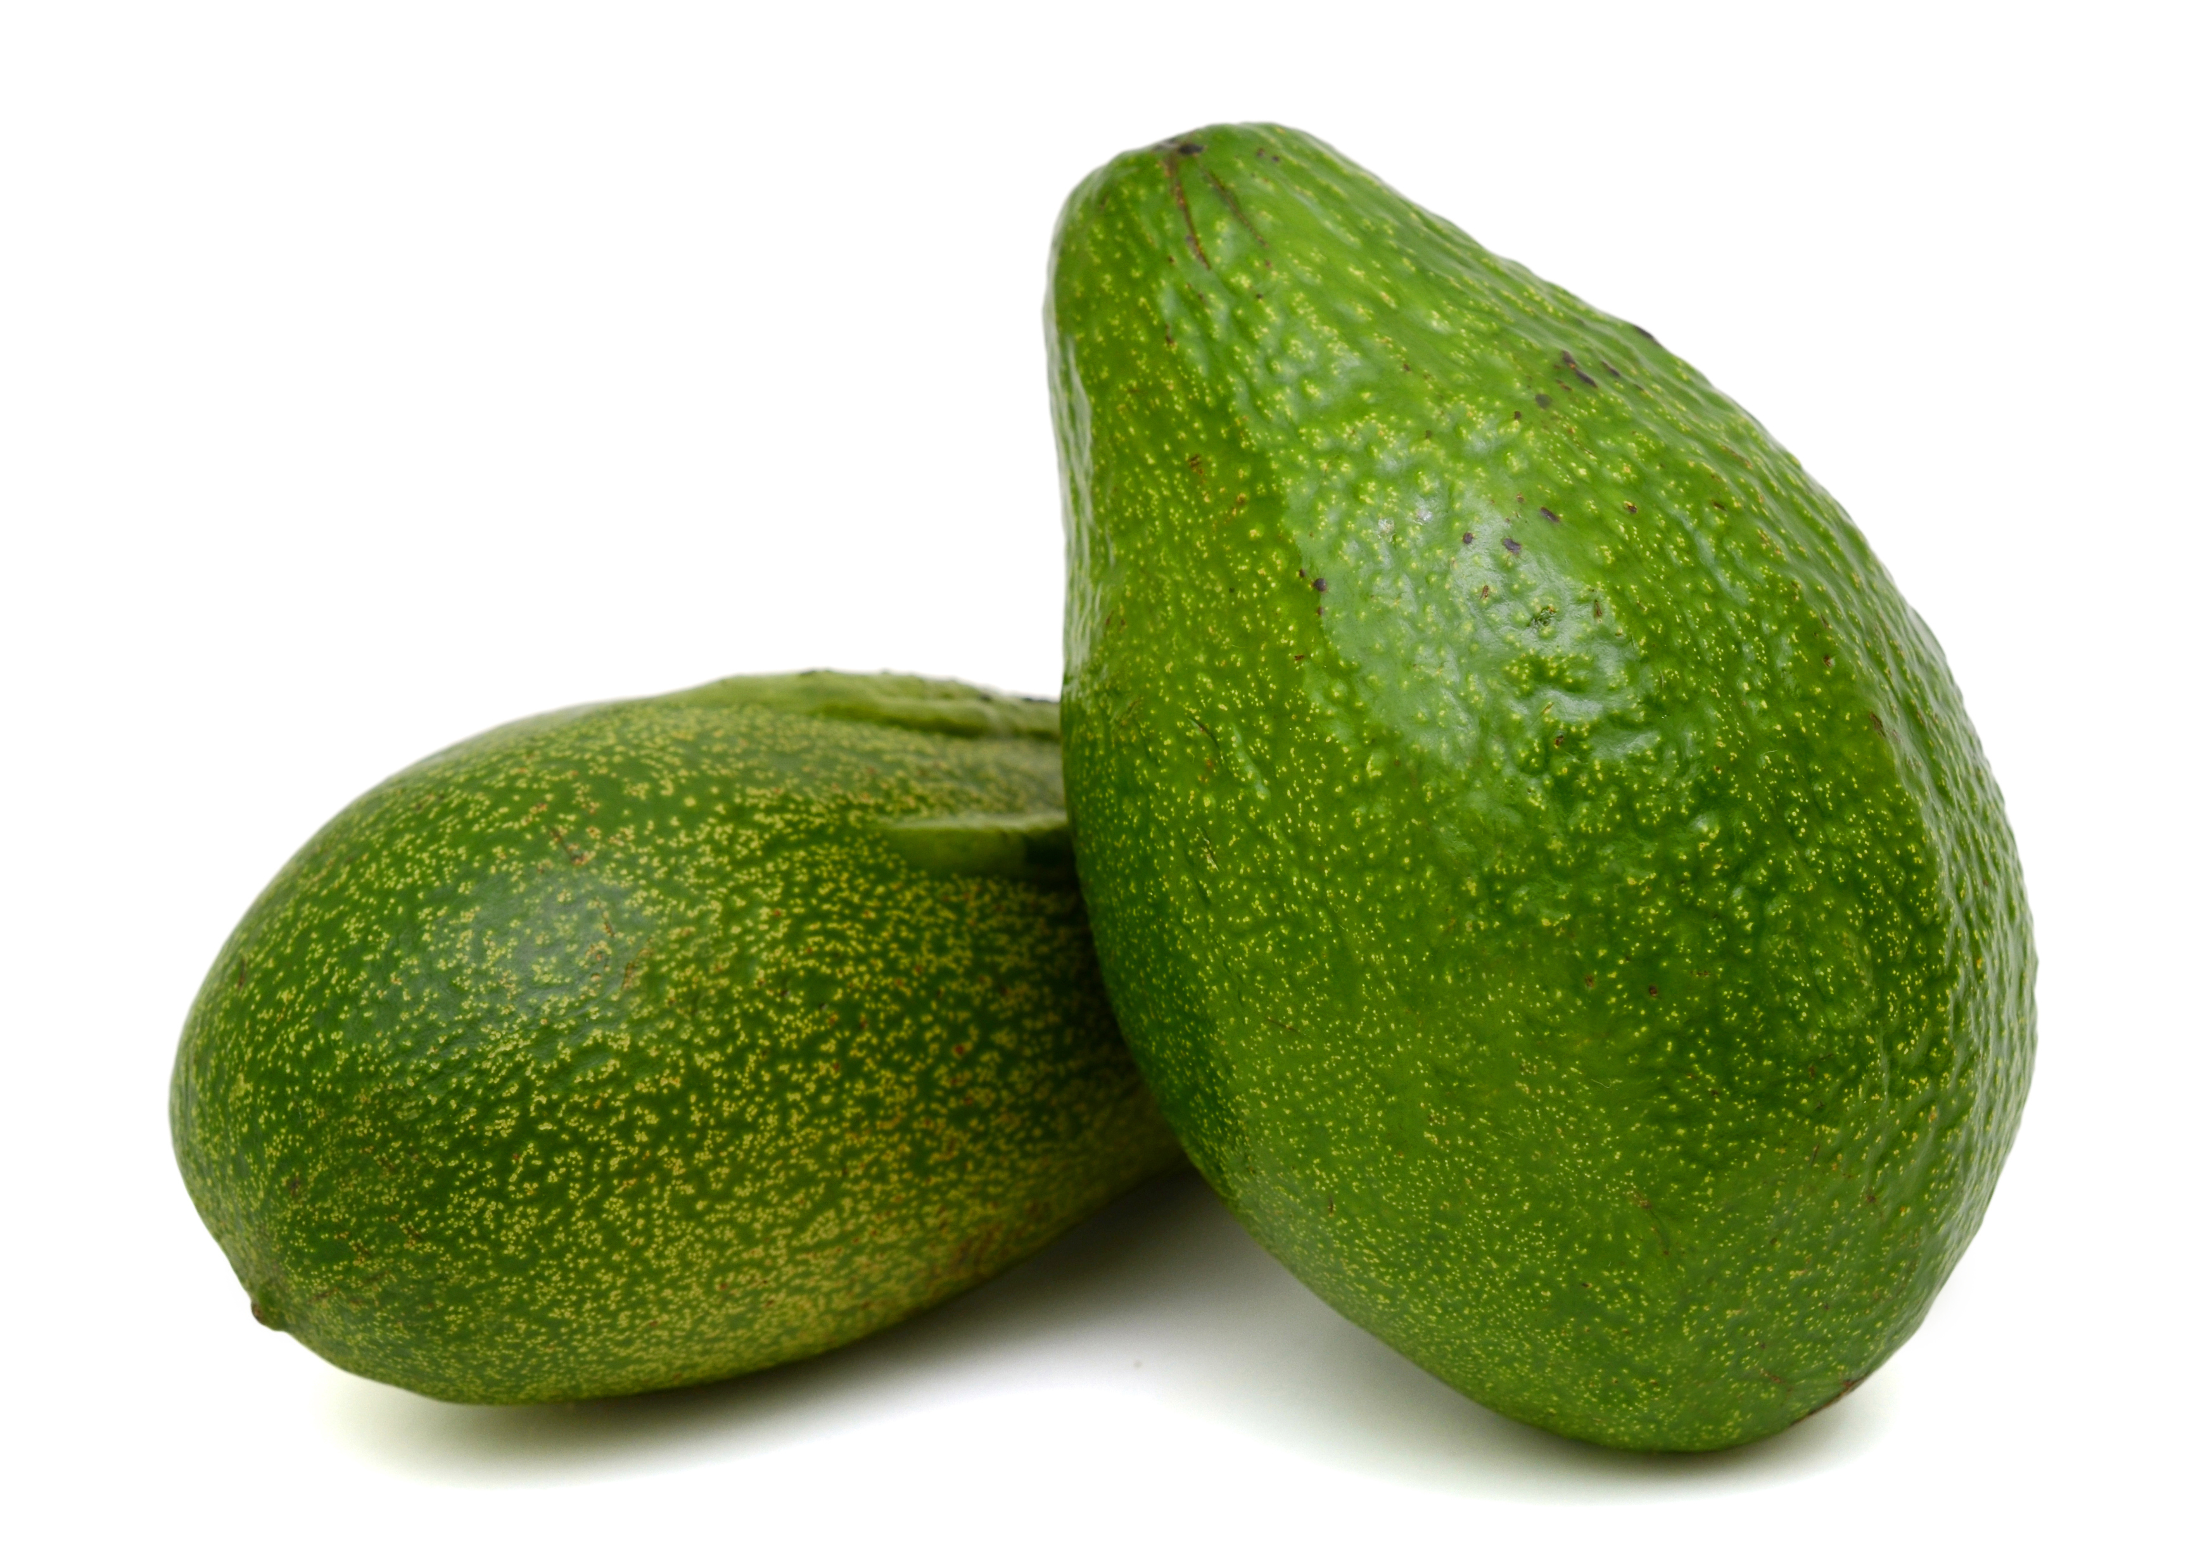
NUTRITION NUGGET
The heart-healthy fats found in avocados can help you maintain a healthy nervous system and heart.
Avocados have the highest protein content of any fruit.
Avocados are a good source of Vitamin C, E and K

Slide 4
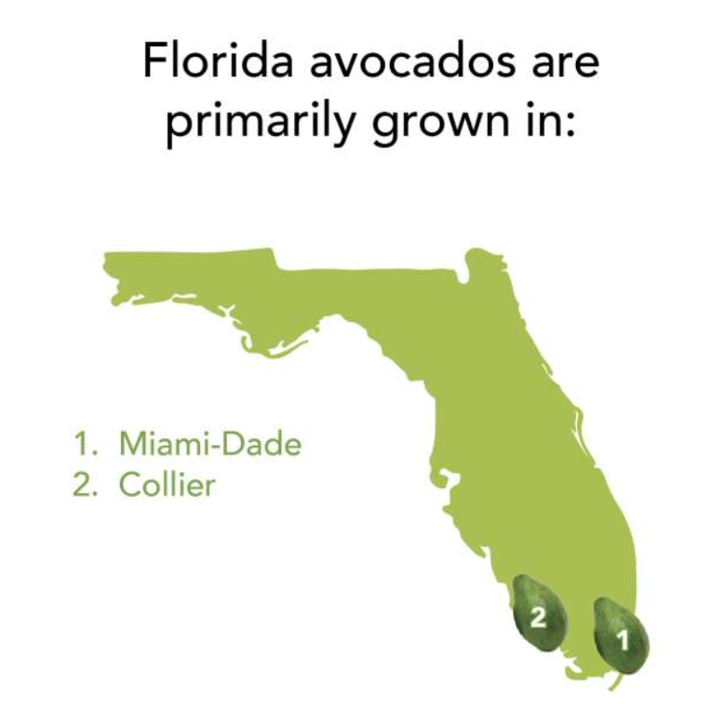
Spot it on the map
How close do you live to where Florida Avocados are grown?
More than 98% of Florida avocados are grown in Miami-Dade.

