Slide 1
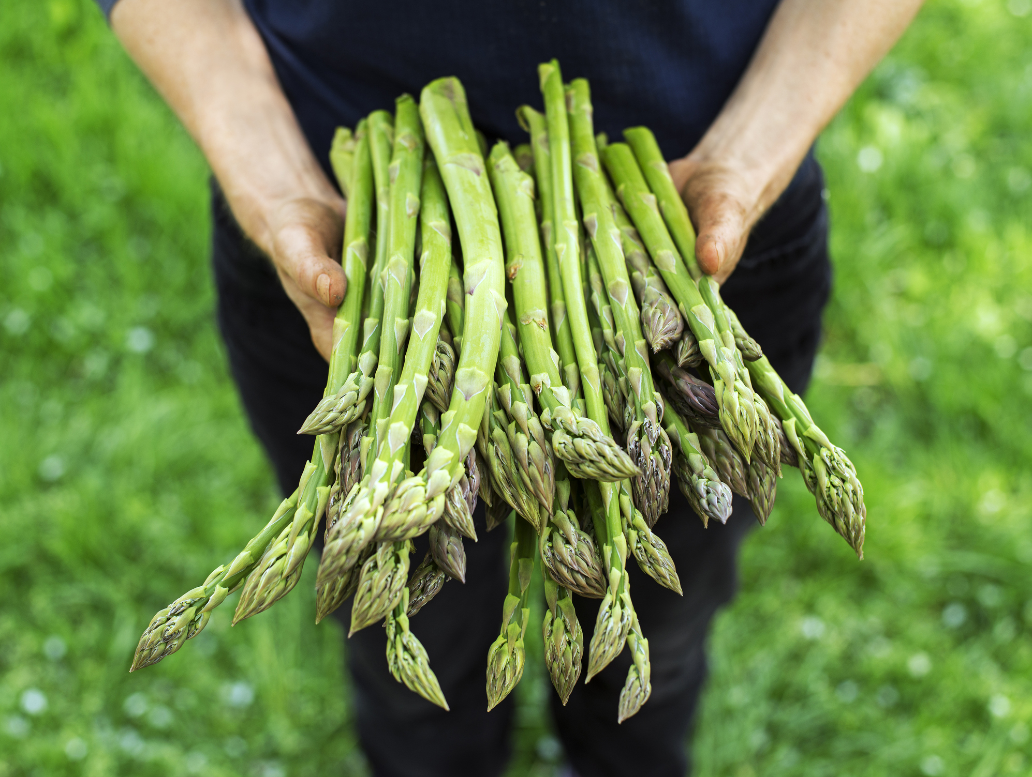
What we are learning today
Today we will be learning about the Asparagus!

Slide 2
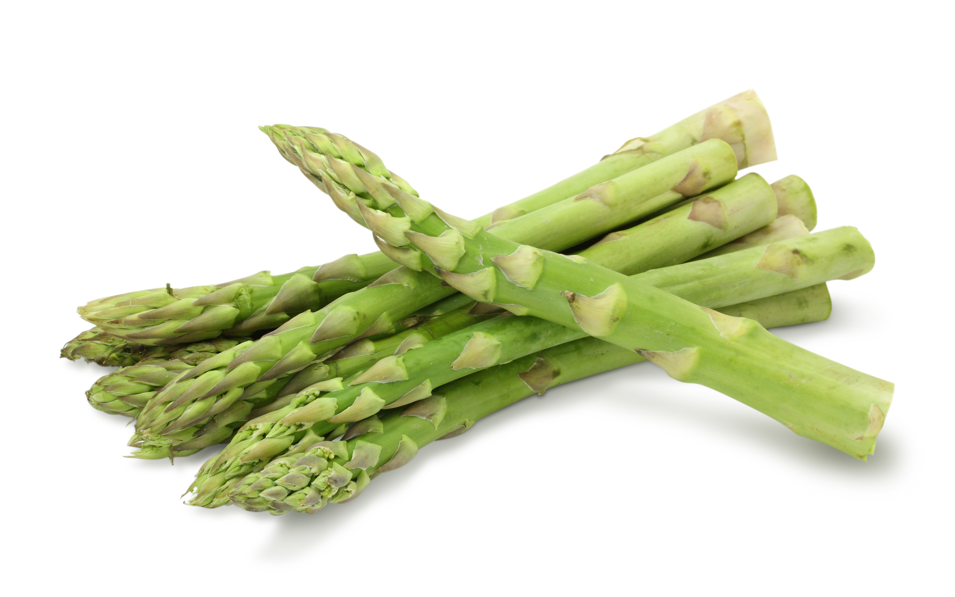
FUN FACTS
It takes about three years for asparagus to harvest, but can keep growing for 10 years or more.
Asparagus is a member of the Lily family.
It’s said that Queen Nefertiti proclaimed asparagus to be the food of the Gods.
One of the most popular varieties of green asparagus is named after Martha Washington, the wife of George Washington.

Slide 3
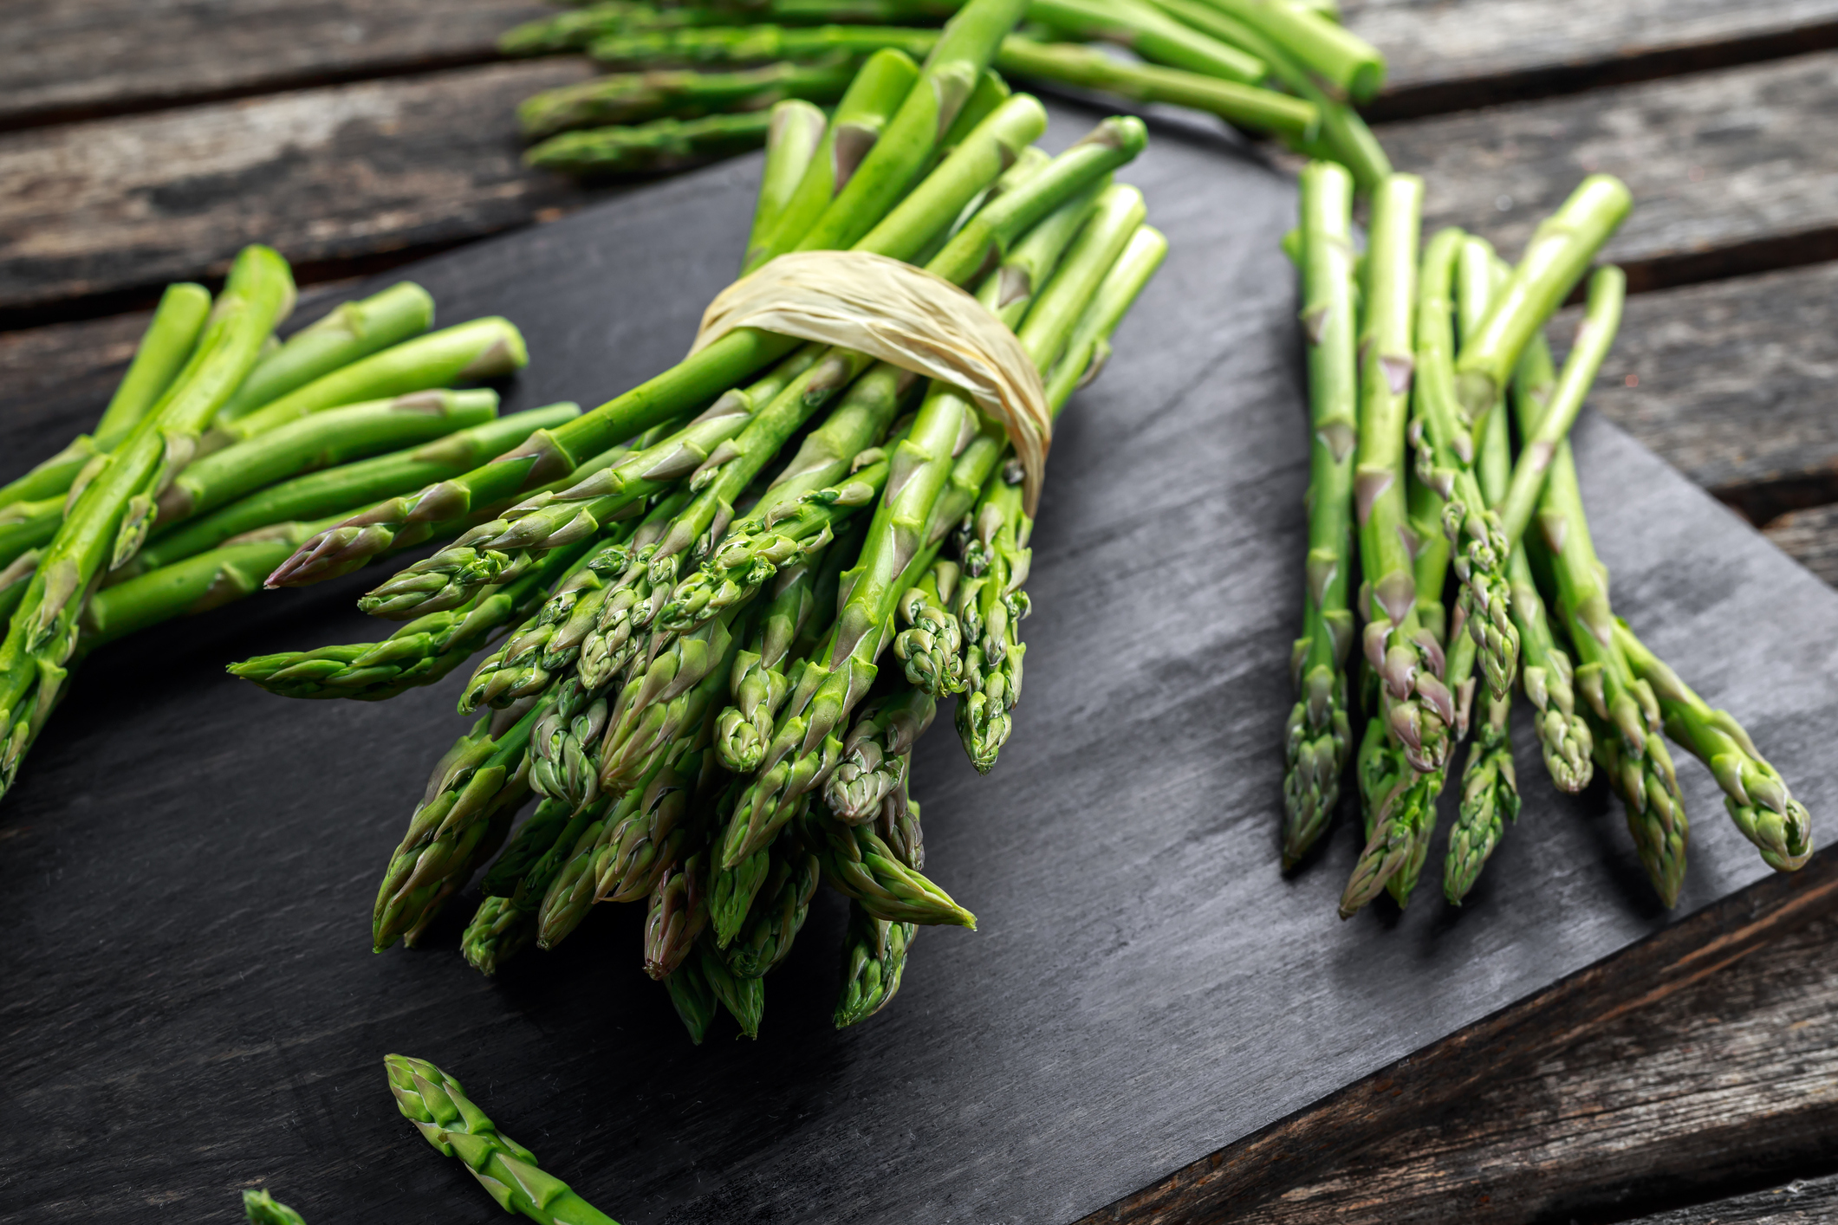
NUTRITION NUGGET
Asparagus is really good for you! It has protein, fiber, potassium, vitamin A, and vitamin C.
It contains glutathione, a compound scientists believe can prevent some kinds of cancers.
It’s a rich source of antioxidants and folate, which can help slow aging and keep our brains healthy.

Slide 4

Spot it on the map
California grows about 70% of all the asparagus grown in the United States.
More than 50,000 tons of asparagus are grown in California every year.

