Slide 1
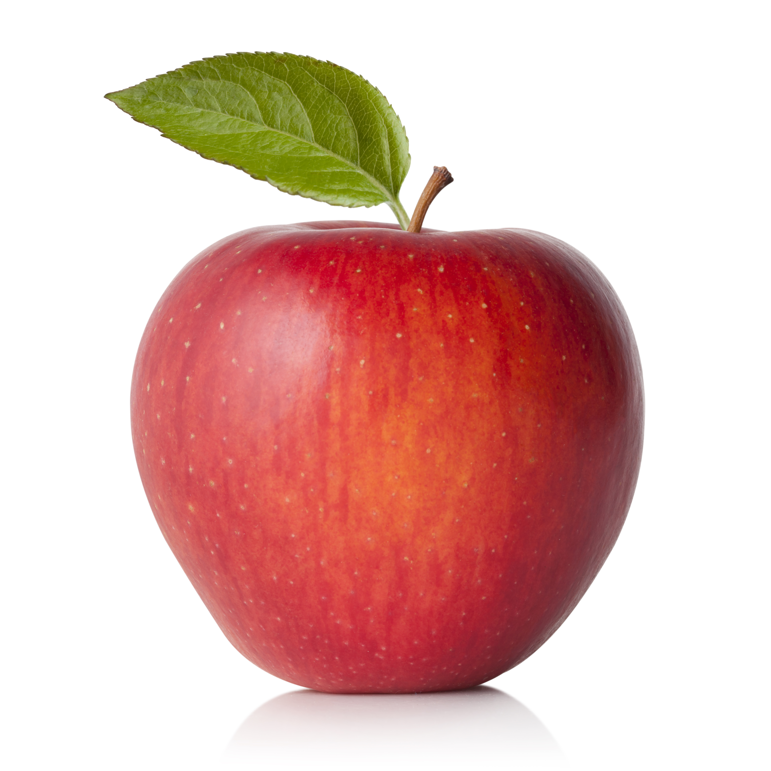
What we are learning today
Today we will be learning all about apples!

Slide 2
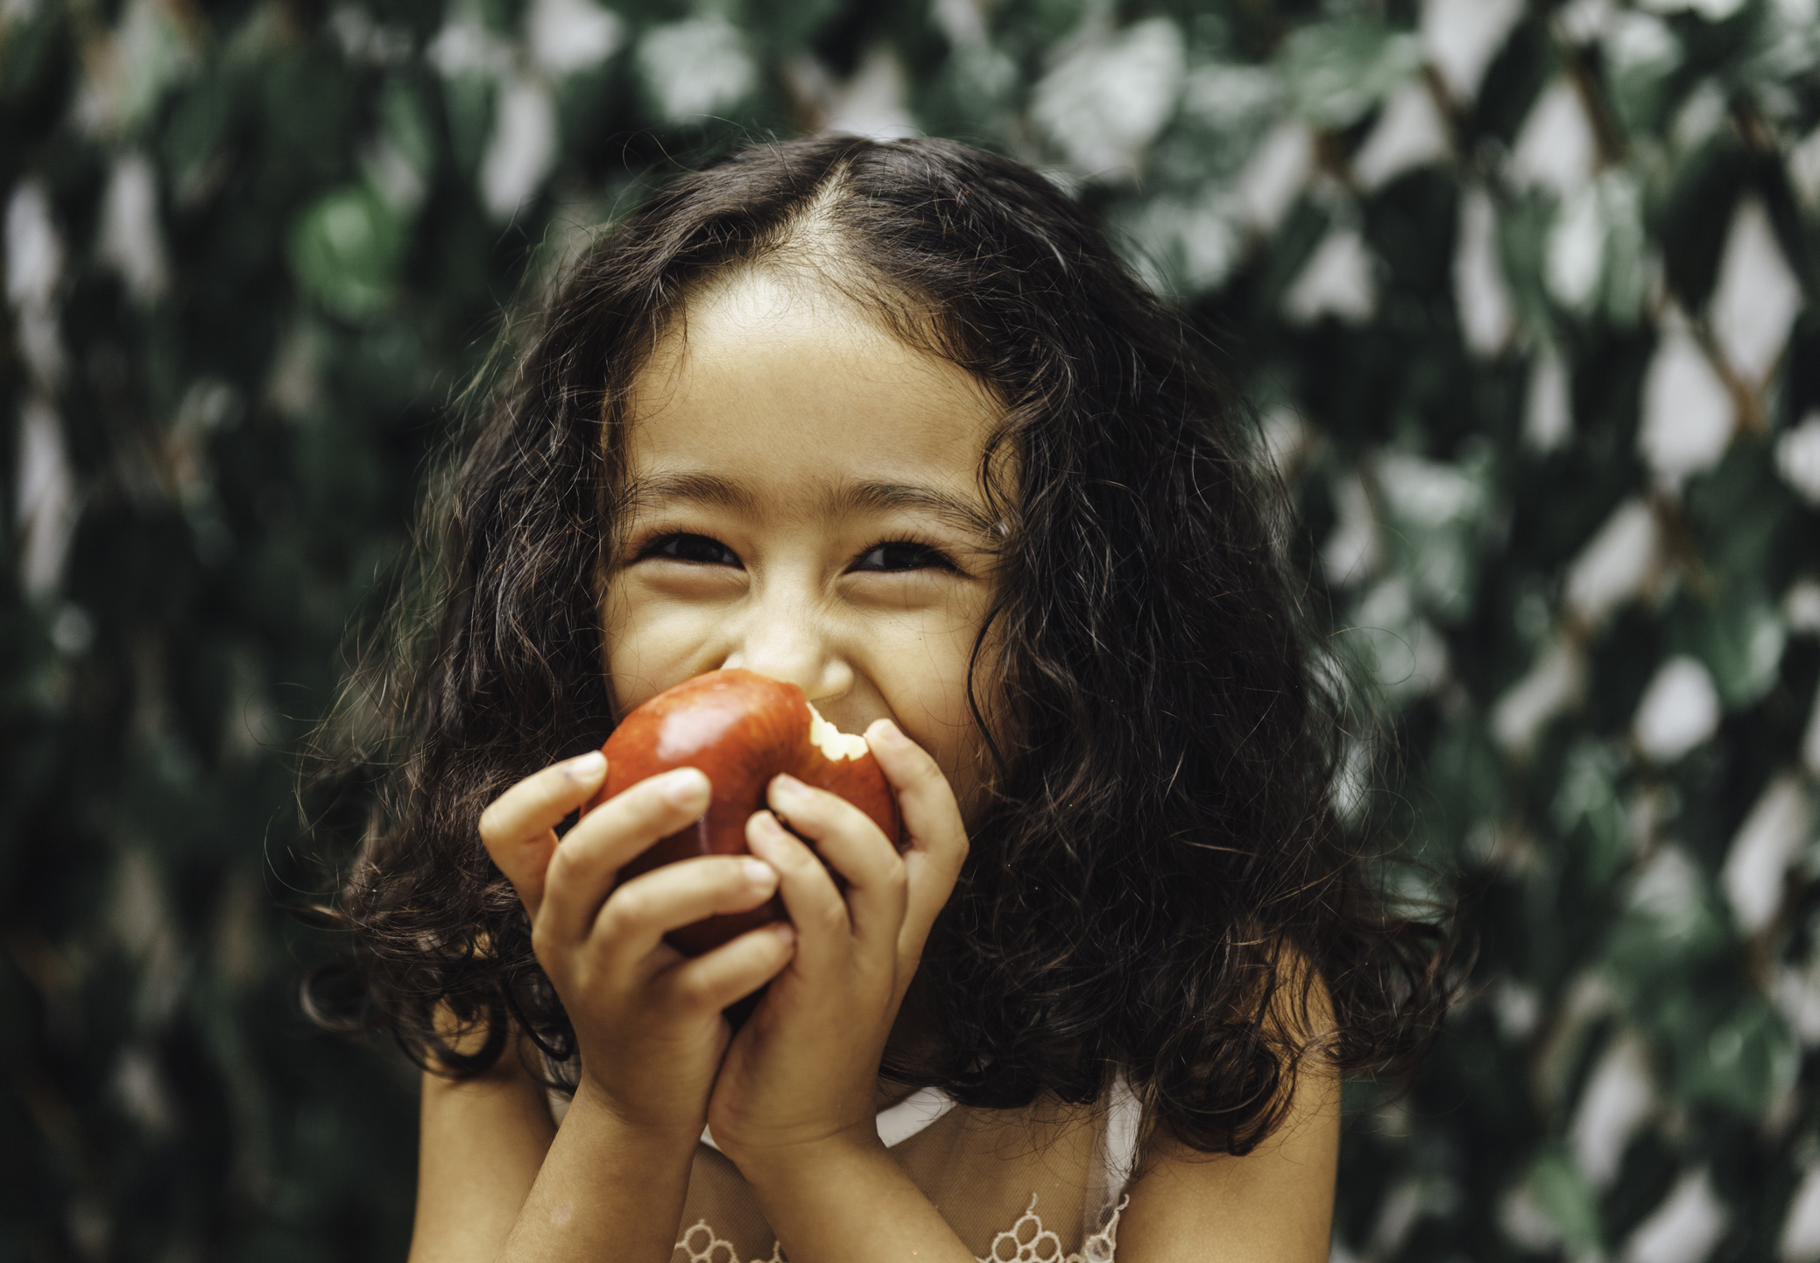
FUN FACTS
There are over 7,500 different types of apples grown in the world.
Apple trees are 4 or 5 years old before they grow apples.
Apples are members of the rose family.
The first apple tree in the United States was planted by the pilgrims when they came to the United States from Europe.
Apple trees can live to be about 100 years old.

Slide 3
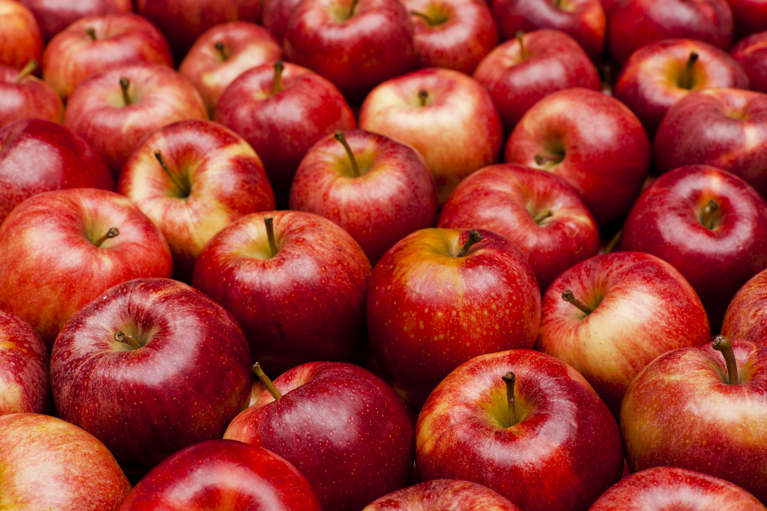
NUTRITION NUGGET
Apples are very nutritious! Apples are filled with potassium, vitamin C, carbohydrates, fiber and antioxidants.
These are all substances that keep our bodies safe and healthy.
Apples can help prevent tooth decay and boost memory.

Slide 4

Spot it on the map
The top apple producers around the world are China, the United States, Turkey, Poland and Italy.
In the United States, Washington grows the most apples.

