Slide 1
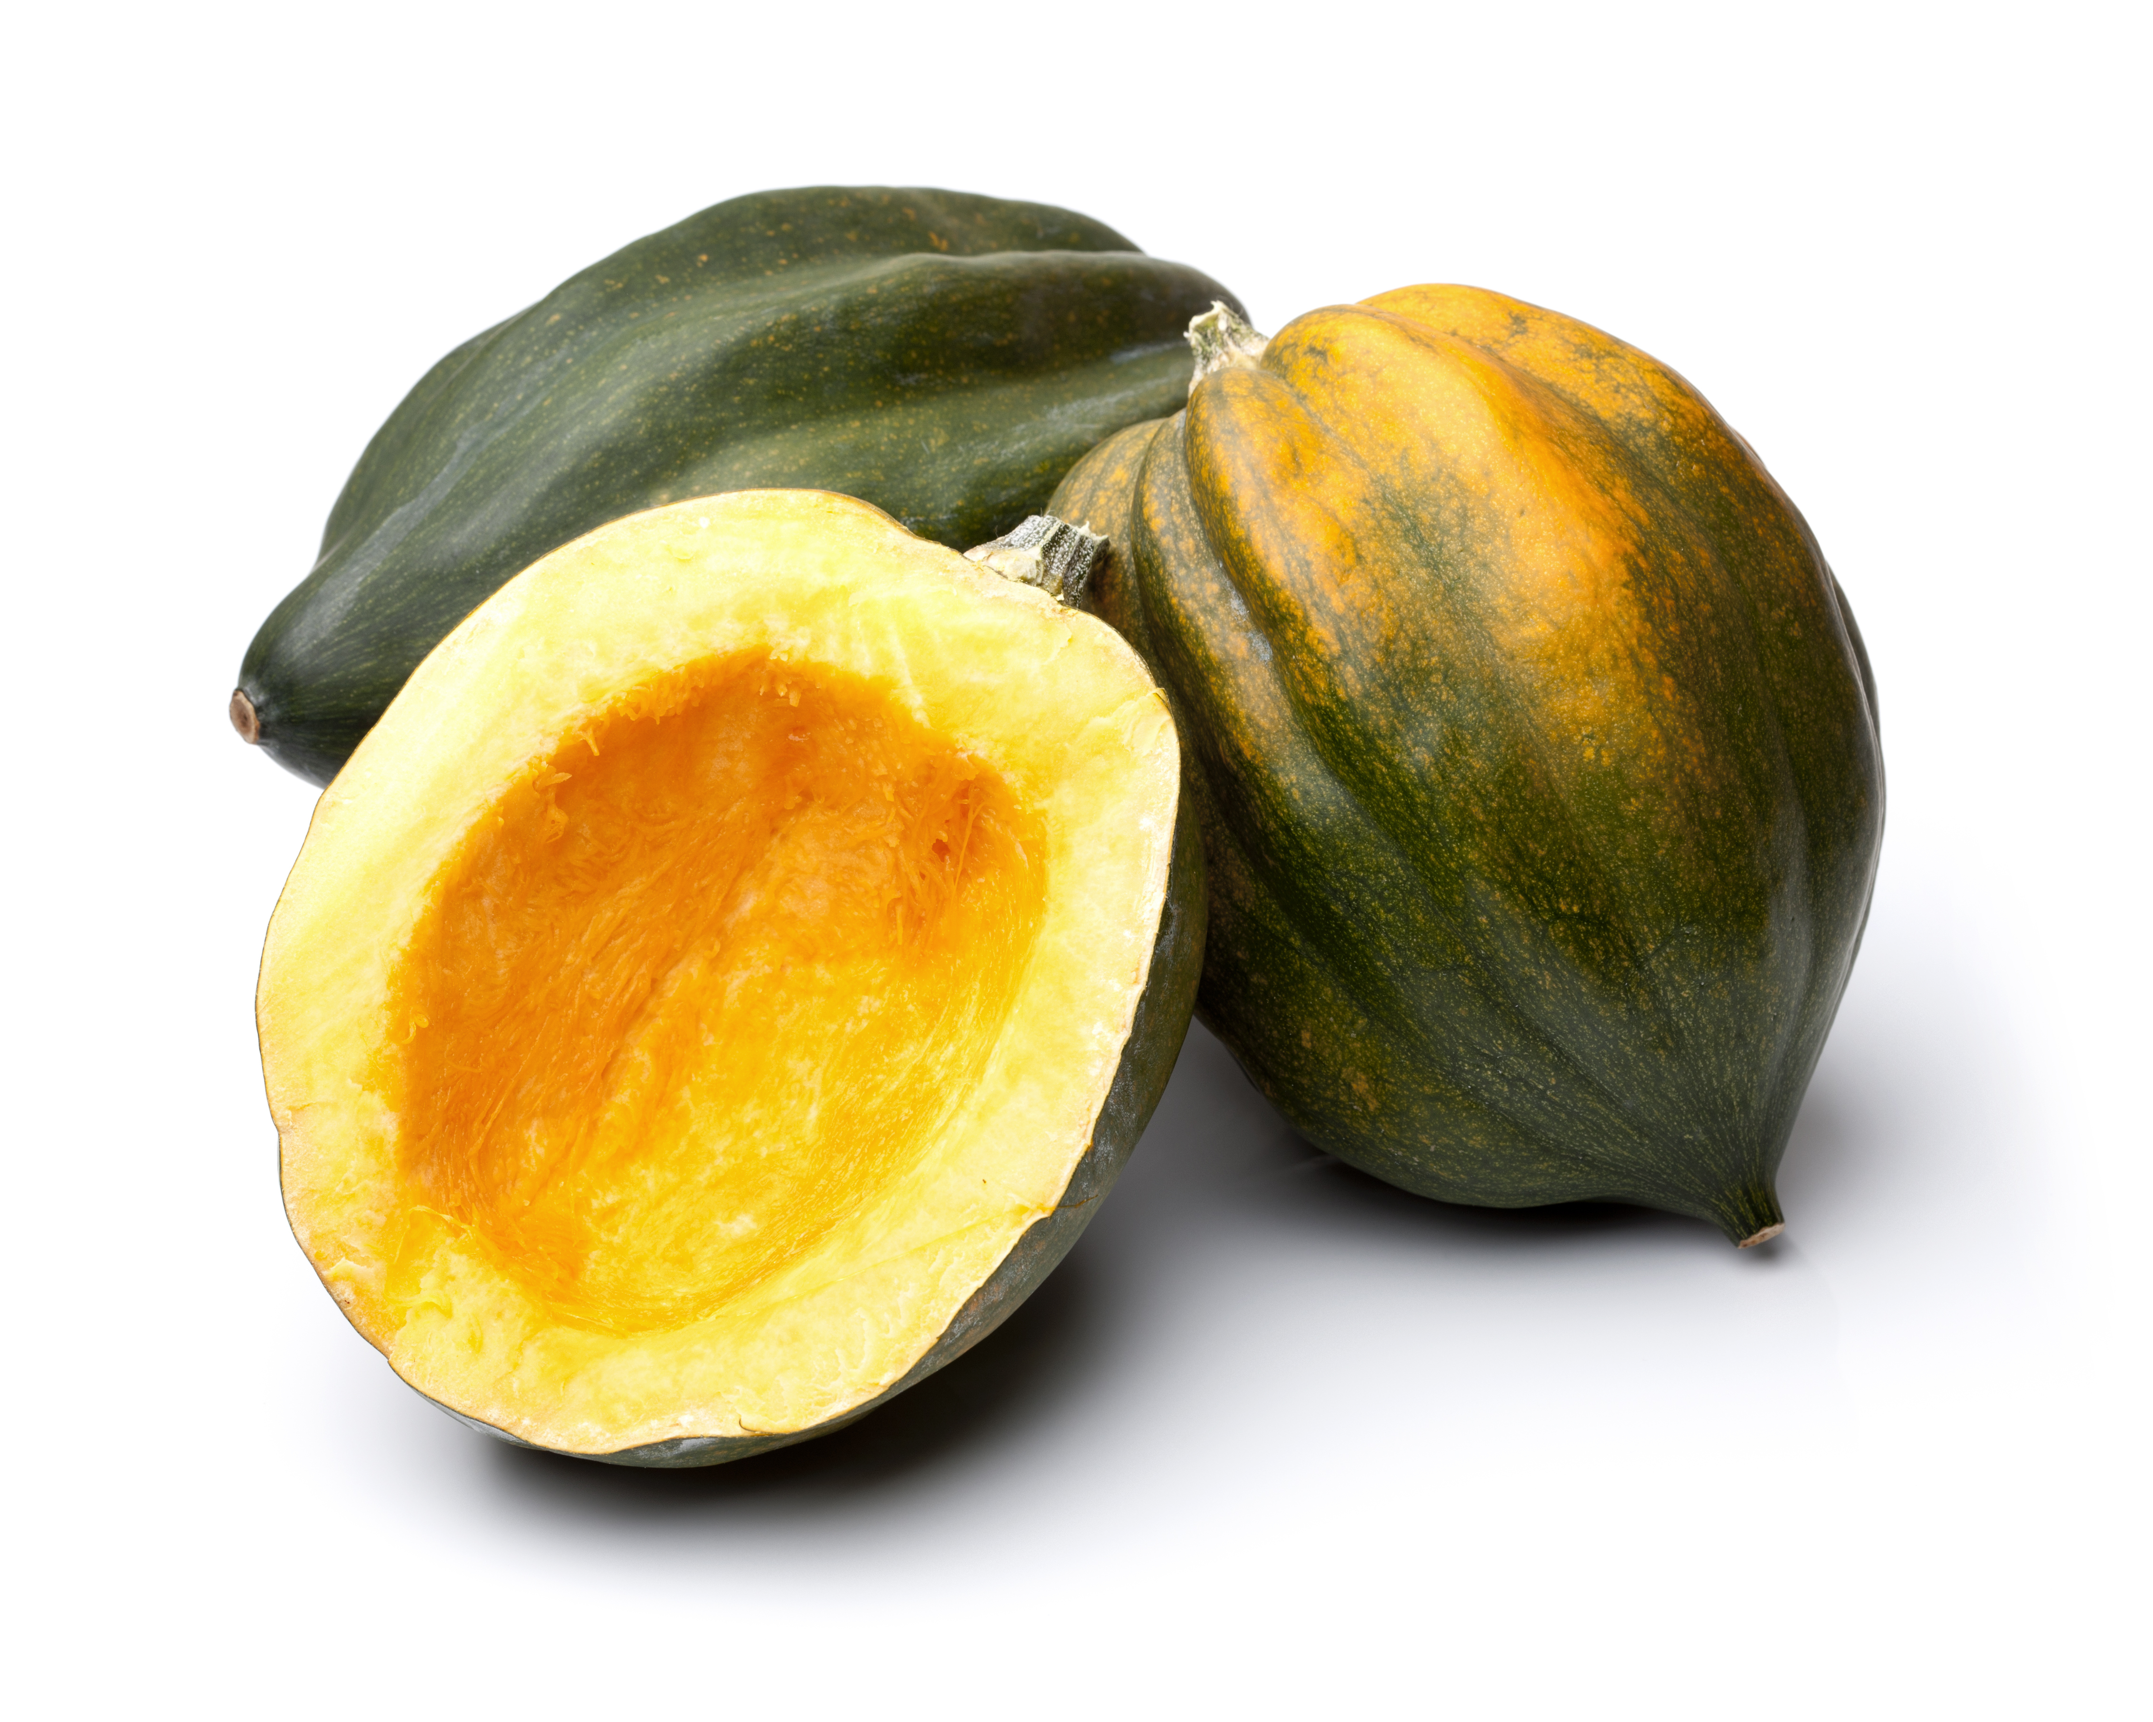
What we are learning today
Today we will be learning about the acorn squash!

Slide 2
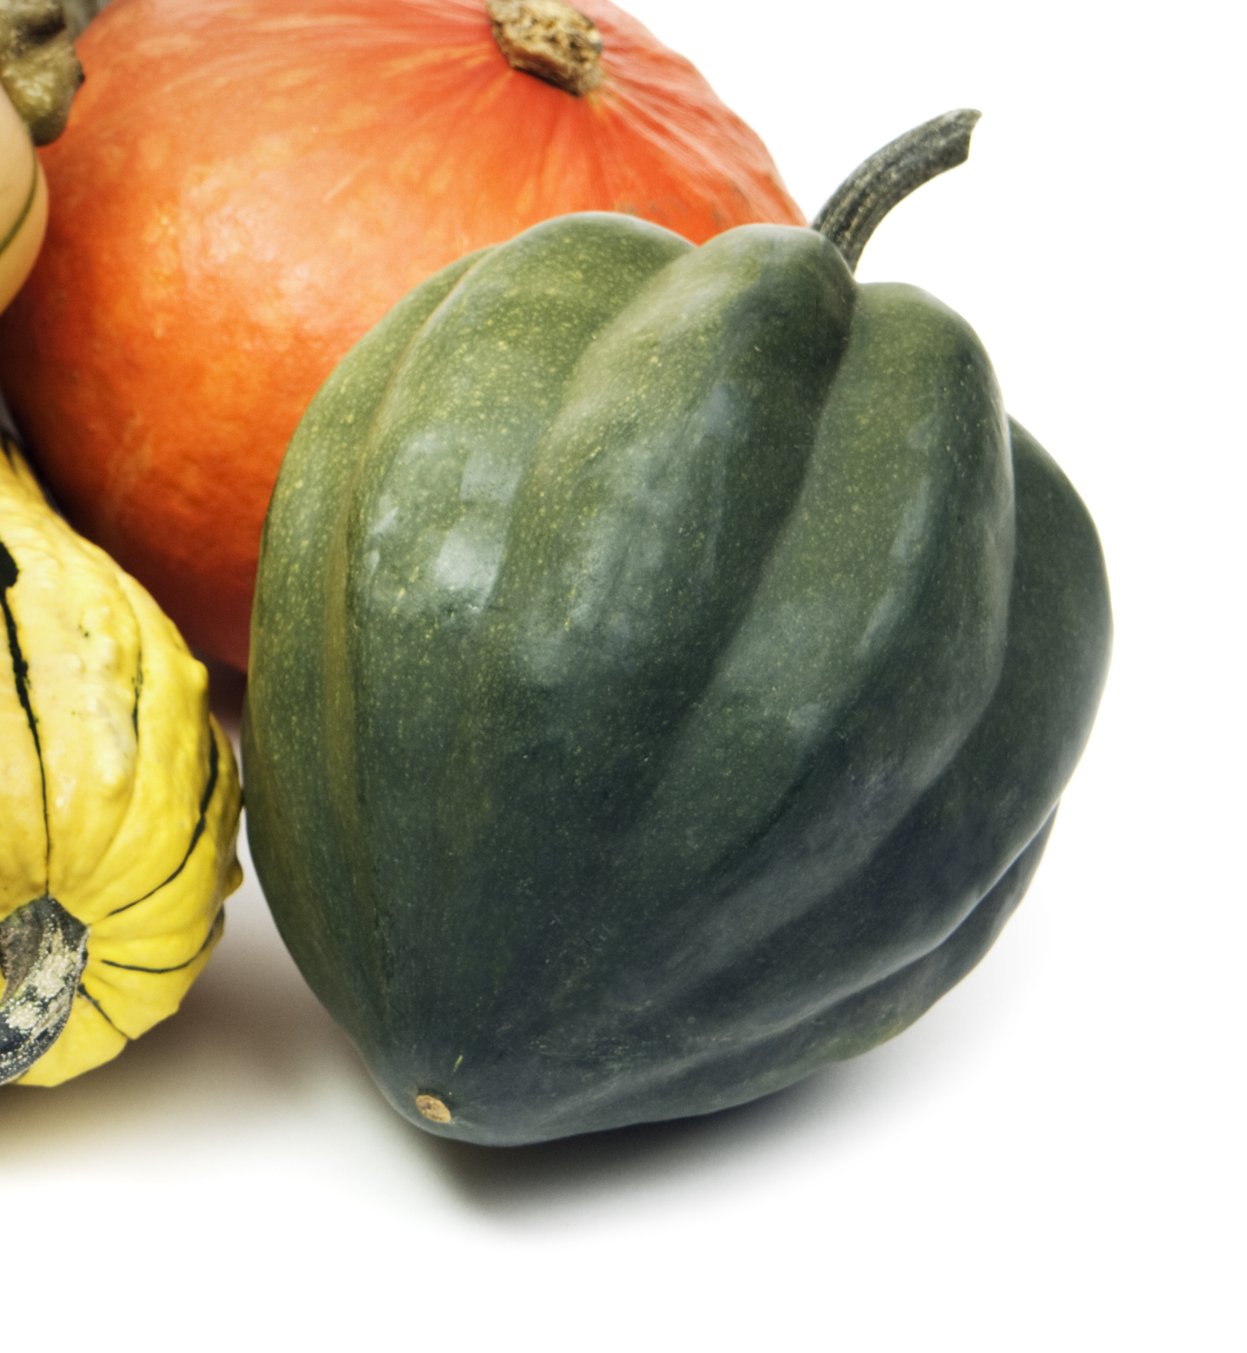
Did you know?
Acorn squash gets its name because when they are full grown they look like acorns.
Acorn Squash originated in North and Central America, but spread across the world when European explorers took squash seeds to their homeland to grow.

Slide 3
NUTRITION NUGGET
Acorn Squash is high in antioxidants and
Vitamin C.
It can boost your immune system and helps you stay healthy.
Acorn Squash can also improve your vision and skin and build strong bones.

