Slide 1


Florida Automated Nutrition System (FANS)
Fresh Fruit and Vegetable Program (FFVP)
Florida Department of Agriculture and Consumer Services

Slide 2

FFVP Claims Module
Florida Automated Nutrition System (FANS)
Fresh Fruit and Vegetable Program (FFVP)

Slide 3
FFVP Training Topics
Menu and Navigation
View Grant Details
Add an Original Claim
Reimbursable Costs
Submit Claim for Payment

Slide 4
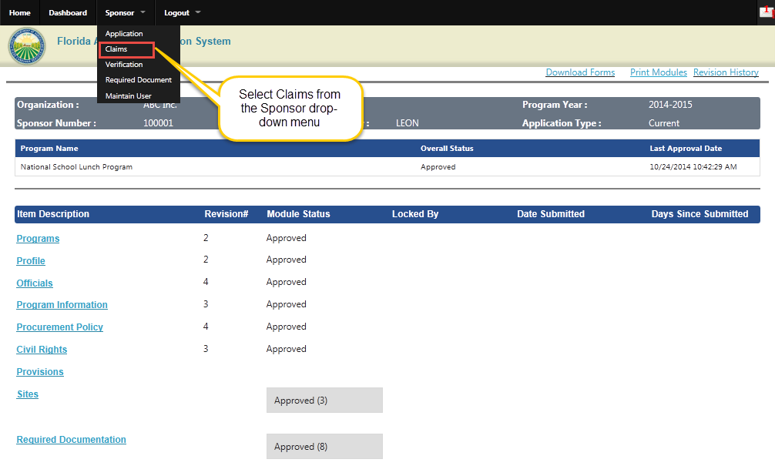
FFVP Claims: Menu
Notes:
To submit an Original Claim, view or modify an existing Claim, Log on to FANS, and then select the Claims item from the Sponsor drop-down menu.
Selecting Claims takes you to the Claim Year Summary page which defaults to NSLP Claiming.

Slide 5
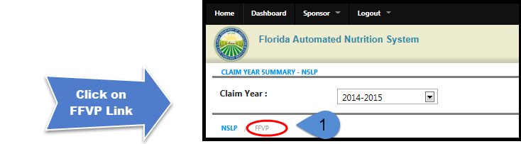
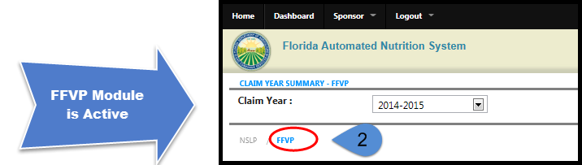
FFVP Claims: Navigation
Notes:
Since we default to the NSLP Claiming Module, this slide shows two different screen clips of just the FFVP link to show you further detail for navigating to the FFVP Claiming Module.
You will be able to access the various claiming modules by toggling back and forth between programs.
Initially, Sponsors that participate in FFVP will see a link to go to FFVP claims directly under the Claim Year field.
To go to FFVP, click on the gray FFVP link.
The module will change from the NSLP default to the FFVP Claiming Module.
Note that the ‘NSLP / FFVP’ link will change color depending on which program is active.

Slide 6
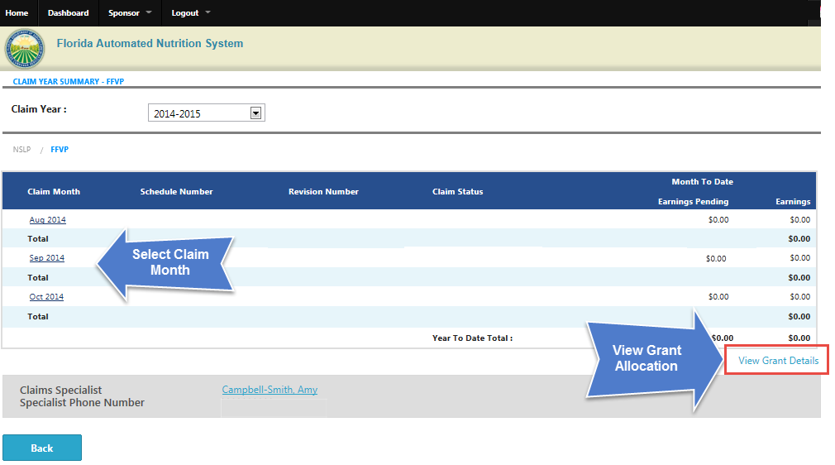
FFVP Claims: Navigation
Notes:
Clicking on the FFVP link will direct you to the Claim Year Summary page. The options on this page include the following:
Claim Year Drop-Down Box – Defaults to the current federal fiscal year. Option to select prior year(s) – if available.
‘NSLP / FFVP’ Program Link – Displays the available program links for the Sponsor. Select the program to change the view for claiming in NSLP to FFVP.
Claim Month Link – Shows a link for each month that is active for viewing, data entry or modification. In this example, the August, September, and October claim months are linked for data entry.
View Grant Details – Provides the Grant Allocation, Amount Spent and Remaining Balance for each site.
Back Button – Goes to the Sponsor Dashboard.

Slide 7
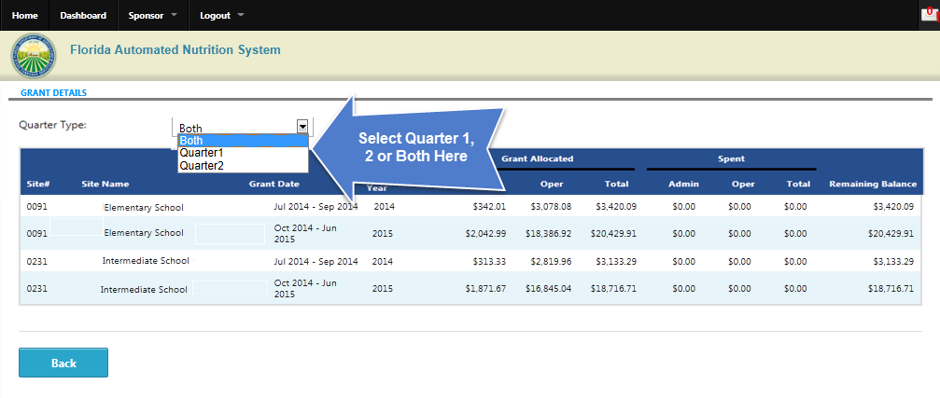
FFVP Claims: View Grant Details
Notes:
Grant allocation details are listed on this page for each site. Select Quarter 1, Quarter 2 or Both. The Grant Allocation is broken out into two categories for each quarter. Processed claim amounts for each category will display under the Spent columns. The Remaining Balance will be automatically calculated for each quarter.

Slide 8
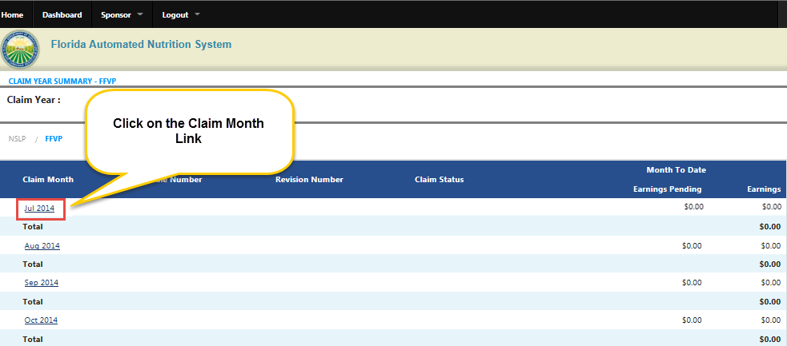
FFVP Claims: Add an Original Claim
Notes:
To add an Original Claim, click on the link for the month in which you wish to file a claim.

Slide 9
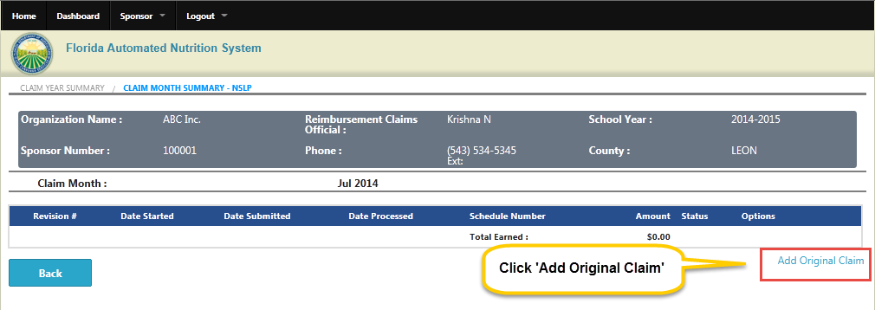

FFVP Claims: Add Original Claim
Notes:
After selecting the month you wish to file a claim in, the system will direct you to the FFVP claim month summary screen. Click on the ‘Add Original Claim’ link to file a new claim. You will be directed to the Sites Screen to enter your claiming information.

Slide 10
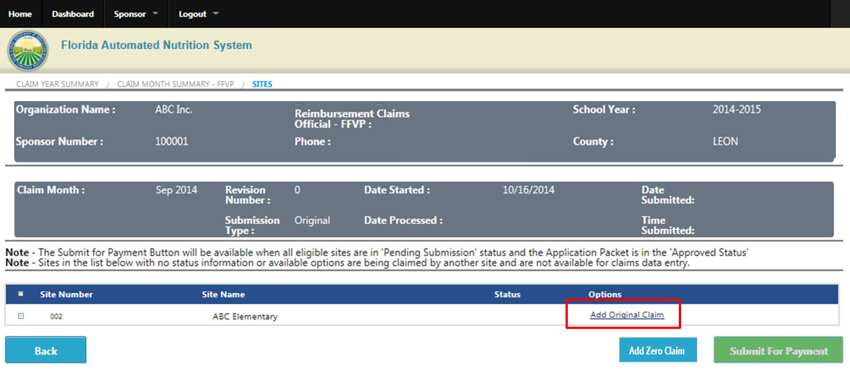
FFVP Claims: Add Original Claim
Notes:
After selecting the month you wish to file a claim in, the system will direct you to the FFVP claim month summary screen.
Click on the ‘Add Original Claim’ link to file a new claim. You will be directed to the Sites Screen to enter your claiming information.
If needed, you also have the option of filing a Zero Claim. Select the check box for that site, and then click on the Add Zero Claim button.

Slide 11
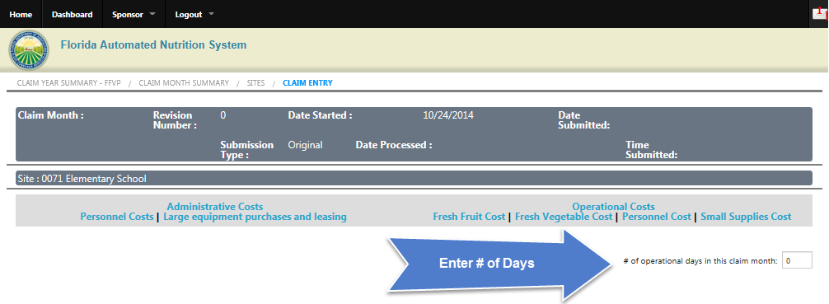


FFVP Claims: Add Original Claim
Notes:
Start by entering the number of operational days in the claim month.
Next, select the link for the type of reimbursable costs that will be entered into the claim. Reimbursable costs are either Administrative or Operational. Administrative Costs are categorized into personnel costs or large equipment purchases and leasing costs. Operational costs include fresh fruit cost, fresh vegetable cost, personnel cost and/or small supplies cost.

Slide 12
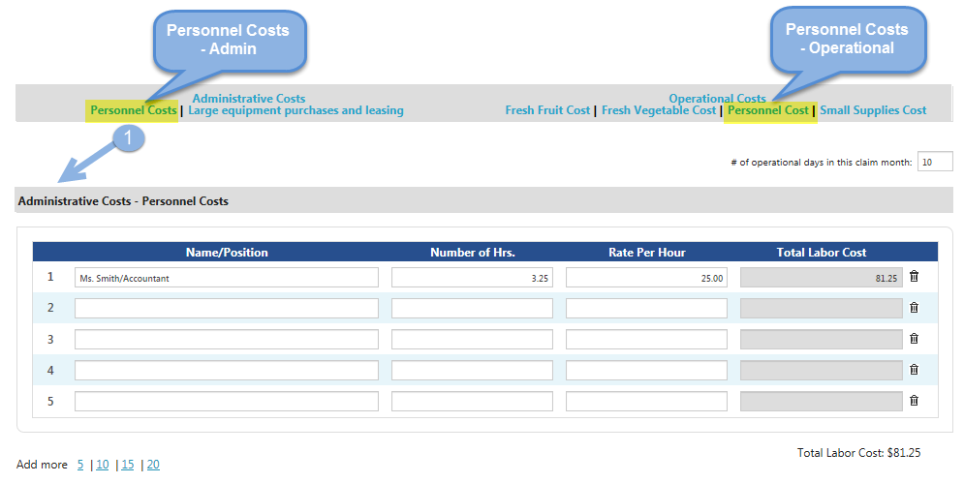
FFVP Claims: Reimbursable Costs
Notes:
Personnel costs are broken out into two categories: Administrative Costs and Operational Costs. Administrative costs include the FFVP share of salaries for employees who maintain claims for reimbursement and other financial reports, plan and write menus, order produce, track inventory and coordinate nutrition promotion activities.
Administrative Personnel costs appear first on the FFVP claim form. To go to the appropriate section, scroll up or down the page or select the Personnel Cost Link under Administrative Costs.
Enter in the Name/Position, Number of hours and Rate Per Hour. Use one line per position. Total Labor Cost will be automatically calculated for you.

Slide 13
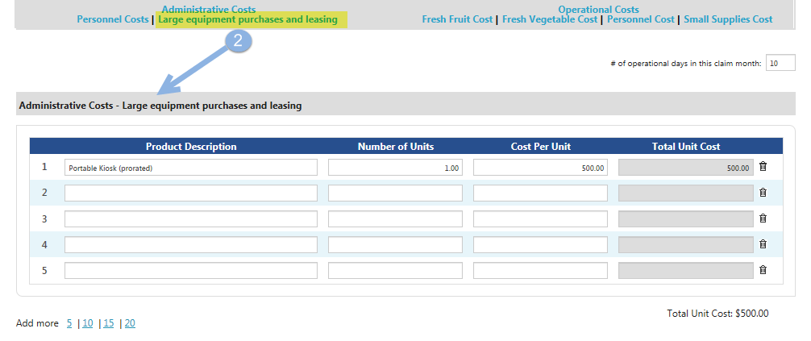
FFVP Claims: Reimbursable Costs
Notes:
Large equipment purchases and leasing are categorized as Administrative Costs. Selecting the Large equipment purchases and leasing link will direct you to this section of the claim form.
Enter in the Product Description, Number of Units and Cost per Unit. The Total Unit Cost will be automatically calculated for you.

Slide 14
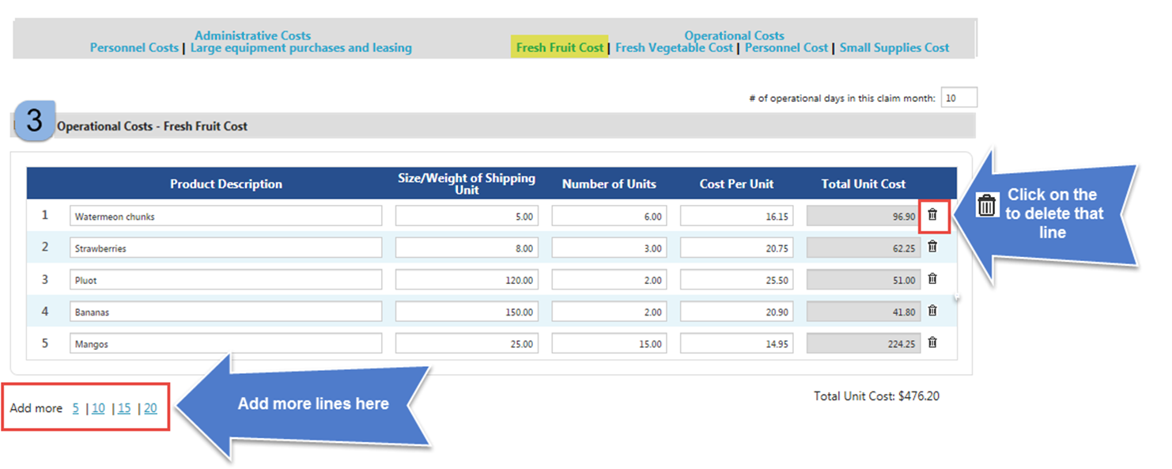
FFVP Claims: Reimbursable Costs
Notes:
Under Operational Costs, select the Fresh Fruit Cost Link or scroll down the claim form to enter the school’s fresh fruit products.
Enter in the Product Description, Size/Weight of Shipping Unit, Number of Units and Cost per Unit for each item. The Total Unit Cost will be automatically calculated for you.
If there is a line error, delete the entire row by clicking on the Trash Can Icon next to that line.
If you need to enter more product, click on 5, 10, 15 or 20 to add more rows.

Slide 15
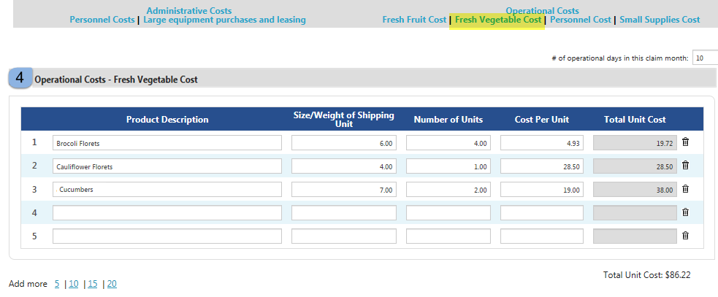
FFVP Claims: Reimbursable Costs
Notes:
Next, select the Fresh Vegetable Cost Link under Operational Costs or Scroll down the claim form to enter the school’s fresh fruit products.
Enter in the Product Description, Size/Weight of Shipping Unit, Number of Units and Cost per Unit for each item.
The Total Unit Cost will be automatically calculated for you.

Slide 16
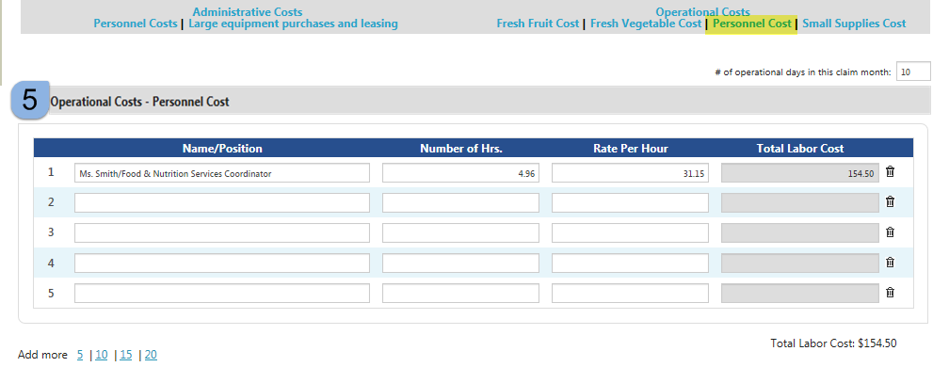
FFVP Claims: Reimbursable Costs
Notes:
Personnel costs for operational items include the FFVP share of salaries for employees who do such tasks as washing and chopping produce, preparing trays, distributing produce to classrooms, setting up kiosks, restocking vending machines and cleaning up.
Operational personnel costs appear towards the bottom of the FFVP claim form. To go to the correct section, either scroll down on the form or select the Personnel Cost Link under Operational Costs.
Enter in the Name/Position, Number of hours and Rate Per Hour. Use one line per position. Total Labor Cost will be automatically calculated for you.

Slide 17
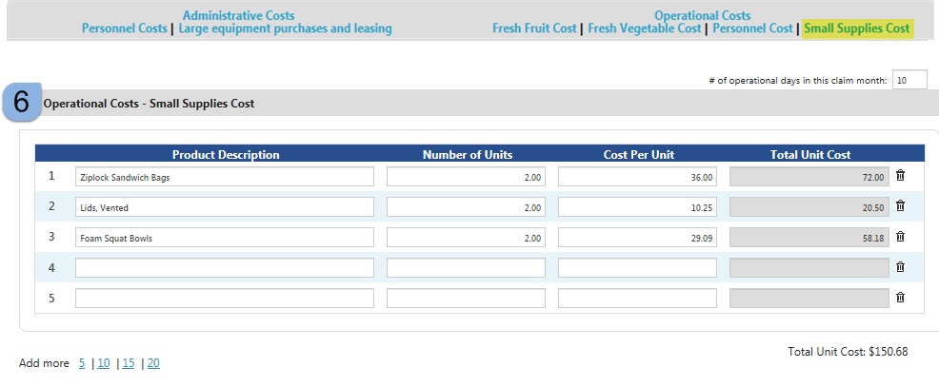
FFVP Claims: Reimbursable Costs
Notes:
Small Supplies Cost is one of the last sections of the form. It includes nonfood items like napkins, paper plates, serving bowls and trays, cleaning supplies and trash bags.
Click on the Small Supplies Link to go to this section of the claim form.
Enter in the Product Description, Number of Units and Cost per Unit. The Total Unit Cost will be automatically calculated for you.

Slide 18
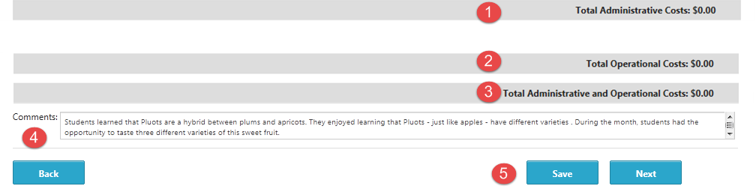
FFVP Claims: Total Costs and Comments
Notes:
Items 1 -3 above show total administrative and operational costs for this claim. To view total costs, continue to scroll up or down the page as total costs are listed after each section.
Item 4 shows the optional comments section which is located at the bottom of the claim form following Total Administrative and Operational Costs. Enter any comments that you have for that site.
For Item 5, saving will keep you on the claim entry screen so you can review the claim for incomplete data or add more expenditures if needed.

Slide 19
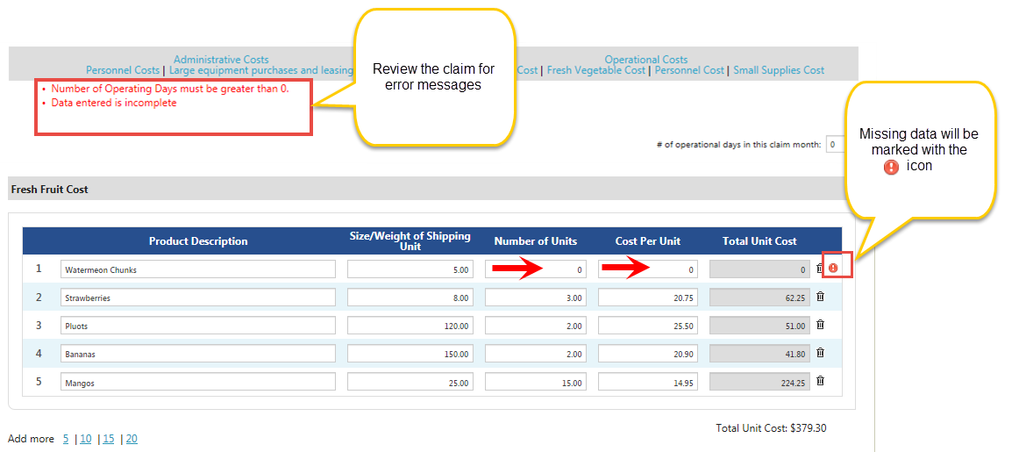
FFVP Claims: Review
Notes:
On save, the system will save the entire FFVP claim, check for any missing data and provide error or warning messages for any items that need to be resolved. Review each part of the claim by clicking on each category. The exclamation mark icon will display for any lines that need to be reviewed.
As an example, Line 1 above has missing data for ‘Number of Units’ and ‘Cost Per Unit.’ The description of the issue, “Data entered is incomplete,” will display at the top of the page. In addition, the red Exclamation Point Icon will display next to the line that needs to be reviewed.

Slide 20
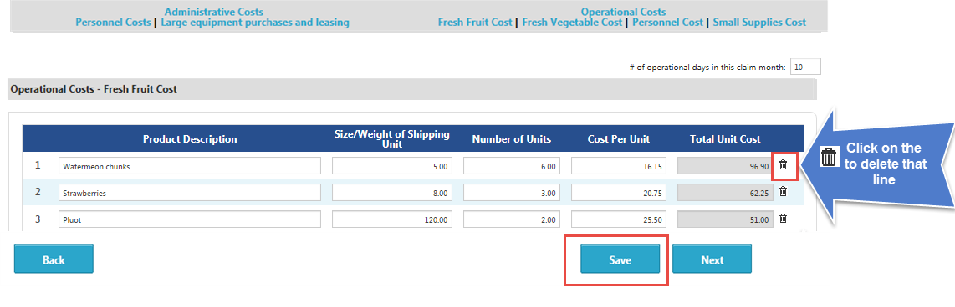
FFVP Claims: Reimbursable Costs
Notes:
In this next example, we found a mistake in that needs to be corrected before the claim can be paid. First click on the trash can icon, and then select the save button to delete the line.
Once the claim errors have been resolved, select Next to finish the claim.

Slide 21
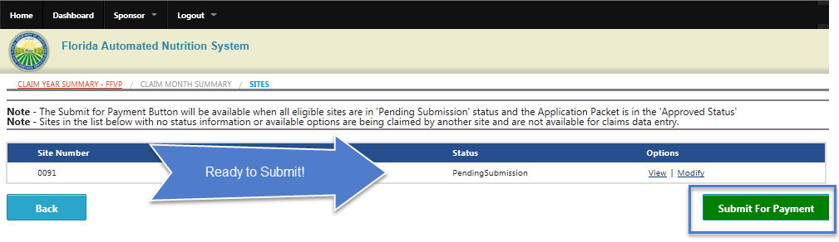
FFVP Claims: Submit for Payment
Notes:
Upon clicking the ‘Next’ button on the Claim Entry screen, you will be directed to the Sites screen to enter data for additional sites or to submit the claim for payment.
Note that the ‘Submit for Payment’ Button will be available when all eligible sites are in ‘Pending Submission’ status.
Selecting the Submit for Payment button will direct you to the certification page.

Slide 22
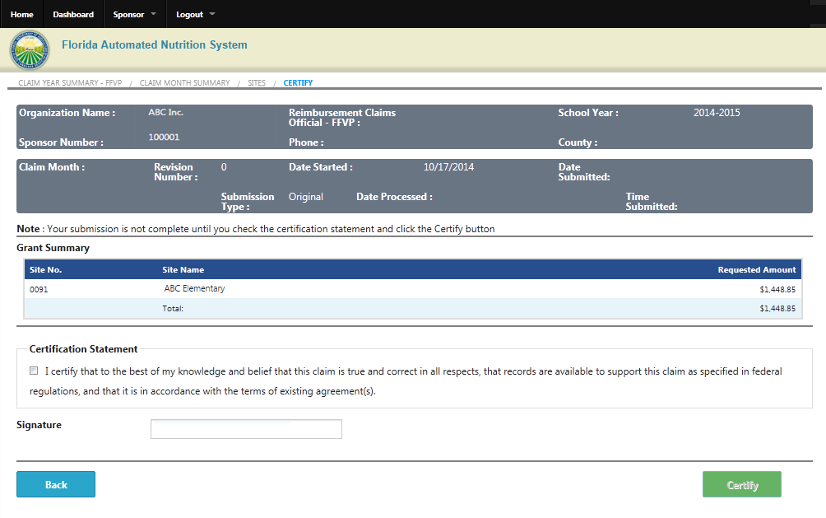
FFVP Claims: Submit for Payment
Notes:
Your submission is not complete until you check the Certification Statement and click the Certify button. You will receive a message that your Claim has been successfully submitted for review by the FFVP Claims Specialist.

Slide 23
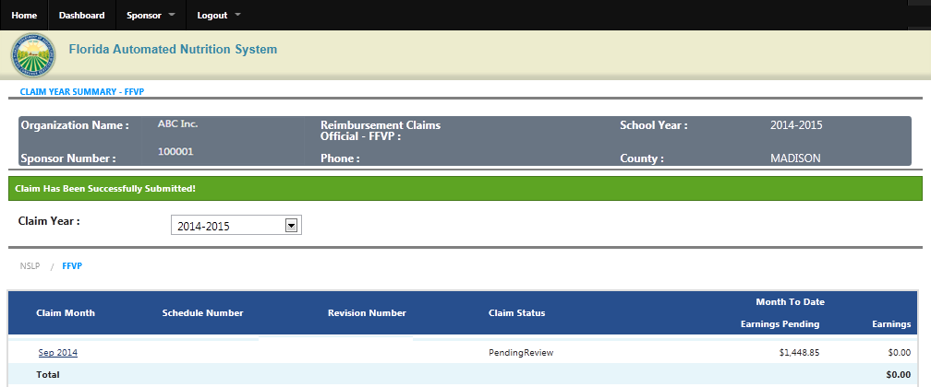
FFVP Claims: Submit for Payment
Notes:
You will receive a message that your Claim has been successfully submitted and is pending review by the FFVP Claims Specialist.

Slide 24
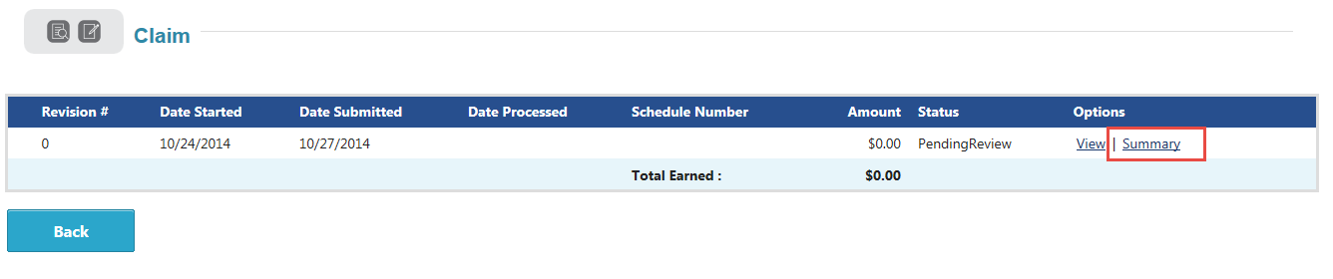
FFVP Claims: Submit for Payment
Notes:
You will be directed to the Claim Year Summary Page for FFVP. To go to Claim details for the claim, select the claim month link.
Sponsor claim summary amounts for the month may be viewed by clicking on the ‘Summary’ link under Options.

Slide 25
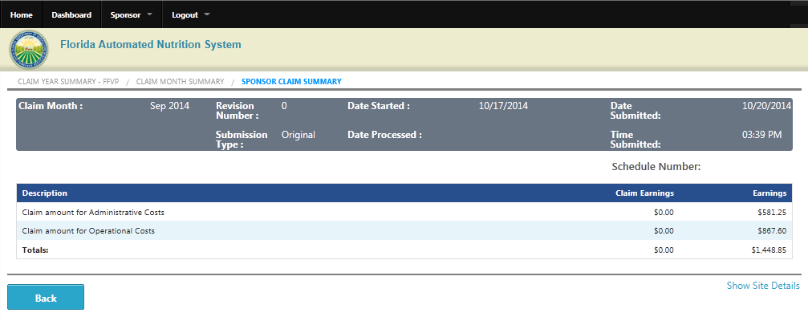
FFVP Claims: Claim Summary
Notes:
Selecting show site details to view claim information for each site.

Slide 26
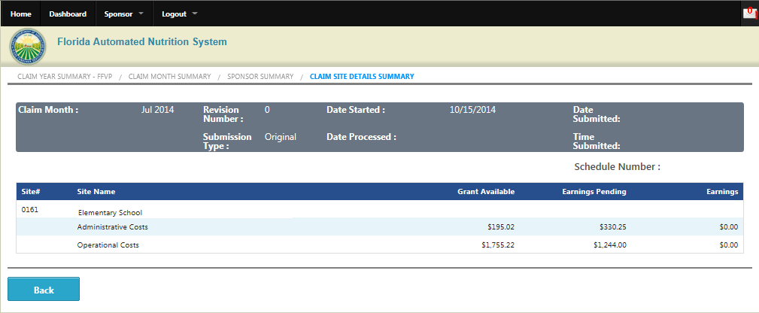
FFVP Claims: Submit for Payment
Notes:
The claim details for each site are available on this page. Click the Back button to return to the Claim Year Summary page.

Slide 27
Contact Information
Amy Campbell-Smith
850/617-7411
amy.campbell-smith@FDACS.gov

