Slide 1

BUREAU OF STANDARDS
METER MECHANIC CLINIC 2026 - 2027
Notes:
“Hello and welcome to the 2026-2027 Bureau of Standards Petroleum Meter Mechanic Presentation. Make sure to have a pen and notepad available during the presentation to write down notes, telephone numbers, or form requirements.”

Slide 2

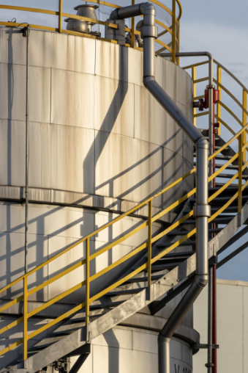
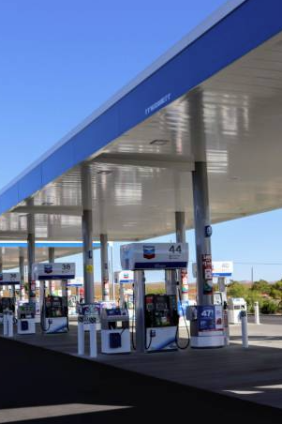

Petroleum Registration
Notes:
The Florida Department of Agriculture and Consumer Services (FDACS) helps strengthen Florida’s fuel industry and ensure consumer safety. A vital part of this mission is the Petroleum Station Registration and/or the Petroleum Wholesale Registration required under Section 525.19, Florida Statutes, and Rule 5J-21.010, Florida Administrative Code. By registering each year, facilities ensure they are part of a coordinated network capable of providing essential status updates during a declared state of emergency, which helps Florida respond effectively to crises and maintain fuel supply chain resiliency.

Slide 3

Benefits of registration include:
Efficient petroleum facilities that meet state-mandated safety, quality and operational standards.
Organized communication, preparation and restoration in the event of natural disasters.
Eligibility for state programs such as the Florida Retail Fuel Transfer Switch Modernization Grant Program (526.147, F.S. And 5J-21.011, F.A.C.).
Notes:
Benefits of registration include efficient petroleum facilities that meet state-mandated safety, quality and operational standards. Organized communication, preparation and restoration in the event of natural disasters. Eligibility for state programs such as the Florida Retail Fuel Transfer Switch Modernization Grant Program.

Slide 4
How to Register Annually?
The registration is made online through the official www.FDACS.gov website.
Registration must be completed prior to May 1st each year or upon order of the department.
Failure to register may result in administrative fines up to $5,000.00.
Notes:
How to register annually? The registration is made online through the official www.FDACS.gov website. Registration must be completed prior to May 1st each year or upon order of the department. Failure to register may result in administrative fines up to $5,000.00.

Slide 5
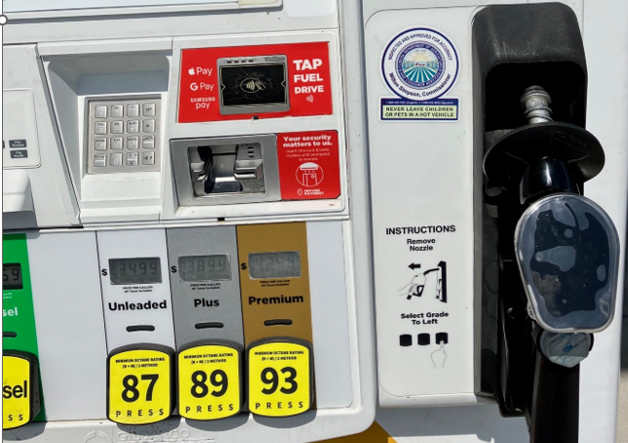

INSPECTION IDENTIFICATION STICKERS
Notes:
“Here are the current Commissioner decals with phone numbers.
They are circular– and state, “Inspected and Approved for accuracy.”

Slide 6

INSPECTION IDENTIFICATION STICKERS
It shall be a violation of this section for
any person unless authorized by the
Department, to remove, deface,
conceal or in any way obliterate or
change this official sticker after it has
been affixed by an inspector.
Notes:
“Once affixed by an inspector, it shall be a violation of this section for any person unless authorized by the Department, to remove, or deface, conceal or in any way obliterate or change this official sticker.”

Slide 7


WHAT ARE MY RESPONSIBILITIES
AS A METER MECHANIC?
Notes:
“It is the meter mechanics’ responsibility to contact the Department for placed in service, new meters, or new installations.”
5J-21.007 is the General Code and the Codes of Liquid-Measuring Devices, Liquefied Petroleum Gas and Anhydrous Ammonia Liquid-Measuring Devices, Hydrocarbon Gas Vapor-Measuring Devices, Vehicle-Tank Meters, and Vehicle Tanks Used as Measures of National Institute of Standards and Technology Handbook 44 Meter Sealing Requirements, and Other Related Requirements.

Slide 8

REGISTRATION
Who must register?
All persons or service agencies that repair or install petroleum fuel measuring devices must register.
Rule 5J-21.005(4) F.A.C.
https://www.flrules.org/gateway/ChapterHome.asp?Chapter=5J-21
Notes:
“Who must register? – All persons or service agencies that repair or install petroleum fuel measuring devices must register annually. Registration requirements are covered in rule 5J-21.005(4) F.A.C. Measuring devices includes all measuring devices.”

Slide 9


REGISTRATION 2
REGISTRATION
Where, When, & How
do I register?
Meter Mechanics must register (or re-register) annually with the Department by submitting the registration form and review current rules and regulations.
Notes:
“Meter mechanics must register with the Department annually by submitting a registration form and review current rules and regulations.”

Slide 10


REGISTRATION 3
REGISTRATION
Are there any requirements for registration?
Notes:
“There are some registration requirements that Meter Mechanics should know about.”

Slide 11

REGISTRATION REQUIREMENTS
REGISTRATION REQUIREMENTS
Annually apply with FDACS and review the annual meter mechanic presentation.
Notes:
“Step 1: Annually apply with FDACS and review the annual meter mechanic presentation.”
“Mechanics must provide a calibration report not more than 1 year old.
Be sure to use an appropriate size test measure according to the National Institute of Standards and Technology (NIST) Handbook 44, and that has been calibrated with standards traceable to NIST.”
“Retail Test Measures are 5 gal minimum. HV Test Measures are typically 50 gal, HV mechanics may also have 5g prover for retail. Each and every mechanic must have their own calibration report for each test measure.”

Slide 12
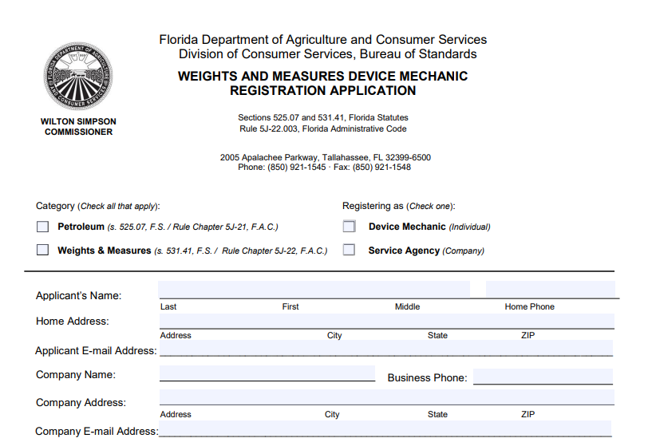
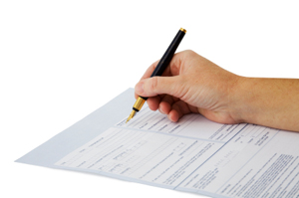
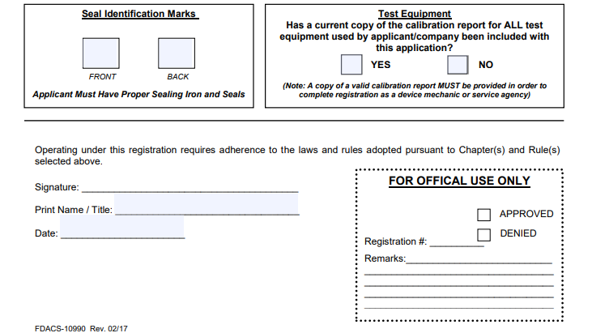
REGISTRATION REQUIREMENTS 2
REGISTRATION REQUIREMENTS
2) Complete an Application for Registration of Authorized Meter Mechanic (FDACS- 10990) http://forms.FDACS.GOV/10990.pdf
http://forms.FDACS.GOV/10990.pdf
Notes:
“Step 2: It is the mechanics’ responsibility to complete an “Application for Registration of Authorized Meter Mechanic.” FDACS Form-10990. Remember to apply annually and participate in review of current rules and regulations.” Here is an example of FDACS Form-10990

Slide 13
REGISTRATION REQUIREMENTS 3
REGISTRATION REQUIREMENTS
or Complete an Application for Registration of Service Agencies (FDACS- 10990)
http://forms.FDACS.GOV/10990.pdf
http://forms.FDACS.GOV/10990.pdf
Notes:
“Registered service agencies must complete an “Application for Registration of Service Agencies,” FDACS Form-10990.” Here is an example of FDACS Form-10990.

Slide 14

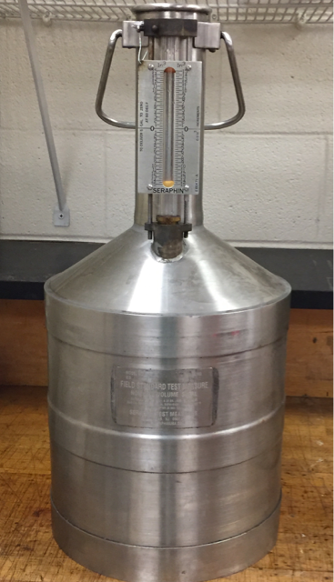
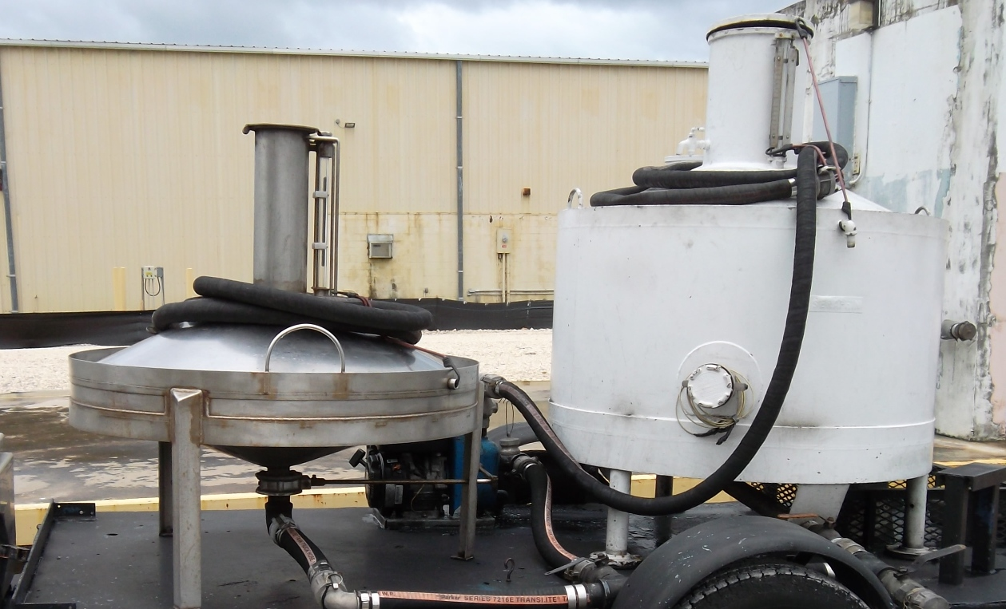
REGISTRATION REQUIREMENTS 4
REGISTRATION REQUIREMENTS
3) Maintain a test measure of appropriate size according to the National Institute of Standards and Technology (NIST)
Notes:
“Step 3: Maintain a Test Measure of appropriate size according to the National Institute of Standards and Technology (NIST). Each mechanic must provide their own, valid calibration report from a certified laboratory no more than 1 year old.”

Slide 15
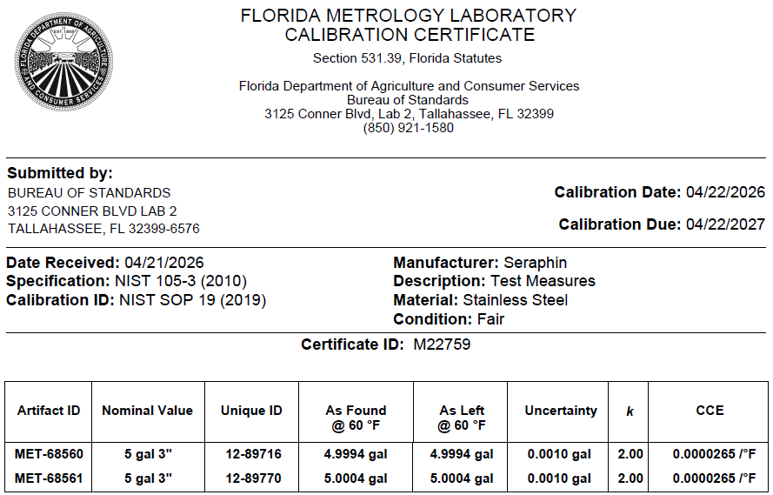
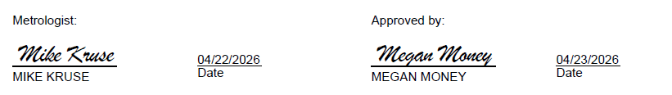

REGISTRATION REQUIREMENTS 5
REGISTRATION REQUIREMENTS
3) Maintain a test measure of appropriate size.
Notes:
“The Calibration report must have a signature page. The “Calibration Due” date will be examined to ensure calibration report is valid and current. You may schedule a test measure calibration with the Bureau of Standards Laboratory up to one year in advance, otherwise a waiting period will apply. Any prover over 500 gallons is to be recalibrated every 3 years.”

Slide 16
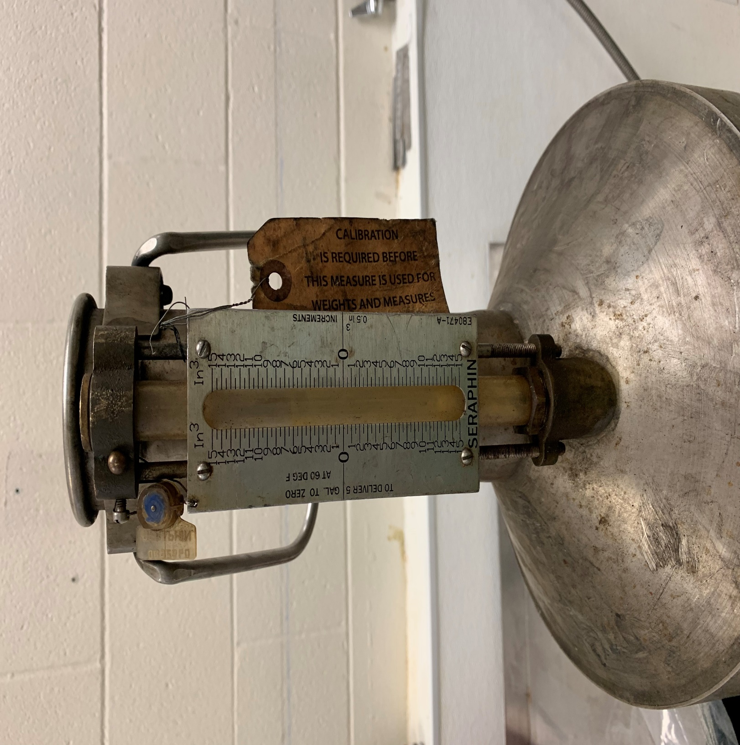
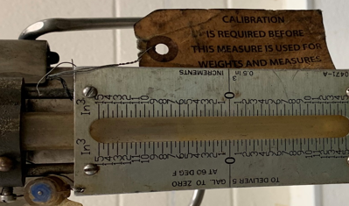
CALIBRATION REPORT REQUIREMENT
Legal for use?
Not with a Seraphin seal.
ALL TEST EQUIPMENT MUST BEAR SEAL OF APPROVED LAB AND BE ACCOMPANIED BY A CURRENT CALIBRATION REPORT !
Notes:
Look closely at the prover. Is this seal affixed to this prover legal for use? Not with a Seraphin seal.
“All test measures must bear seal of approved laboratory and be accompanied by a current calibration report. We’ve been seeing a lot of test measures come through the lab lately that have been used without being calibrated in a laboratory. They still have the manufacturer seals on them and a tag stating, “needs calibration.”

Slide 17

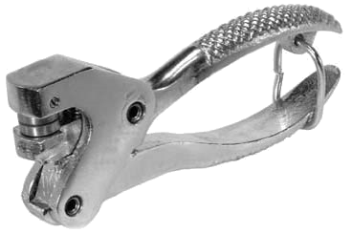
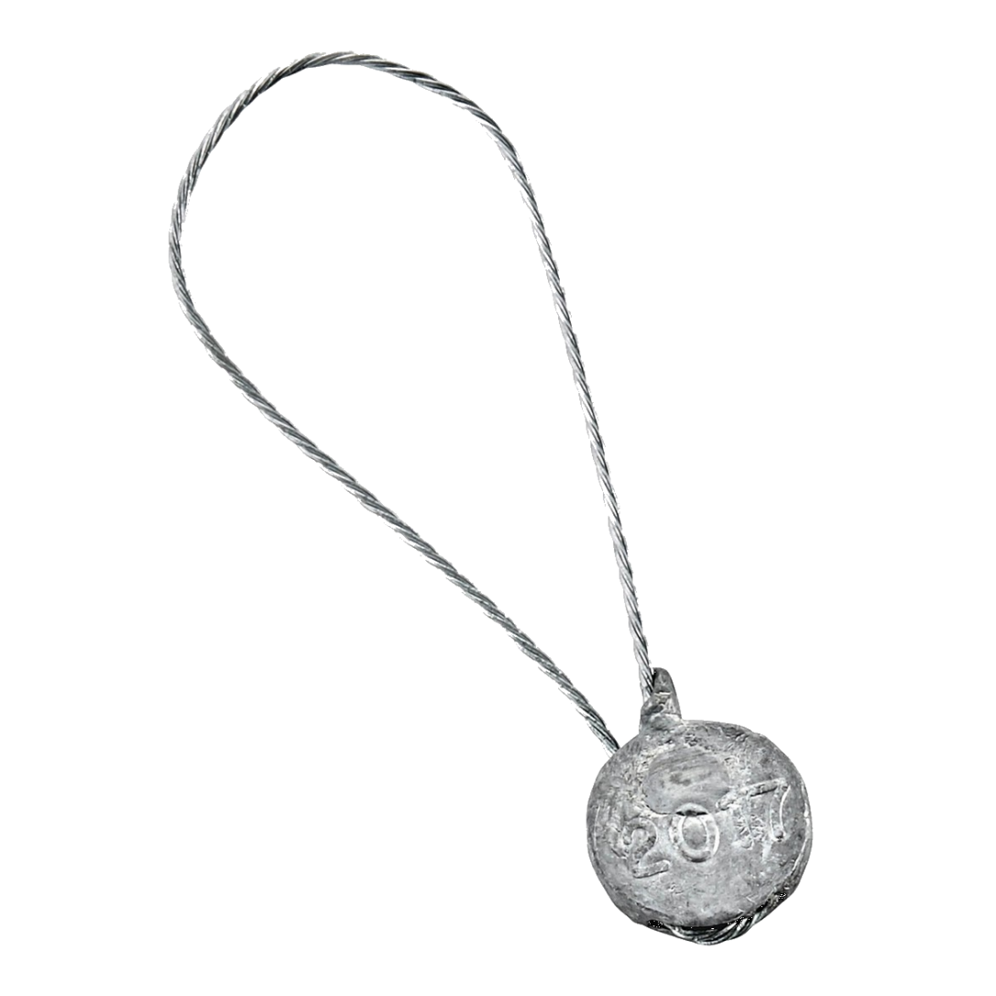
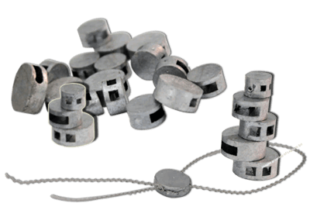
REGISTRATION REQUIREMENTS 6
REGISTRATION REQUIREMENTS
4) Use a sealing iron bearing at least the registered mechanic’s name or initials that are on file with the Department.
Notes:
“Step 4: All mechanics must use a sealing iron bearing at least the registered mechanics name or initials that are on file with the Department. Once the Application is processed, the initials, which are verified by the person accepting the Applications, are officially on file.”

Slide 18

REGISTRATION REQUIREMENTS 7
REGISTRATION REQUIREMENTS
5) All NEW applicants need Proof of Experience and must have at least one year of experience in the field. The applicant must provide a letter stating proof of experience from their registered service agency.
Notes:
“Step 5: only applies to new applicants. All new applicants need Proof of Experience and must have at least one year of experience in the field. The applicant must provide a reference letter with the necessary letterhead stating proof of experience from their registered service agency.”
“No experience? The applicant may work for a service agency that repairs or installs petroleum fuel measuring devices that is currently registered with the Department.”
“Email chains are not a valid form of a reference letter with the necessary letterhead and will not be accepted.”

Slide 19

REGISTRATION RECAP
REGISTRATION RECAP
1) Annually apply . . . -- Application – Review -
2) Complete Applications
3) Maintain a test measure of
appropriate size. -- Calibration Report --
4) Sealing Iron with at least Initials
5) All NEW applicants need proof of
experience letter.
6) Submit survey of presentation completion. (Not valid unless submitted) *Link to be provided by Field Office.
ARE YOU READY
FOR A RECAP?
Notes:
“Registration Recap! Make sure these are completed entirely.
Step 1: Annually Apply – Or review application and reapply.
Step 2: Complete and Submit all Applications.
Step 3: Maintain a test measure of appropriate size – current calibration report
Step 4: Obtain sealing iron with at least initials.
Step 5: All NEW applicants need proof of experience letter.
Step 6: Submit the survey after completing the meter mechanic clinic – link will be provided by BoS field office.
Materials we need to see:
1. Calibration Report
2. Sealing Iron
3. New licenses – need letter from the company
4. Application – completely and properly filled out
5. Completion of Meter Mechanic survey.”

Slide 20

BUREAU CONTACT INFORMATION
BUREAU CONTACT INFORMATION
Registration information for Retail Petroleum, High-Volume, and LP Gas can be obtained on our website or by emailing the Bureau at
Standards-field@FDACS.GOV
Florida Dept of Agriculture & Consumer Services
Division of Consumer Services
Bureau of Standards
2005 Apalachee Parkway Office 200
Tallahassee, FL 32399
PH: (850) 921-1545
Notes:
“Please take the time to copy down the departments contact information. The email, mailing address, and telephone number of our Field Office are available here.
Registration information for retail petroleum, High-Volume, or LP Gas can be obtained at our website or by emailing Standards-Field@FDACS.gov.”

Slide 21


RESPONSIBILITIES
Florida Rule 5J-21.007: Florida has adopted the codes of NIST Handbook 44 (2025)for meter sealing & related requirements.
https://www.nist.gov
Notes:
“Responsibilities of Meter Mechanics are outlined in Florida Rule 5J-21.007 for meter sealing and related requirements.”

Slide 22

RESPONSIBILITIES 2
RESPONSIBILITIES
Notify the department immediately after any repairs and/or adjustments to any petroleum measuring device(s).
Field Office:
PH: (850) 921-1545
CALL YOUR LOCAL INSPECTOR…
Notes:
“Mechanics should immediately notify the department after any repair or adjustment is made to any petroleum measuring device(s). If a measuring device is replaced, a ‘Placed in Service’ report is required – these will be discussed later.”

Slide 23

RESPONSIBILITIES: SEALING
RESPONSIBILITIES: SEALING
Notes:
The State of Florida requires manufacturers to design adjusting mechanisms with a means to be sealed against tampering.

Slide 24

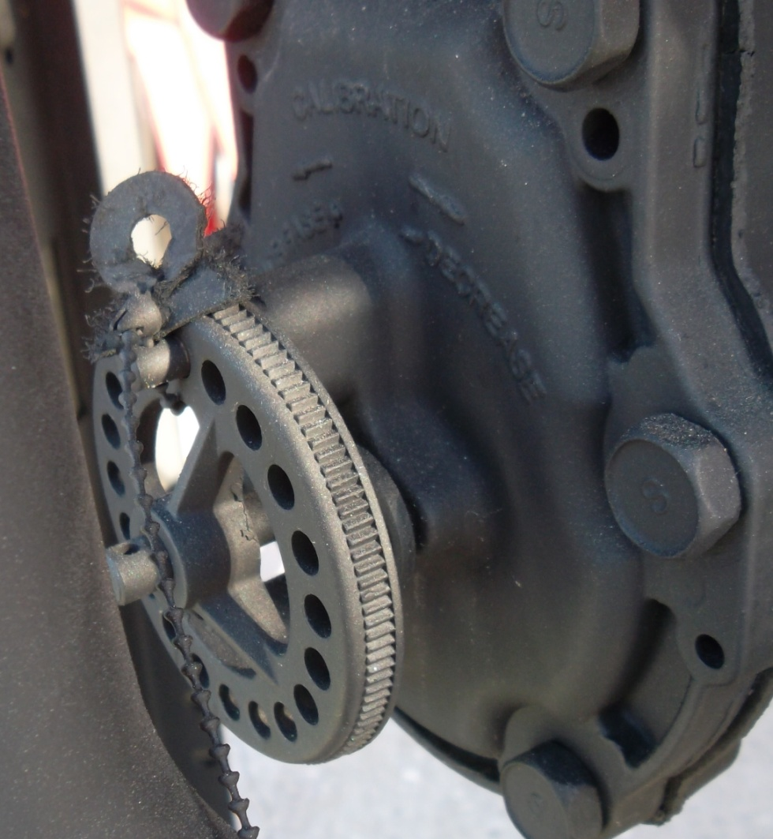
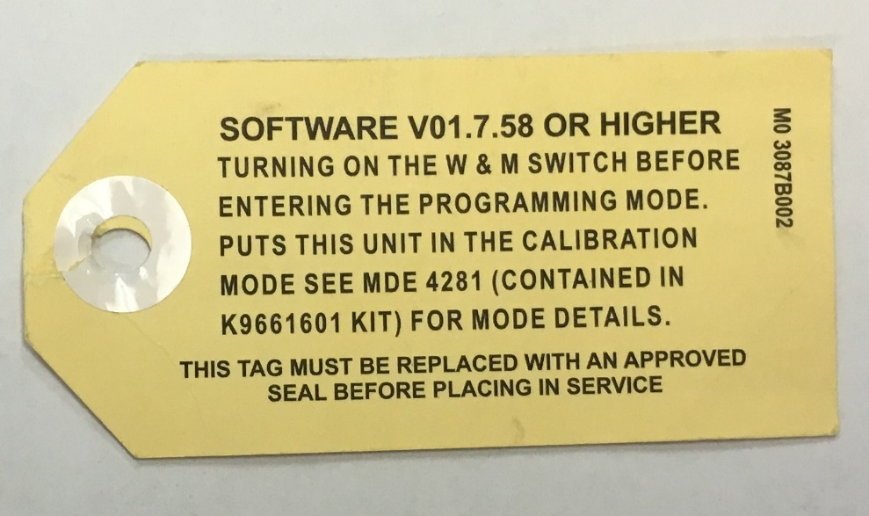
NO meter is to be left unsealed for ANY reason.
SEALING RESPONSIBILITES
Handbook 44, General Code, User Requirements -UR.4.5. Security Seal. – A security seal shall be appropriately affixed to any adjustment mechanism designed to be sealed.
Notes:
“A security seal shall be appropriately affixed to any adjustment mechanism designed to be sealed. NO meter should be left unsealed for ANY reason.”

Slide 25

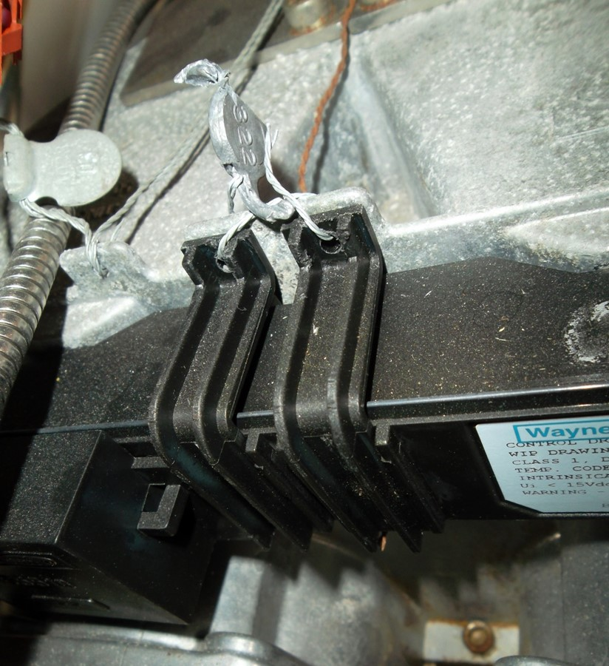
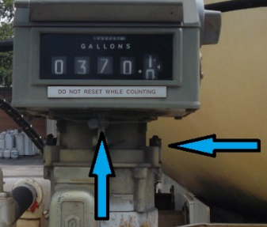
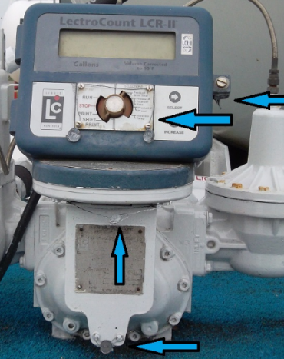
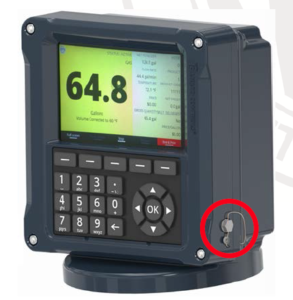
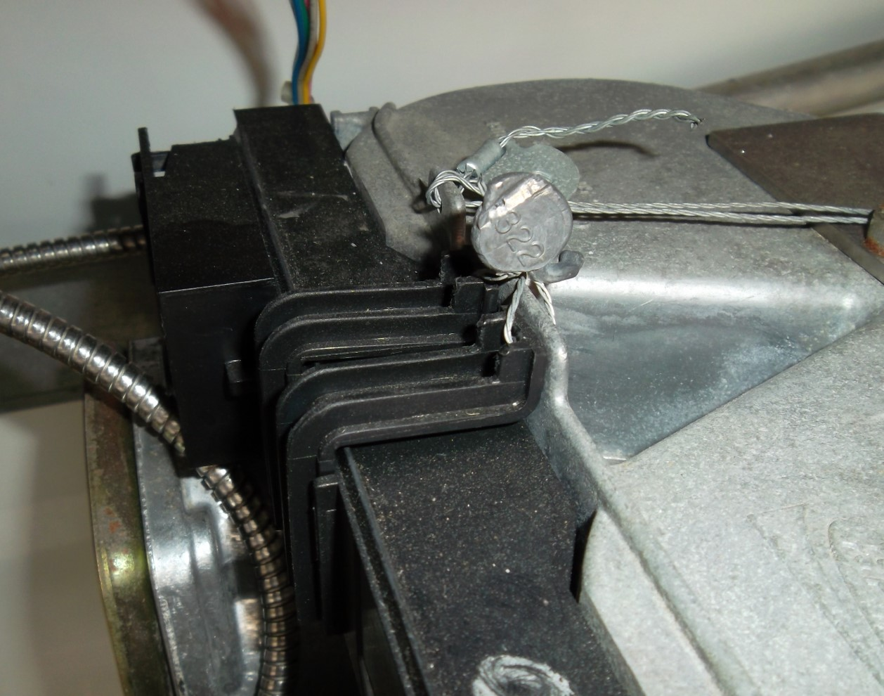
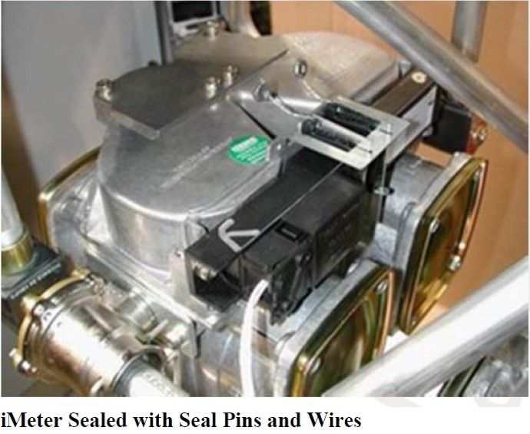
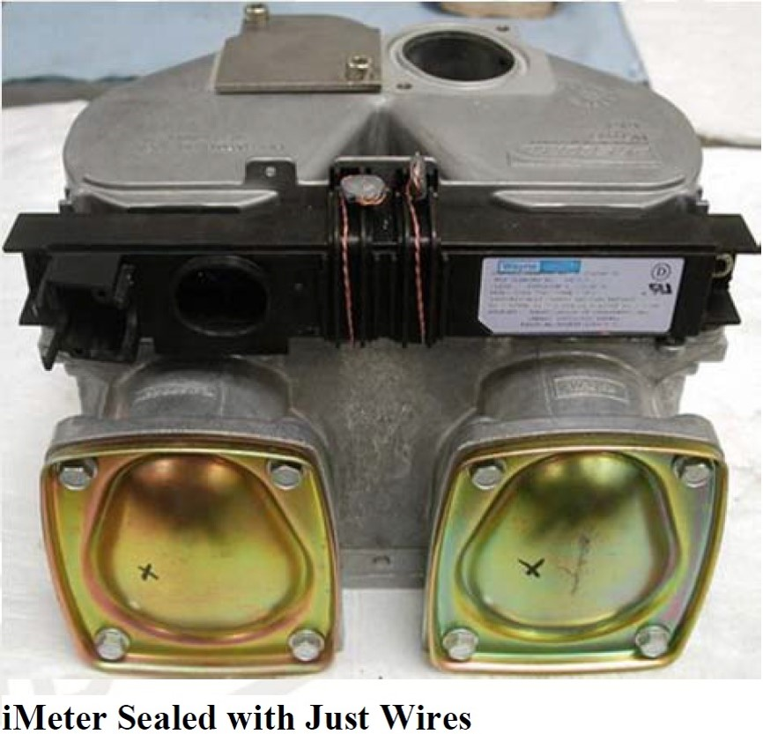

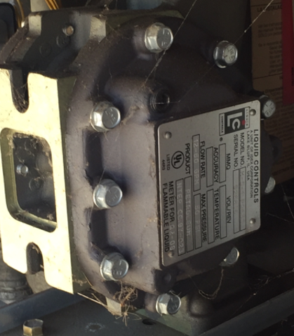
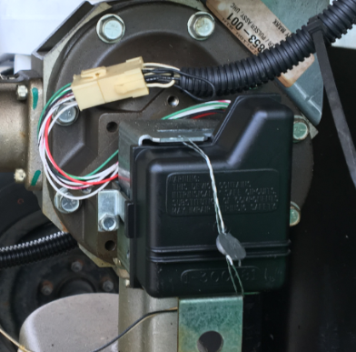
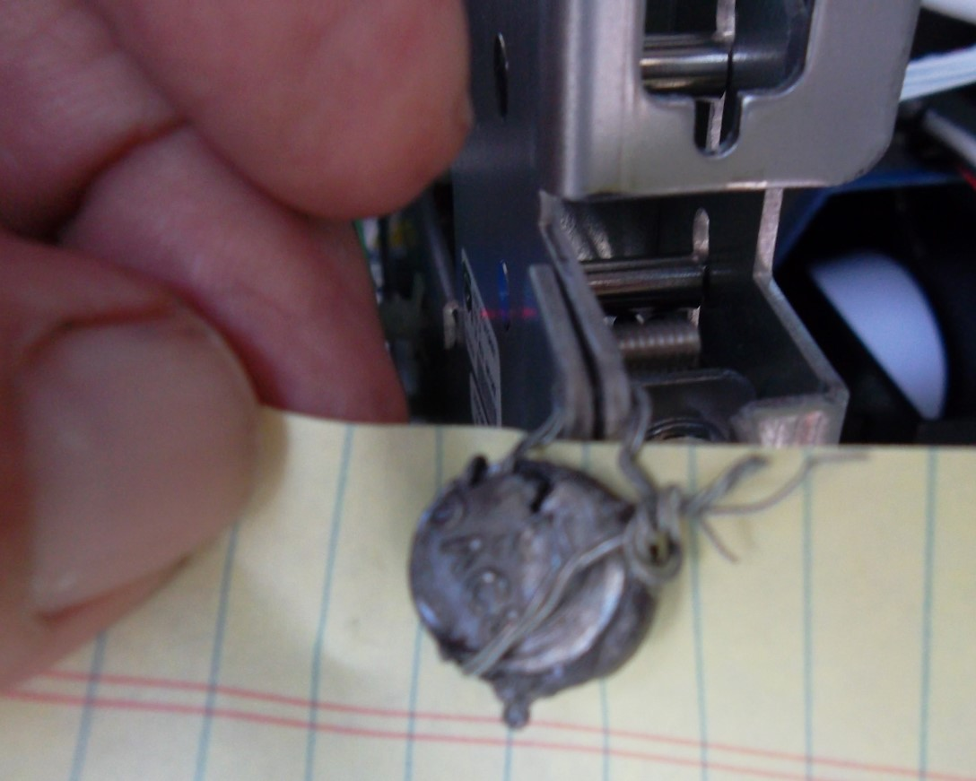
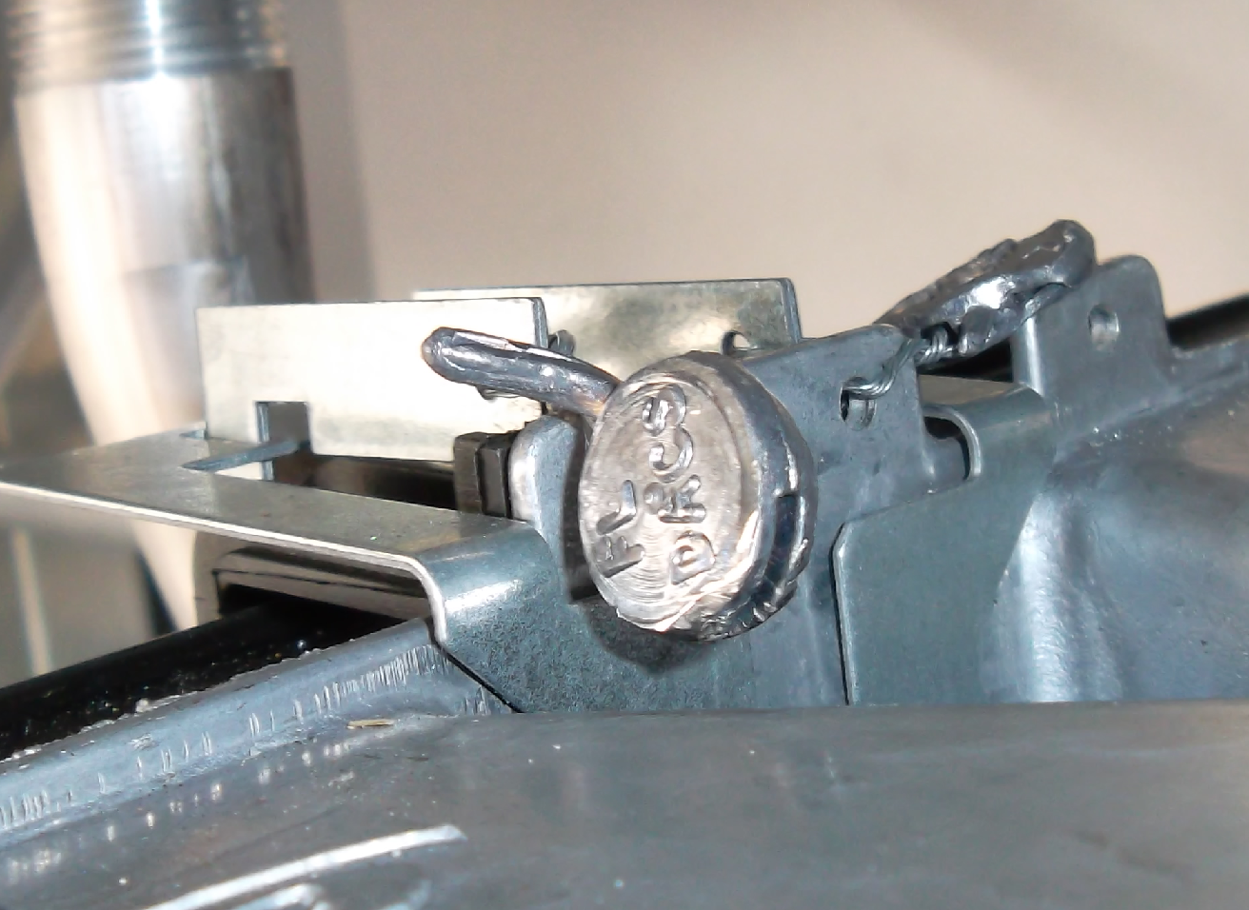
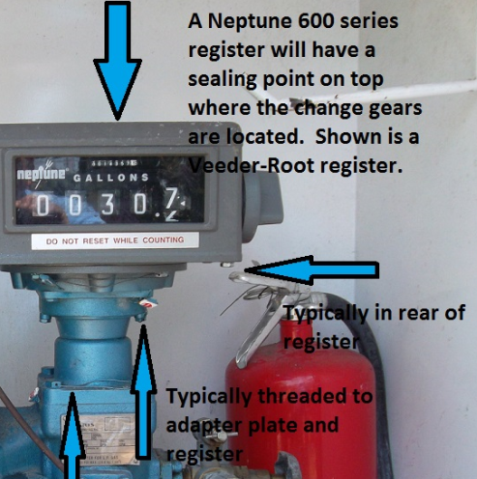
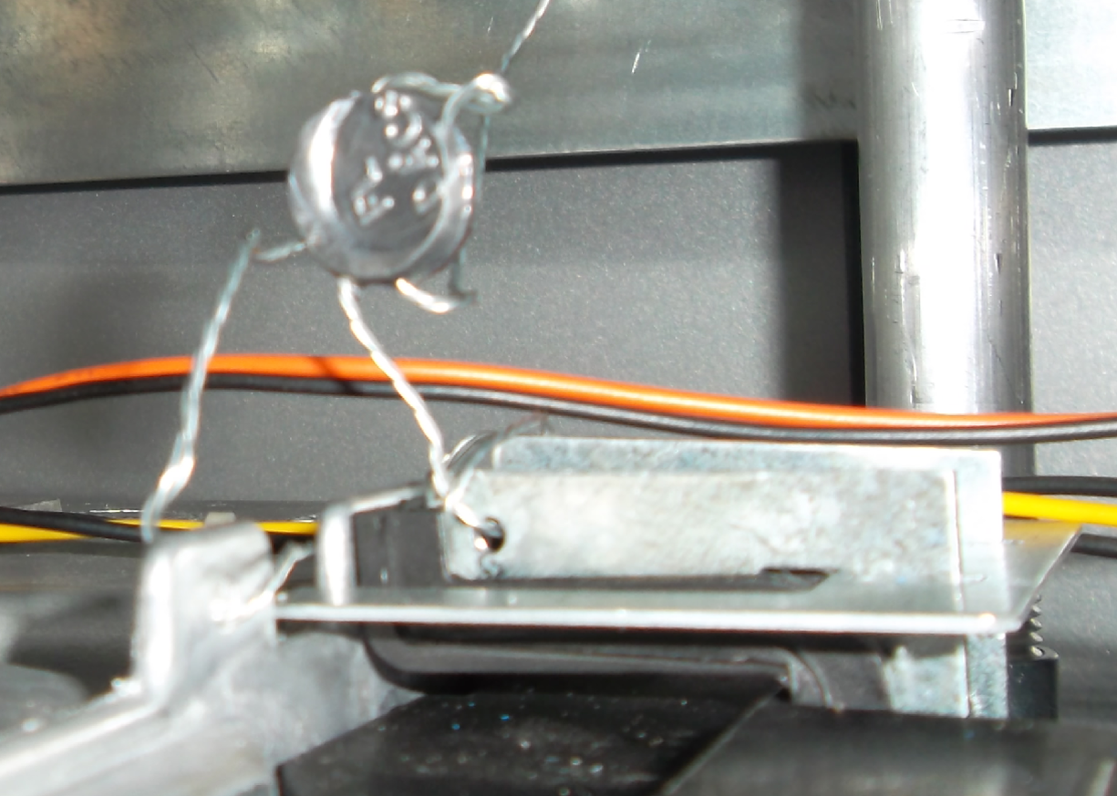
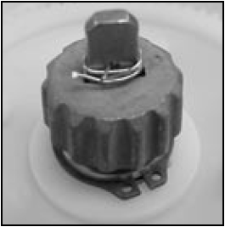
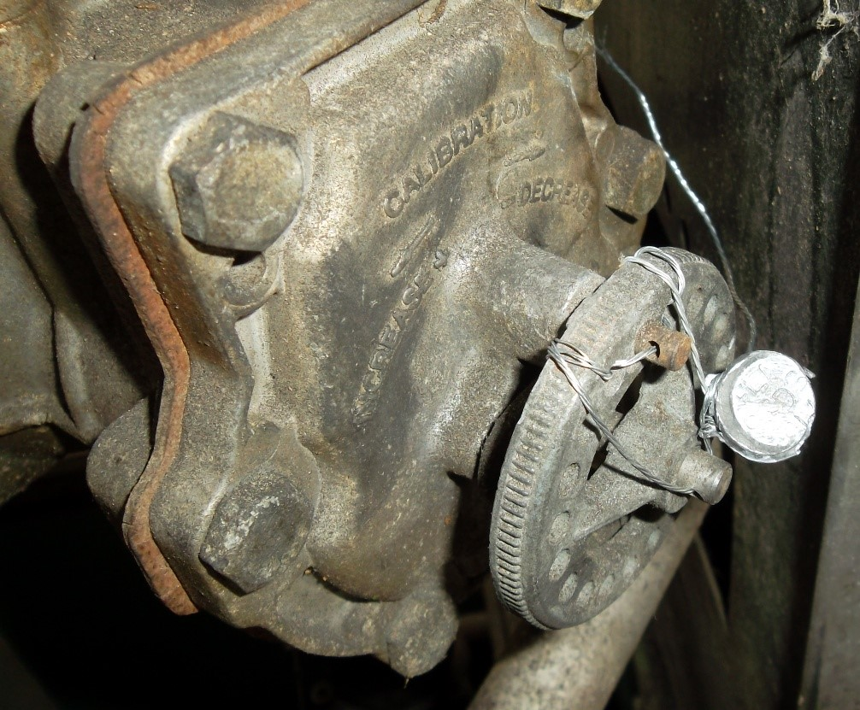
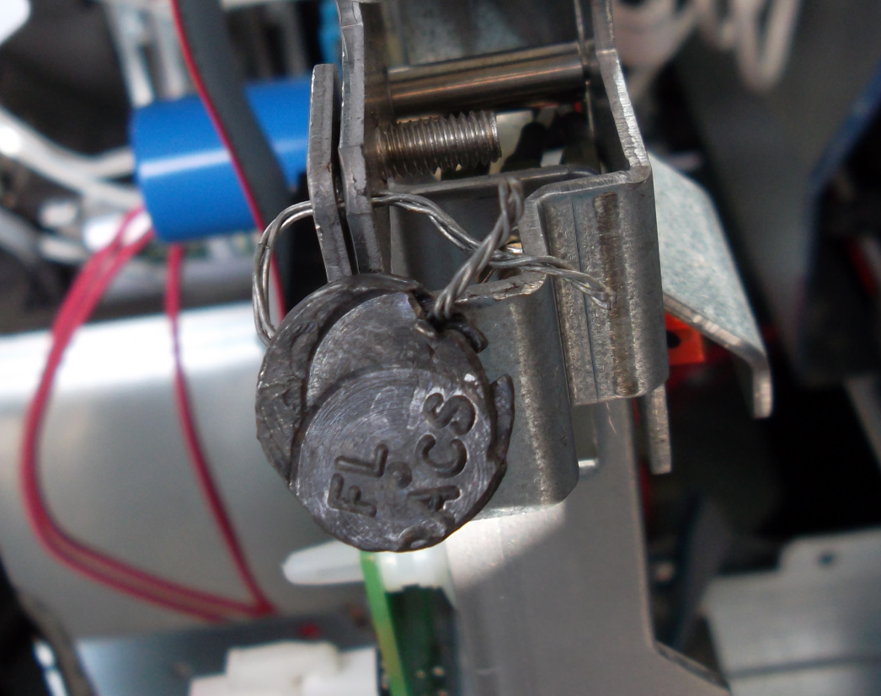
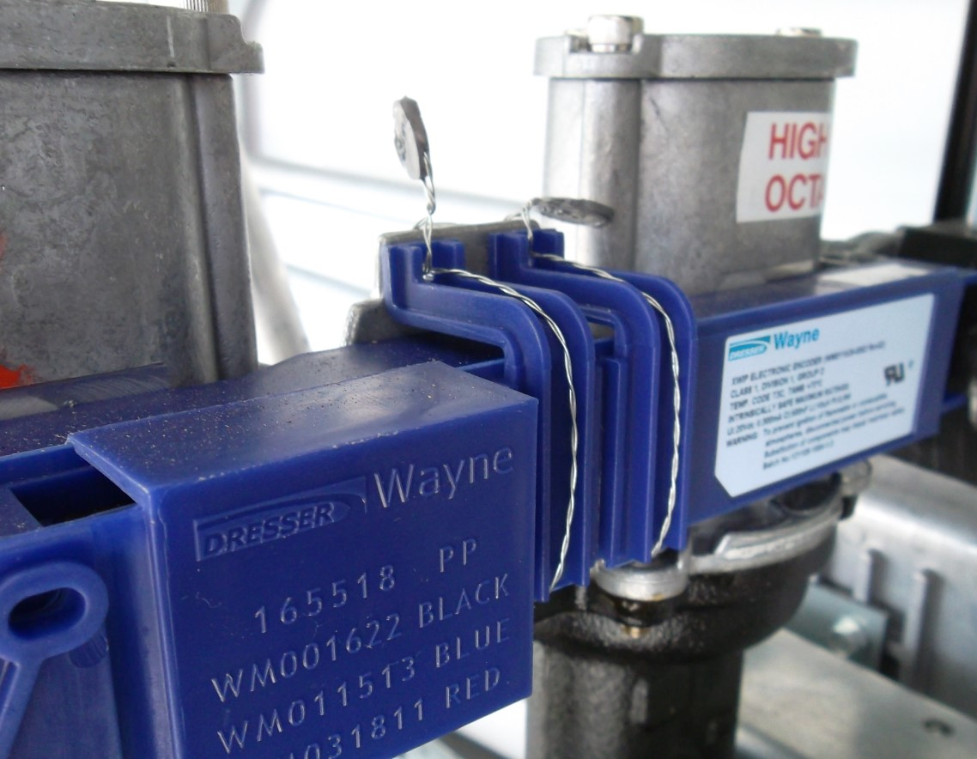
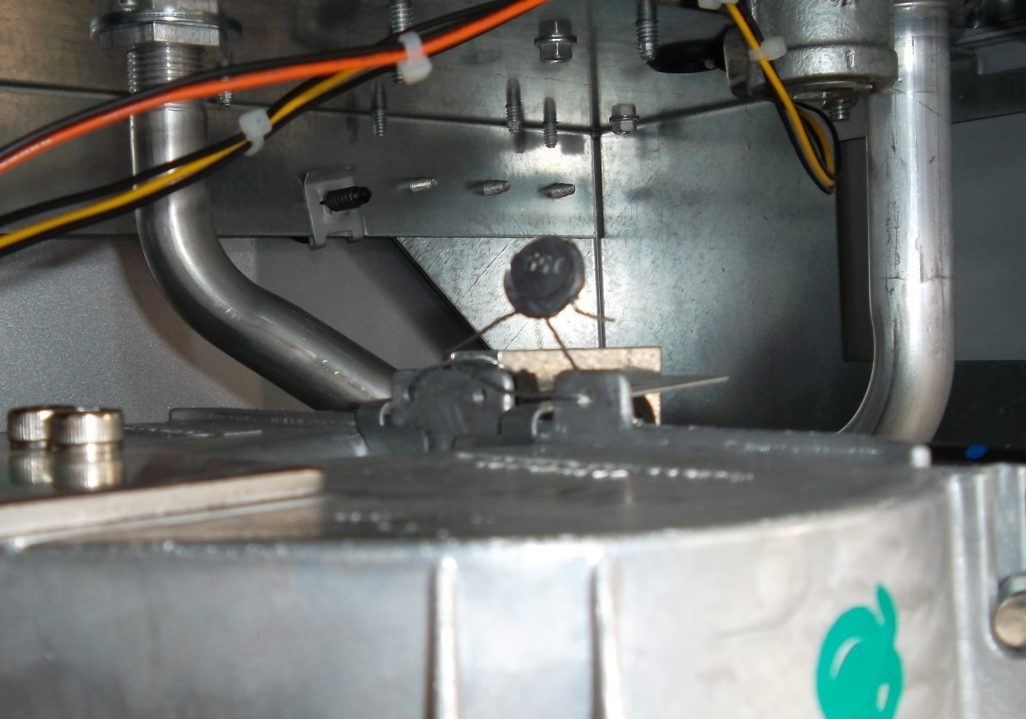
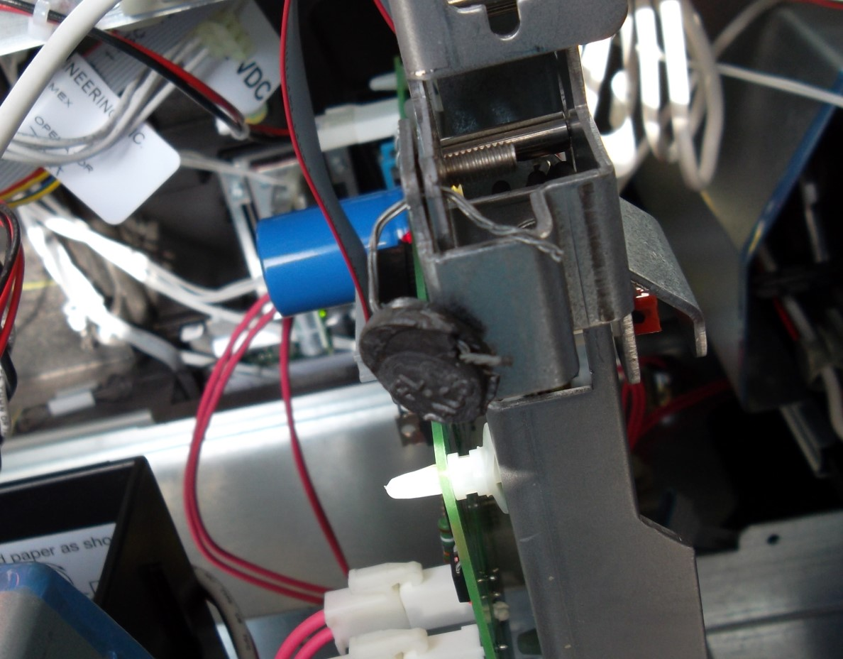
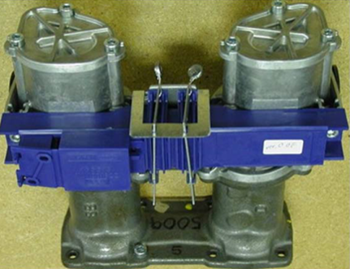
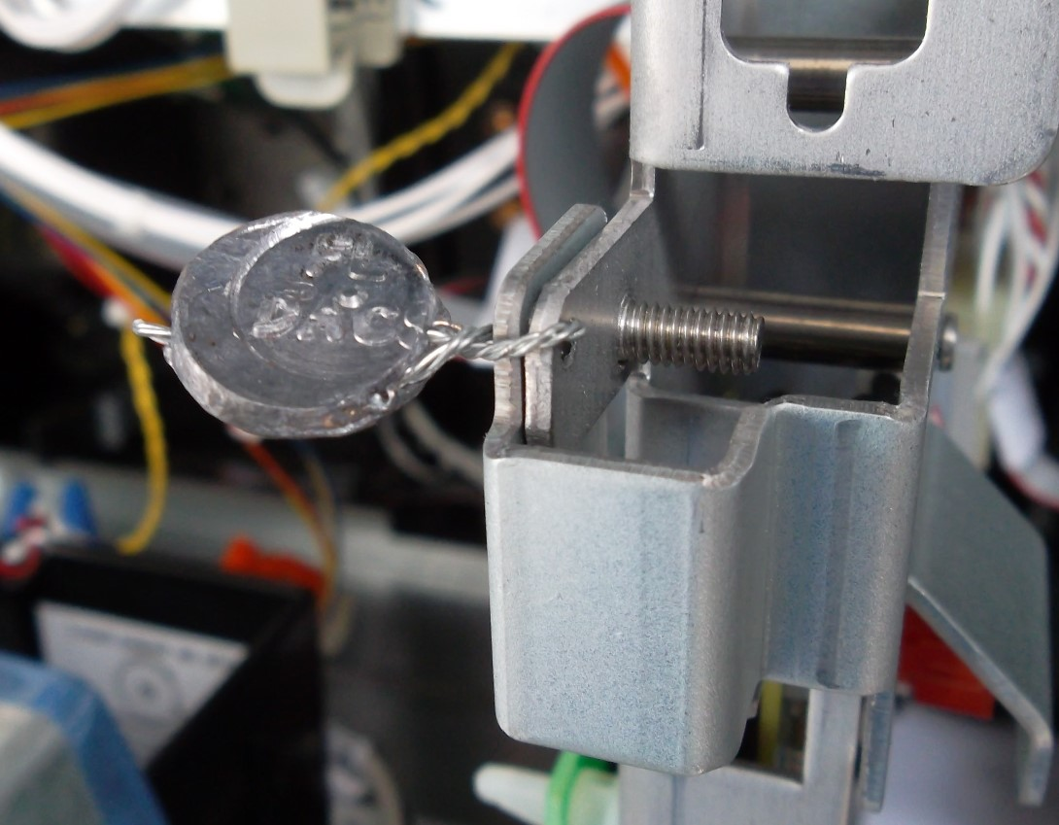

Proper Sealing Quiz
LET’S PLAY
IS THE METER
PROPERLY SEALED?
PROPERLY OR IMPROPERLY SEALED?
Notes:
Lets play a game called, is the meter properly sealed?
“Seals are installed to prevent any adjustments to the meter.”
“This is a properly sealed, Wayne meter.”
“Make sure the wire is not broken and that the meter is sealed.”
“This device is properly sealed with brackets.”
“This device is not properly sealed.”
“Here’s another look.”
“Another view of the not properly sealed device.”
“This next meter is properly sealed.”
“This device is also properly sealed.”
“This device is properly sealed.”
“Another properly sealed Wayne meter.”
“Another Wayne meter properly sealed with the brackets.”
“This meter is not properly sealed.”
“The old Gilbarco meter is properly sealed.”
“Do not reuse the seals, no meter is to be left unsealed.”
“Here is another example of resealing.”
This device is properly sealed.

Slide 26

RESPONSIBILITES:
CALIBRATION
RESPONSIBILITES:
CALIBRATION
Notes:
“Meter Mechanics’ calibration responsibilities are outlined in Florida Rule 5J-21.005 FAC – Inaccurate Measuring Devices.”

Slide 27
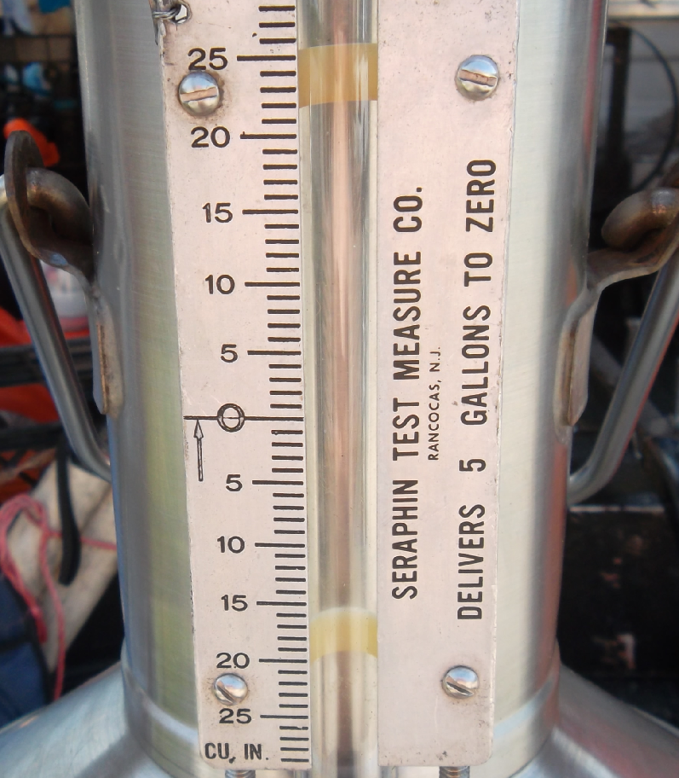
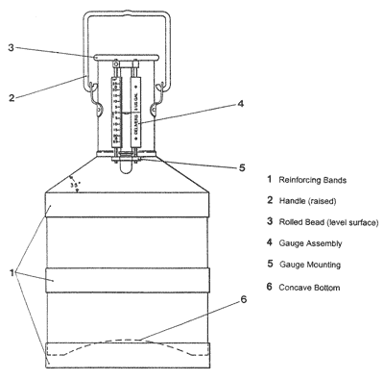
Calibrate meters as close to zero error as possible.
Rule 5J-21.005 F.A.C.
CALIBRATION RESPONSIBILITIES
zero
Notes:
“Meter mechanics should be calibrating meters as close to zero as possible.”
“General User Requirement 4.1 – Maintenance of Equipment says that All devices shall be continuously maintained in proper operating condition throughout the period of such service. Our inspectors are issuing G-UR 4.1 violations to facilities predominantly dispensing on the minus side.”

Slide 28
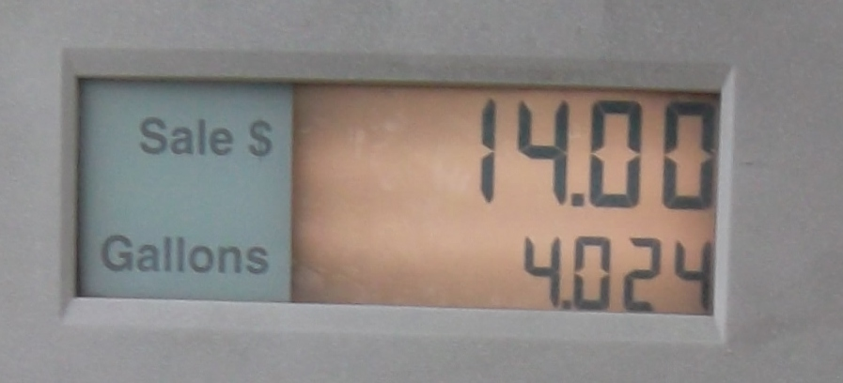
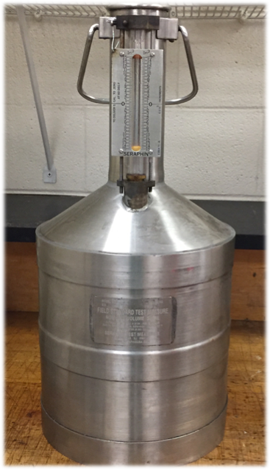
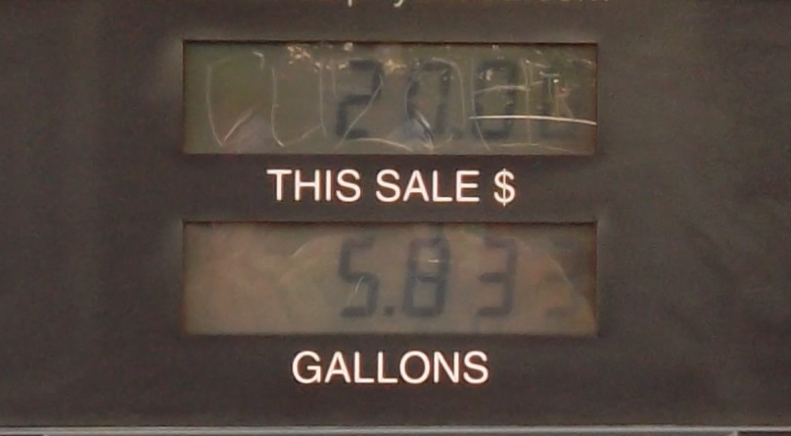
Over- registering = Short Measure and
Short Measure = OUT OF SERVICE
Error = 0 Fuel = 5 gallons
Under- registering
Error = 0 Fuel = 5 gallons
Over- registering
Notes:
“Under-registration means the device is charging the customer for less product, Over-registration means the device is charging the customer for more product.”
“The term, ‘short measure’ shall mean the over-registration of fuel by petroleum measuring devices.”
“Over-registration = short measure = OUT OF SERVICE.”
“Maintenance Tolerance on a 5-gallon test measure is ±6 cubic inches”
“Acceptance Tolerance on a 5-gallon test measure is ±3 cubic inches within 30 days of installation or returned to service.”

Slide 29
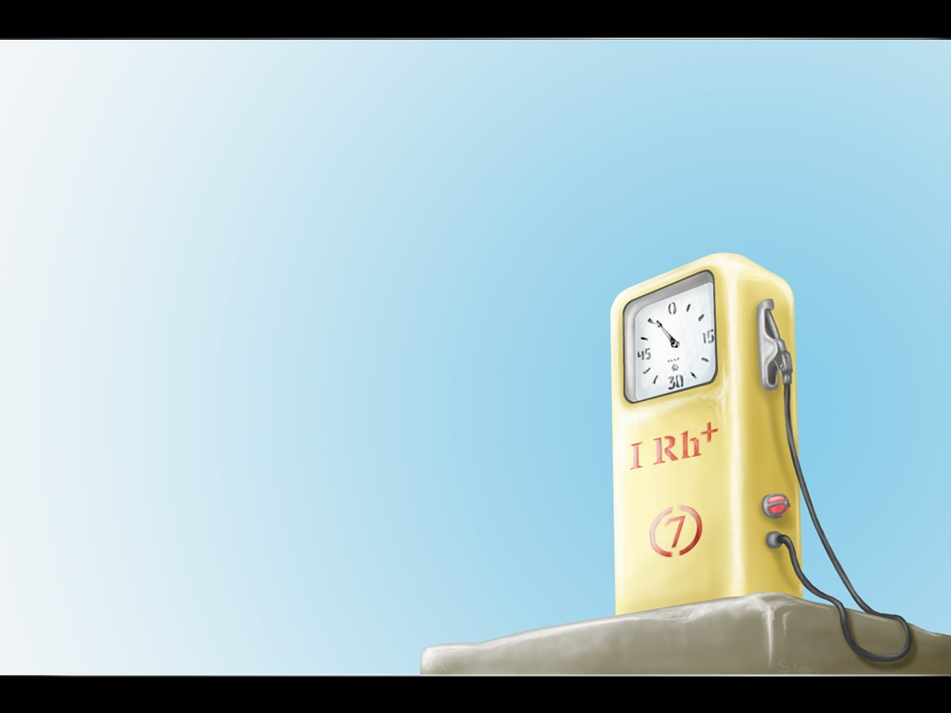
CALIBRATION RESPONSIBILITIES
CALIBRATION RESPONSIBILITIES
Devices under- registering
beyond tolerance must
be recalibrated.
Devices over- registering
beyond tolerance are
placed out of service
until corrected.
Notes:
“If any petroleum fuel measuring device is found to be under-registering fuel in excess of the specifications and tolerances established by the department, the inspector shall give in writing the operator or owner of the device up to five days to fix or adjust the device.”
“If any petroleum fuel measuring device is found to be over-registering fuel in excess of the specifications and tolerances established by the department, the device shall be placed out-of-service by the Department with FDACS-10992.
“Such measuring devices placed out-of-service for inaccuracy shall be rendered inoperative either by removal or by the locking of working parts with led and wire seal. Remember to notify the State when you place the device back in service.”

Slide 30

RESPONSIBILITIES: METERING DEVICES
Notes:
Meter mechanics obtain the responsibility to ensure the accuracy of meters

Slide 31
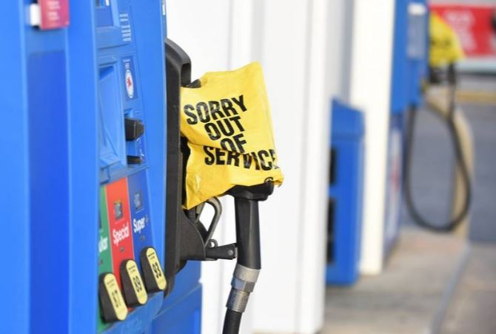
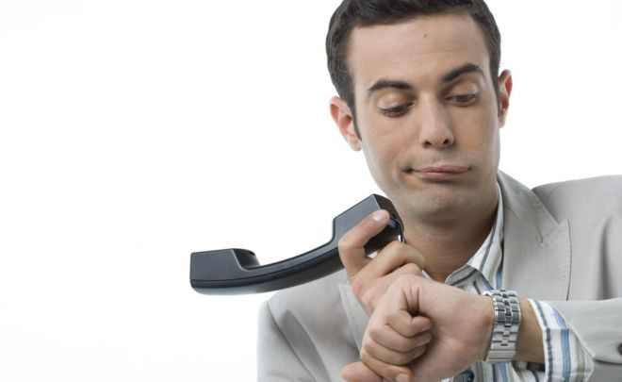

NOT SURE OF THE PROBLEM?
A meter that cannot be repaired must be placed out of service
WAITING ON PARTS?
Notes:
“Supply chain issues? Parts on back order? Meters that cannot be repaired must be placed out of service.”

Slide 32
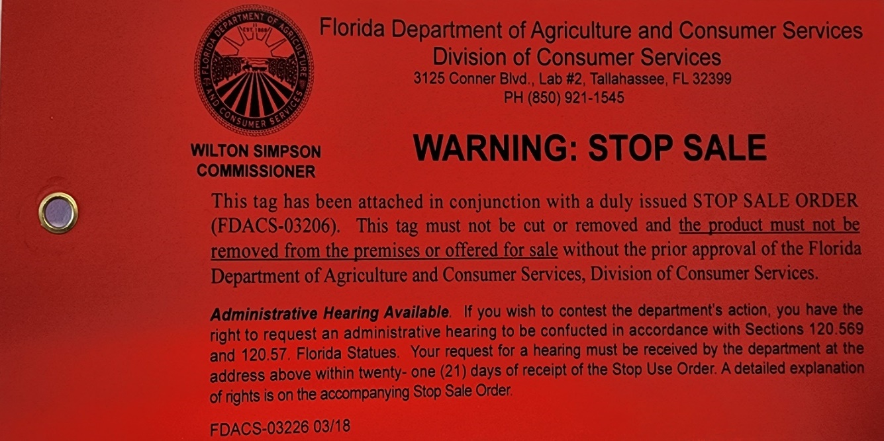
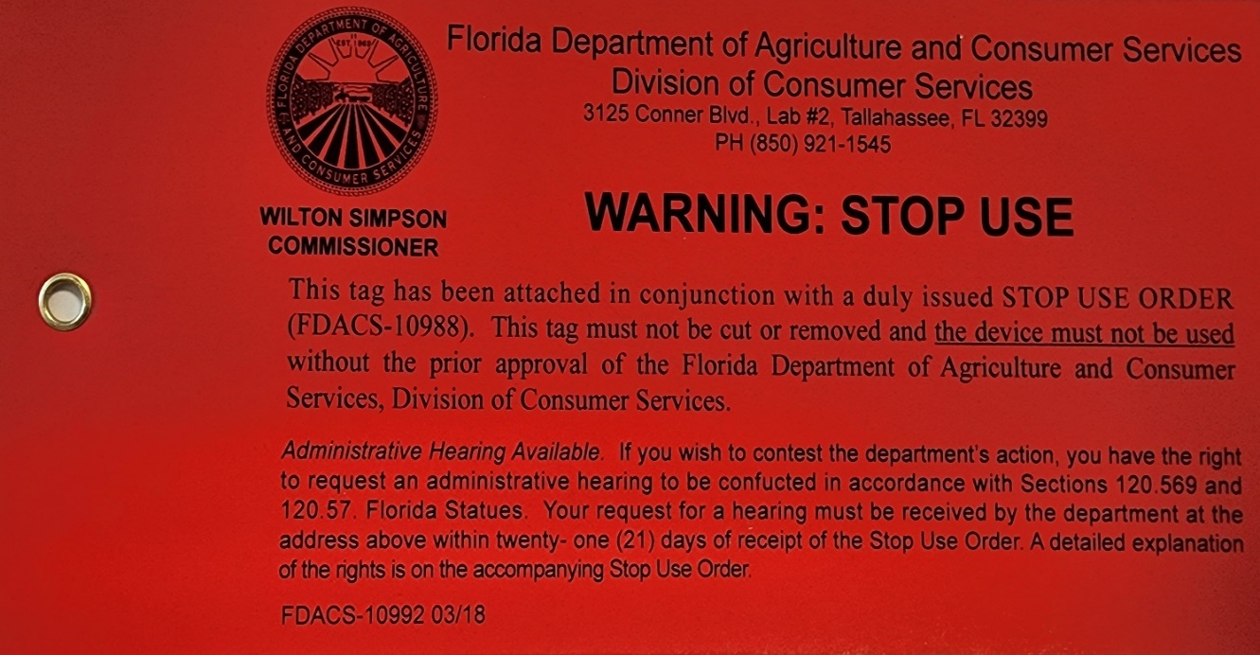
RESPONSIBLITIES: OUT OF SERVICE TAGS
Notes:
“The old Out of Service tags have been phased out. LP Gas meter mechanics are authorized to place an LP Gas meter back in service without an inspector re-inspection. Meter Mechanics are authorized to place devices back in service IF the device is compliant with the Promissory Release. Be sure to notify the Department if you return a device to service.”

Slide 33
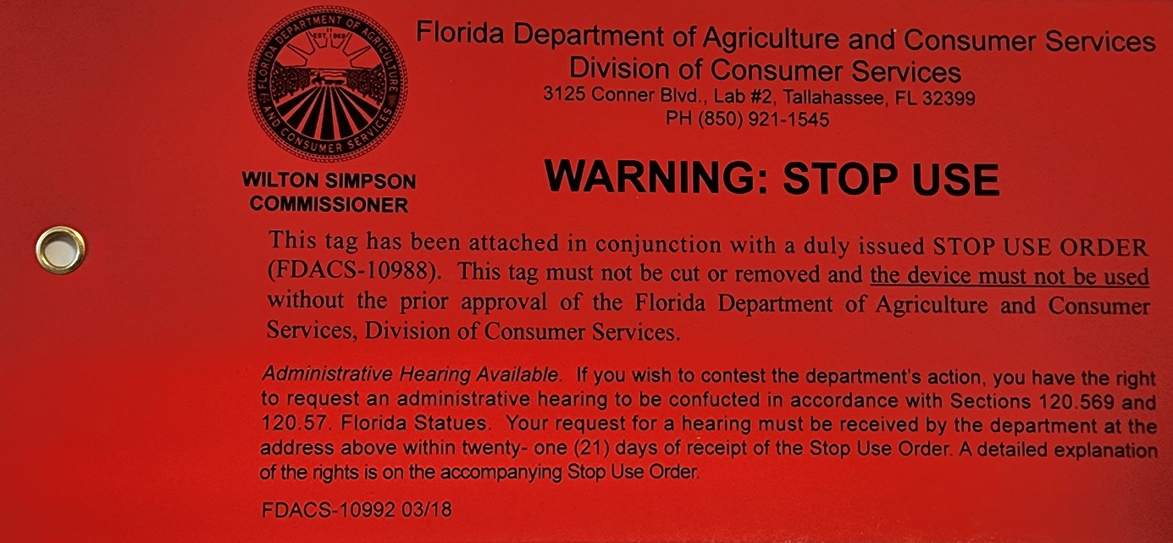
RESPONSIBILITIES: OUT OF SERVICE TAGS 2
RESPONSIBILITIES: OUT OF SERVICE TAGS
What if the device is over- registering?
This is the tag the Department uses to place devices out of service, including applicable device calibration violations.
Notes:
FDACS-10992 Stop Use tags are applied to any device that is over-registering. This tag places the device out of service until brought into compliance.”

Slide 34

RESPONSIBILITIES: OUT OF SERVICE TAGS 3
RESPONSIBILITIES: OUT OF SERVICE TAGS
May be removed when:
ALL conditions of accompanying Promissory Release have been satisfied .
Notes:
“Out of service tags may be removed, and the device may be returned to service, after all conditions of the accompanying promissory release have been met. Again, notify the department when you have placed a device back in service.”

Slide 35
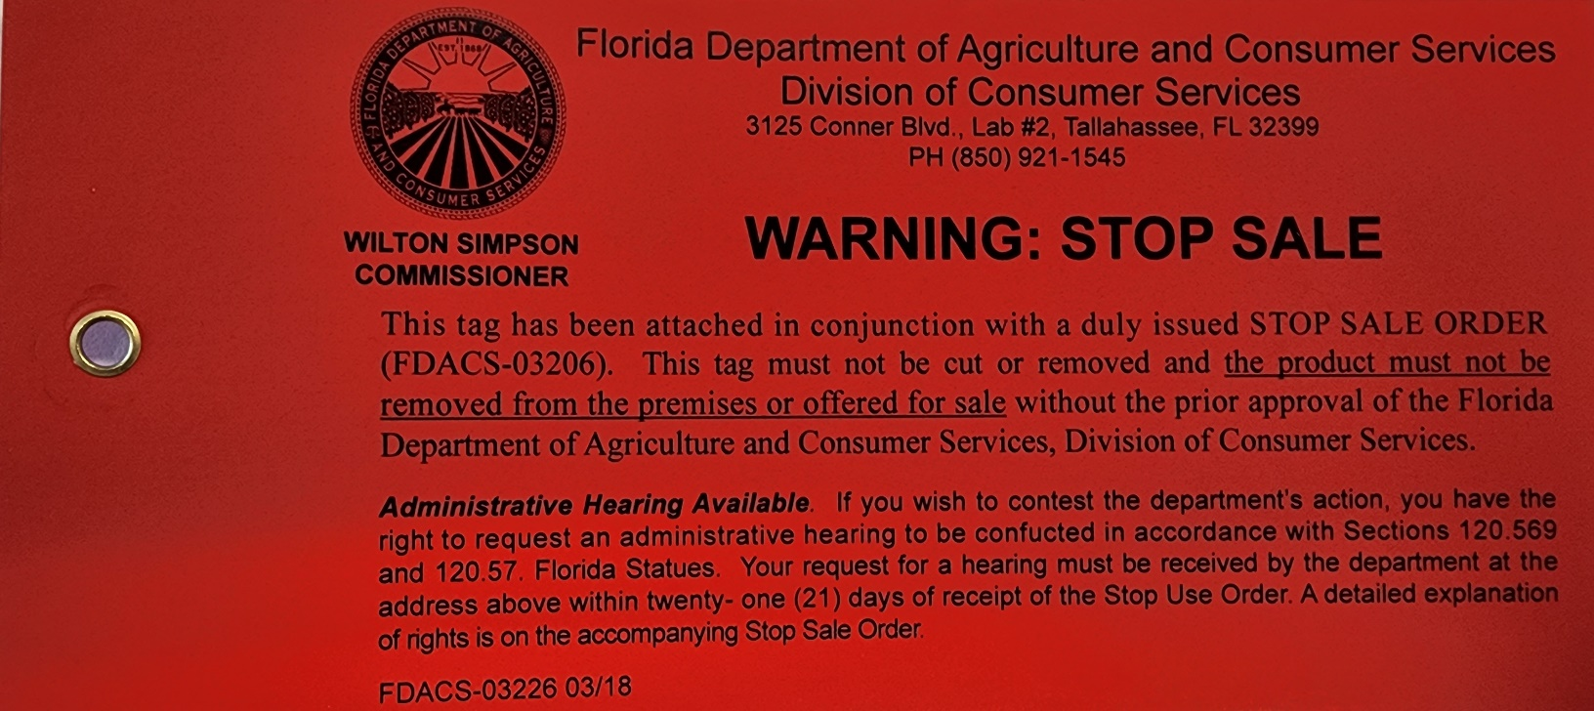
RESPONSIBILITIES: OUT OF SERVICE TAGS 4
RESPONSIBILITIES: OUT OF SERVICE TAGS
What if there is a sub-standard product?
This is the tag the Department uses to prevent substandard product from sale to the public.
Notes:
“If a measuring device is delivering substandard products, FDACS-03226 is issued with an accompanying Stop Sale order, preventing substandard fuel products from sale to the public.”

Slide 36
RESPONSIBILITIES: OUT OF SERVICE TAGS 5
RESPONSIBILITIES: OUT OF SERVICE TAGS
May be removed:
IF a Promissory Release was issued AND
ALL conditions of that Release are satisfied.
Can not be removed for violations of water, or suspended matter.
Notes:
Stop Sale tags may only be removed IF a promissory release was issued AND all conditions of that release are satisfied. Stop Sale tags cannot be removed for violations of water or suspended matter. If you have any questions regarding Stop Sale Orders, call the Department at 850-921-1545.”

Slide 37


RESPONSIBILITIES:
RETURN TO SERVICE & CORRECTION NOTICES
Notes:
“Once violations have been corrected, mechanics need to notify the Department by completing and returning the signed Correction Notice form. It is the mechanics’ responsibility to send this form to the Department.”

Slide 38



RESPONSIBILITIES: CORRECTION NOTICES
V
Notes:
“Meter mechanics are required to complete repair work for ‘Devices Out of Tolerance,’ and shall include the date corrections were made, their technician license number, and initial certifying they are an authorized technician. Device violations may be addressed by facility staff. Correction Notices may be copied; the mechanic can complete the entries for the work they have completed and submit that copy, leaving the rest for the facility to complete. Again, make sure you are sending in the Correction Notices after you have completed them.”

Slide 39

RESPONSIBILITIES: CORRECTION NOTICES 2
RESPONSIBILITIES: CORRECTION NOTICES
Notes:
When reading a Correction Notice, the Location references the pump number on which a violation was observed, Prod refers to the grade of fuel(s) being dispensed, and Violation indicates why the device is not in compliance. The Comments section is reserved to clarify violations when necessary. Depending on the severity of the violation, the Bus. Days to Correct or Correction Time will reflect how many business days the facility has to correct the violation. If repair times are going to take longer than the allotted days to correct, notify the Department.”

Slide 40


RESPONSIBILITIES: CORRECTION NOTICES 3
RESPONSIBILITIES: CORRECTION NOTICES
All violations must be corrected within the amount of time specified on the Correction Notice.
Strict adherence to time limits is essential.
Time limits do not include weekends
Notes:
“It is imperative that all Correction Notices are addressed within the number of days provided to make the correction. Adherence to these time limits is essential, do not wait to return Correction Notices. Weekends and state observed holidays are not included in time limits.”

Slide 41

RESPONSIBILITIES: CORRECTION NOTICES 4
RESPONSIBILITIES: CORRECTION NOTICES
Notes:
“Once Correction Notices have been completed by the technician, they need to be submitted to the Bureau of Standards. An email address is provided on the top of each Correction Notice issued by the Department. Once the form is filled out, scan and email the form to one of the corresponding points of contact. These correction notices will be forwarded to the inspector to schedule a re-inspection.”

Slide 42

RESPONSIBILITIES: CORRECTION NOTICES 5
RESPONSIBILITIES: CORRECTION NOTICES
2005 Apalachee Parkway Tallahassee, Florida 32399-6500
Notes:
“Stop Sale Orders are issued to the facility for product violations.”

Slide 43

RESPONSIBILITIES: CORRECTION NOTICES 6
RESPONSIBILITIES: CORRECTION NOTICES
2005 Apalachee Parkway Tallahassee, Florida 32399-6500
Notes:
“Depending on the severity of the Stop Sale Order, a facility may also be issued a Promissory Release. Promissory Releases are not processed by Meter Mechanics; they are just a notice to the facility. In order for a Promissory Release to become official, the facility must satisfy ALL conditions listed on the release. Any questions, call 850-921-1545.”

Slide 44

RESPONSIBILITIES: CORRECTION NOTICES 7
RESPONSIBILITIES: CORRECTION NOTICES
The job is NOT complete until the Correction Notice has been correctly filled in with the Date Corrected, Technician’s Registration #, and Authorized Tech Signature and sent to the State:
Mail
Florida Department of Agriculture & Consumer Services
The Rhodes Building
2005 Apalachee Parkway
Office 200
Tallahassee, FL 32399-6500
FAX
850-921-1548
EMAIL
csfaxme@FDACS.GOV
Notes:
“Facility repairs are not complete until the Correction Notice is correctly filled in with the date corrected, authorized technician’s registration number, authorized technician’s signature, and sent back to the state. Email the documents to CSFAXME@FDACS.gov.”

Slide 45

RESPONSIBILITIES: PREDOMINANCE
Notes:
“Technicians must uphold their responsibility of predominance

Slide 46

RESPONSIBILITIES: PREDOMINANCE 2
RESPONSIBILITIES: PREDOMINANCE
G-UR.4.1. Maintenance of Equipment.
– All equipment in service . . . shall be continuously maintained in proper operating condition throughout the period of such service.
Notes:
Predominance is associated with a facilities overall delivery of product to the consumer; it determines whether the facility predominantly over-charges or under-charges for their products. Meter Mechanics should keep predominance as neutral as possible. G-UR.4.1. Maintenance of Equipment says that, ‘All equipment shall be continuously maintained in proper operating condition throughout the period of such service.’ Meters must be set as close to zero as possible.”

Slide 47

CALIBRATION PREDOMINANCE
Meters predominately set on the minus side WILL NOT BE ACCEPTED!
HB44 – G-UR.4.1. – . . . Equipment in service at a single place of business found to be in error predominantly in a direction favorable to the device user. . .shall not be considered “maintained in a proper operating condition.”
Notes:
All meters on the minus side must be set

Slide 48

OCTANE PREDOMINANCE
Blend ratios on blending devices MUST be set to meet the octane rating listed on the device!
Blend ratios set in favor of the business will NOT be accepted!
Blend Ratio Calculation:
(Grade1 X Percentage) + (Grade2 X Percentage)= AKI
(87 x 0.65) + (93 x 0.35) =
56.55 + 32.55 = 89.1
Notes:
“Predominance of blend ratios set in favor of the business will NOT be accepted, however, there is no violation for blend ratios. Instead, the Department will take samples and, if a Predominance of those samples are in favor of the vendor, the lab will notify the inspector to issue a Stop Sale for octane predominance.”

Slide 49



RESPONSIBILITIES: PREDOMINANCE
Any mechanic found manipulating devices in this manner will be considered in Violation of Chapter 525, F.S and may be subject to:
suspension of licensure
and/or
fines of up to $5000 per occurrence!
Notes:
“Any meter mechanic found guilty of manipulating devices in a manner that predominantly favors a business will be considered in violation Chapter 525 Florida Statues and may be subject to suspension of licensure and/or fines of up to $5000 per occurrence.”

Slide 50



“PLACED IN SERVICE” REPORTS
Notes:
“Any registered person or agency that has installed a petroleum fuel measuring device must report the existence of the petroleum device to the department at (850) 921-1545 or by email, within twenty-four (24) hours of the installation using FDACS Form-03017, Placed in Service Report.’

Slide 51

“PLACED IN SERVICE” REPORTS 2
“PLACED IN SERVICE” REPORTS
If a petroleum fueling measuring device is installed, it must be reported
within twenty-four (24) hours.
Do not report more than ten days (10) prior to installation
Notes:
These reports are distributed to the inspector, so an inspection can be scheduled at the facility. This goes for all petroleum fuel measuring devices, including LP Gas meters. We have not been receiving Placed in Service reports as required.”

Slide 52

“PLACED IN SERVICE” REPORTS 3
“PLACED IN SERVICE” REPORTS
FL Rule 5J-21.007 (3):
. . . report the existence of the
petroleum device to the department at:
Office: (850) 921-1545
Fax: (850) 921-1548
Email: flwm@FDACS.GOV
“Placed in Service” form can be found:
http://forms.FDACS.GOV/03017.pdf
Notes:
If any petroleum fuel measuring device is replaced or newly installed, a ‘Place in Service’ report must be received by the Department within 24 hours. Do NOT submit Placed in Service report more than 10 days prior to the installation.”

Slide 53


Interior Fuel Pulsar
Notes:
The department has been fielding complaints of pulsers being tampered with, if any signs of tampering are present, further investigation may be necessary.

Slide 54




Skimmers 1
SKIMMERS:
CREDIT CARD INFORMATION &
SKIMMING DEVICES
525.07 (10) , F.S.
Notes:
Skimmers are small, electronic devices installed on gas pumps by thieves. They utilize SMS card technology and are able to transmit victims’ financial information to thieves wherever they’re hiding.”

Slide 55


SKIMMERS 2
SKIMMERS
IF YOU HAPPEN TO LOCATE A SKIMMER . . .
Please notify the local Inspector or law enforcement immediately to report the skimmer.
Also, please report finding the skimmer to the
Florida Department of Agriculture and
Consumer Services by contacting:
Field Office
Phone:
850-921-1545
Email:
Standards-Field@FDACS.GOV
Notes:
“If you locate a skimmer while working on a pump, contact your local inspector and law enforcement. State Inspectors are happy to meet you at the location, recover, and document the skimmer, but understand that inspector territories can be large, and it may take some time to travel to the facility. If you address the skimmer yourself, please report the device to the Florida Department of Agriculture and Consumer Services by calling 850-921-1545. This is a crime scene and needs to be reported.”

Slide 56

SKIMMERS 3
SKIMMERS
In-Line still the most common
Notes:
Standard in-line skimmer. This is older technology, not typically seen anymore. This type of skimmer requires thieves to return to the device to collect financial data.”

Slide 57

SKIMMERS 4
SKIMMERS
Technologies advancing
Notes:
“GSM or SMS skimmers are more frequently seen in the field. The main component that allows these skimmers to work can be purchased on Amazon for less than $40, some studies show one skimmer can cause up to $1 million in financial damages.”

Slide 58

SKIMMERS 5
SKIMMERS
Tracking numbers?
Notes:
“We’re finding skimmers that have been numbered; where are the other 49 devices?”

Slide 59

SKIMMERS 6
SKIMMERS
Can you spot the
skimming device?
Notes:
“Sometimes inspectors will find 2 skimming devices on the same pump. It uncertain if one device interrupts another.”

Slide 60

SKIMMERS 7
SKIMMERS
This is the skimming device after it was removed from the pump.
Notes:
Take your time when looking for skimmers, criminals are finding new, more clever ways to disguise skimmers as integral dispenser parts in effort to keep them in the pumps longer.”

Slide 61

SKIMMERS 8
SKIMMERS
This is not a skimmer.
Notes:
“If you’re unsure about whether or not you’ve located a skimmer, check the other card readers at the facility. If all the card-readers look the same except for one, there may be a skimming device installed on that pump.”

Slide 62


Skimmers 9
SKIMMERS
Can you spot the
skimming devices?
Notes:
“You may observe a battery adjacent to a card reader, this most likely is not a skimmer. Rather a component that helps secure the card reader.”

Slide 63

SKIMMERS 10
SKIMMERS
Can you spot the
skimming device?
Notes:
Hidden

Slide 64

SKIMMERS 11
SKIMMERS
Bluetooth technology
Notes:
Bluetooth skimming devices do not need to be retrieved by criminals. If you observe a squiggly antenna on a component connected to the card reader, you are most likely looking at a Bluetooth skimmer.”

Slide 65

SKIMMERS 12
SKIMMERS
Hidden under circuit board.
Notes:
“Here is another hidden skimmer that has been tucked between the card reader and the circuit board. This hidden device was first detectible when the inspector noticed an unusual green wire.”

Slide 66

SKIMMERS 13
SKIMMERS
Hidden under circuit board.
Notes:
“This is another skimmer that has been hidden within the card reader components. This skimmer was actually jammed up into the rubber boot that covers the card reader. These skimmers must be found, they do not easily expose themselves.”

Slide 67



SKIMMERS 14
SKIMMERS
Look for non-professional solder contacts.
Notes:
“This Bluetooth skimmer was wired directly to the circuit board in effort to make the skimming device less recognizable. Look for unprofessional soldering and wiring on these ribbon cables.”

Slide 68



Skimmers 15
SKIMMERS
Silicone is a dead giveaway.
Notes:
Silicone is another indication that a skimmer has been installed on the device. In this image, you can see silicone was used as an adhesive to mount an additional circuit board to the card reader.”

Slide 69

Skimmers 16
SKIMMERS
Modified credit
card reader.
Notes:
“This skimmer was attached using silicone and duct-tape. Remember to compare the card readers of all devices at facility. If there is something unusual, it will be easier to notice.”

Slide 70

Skimmers 17
SKIMMERS
No skimmer here!
Can you spot the
skimming device?
Notes:
“When card readers are replaced, you may see a thick adhesive joining the card reader to the dispenser. This is common when replacing the card reader and is not an indication of skimmers being present.”

Slide 71

Card Reader is Skimming Device
ANTENNA
Notes:
Hidden

Slide 72


Bent Tabs on Lock Boxes after Skimmer Found
Notes:
“Here is another skimmer that was identified by the out of place green wire. The skimmer was hidden in the card reader lockbox. When the inspector tried accessing the lockbox, they noticed the metal tabs had been bent in effort to keep the box sealed.”

Slide 73


GILBARCO PUMP / SKIMMER FOUND ON PANEL
At first we found them on the front, now . . . . .
Notes:
Inspectors have become accustomed to looking at the front of circuit boards to locate skimmers. In this image, the skimming device cannot be seen but the inspector noticed the circuit board connections looked a little odd.”

Slide 74


GILBARCO PUMP / SKIMMER FOUND ON PANEL 2
GILBARCO PUMP / SKIMMER FOUND ON PANEL
BLUETOOTH
now . . . . . They are on the back!!
Notes:
“On the back side of the panel, the thieves have used silicone and a soldering iron to attach a Bluetooth skimming device. People installing the skimmers are either taking longer to install the device or have gotten much more familiar with equipment.”

Slide 75

GILBARCO PUMP / SKIMMER FOUND ON PANEL 3
GILBARCO PUMP / SKIMMER FOUND ON PANEL
now . . . . . They are on the back!!
Notes:
“Here’s another, less elaborate skimming device attached to the back of a Gilbarco circuit board. Notice the skimmer has been numbered to allow thieves to track devices.”

Slide 76

GILBARCO PUMP / SKIMMER FOUND ON PANEL 4
GILBARCO PUMP / SKIMMER FOUND ON PANEL
Notes:
“An easy way to see if skimmers have been installed on the back side of the circuit board is by looking behind the panel. There is about one inch of space between the circuit board and dispenser door; look through that gap to observe out-of-place wiring.”

Slide 77


SKIMMER ON PULL OUT PANEL
Notes:
“Another hiding spot criminals are starting to use is the pull-out panel located inside the pump separating the A side and B side.”

Slide 78

A multi-functional wireless device found attached to a contactless payment terminal at a gas station.
Notes:
A multi-functional wireless device found attached to a contactless payment terminal at a gas station. This installation includes GSM mobile phone components, allowing it to send stolen card data wirelessly via text message. In contrast, most modern pump skimmers transmit stolen card data to the thieves via Bluetooth. The white rectangular module on the right is the mobile phone component; the much smaller, square module below and to the left is thought to be built to handle Bluetooth communications.”

Slide 79


Shimmers are now being seen as an alternative to skimmers seen on the inside of pumps.
Notes:
Shimmers are an alternative skimming device used to also steal customer card information. These are also accompanied with camera installation around the keypad.

Slide 80

Camera installation may be seen with shimmers too.
Notes:
Shimmers are an alternative skimming device used to also steal customer card information. These are also accompanied with camera installation around the keypad.

Slide 81



Skimmers 18
OVERLAYS

Slide 82


Security Seals
Security Seals
No longer are the Minimum Requirement
Notes:
Hidden

Slide 83
Minimum Security Measures
MINIMUM SECURITY MEASURES
Effective January 1, 2022, the owner or operator of a retail petroleum fuel measuring device shall have affixed to or installed onto the measuring device at least two of the security measures listed here.
1. The placement and maintenance of pressure-sensitive security tape over the panel opening that leads to the scanning device for the retail petroleum fuel measuring device in a manner that will restrict the unauthorized opening of the panel or the placement and maintenance of pressure-sensitive custom branded security tape unique to the station in more than one location over the panel opening.
2. A device or system that will render the retail petroleum fuel measuring device or the scanning device in the measuring device inoperable if there is an unauthorized opening of the panel.
3. A device or system that encrypts the customer payment card information in the scanning device.
4. A physical locking mechanism that requires an access key unique to each station to restrict the unauthorized access of customer payment card information.
Notes:
Effective January 1, 2022, the owner or operator of a retail petroleum fuel measuring device shall have affixed to or installed onto the measuring device at least two of the security measures listed here.
1. The placement and maintenance of pressure-sensitive security tape over the panel opening that leads to the scanning device for the retail petroleum fuel measuring device in a manner that will restrict the unauthorized opening of the panel or the placement and maintenance of pressure-sensitive custom branded security tape unique to the station in more than one location over the panel opening.
2. A device or system that will render the retail petroleum fuel measuring device or the scanning device in the measuring device inoperable if there is an unauthorized opening of the panel.
3. A device or system that encrypts the customer payment card information in the scanning device.
4. A physical locking mechanism that requires an access key unique to each station to restrict the unauthorized access of customer payment card information.

Slide 84
Minimum Security Measures 2
MINIMUM SECURITY MEASURES
Effective January 1, 2022, the owner or operator of a retail petroleum fuel measuring device shall have affixed to or installed onto the measuring device at least two of the security measures listed here.
5. A device or system that will sound an alarm to alert the owner or operator if there is an unauthorized opening of the retail petroleum measuring device panel.
6. A daily inspection of each measuring device that includes opening the panels, using an anti-skimmer application that detects wireless-based skimmers, and documenting such inspections.
7. A device or system that permits customers to use a contactless payment method, such as an electronic contact-free system, tap-and-go system, or mobile cryptographic system, for payment that does not use a magnetic strip scanning device.
8. Another security measure approved by the department.
Notes:
5. A device or system that will sound an alarm to alert the owner or operator if there is an unauthorized opening of the retail petroleum measuring device panel.
6. A daily inspection of each measuring device that includes opening the panels, using an anti-skimmer application that detects wireless-based skimmers, and documenting such inspections.
7. A device or system that permits customers to use a contactless payment method, such as an electronic contact-free system, tap-and-go system, or mobile cryptographic system, for payment that does not use a magnetic strip scanning device.
8. Another security measure approved by the department.

Slide 85


Alternative Security Measures
ALTERNATIVE SECURITY MEASURES
Notes:
“Alternate security measures allow the facility to apply additional locks or safe-ways to prevent access to gas pumps.”

Slide 86

Alternative Security Measures 2
F.S. 525.07(10) requires security against access to payment card information.
http://forms.doacs.state.fl.us/03577.pdf
Notes:
If a facility elects to use any security measure besides those listed in 525.07(10) F.S. they are required to submit a ‘Request for Approval of Alternative Security Measures’ FDACS Form-03577, to be compliant. A picture of the alternate security measure needs to accompany this form.

Slide 87



Alternative Security Measures 3
Electronic Prevention
(Wayne Ovation)
Notes:
“Wayne Ovation dispensers utilize electronic prevention which renders the device inoperable when an unauthorized access occurs.

Slide 88


Alternative Security Measures 4
(Verifone UX 300)
Encrypted Card Readers
Notes:
Encrypted card readers like the Verifone UX 300 renders financial information unreadable by unauthorized parties making it harder for criminals to extract any financial information.

Slide 89




Alternative Security Measures 5
Other Security Measures
Notes:
Other security measures like, barricades, cages, or tamper-proof boxes must be accompanied by an Approved request for Alternative Security Measures form and pictures of the alternative security measure.”

Slide 90

Alternative Security Measures 6
FDACS-03577
All parts must be filled out and legible.
Supporting documentation such as photos are often helpful.
Notes:
“Again, the Request for Approval of Alternative Security Measures form number is FDACS-03577. When submitting this form, make sure all applicable fields are filled out. Include pictures of the security measures, these are used to determine their approval.”

Slide 91


Skimmer Prevention
Information Pamphlet on Skimmer Prevention
&
ADA Assistance and Labeling Requirements for Gas Stations
Notes:
Our job is to ensure fuel stations comply with state and federal requirements. To help facilitate that, the Department has created brochures warning people about the dangers of skimmers. We have also created an informational ADA compliance brochure to provide literature on the importance of accessibility.”

Slide 92


ADA Assistance
ADA ASSISTANCE AND LABELING REQUIREMENTS
526.141 (5), F.S.
Notes:
When inspecting a self-service fuel station, inspectors shall confirm that an ADA decal is affixed to each pump. The decal must be blue, at least 15 square inches, and clearly display the international symbol of accessibility. The telephone number of the station, and the words “Call for Assistance,” must be legible. The Department of Agriculture and Consumer Services shall adopt rules to implement and enforce this paragraph and shall confirm that the decals conform with this paragraph and are in place by July 1, 2016.”

Slide 93

ADA Requirements
526.141 F.S. ADA REQUIREMENTS
The ADA requirement will be enforced by FDACS.
The decal must be blue, at least 15 square inches, and clearly display .
Notes:
The A D A decals are a three-inch by five-inch blue, rectangular sticker with a white wheelchair.

Slide 94



ADA Requirements 2
526.141 F.S. ADA REQUIREMENTS
The decal must say “Call for Assistance” and display the phone number to call. The decal must be attached on the upper fifty percent of the pump’s front panel.
850 555 95 13
850-555-9513
Notes:
The decal must also include the words, ‘Call for Assistance’ and a’ telephone number” where someone can be reached. “The sticker must be located on the upper fifty percent of the pump’s front panel.”

Slide 95

Vapor Elimination
VAPOR ELIMINATION
Notes:
“Handbook 44 Section 3.30 Specification 2.1 Vapor Elimination says that liquid-measuring devices shall be equipped with a vapor or air eliminator or other automatic means to prevent the passage of vapor and air through the meter. Those vent lines from the air or vapor eliminator shall be made of metal tubing or other rigid material. Consumers pay for product, not air.”

Slide 96


Vapor Elimination 2
VAPOR ELIMINATION
An air eliminator containing a petcock is considered to be blocked and will result in condemnation of the device.
Liquid-measuring devices must have an automatic means to prevent vapor and air from passing through the meter.
Notes:
Air eliminators that contain a petcock will be considered blocked and result in the condemnation of the device. Ends that have been crimped or soldered closed, as well as soft, plastic tubing, will also result in condemnation of the device.”

Slide 97

HANDBOOK 44 SECTION 3:
3.30 S.2.1 Vapor Elimination on Liquid-Measuring devices
3.30 S.2.1.1. Vapor Elimination on Loading Rack Metering Systems
3.31 S.2.1 Vapor Elimination [on Vehicle Tank Meters]
3.32. S.2.1 LPG and Anhydrous Ammonia Liquid-Measuring Devices
Notes:
All vapor elimination specifications are listed here.”
Liquid measuring devices, loading rack metering systems, vehicle tank meters, liquid measuring devices.

Slide 98

NOZZLES
Notes:
“Specifications in Handbook 44 require anti-drain means on wet-hose pressure-type devices. Those means shall be incorporated to prevent the drainage of the discharge hose.”

Slide 99


NOZZLES: ANTIDRAIN
All nozzles must be equipped with a means to prevent depressurization of the discharge hose.
Notes:
“Nozzles that are not equipped with means to prevent drainage will result in depressurization of the hose. When depressurization occurs, the device will ‘pump jump.’ This is an out-of-service violation.”

Slide 100


Violations: Pump Jumps
VIOLATIONS: PUMP JUMPS
Anti-drain, leak, or meter problem?
Inspectors are NOT mechanics!
Notes:
The inspectors’ job is to observe and report any violation, not to trouble shoot the problem. Pump Jump violations may result from depressurization, leaks, or calibration errors at the meter. As mechanics, if you are unable to replicate the problem, contact the inspector to get more information.”

Slide 101





Violations 2
VIOLATIONS
Registered mechanics will be held accountable for their work.
Anyone who applies a seal must be registered!
Notes:
“If you are unable to replicate the problem and satisfy the correction notice without fixing the problem, you will be held accountable. Communicate with your inspector to resolve the error on the device. Inspectors will check for seals when they return for re-inspections. Make sure the person who applies the seal is registered with the Department.”

Slide 102



Liquified Petroleum Gas
LIQUIFIED PETROLEUM GAS (LPG)
Propane (LPG) (C₃H₈)
By-product of natural gas processing and petroleum refining, it is commonly used as a fuel for engines, oxy-gas torches, portable stoves, and residential central heating.
Notes:
Compressed Natural Gas and LP Gas are becoming more prominent fuel sources, and often times are found at the same facility. Propane is a gas at standard temperature and pressure but is compressed into a liquid for transportation and storage. Propane regulations are already in place.”

Slide 103

Meter Tolerance
Meter Tolerance
Retail Devices – Flow Rate 1 to 19 GPM
PROVER
SIZE
Maintenance Tolerance Acceptance Tolerance
Normal Test (in.3) Special Test (in.3) Normal Test (in.3) Special Test (in.3)
5 GAL 6 6 3 3
10 GAL 11 11 5.5 5.5
50 GAL 58 58 35 58
Devices – Flow Rate over 30 GPM
PROVER
SIZE
Maintenance Tolerance Acceptance Tolerance
Normal Test (in.3) Special Test (in.3) Normal Test (in.3) Special Test (in.3)
50 GAL 35 58 23 58
200 GAL 139 231 92 231
Vehicle Tank Meters – Flow Rate 1 to 30 GPM
PROVER
SIZE
Maintenance Tolerance Acceptance Tolerance
Normal Test (in.3) Special Test (in.3) Normal Test (in.3) Special Test (in.3)
50 GAL 58 58 35 58
Vehicle Tank Meters – Flow Rate over 30 GPM
PROVER
SIZE
Maintenance Tolerance Acceptance Tolerance
Normal Test (in.3) Special Test (in.3) Normal Test (in.3) Special Test (in.3)
50 GAL 35 52 17 52
200 GAL 139 208 69 208
500 GAL 347 520 173 520
1000 GAL 693 1040 347 1040
1010 GAL 700 1050 350 1050
Notes:
“Here we’ve referenced the maintenance and acceptance tolerances for inspecting meters based on prover size and flow rate of the meter.”

Slide 104


High Volume Satellite Dispensers
HV SATELLITE WITH FENCE
HV SATELLITE WITH NO FENCE
Notes:
“Satellite dispensers at High-Volume fuel facilities must have separation between them and the primary dispenser.”

Slide 105


High Volume Satellite Dispensers 2
Primary dispenser must have notification of secondary (satellite) device.
DEF is not a petroleum product, but it is a measuring device.
Notes:
At satellite installations with no fence separating the dispensers, the primary dispenser must have means of notification of secondary device being activated. Diesel Exhaust Fluid, or DEF, is not a petroleum product, but it is a metered product.”

Slide 106

Repair Documentation
Documentation = A+
Maintenance Interval??
Notes:
Be sure to verify service intervals when working on pumps and dispensers.”

Slide 107




Mobile Meters
MOBILE METERS
RACK METERING
HV LC METER
Notes:
Here are a few examples of High Volume and Vehicle Tank Meters. ”Where are the seals on these devices?

Slide 108


Retail Mobile Fueling
RETAIL MOBILE FUELING
PURCHASE VIA PHONE APP
Notes:
Mobile retail fueling services are expanding in South Florida and is considered a hybrid technology by combining a new form of payment to an established delivery method. All components of this fuel delivery system will be held to established requirements. If you come across one of these businesses, educate the owners about the State’s requirements, and notify the Department of their existence.”

Slide 109
THANK YOU!
We appreciate your ongoing cooperation and partnership to make every petroleum transaction in the
State of Florida PERFECT!
Notes:
“Thank you all for the services you provide to the consumers of Florida. Your ongoing cooperation and partnership with the Bureau of Standards help us get closer to making every fuel transaction in Florida perfect. Remember to submit all documents to Standards-Field@FDACS.gov. Call 850-921-1545 if you need access to any form or have questions about your requirements.”

Slide 110

Contact Information
CONTACT INFORMATION
Florida Dept of Agriculture
& Consumer Services
Division of Consumer Services
Bureau of Standards
2005 Apalachee Parkway Office 200
Tallahassee, FL 32399
PH: (850) 921-1545
Standards-field@FDACS.GOV
If you have any questions regarding legal requirements
or Departmental policies and procedures, do not hesitate to contact a Department representative or our Field Administration Office.
Notes:
“The address for the Florida Department of Agriculture and Consumer Services’ Bureau of Standards is 2005 Apalachee Parkway, Office 200, Tallahassee, FL. 32399. The phone number to our field office is 850-921-1545. You can also reach us via email at Standards-Field@FDACS.gov. If you have any questions regarding legal requirements or Department Policies and Procedures, please do not hesitate to contact us. Thank you again and have a great year.”

Slide 111

***Survey must be submitted in order to receive certification

